Slide 1
Key features for any CANstructure:
Must use mostly cans (not boxes of food)
Easily recognizable (without reading a sign)
Structurally sound (can it be supported?)
Avoid small detail (difficult to do with cans)
Needs a good slogan
Use graph paper to show what the structure might look like using cans. It is like drawing a picture with huge pixels.
It should be clever or fun to look at

Slide 2
Arrest | Hunger
Battle | Hunger
Beat | Hunger
Blow Up | Hunger
Break | Hunger
Cease | Hunger
Crush | Hunger
Defeat | Hunger
Defeet | Hunger
Delete | Hunger
Demolish | Hunger
Destroy | Hunger
Eliminate | Hunger
End | Hunger
Erase | Hunger
Expel | Hunger
Fight | Hunger
Flatten | Hunger
Foil | Hunger
Halt | Hunger
Hammer | Hunger
Heal | Hunger
Jail | Hunger
Jump on | Hunger
Kill | Hunger
Knock Out | Hunger
Limit | Hunger
Mute | Hunger
Omit | Hunger
Ruin | Hunger
Squash | Hunger
Stop | Hunger
Stomp on | Hunger
Tackle | Hunger
Think about | Hunger
Undo | Hunger
Upset | Hunger
Vanquish | Hunger
Victory over | Hunger
Wallop | Hunger
X-Out | Hunger
Zap | Hunger
Some ways to brainstorm:
Think of objects to build with cans
Thing of slogans to fight hunger – this might lead to an idea of what to build
Here are a few slogans:

Slide 3
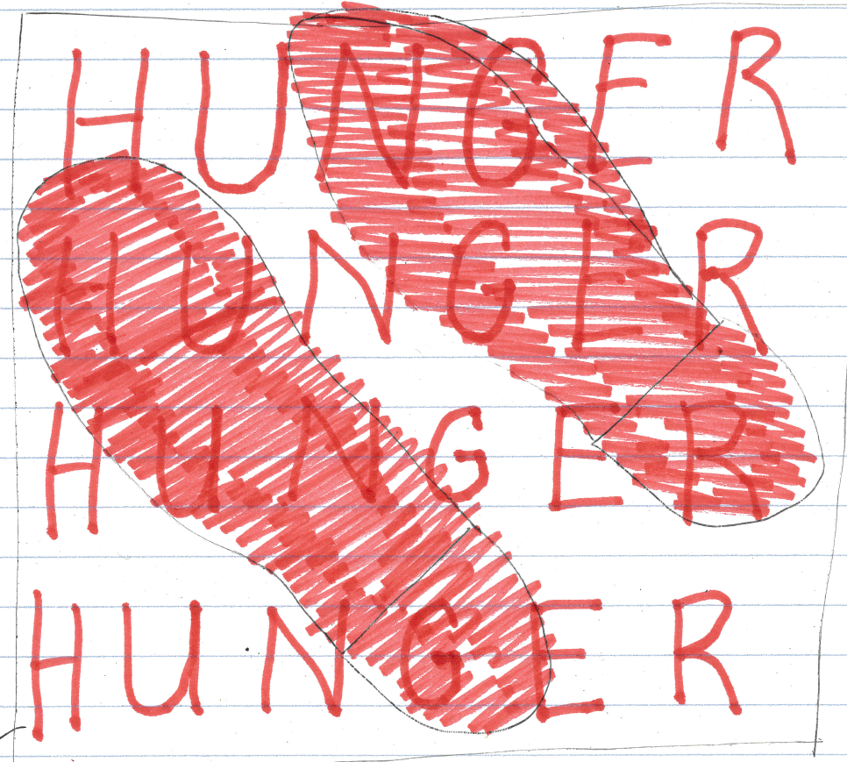
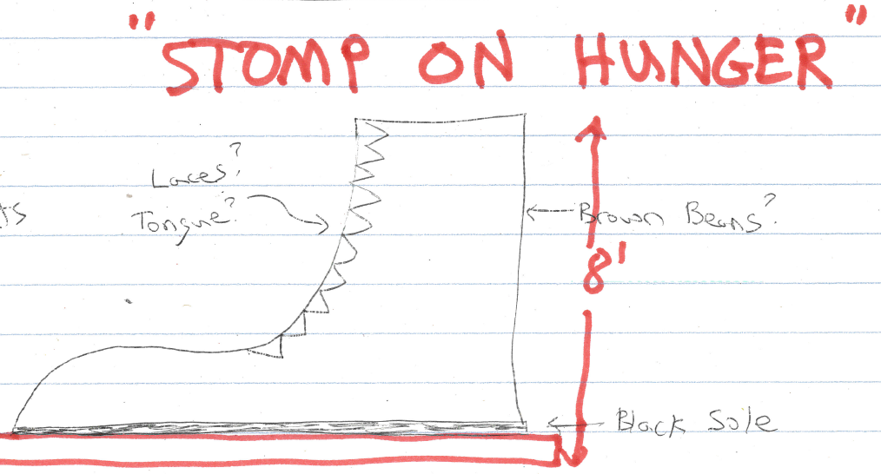

Slide 4
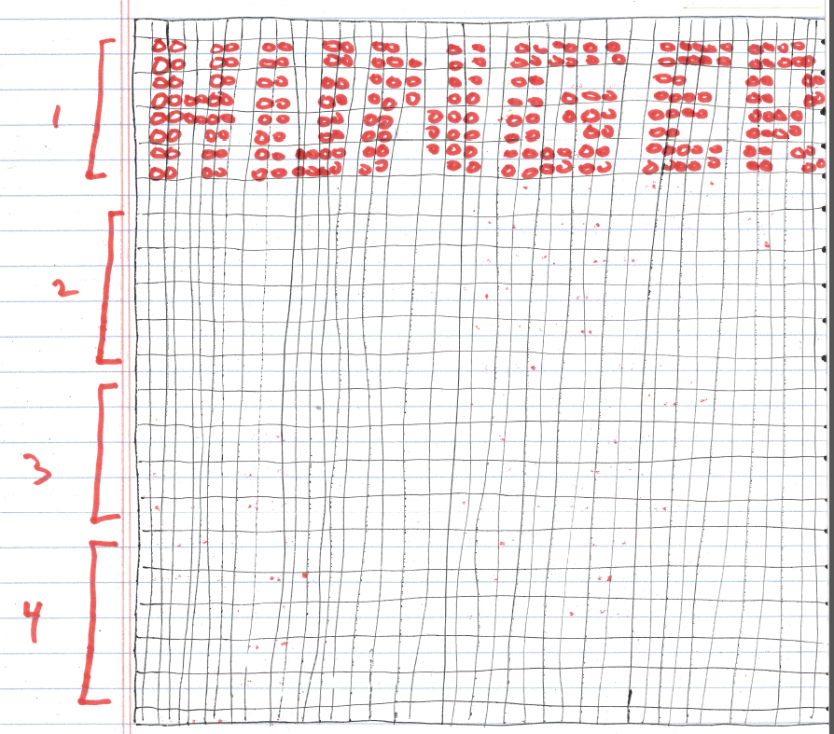
“Stomp On Hunger”
Standard can: φ2-15/16” x 4-7/16”
40 cans x 40 cans fit a 10’ x 10’ area
HUNGER can be spelled out fairly well using a max width of 40 cans

Slide 5
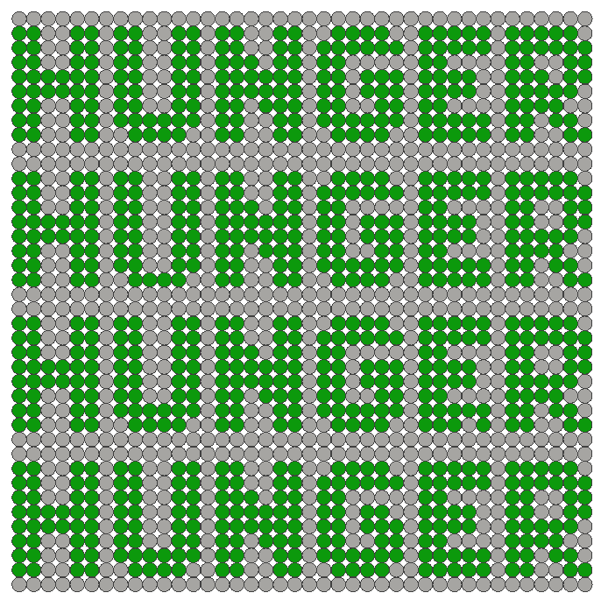
“Stomp On Hunger”
Base modeled using Inventor
40 x 40 = 1600 cans for one layer!
Standard can: φ2-15/16” x 4-7/16”
40 cans x 40 cans fit a 10’ x 10’ area
We could cut out poster board or PVC circles to put on top of each can to make the colors stand out. (1600 circles!)

Slide 6
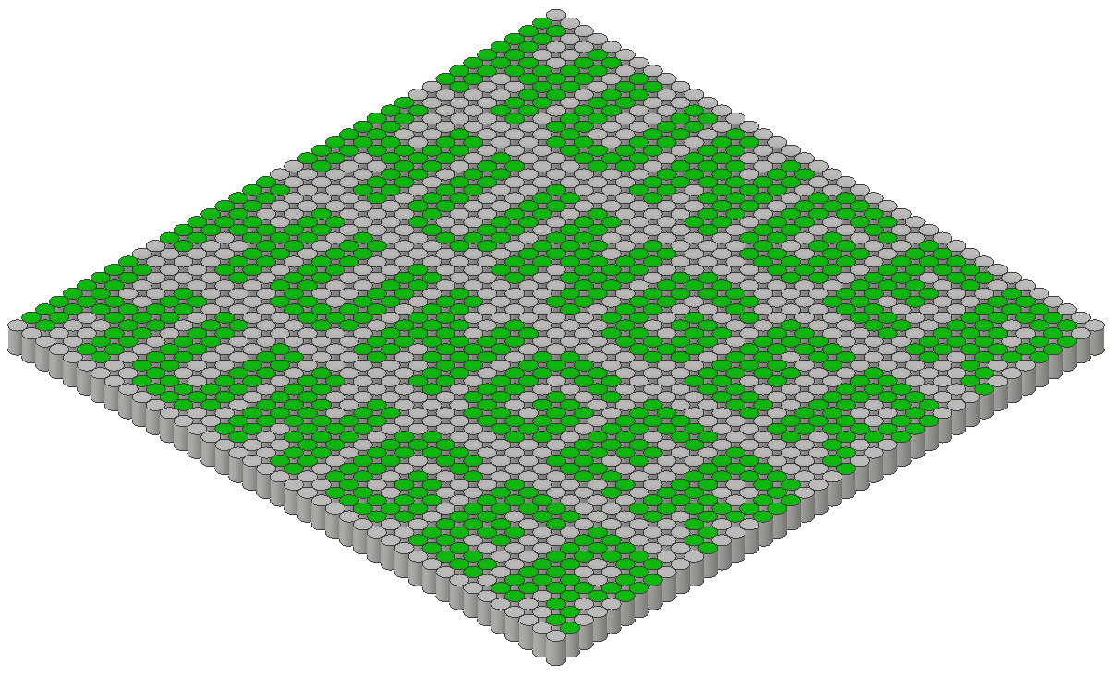
“Stomp On Hunger”

Slide 7
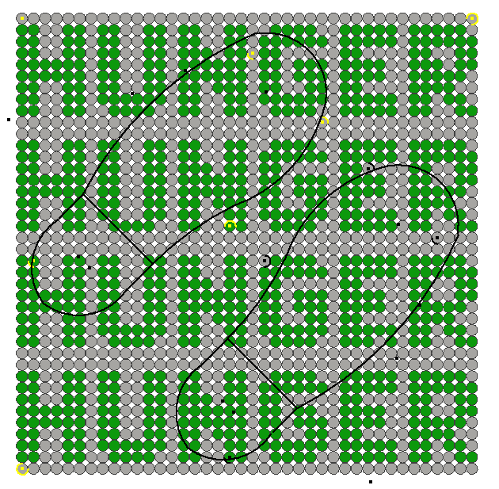
Outlines of shoes were added to make sure that viewers could still see that HUNGER was written on the base.
It seems to work well.
The 8’ tall shoes haven’t been added to the Inventor model yet. Some tinkering with the shoes will be needed to get the shape just right during the practice build.
We will need lots of big pieces of cardboard (appliance or furniture boxes, perhaps).

Slide 8
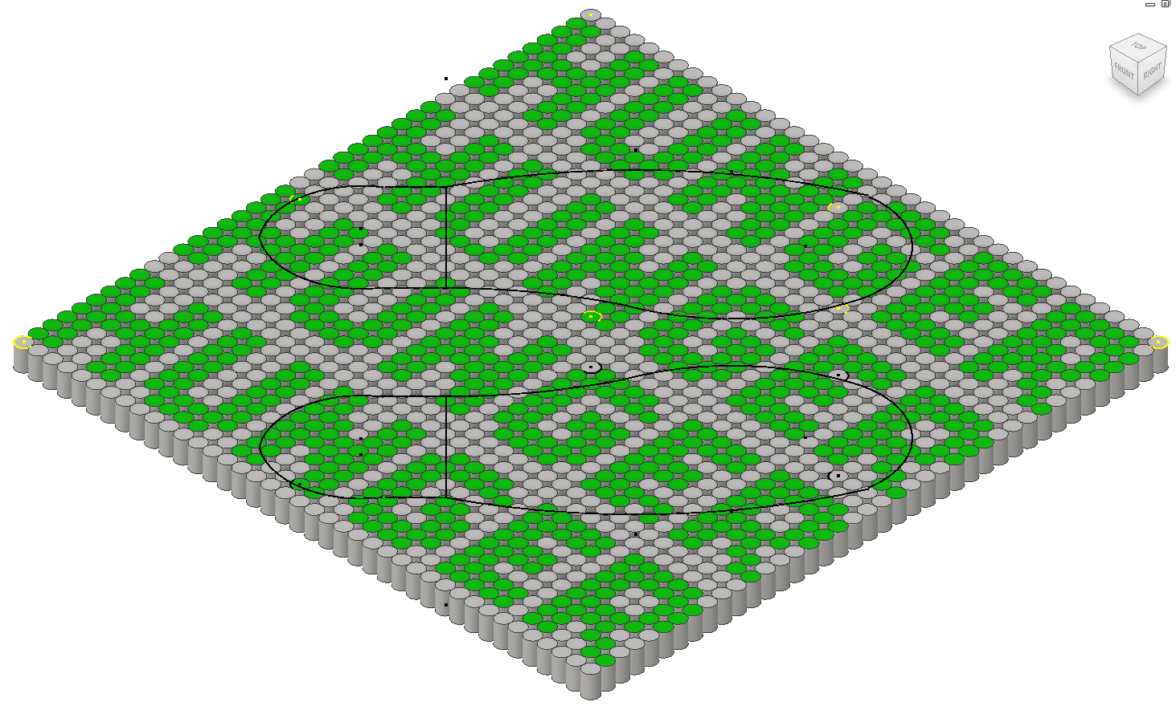

Slide 9
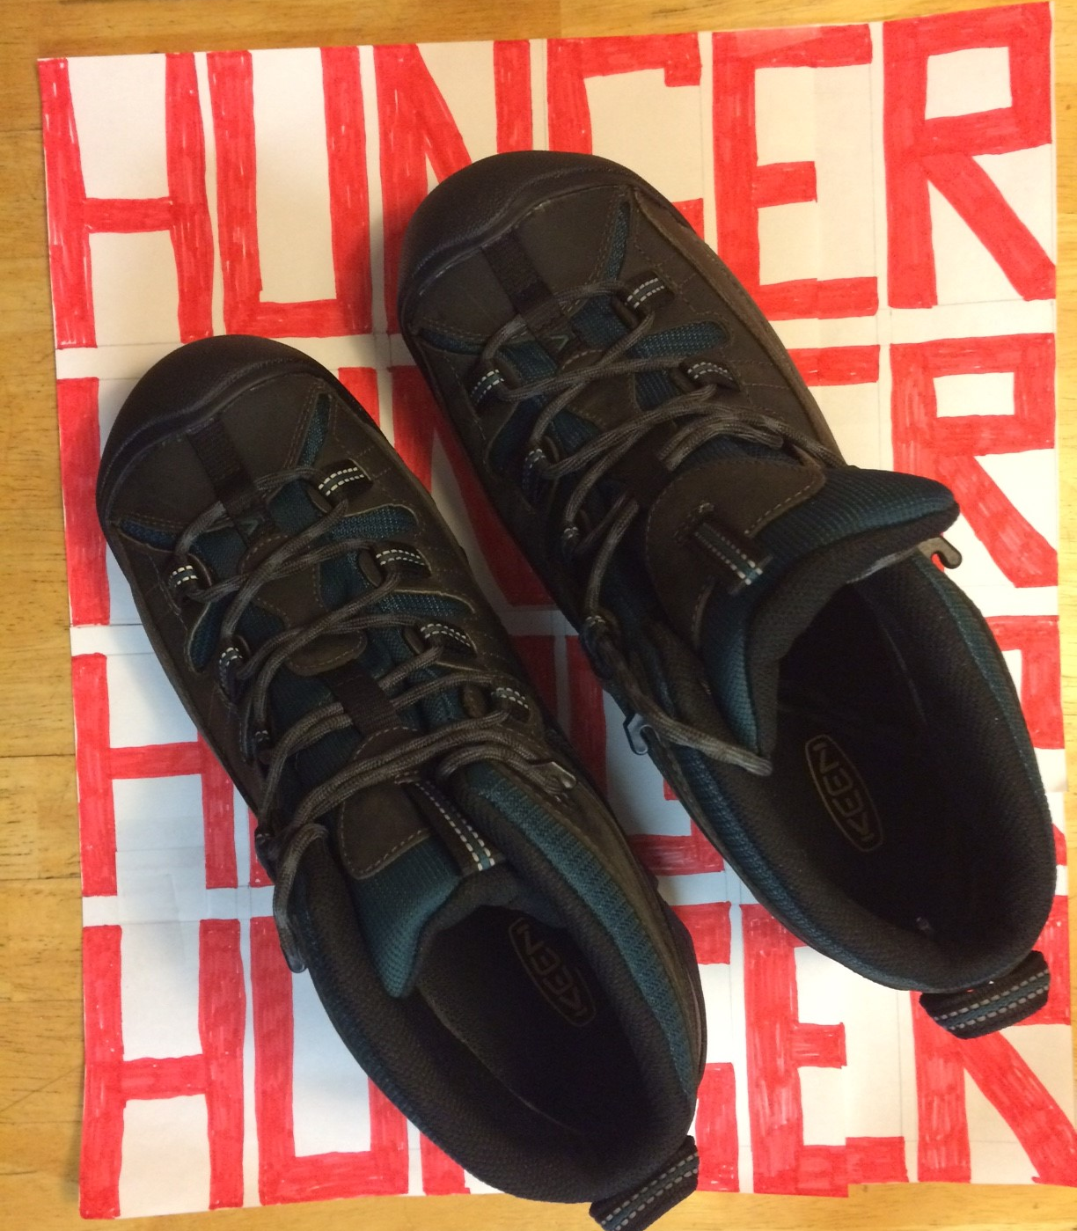
“Stomp On Hunger”
A test with a pair of boots shows that the words HUNGER can still be made out fairly well.

Slide 10
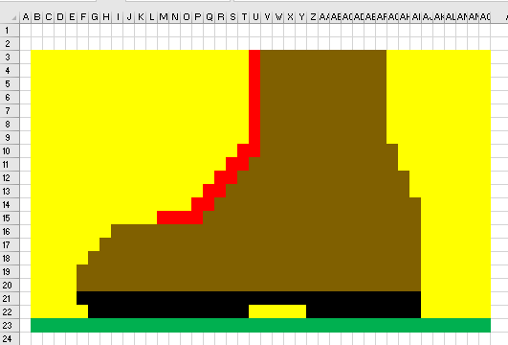
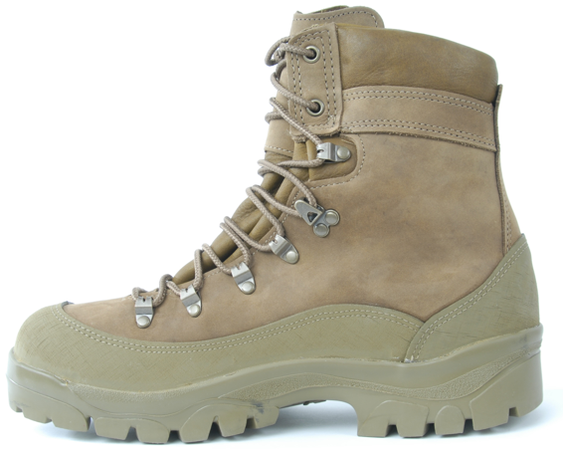
“Stomp On Hunger”
Excel was used to show how cans might be used to form a boot

Slide 11
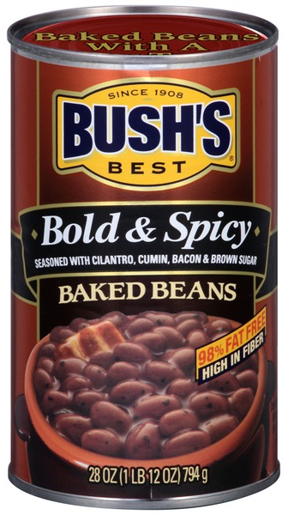
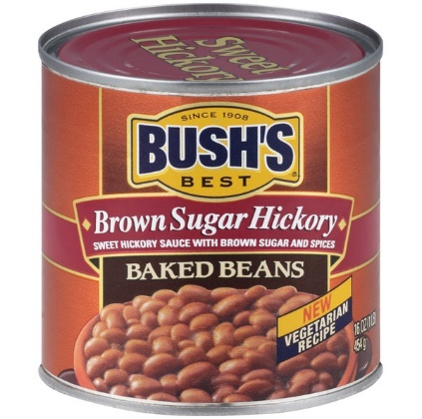
“Stomp On Hunger”
Shorter bean cans could be used to make better curves
Long individually wrapped twizzlers could be used for laces

Slide 12
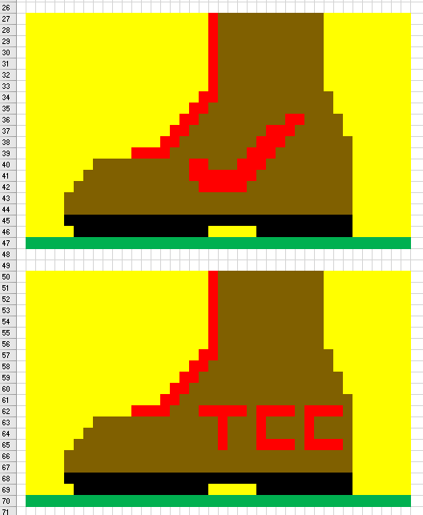
“Stomp On Hunger”

Slide 13
