Slide 1

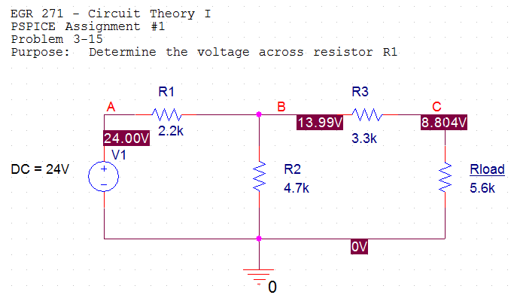
PSPICE Lecture #1
1
Introduction to PSPICE
Reference: (see course web site)
Sample PSPICE Report
PSPICE Example: DC Circuit – First Example
PSPICE Example: Analyzing Circuits with Dependent Sources
PSPICE Assignment #1
Topics to be presented:
Introduction to PSPICE
Creating your first project
Bias Point Analysis
Using PSPICE to analyze circuits with dependent sources

Slide 2
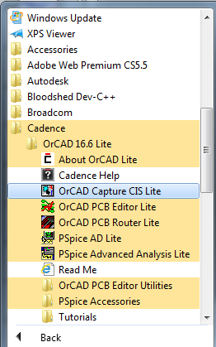
PSPICE Lecture #1
2
ORCAD Capture (PSPICE)
The software is referred to by the generic name PSPICE. It was originally owned by MicroSim and then by ORCAD. It is currently owned by Cadence, but has kept the ORCAD name.
See examples on the course web site. The examples contain numerous comments. A classroom demonstration will provide further examples.
The software is free to download from the Cadence website. Search for Cadence ORCAD download or use the following link:
www.cadence.com/products/orcad/pages/downloads.aspx
Run the software by selecting Start – All Programs – Cadence – Cadence 16.6 Lite - ORCAD Capture CIS Lite

Slide 3
PSPICE Lecture #1
3
Comparison - Evaluation Version versus Full Version
Evaluation Version
Limit of 64 nodes
Limit of 1 page schematic
Standard libraries for sources and basic components are available
EVAL library (eval.slb) contains a couple hundred models of components, such as transistors, diodes, 7400 series IC’s, etc.
Cost: Free
Some advanced features not included (such as printed circuit board layout)
Full Version
Unlimited number of nodes
Unlimited number of pages
Standard libraries for sources and basic components are available
Libraries for most commercially-available components available (tens of thousands of models).
Cost: Thousands of dollars (depends on the platform and the types of features needed)

Slide 4
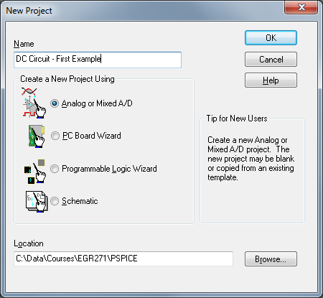
PSPICE Lecture #1
4
Basic steps in creating and analyzing a circuit using PSPICE
(See examples on class web site for more details and illustrations):
1) Create a Project
  A) Select File – New – Project from the main menu
  B) When the New Project box appears, specify the following:
    Assign the project a Name (any name is fine)
    Create project using Analog or Mixed Analog/Digital
    Pick the Location (select Browse and then select Create Dir to make a new folder for your project)

Slide 5
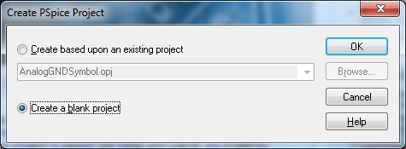
PSPICE Lecture #1
5
Basic steps in creating and analyzing a circuit using PSPICE
(See examples on class web site for details and illustrations):
  1) Create a Project
    C) If asked to create based on an existing project or create a blank project, select Create a blank project.

Slide 6
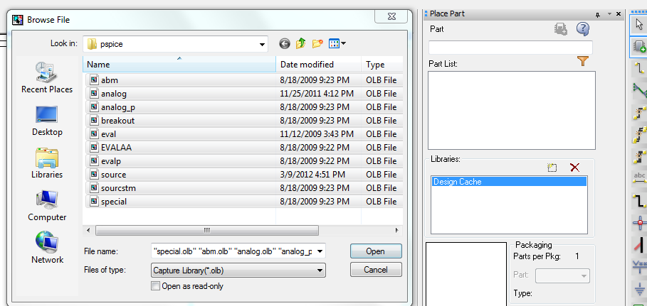
PSPICE Lecture #1
6
Basic steps in creating and analyzing a circuit using PSPICE
  Draw the schematic
    Select Place - Part from the main menu. A list of libraries and parts should appear.
    If no libraries appear, select Add Libraries and select all libraries listed in the PSPICE folder as shown below. Select Open.
Add Libraries
Select these libraries

Slide 7
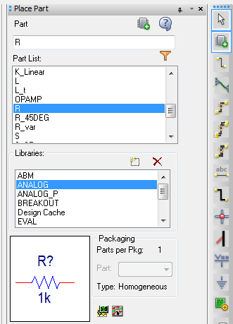
PSPICE Lecture #1
7
Basic steps in creating and analyzing a circuit using PSPICE
  Draw the schematic
      Select the desired part (such as R in the Analog library as shown to the right).

Slide 8
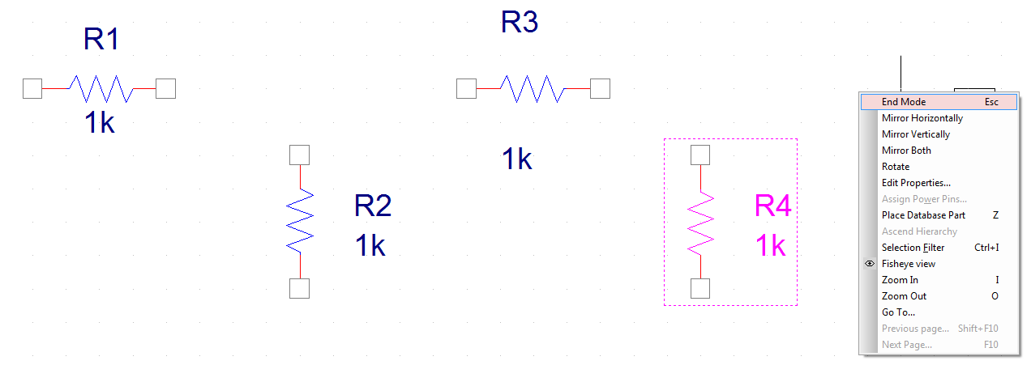
PSPICE Lecture #1
8
Basic steps in creating and analyzing a circuit using PSPICE
  Draw the schematic
      Click where you would like to place the part on the schematic.
      Use R to rotate the part as you place it on the schematic. Once it has been placed, it can be rotated, flipped, or mirrored by right-clicking on the part.
      Continue clicking on the schematic to place multiple parts (such as several resistor) and then right click and select End Mode to stop.

Slide 9
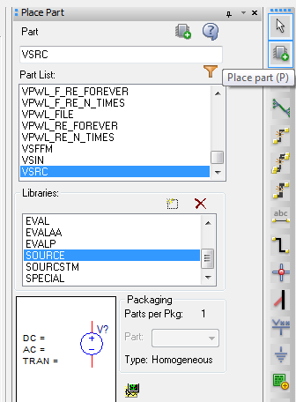
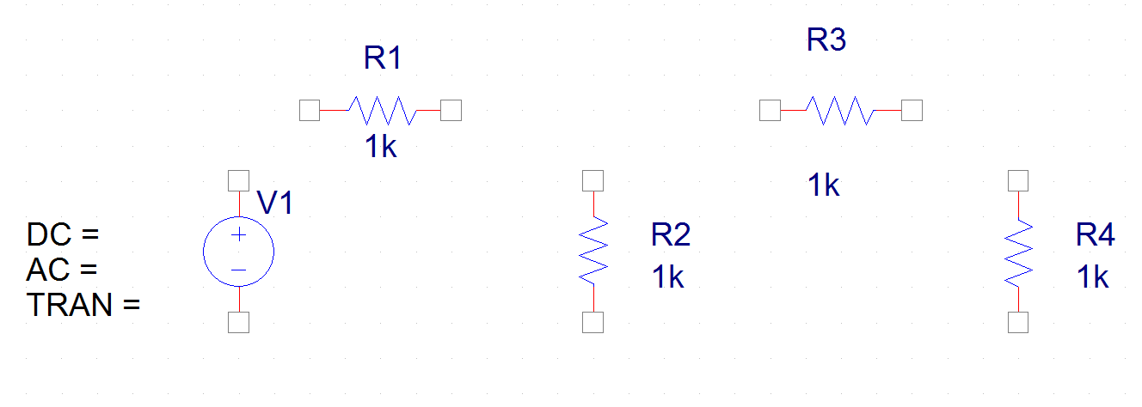
PSPICE Lecture #1
9
Basic steps in creating and analyzing a circuit using PSPICE
  Draw the schematic
    Similarly, add a voltage source – part VSRC from the Source library. You can use Place – Part from the main menu or use the toolbar on the right of the screen. Note that the voltage source has been added to the schematic below.
Place Part

Slide 10

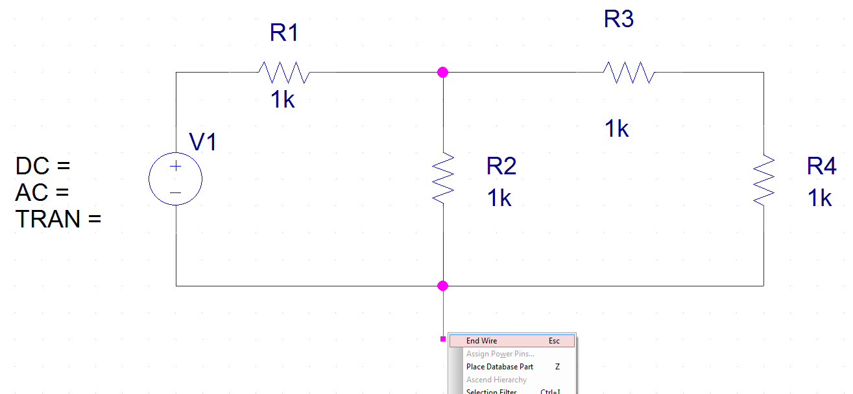
PSPICE Lecture #1
10
Basic steps in creating and analyzing a circuit using PSPICE
  Draw the schematic
    Select Place - Wire (or use the toolbar) and add wires to connect the parts. Right-click and select End Wire (or hit the Esc key) to exit the Place Wire tool.
Place Wire

Slide 11
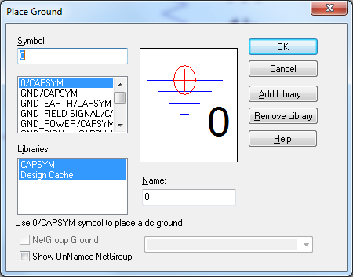
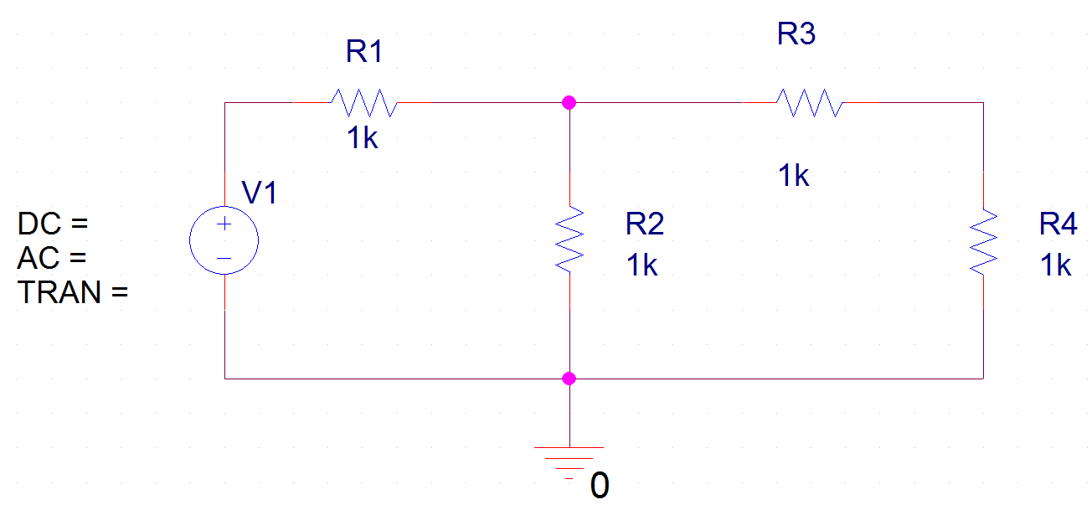
PSPICE Lecture #1
11
Basic steps in creating and analyzing a circuit using PSPICE
  Draw the schematic
    Analysis of circuits in PSPICE is based on nodal analysis, so each circuit must contain a ground symbol. The ground symbol named 0 must be used. If this is omitted, a “floating nodes” error will occur during analysis. The ground is added using Place Ground. If the 0 ground is not available, select Add Library and you should find it in the PSPICE – SOURCE library.
Ground added to the schematic
Place Ground

Slide 12
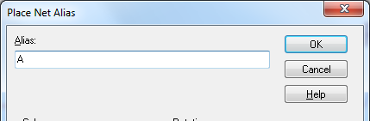
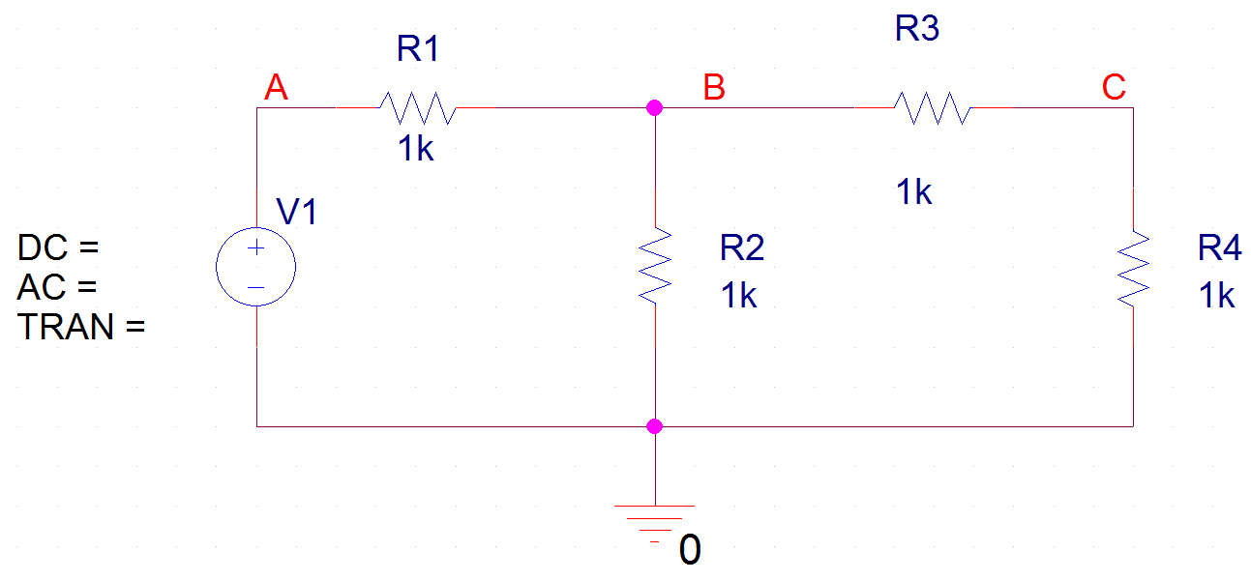

PSPICE Lecture #1
12
Basic steps in creating and analyzing a circuit using PSPICE
  Draw the schematic
    Use Place - Net Alias (or the tool shown to the right) to label each node (N1 button in version 10.5 or abc button in version 16.5 as shown to the right).
Net Alias
Nodes A, B, C, labeled using Net Alias tool. Note that the ground node is already labeled (0).
Note: There is a similar looking button on the toolbar used to place text. Do not use this tool to label nodes.
Text

Slide 13
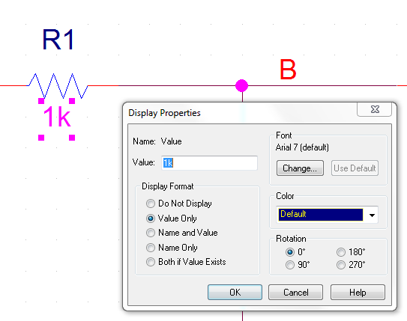
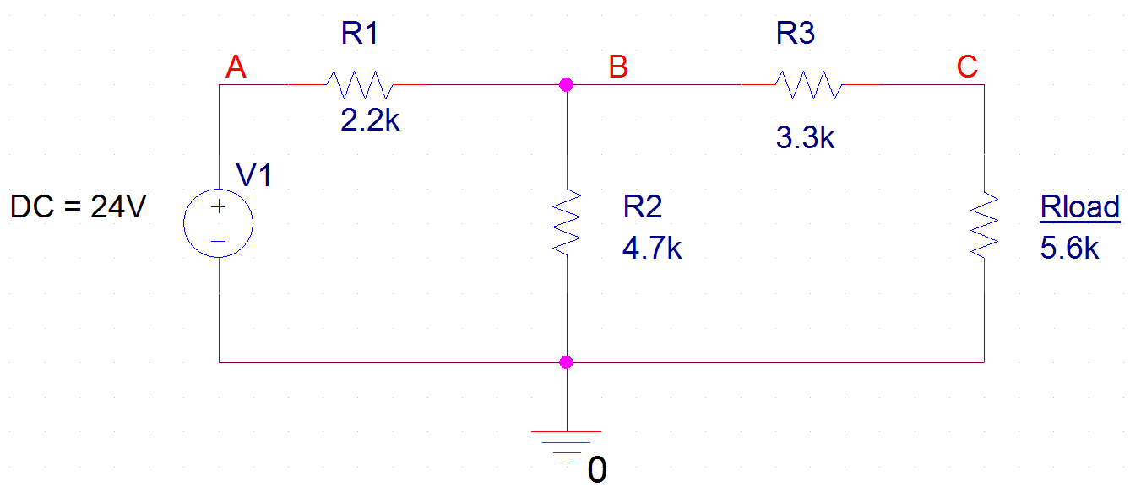
PSPICE Lecture #1
13
Basic steps in creating and analyzing a circuit using PSPICE
  Draw the schematic
    Double-click on the values next to each component to change their value. Similarly, the names of the components can be changed. R4 was changed to Rload below.

Slide 14
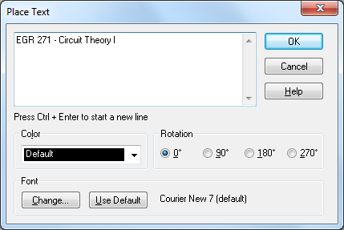
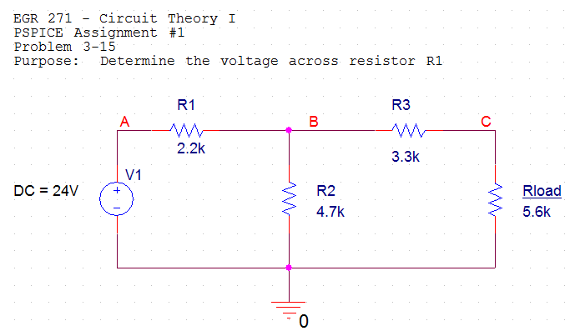
PSPICE Lecture #1
14
Basic steps in creating and analyzing a circuit using PSPICE
  Draw the schematic
    Add text to the schematic using the Place Text tool. Text can be placed anywhere on the schematic.
Place Text

Slide 15
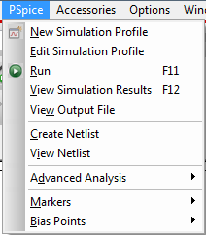
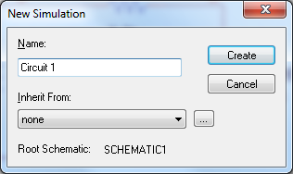
PSPICE Lecture #1
15
Basic steps in creating and analyzing a circuit using PSPICE
  Create a simulation profile (select PSPICE – New Simulation Profile from the main menu)
  A) If the PSPICE menu doesn’t appear, you may not have selected Schematic instead of Analog or Mixed Analog/Digital when you created the project, so start over and create a new project. (You can copy your schematic and paste it into the new project.)
  Enter a Name for the Simulation Profile. Any name is OK.
  Select Create.

Slide 16
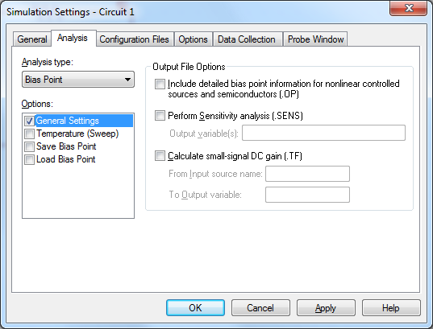
PSPICE Lecture #1
16
Basic steps in creating and analyzing a circuit using PSPICE
  Create a simulation profile (select PSPICE – New Simulation Profile from the main menu)
  Select the type of analysis to be performed (Bias Point) and select OK. There are 4 types of analysis in PSPICE. This presentation will only focus on Bias Point analysis.
    Bias Point (DC analysis where you place voltages, currents, and power on the schematic)
    DC Sweep (vary a source or component)
    AC Sweep (vary frequency)
    Transient (vary time)
Change to Bias Point

Slide 17
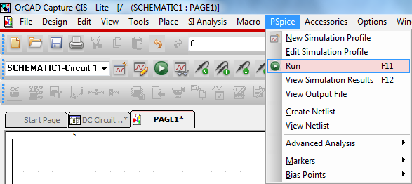
PSPICE Lecture #1
17
Basic steps in creating and analyzing a circuit using PSPICE
  Analyze the circuit (select PSPICE – Run from the main menu or use the RUN button)
RUN button

Slide 18
PSPICE Lecture #1
18
Basic steps in creating and analyzing a circuit using PSPICE
  View the results. Note that some values may have appeared automatically on your schematic. Note voltages are displayed in the example below. We will see how to display other values shortly.

Slide 19
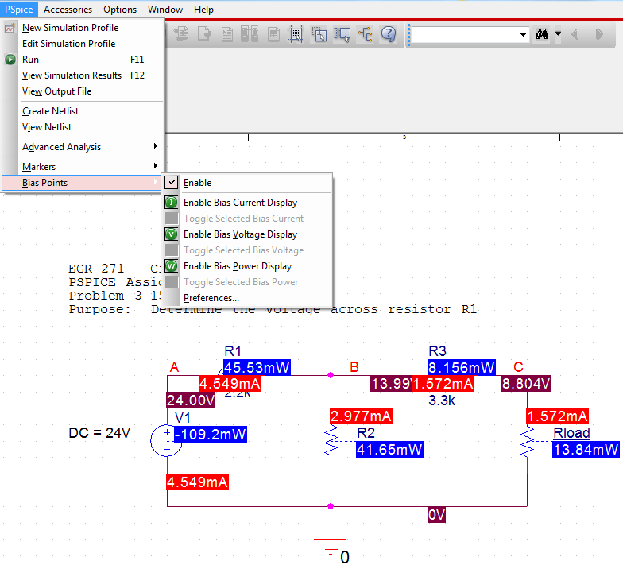
PSPICE Lecture #1
19
Basic steps in creating and analyzing a circuit using PSPICE
    Select PSPICE – Bias Points to select which values you would like to see on the schematic (node voltages, currents, and/or power absorbed). The schematic can get crowded with all values displayed as shown below.

Slide 20
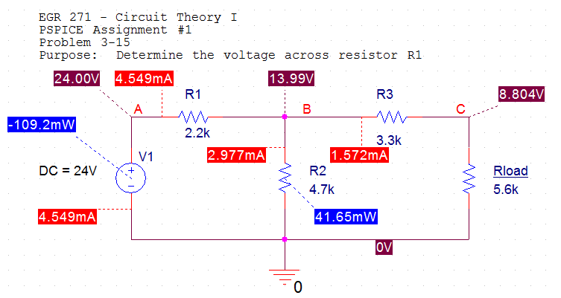
PSPICE Lecture #1
20
    Notes on bias point values displayed in PSPICE:
    Only node voltages can be displayed. Node voltages can be used to calculate component voltages. For example, the voltage across R1 (+ on left) is:
    V_{R1} = V_{A} – V_{B} = 24.00 – 13.99 = 10.01 V
    PSPICE only shows positive current values. A dotted line shows which end of the component the positive current enters. As examples, the current through R1 is to the right, the current through R2 is down, the current through the 24V source is up, etc.
    PSPICE only shows power absorbed. Note that R2 absorbs 41.65 mW of power while the 24V source absorbs -109.2 mW (or delivers +109.2 mW).

Slide 21
PSPICE Lecture #1
21
Component Values in PSPICE
PSPICE is not case-sensitive
Allowable prefixes are shown in the table below
* Note that m or M are used for milli. Use MEG for mega, not M.

Slide 22
PSPICE Lecture #1
22
Component Values in PSPICE
When PSPICE reads a component value:
No space is allowed between the value and the prefix or unit name
PSPICE essentially only looks at the first letter after the value to see if it is a valid prefix. All other letters are ignored, so unit names can be entered in a variety of ways. Several examples of specifying a 100 kΩ resistor are shown below:
Invalid resistor
value (no space
allowed)
Valid resistor values

Slide 23
PSPICE Lecture #1
23
Dependent sources in PSPICE
  Located in the analog library (analog.olb)
  Use E, F, G, and H (not EPOLY, FPOLY, GPOLY, and HPOLY)
  Each source has a round symbol that can be thought of as the source. The other terminals are for the control variable.
  Double click on the source to set the GAIN property (default value = 1). Be sure to change the property settings so that the GAIN is displayed.
Textbook symbols:
PSPICE symbols:

Slide 24
PSPICE Lecture #1
24
I₁
Example using dependent sources
Analyze the circuit shown below by hand.
Verify the results using PSPICE.
8 Ω
+
V₂
_
100V
+_
V₂/20
30 Ω

Slide 25
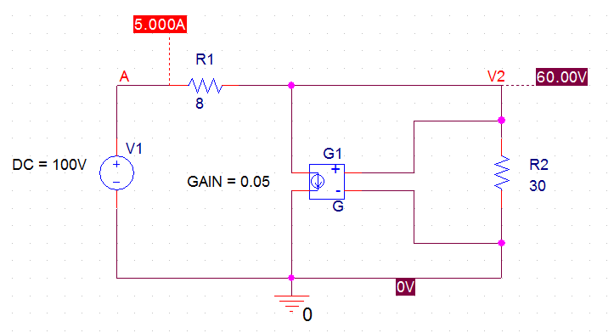
PSPICE Lecture #1
25
Example using dependent sources (continued)
I₁
Notes:
Round symbol in the dependent source in the top schematic corresponds to the diamond shape in PSPICE
Gain set to 1/20 = 0.05
Wires used to connect the control voltage, V₂, to the source
8 Ω
+
V₂
_
100V
+_
V₂/20
30 Ω
PSPICE results match the hand results!

Slide 26
PSPICE Lecture #1
26
PSPICE Demonstration
If time allows and computers are available to the class, the instructor will lead
the class in creating and analyzing circuits using PSPICE.
Demonstration topics:
Launching the software and creating a project
Creating and analyzing schematics
Labeling nodes
Using dependent sources
Changing and displaying properties. In general, display any property that you set or change.
Adding text to a schematic
Displaying results with a Bias Point analysis
Calculating other voltage, current, and power values from the displayed bias point values
Copying schematics to other documents

