Slide 1
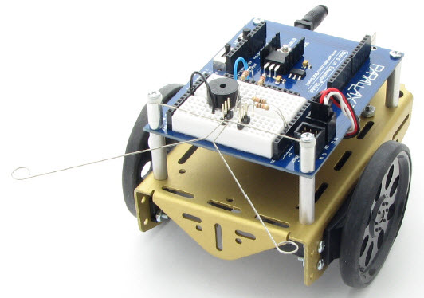
Arduino-BOT Lecture #4 EGR 120 – Introduction to Engineering
1
Navigating the Arduino-BOT with whiskers
References:
1) Arduino-BOT Lectures #1-5 - http://faculty.tcc.edu/PGordy/Egr120/
2) Robotics with the Board of Education Shield for Arduino web tutorials - http://learn.parallax.com/tutorials/robot/shield-bot/robotics-board-education-shield-arduino
3) Board of Education Shield for Arduino documentation - https://www.parallax.com/downloads/robotics-board-education-shield-arduino
Arduino web site (software, microcontrollers, examples, and more) - https://www.arduino.cc/

Slide 2
Arduino-BOT Lecture #4 EGR 120 – Introduction to Engineering
Tactile Navigation with the Arduino-BOT
(Wall following using whiskers)
Tactile navigation, or navigation by touch, is used in a variety of robotic applications, including:
Detecting when a robotic arm encounters an object
Counting objects on a production line
Aligning objects in an industrial process
Detecting walls as a robot navigates its way around a course
In Team Assignment #4, each team will:
Build tactile switches, called whiskers, onto your Arduino-BOT and test them
Program the Arduino-BOT to detect when the whiskers encounter an obstacle
Navigate a course by reacting when a whisker encounters a wall
Whiskers give the Arduino-BOT the ability to sense the world around it through touch, much like the antennae on an ant or the whiskers on a cat.

Slide 3
Arduino-BOT Lecture #4 EGR 120 – Introduction to Engineering
Whiskers

Slide 4
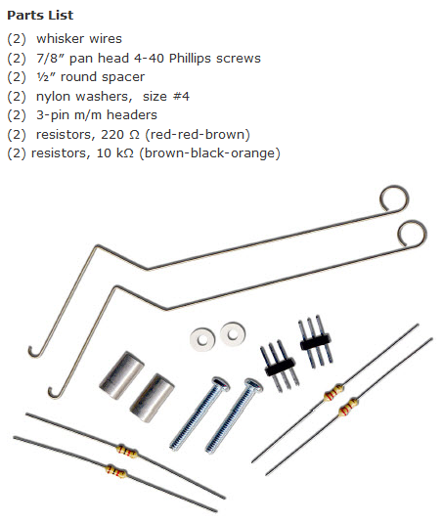
Arduino-BOT Lecture #4 EGR 120 – Introduction to Engineering
Adding whiskers to the Arduino-BOT
If your Arduino-BOT is not already equipped with whiskers, gather the parts listed and follow the instructions on the following slides.

Slide 5
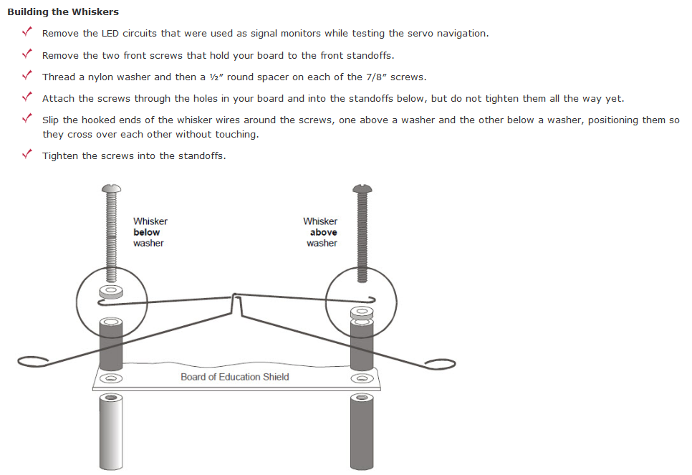
Arduino-BOT Lecture #4 EGR 120 – Introduction to Engineering
Adding whiskers to the BOE-BOT
Instructions for adding whiskers to your Arduino-BOT are shown below.
Note that one whisker is above the nylon washer and one is below the washer (so that they don’t touch).
You might also want to put a piece of tape on one whisker to keep the whiskers from touching.

Slide 6
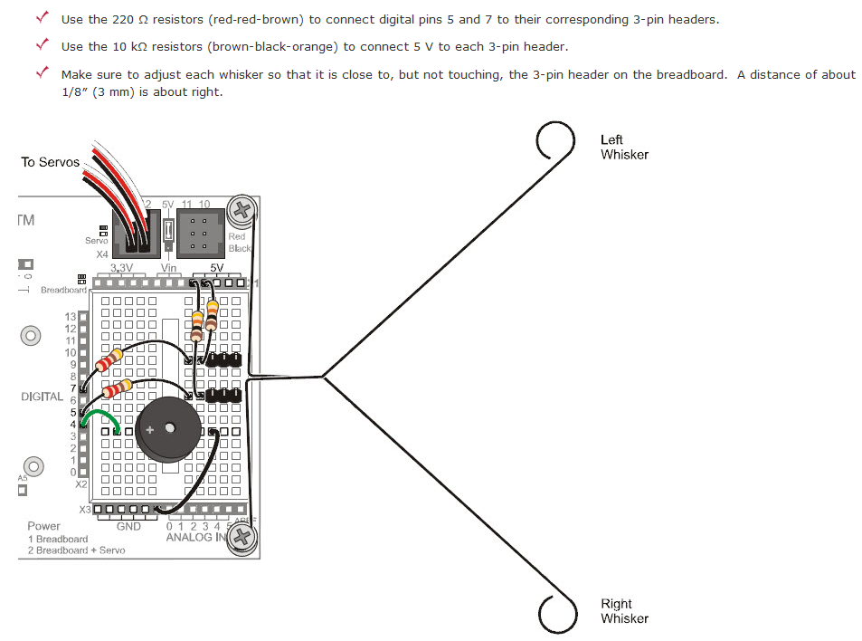
Arduino-BOT Lecture #4 EGR 120 – Introduction to Engineering
Building the Whiskers (continued)

Slide 7
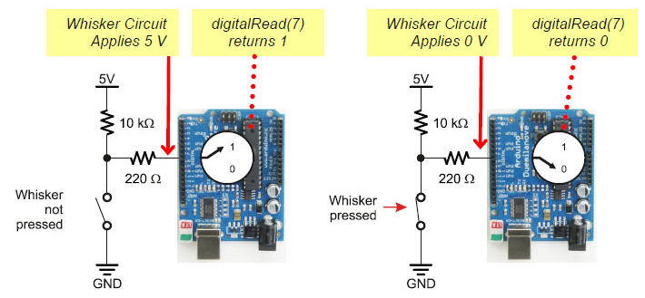
Arduino-BOT Lecture #4 EGR 120 – Introduction to Engineering
How the whisker circuit works
The whiskers work as follows:
The whiskers are connected to standoffs on the Arduino-BOT which are connected to ground.
When no whisker is pressed, the digital input receives a HIGH voltage (5V) through the two resistors.
When the Arduino-BOT runs into a wall, the whisker touches a “header” on the breadboard which will make a connection to a point in the circuit below and essentially closes a switch. This provides a LOW (0V) digital input.

Slide 8
Arduino-BOT Lecture #4 EGR 120 – Introduction to Engineering
Deciding what to do when a whisker is pressed
Since we want the Arduino-BOT to do one thing when a whisker is pressed and another thing when the whisker is not pressed, we need to be able to make decisions in our code. A little more background in C++ is needed.
Decision structures in C++
C++ supports various types of decision structures which allows the program to branch and perform different tasks based on some sort of logical test. A common type of decision structure is the if structure (also the if-else structure).

Slide 9
Arduino-BOT Lecture #4 EGR 120 – Introduction to Engineering
if structure
The if structure has the following form and executes statements when the conditional statement is true. No statements are executed when the conditional statement is false.
if (conditional statement)
{
// execute these statements if true
}
Example:
if (a > b)
{
Serial.print("a is greater than b");
}
Logical
Test
F
T
Do this if true
Other examples of conditional statements:
a > b a >= b +c
a < 0 a + b <= c + 3
a == b a != 0

Slide 10
Arduino-BOT Lecture #4 EGR 120 – Introduction to Engineering
if – else structure
The if – else structure has the following form and executes one set of statements when the conditional statement is true and another set of statements conditional statement is false.
if (conditional statement)
{
// execute these statements if true
}
else
{
// execute these statements if false
}
Example:
if (a > b)
{
Serial.print("a is greater than b");
}
else
{
Serial.print(“a is not greater than b");
}
Logical
Test
F
T
Do this if true
Do this if false

Slide 11
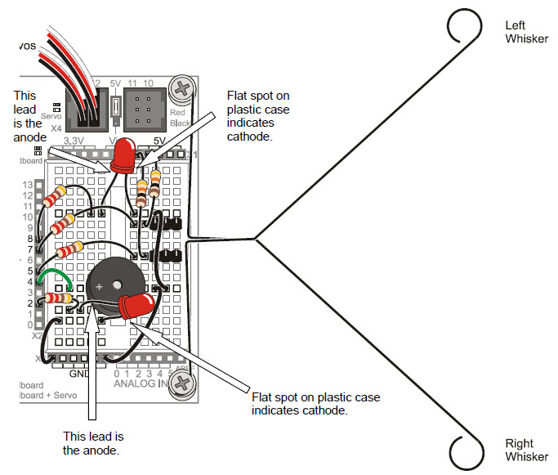
Arduino-BOT Lecture #4 EGR 120 – Introduction to Engineering
Adding a whisker test circuit
It is good to add a whisker test circuit so that we can be sure that the whiskers are working before we attempt to navigate using whiskers.
Test Circuit Operation:
Press left whisker – light LED on pin 8
Press right whisker – light LED on pin 2
Press both whiskers – light both LEDs
No whiskers pressed – neither LED lit
Additional Parts Needed:
Two 220 Ω resistors (red-red-brown)
Two LEDs

Slide 12
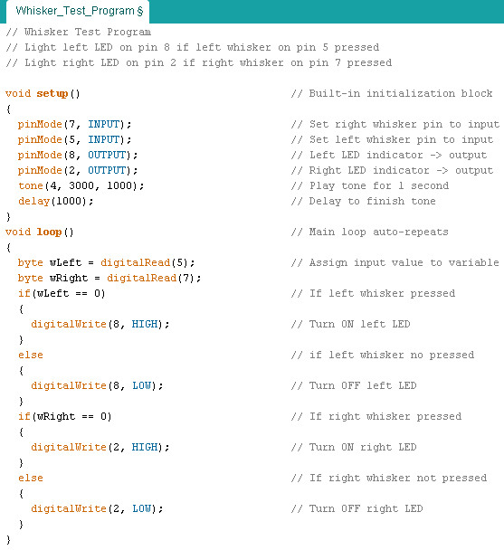
Arduino-BOT Lecture #4 EGR 120 – Introduction to Engineering
Whisker test circuit program
It is nice to have a test circuit, so that we can tell if the whiskers are working properly. An easy solution is to add two LED (with series resistors) so that one LED lights when the left whisker hits a wall and the other LED lights when the right whisker hits a wall. Note that the program below uses and if – else decision structure.

Slide 13
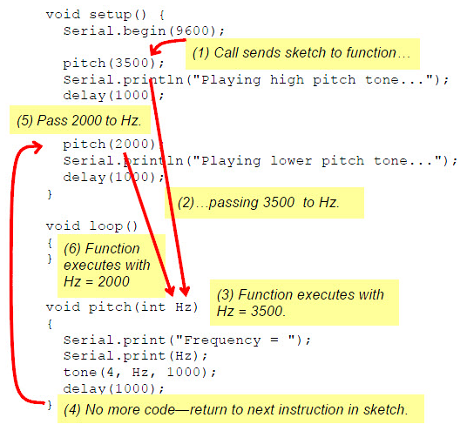
Arduino-BOT Lecture #4 EGR 120 – Introduction to Engineering
More on functions in C++
Our Arduino programs so far have included two key functions: setup( ) and loop( ).
Programs can also have additional functions.
Functions are particularly useful when you are likely to repeat sections of code.
Example:
Use a function named pitch( ) to sound a tone using the buzzer on pin 4 at a specified frequency for 1 second.
Call the function two times from setup( ).

Slide 14
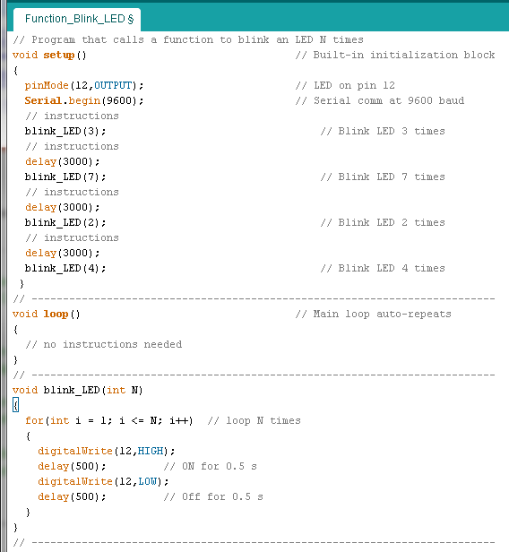
Arduino-BOT Lecture #4 EGR 120 – Introduction to Engineering
Example – Using a function to blink an LED on pin 12 N times

Slide 15
Arduino-BOT Lecture #4 EGR 120 – Introduction to Engineering
Sample whisker navigation program
Several methods could be used to navigate a track using whiskers.
One approach
If neither whisker is pressed, go straight
If the left whisker runs into an obstacle, back up a little bit and turn right 60º
If the right whisker runs into an obstacle, back up a little bit and turn left 60º
If both whiskers run into obstacles, back up a little bit and turn 120º
(See illustration on the following slide)
Using functions
Additionally, functions can be very useful with this method.
Functions can be written to:
Go forward
Turn left
Turn right
Backup

Slide 16
Arduino-BOT Lecture #4 EGR 120 – Introduction to Engineering
Whisker Navigation Program - Illustration
Right
Whisker
Right whisker hits wall. Back up a little and turn left.
Finish
Left whisker hits wall. Back up a little and turn right.
Start

Slide 17
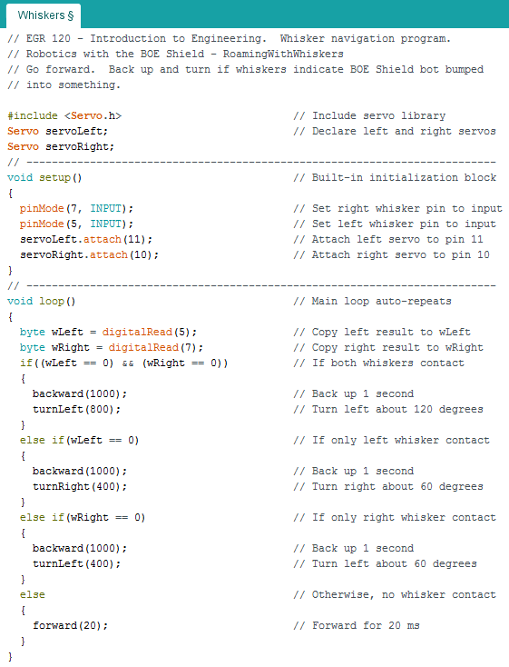
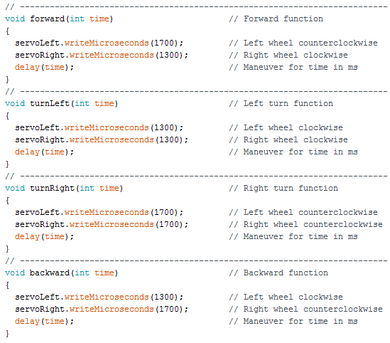
Arduino-BOT Lecture #4 EGR 120 – Introduction to Engineering
Sample whisker navigation program
The following whisker navigation program can be downloaded from the course Blackboard site. Discuss the program in class.

Slide 18
Arduino-BOT Lecture #4 EGR 120 – Introduction to Engineering
18
Modifying the whisker navigation program
The whisker navigation program provided may not work correctly at first. Some things to adjust include:
Adjust the values of Pulse Width to match your Arduino-BOT’s max speed
Adjust how far the Arduino-BOT backs up in the backward( ) function
Adjust how much the Arduino-BOT turns (left or right) when whiskers are hit in the forward( ), turnRight( ), and turnLeft( ) functions.
The Arduino-BOT can sometimes get stuck in a corner as it backs up and turns left and then backs up and turns right. If you avoid making the amount that it turns left and right the same then it can often work its way out of a corner (for example, turn right 40 degrees and turn left 30 degrees).

