Slide 1
A Great Career Choice EGR 120 – Introduction to Engineering
Engineering – A great career choice
Before pursuing an engineering career, you should answer:
What is engineering?
What do engineers do?
Why study engineering?
What are the functions of engineering?
What are the engineering disciplines?
Where does the engineer fit into the technical spectrum?
How are engineers educated?
What are the advantages and disadvantages of graduate degrees?

Slide 2
A Great Career Choice EGR 120 – Introduction to Engineering
What is Engineering?
Some definitions include:
Engineering has been defined in many ways. It is often referred to as the “application of science” because engineers take abstract ideas and build tangible products from them. Another definition is “design under constraint,” because to “engineer” a product means to construct it in such a way that it will do exactly what you want it to, without any unexpected consequences.
- National Academy of Engineering
Engineering is the application of science and mathematics by which the properties of matter and the sources of energy in nature are made useful to people.
- Merriam-Webster online dictionary

Slide 3
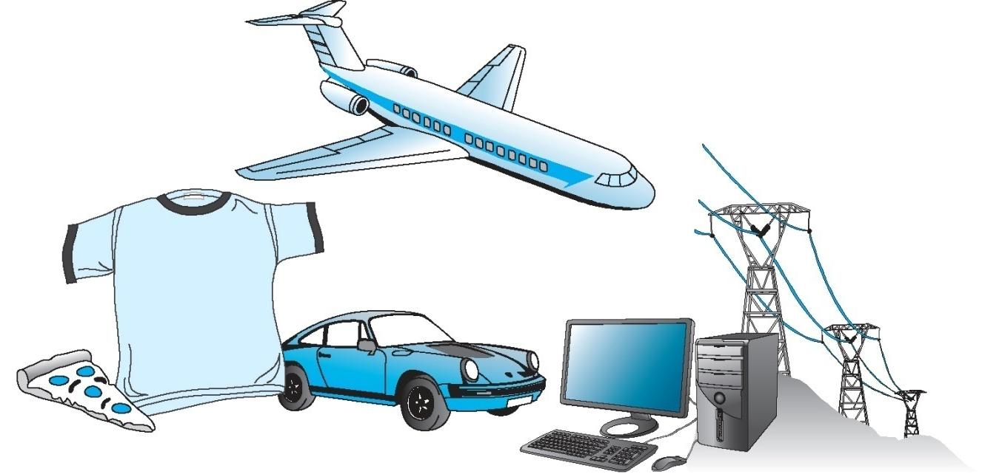
A Great Career Choice EGR 120 – Introduction to Engineering
What do Engineers do?
Engineers make products and provide services that make our lives better
Engineers apply physical and chemical laws and principles and mathematics to design million of products and services that we use in our everyday lives
© 2011 Cengage Learning Engineering. All Rights Reserved.

Slide 4
A Great Career Choice EGR 120 – Introduction to Engineering
Why Engineering?
Why do students pursue degrees in Engineering? Discuss some possible reasons in class:

Slide 5
A Great Career Choice EGR 120 – Introduction to Engineering
Why Engineering?
Maybe you can relate to some of these students’ remarks:
I chose to pursue engineering because I enjoyed math and science in school, and always had a love for tinkering with electronics and mechanical gadgets since I was old enough to hold a screwdriver.
- S. Houghton, Computer Engineer
I wanted to pursue engineering to make some kind of positive and (hopefully) enduring mark on the world.”
- J. Kronberg, Electrical Engineer
I excelled in math and science, my dad was an engineer, and it was a field with a lot of opportunity for women.
- D. Lanigan, Industrial Engineer
Reference: Thinking Like An Engineer, by Stephan

Slide 6
A Great Career Choice EGR 120 – Introduction to Engineering
6
The three largest engineering disciplines
Mechanical (23.9% of 2014 engineering graduates)
Electrical/Computer (18.4%)
3. Civil (12.4%)
So 54.7% of engineering graduates are in one of these three disciplines.
There are many other engineering disciplines. The chart on the following slide shows the number of graduates with BS degrees in each engineering discipline.

Slide 7
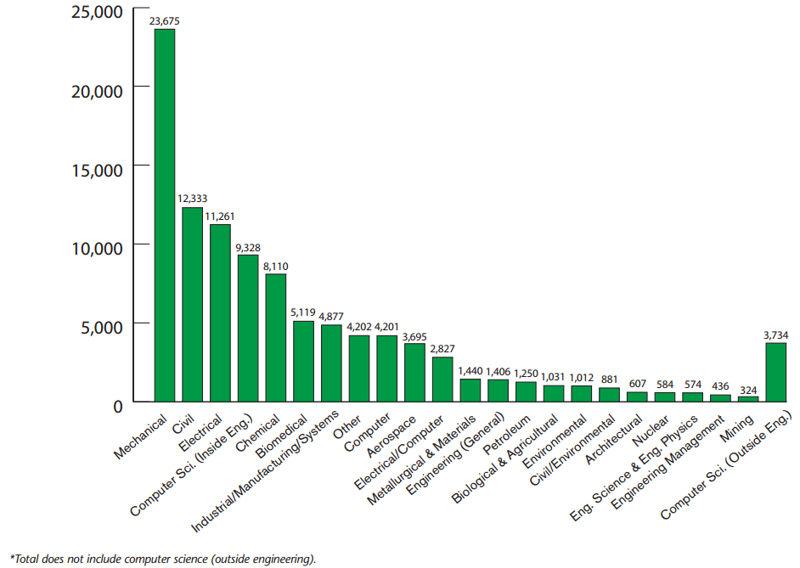
A Great Career Choice EGR 120 – Introduction to Engineering
Bachelor’s Degrees Awarded By Engineering Discipline in 2013-2014: 99,173
Reference: American Society for Engineering Education (ASEE)

Slide 8
A Great Career Choice EGR 120 – Introduction to Engineering
Mechanical Engineering – what is it?
Mechanical engineering is a very broad discipline. Mechanical engineers can work in a wide variety of industries.
“Mechanical engineers research, design, develop, manufacture, and test tools, engines, machines, and other mechanical devices. They work on power-producing machines such as electric generators, internal combustion engines, and steam and gas turbines. They also work on power-using machines such as refrigeration and air-conditioning equipment, machine tools, material handling systems, elevators and escalators, industrial production equipment, and robots used in manufacturing.”
Reference: Sloan Career Cornerstone Center http://www.careercornerstone.org/mecheng/mecheng.htm
8

Slide 9
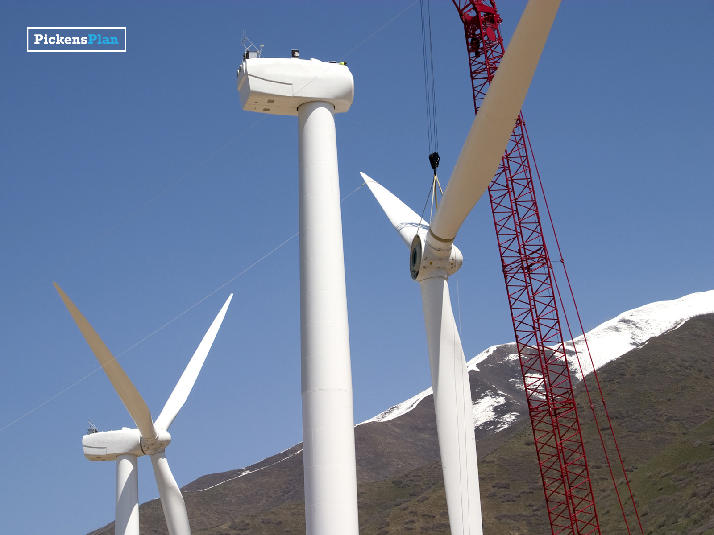
Mechanical Engineering Fields: Energy Conversion – Harnessing any type of energy for useful purposes, from designing and operating nuclear power plants to using alternative fuels for automobiles.
Reference: www.ppicksnsplan.org
9

Slide 10
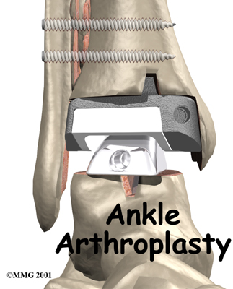
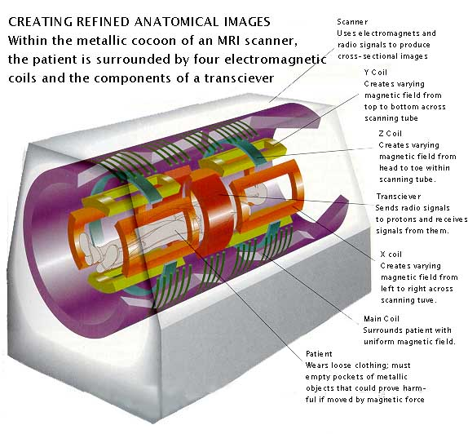
Mechanical Engineering Fields: Bioengineering – Designing biomedical devices, such as artificial joints, or biomedical equipment.
Reference: “How Does An MRI Work?” www.ee.duke.edu

Slide 11
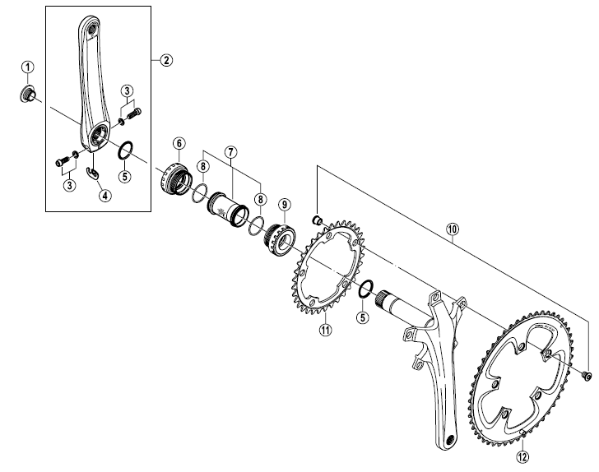
Mechanical Engineering Fields: Applied Mechanics - Designing parts of almost any type, from steering linkages in cars to bicycle frames to toys.
Reference: FC-R700 Crank (www.bike.shimano.com )

Slide 12
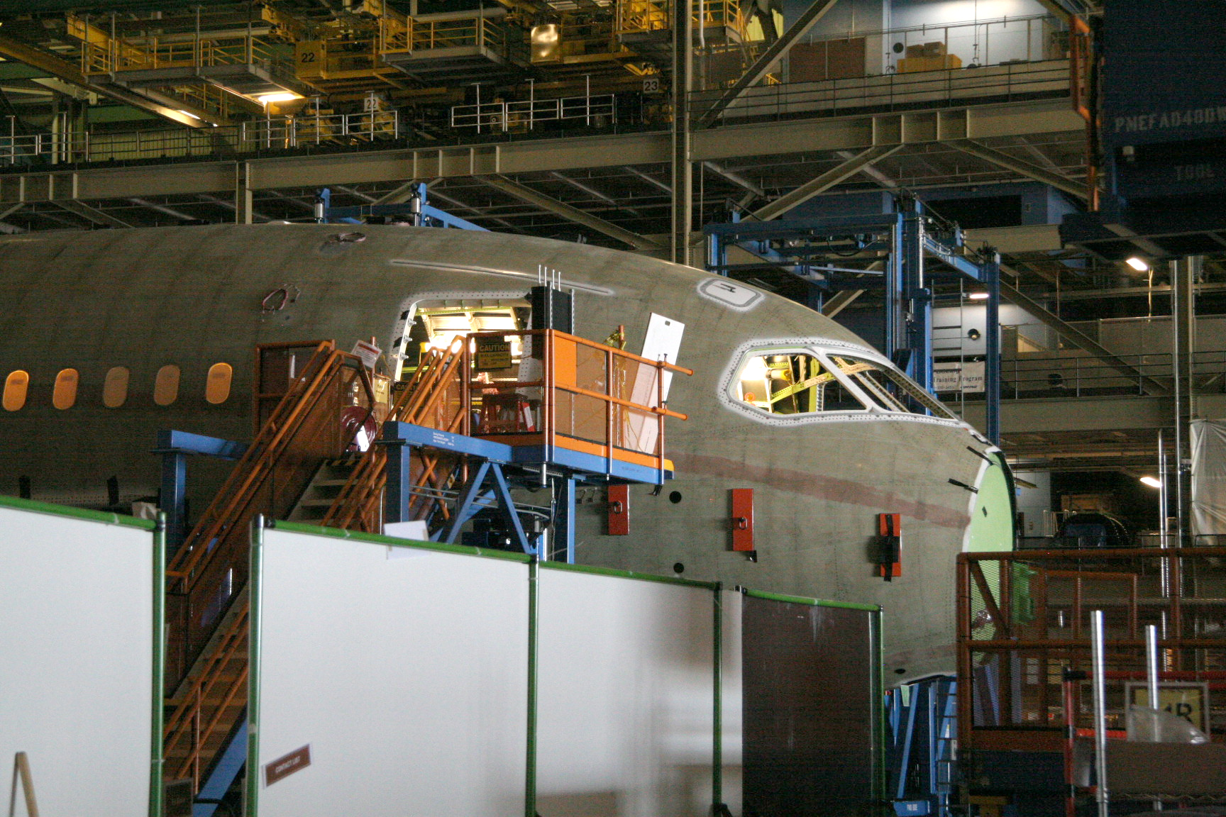
Mechanical Engineering Fields: Manufacturing – Producing products of any type, from computers to sports equipment to heavy equipment. ME’s even need to build the tools to make other tools.
Reference: Manufacturing the Boeing 787 – www.wikepedia.com

Slide 13
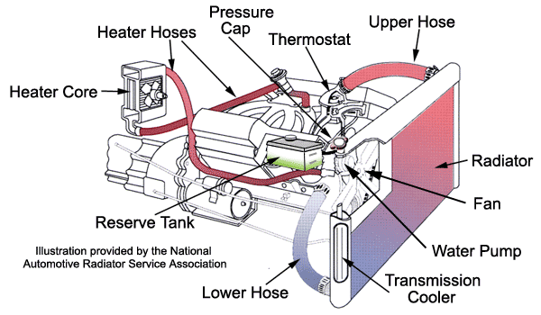
Mechanical Engineering Fields: Fluids Engineering - Dealing with any system where fluids flow, from pumps to turbines to brake lines on automobiles.
Reference: http://www.familycar.com/Classroom/Images/Cooling-System.gif

Slide 14
Mechanical Engineering Fields: Transportation – Providing society with safe, reliable, and efficient means of transportation, from aircraft to subways to automobiles.
Reference: www.ridethetide.com

Slide 15
A Great Career Choice EGR 120 – Introduction to Engineering
Electrical Engineering – what is it?
“Electrical and electronics engineers design, develop, test, and supervise the manufacture of electrical and electronic equipment.
Some of this equipment includes broadcast and communications systems; electric motors, machinery controls, lighting, and wiring in buildings, automobiles, aircraft, and radar and navigation systems; and power generating, controlling, and transmission devices used by electric utilities. Many electrical and electronics engineers also work in areas closely related to computers.”
Reference: Sloan Career Cornerstone Center http://www.careercornerstone.org/eleceng/eleceng.htm
15

Slide 16
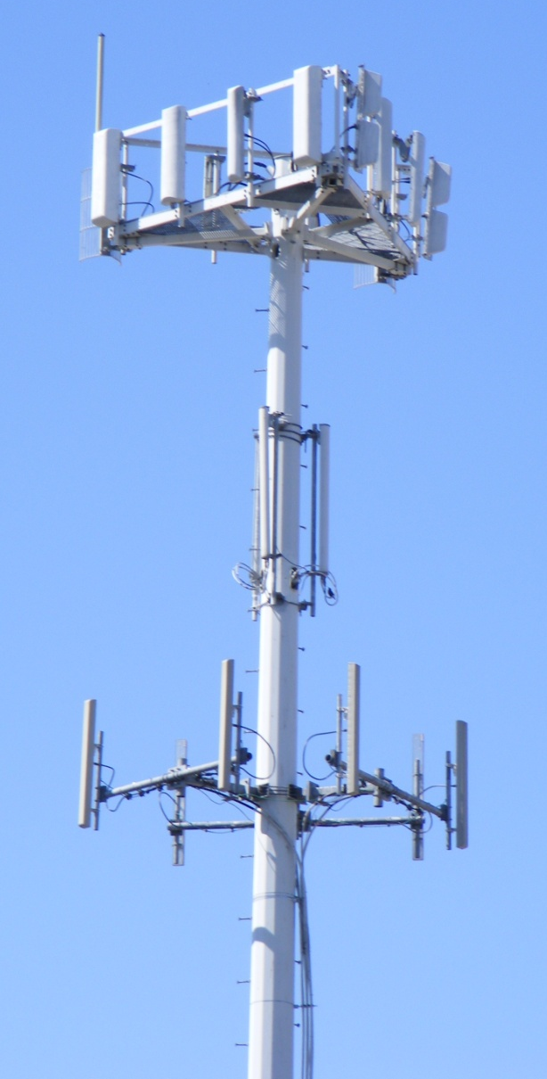
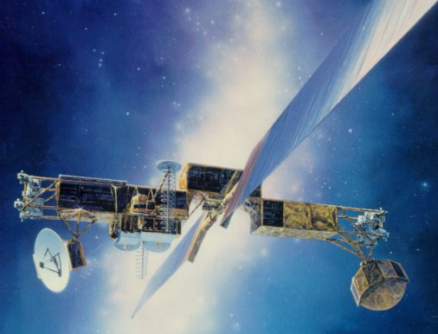
Electrical Engineering Fields: Telecommunications – Designing telecommunications systems, from local area networks to satellite communications, including equipment such as routers, switches, antennas, transmitters, and cell phones.
Reference: Cell-tower and MilStar communications satellite www.wikipedia.com

Slide 17
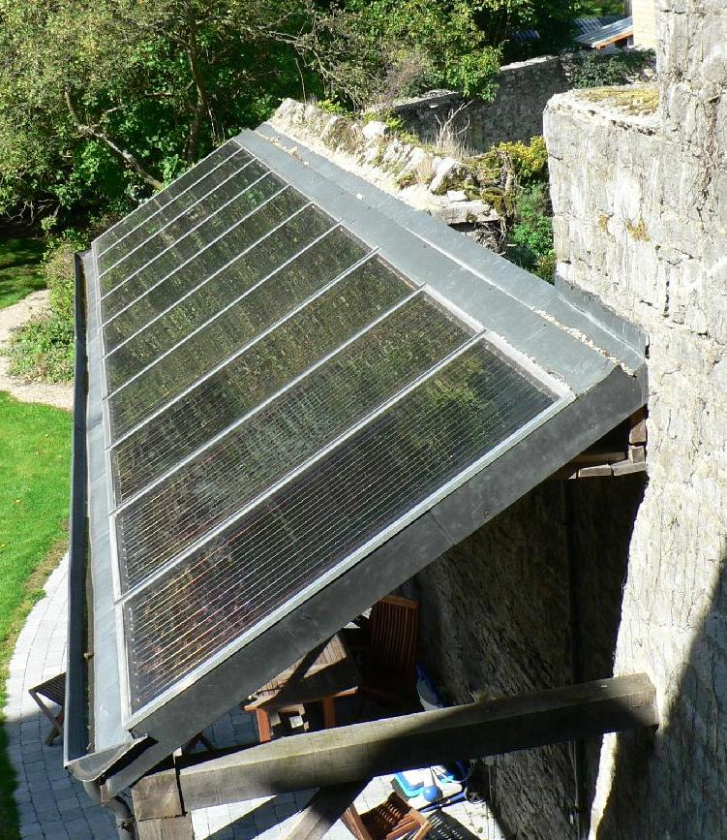
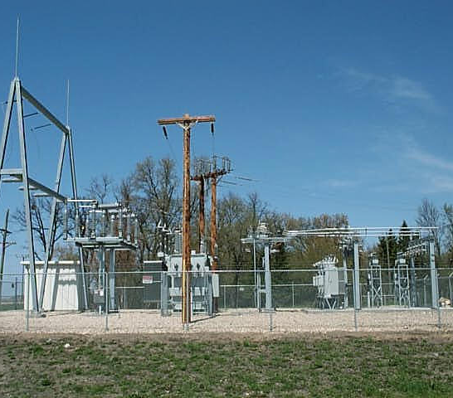
Electrical Engineering Fields: Energy and Electrical Power – Generating power from a variety of sources, including coal, nuclear, wind, fuel cells, etc., to providing power to customers through power distribution networks.
Reference: Electrical substation and solar hot-water heaters www.wikipedia.com

Slide 18
Electrical Engineering Fields: Semiconductors – Design of semiconductor chips from memory to microprocessors, including applications such as imbedded processing and computer products.
Everyone has heard of Intel microprocessors, but the 18 billion microprocessors shipped by Freescale Semiconductors (www.freescale.com) are used all around you in automobiles, home appliances, media players, mobile phones, motor controllers, and networking infrastructures. Freescale is the world’s leading manufacturer of automotive microprocessors.

Slide 19
A Great Career Choice EGR 120 – Introduction to Engineering
Civil Engineering – what is it?
“Civil engineers are problem solvers, meeting the challenges of pollution, traffic congestion, drinking water and energy needs, urban redevelopment, and community planning.”
Reference: Sloan Career Cornerstone Center http://www.careercornerstone.org/civileng/civileng.htm
19

Slide 20
Civil Engineering Fields: Transportation Engineering – Using new materials and construction methods to provide cost-effective solutions with minimal environmental impact to meet our growing transportation needs.
Reference: Chesapeake Bay Bridge-Tunnel www.wikipedia.com

Slide 21
Civil Engineering Fields: Structural Engineering – Designing structures from buildings to bridges to amusement park rides, civil engineers use a variety of materials and techniques to provide the desired strength, durability, and appearance for projects that benefit the public.
Reference: Silver Bullet Roller Coaster – Knotts Berry Farm, Buena Park, CA www.ultimaterollercoaster.com

Slide 22
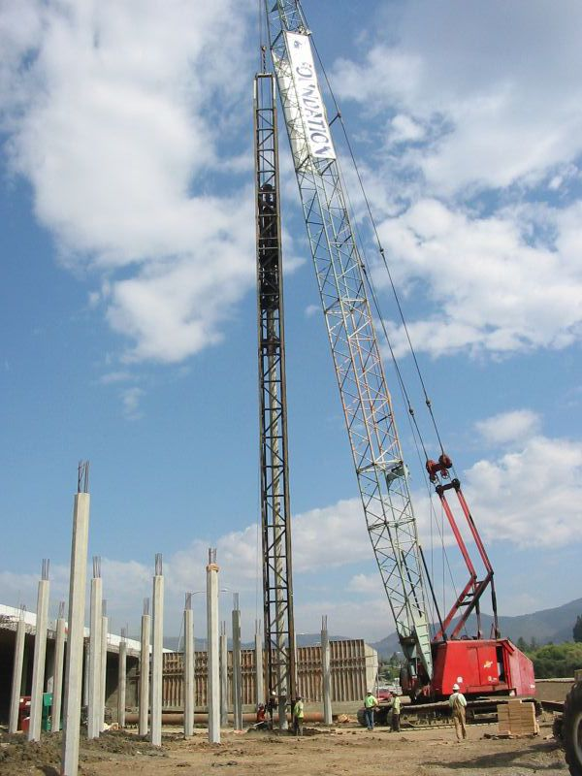
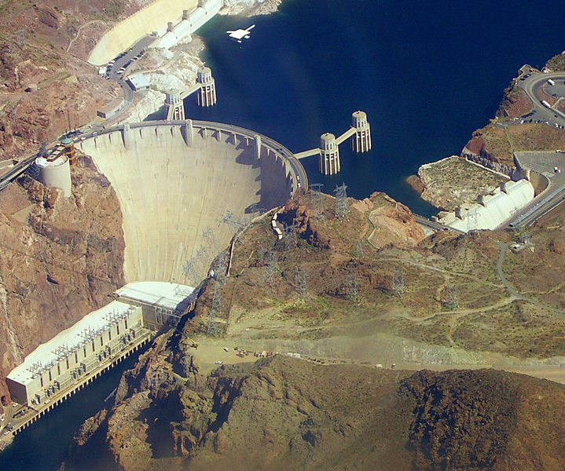
Civil Engineering Fields: Geotechnical Engineering – Designing structures such as tunnels, retaining walls, dams, piers, and offshore platforms. Design aspects include analysis of the soil and rock that support structures and minimizing the effect of earthquakes.
Reference: Driving piles for a bridge in Napa, CA, Hoover Dam www.wikipedia.com

Slide 23
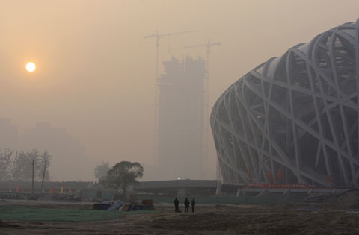
Civil Engineering Fields: Environmental Engineering – Providing safe drinking water, minimizing the impact of projects on wetlands, reducing pollution, cleaning up hazardous waste sites, disposing of wastewater, managing solid wastes, and managing natural resources.
Reference: Smog in Bejiing before the 2008 Olympics www.sprol.com

Slide 24
A Great Career Choice EGR 120 – Introduction to Engineering
Industrial Engineering – what is it?
“Industrial engineers determine the most effective ways to use the basic factors of production -- people, machines, materials, information, and energy -- to make a product or to provide a service. They are the bridge between management goals and operational performance.”
Reference: Sloan Career Cornerstone Center (http://www.careercornerstone.org/industrial/industrial.htm)
24

Slide 25
A Great Career Choice EGR 120 – Introduction to Engineering
Industrial Engineering – what is it?
“Industrial Engineers make processes better in the following ways:
More efficient and more profitable business practices
Better customer service and product quality
Improved efficiency
Increased ability to do more with less
Making work safer, faster, easier, and more rewarding
Helping companies produce more products quickly
Making the world safer through better designed products
Reducing costs associated with new technologies”
Reference: Institute of Industrial Engineers www.iie2net.org
25

Slide 26
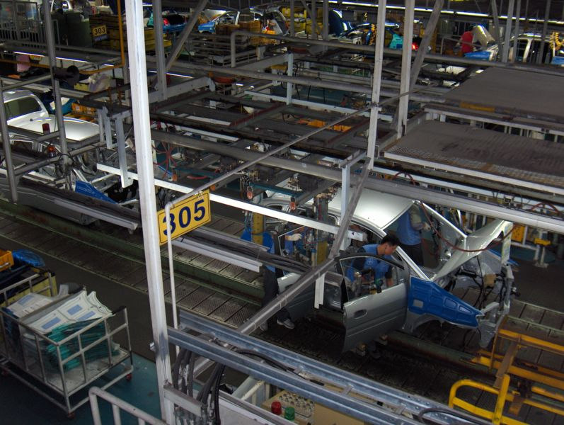
Industrial Engineering: Time and Motion Studies – Industrial engineers might analyze an assembly line to improve efficiency, to reduce expense, or to eliminate injuries.
Reference: Hyundai assembly line (www.wikipedia.com )

Slide 27
Industrial Engineering: Statistical Quality Control – Industrial engineers often work in production environments and use many statistical tools to analyze and improve processes.
Reference: (http://deming.eng.clemson.edu/pub/tutorials/qctools/qct.htm#LIST )

Slide 28
A Great Career Choice EGR 120 – Introduction to Engineering
Other Engineering Disciplines
There are many engineering disciplines and it would be difficult to discuss them all.
Doing some research on engineering disciplines that interest you is a good investment in your future.
Note that large industries often hire engineers, technologists, or technicians from a variety of disciplines. For example, you don’t necessarily need to be an aerospace engineer to work for an aerospace engineering company.
Aerospace Engineering Company
Electrical Engineers
Aerospace Engineers
Industrial Engineers
Mechanical Engineers
Other Engineers
28

Slide 29
A Great Career Choice EGR 120 – Introduction to Engineering
Specialization
Most BS engineering degrees offer electives in the junior and senior years allowing you to specialize to some extent. For example, civil engineering students might specialize in:
- Transportation - Structural - Environmental - Geotechnical - Water
A student might specialize by: - Selecting electives in a specialized area - Some degrees offer official specializations Ex: BS in Mechanical Engineering with specialization in Nuclear Engineering - Pursuing an advanced degree (MS or PhD) Ex: BS in Civil Engineering then pursue a MS in Civil Engineering with almost all of the coursework in structural engineering

Slide 30
A Great Career Choice EGR 120 – Introduction to Engineering
Broad engineering degrees versus specialized engineering degrees?
Discuss the benefits of each option below:
Aerospace
Engineering
degree
Mechanical Engineering
Degree with some
aerospace electives
?
Environmental
Engineering
degree
Civil Engineering
Degree with some
environmental electives
?
Computer
Engineering
degree
Electrical Engineering
Degree with some
Computer Eng. electives
?
Benefits to specialized degrees Benefits to broad degrees

Slide 31
A Great Career Choice EGR 120 – Introduction to Engineering
Where does the engineering fit into the technical spectrum?
Project (Design) Team: responsible for bringing a device, process or system into reality.
Design Team
managers
sale representatives
field service persons
financial representatives
purchasing personnel
Technology Team
Design team often meets for schedules, design specifications, potential problems, etc. Frequent technical communications (in oral/written forms) among team members are essential. Engineers are part of the “Technology Team” that is responsible for the design and production of the product.

Slide 32
A Great Career Choice EGR 120 – Introduction to Engineering
32
Technology Team: responsible for finding successful solutions for human needs. Advanced and sophisticated technology requires a team effort. Not all companies are organized this way, but many define the following levels of technical professionals:
Scientists
Engineers
Technologists
Technicians
Trades
Education
Hands-On
Another similar comparison is shown on the following slide.

Slide 33
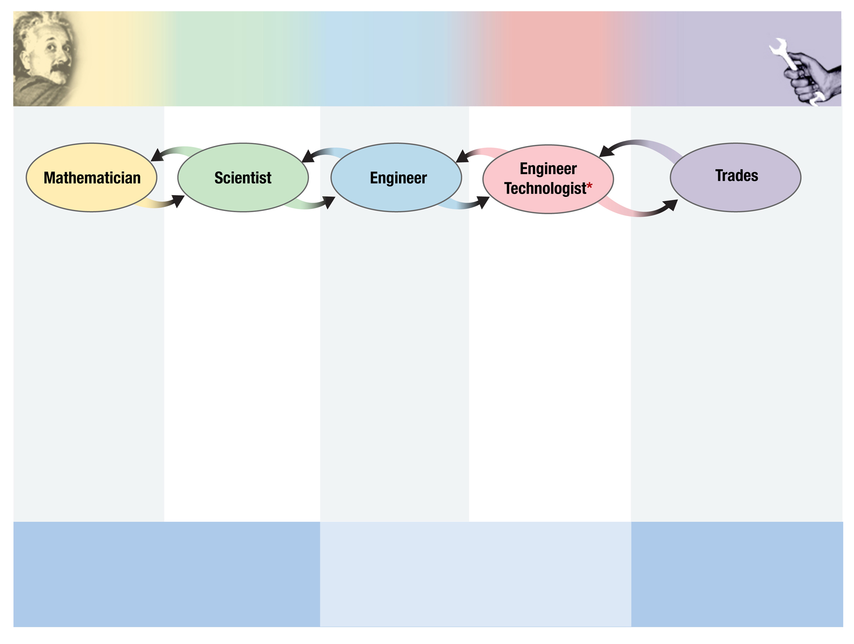
THEORY
S K I L L C O M P O N E N T S
HANDS-ON
Theoretical Physics
Experimental Physics
Discover languages to quantitatively describe existing world
Discover & describe
existing world
Design & build new systems
Fabricate & operate
new systems
Build or repair existing systems/components
Traditional
Welding
HVAC
Electricity
Plumbing
Electronics
Manufacturing
(Surgeon 19th C.)
A+ Comp Repair
Comp Network Admin
CISCO Network
ORACLE Internet
CAD
Model & Simulation
Algebraist
Geometer
Topologist
Statistician
Physicist
Chemist
Biologist
Research MD
Astronomer
Geologist
Aerospace
Automotive
Chemical
Electronics
Computer
Civil
Model & Simulation
Research Surgeon
Wind Tunnel
Aircraft Maintenance
Airframe/Powerplant
Particle Detectors
Integrated Circuits
21st Century
4-yr College (+)
4-yr College (+)
4-yr College (+)
2-yr college/OJT
HS with National Certifications
Traditional Academic
Current K-12 “Gap”
CTE
Jimbatterson@live.com – May 2007
* Sometimes “Instrument Maker”

Slide 34
A Great Career Choice EGR 120 – Introduction to Engineering
34
The Functions of an Engineer
The work that engineers do is very broad. Some examples include:
Research & Development
Design
Production and Testing
Construction
Operations (plant engineer)
Sales & Marketing
Project Management
Consulting
Teaching

Slide 35
A Great Career Choice EGR 120 – Introduction to Engineering
35
Engineering degrees
BS degree: Most engineers work with a BS degree
Minors:
Why get a minor?
What is required?
Double majors:
Why get a double major?
What is required?

Slide 36
A Great Career Choice EGR 120 – Introduction to Engineering
36
Engineering graduate degrees
What is involved in getting a graduate degree in engineering?
Requirements for MS degree in Engineering
Requirements for Ph.D. degree in Engineering
What are the advantages and disadvantages of getting a graduate degree in engineering?
Advantages
Disadvantages

Slide 37
A Great Career Choice EGR 120 – Introduction to Engineering
37
Other graduate degrees often obtained by engineers
Two common graduate degrees obtained after a B.S. degree in engineering are:
M.S. in Engineering Management (Ph.D. also available)
MBA (Master’s in Business Administration)
Why would engineers pursue these degrees?

