Slide 1
Chapter 9 EGR 272 – Circuit Theory II
1
Read: Chapter 9 and Appendix B in Electric Circuits, 10th Edition by Nilsson
Sinusoidal Steady-State Analysis
also called AC Circuit Analysis
also called Phasor Analysis
Discuss each name.
Before beginning a study of AC circuit analysis, it is helpful to introduce (or review) two related topics:
1) sinusoidal waveforms
2) complex numbers

Slide 2
Chapter 9 EGR 272 – Circuit Theory II
2
Sinusoidal Waveforms
In general, a sinusoidal voltage waveform can be expressed as:
v(t) = V_{p}cos(wt) where
V_{p} = peak or maximum voltage
w = radian frequency (in rad/s)
T = period (in seconds)
f = frequency in Hertz (Hz)
Example: An AC wall outlet has V_{RMS} = 120V and f = 60 Hz. Express the voltage as a time function and sketch the voltage waveform.

Slide 3
Chapter 9 EGR 272 – Circuit Theory II
3
Shifted waveforms:
v(t) = V_{p}cos(wt + θ ) where θ = phase angle in degrees
a shift to the left is positive and a shift to the right is negative (as with any function)
Example: Sketch v(t) = 50cos(500t – 30º)
Radians versus degrees:
Note that the argument of the cosine in v(t) = V_{p}cos(wt + θ ) has mixed units – both radians and degrees. If this function is evaluated at a particular time t, care must be taken such that the units agree.
Example: Evaluate v(t) = 50cos(500t – 40º) at t = 1ms.

Slide 4
Chapter 9 EGR 272 – Circuit Theory II
4
Relative shift between waveforms:
V₁ leads V₂ by θ
or
V₂ lags V₁ by θ
Example: v₁(t) = 50cos(500t – 50º) and v₂(t) = 40cos(500t + 60º).
Does v₁ lead or lag v₂? By how much?
If v₁ was shifted 0.5ms to the right, find a new expression for v₁(t).

Slide 5
Chapter 9 EGR 272 – Circuit Theory II
5
Complex Numbers
A complex number can be expressed in two forms:
Rectangular form
Polar form
A complex number can be plotted on the complex plane, where
x-axis: real part of the complex number
y-axis: imaginary (j) part of the complex number

Slide 6
Chapter 9 EGR 272 – Circuit Theory II
6
Rectangular Numbers
A rectangular number specifies the x,y location of complex number in the complex plane in the form:
(rectangular form)

Slide 7
Chapter 9 EGR 272 – Circuit Theory II
7
Polar Numbers
A polar number specifies the distance and angle of complex number from the origin in the complex plane in the form:

Slide 8
Chapter 9 EGR 272 – Circuit Theory II
8
Converting between rectangular form and polar form
  Polar to Rectangular: Rectangular to Polar:
  Given: |X|, θ Given: A, B
  Find: A, B Find: |X|, θ
A = |X|cos(θ)
B = |X|sin(θ)

Slide 9
Chapter 9 EGR 272 – Circuit Theory II
9
Complex numbers using calculators
Refer to the handout entitled “Complex Numbers”
Mathematical Operations Using Complex Numbers
Note: Calculators are used for most numerical calculations. When symbolic calculations are used, the following items may be helpful.
1) Addition/Subtraction – easiest in rectangular form

Slide 10
Chapter 9 EGR 272 – Circuit Theory II
10
2) Multiplication/Division – easiest in polar form
3) Inversion

Slide 11
Chapter 9 EGR 272 – Circuit Theory II
11
4) Exponentiation
5) Conjugate
Example:

Slide 12
Chapter 9 EGR 272 – Circuit Theory II
12
Example: Convert to the other form or simplify.
1) -3 2) -j3
3) j6 4) -4/j
5) 1/(j2) 6) j²
7) j³ 8) j⁴
9) 300 – j250 10) 250∠-75°
11) (-3 - j6)* 12) (250∠-75°)*
13) (4 + j7)² 14) (-4 + j6)⁻¹

Slide 13
Chapter 9 EGR 272 – Circuit Theory II
13
Example: Simplify the following (by hand or using a calculator)
Note for Mastering Engineering:
If a problem asks you to enter a result as a “complex number”, use rectangular form.
If a problem asks you to enter a result in “polar form”, use polar form.

Slide 14
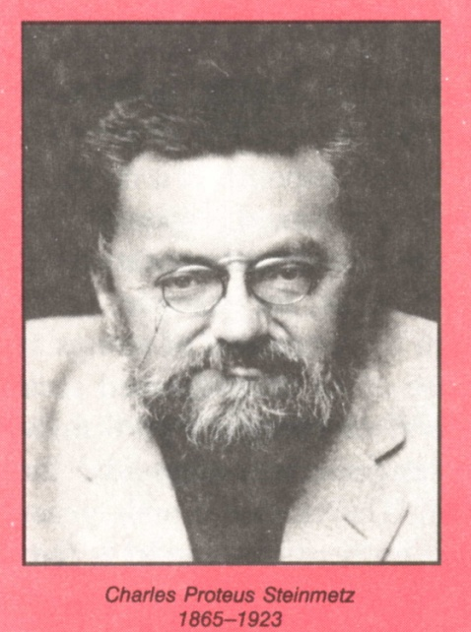
Chapter 9 EGR 272 – Circuit Theory II
14
Phasor Analysis
“I have found the equation that will enable us to transmit electricity through alternating current over thousands of miles. I have reduced it to a simple problem in algebra.”
Charles Proteus Steinmetz
The use of complex numbers to solve ac circuit problems – the so-called phasor method considered in this chapter – was first done by German-Austrian mathematician and electrical engineer Charles Proteus Steinmetz in a paper presented in 1893. He is noted also for the laws of hysteresis and for his work in manufactured lighting.
Steinmetz was born in Breslau, Germany, the son of a government railway worker. He was deformed from birth and lost his mother when he was 1 year old, but this did not keep him from becoming a scientific genius. Just as his work on hysteresis later attracted the attention of the scientific community, his political activities while he was at the University at Breslau attracted the police. He was forced to flee the country just as he had finished the work for his doctorate, which he never received. He did electrical research in the United States, primarily with the General Electric Company. His paper on complex numbers revolutionized the analysis of ac circuits, although it was said at the time that no one but Steinmetz understood the method. In 1897 he also published the first book to reduce ac calculations to a science.
(Electric Circuit Analysis, 2nd Edition, by Johnson, Johnson, and Hilburn, p. 307)

Slide 15
Chapter 9 EGR 272 – Circuit Theory II
15
Phasor – a complex number in polar form representing either a sinusoidal voltage or a sinusoidal current.
Symbolically, if a time waveform is designated at v(t), then the corresponding phasor is designated by .
Examples: Convert to the other notation (time waveform or phasor)
Should phasors use cos( ) or sin( )?
It doesn’t matter as long as you are consistent.
Our textbook typically uses cos( ).

Slide 16
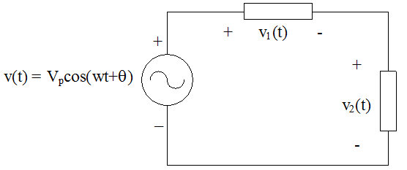
Chapter 9 EGR 272 – Circuit Theory II
16
Justification for “phasor analysis” Consider the circuit shown below.
v₁(t) and v₂(t) must have the same form as the voltage source, v(t) (or forcing function).
So v₁(t) = V₁cos(wt+α) and v₂(t) = V₂cos(wt+β)
KVL yields: v(t) = v₁(t) + v₂(t) (KVL in the time-domain)
V_{P}cos(wt+θ) = V₁cos(wt+α) + V₂cos(wt+β)
Now replacing the equation by an equation with the same real part:
V_{P}e^{j(wt+θ)} = V₁e^{j(wt+α)} + V₂e^{j(wt+β)}
Dividing by e^{jwt} yields
V_{P}e^{j θ} = V₁e^{jα} + V₂e^{jβ}
But these are simply polar numbers (in true polar form) so
V_{P}∠ θ = V₁∠ α + V₂∠ β or
(KVL using phasors)
This is essentially a short proof showing why phasor analysis works.

Slide 17
Chapter 9 EGR 272 – Circuit Theory II
17
Before we get into the details of phasor analysis, we need a method of representing components in AC circuits. We will introduce a new term called impedance.
Complex Impedance
Z = impedance or complex impedance (in Ω)
Note that the relationship above is similar to Ohm’s Law.
Now we will define impedance for resistors, inductors, and capacitors.
Resistors:
If i(t) = I_{p}cos(wt + θ), find v(t) and show that

Slide 18
Chapter 9 EGR 272 – Circuit Theory II
18
Inductors:
If i(t) = I_{p}cos(wt + θ), find v(t) and show that
Capacitors:
If v(t) = V_{p}cos(wt + θ), find i(t) and show that

Slide 19
Chapter 9 EGR 272 – Circuit Theory II
19
AC Circuit Analysis Procedure:
1) Draw the phasor circuit (showing voltage and current sources as phasors and using complex impedances for the components).
2) Analyze the circuit in the same way that you might analyze a DC circuit.
3) Convert the final phasor result back to the time domain.
Example: Find I(t) in the circuit below using phasor analysis.

Slide 20
Chapter 9 EGR 272 – Circuit Theory II
20
KVL and KCL in AC circuits:
KVL and KCL are satisfied in AC circuits using phasor voltages and currents. They are not satisfied using the magnitudes of the voltages or the currents.
Example: For the previous example, show that:
Example: For the previous example, show that
using a phasor diagram.

Slide 21
Chapter 9 EGR 272 – Circuit Theory II
21
Example: Analyze the circuit below using phasor analysis. Specifically,
A) Find the total circuit impedance
B) Find the total current, i(t) (Example is continued on the following slide)

Slide 22
Chapter 9 EGR 272 – Circuit Theory II
22
Example: (continued)
C) Use current division to find i₁(t) and i₂(t)
Show that KCL is satisfied using current phasors, but not current magnitudes.
E) Show that KCL is satisfied using a phasor diagram.

Slide 23
Chapter 9 EGR 272 – Circuit Theory II
23
Using Phasors to Add Sinusoids
Sinusoidal voltages or currents could be added using various trigonometric identities; however, they are more easily combined using phasors.
Example: If v₁ = 10cos(200t + 15°), v₂ = 15cos(200t + -30°), and v₃ = 8sin(200t), find v₄.
+
V₂
_
+
+
V₁
V₃
_
_
+
V₄
_

Slide 24
Chapter 9 EGR 272 – Circuit Theory II
24
Review of DC Circuit Analysis Techniques
Analyzing AC circuits is very similar to analyzing DC resistive circuits. Several examples are presented below which will also serve to review many DC analysis techniques, including:
Source transformations
Mesh equations
Node equations
Superposition
Operational Amplifiers (op amps)
Thevenin’s and Norton’s theorems
Maximum Power Transfer theorem

Slide 25
Chapter 9 EGR 272 – Circuit Theory II
25
Source transformations
A phasor voltage source with a series impedance may be transformed into a phasor current source with a parallel impedance as illustrated below. The two sources are identical as far as the load is concerned.
Notes:
Not all sources can be transformed. Discuss.
The two sources are not equivalent internally. For example, the voltage across Z_{s} is not equivalent to the voltage across Z_{p}.
Dependent sources can be transformed.
Converting a real current source
to a real voltage source:
Converting a real voltage source
to a real current source:

Slide 26
Chapter 9 EGR 272 – Circuit Theory II
26
Example: Solve for the voltage V using source transformations.

Slide 27
Chapter 9 EGR 272 – Circuit Theory II
27
Mesh equations:
Example: Solve for the voltage V using mesh equations.

Slide 28
Chapter 9 EGR 272 – Circuit Theory II
28
Node equations:
Example: Solve for the current i(t) using node equations.

Slide 29
Chapter 9 EGR 272 – Circuit Theory II
29
Superposition:
Superposition can be used to analyze multiple-source AC circuits in a manner very similar to analyzing DC circuits. However, there are two special cases where it is highly recommended that superposition be used:
Circuits that include sources at two or more different frequencies.
Circuits that include both DC and AC sources (Note: you could think of DC
sources as acting like AC sources with w = 0.)
Example 1 (sources with different frequencies): Solve for the voltage V using superposition.

Slide 30
Chapter 9 EGR 272 – Circuit Theory II
30
Example 2 (AC and DC sources): Solve for the voltage V using superposition.

Slide 31
Chapter 9 EGR 272 – Circuit Theory II
31
Thevenin’s and Norton’s Theorems – Recall that any one-port network N may be represented by either of the following types of equivalent circuits:
Thevenin Equivalent Circuit (TEC) – consisting of a voltage source and a series impedance
Norton Equivalent Circuit (NEC) – consisting of a current source and a parallel impedance
I
I
I
Network N
independent sources, dependent sources, and resistors
Network N
(independent sources,
dependent sources,
and resistors)
+
V
_
R_{TH}
+
V
_
+
V
_
Load
V_{TH}
+
-
Load
I_{N}
R_{N}
Load
where:
TEC
NEC

Slide 32
Chapter 9 EGR 272 – Circuit Theory II
32
Thevenin’s and Norton’s Theorems with AC Circuits:
Thevenin’s and Norton’s theorems apply to AC circuits as well, but
and are now phasors and R_{TH} or R_{N} are replaced by Z_{TH} or Z_{N} as shown below.
Network N
(independent sources,
dependent sources,
resistors, capacitors, & inductors)
I
I
I
Network N
independent sources, dependent sources, and resistors
+
V
_
Z_{TH}
+
V
_
+
V
_
Load
V_{TH}
+
-
Load
I_{N}
Z_{N}
Load
TEC
NEC
where:

Slide 33
Chapter 9 EGR 272 – Circuit Theory II
33
Thevenin’s Theorem:
Example: Find the Thevenin Equivalent Circuit seen by R_{L} in the circuit below.
+
_
30
3mH
50cos(5000t) V
5μF
R_{L}

Slide 34
Chapter 9 EGR 272 – Circuit Theory II
34
Op Amps - Analyzing op amps with AC sources is similar to analyzing op amps with other sources. Recall three key steps:
V+ = V⁻ (the voltage is the same at the two input terminals)
I⁺ = I⁻ = 0 (no current enters the op amp at the inputs)
Use node equations
Example: Solve for V_{o} and I_{o} in the op am circuit below.
I_{o}
20cos(10t) V
+
V_{o}
_

Slide 35
Chapter 9 EGR 272 – Circuit Theory II
35
Impedance, Resistance, and Reactance
Recall that impedance, Z, is defined as follows:
Expressing Z in rectangular and polar form yields:
and
Also note that
where:

Slide 36
Chapter 9 EGR 272 – Circuit Theory II
36
Impedance Diagram:
The relationship between Z, R, and X is sometimes illustrated using an impedance diagram as shown:
Im
Z
X
|Z|
or
|Z|
jX
θ
θ
Re
R
R
Inductive reactance:
Recall that the impedance for an inductor was defined as:
So inductive reactance is defined as follows:
or

Slide 37
Chapter 9 EGR 272 – Circuit Theory II
37
Capacitive reactance:
Recall that the impedance for a capacitor was defined as:
So capacitive reactance is defined as follows:
or
I
+
Example:
If w = 100 rad/s, find:
The resistance of the circuit
The reactance of the circuit
If the impedance is to be represented by a series RC circuit, find R and C
If the impedance is to be represented by a parallel RC circuit, find R and C
V
_

Slide 38
Chapter 9 EGR 272 – Circuit Theory II
38
Admittance, Conductance, and Susceptance
Admittance is defined as follows:
(Ω)
Expressing Y in rectangular form yields:
where:
Note that G and B can be expressed in terms of R and X as follows:
so

Slide 39
Chapter 9 EGR 272 – Circuit Theory II
39
Example:
If w = 10 rad/s for the circuit shown, find Z, |Z|, R, X, Y, G, and B
I
+
V
10uF
1.5kΩ
_

Slide 40
Chapter 9 EGR 272 – Circuit Theory II
40
Resonance – the condition where the reactive components in a circuit cancel resulting in a purely resistive circuit. This condition can sometimes yield unusually large voltages or currents.
Series resonant circuit:
Show that
i(t)
+
_
R
L
V_{m}cos(wt) V
C
Z_{eq}

Slide 41
Chapter 9 EGR 272 – Circuit Theory II
41
Series Resonant Circuit: (continued)
Solve for the current and all component voltages both as phasors and functions of time. Sketch the time waveforms.

Slide 42
Chapter 9 EGR 272 – Circuit Theory II
42
Series Resonant Circuit: (continued)
Define Q_{s} = “Quality factor” for a series resonant circuit.
Show that

Slide 43
Chapter 9 EGR 272 – Circuit Theory II
43
Example: The series RLC circuit below is in resonance.
i(t)
+
_
4
10mH
100cos(wt) V
1uF
A) Determine the resonant frequency, w_{o} (in rad/s) and f_{o} (in Hz).
Draw the phasor circuit if w = w_{o}. Label
Find
Sketch a phasor diagram illustrating the relationship between the voltages in the circuit.

Slide 44
Chapter 9 EGR 272 – Circuit Theory II
44
Parallel resonant circuit:
Show that
+
V
_
I_{m}cos(wt) A
R
L
C
Z_{eq}
Also determine expressions for resistor, capacitor, and inductor current.

Slide 45
Chapter 9 EGR 272 – Circuit Theory II
45
Resonance in other circuits
The relationships developed for w_{o} for series and parallel RLC circuits do not apply to other resonant circuits. The value of w_{o} can be determined for other circuits by finding the total circuit impedance and determining at what frequency the total circuit impedance is real.
Example: Find the resonant frequency, w_{o}, for the circuit below. Compare it to the following incorrect formula:
+
_
5H
V_{m}cos(wt) V
10
0.1F

Slide 46
Chapter 9 EGR 272 – Circuit Theory II
46
Transformers:
Our earlier study of inductors introduced the idea that current through a set of windings creates a magnetic field and magnetic flux, φ, flows through the core. If φ then flows through a second set of windings another magnetic field is created and a secondary voltage is induced across these windings. This arrangement of two windings on a common core is called a transformer (illustrated below).

Slide 47
Chapter 9 EGR 272 – Circuit Theory II
47
Recall that
λ = flux linkage
N = number of turns
φ = magnetic flux (in Webers, Wb)
and λ = Nφ = Li , where L = inductance in Henries, H
Also
So
Since the same magnetic flux, φ, flows through the windings it is also true that the rate of change of magnetic flux, dφ/dt is the same, so
where a = turns ratio

Slide 48
Chapter 9 EGR 272 – Circuit Theory II
48
Key transformer relationships
We just saw that
Similarly
where a = turns ratio
so

Slide 49
Chapter 9 EGR 272 – Circuit Theory II
49
Transformer symbols
General Transformer
Iron-core Transformer

Slide 50
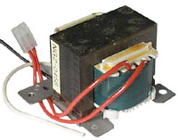
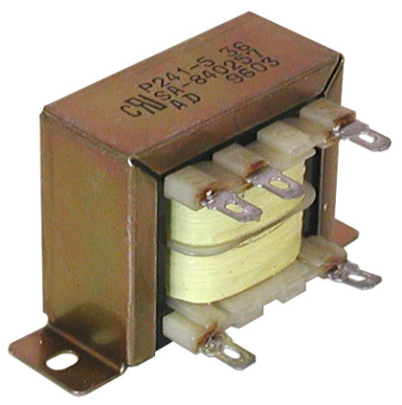
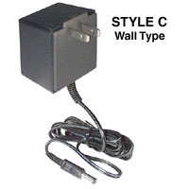
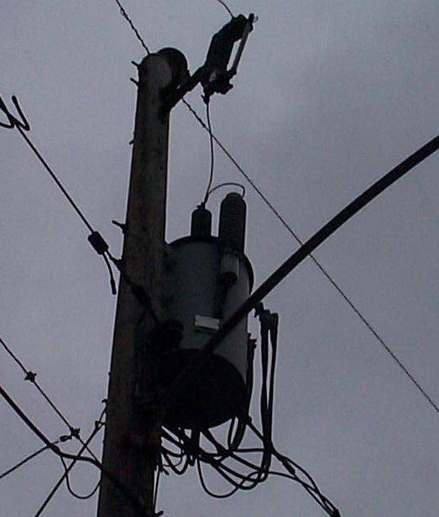
Chapter 9 EGR 272 – Circuit Theory II
50
Examples of transformers (reference: www.allelectronics.com)
Primary: 120V
Secondary: 28V, 1.5A
Primary: 120V
Secondary: 40VCT, 0.25A
Primary: 110V
Secondary: 15V, 0.4A
Utility pole transformer

Slide 51
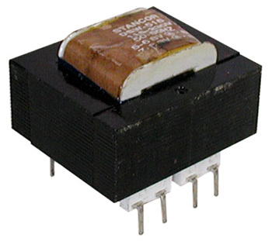
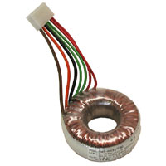
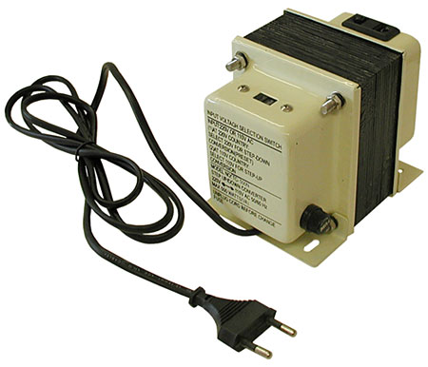
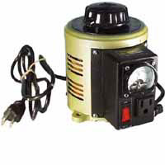
Chapter 9 EGR 272 – Circuit Theory II
51
Examples of transformers (reference: www.allelectronics.com)
PC Mount Transformer
Primary: 120V
Secondary: 16VCT, 0.8A or 8V, 1.6A
Toroidal Transformer
Primary: 120V
Secondary: 8.5V and 9.4V
Variac (Variable Transformer)
Input: 110V
Output: 0 to 130V
Up/Down Transformer
(110V to 220V) or (220V to 110V)

Slide 52
Chapter 9 EGR 272 – Circuit Theory II
52
Dot Convention
The direction of the windings in the secondary with respect to the direction of the windings in the primary determines the polarity of the secondary voltage. However, rather than showing the direction of the windings, dots are often placed at one end of each winding. Then the following convention applies:
Dot convention: “A positive voltage at one dotted terminal will produce a positive voltage at the other dotted terminal.”
Note that the relationships
Imply that:
the positive terminals of V₁ and V₂ are at the dotted terminals
I₁ enters the dotted terminal and I₂ leaves the dotted terminal
These voltage polarities and
current directions are indicated
to the right.
a : 1
i₁
N₁:N₂
i₂
+
+
V₁
V₂
_
_

Slide 53
Chapter 9 EGR 272 – Circuit Theory II
53
Four Common Transformer Uses
Change voltage levels
Change current levels
Change impedance levels (impedance matching)
Isolation (e.g., to isolate the secondary load from the ground in the primary)
Examples: Show simple examples of the four transformer uses listed above.

Slide 54
Chapter 9 EGR 272 – Circuit Theory II
54
Example: Determine the V₁ and i₂ in the circuit below. Find these values by:
A) Using KVL equations around each loop
2:1
+
20 mF
5
+
2
50cos(10t)
V₁
20 mH
_
_
i₂

Slide 55
Chapter 9 EGR 272 – Circuit Theory II
55
Example: Determine the V₁ and i₂ in the circuit below. Find these values by:
B) Reflecting the impedance of the secondary to the primary.
2:1
+
20 mF
5
+
2
50cos(10t)
V₁
20 mH
_
_
i₂
Note: There are two similar homework problems on transformers in addition to Mastering Engineering problems. See the handout “Ch. 9 - Extra Homework Problems” on the course website or in Blackboard.

Slide 56
Chapter 9 EGR 272 – Circuit Theory II
56
Example: Determine the value of Z_{ab} below.
1:2
3:1
1:2
a
10
10
10
Z_{ab}
10
b

Slide 57
Chapter 9 EGR 272 – Circuit Theory II
57
Example: Recall the example presented in EGR 271 where a transformer was used to insure that maximum power was delivered to a 4 ohm speaker from the output of an amplifier with an output resistance of 100 ohms.
Case 1: 4 Ω speaker is connected directly to the 100 Ω output. Terrible results occur due to mismatched impedances. Recall that we need R_{o} = R_{Th} for max power. “Impedance matching” is important in many applications.
Audio
Amplifier
R_{o} = 100Ω
4 Ω speaker
Case 2: A transformer is used to match the impedances.
What value of a (turns ratio is necessary?
a = ________
What impedance R1 is seen by the amplifier?
R₁ = ________
What impedance R2 is seen by the speaker?
R₂ = ________
a:1
Audio
Amplifier
R_{o} = 100Ω
R₁
R₂
4 Ω speaker

Slide 58
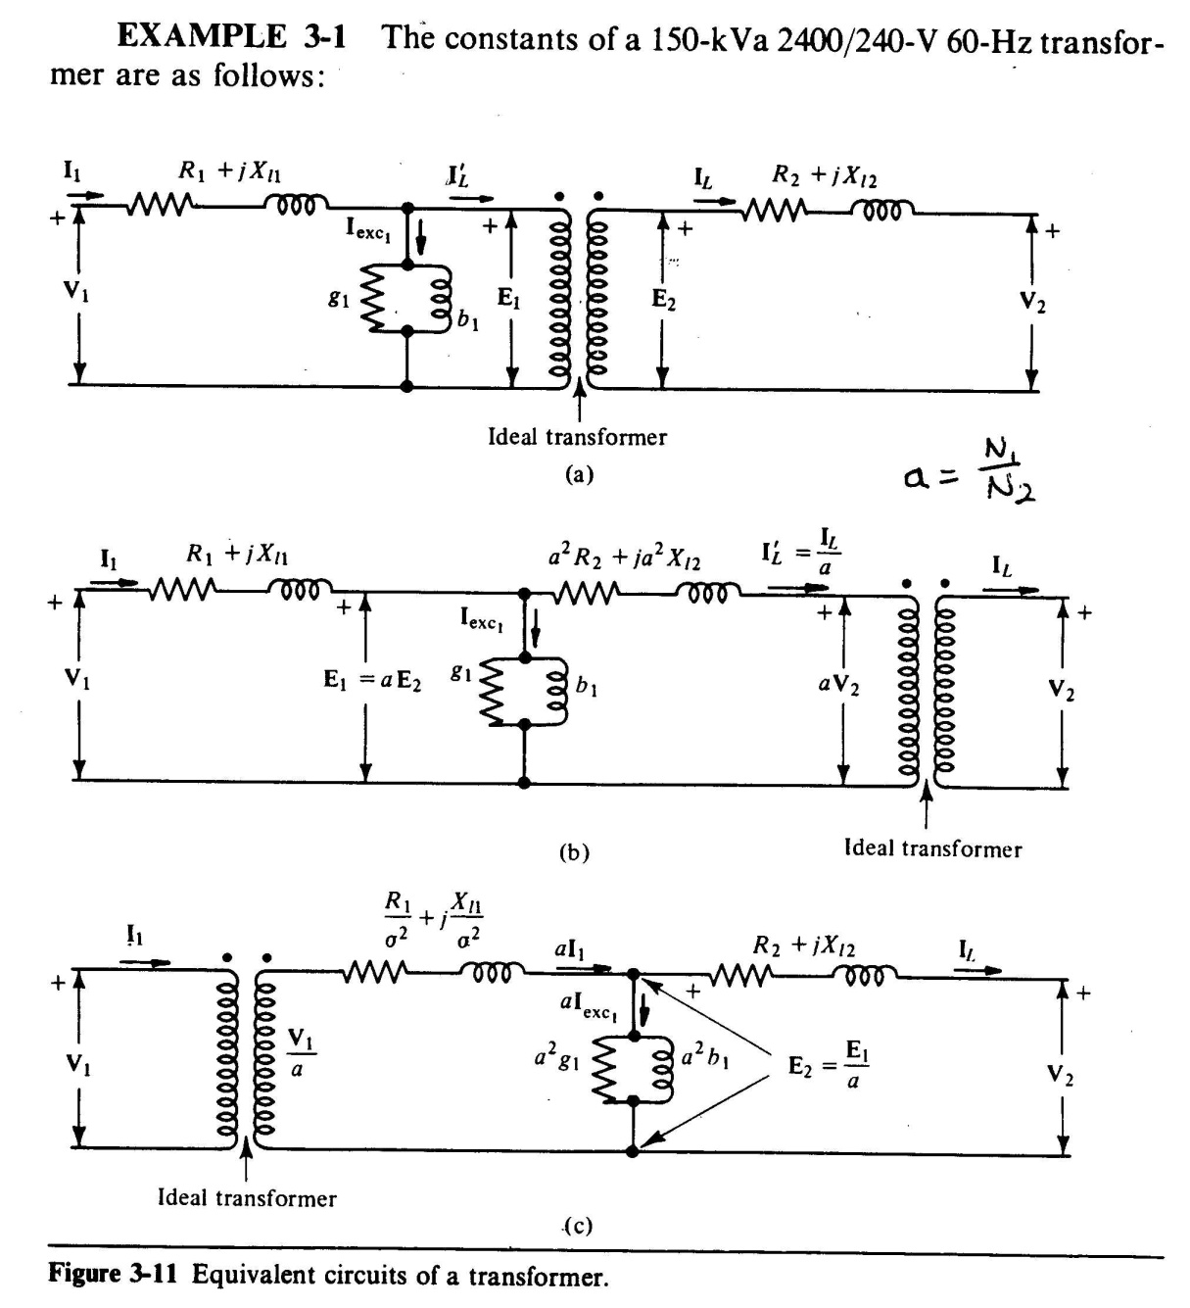
Chapter 9 EGR 272 – Circuit Theory II
(Just for reference)
58
Transformer Models:
Transformers considered in this course have been considered to be ideal. Although transformer behavior is often close to ideal, there are cases where non-ideal behavior might be examined. The figures to the left (reference: Electric Power & Machinery by Matsch) show models of a transformer used to approximate non-ideal behavior. The resistances, R₁ and R₂, represent the resistance of the windings and the inductive reactances, X_{l1} and X_{l2}, represent leakage magnetic flux.

