Slide 1
Chapter 15 EGR 272 – Circuit Theory II
1
Read: Ch. 15, Sect. 1-2; and Appendices D&E in Electric Circuits, 10th Edition by Nilsson
Bode Plots
We have determined the frequency response for several 1st and 2nd order circuits. Using the same methods for higher order circuits would become very difficult. A new method will be introduced here, called the Bode plot, which will allow us to form accurate “straight-line” approximations for the log-magnitude and phase responses quite easily for even high-order transfer functions. This technique will also show how various types of terms in a transfer function affect the log-magnitude and phase responses.
Illustration - A Bode plot is used to make a good estimate of the actual response.
20log|H(jw)|
Bode “straight-line” approximation
Actual log-magnitude response
w(rad/s)
(w on a log scale)

Slide 2
Chapter 15 EGR 272 – Circuit Theory II
2
Decibels
However, when scaled logs of the quantities are taken, the unit of decibels (dB), is assigned.

Slide 3
Chapter 15 EGR 272 – Circuit Theory II
3
Decibels are used in various areas, including:
Gain: Voltage gain, current gain, or power gain is often measured in dB (EGR 272)
Acoustics: Loudness (or sound pressure level) is measured in dB
Power: Output power relative to an input 1mW is expressed in dBm
(used in EGR 272)

Slide 4
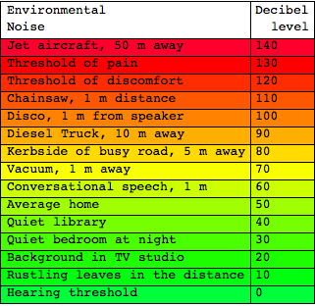
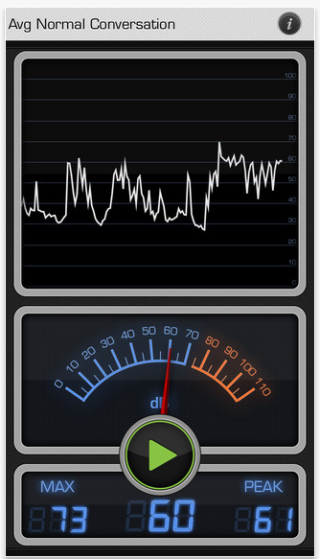
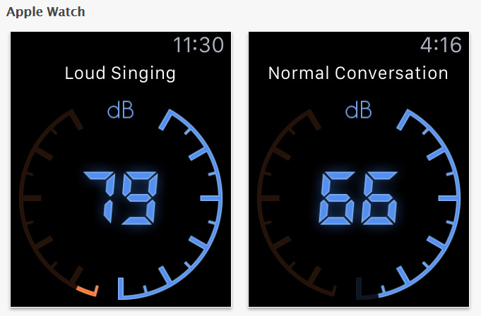
Chapter 15 EGR 272 – Circuit Theory II
4
Typical acoustic levels in dB
Acoustic levels in dB are shown below. This is not our main concern in EGR 272, but it is perhaps a more familiar use of dB. Note that dB meters are commonly used and you can even download free dB apps for smart phones to measure dB levels. Demo?
mathematica.stackexchange.com

Slide 5
Chapter 15 EGR 272 – Circuit Theory II
5
There are two types of Bode plots:
The Bode straight-line approximation to the log-magnitude (LM) plot, LM versus w (with w on a log scale)
The Bode straight-line approximation to the phase plot, φ(w) versus w (with w on a log scale)
Example: (details later)
Standard form for H(jw):
Before drawing a Bode plot, it is necessary to find H(jw) and put it in “standard form.”
Show the “standard form” for H(jw) below:

Slide 6
Chapter 15 EGR 272 – Circuit Theory II
6
Example:
Find H(jw) for H(s) shown below and put H(jw) in “standard form.”

Slide 7
Chapter 15 EGR 272 – Circuit Theory II
7
The additive effect of terms in H(jw):
The reason that Bode plot approximations are used with the log-magnitude is due to the fact that this makes individual terms in the LM additive. The phase is also additive.
Show how the LM and phase of each term in 20log|H(jw)| is additive (or acts separately).
Drawing Bode plots:
To draw a Bode plot for any H(s), we need to:
1) Recognize the different types of terms that can occur in H(s) (or H(jw))
2) Learn how to draw the log-magnitude and phase plots for each type of term.

Slide 8
Chapter 15 EGR 272 – Circuit Theory II
8
5 types of terms in H(jw)
1) K (a constant)
2) (a zero) or (a pole)
3) jw (a zero) or 1/jw (a pole)
4)
5) Any of the terms raised to a positive integer power.
Each term is now examined in detail.

Slide 9
Chapter 15 EGR 272 – Circuit Theory II
9
1. Constant term in H(jw)
If H(jw) = K = K/0°
Then LM = 20log(K) and φ(w) = 0° , so the LM and phase responses are:
Summary: A constant in H(jw):
Adds a constant value to the LM graph (shifts the entire graph up or down)
Has no effect on the phase

Slide 10
Chapter 15 EGR 272 – Circuit Theory II
10
2. A) 1 + jw/w₁ (a zero): The straight-line approximations are:
To determine the LM and phase responses, consider 3 ranges for w:
1) w << w₁
2) w >> w₁
3) w = w₁

Slide 11
Chapter 15 EGR 272 – Circuit Theory II
11
The Bode approximations (LM and phase) for 1 + jw/w₁ are shown below.
Discuss the amount of error between the actual responses and the Bode approximations.
Summary: A 1 + jw/w₁ (zero) term in H(jw):
Causes an upward break at w = w₁ in the LM plot. There is a 0dB effect before the break and a slope of +20dB/dec or +6dB/oct after the break.
Adds 90° to the phase plot over a 2 decade range beginning a decade before w₁ and ending a decade after w₁ . The slope is +45 deg/dec or +13.5 deg/oct.

Slide 12
Chapter 15 EGR 272 – Circuit Theory II
12
2B) (a pole): The straight-line approximations are:
To determine the LM and phase responses, consider 3 ranges for w:
1) w << w₁
2) w >> w₁
3) w = w₁

Slide 13
Chapter 15 EGR 272 – Circuit Theory II
13
The Bode approximations (LM and phase) for are shown below.
Discuss the amount of error between the actual responses and the Bode approximations.
Summary: A 1 + jw/w₁ (zero) term in H(jw):
Causes an downward break at w = w₁ in the LM plot. There is a 0dB effect before the break and a slope of -20dB/dec or -6dB/oct after the break.
Adds -90° to the phase plot over a 2 decade range beginning a decade before w₁ and ending a decade after w₁ . The slope is -45 deg/dec or -13.5 deg/oct.

Slide 14
Chapter 15 EGR 272 – Circuit Theory II
14
Example: Sketch the LM and phase plots for the following transfer function.

Slide 15
Chapter 15 EGR 272 – Circuit Theory II
15
Example: Sketch the LM and phase plots for the following transfer function.

Slide 16
Chapter 15 EGR 272 – Circuit Theory II
16
LM: Working with slopes on Bode plots:
If the LM has a slope of 20 dB/dec, the change in LM between two frequencies can be calculated using:
Example: Determine the value of LM₂ below.
LM
40 dB
-20 dB/dec
LM₂
w (rad/s)
45
725

Slide 17
Chapter 15 EGR 272 – Circuit Theory II
17
Phase: Working with slopes on Bode plots:
If the phase has a slope of 45 deg/dec, the change in phase (in degrees) between two frequencies can be calculated using:
Example: Determine the value of φ₂ below.
φ (deg)
90°
-45 deg/dec
φ₂
w (rad/s)
150
5200

Slide 18
Chapter 15 EGR 272 – Circuit Theory II
18
Example: Sketch the LM and phase plots for the following transfer function.
(Solution provided on the following slide)

Slide 19
Chapter 15 EGR 272 – Circuit Theory II
19
Example: Sketch the Bode LM and phase plots for:
40.64°

Slide 20
Chapter 15 EGR 272 – Circuit Theory II
20
Example: Sketch the LM and phase plots on the 4-cycle semi-log graph paper shown below for the following transfer function. (Pass out 2 sheets of graph paper.)
Log-magnitude (LM) plot:

Slide 21
Chapter 15 EGR 272 – Circuit Theory II
21
Example: (continued)
Phase plot:

Slide 22
Chapter 15 EGR 272 – Circuit Theory II
22
3A) jw term in H(jw)
If H(jw) = jw = w/90°
Then LM = 20log(w) and φ(w) = 90°
Calculate 20log(w) for several values of w to show that the graph is a straight line for all frequency with a slope of 20dB/dec (or 6dB/oct).
The LM and phase for H(jw) = jw are shown below.
So a jw (zero) term in H(jw) adds an upward slope of +20dB/dec (or +6dB/oct) to the LM plot.
And a jw (zero) term in H(jw) adds a constant 90° to the phase plot.

Slide 23
Chapter 15 EGR 272 – Circuit Theory II
23
3B) 1/(jw) term in H(jw)
If H(jw) = 1/(jw) = (1/w)/-90°
Then LM = 20log(1/w) = -20log(w) and φ(w) = -90°
A few calculations could easily show that the graph of 20log(1/w)is a straight line for all frequency with a slope of -20dB/dec (or -6dB/oct).
The LM and phase for H(jw) = 1/(jw) are shown below.
So a 1/(jw) (pole) term in H(jw) adds a downward slope of -20dB/dec (or -6dB/oct) to the LM plot.
And a 1/(jw) (pole) term in H(jw) adds a constant -90° to the phase plot.

Slide 24
Chapter 15 EGR 272 – Circuit Theory II
24
Example: Sketch the LM and phase plots for the following transfer function.

Slide 25
Chapter 15 EGR 272 – Circuit Theory II
25
Example: Sketch the LM and phase plots for the following transfer function.

Slide 26
Chapter 15 EGR 272 – Circuit Theory II
26
Calculation of exact points to check Bode Plots
Evaluating H(jw) at a particular value of w is helpful to check Bode Plots. An example is shown below.

Slide 27
Chapter 15 EGR 272 – Circuit Theory II
27
Example:
Evaluate the H(jw) on the last page at w = 500 rad/s and w = 8000 rad/s. Compare the values with the Bode plots. Do they appear to be correct?

Slide 28
Chapter 15 EGR 272 – Circuit Theory II
28
5. Poles and zeros raised to an integer power in H(s)
In the last class it was demonstrated that terms in H(jw) are additive. Therefore, a double terms (such as a pole or zero that is squared) simply acts like two terms, a triple term acts like three terms, etc.
Illustration: Show that (1 + jw/w₁)^{N} results in the following responses:
LM plot:
Has a 0dB contribution before its break frequency
Will increase at a rate of 20NdB/dec after the break
There will be an error of 3NdB at the break between the Bode straight-line approximation and the exact LM
Phase plot:
Has a 0 degree contribution until 1 decade before its break frequency
Will increase at a rate of 45Ndeg/dec for two decades (from 0.1w₁ to 10w₁).
The total final phase contribution will be 90N degrees.

Slide 29
Chapter 15 EGR 272 – Circuit Theory II
29
So (1 + jw/w₁)^{N} results in the following responses:

Slide 30
Chapter 15 EGR 272 – Circuit Theory II
30
Example: Sketch the LM plot for the following transfer function.

Slide 31
Chapter 15 EGR 272 – Circuit Theory II
31
Generating LM and phase plots using Excel and MATLAB:
Refer to the handout entitled “Frequency Response” which includes detailed examples of creating LM and phase plots using Excel and MATLAB.
Generating LM and phase plots using PSPICE:
Refer to the handout entitled “PSPICE Example: Frequency Response (Log-Magnitude and Phase)” which includes a detailed example of creating LM and phase plots using PSPICE.
Classroom Demonstration/Exercise (optional)
Determine H(s) = I_{R}(s)/I(s) for a parallel RLC circuit with C = 1uF, L = 0.25H, and R = 200 Ω.
Draw the Bode LM and phase plots
Use Excel and/or MATLAB to graph the exact LM and phase plots
Analyze the circuit with PSPICE and graph the exact LM and phase plots.

Slide 32
Chapter 15 EGR 272 – Circuit Theory II
32
Bode Plots - Recall that there are 5 types of terms in H(s). The first four have already been covered.
5. Complex terms in H(s)
A second order term in H(s) with complex roots has the general form s² + 2αs + w_{o}² . After factoring out the constant has the w_{o}² , the corresponding term in H(jw) is:
Key point: The complex term above is identical to a double real pole or a double real zero in the Bode straight-line approximation, but they differ in the exact curves.

Slide 33
Chapter 15 EGR 272 – Circuit Theory II
33
Complex peaks and damping ratio
Exercise: Complete the table below showing the value of the complex peak (for a complex zero)
* ζ = 1 is not complex. It corresponds to a double-zero.

Slide 34
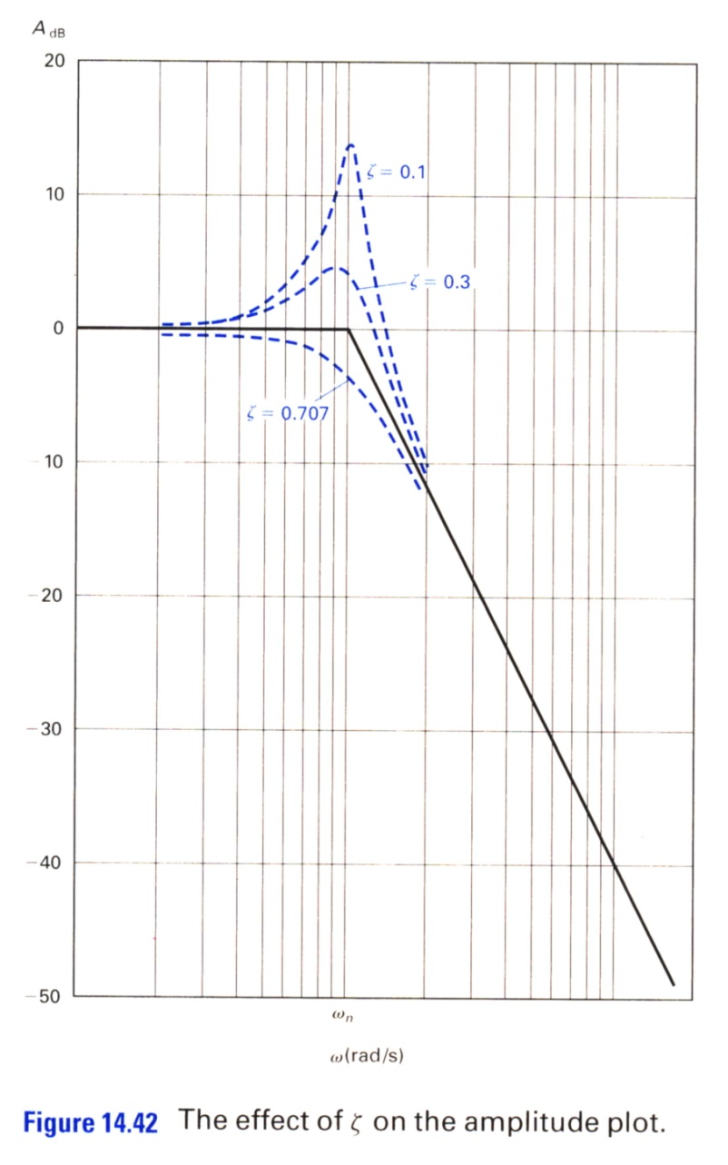
Chapter 15 EGR 272 – Circuit Theory II
34
The following graphs from the text (Electric Circuits, 9th Edition, by Nilsson) below show the Bode straight-line approximation and the exact curve for different values of ζ .

Slide 35
Chapter 15 EGR 272 – Circuit Theory II
35
Example: Sketch the LM responses for H₁(s), which has a double zero, and H₂(s), which has a complex zero.
A) Find H₁(jw) and sketch the LM response

Slide 36
Chapter 15 EGR 272 – Circuit Theory II
36
Example: Sketch the LM responses for H₁(s), which has a double zero, and H₂(s), which has a complex zero.
B) Find H₂(jw) and sketch the LM response

Slide 37
Chapter 15 EGR 272 – Circuit Theory II
37
Filter order
Unfortunately, we can’t build ideal filters. However, the higher the order of a filter, the more closely it will approximate an ideal filter.
The order of a filter is equal to the degree of the denominator of H(s).
(Of course, H(s) must also have the correct form.)
LM
Ideal LPF
slope = ∞
4th-order LPF
slope = -80dB/dec
3rd-order LPF
slope = -60dB/dec
2nd-order LPF
slope = -40dB/dec
1st-order LPF
slope = -20dB/dec
w
w_{C}

Slide 38
Chapter 15 EGR 272 – Circuit Theory II
38
Recognizing filter types from the transfer function
Low-pass filter (LPF) - Discuss the form of LM, H(jw), and H(s).
High-pass filter (HPF) - Discuss the form of LM, H(jw), and H(s).

Slide 39
Chapter 15 EGR 272 – Circuit Theory II
39
Band-pass filter (BPF) - Discuss the form of LM, H(jw), and H(s).
Band-stop filter (BSF) - Discuss the form of LM, H(jw), and H(s). Also define a “notch” filter.

Slide 40
Chapter 15 EGR 272 – Circuit Theory II
40
Practical Filter Examples: Discuss a stereo tuner, 5-band equalizer, 60 Hz interference block.

Slide 41
Chapter 15 EGR 272 – Circuit Theory II
41
Active and passive filters
Passive filter - a filter constructed using passive circuit elements (R’s, L’s, and C’s)
Active filter - a filter constructed using active circuit elements (primarily op amps)
Analysis of active filters
Active filters are fairly easy to analyze. Recall that a resistive inverting amplifier circuit has the following relationship:
Replacing the resistors with impedances yields a transfer function, H(s):

Slide 42
Chapter 15 EGR 272 – Circuit Theory II
42
Example: Find H(s) =V_{o}(s)/V_{in}(s) for the circuit below and sketch the LM response.

Slide 43
Chapter 15 EGR 272 – Circuit Theory II
43
Impedance and Frequency Scaling
Filter tables are commonly available that list component values for various types of filters. However, the tables could not possibly list component values for all possible cutoff frequencies. Typically, filter tables will list cutoff frequencies of perhaps 1 Hz or 1 kHz. The user can then scale the cutoff frequencies to the desired values using frequency scaling. Similarly, component values may be too large or too small (for example, a filter might be shown using 1 ohm resistors or 1F capacitors) so the components need to be scaled using impedance scaling.

Slide 44
Chapter 15 EGR 272 – Circuit Theory II
44
Impedance Scaling – a procedure used to change the impedance of a circuit without affecting its frequency response. Consider the series RLC circuit shown below.
R
sL
Z(s)
Show that to scale the impedance by a factor K_{Z} :

Slide 45
Chapter 15 EGR 272 – Circuit Theory II
45
Frequency Scaling – a procedure used to scale all break frequencies in the frequency response of a circuit. The frequency response is scaled without affecting the circuit impedance (the impedance is the same at the original and new break frequencies). Consider the series RLC circuit shown below.
+
sL
+
V_{i}(s)
R
V_{o}(s)
_
_
As seen in an earlier class, H(s) is described below.
Note that H(s) described above is the transfer function of a band-pass filter. The LM is shown on the following page.

Slide 46
Chapter 15 EGR 272 – Circuit Theory II
46
LM of the original band-pass filter (center frequency = w_{o}):
LM of the frequency-scaled band-pass filter (center frequency = K_{F}w_{o}):

Slide 47
Chapter 15 EGR 272 – Circuit Theory II
47
Show that to scale the frequency by a factor K_{F} :

Slide 48
Chapter 15 EGR 272 – Circuit Theory II
48
Example: Impedance and frequency scaling.
A) Determine H(s) = V_{o}(s)/V_{i}(s)
B) Sketch the LM response

Slide 49
Chapter 15 EGR 272 – Circuit Theory II
49
Example: (continued)
C) A cutoff frequency of 1 rad/s and component values of 1 ohm and 1 Farad are not very useful. Scale the frequency so that the cutoff frequency is 500 rad/s. Also use a 1 kΩ resistor instead of a 1 Ω resistor.

Slide 50
Chapter 15 EGR 272 – Circuit Theory II
50
Example: (continued)
D) Draw the new circuit. Determine the new H(s) and verify that the LM response has been shifted as planned.
E) Calculate the circuit impedance at the break frequency for the new circuit and compare it to the circuit impedance at the break frequency for the original circuit.

