Slide 1
MATLAB Lecture #1 EGR 271 – Circuit Theory I
MATLAB in EGR 271-272
MATLAB is a powerful and widely used application for mathematics and engineering. It is commonly used by electrical and computer engineers and it is highly likely that electrical and computer engineering students will use MATLAB in later courses and as working engineers.
MATLAB will be used in EGR 271-272 in many areas, including:
Solving systems of equations
Performing symbolic calculations
Writing interactive programs
Determining graphical results
Analyzing AC circuits using complex numbers
Analyzing circuits and systems using with Laplace transforms

Slide 2
MATLAB Lecture #1 EGR 271 – Circuit Theory I
MATLAB Student Edition
We will use MATLAB routinely in this course. Although MATLAB is available on campus in H-151, H-164, and H-208, it would be advantageous to purchase a copy of the student edition of MATLAB. The student version is full-featured and will be useful in later courses as well. To purchase the student edition, do a quick online search for “MATLAB student edition” or go to: http://www.mathworks.com/academia/student_version/

Slide 3
MATLAB Lecture #1 EGR 271 – Circuit Theory I
MATLAB Student Edition
If you purchase the student edition of MATLAB you will need to set up a new account using your TCC email address. Note that there are additional add-on products available with MATLAB, but we will only need the standard student version as indicated below.
Check this box only

Slide 4
MATLAB Lecture #1 EGR 271 – Circuit Theory I
MATLAB Basics (mostly review from EGR 110)
MATLAB is typically covered in EGR 110, so it is assumed that most students have a basic understanding of MATLAB. Any students that are not familiar with MATLAB may need to spend more time reviewing this presentation or the presentations from EGR 110.
MATLAB presentations from EGR 110 are available at: http://faculty.tcc.edu/pgordy/EGR110/index.htm
The instructor may go through the slides in this presentation very quickly or simply skip to the end and demonstrate MATLAB using some of the examples at the end of the presentation. You can refer to this presentation as you work on assignments.

Slide 5
MATLAB Lecture #1 EGR 271 – Circuit Theory I
MATLAB Environment
When MATLAB is launched, several windows will appear. An important part of learning MATLAB is learning how to use each of these windows.
Workspace Window
Current Folder Window
Command Window
As we will see later, MATLAB uses a number of
other windows as well, including:
Editor – for creating and editing MATLAB programs
Array editor
Help window
Properties windows
Command History Window

Slide 6
MATLAB Lecture #1 EGR 271 – Circuit Theory I
Vectors and scalars in MATLAB
MATLAB is designed to work with vector quantities or matrices, where the elements of the vector or matrix are placed inside brackets [ ] with the elements in each row separated by spaces and the rows separated by semicolons. However, MATLAB can also be used to work with variables defined by a single value called scalars.
Example:
Type of quantity Mathematical notation: MATLAB notation:
Vector A = [2 3 4;7 9 –1]
Scalar x = 2 x = 2

Slide 7
MATLAB Lecture #1 EGR 271 – Circuit Theory I
Variable names in MATLAB
are case-sensitive
can contain up to 63 characters (any characters beyond the 63rd are ignored)
must start with a letter, followed by any comb. of letters, numbers, and underscores
cannot contain spaces
Exercise: Indicate whether each variable used below is valid or invalid.
Inductive Reactance = 12.5; Valid/Invalid
2nd _derivative = 10; Valid/Invalid
X1X2X3 = 54; Valid/Invalid
Energy-Delivered = 1.25E6; Valid/Invalid
Fifteen = 16; Valid/Invalid
Problem_5.2_Answer = 7; Valid/Invalid
Capacitor_Voltage = 125; Valid/Invalid

Slide 8
MATLAB Lecture #1 EGR 271 – Circuit Theory I
Expressions in MATLAB
MATLAB, like most programming languages, requires that expressions contain a single variable to the left of the assignment operator (equals sign).
Example:
X = 2*A + 3*B - 15
Single
variable
Assignment
operator
Expression involving variables, functions, numbers, etc
Additionally, MATLAB performs the calculations to the right of the assignment operator (=) using existing values of variables and then assigns the result to the variable to the left of the equals sign.
So the expression X = X + 2 should be interpreted as X_{new} = X_{old} + 2
Note the result of the following sequence of instructions in MATLAB (try it!):
Note: a semicolon (;) after a command suppresses the value from being printed

Slide 9
MATLAB Lecture #1 EGR 271 – Circuit Theory I
MATLAB’s Basic Scalar Arithmetic Operators
Operation
Symbol
Example
Addition
+
X = A + B
Subtraction
-
X = A - B
Multiplication
*
X = A*B
Division
/
X = A/B
Exponentiation
^
X = A^2 + B^2
MATLAB’s Order of Operations (for scalars)
Operators are executed left to right using the following precedence.
Operation
Symbol
Precedence
Parentheses
( )
Highest
Exponentiation
^
Negation
-
Multiplication or division
* or /
Addition or subtraction
+ or -
Lowest

Slide 10
MATLAB Lecture #1 EGR 271 – Circuit Theory I
Function
Description
MATLAB built-in functions
MATLAB has hundreds of built-in functions. A few of the functions commonly used with scalars are shown in the table.
pi
returns π to 15 significant digits
cos(x)
returns cosine of x, with x in radians
sin(x)
returns sine of x, with x in radians
tan(x)
returns tangent of x, with x in radians
acos(x)
returns arccosine of x, in radians
More functions
Open MATLAB and select Help – Function Browser and check out the vast number of functions available in MATLAB. What do the following functions do?
sind(A)
hypot (a,b)
cot(A)
mod(N,M)
atan2(y,x)
asin(x)
returns arcsine of x, in radians
atan(x)
returns arctangent of x, in radians
exp(x)
returns the value of e^{x}
sqrt(x)
returns the square root of x
factorial(x)
returns factorial of x
log(x)
returns ln(x)
log10(x)
returns log₁₀(x)
abs(x)
returns absolute value of x
sinh(x)
returns the hyperbolic sine of x
round(x)
rounds x off toward nearest integer
ceil(x)
rounds x toward positive infinity
floor(x)
rounds x toward negative infinity

Slide 11
MATLAB Lecture #1 EGR 271 – Circuit Theory I
MATLAB Command
Description
Example
X = 2/3 displayed as:
format short
express using 4 digits after decimal point (default)
0.6667
format long
express using 14 digits after decimal point (d.p.)
0.66666666666667
format rat
express using a ratio of two integers
2/3
format bank
express using 2 digits after d.p.
0.67
format short e
express in scientific notation w/ 4 digits after d.p.
6.6667e-001
format long e
express in scientific notation w/ 14 digits after d.p.
6.666666666666667e-001
format compact
suppresses blank lines in the output (Nice option!)
(see example below)
MATLAB Format Commands
MATLAB offers a few commands for controlling the format of the output. Additional useful commands are provided on the next page.

Slide 12
MATLAB Lecture #1 EGR 271 – Circuit Theory I
MATLAB Command
Description
clc
clear the Command Window
clear
clear values of all variables
disp(x)
display value of a single variable or expression
(see examples below)
fprintf(a,b,c,…)
Display values of variables and text with a desired number of digits (see examples on the next page).
Formatting can include:
‘\n’ – linefeed (carriage return)
‘\t’ – tab
‘%0.4f’ – use fixed format w/4 digits after the decimal point (dp)
‘%9.4f – use fixed format w/4 digits after the dp and 9 total spaces
‘%0.4e’ – use scientific notation w/4 digits after dp
‘%0.4g’ – use 4 significant digits (in fixed or scientific)

Slide 13
MATLAB Lecture #1 EGR 271 – Circuit Theory I
Example using fprintf( )
Variable to be printed with the formatter
Text
Text
% - start of formatter
0 - use as many spaces as needed
2 - use 2 digits after dp
f - use a fixed (f) format (i.e., not scientific notation)
\n = “newline” character (go to a new line)
Output:

Slide 14
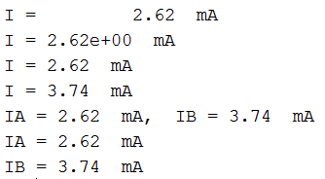
MATLAB Lecture #1 EGR 271 – Circuit Theory I
Additional examples using fprintf( )
12 spaces
Output:

Slide 15
MATLAB Lecture #1 EGR 271 – Circuit Theory I
MATLAB Script Files (.m files)
We have seen how to execute MATLAB commands in the Command Window. We will now see how to write a program in MATLAB. The program (called a script file or .m file) is a file containing a series of statements much like those used previously in the Command Window. A program has the advantage of being reusable. You can easily try a sequence of commands and then modify them if the output isn’t correct. The program can be executed by typing its name in the Command Window.
The Current Directory
When the name of a program is entered into the Command Window, MATLAB looks for the program in the Current Directory and executes it if it is located there.
Change current folder here
MATLAB
files in current folder
The Current Folder is shown here.
Run program example.m in the current folder

Slide 16
MATLAB Lecture #1 EGR 271 – Circuit Theory I
Changing the Current Folder
It is recommended that you change the current folder to the folder on your personal drive where you will save your files.
Current Folder has been changed
Change drive and folders
Add a New Folder

Slide 17
MATLAB Lecture #1 EGR 271 – Circuit Theory I
Creating a script (.m) file
MATLAB editor
Type edit in the Command Window to run the MATLAB editor
Notes:
Type edit to open the editor
Type edit MyFile.m to create a new file named MyFile.m (if it does not exits)
Type edit MyFile.m to open an existing file named MyFile.m

Slide 18
MATLAB Lecture #1 EGR 271 – Circuit Theory I
Using MATLAB’s INPUT function
The following MATLAB function is used to prompt the user to enter inputs:
input (‘message’) % returns a value entered from the keyboard.
Example:
R = input(‘Enter the resistance in ohms’);
Example:
Write a MATLAB program to calculate the power absorbed by a resistor.
Prompt the user to enter the resistance and the voltage.
Display the input values and the output (with units).
Solution – next page

Slide 19
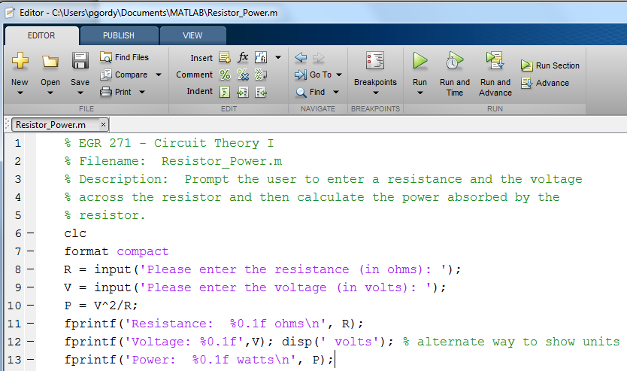
MATLAB Lecture #1 EGR 271 – Circuit Theory I
Sample MATLAB program
Run the program by selecting Run in the editor or by entering Resistor_Power in the Command Window.
Sample Output:

Slide 20
MATLAB Lecture #1 EGR 271 – Circuit Theory I
Symbolic Expressions in MATLAB
MATLAB is a powerful tool for working with symbolic expressions.
Useful operations with symbolic expressions include:
Solving for variables as functions of other variables (algebraic manipulation)
Solving simultaneous equations
Finding derivatives and integrals
Solving differential equations (useful in EGR 272)
Finding Laplace and inverse Laplace transforms (useful in EGR 272)
Much more!
Output:

Slide 21
MATLAB Lecture #1 EGR 271 – Circuit Theory I
Example:
Use MATLAB to find a symbolic solution to the quadratic equation.
Use the symbolic function solve( ).

Slide 22
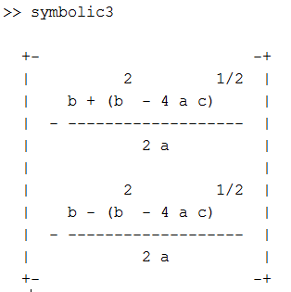
MATLAB Lecture #1 EGR 271 – Circuit Theory I
Example: - Some modifications to the previous example:
Output:
Output:

Slide 23
MATLAB Lecture #1 EGR 271 – Circuit Theory I
Symbolic versus numeric result
Note that there is often no difference between solving equations that have a numeric result and equations that have a symbolic result. It is simply a matter of the number of equations versus the number of unknowns.
Example: 2 equations, 2 unknowns → numeric solution
Example: 2 equations, 3 unknowns → symbolic solution

Slide 24
MATLAB Lecture #1 EGR 271 – Circuit Theory I
Example – solving simultaneous equations:
Use MATLAB to solve the following two simultaneous equations (with numeric results): 2x + 3y = 14
x - y = -3
Use the symbolic function solve( ).
Note: We will introduce simpler methods for solving simultaneous equations with numeric results later.

Slide 25
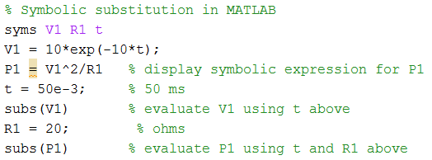
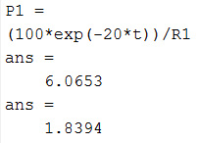
MATLAB Lecture #1 EGR 271 – Circuit Theory I
Symbolic substitution:
If we would like to evaluate a symbolic expression for specific values, we can use the symbolic substitution function in MATLAB: subs( )
Example: If V₁ = 10e^{-10t}, find symbolic expressions for V₁ and
P₁ = (V₁)²/R₁. Then use subs( ) to find numeric values for V₁ and P₁ when t = 50 ms and R₁ = 20 ohms.
V₁ = 6.0653 V when t = 50 ms
P₁ = 1.8394 W when t = 50 ms and R₁ = 20 ohms

Slide 26
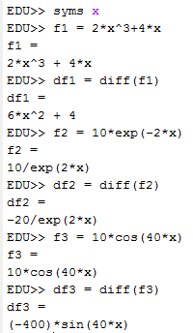
MATLAB Lecture #1 EGR 271 – Circuit Theory I
Finding derivatives in MATLAB
diff(f ) – finds the derivative of symbolic function f
diff(f, 2) – finds the 2nd derivative of f
(same as diff(diff(f))
If f is a function of both x and y,
diff(f, x) – partial derivative of f w.r.t. x
diff(f, y) – partial derivative of f w.r.t. y
Examples: (shown to the right)
Before proceeding with more advanced derivatives and applications, it may be useful to discuss different ways of representing functions in MATLAB.

Slide 27
MATLAB Lecture #1 EGR 271 – Circuit Theory I
Performing integration in MATLAB
int(S) – finds the indefinite integral of a symbolic expression S with respect to its symbolic variable (or variable closest to x)
int(S, z) – finds the indefinite integral of a symbolic expression S with respect to z
int(S, a, b) – finds the definite integral of a symbolic expression S from a to b with respect to its symbolic variable (or variable closest to x)
int(S, z, a, b) – finds the definite integral of a symbolic expression S from a to b with respect to z
double(int(S, z, a, b)) – finds a numeric result for the definite integral of a symbolic expression S from a to b with respect to z. This is useful in cases where MATLAB can’t find a symbolic solution.

Slide 28
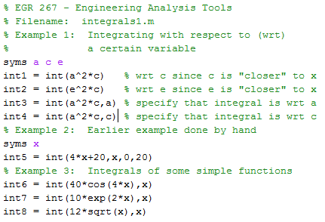
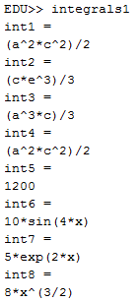
MATLAB Lecture #1 EGR 271 – Circuit Theory I
MATLAB Examples:

Slide 29
MATLAB Lecture #1 EGR 271 – Circuit Theory I
Classroom Demonstration: Try the following examples on your own or the instructor may demonstrate them in class.
Command Window: Try some simple calculations using the command window.
Calculate V and P if R = 1.2 kΩ and I = 3.75 mA
Try using clc, format compact, and clear
Try using format long, format rat, and format short
Try editing expressions already executed using the Command History window or using the up and down arrows.
Writing a program requiring inputs and formatted output:
Write MATLAB program to do the following:
Prompt the user to enter the value of R₁ in ohms
Prompt the user to enter the value of R₂ in ohms
Calculate R₁ || R₂ and display the result in ohms (with 1 digit after the decimal point).
If you enter R1 = 20 and R2 = 30, try to format the output to look as follows:
R1 = 20.0 ohms, R2 = 30.0 ohms, Result: 12.0 ohms
R1 = 20.0 ohms
R2 = 30.0 ohms
R1 || R2 = 12.0 ohms

Slide 30
MATLAB Lecture #1 EGR 271 – Circuit Theory I
Classroom Demonstration: Try the following examples on your own or the instructor may demonstrate them in class.
Symbolic manipulation: Solve for IX in the following symbolic expression (KVL in a simple series circuit): -V + I_{X}*R₁ + I_{X}*R₂ + I_{X} *R₃ = 0
(Note that Ix was used instead of I. Avoid using variables i, j, or I in MATLAB.)
Calculus:
If Q₁ = 10e^{-4t} mC, use MATLAB to find a symbolic expression for I₁
If V₂ = 10e^{-1000t} V and I₂ = 20e^{-2000t} mA:
Find a symbolic expression for P₂ = V₂*I₂
Evaluate P₂ at time t = 1ms
Find a symbolic expression for W₂
Find the energy from 0 to 1ms

