Slide 1
Chapter 6 EGR 270 – Fundamentals of Computer Engineering
1
Reading Assignment: Chapter 6 in Logic and Computer Design Fundamentals, 5th Edition by Mano
Chapter 6 – Counters and Registers
In chapter 6 we explored methods of designing synchronous sequential circuits. Chapter 6 introduces asynchronous sequential circuits (ripple counters) as well as registers and other examples of counters.
Counters
Two types of counters are commonly available:
1) synchronous counters
a) all flip-flops clock inputs are tied together so that the flip-flops are clocked synchronously
b) counters can be designed using standard synchronous sequential circuit design methods (such as the excitation table method, the state equation method, and the “one-hot” method)
2) asynchronous counters (ripple counters)
a) not all flip-flops are clocked synchronously - clock inputs may come from
various points
b) standard synchronous sequential circuit design methods cannot be used (we have no clear methods, but we will study some existing designs to see how they work).

Slide 2
Chapter 6 EGR 270 – Fundamentals of Computer Engineering
2
Ripple Counters
Example 1: Draw a timing diagram for the 4-bit ripple counter shown below in order to determine its counting sequence. Discuss why this is a ripple counter and not a synchronous counter. Begin with count 0.
Q1 (LSB)
Q2
Q3 (MSB)
1
J1
Q1
1
J2
Q2
1
J3
Q3
Clock
1
K1
Q1
1
K2
Q2
1
K3
Q3
Clock
Q1
Q2
Q3
Count 0

Slide 3
Chapter 6 EGR 270 – Fundamentals of Computer Engineering
3
Ripple Counters
Example 2: Repeat Example 1 using positive-edge triggered flip-flops.
Q1 (LSB)
Q2
Q3 (MSB)
1
J1
Q1
1
J2
Q2
1
J3
Q3
Clock
1
K1
Q1
1
K2
Q2
1
K3
Q3
Clock
Q1
Q2
Q3
Count 0

Slide 4
Chapter 6 EGR 270 – Fundamentals of Computer Engineering
4
Ripple Counters
Example 3: Repeat Example 1 with clock for flip-flop_{N} = Q’_{N-1} for N > 1.
Q1 (LSB)
Q2
Q3 (MSB)
1
J1
Q1
1
J2
Q2
1
J3
Q3
Clock
1
K1
Q1
1
K2
Q2
1
K3
Q3
Clock
Q1
Q2
Q3
Count 0

Slide 5
Chapter 6 EGR 270 – Fundamentals of Computer Engineering
5
Ripple Counters
Example 4: Repeat Example 3 with positive-edge triggered flip-flops.
Q1 (LSB)
Q2
Q3 (MSB)
1
J1
Q1
1
J2
Q2
1
J3
Q3
Clock
1
K1
Q1
1
K2
Q2
1
K3
Q3
Clock
Q1
Q2
Q3
Count 0

Slide 6
Chapter 6 EGR 270 – Fundamentals of Computer Engineering
6
Summary
Notes:
1) The type of triggering is often irrelevant with synchronous counters. All of our examples in Chapter 6 (and in lab) could have used any type of triggering.
2) The type of triggering used in ripple counters is important and may affect circuit operation.
3) All flip-flops are clocked by the same source (i.e., synchronously) in synchronous circuits.
4) All flip-flops are not clock by the same source in asynchronous (ripple) counters. The choice of the clocking signal for each flip-flop is critical.

Slide 7
Chapter 6 EGR 270 – Fundamentals of Computer Engineering
7
Propagation Delay - Propagation delay can be a problem in ripple counters at high frequency as the clock signals “ripple” though the circuit.
Example 5: Repeat example 1 using an input 10 MHz clock and a propagation delay of 20 ns.
Q1 (LSB)
Q2
Q3 (MSB)
1
J1
Q1
1
J2
Q2
1
J3
Q3
Clock
1
K1
Q1
1
K2
Q2
1
K3
Q3
Clock
Q1
Q2
Q3
Count 0

Slide 8
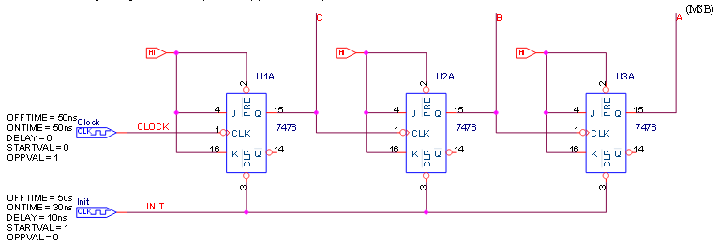
Chapter 6 EGR 270 – Fundamentals of Computer Engineering
8
PSPICE Example: 3-Bit Ripple Counter (see Bb or course website). Note that this circuit matches the previous example, including the 10MHz clock.

Slide 9
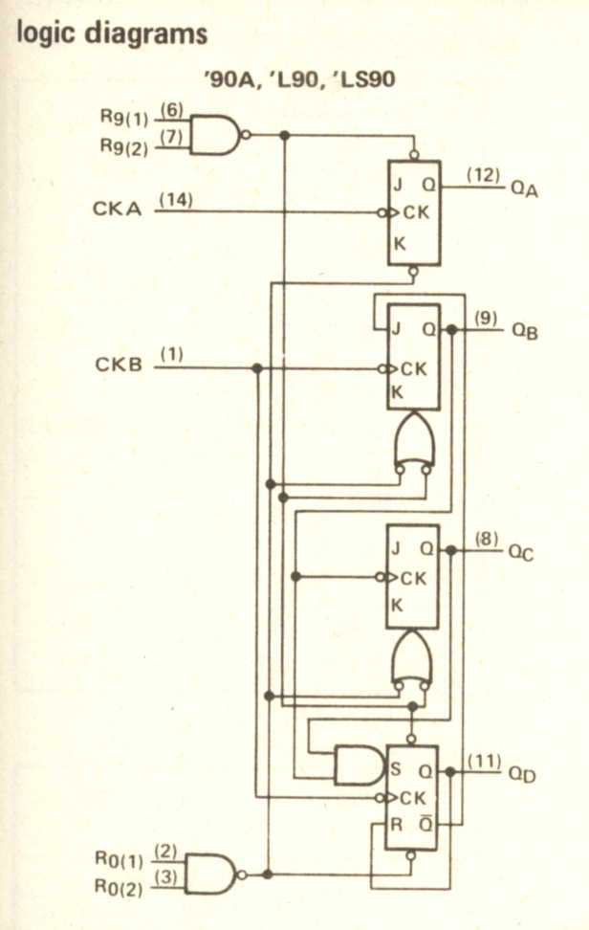
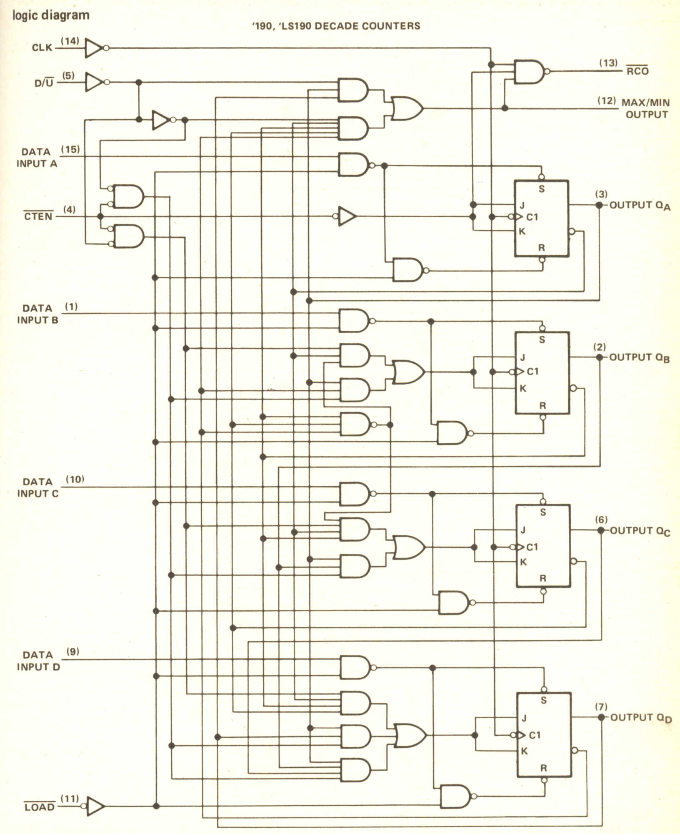
Chapter 6 EGR 270 – Fundamentals of Computer Engineering
9
Commercially-available Counters
Both synchronous and asynchronous (ripple) counters are available commercially.
7490 Decade Counter – synchronous counter or ripple counter?
74190 Up/Down Decade Counter - synchronous counter or ripple counter?

Slide 10
Chapter 6 EGR 270 – Fundamentals of Computer Engineering
10
Example 6: Use a timing diagram to determine the counting sequence for the ripple counter below. Begin with count 0.
Q1 (LSB)
Q2
Q3
Q4 (MSB)
1
J1
Q1
J2
Q2
1
J3
Q3
J4
Q4
Clock
1
K1
Q1
1
K2
Q2
1
K3
Q3
1
K4
Q4
Clock
J2
K2
J4
K4
C
Q1
Q2
Q3
Q4
Count 0

Slide 11
Chapter 6 EGR 270 – Fundamentals of Computer Engineering
11
Synchronous Counters
Synchronous counters have all flip-flop clock inputs tied together and clocked simultaneously.
Synchronous counter may be designed by:
The excitation table method (covered earlier)
The state equation method (covered earlier)
The “one-hot” method (covered earlier)
By inspection (for relatively simple counters) – covered below
Synchronous Counter Design by Inspection
This method is sometimes useful for simple counter designs.
This method may not yield the simplest solution, but it is typically easy to perform.
Based on the use of T flip-flops (or JK flip-flops in the toggle mode). Determine when each flip-flop must toggle by observing the bit changes in the counting sequence.

Slide 12
Chapter 6 EGR 270 – Fundamentals of Computer Engineering
12
Example: Design a 4-bit synchronous counter using the inspection method and JK flip-flops.

Slide 13
Chapter 6 EGR 270 – Fundamentals of Computer Engineering
13
N-bit synchronous counter
Show how an n-bit counter can be implemented using N flip-flops and (N-2) two-input AND gates
Discuss the delay problems
Show how the delay can be improved by using ANDs with increasing numbers of inputs

Slide 14
Chapter 6 EGR 270 – Fundamentals of Computer Engineering
14
Example: Design a 5-bit synchronous up/down counter using the inspection method and JK flip-flops. Discuss the amount of work involved in a similar design using the excitation table method.

Slide 15
Chapter 6 EGR 270 – Fundamentals of Computer Engineering
15
Timing Sequences
So far we have designed circuits to:
produce desired outputs for certain input combinations (combinational circuits)
produce a desired sequence of states or input output sequence (sequential circuits)
One type of circuit that we have not directly dealt with is a circuit that will produce a series of control signals (or timing sequences) where each signal is HIGH or LOW for a specified length of time.
Such timing sequences are often needed. Examples might include:
signals to stop, start, and control the length of time for each cycle in a washing machine
signals to control the RED, YELLOW, and GREEN signals for a stop light
signals to control the opening and closing of valves

Slide 16
Chapter 6 EGR 270 – Fundamentals of Computer Engineering
16
Decoders – Can be used to indicate when certain counts occur. Similarly, they can be used to start or stop events at certain times.
Example: Design a decoder to detect when count 4 occurs in a 3-bit counter. (Use an AND gate and inverters)
Example: Design a decoder to detect when counts 1, 5, or 7 occur in a 3-bit counter. (Use a 3x8 decoder and an OR gate.)

Slide 17
Chapter 6 EGR 270 – Fundamentals of Computer Engineering
17
Example: Design a circuit that will output a signal that is HIGH for 3 seconds and LOW for 5 seconds.

Slide 18
Chapter 6 EGR 270 – Fundamentals of Computer Engineering
18
Example: Design a circuit that will produce the following control signals.

Slide 19
Chapter 6 EGR 270 – Fundamentals of Computer Engineering
19
Example: Design a traffic light controller with the following control signals.
Notes:
Whenever N/S Green or N/S Yellow are HIGH, E/W Red must also be HIGH.
Whenever E/W Green or E/W Yellow are HIGH, N/S Red must also be HIGH.
(Discuss the design then view the circuit simulated in PSPICE on the following slides.)

Slide 20
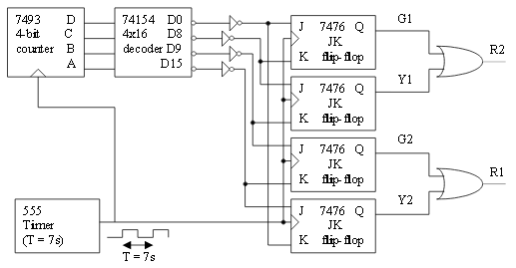
Chapter 6 EGR 270 – Fundamentals of Computer Engineering
20
Example: Traffic light controller (continued)

Slide 21
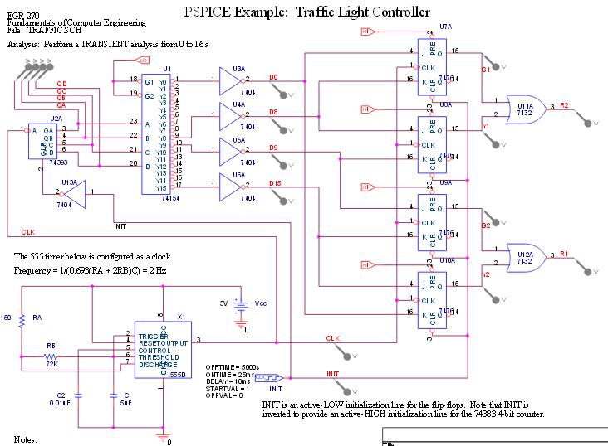
Chapter 6 EGR 270 – Fundamentals of Computer Engineering
21
Example: Traffic light controller (continued)

Slide 22
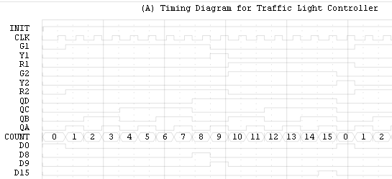
Chapter 6 EGR 270 – Fundamentals of Computer Engineering
22
Example: Traffic light controller (continued)

Slide 23
Chapter 6 EGR 270 – Fundamentals of Computer Engineering
23
Shift Registers
Register - a group of binary storage cells (flip-flops)
Common Register Uses:
Temporary data storage and transfer
Parallel-to-serial and serial-to-parallel conversion
Data manipulation (complementation, rotation, etc)
Shift register - A register is often also referred to as a "shift register" since one of its key functions involves the shifting of data through the register.
Example: A register might be a group of 8 flip-flops used to store some binary data (byte or word). Sketch the circuit.

Slide 24
Chapter 6 EGR 270 – Fundamentals of Computer Engineering
24
Common register functions: (briefly illustrate each)
1) Serial shifting of data (SISO - right or SISO - left) (SISO = Serial-input, Serial-output)
2) Parallel input of data (PI)
3) Parallel output of data (PO)
4) Rotation of data (left or right)

Slide 25
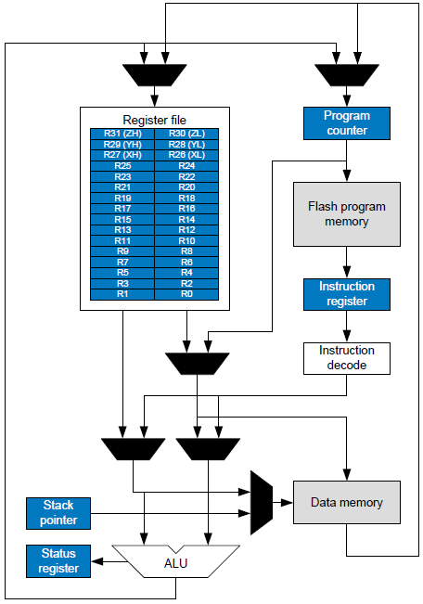
Chapter 6 EGR 270 – Fundamentals of Computer Engineering
25
Example: Discuss the registers in the Atmega328P (used in the Arduino Nano) and some specific register instructions.
Recall that there are 32 general purpose registers in the Atmega328P (R0-R31). Some key instructions that manipulate register contents (using R16 as an example) include:
COM R16 ; 1’s complement
NEG R16 ; 2’s complement
ROL R16 ; rotate left through carry
ROR R16 ; rotate right through carry
LDI R16, 0xAF ; parallel load (input).
;Takes one clock cycle.
;Serial load would take 8 clock cycles.
OUT PortD, R16 ; parallel output

Slide 26
Chapter 6 EGR 270 – Fundamentals of Computer Engineering
26
Parallel load shift register using D flip-flops – illustrate

Slide 27
Chapter 6 EGR 270 – Fundamentals of Computer Engineering
27
Parallel load shift register with an enable
Discuss the limitations of the prior shift register (loads on every clock pulse).
Show how to implement the register above using SR or JK flip-flops and then add an Enable line (ANDed with each input).

Slide 28
Chapter 6 EGR 270 – Fundamentals of Computer Engineering
28
Serial-In Serial-Out (SISO) register
Illustrate using D flip-flops and JK flip-flops.

Slide 29
Chapter 6 EGR 270 – Fundamentals of Computer Engineering
29
Rotation of data
Illustrate rotate-right and rotate-left registers using D flip-flops and JK flip-flops.

Slide 30
Chapter 6 EGR 270 – Fundamentals of Computer Engineering
30
Multi-function shift register
Design a shift register with two mode controls, x and y, that will function as follows (fill in the input connections for D0 – D3).
x | y | Function | D0 | D1 | D2 | D3
0 | 0 | SISO - right
0 | 1 | Parallel load
1 | 0 | Rotate right
1 | 1 | Rotate left
Draw the shift register. Show how to use either logic gates or multiplexers for the input connections.

Slide 31
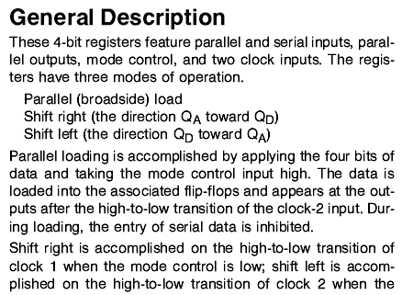
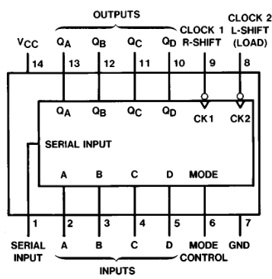
Chapter 6 EGR 270 – Fundamentals of Computer Engineering
31
7495 Data Sheet. Discuss the features available on this 4-bit shift register.

Slide 32
Chapter 6 EGR 270 – Fundamentals of Computer Engineering
32
Three-State Devices (Tri-State Devices)
Devices used so far have two output states: logic 0 or logic 1
Tri-state devices have three output states:
Logic 0
Logic 1
High impedance (Z) state
When a tri-state device is in the high Z state, the output appears to be disconnected. This allows several outputs to be connected together, such as in the case where several outputs are connected to a common bus.
Although tri-state outputs are available with various types of gates, the most common is probably the tri-state buffer.
Input A
Output Y =
A if C = 1
High Z if C = 0
Control C
Tri-state buffer

Slide 33
Chapter 6 EGR 270 – Fundamentals of Computer Engineering
33

Slide 34
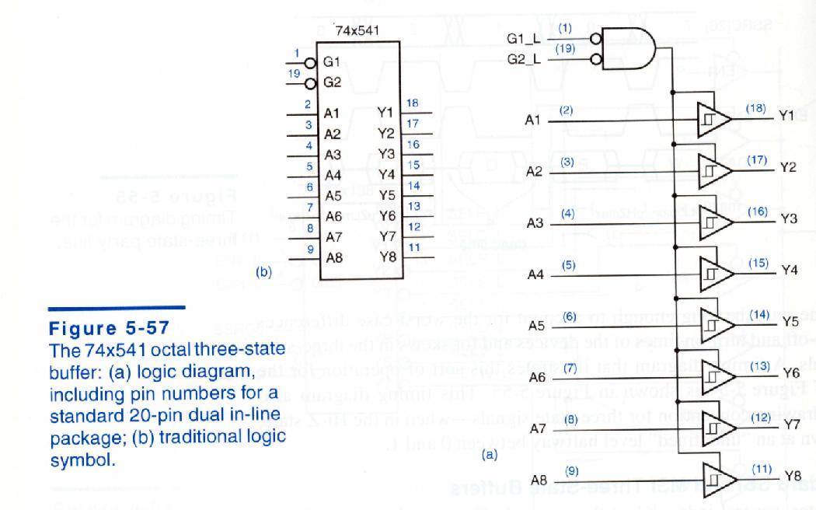
Chapter 6 EGR 270 – Fundamentals of Computer Engineering
34
Octal 3-state buffer:
Reference: John Wakerly, Digital Design – Principles & Practices, 3rd Edition, Prentice-Hall

Slide 35
Chapter 6 EGR 270 – Fundamentals of Computer Engineering
35
Application: Connecting several peripheral devices to a bus
Can be used to indicate when certain counts occur. Similarly, they can be used to start or stop events at certain times.
Note in the example below that the bus controller connects Device 2 to the bus and Devices 1 and 3 are in the high-Z state.
1
0
0
1
4-bit bus
Z
Z
Z
Z
1
0
0
1
Z
Z
Z
Z
0
0
1
1
0
1
0
1
0
0
1
1
1
0
0
Device 1
Bus
Controller
Device 2
Device 3

Slide 36
Chapter 6 EGR 270 – Fundamentals of Computer Engineering
36
Rather than show each wire in a bus, it is more convenient to show a bus as follows:
8
Notation for an 8-bit bus
The last diagram repeated using bus notation:
4
Z
1
Z
4
4
4
0
1
0
Device 1
Bus
Controller
Device 2
Device 3

Slide 37
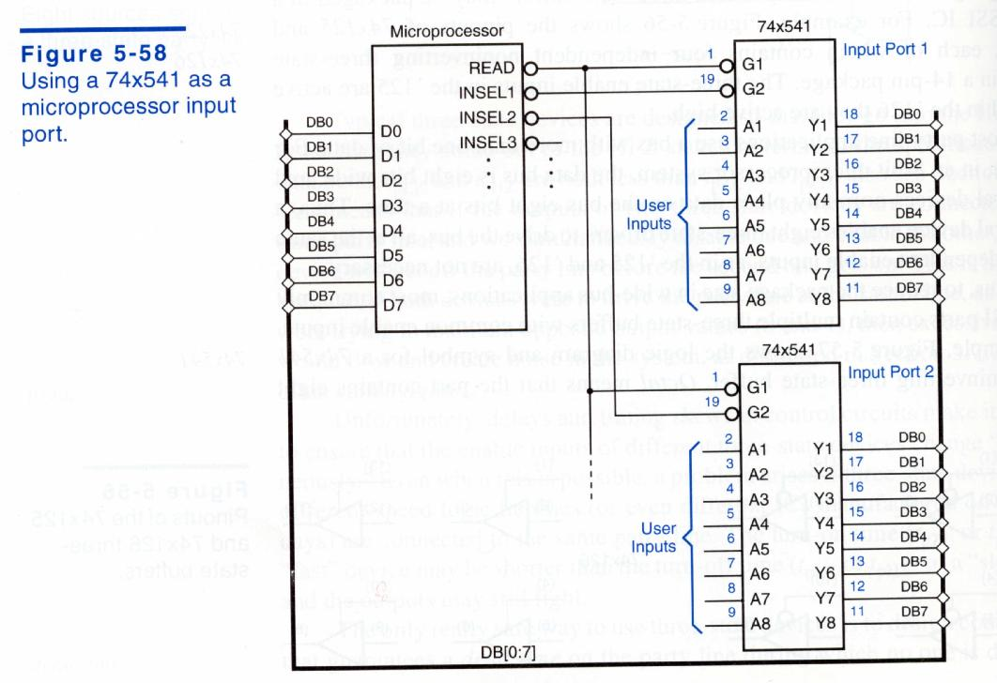
Chapter 6 EGR 270 – Fundamentals of Computer Engineering
37
Application: Using two 74541 IC’s to connect two 8-bit user inputs to a common data bus (DB) connected to a microprocessor
Reference: John Wakerly, Digital Design – Principles & Practices, 3rd Edition, Prentice-Hall

Slide 38
Chapter 6 EGR 270 – Fundamentals of Computer Engineering
38
Transceiver - A device capable of transferring information in either direction. A transceiver can be constructed using two tri-state buffers along with some control logic, as shown below.
A
B
Enable
Direction
Enable
0: enable transceiver
1: disable transceiver
Direction
0: transfer A to B
1: transfer B to A
Buffer Control Lines
1: enable buffer
0: disable buffer (high Z)

Slide 39
Chapter 6 EGR 270 – Fundamentals of Computer Engineering
39
Illustration – Add logic values to the diagrams below to illustrate the transceiver operation.
A
B
Case 1:
Enable = 1
Enable
Direction
A
B
Case 2:
Enable = 0
Direction = 0
Enable
Direction
A
B
Case 3:
Enable = 0
Direction = 1
Enable
Direction

Slide 40
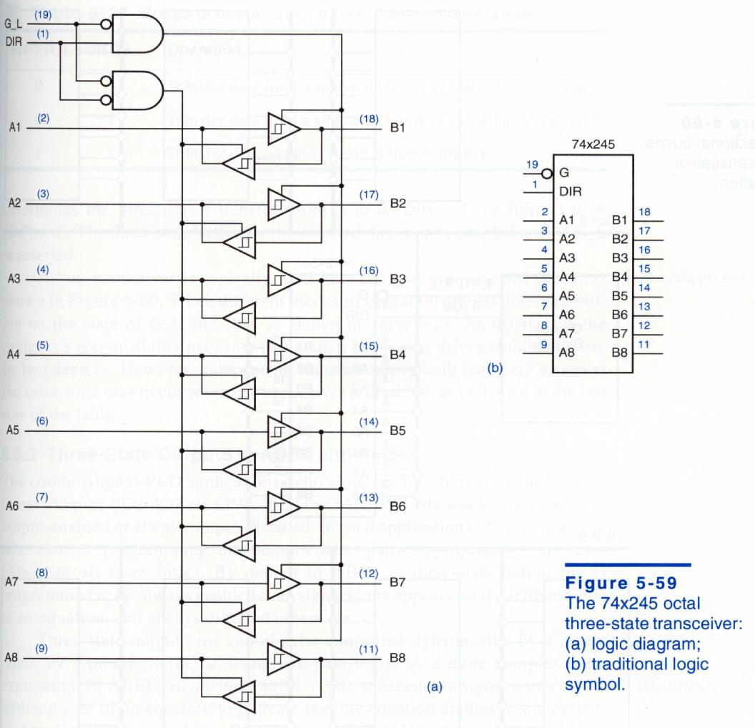
Chapter 6 EGR 270 – Fundamentals of Computer Engineering
40
Octal 3-state transceiver:
Reference: John Wakerly, Digital Design – Principles & Practices, 3rd Edition, Prentice-Hall

Slide 41
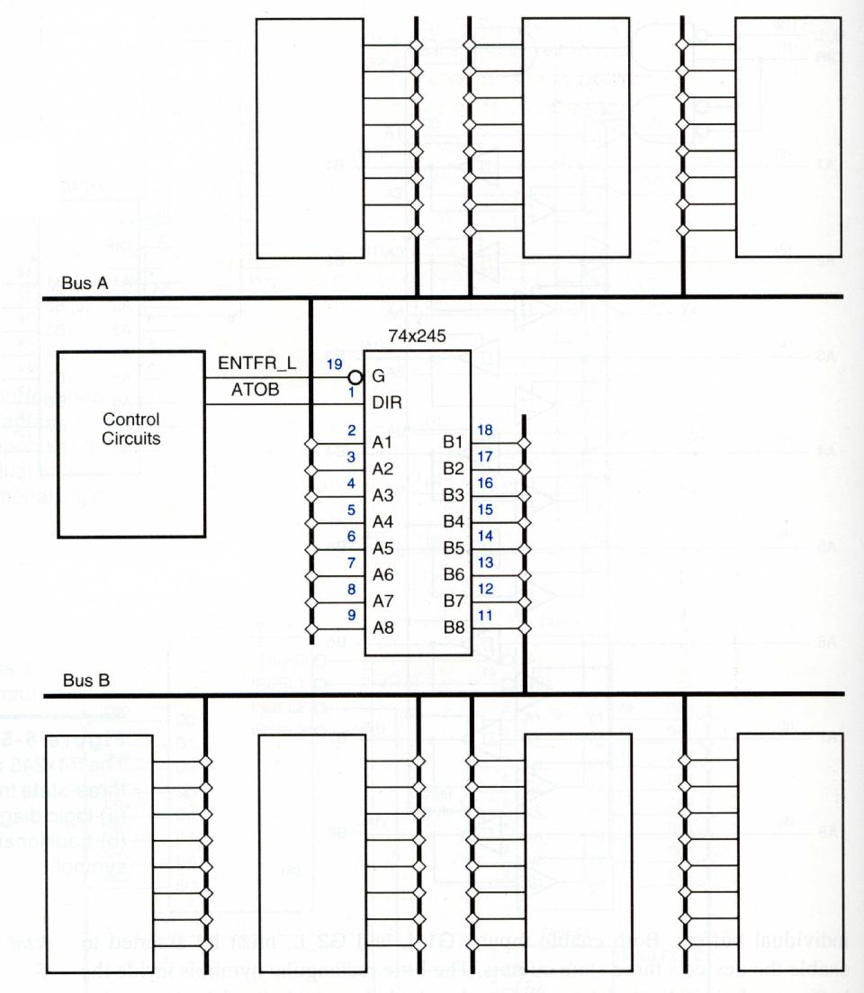
Chapter 6 EGR 270 – Fundamentals of Computer Engineering
41
Application: Octal 3-state
transceiver used to connect
two data buses:
Figure 5-60
Bidirectional buses
and transceiver
operation.
Reference: John Wakerly, Digital Design – Principles & Practices, 3rd Edition, Prentice-Hall

Slide 42
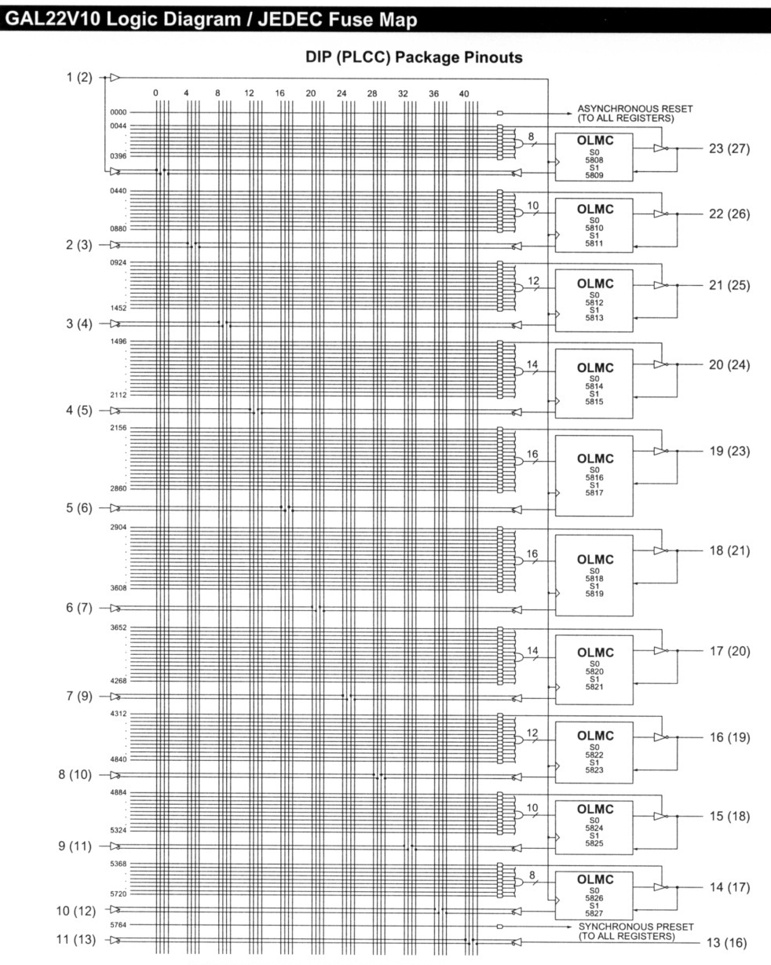
Chapter 6 EGR 270 – Fundamentals of Computer Engineering
42
Tri-state outputs with PLD’s:
Recall that the GAL22V10 PLD was discussed earlier. It has 22 Output Logic MacroCells (OLMCs) that can be configured as inputs or outputs. How is this possible? By using tri-state buffers.

