Slide 1
Chapter 3B EGR 270 – Fundamentals of Computer Engineering
1
Reading Assignment: Chapter 3B in Logic and Computer Design Fundamentals, 5th Edition by Mano
Combinational Functions and Circuits
Functions and fundamental circuits are introduced in this chapter which are useful in designing larger digital circuits.
These circuits are presented as functional blocks – fundamental, reusable circuits. The focus is to develop the functional blocks such that they are reusable, are easily expanded for use with larger functions, and are efficiently designed for implementing via VHDL programming.
Examples of functional blocks to be introduced:
Decoders
Encoders
Priority encoders
Multiplexers
De-multiplexers
Magnitude Comparators
Programmable Logic (Chapter 6)

Slide 2
Chapter 3B EGR 270 – Fundamentals of Computer Engineering
2
Combinational Logic Using MSI and LSI devices
Although our focus will be more on defining functional blocks that are designed to be reusable and to be implemented using VHDL, many of these fundamental circuits are also available as commercially available IC’s.
Commercial devices can perform complex functions using perhaps a single IC, thus saving space. They are typically faster that equivalent circuits that we might build using discrete logic gates.
Examples of commercially available combinational logic devices

Slide 3
Chapter 3B EGR 270 – Fundamentals of Computer Engineering
3
Decoders
An N-bit decoder has 2^{N} outputs, only one of which may be activated at a given time.
If the device is active-HIGH , then only one output may be HIGH at any time.
If the device is active-LOW , then only one output may be LOW at any time.
Example: A 3-bit decoder might also be called a 3-line-to-8-line decoder or a 3x8 decoder. The block diagram is shown below:
Discuss:
basic operation
the truth table

Slide 4
Chapter 3B EGR 270 – Fundamentals of Computer Engineering
4
Active-LOW versus Active-HIGH decoders
Enable lines – essentially act as ON/OFF switches
Example: Show the truth table and block diagram for an active-LOW 2x4 decoder with an enable line, E.

Slide 5
Chapter 3B EGR 270 – Fundamentals of Computer Engineering
5
Circuit Design
Show that decoder outputs are essentially minterms and draw a circuit for a 2x4 decoder (no enable, active-HIGH outputs)
Solution:
D0 is only HIGH when A = 0 and B = 0, so D0 = A’B’ = m_{o}
etc.

Slide 6
Chapter 3B EGR 270 – Fundamentals of Computer Engineering
6
Decoder expansion using hierarchy
The text introduces a procedure for forming any (n x 2^{n}) decoder by expanding smaller decoders. The result requires only 2-input AND gates (rather than n-input) and inverters. This technique is especially useful for building large decoders using reusable fundamental blocks. Figure 3-19 below illustrates a 3x8 decoder constructed using this method:

Slide 7
Chapter 3B EGR 270 – Fundamentals of Computer Engineering
7
Implementing Boolean functions using decoders
Note that the decoder outputs for active-HIGH decoders are simply minterms, so
F = Σ(minterms) = Σ(active-HIGH decoder outputs)
Example: Implement f(A,B,C) = Σ(0, 3, 5, 6) using a 3 x 8 decoder with active-HIGH outputs
Note that the decoder outputs for active-LOW decoders are simply maxterms, so
F = Π(maxterms) = Π (active-LOW decoder outputs)
Example: Implement f(A,B,C) = Σ(0, 3, 5, 6) using a 3 x 8 decoder with active-LOW outputs

Slide 8
Chapter 3B EGR 270 – Fundamentals of Computer Engineering
8
Decoder IC’s
74155 Data Sheet (dual 2x4 decoder/single 3x8 decoder) – see next slide
How many enable lines does the 74155 have? Are they active-LOW or active-HIGH? (study the truth table on the next slide)
Is B is MSB or LSB? (check the data sheet on the next slide)
1C 1G
1Y0
1Y1
1Y2
1Y3
B
A
B
A
74155
2Y0
2Y1
2Y2
2Y3
B
A
2C 2G

Slide 9
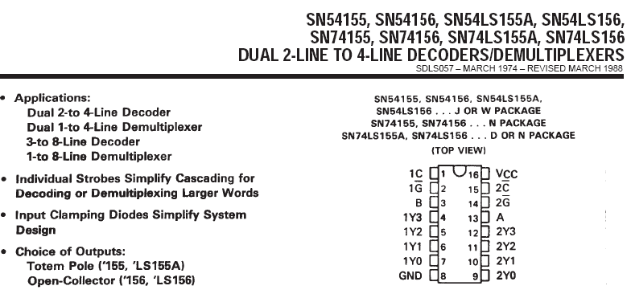
Chapter 3B EGR 270 – Fundamentals of Computer Engineering
9

Slide 10
Chapter 3B EGR 270 – Fundamentals of Computer Engineering
10
74155 connected as a 2x4 decoder
Label the outputs below. Which 2x4 decoder is being used?
1
0
1C 1G
1Y0
1Y1
1Y2
1Y3
B
A
1
B
A
0
74155
2Y0
2Y1
2Y2
2Y3
B
A
2C 2G
1
0

Slide 11
Chapter 3B EGR 270 – Fundamentals of Computer Engineering
11
74155 connected as a 3x8 decoder
Show how to connect inputs C, B, and A.
Label the outputs D0, D1, …, D7 (they are NOT in order!)
Add an example (pick some input and label all outputs)
1C 1G
1Y0
1Y1
1Y2
1Y3
B
A
B
A
74155
2Y0
2Y1
2Y2
2Y3
B
A
2C 2G

Slide 12
Chapter 3B EGR 270
74155 connected as a 4x16 decoder
Show how to connect inputs D, C, B, and A. Note that one NOT gate will be needed.
Label the outputs D0, D1, …, D15 (they are NOT in order!)
Add an example (pick some input and label all outputs)
1C 1G
1Y0
1Y1
1Y2
1Y3
B
A
B
A
74155
2Y0
2Y1
2Y2
2Y3
B
A
2C 2G
1C 1G
1Y0
1Y1
1Y2
1Y3
B
A
B
A
74155
2Y0
2Y1
2Y2
2Y3
B
A
2C 2G
12

Slide 13
Chapter 3B EGR 270 – Fundamentals of Computer Engineering
13
Encoder
An encoder is essentially the opposite of a decoder.
An N-bit encoder has 2^{N} inputs lines, one of which is active, and N output lines that carry the binary code corresponding to the active input.
The 8 x 3 encoder shown below might also be called an octal-to-binary encoder.
I0
I1
I2
8 x 3
Encoder
2²
x
Only one input may be activated
(active-HIGH inputs shown)
I3
Output
Code
2¹
y
I4
I5
2⁰
z
I6
I7
Example: Add a set of valid binary values to the input and show the corresponding output.

Slide 14
Chapter 3B EGR 270 – Fundamentals of Computer Engineering
14
Note: Encoders and decoders perform the opposite function
Example: Show an 4x2 encoder followed by a 2x4 decoder with some sample inputs and outputs. (This isn’t useful, but emphasizes that they perform opposite functions.)
Example: Show a 2x4 decoder followed by an 4x2 encoder with some sample inputs and outputs.

Slide 15
Chapter 3B EGR 270 – Fundamentals of Computer Engineering
15
Encoder Truth Table
Draw the truth table for an 8x3 encoder. From the truth table, determine expressions for the outputs x, y, and z. (List only the 8 valid inputs, not all 256 combinations.)

Slide 16
Chapter 3B EGR 270 – Fundamentals of Computer Engineering
16
Encoder – adding a Valid output line, V
Valid Output? One problem with the encoder design above is that there is no way to indicate that an invalid input occurred. This problem can be resolved by using an additional output called a valid line, V.
I0
I1
I2
8 x 3
Priority
Encoder
2²
x
I3
2¹
y
Output
Code
I4
I5
2⁰
z
I6
V
V = 1 for a valid code (0 if invalid)
I7

Slide 17
Chapter 3B EGR 270 – Fundamentals of Computer Engineering
17
Basic Encoder Design
Note that if the input is valid, the x = 1 when I4, I5, I6, or I7 = 1. So:
V = 1 only for the 8 valid input combinations, so:
Draw the circuit

Slide 18
Chapter 3B EGR 270 – Fundamentals of Computer Engineering
18
Decoders and Encoders - Applications
Decoders can be used to reduce the number of wires needed to control multiple outputs.
Encoders can be used to reduce the number of wires needed to read multiple inputs.
These wires might be to external devices or might be within a digital circuit.
Encoder Example 1 – Reading 256 external sensors with a computer
How could your read the status of 256 sensors in a special application where only one sensor would ever be HIGH at a given time.
One Solution: Use a 256-pin connector to work with the computer (good luck).
Better Solution: Use an 256x8 encoder and use an 8-bit connector on the computer. The computer could then simply read the code to determine which sensor was activated.
Encoder Example 2 – Reading a keyboard
Encoders are also used in keyboards.
Rather than send over 100 different signals from the keyboard corresponding to the key that has been pressed, the keys are encoded using an ASCII code.
A 7-bit ASCII code is sufficient to represent all keys along with a 128x7 encoder.

Slide 19

Chapter 3B EGR 270 – Fundamentals of Computer Engineering
19
Encoder Example 3:
In a previous IEEE competition, Computer Engineering students were given the challenge of designing a program to control an HO-scale train. A track was set up with 32 sensors. A sensor would read HIGH when the train was over it and LOW otherwise. A 32x5 encoder was used to encode the sensor information. The train, track, sensors, and encoder were provided and the distance between the sensors was specified. Student teams had to write software to:
1) stop and start the train at any sensor location
2) execute a planned train route
3) display the speed of the train
etc.
32 x 5
Encoder
.
.
.

Slide 20

Chapter 3B EGR 270 – Fundamentals of Computer Engineering
20
Decoder Example:
A few years ago TCC worked with ODU, William & Mary, and Hampton University on the Virginia Student Balloon Launch (VSBL) Program.
NASA sponsors a number of such projects, where NASA engineers provide a high-altitude balloon (up to 100,000 ft) and engineering students at colleges and universities design experiments for the upper atmosphere.
In one experiment William and Mary students provided 8 stainless steel cylinders that were pumped to a vacuum just before liftoff. The valve on each cylinder was opened briefly at precise altitudes so that they would suck in a sample of the air which was analyzed after landing to detect the presence of certain pollutants.
The onboard computer could have tied up 8 output lines to control the 8 cylinders, but instead used a 3x8 decoder and thus only used 3 output lines were needed.

Slide 21
Chapter 3B EGR 270 – Fundamentals of Computer Engineering
21
Priority Encoder
A priority encoder is an encoder where:
more than one input may be activated
each input is assigned a priority
the output code corresponds to the highest priority input that has been activated.
Highest priority
I7
.
.
.
.
I6
I5
8x3
Priority
Encoder
2²
x
I4
2¹
y
Output
I3
Code
I2
2⁰
z
I1
V
V = 1 for a valid code (0 if invalid)
Lowest priority
I0
Example: Add a set of valid binary values to the input (with 2 or more active) and show the corresponding output.

Slide 22
Chapter 3B EGR 270 – Fundamentals of Computer Engineering
22
Example: Show the truth table for an 8x3 priority encoder with an output line V with active-HIGH inputs and outputs. (Only 9 lines are needed in the truth table if you make use of don’t cares.)
How many invalid inputs are possible?

Slide 23
Chapter 3B EGR 270 – Fundamentals of Computer Engineering
23
Magnitude Comparators
A magnitude comparator is used to compare two binary inputs. The output will indicate if the inputs are equal or which input is larger.
Comparing for equality (also discussed earlier)
1-bit comparison for equality:
4-bit comparison for equality:
Two 4-bit words A = A₃A₂A₁A₀ and B = B₃B₂B₁B₀ are equal if A₃ = B₃ , A₂ = B₂ , etc.

Slide 24
Chapter 3B EGR 270 – Fundamentals of Computer Engineering
24
Comparing to determine if A > B, A < B, or A = B
A typical block diagram for a 4-bit
comparator is shown to the right.
Algorithm for A > B:
A > B if A₃ = 1 and B₃ = 0, (A₃' B₃ )
A > B if A₃ = B₃ (i.e., x₃ - see previous page) and A₂ = 1 and B₂ = 0, (x₃A₂' B₂ )
So:
Similarly:

Slide 25
Chapter 3B EGR 270 – Fundamentals of Computer Engineering
25
Diagram for 4-bit comparator based on algorithm’s developed on the last two slides:

Slide 26
Chapter 3B EGR 270 – Fundamentals of Computer Engineering
26
Multiplexers (Data Selectors)
A multiplexer (MUX) is a device that allows several low-speed signals to be sent over one high-speed output line.
“Select lines” are used to specify which input signal is sent to the output.
A demultiplexer (DEMUX) performs the opposite task as the multiplexer: it divides one high-speed input signal into several low-speed components.
Multiplexers and demultiplexers must be synchronized so that the proper signals are selected.
This type of multiplexing is referred to as time-division multiplexing (TDM). Another type of multiplexing is frequency-division multiplexing (FDM), which is typically covered in a communications course.
Multiplexed signals are typically transmitted in precisely organized manners according to a set of rules for transmission called a protocol.
An example of multiplexed signals is shown below using two TTL devices.

Slide 27
Chapter 3B EGR 270 – Fundamentals of Computer Engineering
27
0
1
2
3
0
1
2
3
Example – Sketch Y for the 4x1 MUX above for A, B, C, D, S1, and S0 shown below.

Slide 28
Chapter 3B EGR 270 – Fundamentals of Computer Engineering
28
Multiplexer Design – Develop a simple Boolean expressions for a 4x1 multiplexer output. Draw the multiplexer circuit.
Solution:
Input A is transferred to Y when S1 = 0 and S0 = 0, so Y = A⋅S1⋅S0
etc.

Slide 29
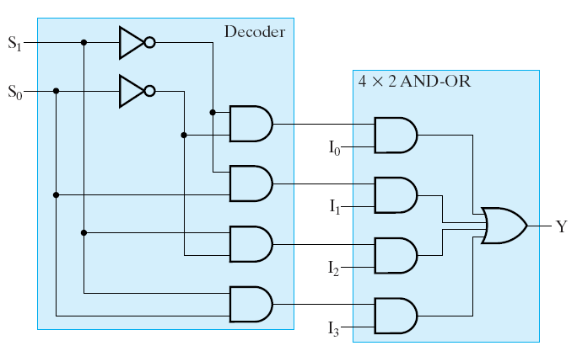
Chapter 3B EGR 270 – Fundamentals of Computer Engineering
29
Designing multiplexers using decoders and AND-OR arrays
The previous approach for designing multiplexers results in AND gates with increasing numbers of inputs as the size of the multiplexer increases. A better approach based on primitive blocks with reusable code is to construct multiplexers using decoders and AND-OR arrays.
Figure 3-26: 4x1 MUX using a 2x4 decoder and a 4x2 AND-OR array.

Slide 30
Chapter 3B EGR 270 – Fundamentals of Computer Engineering
30
Expanding multiplexers – Show how two 4 x 1 multiplexers and a 2 x 1 multiplexer can be used to create an 8 x 1 multiplexer.
Solution: Begin by drawing the components and the solution may become apparent
Draw and 8x1 MUX
Draw two 4 x 1 multiplexers and a 2 x 1 multiplexer. What connections are needed to turn these components into an 8x1 MUX?

Slide 31
Chapter 3B EGR 270 – Fundamentals of Computer Engineering
31
Implementing Boolean functions using multiplexers
A multiplexer with N select lines can be used to implement a Boolean function of (N+1) variables. For example:
4x1 MUX (2 two select lines)→ used to implement f(A,B,C)
8x1 MUX (3 two select lines)→ used to implement f(A,B,C,D)
16x1 MUX (4 two select lines)→ used to implement f(A,B,C,D,E)
I0
I1
I0
I1
I2
I3
I2
0, 1, C, or C’
I3
8 x 1
f(A, B, C, D)
4 x 1
Y
f(A,B,C)
0, 1, D, or D’
MUX
Y
MUX
I4
S1
S0
I5
I6
I7
S2
S1
S0
A
A
B
B
C

Slide 32
Chapter 3B EGR 270 – Fundamentals of Computer Engineering
32
General procedure for implementing a Boolean function with a MUX
(for implementing a function of n variables using a MUX with n-1 select lines)
List the truth table for the Boolean function.
The first n-1 variables are applied to the select lines as inputs.
For each combination of the selection inputs, evaluate the output F in terms of a function of the remaining input variable. If the variable is X, then F will be expresses as 0, 1, X, or X’. These values are then applied to the 2^{n-1} inputs.
The circuit generated is illustrated below for functions of 3 or 4 variables.
I0
I1
I0
I1
I2
I3
I2
0, 1, C, or C’
I3
8 x 1
f(A, B, C, D)
4 x 1
Y
f(A,B,C)
0, 1, D, or D’
MUX
Y
MUX
I4
S1
S0
I5
I6
I7
S2
S1
S0
A
A
B
B
C

Slide 33
Chapter 3B EGR 270 – Fundamentals of Computer Engineering
33
Example: Implement the function f(A, B, C) = Σ(0, 5, 6, 7) using an 4 x 1 multiplexer.

Slide 34
Chapter 3B EGR 270 – Fundamentals of Computer Engineering
34
Example: Implement the function f(A, B, C, D) = A’C’ + A’B + BC’D’ + AB’CD’ using an 8 x 1 multiplexer.

Slide 35
Chapter 3B EGR 270 – Fundamentals of Computer Engineering
35
Multiplexer Input Ordering:
Recall that it is best if the MSB of the function is connected to the MSB of the select lines (and so forth). If a different order is used, beware that the minterms may be in scrambled order.
Example: Consider the two MUX examples below:
In the MUX circuit on the left, the MSB of the input is connected to the MSB of the select line as recommended. Determine the output, f(A,B,C).
In the MUX circuit on the left, inputs A and B have been reversed so care is needed when determining the minterms. Determine the output, f(A,B,C).
0
1
C
C’
I0
I1
I2
I3
0
1
C
C’
I0
I1
I2
I3
4 x 1
Y
f(A,B,C) = Σ( ?)
4 x 1
Y
f(A,B,C) = Σ( ?)
MUX
MUX
S1
S0
S1
S0
A
B
B
A

Slide 36
Chapter 3B EGR 270 – Fundamentals of Computer Engineering
36
Alternate Multiplexer Symbol
Our textbook uses the symbol on the left, but you may find the symbol on the right used in other texts or schematics.
I0
I1
I2
I3
I0
I1
I2
I3
4 x 1
MUX
Y
4 x 1
MUX
Y
S1
S0
S1
S0

Slide 37
Chapter 3B EGR 270 – Fundamentals of Computer Engineering
37
Other Multiplexer Examples:
If time allows, try the following (also covered in the text)
Implementing a function of 4 variables with a 4x1 MUX (rather than an 8x1 MUX).
Note that using an 8x1 MUX would be more efficient.
If f(A,B,C,D) is to be implemented, then connect A and B to the select lines (A to the most significant select line). The inputs for C and D will be one of the following: 0, 1, C’D’, C’D, CD’, CD)
Omit this slide
The text shows examples using this procedure, but if the correct size MUX is used, no AND gates are needed.

Slide 38

Chapter 3B EGR 270 – Fundamentals of Computer Engineering
38
Demultiplexers and decoders
A decoder can also serve as a demultiplexer if the decoder has either:
Active-LOW outputs and an active-LOW enable line or
Active-HIGH outputs and an active-HIGH enable line
Examples:
A 2x4 decoder can also serve as a 1x4 DEMUX
A 3x8 decoder can also serve as a 1x8 DEMUX
A 4x16 decoder can also serve as a 1x16 DEMUX
Note that the data sheet (see slide 9) for the 74155 (used in Lab 4) describes it as a decoder/demultiplexer
Example: Illustrate how a 2x4 decoder can also serve as a 1x4 demultiplexer. Test it for one or more inputs.

Slide 39
Chapter 3B EGR 270 – Fundamentals of Computer Engineering
39
Programmable Logic Devices (PLD’s) – See section 5.2 in the text
PLD’s are used to build customized circuits. PLD’s contain huge arrays containing hundreds of thousands (or perhaps millions) of AND, OR, and NOT gates (and flip-flops also – to be covered in the next chapter). PLD’s are programmed to make interconnections between the gates, thus yielding a single IC that might easily replace huge circuits. PLD’s are often erasable so that they can be easily reprogrammed.
PLD’s may be:
mask programmable – factory programmed. Customized for the user by the manufacturer. Only feasible in huge quantities.
Field programmable – programmed by the user.

Slide 40
Chapter 3B EGR 270 – Fundamentals of Computer Engineering
40
In order to program a PLD, the following items are required:
PLD – there are numerous manufacturers of PLD’s. They come in various sizes containing up to millions of equivalent gates.
VHDL programming software – VHDL (or VHSIC HDL or Very High Speed Integrated Circuit Hardware Description Language) is an IEEE standard language used to implement logic designs. When the design is to be implemented into a PLD, the compiled program produces a JEDEC file , which is essentially an industry standard binary file containing information on how to make connections within a given PLD. There are numerous brands of software designing logic circuits and implementing their designs into PLDs, including Aldec, MAX PLUS II, XILINX, and many others.
PLD programmer – this piece of hardware might contain a universal socket that could hold various types and sizes of PLD’s. The PLD software produces a JEDEC file which is downloaded into the programmer. The programmer can typically program, copy, erase, and verify the contents of PLD’s.

Slide 41
Chapter 3B EGR 270 – Fundamentals of Computer Engineering
41
Programming a PLD
PLD inserted into ZIF socket that accepts chips of various sizes.
PLD Programmer
Universal Programmer that includes a 40-pin ZIF (Zero Insertion Force) socket.
JEDEC file
downloaded
Computer with VHDL or other logic design software. In lab we will use Aldec Active-HDL.
There are several types of architectures that are used in PLD’s. Two of the simplest are:
Programmable Logic Array (PLA’s)
Programmable Array Logic (PAL’s)

Slide 42
Chapter 3B EGR 270 – Fundamentals of Computer Engineering
42
Programmable Logic Arrays (PLA’s)
contain AND-OR arrays for implementing SOP expressions
both complemented and uncomplemented outputs are typically available
Figure 5-8 in the text (see next slide) shows a small PLA (for illustration) that uses 3 inputs, 3 product terms, and 2 outputs (use X’s to indicate programmed connections).
Programming notation
A
A'
B
B'
C
C'
D
D'
complemented and uncomplemented
outputs are available and may be shown
in one of the two manners below:
F = A'CD'
A
A
A'
an X is used to indicate a programmed connection
A
0
A
A
1
A’

Slide 43
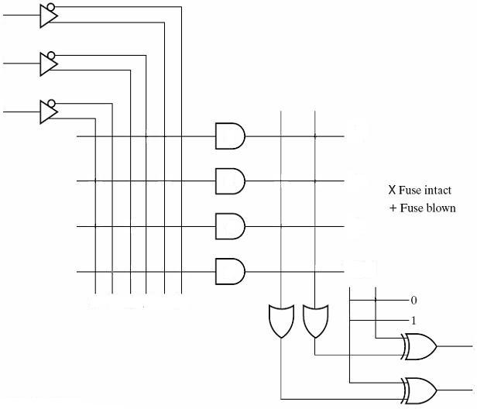
Chapter 3B EGR 270 – Fundamentals of Computer Engineering
43
Example: Use the PLA shown in Figure 5-8 in the text to implement
F1(A,B,C) = Σ(0,1,2,6) and F2(A,B,C) = Σ(0,1,3,5,7).

Slide 44
Chapter 3B EGR 270 – Fundamentals of Computer Engineering
44
Programmable Array Logic (PAL’s)
contain fixed OR gates with programmable AND’s only
there are no shared product terms except through feedback connections
each OR has a fixed number of product terms, so if more product terms are required, they must be obtained through feedback
Figure 5-10 in the text shows a small PAL (for illustration) that uses 4 macrocells, each containing 3 product terms and a fixed OR gate. The following notation is used to indicate programmed connections in the array:
The Lattice GAL22V10 is a PAL that contains 10 macrocells and 22 input/output connections. It used to be used in some labs for this course.

Slide 45
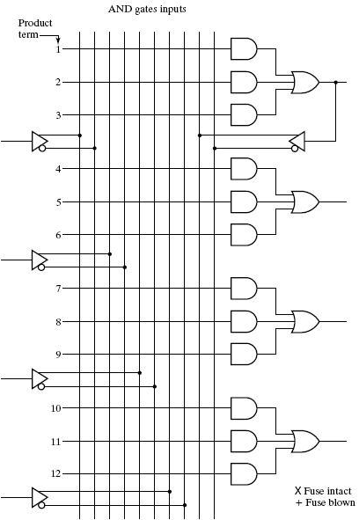
Chapter 3B EGR 270 – Fundamentals of Computer Engineering
45
Example: Use the PAL shown in Figure 5-10 in the text to implement the following functions:
F1(A,B,C,D) = Σ(2,3,5-7,10,12-14) F2(A,B,C,D) = Σ(2,3,6,7,9 -14)

Slide 46
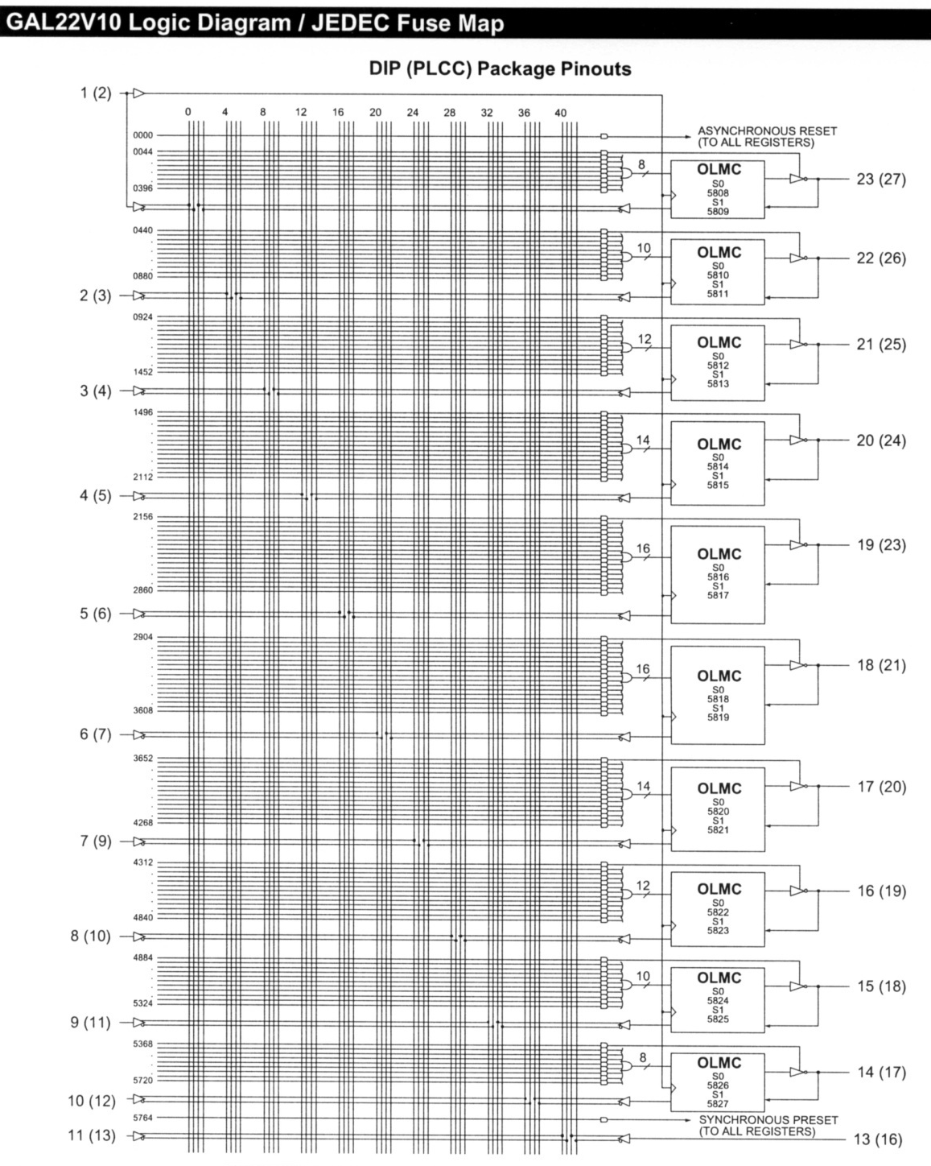
Chapter 3B EGR 270
PAL Example
Shown to the right is the “fuse map” for the GAL22V10. This device was previously used in the lab for this course, but has been replaced with an FPGA (to be introduced later).
Note that this is a PAL as the number of product (AND) terms for each of the fixed OR gates.
(OLMC stands for “Output Logic MacroCell”)
46

Slide 47
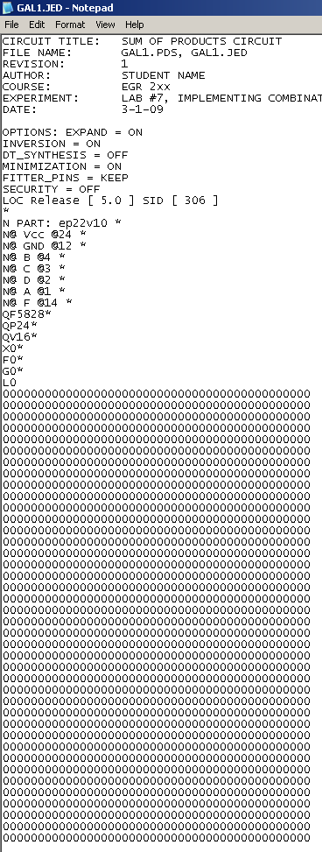

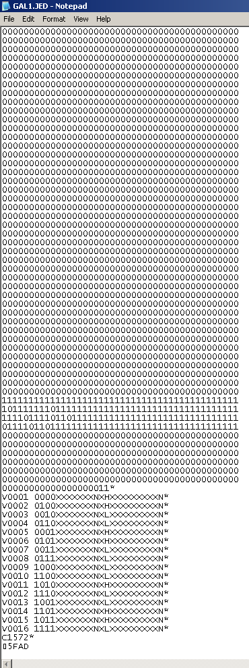
JEDEC file
for a
GAL22V10
used to implement
F(A,B,C,D) = Σ(0,1,4,5,10,
13,14) = A'C' + BC'D + ACD‘
Can you spot the area in the fuse map where the function was programmed?

