Slide 1
Lab 9 EGR 262 – Fundamental Circuits Lab
EGR 262
Fundamental Circuits Lab
Presentation for Lab #9
Serial Communication and Motor Controllers
Instructor: Paul Gordy
Office: H-115
Phone: 822-7175
Email: PGordy@tcc.edu

Slide 2
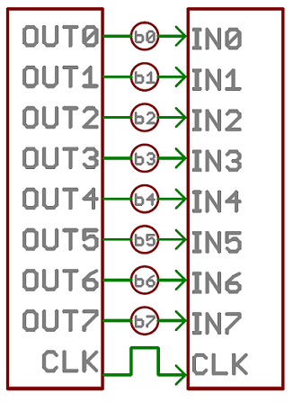
Lab 9 EGR 262 – Fundamental Circuits Lab
Communication between devices
A microprocessor can communication with external devices in several manners. The two basic types of communication are:
Parallel – fast, but requires many I/O lines
Serial – slower, but requires very few I/O lines
Using parallel communication is like using an 8-lane highway, whereas using serial communication is like using a one-lane road! Although serial communications is slower, it is simpler and is commonly used.
Parallel Communication
Transferring 8 bits on each clock cycle (or 16 bits, 32 bits, etc)
Serial Communication (synchronous)
Transferring 1 bit on each clock cycle
Reference: https://learn.sparkfun.com/tutorials/serial-communication

Slide 3
Lab 9 EGR 262 – Fundamental Circuits Lab
Serial Communication
Serial communications is commonly used with microprocessors. It is also used with USB and Ethernet connections. There are two broad types of serial communications:
Synchronous – Pairs the data with a clock, so the communicating devices must share a common clock
Asynchronous – The data is sent without a clock
Synchronous Serial Communication
Data and clock are transmitted and/or received
Asynchronous Serial Communication
Only data are transmitted and/or received
The Arduino UNO uses asynchronous serial communications.

Slide 4
Lab 9 EGR 262 – Fundamental Circuits Lab
Protocols
A protocol is a set of rules for formatting data for parallel or serial communication. There are many different protocols. I²C and SPI are two common synchronous serial protocols. We will use an asynchronous protocol in EGR 262.
Serial protocols will generally specify:
Data bits (typically in ASCII form)
Synchronization bits (such as Start bits and Stop bits to mark the start and end of the data)
Parity bits (a bit added to make the data have even or odd parity)
Baud rate (This is the number of bits per second (bps) that are transmitted. Common values include 1200, 2400, 4800, 9600, 19800, 38400, 57600, and 115200)
Each byte of information is sent in a packet or frame as follows:

Slide 5
Lab 9 EGR 262 – Fundamental Circuits Lab
Example: An example asynchronous serial protocol is 9600 8N1. This protocol uses:
9600 baud
8 data bits (1 byte)
No parity bit
1 stop bit
(1 start bit is assumed)
In the example shown below, two bytes of information are sent representing the letters “OK”. The ASCII code for “O” is 79₁₀ or 01001111₂ and the ASCII code for letter “K” is 75₁₀ or 01001011₂. In this example the LSB is sent first.
ASCII for “O”
ASCII for “K”
Note that 10 bits are actually sent for each byte (1 start bit, 8 data bits, and 1 stop bit). So at 9600 baud, 9600/10 = 960 bytes are sent each second.

Slide 6
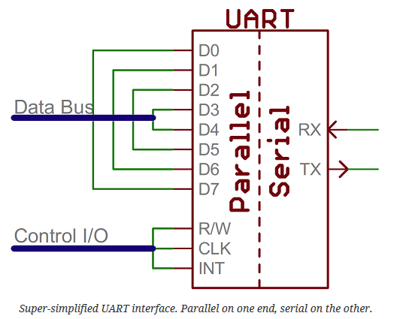
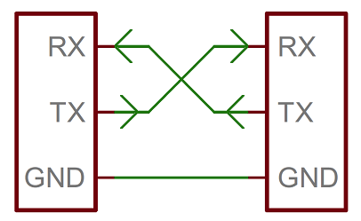
Lab 9 EGR 262 – Fundamental Circuits Lab
UART (Universal Asynchronous Receiver Transmitter)
How do the microcontroller and the peripheral device actually send the serial data? Typically a UART (Universal Asynchronous Receiver Transmitter) is used. The Arduino UNO’s microcontroller (Atmega-328) has a built-in UART. The motor controller that we will use in Lab 9 also has a UART. The UART essentially converts parallel data into serial form for transmission and the opposite for receiving. The UNO and the motor controller have designated pins for receiving (RX) and transmitting (TX). Note that when they are connected we connect RX to TX and TX to RX.
Arduino UNO
Motor Controller

Slide 7
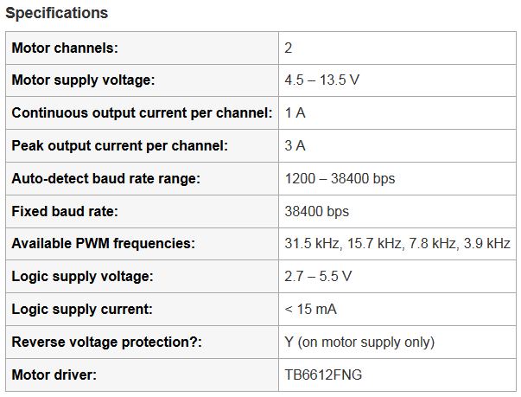
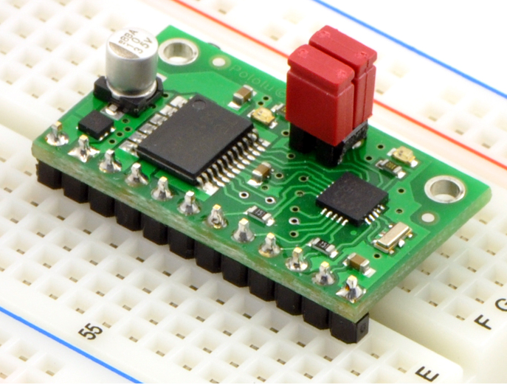
Lab 9 EGR 262 – Fundamental Circuits Lab
Motor Controllers
In Lab 6 we used PWM to control the speed of a motor. A more common method is to use a motor controller, which can often control multiple motors. Serial communication is typically used to send commands to control the speed and direction of each motor.
Pololu Qik 2s9v1 Motor Controller
“This small, inexpensive motor controller allows variable speed and direction control of two small, brushed DC motors using a simple serial interface, making it easy to add motors to your microcontroller- or computer-based project. The motor supply voltage range is 4.5 to 13.5 V; the continuous current per channel is up to 1 A (3 A peak).” Reference: http://www.pololu.com/product/1110/

Slide 8
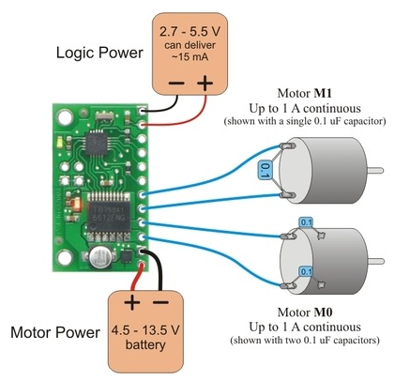
Lab 9 EGR 262 – Fundamental Circuits Lab
Connections for the Qik 2s9v1 Motor Controller
Note: Three 0.1uF capacitors are recommended for each motor to reduce motor noise, but they are optional. We will not use the capacitors in lab.

Slide 9
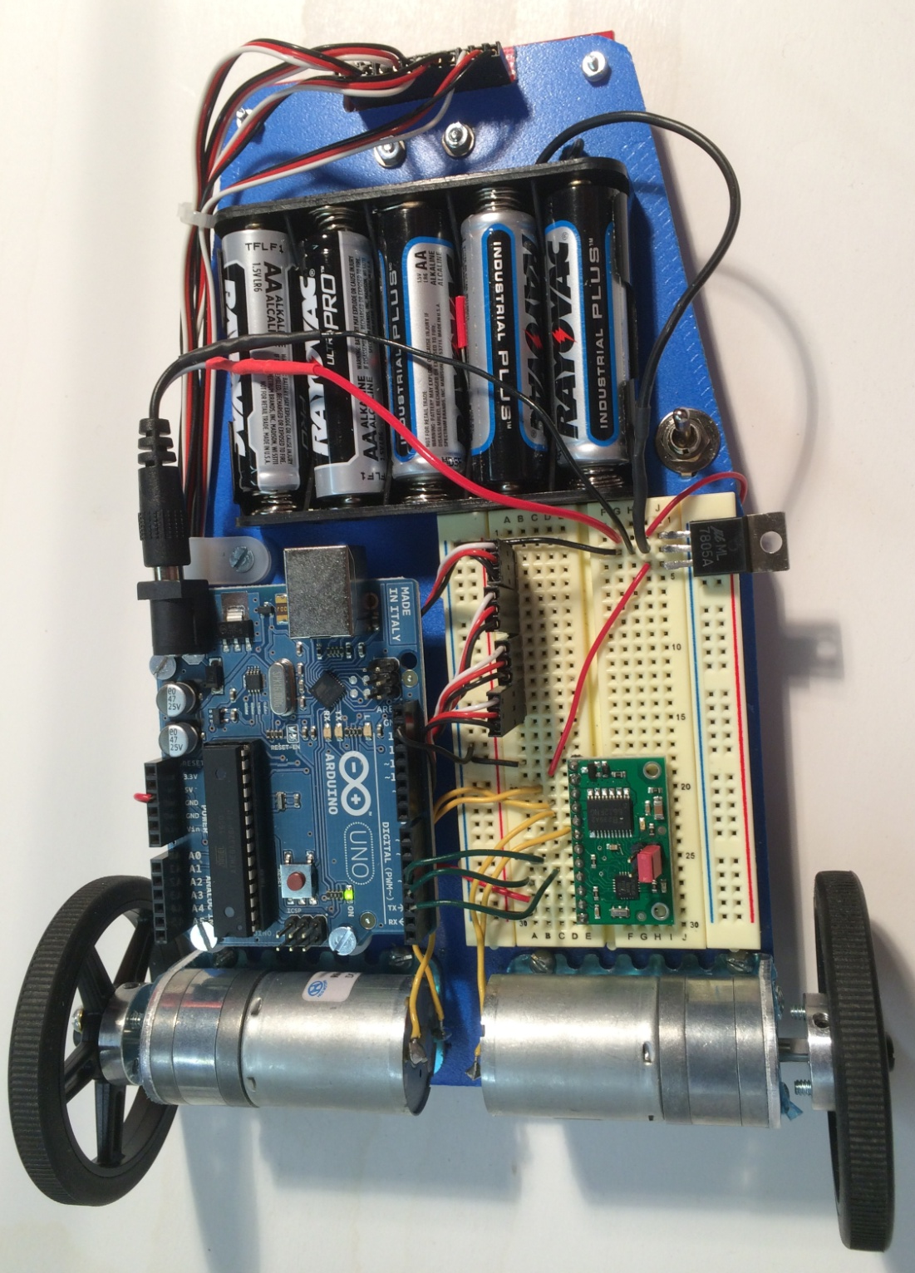
Lab 9 EGR 262 Fundamental Circuits Lab
Robot used in EGR 262 lab
Key robot features:
Arduino UNO
Pololu Qik 2s9v1 dual motor controller (4.5-13.5V, 1A continuous, 3A peak)
580 rpm gearhead motors (6V, 80mA free run current, 1.1A stall current)
Half-size breadboard
QTR-8RC infrared (IR) reflective sensor array (for later labs)
Battery pack (5 AA batteries, 7.5V)
See larger photo and wiring diagram on the following slides
QTR-8RC IR sensor array
7805 – 5V regulator
Arduino UNO
Qik 2s9v1 motor controller
580 rpm gearhead motors

Slide 10
Lab 9 EGR 262 Fundamental Circuits Lab

Slide 11
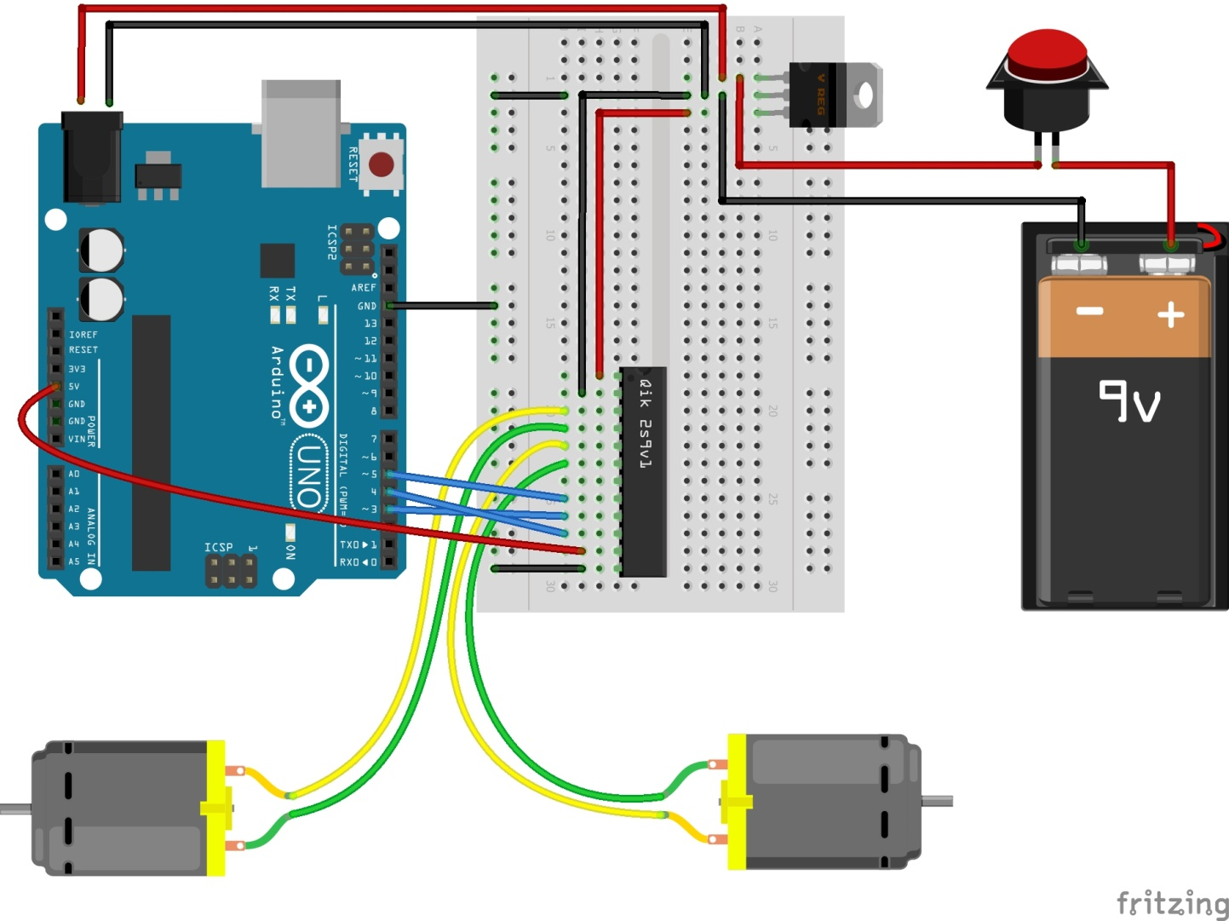
Lab 9 EGR 262 – Fundamental Circuits Lab
7805 - 5V Regulator
Toggle switch, not pushbutton
5 AA batteries (7.5V), not 9V
Wiring Diagram (using Fritzing)
Notes:
The Qik is rotated 180° in the schematic
7.5V goes to the 7805 5V regulator and to the Arduino barrel plug input
5V from the 7805 to the motor voltage input
5V from the Arduino to the Vcc input
Common ground throughout the schematic

Slide 12
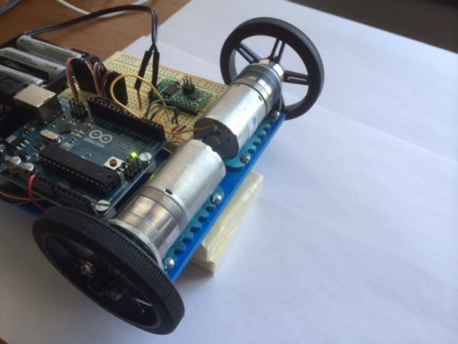
Lab 9 EGR 262 – Fundamental Circuits Lab
Testing the motor controller
The Qik manual indicates that the Demo-mode jumper indicated below can be used to test the motor controller before you even connect it to an Arduino. This is a good idea to make sure that the motor controller, solder connections, motors, wiring, etc., are all good.
The demo runs one motor forward then backwards, then runs the other motor forward then backwards, and then repeats indefinitely.
This also a good way to make sure that the polarity is correct on each motor (i.e., it should go forward first, not backwards first). If the motor turns in the wrong direction, simply reverse the motor leads.
Video of demo program running using the Qik2s9v1, the Arduino UNO, and two DC motors (double-click black image to launch video).
Demo jumper in place

Slide 13
Lab 9 EGR 262 – Fundamental Circuits Lab
Serial Communication with the Qik 2s9v1 Motor Controller
The Qik can be used with two protocols:
Compact Protocol – simpler and the best choice for one peripheral device. We will use this protocol. We will later introduce an Arduino library for the Qik that also uses this protocol.
Pololu Protocol – Compatible with protocols for other motor controllers and servo controllers. Multiple-devices can be addressed using device IDs.
Compact Protocol
The compact protocol simply consists of sending single command bytes followed by any required data bytes.
Form: Command byte – Data Bytes
Example:
10001101₂ = 141₁₀ = 8D₁₆ is the command byte to turn motor M1 forward
01111111₂ = 127₁₀ = 7F₁₆ is the data byte for full speed
So using the form Command byte – Data Bytes we would send 141, 127 (in decimal form). As we will see shortly, this might look like:
Serial.write(141); Serial.write(127); // M1 forward full speed
or Serial.write(0x8D); Serial.write(0x7F); // same thing using hexadecimal

Slide 14
Lab 9 EGR 262 – Fundamental Circuits Lab
Compact Protocol – more details
Some useful commands for this protocol are shown below. Refer to the Qik 2s9v1 User’s Guide for additional commands and information (see Pololu website).
Baud rate commands:
The Qik will autodetect the baud rate, but you must tell it to exit autodetect mode using:
Command 0xAA - Exit autodetect mode: Form: 0xAA (170)
Motor Commands:
There are different commands for two modes of speed resolution.
7-bit mode uses speeds 0-127. 8-bit mode uses speeds 0-255.
We will use the default 7-bit mode.
Command 0x88 - Motor M0 Forward: Form: 0x88 (136), motor speed (0-127)
Command 0x8A - Motor M0 Reverse: Form: 0x8A (138), motor speed (0-127)
Command 0x8C - Motor M1 Forward: Form: 0x8C (140), motor speed (0-127)
Command 0x8E - Motor M1 Reverse: Form: 0x8E (142), motor speed (0-127)
Command 0x86 - Motor M0 Coast: Form: 0x86 (134)
Command 0x87 - Motor M1 Coast: Form: 0x87 (135)
Example: Serial.write(138); Serial.write(63); // M0 half speed reverse

Slide 15
Lab 9 EGR 262 – Fundamental Circuits Lab
SoftwareSerial Library
Recall that the Arduino UNO uses pins 0 and 1 (RX and TX) to communicate with the computer monitor. If we use these pins for serial communication with the Qik motor controller, then we won’t be able to use the computer monitor.
Arduino’s SoftwareSerial library (class) allows you to easily define other pins for serial communication. The following code will set up pins 2 and 3 for serial communications as well.
This new serial connection is used much like the existing one for the monitor:
#include <SoftwareSerial.h> // library used to set up other pins for serial comm
SoftwareSerial QikSerial(2,3); // RX, TX to communicate with the Qik
QikSerial - Pick any valid name for this object
Serial.begin(9600); // baud rate for the computer monitor
QikSerial.begin(38400); // baud rate for the Qik (it will autodetect the rate)
Serial.write(“Hello, World!”); // write to the computer monitor
QikSerial.write(134); // send command for motor M0 to coast

Slide 16
Lab 9 EGR 262 – Fundamental Circuits Lab
Resetting the Qik 2s9v1 Motor Controller
The Qik should be reset when you download a program, restart a program, or clear an error message (we won’t do this).
The Qik is reset by placing a LOW voltage on the RESET pin. This can be done with hardware (a switch, perhaps) or with software. It can be done with software as follows:
// Reset the motor controller - connected to pin D4 on the Arduino
digitalWrite(4, LOW); // Reset the Qik with a LOW
delay(1); // wait 1 ms
pinMode(4, INPUT); // Return to high-impedance input (the reset is
// internally pulled HIGH on qik)
delay(1); // wait 1 ms

Slide 17
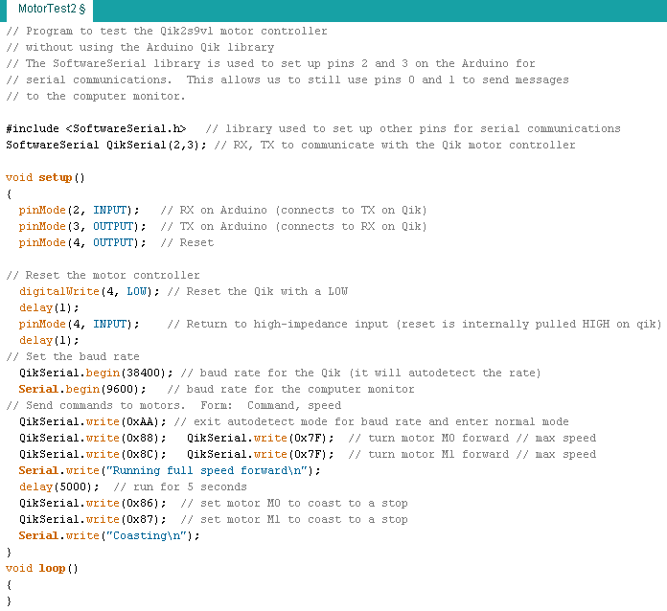
Lab 9 EGR 262 – Fundamental Circuits Lab
Sample program (MotorTest2): Control two motors using the Qik
Note: There was no need to use the computer monitor in this program, but it was included since this might sometimes be useful for diagnostics.
Double-click to launch video

Slide 18
Lab 9 EGR 262 – Fundamental Circuits Lab
Using the Qik Library for the Arduino
There is actually an easier way to control motors using a Qik library for the Arduino! It takes care of most of the details of serial communications and allows you to use simple functions to control each motor. The Qik library for the Arduino:
Sets up pins 2 and 3 for serial communications
Sets up pin 4 for Reset and automatically resets the Qik
Provides easy-to-use functions so that you don’t need to know the command numbers for the Qik
Provides two example programs: a demo program and a configuration program.
So why didn’t we use this Library to start with? Because we wanted to learn the basics of serial communications. Many peripheral devices don’t come with such nice libraries. The Qik has a library for the Arduino, but not for many other types of commonly used microcontrollers.

Slide 19
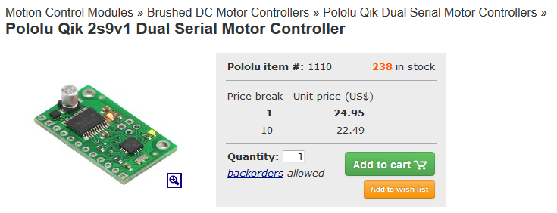
Lab 9 EGR 262 – Fundamental Circuits Lab
Downloading the Qik Library for the Arduino
Go to the Pololu Qik website (search for Pololu Qik 2s9v1 or use this link:
http://www.pololu.com/product/1110/
Scroll down to here and select the link for the Arduino library:
Sample Code
We have written a basic Arduino library for the qik dual serial motor controllers that makes it simple to interface these controllers with an Arduino. The library handles the details of serial communication with the qik, allowing two brushed DC motors to be controlled easily.
Link above leads to GitHub (see next slide)

Slide 20
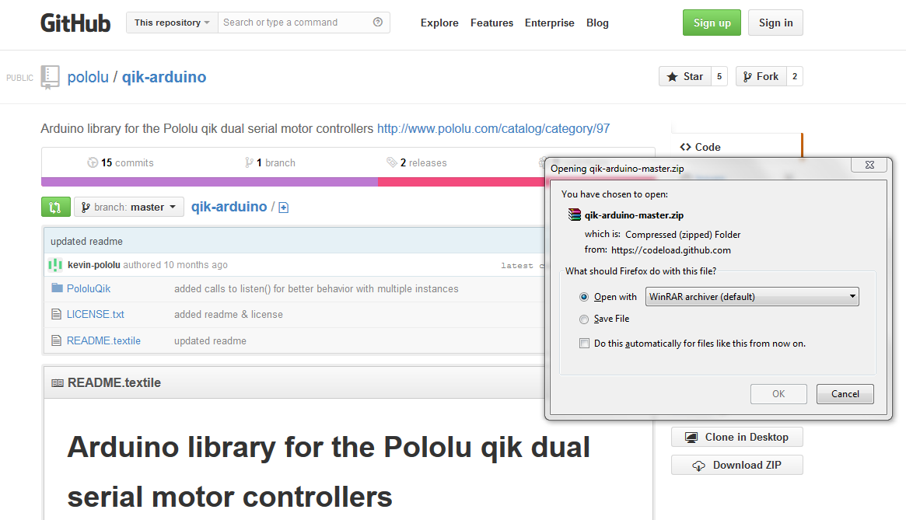
Lab 9 EGR 262 – Fundamental Circuits Lab
Downloading the library from GitHub
Download the archive from GitHub as shown below, extract the files, and drag the “PololuQik” folder to your Arduino/libraries directory.

Slide 21
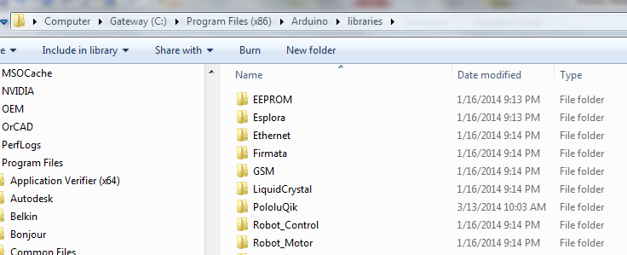
Lab 9 EGR 262 – Fundamental Circuits Lab
Copying the PololuQik folder into the Arduino library folder
Downloaded qik-arduino-master.zip onto the desktop.
Right-click on it and select Extract Files…
Copy the PololuQik folder into /Arduino/Libraries
Warning: Do not copy the qik-Arduino-master folder into the Arduino library folder or it will not work correctly. Only copy the PololuQik folder as shown below.

Slide 22
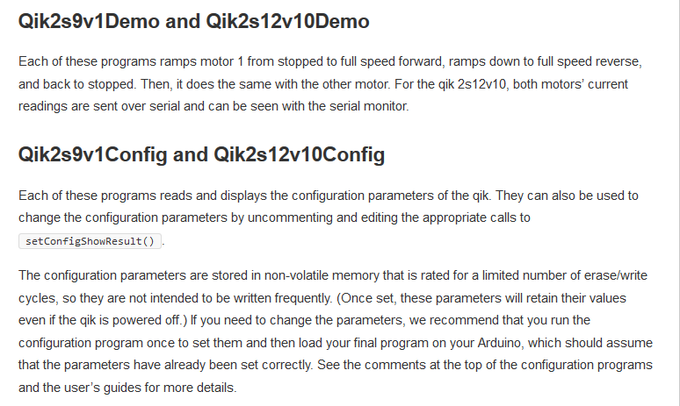
Lab 9 EGR 262 – Fundamental Circuits Lab
PololuQik Library – Sample Programs
The PololuQik folder contains two examples for the Quik2s9v1:
Qik2s9v1Config
Qik2s9v1Demo
Sample Programs
Descriptions for both sample programs are available online (and shown to the left) https://github.com/pololu/qik-arduino
The programs have been modified and tested. See following slides.

Slide 23
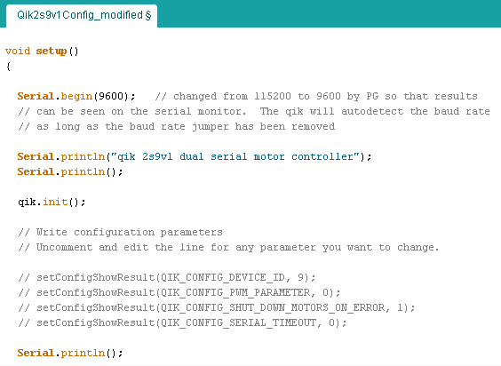
Qik2s9v1Config:
Qik2s9v1Config is used to read current configuration values from the qik or to set configuration values for the qik (which is done by “uncommenting” any or all of the 4 lines indicated).
Part of Qik2s9v1Config is shown below.
It is probably not necessary to use this program as the current configuration seems to work fine.
The result of running the program is shown on the next slide.
Changed from 115200 to 9600
I did not find it necessary to uncomment these lines.

Slide 24
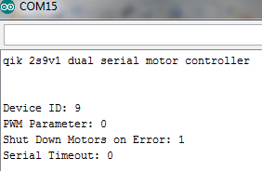
Lab 9 EGR 262 – Fundamental Circuits Lab
Qik2s9v1Config:
Output to Serial Monitor from original
Qik2s9v1Config program
Output to Serial Monitor from modified Qik2s9v1Config program (baud rate changed to 9600)

Slide 25
Lab 9 EGR 262 – Fundamental Circuits Lab
Qik2s9v1 Demo Program
Pololu provides a demo program to test the motors using the Qik2s9v1: Qik2s9v1Demo
The Demo program (Qik2s9v1Demo) seems to work fine and runs the same Demo as described in the qik manual (described earlier: no programming, just add the jumper and apply a LOW to Reset).
Be sure that the PololuQik folder has been copied into the Arduino library folder
Be sure to change the baud rate to 9600 (the program properly controls the motors without this change, but the message sent to the Serial Monitor will consist of strange symbols if the baud rate isn’t changed).
Note: If either motor turns in the wrong direction (it should turn forward and then reverse), change the polarity of the motor.
Video of demo program running using the Qik2s9v1, the Arduino UNO, and two DC motors (double-click black image to launch video).

Slide 26
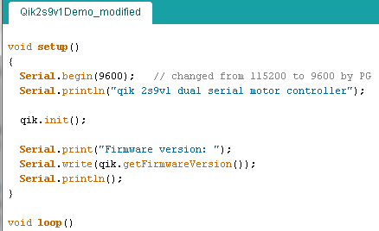
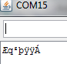
Qik2s9v1Demo:
Part of Qik2s9v1Demo is shown below
Changed from 115200 to 9600
Output to Serial Monitor from original Qik2s9v1Config program
Output to Serial Monitor from with baud rate changed to 9600

Slide 27
Lab 9 EGR 262 – Fundamental Circuits Lab
Functions in the PololuQik Library
The demo program shows how to use the functions in this library, but some key functions are summarized below.
In each case the argument speed is from -127 to +127, where -127 is full speed reverse and + 127 is full speed forward (7-bit mode)
void setM0Speed(int speed) - set motor M0 speed
void setM1Speed(int speed) – set motor M1 speed
void setSpeeds(int M0speed, int M1speed) – set speeds for both motors
void setM0Coast( ) – sets motor M0 to coast
void setM1Coast( ) – sets motor M1 to coast
void setCoasts( ) – sets both motors to coast
PololuQik (unsigned char receivePin, unsigned int transmitPin, unsigned int resetPin) – sets pins to be used for RX, TX, and RESET

Slide 28
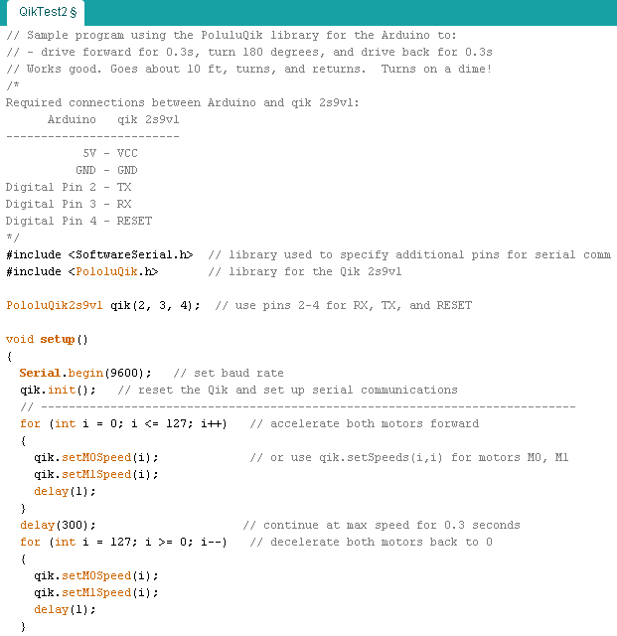
Sample program (QikTest2)
This program uses the PololuQik library to control two motors and drive a robot.
Notes:
Accelerating the motors may not be necessary, but is included as an example.
Sending a motor the speed of 0 applies braking to the motor, whereas using the Coast functions will allow the motor to coast to a stop. You can also use a loop to decelerate a motor for controlled slowing.
Continued on next slide

Slide 29
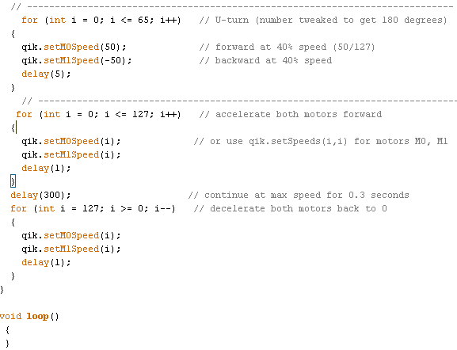
Lab 9 EGR 262 – Fundamental Circuits Lab

