Slide 1
Lab 8 EGR 262 – Fundamental Circuits Lab
1
EGR 262
Fundamental Circuits Lab
Presentation for Lab #8
ADC, PWM, and class Servo
Instructor: Paul Gordy
Office: H-115
Phone: 822-7175
Email: PGordy@tcc.edu

Slide 2
Lab 8 EGR 262 – Fundamental Circuits Lab
ADC using the Arduino UNO
In Lab 7 we built a 3-bit successive approximation ADC. The Arduino UNO has 6 built-in 10-bit successive approximation ADCs.
External, 1-channel
3-bit successive
approximation
ADC
Arduino
UNO
Arduino
UNO
D10
D13
D12
D11
+5V
A0
A1
A2
A3
A4
A5
+
_
Internal
6-channel
10-bit successive
approximation
ADC
Six
Analog
Inputs
(0-5V)
+5V
One Analog
Input
(0-5V)
10k

Slide 3
Lab 8 EGR 262 – Fundamental Circuits Lab
3
3-bit ADC (8 ranges)
10-bit ADC (1024 ranges)
Analog Input Range (V) | Digital Output
0.000 – 0.625 | 000
0.625 – 1.25 | 001
1.250 – 1.875 | 010
1.875 – 2.500 | 011
2.500 – 3.125 | 100
3.125 – 3.750 | 101
3.750 – 4.375 | 110
4.375 – 5.000
Analog Input Range (V) | Digital Output
0.00000 – 0.00488 | 0000000000
0.00488 – 0.00976 | 0000000001
0.00976 – 0.01465 | 0000000010
0.01465 – 0.01953 | 0000000011
• | •
• | •
• | •
4.98047 – 4.98535 | 1111111100
4.98535 - 4.99023 | 1111111101
4.99023 - 4.99512 | 1111111110
4.99512 – 5.00000 | 1111111111

Slide 4
Lab 8 EGR 262 – Fundamental Circuits Lab
4
Arduino UNO functions for analog inputs
analogRead( ) – This function is used to read analog inputs.
Used to read analog inputs from pins A0 – A5
Converts a 0-5V input to a 10-bit value from 0 to 1023
(0000000000 to 1111111111)
The function returns an integer in the range 0 to 1023
Convert time is about 100 us, so the maximum read time is about 10,000 times per second (25 clock cycles for the first conversion and 13 clock cycles for all later conversions)
The analog inputs A0 – A5 do not need to be specified as inputs
Example:
int valueA = analogRead(A5)
float voltageA = 5*valueA/1024;

Slide 5
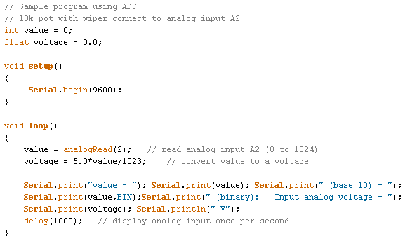
Lab 8 EGR 262 – Fundamental Circuits Lab
5
Example: If a potentiometer is used to apply a voltage from 0 – 5V to analog input A2, write a program to read the input value and to calculate the input voltage. This is illustrated below for the input 3.246 V (actually tested in lab).
Arduino
UNO
+5V
A0
A1
A2
A3
A4
A5
+3.246 V
10k

Slide 6
Lab 8 EGR 262 – Fundamental Circuits Lab
6
Class exercise: Calculate the analog input voltage on A2 and the value read (in decimal and binary) using: int value = analogRead(A2)
Arduino
UNO
Arduino
UNO
Arduino
UNO
5V
A0
A1
A2
A3
A4
A5
A0
A1
A2
A3
A4
A5
A0
A1
A2
A3
A4
A5
1k
8k
4k
6k
5V
+
_
9k
5V
+
_
2k
(10k pot)
analog input voltage = ______
value = __________ (base 10)
value = __________ (base 2)
analog input voltage = ______
value = __________ (base 10)
value = __________ (base 2)
analog input voltage = ______
value = __________ (base 10)
value = __________ (base 2)

Slide 7
Lab 8 EGR 262 – Fundamental Circuits Lab
7
Arduino UNO functions for analog inputs (continued)
analogReference(type) – This function is used to specify the input analog voltage range (the default range is 0-5V). There are three options for the argument (type of reference to use) for the Arduino UNO:
DEFAULT: analog inputs are in the range 0-5V (on a 5V Arduino UNO board)
INTERNAL: analog inputs are in the range 0-1.1V (for the Arduino UNO or other Atmega 328 boards)
EXTERNAL: analog inputs are in the range 0V to the voltage applied to the AREF pin (0-5V only)
Examples:
analogReference(DEFAULT); // this is the default so it can be omitted
int valueA = analogRead(A5); // convert 0-5V to value 0-1023
analogReference(INTERNAL);
int valueA = analogRead(A5); // convert 0-1.1V to value 0-1023
analogReference(EXTERNAL);
int valueA = analogRead(A5); // convert 0-AREF voltage to value 0-1023

Slide 8
Lab 8 EGR 262 – Fundamental Circuits Lab
8
Class exercise: Calculate the analog input voltage on A2 and the value read (in decimal and binary) using:
analogReference(EXTERNAL);
int value = analogRead(A2)
Arduino
UNO
3.3V
AREF
A0
A1
A2
A3
A4
A5
+
_
3.3V
3k
7k
(10k pot)
analog input voltage = ______
value = __________ (base 10)
value = __________ (base 2)
Analog
Reference
AREF
Analog
Inputs
Note: The Arduino website warns that after changing to the analog reference, the first few readings from analogRead( ) may not be accurate)

Slide 9
Lab 8 EGR 262 – Fundamental Circuits Lab
9
Example – Controlling the brightness of an LED with a potentiometer
A potentiometer can be used to provide an input analog voltage in the range 0-5V. analogRead( ) will convert this input to a value from 0-1023.
analogWrite( ) converts a number from 0-255 into a PWM signal.
We can simply divide the value from analogRead( ) by 4 to produce the input for analogWrite( ).
5V
Arduino UNO
A0
A1
A2
A3
A4
A5
1.00V
In=analogRead(2); //204
Out = In/4; // 51
analogWrite(11,Out);
~D11
~ D10
~ D9
~ D6
~ D5
~ D3
(10k pot)
220 Ω
LED

Slide 10
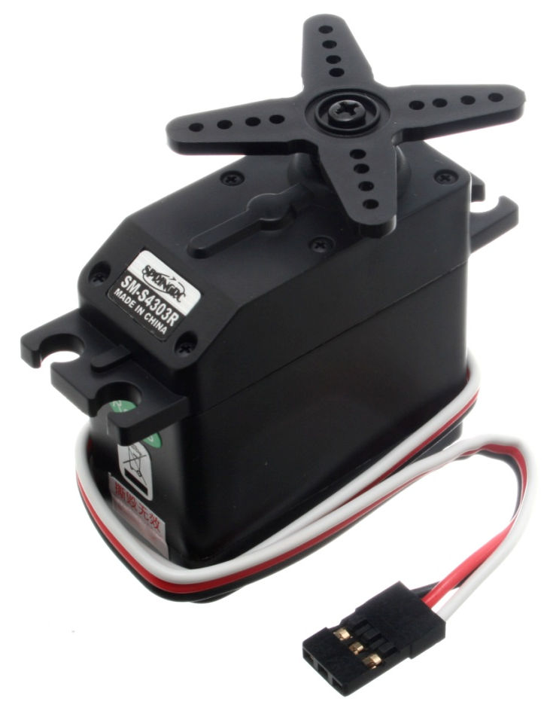
Lab 8 EGR 262 – Fundamental Circuits Lab
10
Servo - A servo is a device that contains:
Motor
Gearbox that gears down the motor to provide slower speeds (than most motors) and higher torque (power to turn).
Built-in electronics such that the motor position or speed can be controlled by a series of pulses. The servo is powered using 5V (4.8 – 6.0 V)
Control horn
Mounting flange
Motor, circuits, and gears
Note: Small DC motors typically have max speeds of 1000-3000 rpm. A servo typically has a max speed of only around 50 rpm!
Plug for 5V (red), ground (black), and PWM signal

Slide 11
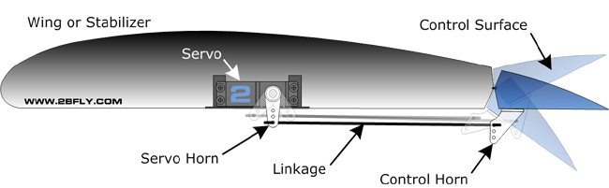
Lab 8 EGR 262 – Fundamental Circuits Lab
11
Servo Applications
RC Car Steering
Robot Arms
Driving Robot Wheels
http://www.societyofrobots.com/robot_arm_tutorial.shtml
http://www.youtube.com/watch?v=G3coyUydPU0&feature=player_embedded
RC Airplanes – Moving Control Surfaces
(bottom of robot shows 2 servos)
http://2bfly.com/knowledgebase/airplanes/control-surfaces/

Slide 12
Lab 8 EGR 262 – Fundamental Circuits Lab
12
Types of servos
There are two types of servos:
Unmodified servos – the servo can turn over a certain range, such as 180º
Used commonly on RC (radio control) cars and airplanes for steering, moving control flaps, etc.
Available online or in local hobby stores, such as Debbie’s RC World
The servo position is controlled by varying the pulse width of a control signal (see below)
Modified servos
Servo has been modified internally so that it will turn continuously.
Commonly used as a drive motor for a robot, such as the Arduino-BOT.
The servo speed is controlled by varying the pulse width of a control signal (see below)
Pass around servos of each type in class
0 degrees
90 degrees
180 degrees
0º
180º
90º
Full speed CW
Stop
Full speed CCW
CW
Stop
CCW

Slide 13
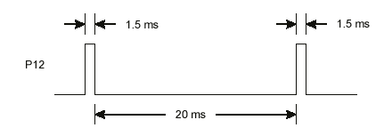
Lab 8 EGR 262 – Fundamental Circuits Lab
13
Servo Signals
Servos are typically operated using pulse-width modulation (PWM), where they receive control signals to make them turn.
The pulse width typically varies from about 1.3ms to about 1.7ms (or 1300 μs to 1700 μs) and the pulses are separated by 20ms. These values can vary and are set by the manufacturer.
Varying the pulse as described can be used to make a continuous servo turn at any speed between full speed CW to full speed CCW (typically about 50 rpm max).
The pulses must continue to keep the servo moving. If the pulses stop, the servo stops.
1.3 ms
1.3 ms
Full speed CW
20 ms
1.5 ms
1.5 ms
Stop
20 ms
1.7 ms
1.7 ms
Full speed CCW
20 ms

Slide 14
Lab 8 EGR 262 – Fundamental Circuits Lab
14
Controlling servos with the Arduino
Sending a series of pulses to a servo is similar to turning ON and OFF and LED. Recall earlier examples, such as the one below where an LED on digital pin D13 turns ON for 0.5 s and OFF for 0.5 s. The LED will blink indefinitely.
0.5 s
LED
ON
LED
OFF
0.5 s
220 Ω
D13
LED
Arduino
UNO

Slide 15
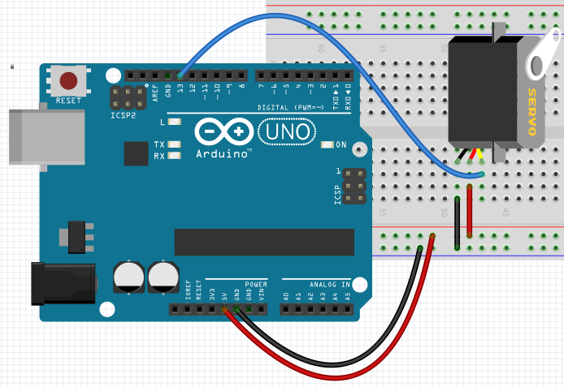
Lab 8 EGR 262 – Fundamental Circuits Lab
15
Controlling servos with the Arduino
The code on the previous page can be adjusted to make a continuous servo on pin D13 move full speed CW.
1.3 ms
1.3 ms
Full speed CW
20 ms
Disadvantage: One problem with this method is that we must keep the loop running. As we add other code to the loop the timing may be affected. For example, pausing for a user input would stop the servo!

Slide 16
Lab 8 EGR 262 – Fundamental Circuits Lab
16
Controlling servos with the Arduino
Could we use the PWM outputs on D11, D10, D9, D6, D5, and D3?
Recall that PWM outputs on D11, D10, D9, D6, D5, and D3 have a set frequency of 490 Hz, so T = 1/f = 1/490 = 2.05ms. This is not suitable since servos require pulses that are separated by 20ms, so T = 20ms.
Note that for this servo the pulse width should vary from 900μs to 2100 μs.

Slide 17
Lab 8 EGR 262 – Fundamental Circuits Lab
17
A better way to control servos
The Arduino programming language includes a better way to control servos. It involves using the Arduino Servo library.
The library is actually a class. Using a class allows you to declare objects and use member functions that work with those objects.
Useful Arduino servo library instructions:
#include <servo.h> // include the servo library (class)
Servo servoLeft, servoRight; // declare two new objects in class Servo. Any
// name is OK, but servoLeft is descriptive
servoLeft.attach(13); // associate the left servo with pin D13 // (any digital pin)
servoLeft.writeMicroseconds(1300) // send a pulse train continuously to D13 with
// a high time of 1300μs = 1.3ms
// and a period of 20 ms (default)
servoLeft.detach(); // disassociate the left servo from current pin
// this will stop the servo
objects
member function

Slide 18
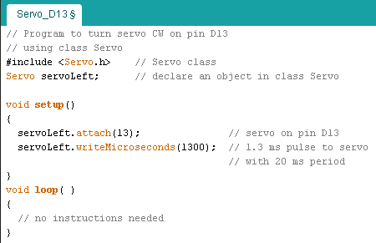
Lab 8 EGR 262 – Fundamental Circuits Lab
18
A better way to control servos
So the previous example used to turn a servo full speed CW on D13 can be re-written using the Servo class as shown below. Note that any of the 14 digital outputs on the Arduino UNO could be used.
One way to control a servo
A better way to control a servo – using the Servo class

Slide 19
Lab 8 EGR 262 – Fundamental Circuits Lab
19
Starting and stopping a servo
The previous example was used to turn a servo continuously.
Suppose that we wanted it to only turn for 10 seconds?
One way to accomplish this is to turn it on, wait for 10 s, and then turn it off.
pin D13
pin D13
pin D13
Notes:
The argument for the delay( ) function is an unsigned long int which can have a value from 0 to 4,294,967,295 so the max delay is 4,294,967,295 ms = 4,294,967.295 s ≈ 8.2 years!
We will use the delay( ) function for delays of several seconds in our programs, but long delays are typically discouraged as most Arduino functions will be halted during the delay (such as reading sensors).

Slide 20
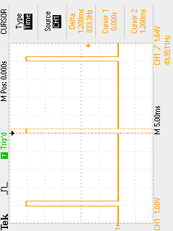
Lab 8 EGR 262 – Fundamental Circuits Lab
20
Servo – viewing the output on an oscilloscope
Note: I’m not sure why the command to produce a 1300μs pulse seemed to produce a 1200μs pulse in lab, but the values were consistently off:
Value (μs) | Measured PW (μs)
1300 | 1200
1500 | 1400
1700 | 1600
Two cursors were used to measure the pulse width:
T_{H} = 1.200ms = 1200 μs
T = 1/f = 1/49.8984 Hz
T = 20.04 ms (as expected)

Slide 21
Lab 8 EGR 262 – Fundamental Circuits Lab
21
Example – Controlling a servo with a potentiometer
A potentiometer can be used to provide an input analog voltage in the range 0-5V. analogRead( ) will convert this input to a value from 0-1023.
The range of pulse for each servo is different, but a typical range might be 1300 – 1700μs. The input from analog read could be converted to values in this range as follows: servoValue = 1300+(1700-1300)/1024.0*inputValue
We can then turn the servo using writeMicroseconds(servoValue).
5V
Arduino UNO
D13
D12
D11
D10
D9
D8
D7
D6
D5
D4
D3
D2
D1
D0
A0
A1
A2
A3
A4
A5
inputValue=analogRead(2);
servoValue = 1300+(1700-1300)/1024.0*inputValue;
writeMicroseconds(servoValue);
Servo
(10k pot)

