Slide 1
Lab 10 EGR 262 – Fundamental Circuits Lab
EGR 262
Fundamental Circuits Lab
Presentation for Lab #10
Using Infrared (IR) Sensors with the Arduino UNO
Instructor: Paul Gordy
Office: H-115
Phone: 822-7175
Email: PGordy@tcc.edu

Slide 2
Lab 10 EGR 262 – Fundamental Circuits Lab
Infrared (IR) Sensors
If you took EGR 120 at TCC you may recall using Infrared (IR) sensors for line following. One of the EGR 120 “ArduinoBOTs” is shown to the right with two IR sensors attached for line following.
We will test the single IR sensors used in EGR 120, but will then move on to an IR sensor module with 8 IR sensors.
Some of the following slides are also part of the EGR 120 presentation on IR sensors.
EGR 120 ArduinoBOT with two infrared sensors for line following

Slide 3
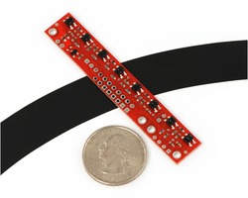
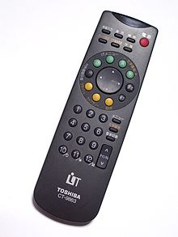
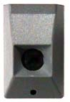
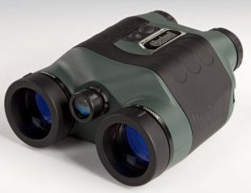
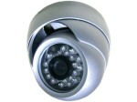
Arduino-BOT Lecture #5 EGR 120 – Introduction to Engineering
3
Infrared Applications
Infrared (IR) technology is used widely today with applications such as:
Remote control of TV and other electronic devices
Remote control of environmental systems and computers
Operation of information kiosks and talking signs
Remote temperature sensing
Night vision devices with infrared illumination
Infrared imaging cameras detect heat loss or overheating
Array of 8 IR sensors for line following
Stanley garage door IR safety beam sensor
IR night vision camera
Fluke IR Building Diagnostics thermal imaging camera
Bushnell
night vision binoculars
Toshiba TV remote

Slide 4
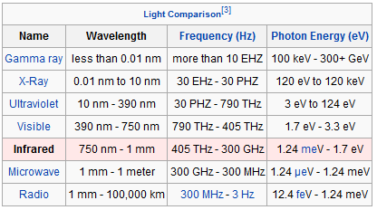
Arduino-BOT Lecture #5 EGR 120 – Introduction to Engineering
4
Infrared Light
The table below shows the wavelength for different types of light. Note that infrared light is not in the visible spectrum. This means that:
We cannot see the light used to navigate with infrared sensors.
The infrared sensors do not depend on visible light, so the robots navigating with infrared sensors work just as well in the dark!
Reference: http://en.wikipedia.org/wiki/Infrared

Slide 5
Arduino-BOT Lecture #5 EGR 120 – Introduction to Engineering
5
Infrared sensor circuits
The sensor circuit consists of an infrared LED (transmitter) and a phototransistor mounted in a housing.
The infrared diode shines a beam downward onto the track.
The beam bounces off the track and is received by a phototransistor (receiver).
The sensor circuit can detect the difference between light-colored surfaces and dark-colored surfaces by the amount of light that is reflected.
Critical Distance
(depends on the type of sensor)
Infrared light bounces off track surface
0.25”

Slide 6
Arduino-BOT Lecture #5 EGR 120 – Introduction to Engineering
6
Navigating with infrared sensors
There are many possible approaches to navigation using infrared sensors. One very simple approach is described below.
Basic navigation method:
If the left sensor hits the tape, turn left (slow the left wheel).
If the right sensor hits the tape, turn right (slow the right wheel).
How much should each wheel be slowed? It depends on:
The speed of the Arduino-BOT.
The sharpness of the turn.
Light from left sensor sees tape, so turn left

Slide 7
Arduino-BOT Lecture #5 EGR 120 – Introduction to Engineering
7
QTI sensors
Connect Black wire to B
In lab we will test the same QTI sensors used in EGR 120 before moving on to more powerful arrayw with 8 IR sensors. The QTI sensor comes with a cable (which must be connected as shown). A 3-pin header is used on the other end of the cable to plug it into a breadboard.
Connect White wire to W

Slide 8
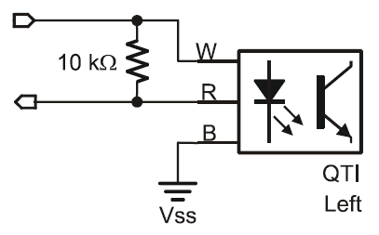
Arduino-BOT Lecture #5 EGR 120 – Introduction to Engineering
8
Wiring the QTI sensors
Each QTI sensors should be wired on the breadboard as indicated below.
5V
D6
GND
Digital vs Analog IR sensors
Digital sensor - returns 1 if IR signal is not reflected and 0 if IR signal is reflected (or perhaps the opposite)
Analog sensor – returns a voltage from 0V to 5V based on the amount of reflection.
The QTI sensor is a digital sensor and returns a 1 is the IR signal is not reflected (black tape, for example) and a 0 if the signal is reflected.

Slide 9
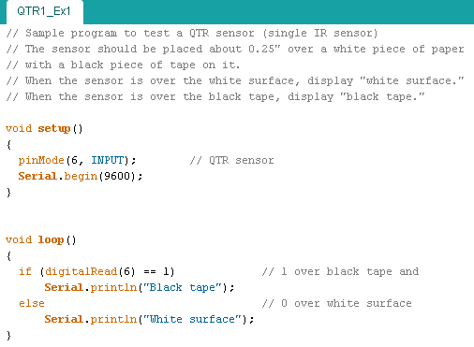
Arduino-BOT Lecture #5 EGR 120 – Introduction to Engineering
9
9
Testing a QTI sensor
The sample program below can be used to test a QTI sensor. A sample output is also shown below as the sensor is moved back and forth over black tape and a white surface. The sensor height was kept at around 0.25” over the surface.

Slide 10
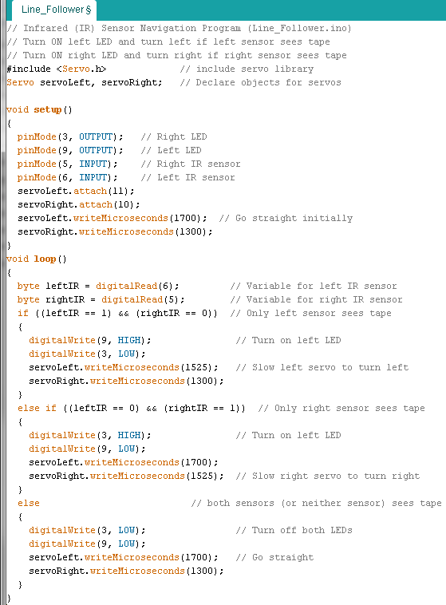
Arduino-BOT Lecture #5 EGR 120 – Introduction to Engineering
10
Navigating with infrared sensors The program shown was used in EGR 120 to navigate using two IR sensors (leftIR and rightIR) connected to D5 and D6). LEDs were also connected to D3 and D9 to indicate when a sensor was over tape.
This program works OK, but:
Only works well for a slow robot
The robots path isn’t very smooth as is turns back and forth trying to keep the black line between the two sensors
How can this be improved?

Slide 11
Arduino-BOT Lecture #5 EGR 120 – Introduction to Engineering
11
Possible improvements for line following:
Add more sensors
In EGR 262 we will use an IR sensor module with 8 IR sensors
Use a better algorithm (program):
Two sensors were used to provide two steering options in EGR 120 (sharp left or sharp right). With 7 sensors you could have 7 possible steering positions: sharp left, medium left, slight left, straight, slight right, medium right, sharp right.
Instead of assigning exact motor speeds to each sensor, the motor speed (0 to 127 perhaps) could be incremented or decremented. The 7 sensors could perhaps correspond to decrement by 10, decrement by 5, decrement by 2, straight, increment by 2, increment by 5, and increment by 10.
Use a PID (Proportional-Integral-Derivative) controller – a sophisticated, but widely used algorithm to minimize the error between the intended and actual path. (Lab 11)
Other improvements
When IR sensors are placed close together, the IR light emitted by one sensor might be detected by another sensor (splash over). This can be eliminated by only turning on each sensor when it is to be read.
Example: Turn ON sensor 1, read sensor 1, turn OFF sensor 1
Turn ON sensor 2, read sensor 2, turn OFF sensor 2, etc

Slide 12
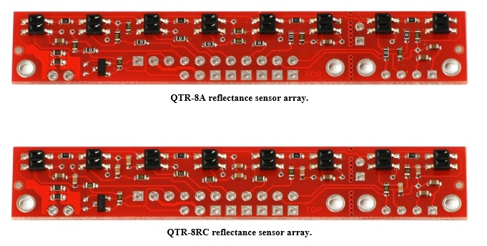
Arduino-BOT Lecture #5 EGR 120 – Introduction to Engineering
12
QTR-8x Reflective Sensor Arrays
Pololu makes two popular IR sensor arrays (they look nearly identical):
QTR - 8A – Analog Sensor Array
QTR - 8RC – Digital Sensor Array (used in EGR 262)

Slide 13
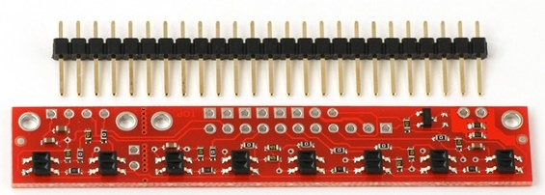
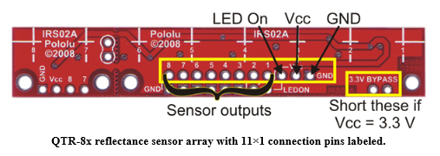
Arduino-BOT Lecture #5 EGR 120 – Introduction to Engineering
13
QTR-8RC Specifications
Operating voltage: 3.3-5.0 V
Supply current: 100 mA
Output format: 8 digital I/O-compatible signals that can be read as a timed high pulse
Optimal sensing distance: 0.125" (3 mm)
Maximum recommended sensing distance: 0.375" (9.5 mm)
The QTR-8RC comes with a 25-pin header that can be cut to length and soldered on the board. The QTR sensors used in lab have an 11-pin header soldered to provide access to:
8 sensor outputs (labeled 1-8 below)
Vcc (5V), GND, and LED On (LED will light when sensors are powered)
Cables will be used in EGR 262 to connect these pins to the breadboard (using another header).

Slide 14
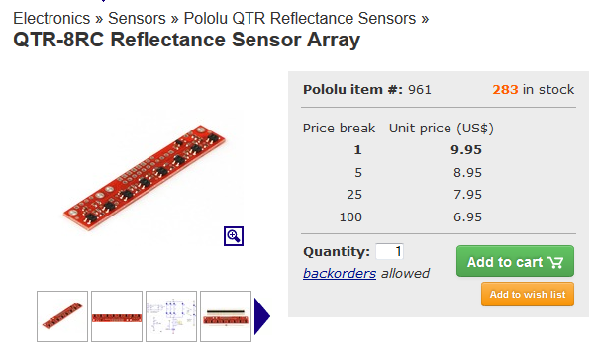
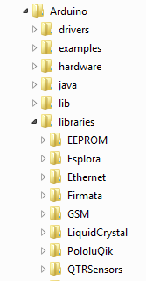
Arduino-BOT Lecture #5 EGR 120 – Introduction to Engineering
14
Arduino Library for the QTR-8RC
An Arduino library comes with the QTR-8RC sensor array.
The library (zip file) can be downloaded from Pololu’s website http://www.pololu.com/product/961/ .
Extract the zip file and copy the QTRSensors folder into the Arduino library folder.
The library works for both the QTR-8RC (digital) and the QTR-8A (analog)
Our Pololu AVR library provides functions that make it easy to use these sensors with our Orangutan robot controllers; please see the QTR Reflectance Sensors section of our library command reference for more information. We also have a Arduino library for these sensors.

Slide 15
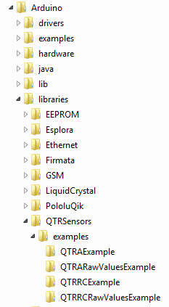
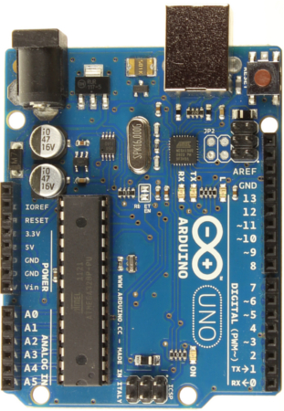
Arduino-BOT Lecture #5 EGR 120 – Introduction to Engineering
15
Sample Arduino program QTR-8RC
The Arduino library comes a sample program (QTRRCExample) for calibrating and reading the QTR-8RC sensor array.
Comments in the program indicate that the 8 sensors and the LEDON inputs can be assigned to any of the 14 digital inputs (D0-D13). Additionally, analog inputs A0-A5 can also be used and are treated as digital inputs D14-D19 as indicated below.
Inputs D0-D13
Inputs D14-D19
(A0-A5)

Slide 16
Arduino-BOT Lecture #5 EGR 120 – Introduction to Engineering
16
Assigning input pins for the QTR-8RC
There weren’t enough free digital pins in the range D0-D13, so some of the analog inputs need to be used as digital inputs (A0-A5 can serve as D14-D19). Rather than use all digital pins, 2 digital pins (D5-D6) and three analog pins (A3-A5) were left unused for future experiments.
D13 – diagnostics
D12 – S5
D11 – S4
D10 – S3
D9 – S2
D8 – S1
D7 – LEDON
D6 – unused
D5 – unused
D4 – motor controller
D3 – motor controller
D3 – motor controller
D1 – computer monitor
D0 – computer monitor
S8 - D14 (A0)
S7 – D15 (A1)
S6 – D16 (A2)
unused – A3
unused – A4
unused – A5

Slide 17
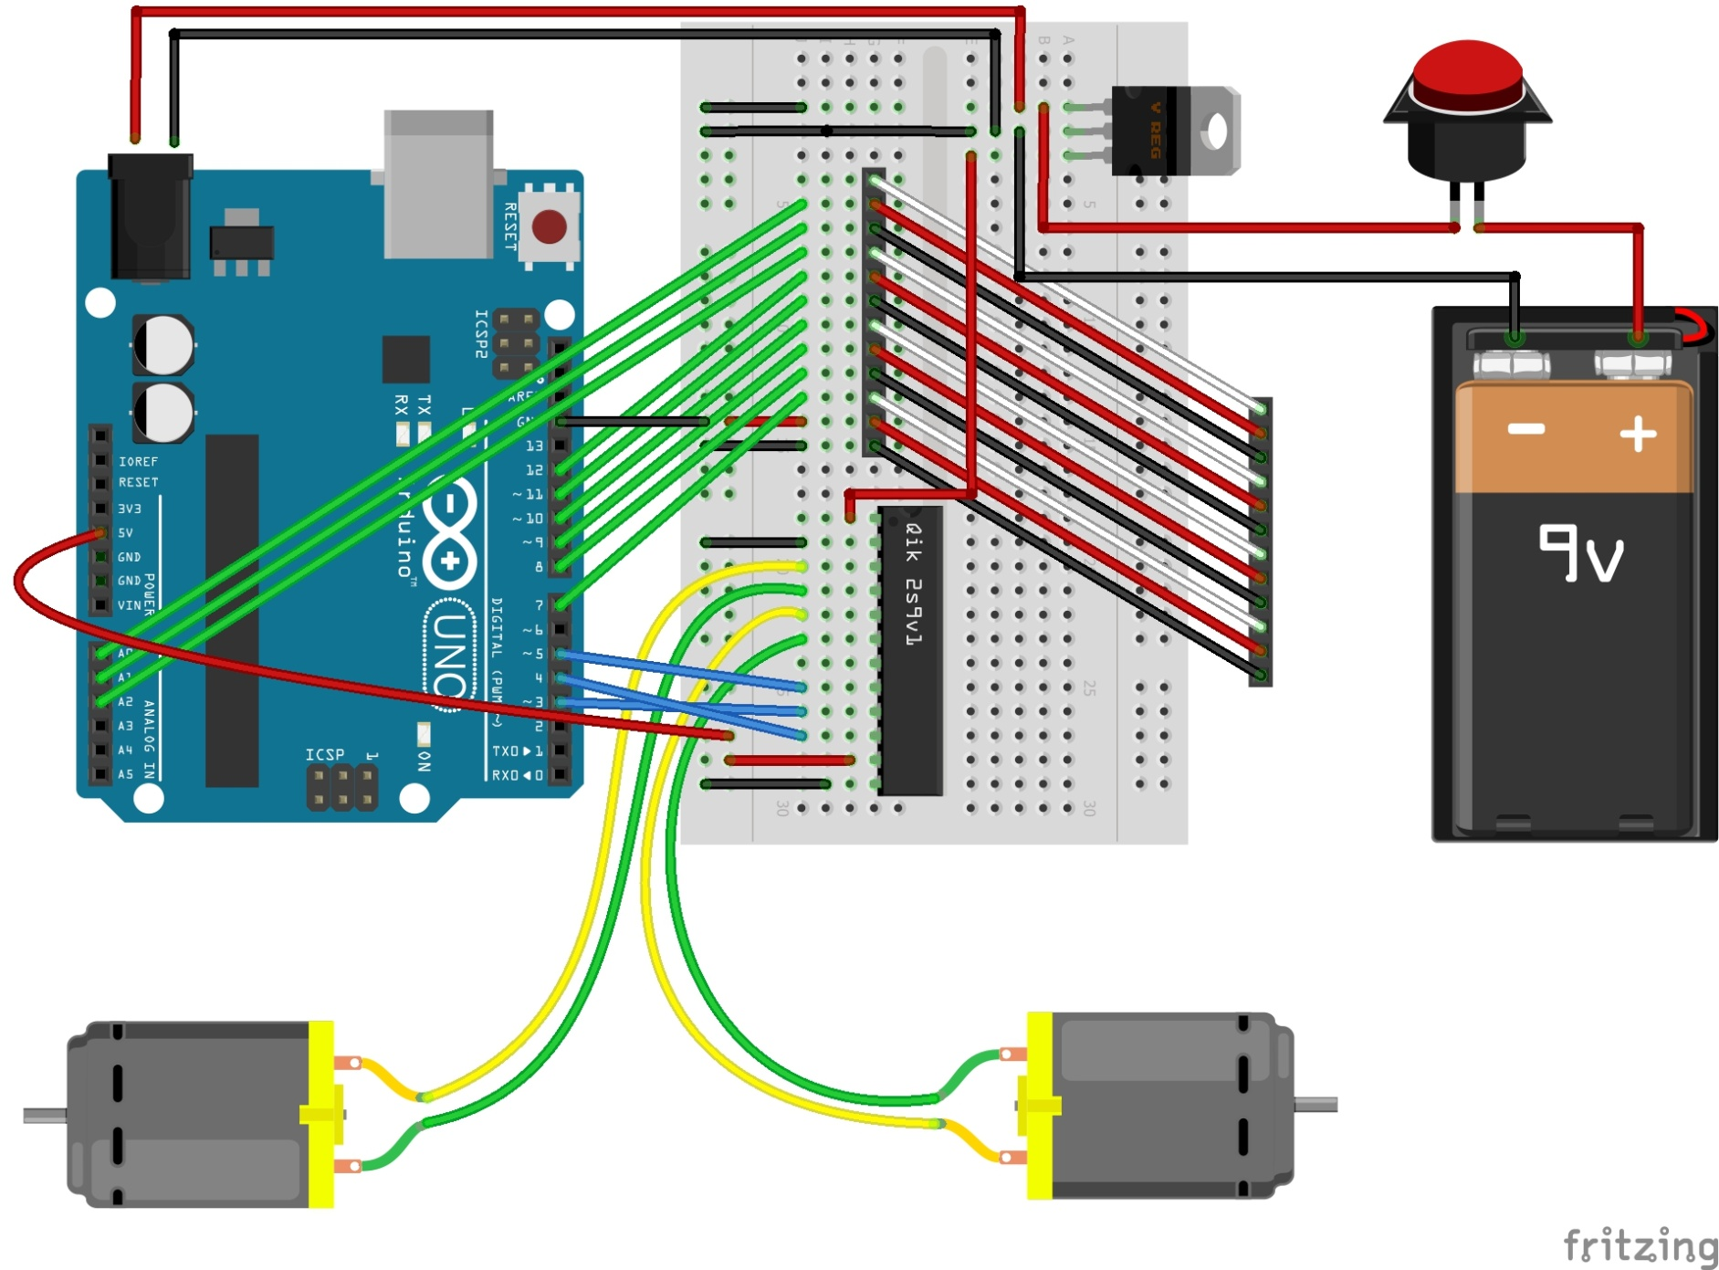
Arduino-BOT Lecture #5 EGR 120 – Introduction to Engineering
17
QTR-8RC Wiring
7
6
5
4
3
2
1
0
LEDON
Vcc
GND
QTR8RC
sensor array

Slide 18
Arduino-BOT Lecture #5 EGR 120 – Introduction to Engineering
18
Sample program
The sample program provided with the Arduino library (QTRRCExample) was modified slightly for the pin assignments chosen. The modified program is named QTR8RCEx1. Part of the program is shown here (more is shown later). All changes made to the original program are highlighted.
Pin for LEDON changed
// …
Pins for the 8 sensors assigned

Slide 19
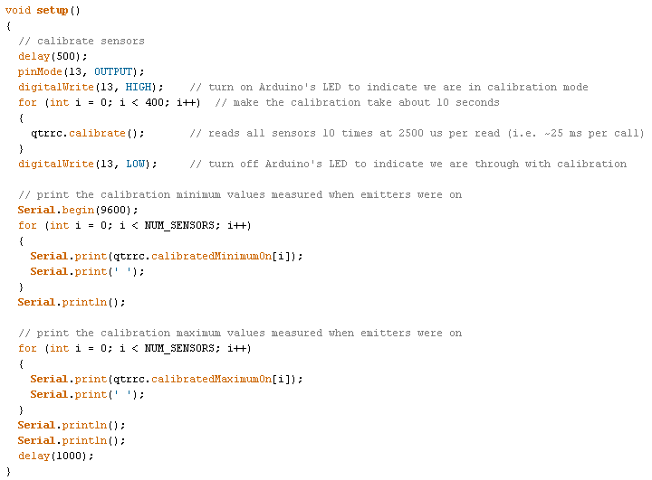
Arduino-BOT Lecture #5 EGR 120 – Introduction to Engineering
19
Sample program – calibrating the sensors
The next part of the sample program deals with calibrating the sensors. As the sensor array (or robot) is moved back and forth across a black line, scores for each sensor, as well as the total score and the interpretation are printed (see next slide).

Slide 20
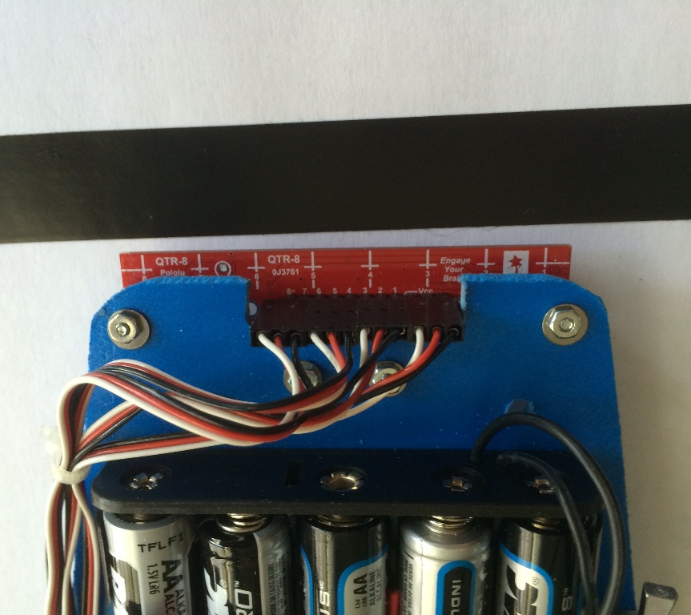
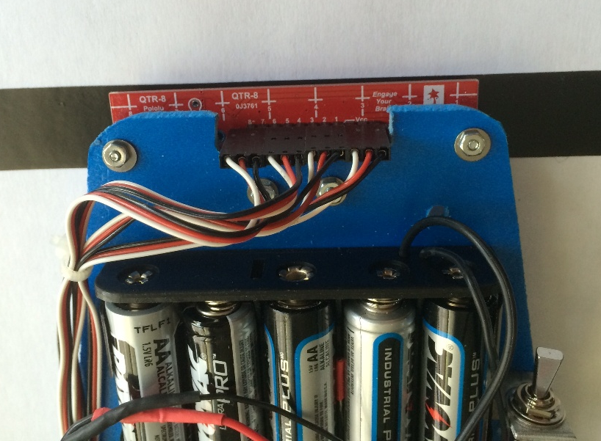
Arduino-BOT Lecture #5 EGR 120 – Introduction to Engineering
20
QTR-8RC Sensor Calibration
Run the program QTR8RCEx1
The program will run for about 10 seconds.
The Arduino’s built-in LED for D13 will turn on during calibration mode.
Move the sensors back and forth over black tape/light surface as shown (1s over each?)
The program will print max and min values for each sensor. They should be somewhat close to 0 and 2500.
A bad and a good set of values are shown below.
Good sensor min and max values
Bad sensor min and max values

Slide 21
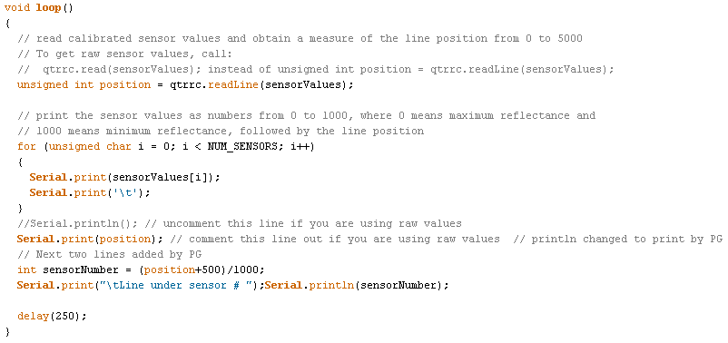
Arduino-BOT Lecture #5 EGR 120 – Introduction to Engineering
21
Sample program - Reading QTR-8RC Sensor Values
The last part of the sample program is shown below. As the sensor array (or robot) is moved back and forth across a black line, scores for each sensor, as well as the total score and the interpretation are printed (see following slides).
Added to display sensor number

Slide 22
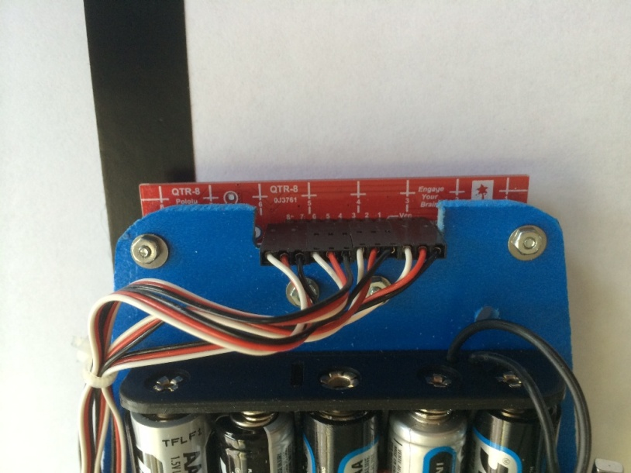
Arduino-BOT Lecture #5 EGR 120 – Introduction to Engineering
22
Reading QTR-8RC Sensor Values
After the program QTR8RCEx1 calibrates the sensors it will begin to print out values seen by each sensor.
The value displayed for each sensor is ideally 1000 if over black tape and 0 if over the light surface.
The total of all sensor values is determined by multiplying the sensor value by the sensor number (1-8).
As a result the total scores can be interpreted as:
Note: The sensors on the array are labeled 1-8, but in the program they are 0-7.
Total (ideal) | Total (practical) | Tape is under sensor
0 | < 500 | 1
1000 | 500 - 1500 | 2
2000 | 1500 - 2500 | 3
3000 | 2500 – 3500 | 4
4000 | 3500 – 4500 | 5
5000 | 4500 – 5500 | 6
6000 | 5500 – 6500 | 7
7000 | > 6500 | 8

Slide 23
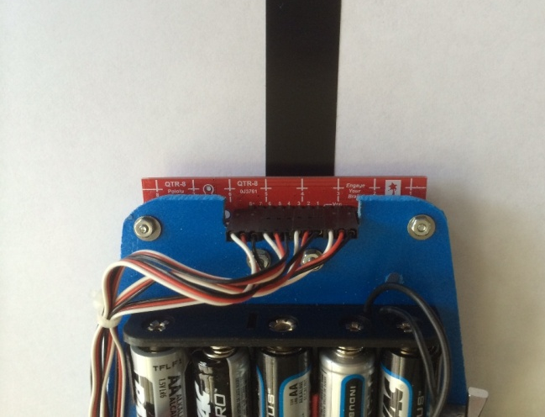
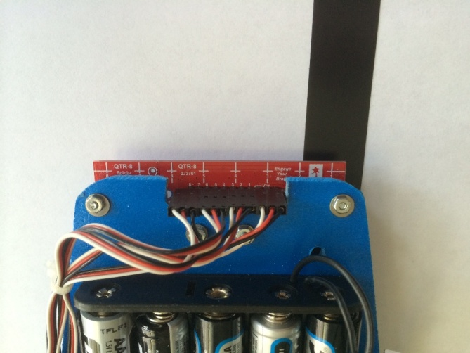
Arduino-BOT Lecture #5 EGR 120 – Introduction to Engineering
23
Reading QTR-8RC Sensor Values
As the sensor array (or robot) is moved back and forth across a black line, scores for each sensor, as well as the total score and the interpretation are printed.
Line for S5
Line for S0
Note how the tape spans multiple lines (sensors)
S0 S1 S2 S3 S4 S5 S6 S7 Total Interpretation

Slide 24
Arduino-BOT Lecture #5 EGR 120 – Introduction to Engineering
24
Reading QTR-8RC Sensor Values
According to comments in the programs provided for the Arduino, the Total value below is calculated as follows, although I can’t seem to always match their values.
S0 S1 S2 S3 S4 S5 S6 S7 Total Interpretation

Slide 25
Arduino-BOT Lecture #5 EGR 120 – Introduction to Engineering
25
Navigating a robot using QTR-8RC sensor values
There are many possible navigation algorithms. A simple algorithm would be to turn more sharply for outer sensors and less sharply for inner sensors.
Total (practical) | Turn | Left motor speed (0 - 127) | Right motor speed (0 – 127)
< 500 | Sharp right | 127 | 67
500 - 1500 | Medium right | 127 | 87
1500 - 2500 | Gentle right | 127 | 107
2500 – 3500 | Straight | 127 | 127
3500 – 4500 | Straight | 127 | 127
4500 – 5500 | Gentle left | 107 | 127
5500 – 6500 | Medium left | 87 | 127
> 6500 | Sharp left | 67 | 127

Slide 26
Arduino-BOT Lecture #5 EGR 120 – Introduction to Engineering
26
Navigating a robot using QTR-8RC sensor values
Once the sensor number has been calculated, motor speeds can be adjusted as follows. The exact motor speeds for best performance may need to be adjusted during testing on the track.
if (sensorNumber == 0) // sharp right
{
qik.setM0Speed(127);
qik.setM1Speed(57);
}
else if (sensorNumber == 1) // medium right
{
qik.setM0Speed(127);
qik.setM1Speed(77);
}
// etc

