Slide 1
Lab 1 EGR 262 – Fundamental Circuits Lab
1
EGR 262
Fundamental Circuits Lab
Presentation for
Lab #1: Breadboarding Circuits
Instructor: Paul Gordy
Office: H-115
Phone: 822-7175
Email: PGordy@tcc.edu
Items passed out in lab (print your own items for future labs):
Syllabus
Presentation for Lab #1
Lab Guide for Lab #1
Pinouts (connection information and data sheets for parts)

Slide 2
Lab 1 EGR 262 – Fundamental Circuits Lab
2
Sequence of Electrical/Computer Engineering Courses at TCC
EGR 271 (3 cr)
Circuit Theory I
ODU equiv: ECE 201
Offered: F, Sp, Su
MTH 279 (4 cr)
Differential
Equations
EGR 125 (4 cr)
Into to Engineering
Methods (C++)
EGR 272 (3 cr)
Circuit Theory II
ODU equiv: ECE 202
Offered: F, Sp
EGR 262 (2 cr)
Fund. Circuits Lab
ODU equiv: ECE 287
Offered: F, Sp, Su
EGR 270 (4 cr)
Fund. Of Computer EGR
ODU equiv: ECE 241
Offered: F, Sp, Su
Notes:
Classes available at the Virginia Beach Campus, the Chesapeake Campus, and the Tri-Cities Center
EGR 271-272 transfers to Virginia Tech as ECE 2004
EGR 270 transfers to Virginia Tech as ECE 2504
EGR 262 does not transfer to Virginia Tech

Slide 3

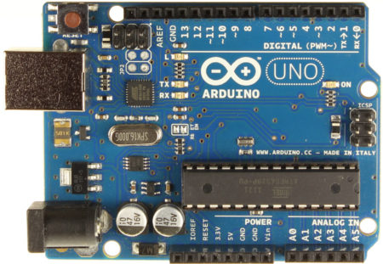
Lab 1 EGR 262 – Fundamental Circuits Lab
3
Focus of EGR 262
EGR 262 is a unique lab course that originally used materials developed at Notre Dame for the 68HC11 microprocessor. It is been drastically modified to use the much newer Arduino UNO microprocessor.
The lab involves a combination of hardware and software as various experiments are conducted by writing C++ programs to use a microprocessor to control various types of circuits.
Arduino 1.05 C++ Software
Arduino UNO R3
Microprocessor
Circuit

Slide 4
Lab 1 EGR 262 – Fundamental Circuits Lab
4
Lab Topics/Lectures
EGR 262 introduces many topics that will be unfamiliar to the student. These topics will be introduced in a lecture (or recitation) associated with the lab. Background material is provided in the lab manual and the instructor will lecture each week on topics to be covered the following week.
Lab/lecture topics include:
Report writing (lab notebooks)
C++ programming
Microprocessor architecture
Lab test equipment
New circuit devices (LED’s, comparators, diodes, etc)
New circuit applications (digital-to-analog conversion, analog-to-digital conversion, power supplies, pulse-width modulation, etc)

Slide 5

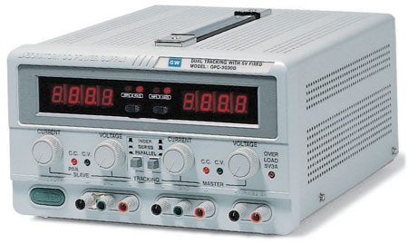
Lab 1 EGR 262 – Fundamental Circuits Lab
5
Lab Equipment
Before beginning Lab #1 next week, let’s take some time to become familiar with some of the equipment in the lab. Manuals are available online for more detailed information.
Agilent 34401 Multimeter
Use to measure voltage, current, resistance, frequency, and more.
PS280 DC Power Supply
Two 0-30V variable supplies and one fixed 5V supply.
Breadboard
Circuits will be constructed on solderless breadboards

Slide 6
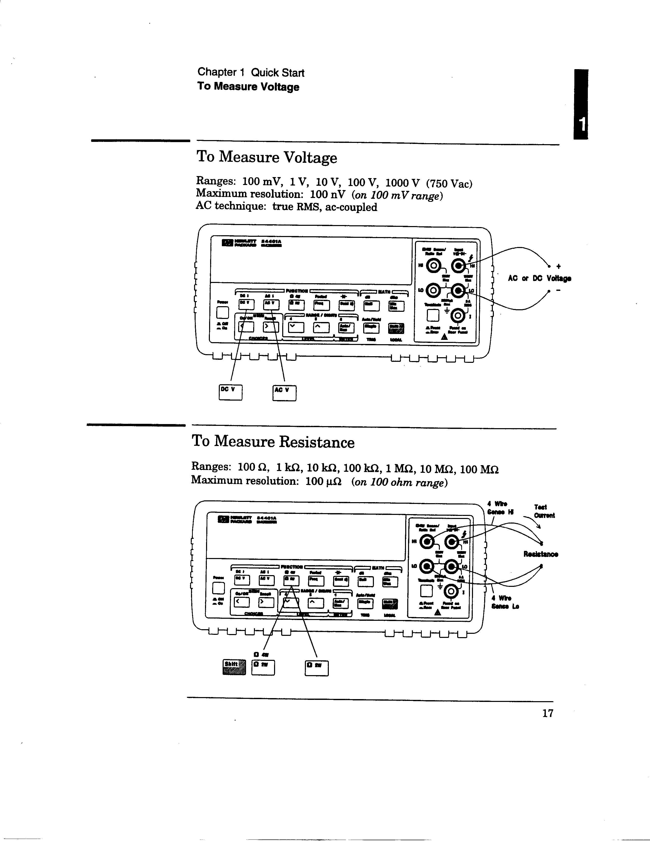
Lab 1 EGR 262 – Fundamental Circuits Lab
6
Agilent 34401 Multimeter
Each workstation has two Agilent multimeters. We will primarily use these meters to measure:
  Voltage
  Current
  Resistance
Note the location of the test leads as well as the buttons that are pushed for each type of measurement (see following pages also).
To measure voltage
Buttons: Press DC V or AC V
Leads: Use the top two connections on the right as shown. Use red and black leads to match the connectors.
Usage: Voltage is always measured in parallel. You can measure voltage without disconnecting any circuit elements.

Slide 7
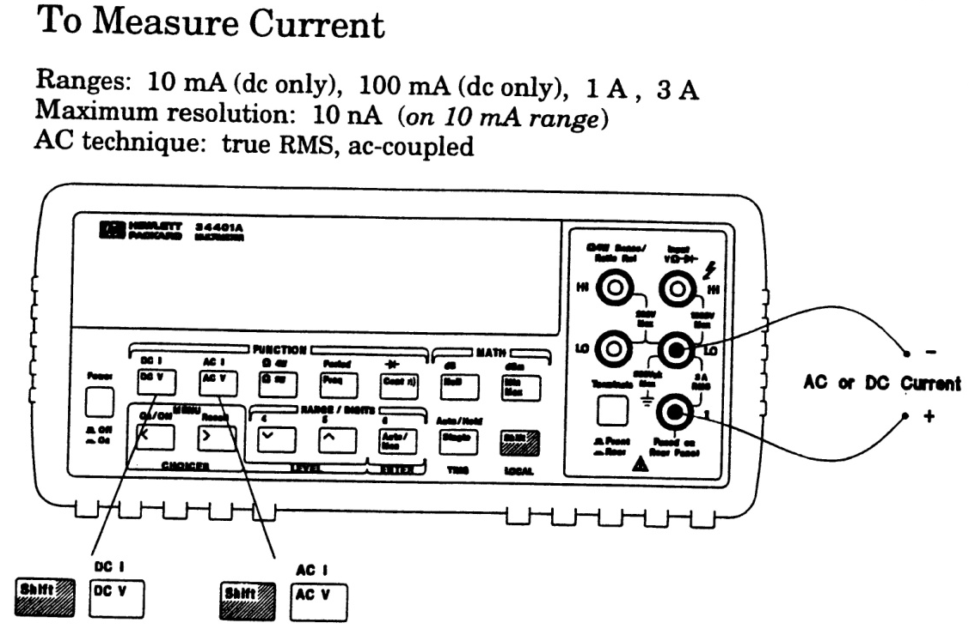
Lab 1 EGR 262 – Fundamental Circuits Lab
7
To measure current
Buttons: Press DC I or AC I
Leads: Use the lower two connections on the right as shown. Use red and black leads to match the connectors.
Usage: Current is always measured in series. You must break a circuit connection in order to insert the meter in series. Current should enter the red (+) terminal for the meter to display the correct sign.
To measure resistance
Buttons: Press Ω 2W or Ω 4W
Leads: top two connections on the right as shown (same as for a voltmeter). Use red and black leads to match the connectors.
Usage: Resistance is always measured in parallel. The circuit must be dead (power off) and the resistance should be disconnected from the circuit.
Note: The two leftmost leads can be omitted in many cases.

Slide 8
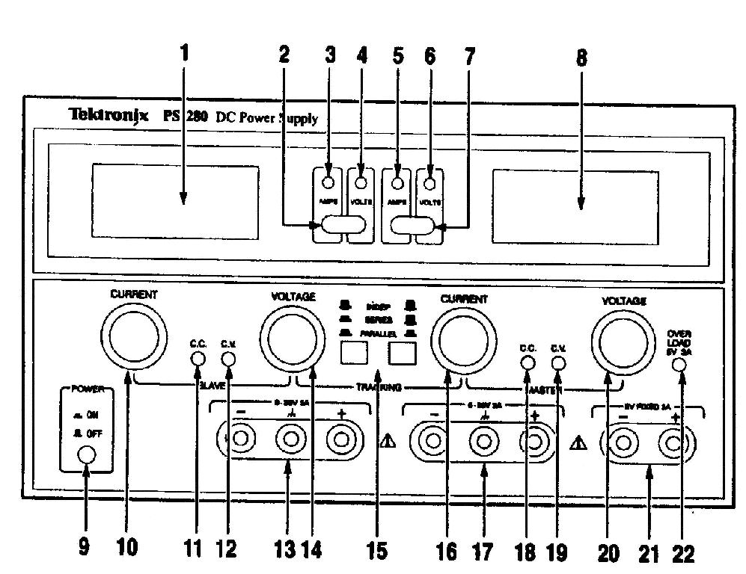
Lab 1 EGR 262 – Fundamental Circuits Lab
8
PS280 DC Power Supply
The DC power supply used in lab has two variable supplies and one fixed 5V supply.
Notes:
The voltage and current displays and adjustment knobs are only used with the variable supplies. The 5V supply has no display or control knobs.
Select CV (constant voltage) for a voltage source. This is commonly used. Also turn the current knob fully CW as this is simply a safety limit to protect the supply.
Select CC (constant current) for a current source. This is rarely used.
0-30V
0-30V
5V

Slide 9
Breadboard

Slide 10
Lab 1 EGR 262 – Fundamental Circuits Lab
10
Example: Connect the following circuit using the SK-10 solderless breadboard.
5.6 kΩ
3.3 kΩ
10 V
+
_
1.0 kΩ
1.5 kΩ
2.2 kΩ
Connections to
10 V power supply
Jumper
+
_
Jumper

Slide 11
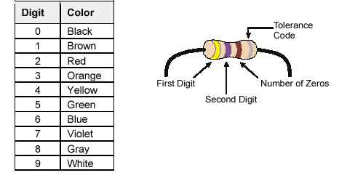
Lab 1 EGR 262 – Fundamental Circuits Lab
11
Resistor Color Code
The resistance of carbon resistors is indicated by colored bands on the resistor. The first three bands (A,B,C) indicate the value of the resistance and the last band (D) indicates the tolerance.
Values for Bands
A, B, and C
A B C D
A = First Digit
B = Second Digit
C = Number of Zeros
D = Tolerance Code
Values for Band D
Gold – 5% tolerance
Silver – 10% tolerance
None – 20% tolerance
R is calculate using:
R = AB x 10^{C}
Examples:
Yellow, Violet, Brown, Silver: R = 47 x 10¹ = 470 Ω, 10% tolerance
Brown, Black, Orange, Gold: R =______________, _______ tolerance
R = 3.9 k Ω, 10% tolerance: Color bands are: ________ ________ ________ ________

Slide 12
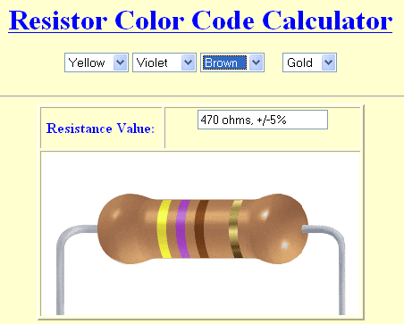
Lab 1 EGR 262 – Fundamental Circuits Lab
12
Online Resistor Color Code Calculators – It is easy to find an online calculator such as the one shown below.
Resistor Color Code – Carbon resistors typically have 4 color bands that indicate their value and tolerance. You can determine the value of resistance and tolerance using the handy online Resistor Color Code Calculator shown to the right. It is available at: www.electrician.com/resist_calc/resist_calc.htm

Slide 13
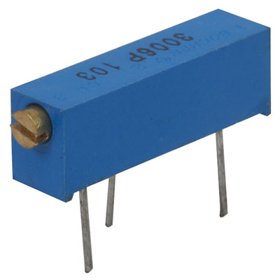
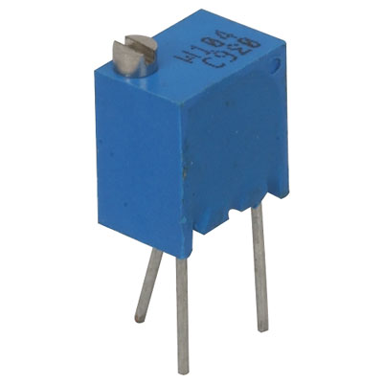
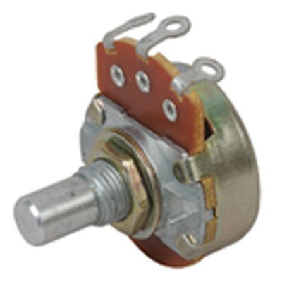
Lab 1 EGR 262 – Fundamental Circuits Lab
13
Potentiometers
Three styles of potentiometers are shown below. The center lead in each style is referred to as the “wiper.” Potentiometers are also sometimes called “pots” or “trim pots.”
turn to adjust
wiper
turn to adjust
wiper
wiper
Potentiometer symbols
turn knob
to adjust
wiper
Note: If a potentiometer is used as an adjustable resistor, use the center lead (wiper) and either side lead.

Slide 14

Lab 1 EGR 262 – Fundamental Circuits Lab
14
Diode
A diode is a semiconductor device that acts somewhat like a voltage controlled switch. The symbol for a diode is shown below. The positive terminal of the diode is called the anode and the negative terminal is the cathode. An ideal diode acts like a closed switch when it has a positive voltage from anode to cathode as shown.
_
+
V
anode
cathode
Diode Symbol
Diode Picture

Slide 15

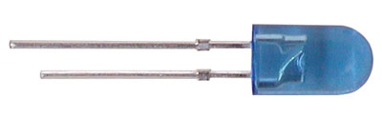
Lab 1 EGR 262 – Fundamental Circuits Lab
15
LED (Light emitting diode)
LED’s are diodes that emit light when they are forward biased (a positive voltage placed across the LED from anode to cathode as in Figures 2A and 2B). The amount of light produced is proportional to the current through the LED
The resistance of an LED is sufficiently low such that if a few volts is placed directly across an LED, it will be destroyed. Therefore, a current-limiting resistor should always be used with an LED. The resistor must be chosen to yield a current such that an appropriate brightness is obtained.
Luminous
destruction
intensity
anode
cathode
+
V
_
anode
cathode
(long)
(short)
Forward-biased LED
I (mA)
Physical appearance
12
20
Typical LED characteristics
Pictures of LEDs

Slide 16
Lab 1 EGR 262 – Fundamental Circuits Lab
16
Adjusting the brightness of an LED
In the circuit shown below, a potentiometer (adjustable resistor) can be varied to control the amount of current through the LED (and thus control its brightness).
Current-limiting R
V
+
LED
_

Slide 17
Lab 1 EGR 262 – Fundamental Circuits Lab
17
Diode Characteristics
Diodes act somewhat like voltage-controlled switches where:
  The switch is closed when a positive voltage is placed across the diode
  The switch is open when a negative voltage is placed across the diode
The characteristics of an ideal diode are shown below:
Ideal Diode Characteristics
I
Forward biased diode
- diode acts like a short
(OV, any current)
V
Reverse biased diode
- diode is an open
(OA, any voltage < 0)

Slide 18
Lab 1 EGR 262 – Fundamental Circuits Lab
18
Actual Diode Characteristics
Actual diodes typically require a small amount of voltage before they act essentially like closed switches (short circuits). Additionally, the relationship between I and V diodes in the forward biased region is exponential and can be described by the Shockley Diode equation.
Actual Diode Characteristics
I
Vo is typically
0.6 – 0.7V for many diodes, but may be higher for an LED
Breakdown
region
V
Vo
Reverse biased
region (open)
Forward biased
region (approx. short)

Slide 19
Lab 1 EGR 262 – Fundamental Circuits Lab
19
Diode Modeling
Diodes models are often used to analyze circuits containing diodes. Diode models will be covered more extensively in later courses, but three diode models are presented below. Which model most closely represents an actual diode’s characteristics?
Model 2: Ideal Diode
and voltage source
Model 3: Ideal Diode, voltage source, resistor
Model 1: Ideal Diode
I
I
I
Slope =
1/Ro
V
V
V
Vo
Vo
+ -
+ -
Ideal
Ideal
Vo
Ideal
Vo
Ro
(Replace the actual diode by a model when analyzing a diode circuit.
Actual

Slide 20
Lab 1 EGR 262 – Fundamental Circuits Lab
20
Analyzing a Diode Circuit
A circuit with a diode can be analyzed by replacing the diode with an appropriate model (if the diode is in the correct region of operation).
For the example below, determine the current through the LED if a model for the LED is used with Vo = 1V and Ro = 100 ohms.
I
500 Ω
+
LED
5V
_
LED model values to be used for Lab #1:
Vo = __________
Ro = __________

Slide 21
Lab 1 EGR 262 – Fundamental Circuits Lab
21
Tables in Lab Reports
Many lab reports will require tables. All tables should be created using good style to create a professional appearance. Good tables should include:
Grid lines
Centered columns
An appropriate number of digits (3 significant digits in most cases and often maintain a certain number of digits after the decimal point)
Column headings with variable name, variable symbol, and units
Sample formulas for any calculations
Example: Poorly formatted table
Example: Nicely formatted table
voltage | current | power
0 | 1.21 | 0.00000000
1.25 | 2.45 | 3.06250000
2.5 | 3.69 | 9.22500000
3.75 | 4.93 | 18.48750000
5 | 6.17 | 30.85000000
6.25 | 7.41 | 46.31250000
7.5 | 8.65 | 64.87500000
8.75 | 9.89 | 86.53750000
10 | 11.13 | 111.30000000
Voltage, V (V) | Current, I (mA) | Power, P (mW)
0.00 | 1.21 | 0.00
1.25 | 2.45 | 3.06
2.50 | 3.69 | 9.23
3.75 | 4.93 | 18.49
5.00 | 6.17 | 30.85
6.25 | 7.41 | 46.31
7.50 | 8.65 | 64.88
8.75 | 9.89 | 86.54
10.00 | 11.13 | 111.30
Sample Calulation:
Cell C4: | =A4*B4

Slide 22
Lab 1 EGR 262 – Fundamental Circuits Lab
22
Graphs in Lab Reports
Many lab reports will require graphs. All graphs should be created using good style to create a professional appearance. Good graphs should include:
Grid lines
Appropriate titles
Correct graph type – typically use x-y scatter graphs in Excel, NOT line graphs
Axes labeled with variable name, variable symbol, and units
Legend for multiple curves
Show points and lines for measured data. Show lines only for theoretical curves.
Example: Poorly formatted graph
Example: Nicely formatted graph
Note that the x-axis values are unscaled. Avoid line graphs!
X-Y scatter graphs are properly scaled.

Slide 23
Lab 1 EGR 262 – Fundamental Circuits Lab
23
Lab Report Format
Each lab report should include:
1) Title Page (Course number , Lab number, Lab title, date, name, partner’s name)
Pre-Lab Tasks (items you should be before coming to lab)
In-Lab Tasks (comments and data recorded during lab)
Post-Lab Tasks (further calculations using lab data, discussions, etc., as specified in the lab guide).
Be sure to do the Pre-Lab Tasks for Lab #1 before our next lab meeting.

