Slide 1
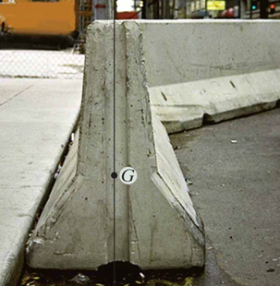
Center of Gravity, Center of Mass, and Centroid of a Body
Chapter 9 Objectives:
Students will:
a) Be familiar with the concepts of center of gravity, center of mass, and centroid.
b) Be able to determine the location of these points for a body.
The center of gravity, G, is important in the design of this concrete wall.

Slide 2
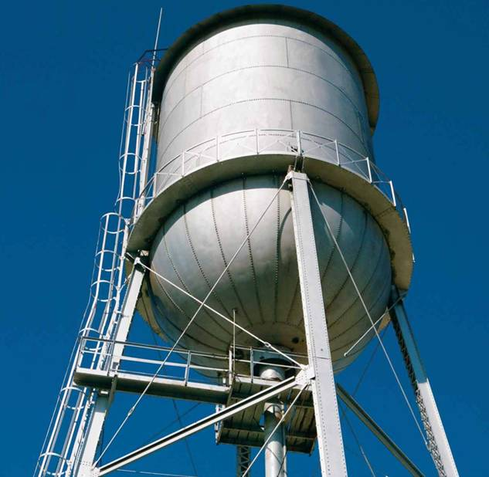
APPLICATIONS
To design the structure for supporting a water tank, we will need to know the weights of the tank and water as well as the locations where the resultant forces representing these distributed loads act.
How can we determine these weights and their locations?

Slide 3
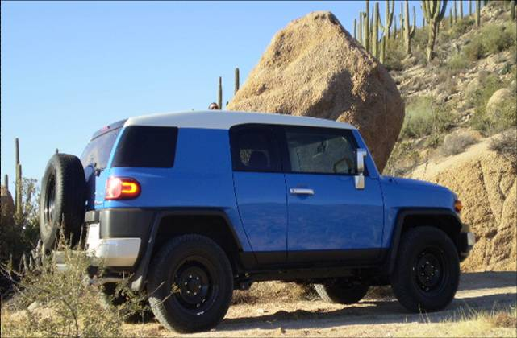
APPLICATIONS (continued)
One concern about a sport utility vehicle (SUV) is that it might tip over while taking a sharp turn.
One of the important factors in determining its stability is the SUV’s center of mass.
Should it be higher or lower to make a SUV more stable?
How do you determine the location of the SUV’s center of mass?

Slide 4
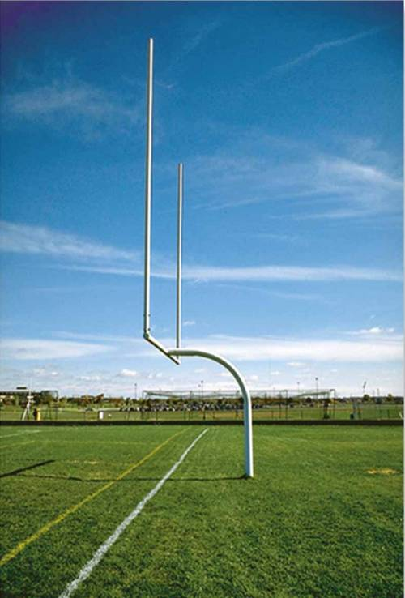
APPLICATIONS (continued)
To design the ground support structure for the goal post, it is critical to find total weight of the structure and the center of gravity location.
Integration must be used to determine total weight of the goal post due to the curvature of the supporting member.
How do you determine the location of its center of gravity?

Slide 5
Center of Gravity and Centroids
The earth exerts a gravitational force on each of the particles forming a body. These forces can be replaced by a single equivalent force equal to the weight of the body and applied at the center of gravity for the body.
If the material is uniform, the center of gravity, G, is equivalent to the centroid, C (the center of the area).
y
y
y
C
C
(x, y )
W
y
x
x
x
x
The weight actually
We show the resultant
acts over the entire
acting at the center of mass.
volume.

Slide 6
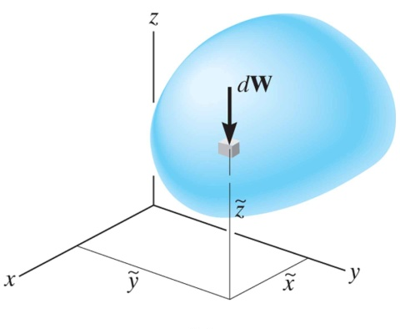
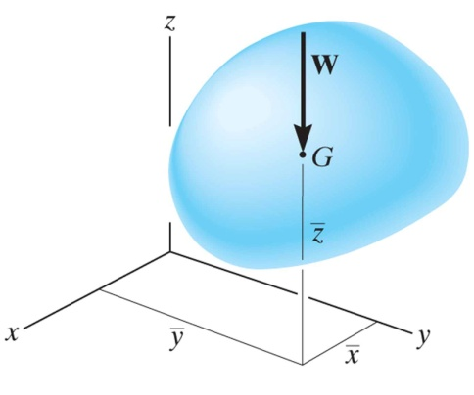
Concept of Center of Gravity, CG
A body is composed of an infinite number of
particles, and so if the body is located within a
gravitational field, then each of these particles will have a weight dW.
The center of gravity (CG) is a point, often shown as G, which locates the resultant weight of a system of particles or a solid body.
From the definition of a resultant force, the sum of moments due to individual particle weight about any point is the same as the moment due to the resultant weight located at G.
Also, note that the sum of moments due to the individual particle’s weights about point G is equal to zero.

Slide 7
Concept of Center of Gravity, CG (continued)
The location of the center of gravity, measured from the y axis, is determined by equating the moment of W about the y axis to the sum of the moments of the weights of the particles about this same axis.
~
~
~
If dW is located at point (x, y, z), then
_
~
x W = ∫ x dW
_
_
~
Similarly,
~
z W = ∫ z dW
y W = ∫ y dW
Therefore, the location of the center of gravity G with respect to the x, y, and z axes becomes

Slide 8
Center of Mass and Centroid of a Body
By replacing the W with a m in these equations, the coordinates of the center of mass can be found.
Similarly, the coordinates of the centroid of volume, area, or length can be obtained by replacing W by V, A, or L, respectively.

Slide 9
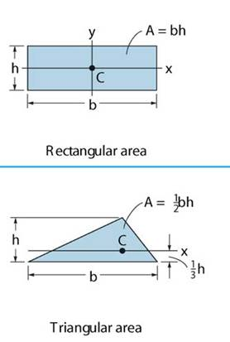
Concept of a Centroid
The centroid, C, is a point which defines the geometric center of an object.
For simple shapes, the centroid, C, can be found by inspection or by using tables of values provided in the text.
The centroid coincides with the center of mass or the center of gravity only if the material of the body is homogenous (density or specific weight is constant throughout the body).

Slide 10
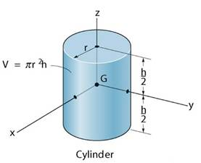
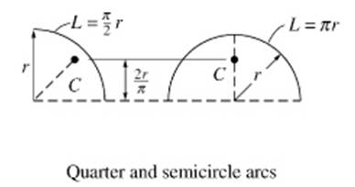
Concept of a Centroid
If an object has an axis of symmetry, then the centroid of object lies on that axis.
In some cases, the centroid is not located on the object.

Slide 11
Methods for Determining the Centroid of an Object
Centroids can be found using three methods:
Composites – If an object can be divided up into relatively simple shapes with known centroids, then the centroid of the entire object can be found using the weighted average of the centroids of the composites.
Integration – If the area, volume, or line of an object can be described by a mathematical equations, then the centroid can be determined through integration.
Solid modeling software – Software such as AutoCAD, Inventor, and SolidWorks can be used to construct 3D models of objects. The software can also determine the centroid of the objects (as well as volumes, moments of inertia and other mass properties). This is not a required element of this course, but an example will be provided.

Slide 12
Steps to determine the centroid by integration
1. Choose an appropriate differential element dA at a general point (x,y). Hint: Generally, if y is easily expressed in terms of x (e.g., y = x² + 1), use a vertical rectangular element. If the converse is true, then use a horizontal rectangular element.
2. Express dA in terms of the differentiating element dx (or dy).
~
~
3. Determine coordinates ( x , y ) of the centroid of the rectangular element in terms of the general point (x,y).
4. Express all the variables and integral limits in the formula using either x or y depending on whether the differential element is in terms of dx or dy, respectively, and integrate.
Note: Similar steps are used for determining the CG or CM. These steps will become clearer by doing a few examples.

Slide 13
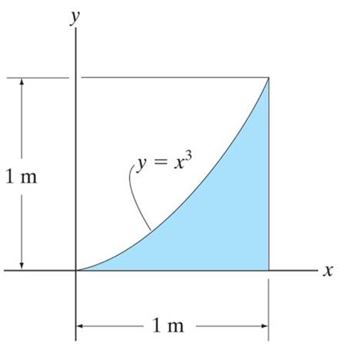
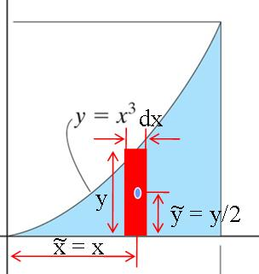
Example: Determining a centroid using integration (Ex F9-2)
Given: The area as shown.
Find: The centroid location (x , y)
Plan: Follow the steps.
Solution
1. Since y is given in terms of x, choose dA as a vertical rectangular strip.
2. dA = y dx = x³ dx
3. x = x and y = y / 2 = x³ / 2
~
~

Slide 14
Example (continued)
~
4. x = ( ∫_{A} x dA ) / ( ∫_{A} dA )
₀∫ x (x³ ) d x 1/5 [ x⁵ ]¹
₀∫ (x³ ) d x 1/4 [ x⁴ ]¹
= ( 1/5) / ( 1/4) = 0.8 m
¹
0
=
=
¹
0
~
¹
∫_{A} y dA ₀ ∫ (x³ / 2) ( x³ ) dx 1/14[x⁷]¹
∫_{A} dA ₀ ∫ x³ dx 1/4
y =
=
=
0
¹
= (1/14) / (1/4) = 0.2857 m

Slide 15
Example (continued)
Repeat the last two integrals using MATLAB:

Slide 16
Example: Determining a centroid using integration
Find the centroid for a general triangle-shaped area with base b and height h using a vertical incremental area. Specifically:
Find the equation of the line along the top of the triangle (y = mx + b).
Find the coordinates (x,y) of the centroid of the incremental area.
Find dA, the area of the incremental strip.
Find x
Compare this result to the one found in the table on the following page.
y
Centroid of incremental
area
Incremental
area (strip)
h
x
b

Slide 17
Centroids of Common 2D Shapes
If an object has a simple shape or can be divided into different parts with simple shapes, the centroid of the entire object can be easily found. The centroids for common shapes are available in the textbook and are shown below.

Slide 18
Centroids of Common 2D Shapes (continued)

Slide 19
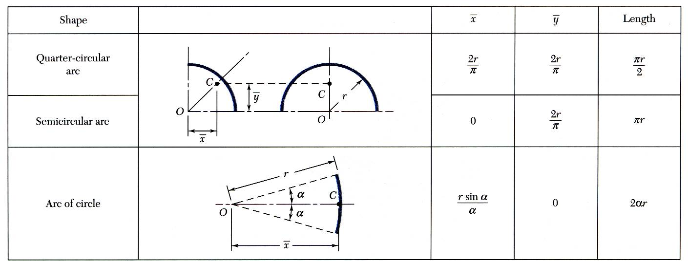
Centroids of Simple Lines

Slide 20
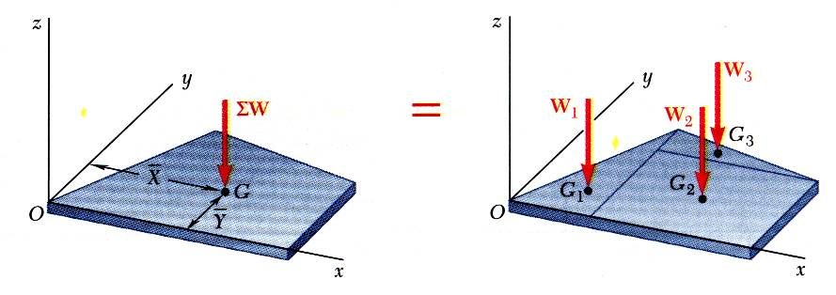
Finding Centroids of Composite Bodies
Centroids can be found by dividing an object into two or more simple shapes.
Find the moment about the x- or y-axis due to the weights yields the following relationships.
Composite plates
Composite area

Slide 21
Finding Centroids of Composite 2D Bodies - Illustration
Example: Find the centroid of the area shown below.
1) Divide the area into common shapes.
2) Find the centroid of each common shape from the table in the back of the text.
3) Find a weighted average of the centroids of the common shapes.
A₂
A₃
A₁
(x₁ , y₁)
(x₂ , y₂)
(x₃ , y₃)

Slide 22
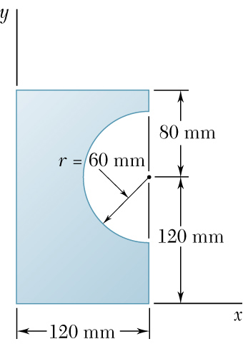
Example: Finding Centroids of Composite 2D Bodies
Locate the centroid of the plane area shown.

Slide 23
Example: Finding Centroids of Composite 2D Bodies
Find the centroid of the object shown below. Can either of the coordinates of the centroid be found by inspection?

Slide 24
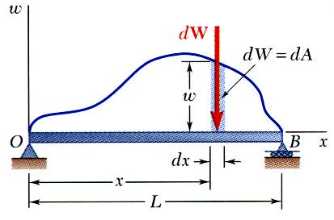
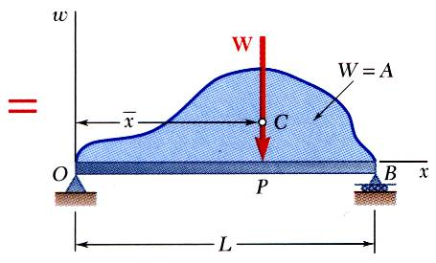
Distributed Loads on Beams
A distributed load is represented by plotting the load per unit length, w (N/m) . The total load is equal to the area under the load curve.
A distributed load can be replace by a concentrated load with a magnitude equal to the area under the load curve and a line of action passing through the area centroid.

Slide 25
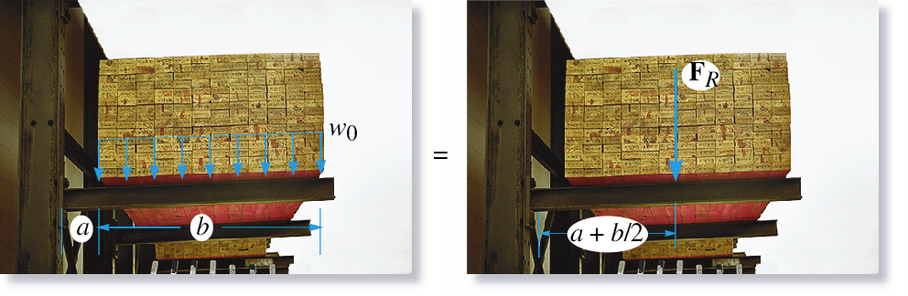
Distributed Loads on Beams
Illustration: The lumber on the rack shown below distributes the weight evenly across the supporting beam. This uniform loading is represented by a load curve with equal length lines. The total weight (resultant) equals the area under the load curve and it acts at the centroid of the load curve.

Slide 26
Distributed Loads on Beams
Example: Replace the distributed load shown below by a single equivalent load.

Slide 27
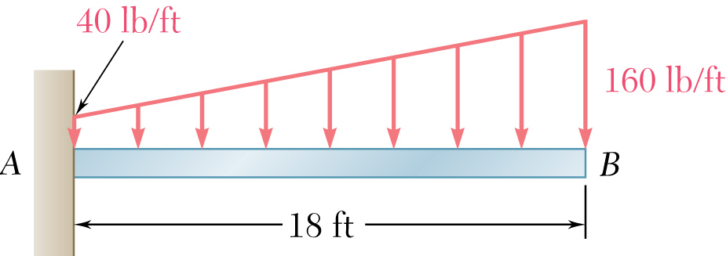
Example: Distributed Load
For the beam and loading shown, determine:
The magnitude and location of the resultant of the distributed load
The reactions at the beam supports.

Slide 28
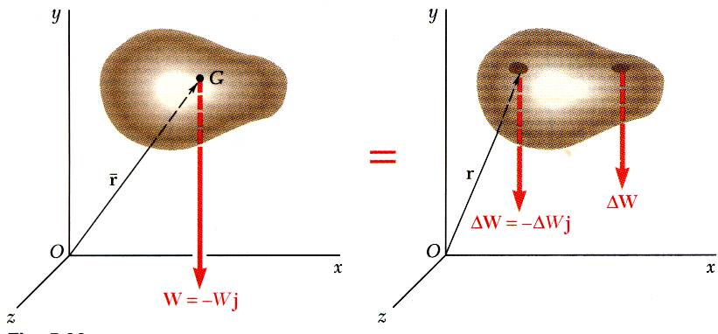
Center of Gravity of a 3D Body
Results are independent of body orientation,
Center of gravity G
For homogeneous bodies,

Slide 29
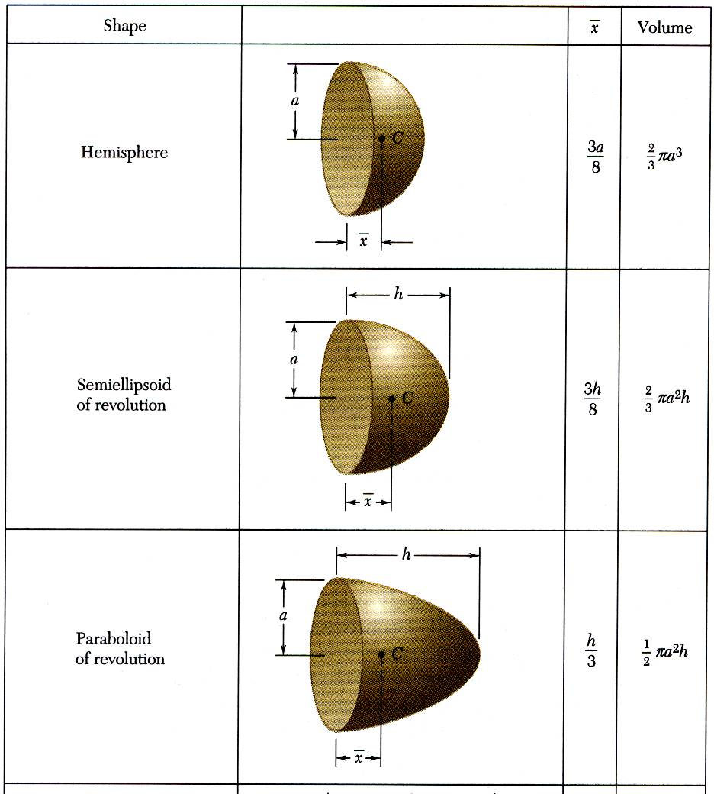
Centroids of Common 3D Shapes

Slide 30
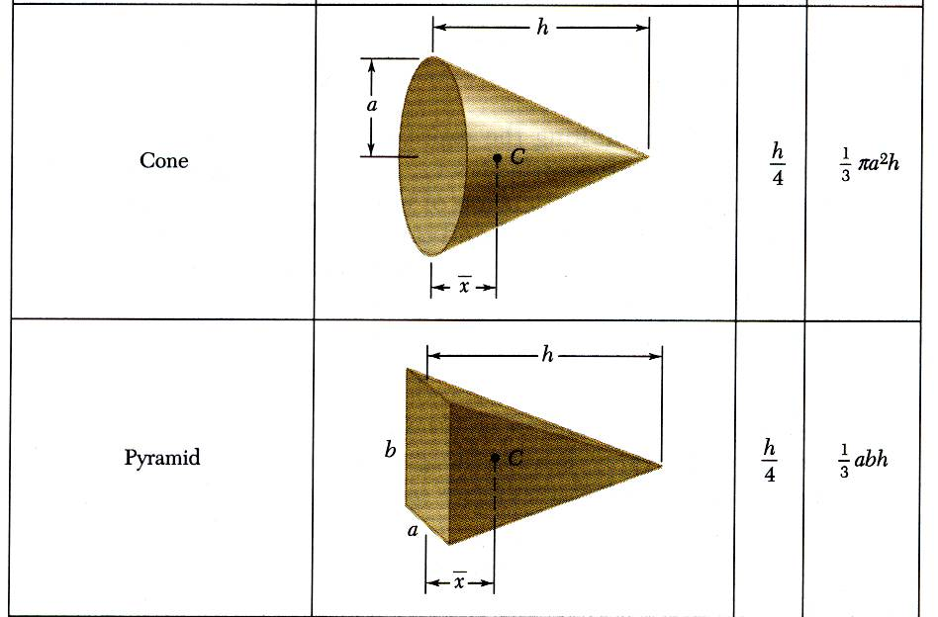
Centroids of Common 3D Shapes (continued)

Slide 31
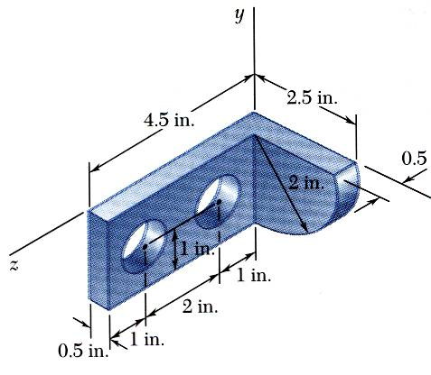
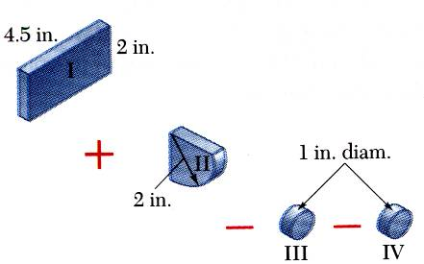
Example: Finding Centroids of Composite 3D Bodies
Moment of the total weight concentrated at the center of gravity G is equal to the sum of the moments of the weights of the component parts.
For homogeneous bodies,

Slide 32
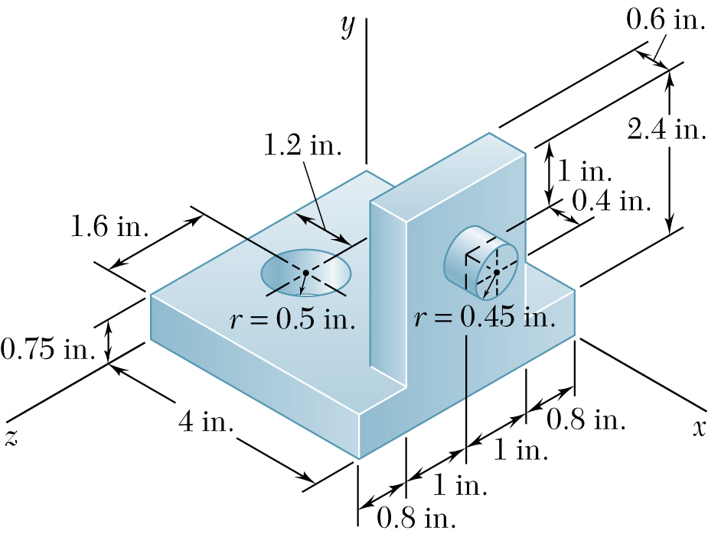
Example: Finding Centroids of Composite 3D Bodies
z
For the machine element shown below, determine the x, y, and z coordinates of the center of gravity.
x
y

Slide 33
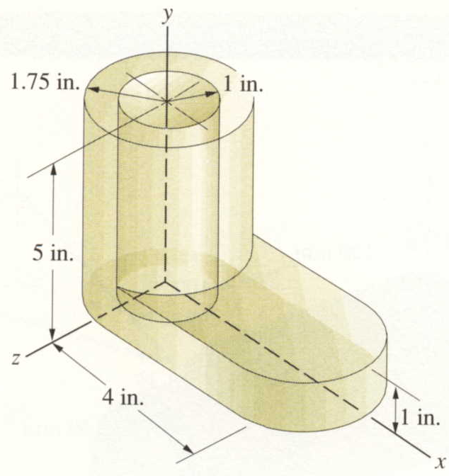
Example: Finding Centroids of Composite 3D Bodies
Locate the centroid of the volume shown below.

Slide 34
Example: Finding Centroids using AutoCAD
Illustrate how to repeat the last problem using AutoCAD. Steps:
1. Construct the solid in AutoCAD. (Use HIDE for correct visibility.)
2. Place the UCS Icon at the desired origin with the correct orientation.
3. Enter the command MASSPROP (printout generated as shown below).
---------------- SOLIDS ----------------
Mass: 46.3977
Volume: 46.3977
Bounding box: X: -1.7500 -- 5.7500
Y: 0.0000 -- 5.0000
Z: -1.7500 -- 1.7500
Centroid: X: 1.0182
Y: 1.8965
Z: 0.0000
Moments of inertia: X: 321.8428
Y: 260.3188
Z: 487.7705
Products of inertia: XY: 23.6211
YZ: 0.0000
ZX: 0.0000
Radii of gyration: X: 2.6337
Y: 2.3687
Z: 3.2423
Principal moments and X-Y-Z directions about centroid:
I: 111.6699 along [0.8361 -0.5486 0.0000]
J: 255.5067 along [0.5486 0.8361 0.0000]
K: 272.7854 along [0.0000 0.0000 1.0000]

Slide 35
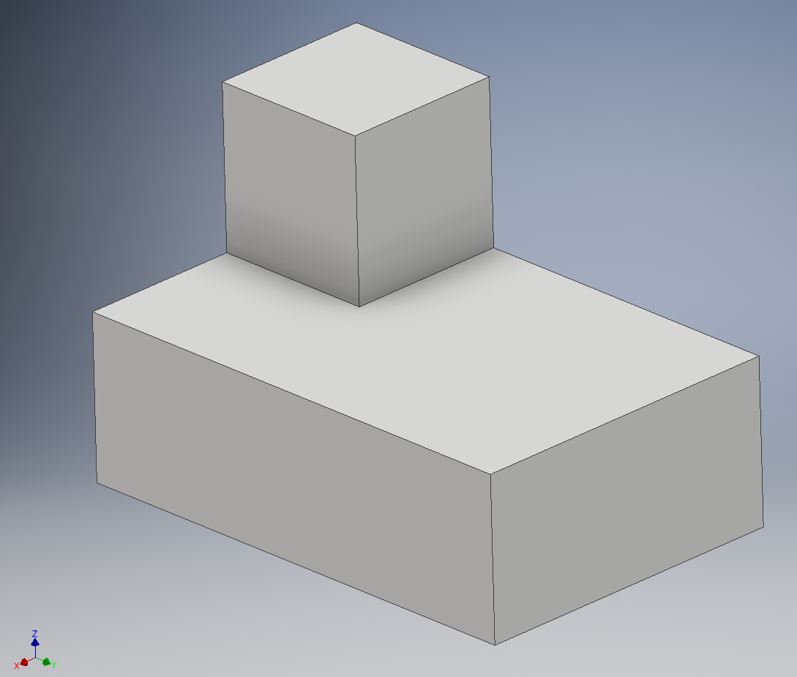
Example: Finding Centroids using Inventor
z
Find the centroid by hand for the object to the right. On the following slide it will be determined using Inventor.
The result should be:
$\overline{x}$ = 1.86, $\overline{y}$ = 2.71, $\overline{z}$ = 1.29
2”
2”
2”
2”
x
y
6”
4”
Shape | $\overline{x}$ (in) | $\overline{y}$ (in) | $\overline{z}$ (in) | V (in³) | $\overline{x}$V (in⁴) | $\overline{y}$V (in⁴) | $\overline{z}$V (in⁴)
Large block
Small block
Total | - - - | - - - | - - -
$\overline{x}$ = $\frac{Σ\overline{x}\text{V}}{Σ\text{V}}= \overline{y}$ = $\frac{Σ\overline{y}\text{V}}{Σ\text{V}}= \overline{z}$ = $\frac{Σ\overline{z}\text{V}}{Σ\text{V}}=$

Slide 36
Example: Finding Centroids using Inventor
Build the model below using Inventor in class if time allows. A small 2 x 2 x 2 block sits on top of a 2 x 4 x 6 block (all in inches) as shown below.
Find the centroid by hand ($\overline{x}$ = 1.86, $\overline{y}$ = 2.71, $\overline{z}$ = 1.29) – see previous slide
Be sure to use the correct axis orientation for the first sketch plane (start with the xy plane for the large block and extrude in the +z direction). Be sure that one corner of the block is located at the origin. Use Orbit to rotate the axes so that they are oriented as indicated in the problem.
Make the YZ, XZ and XY planes visible to emphasize that the part is correctly oriented.
Add a second sketch plane and extrusion.
Right-click on the part name (Part2 below) in the model browser and select iProperties and select the Physical tab. You may need to select Update also.
Important!

Slide 37
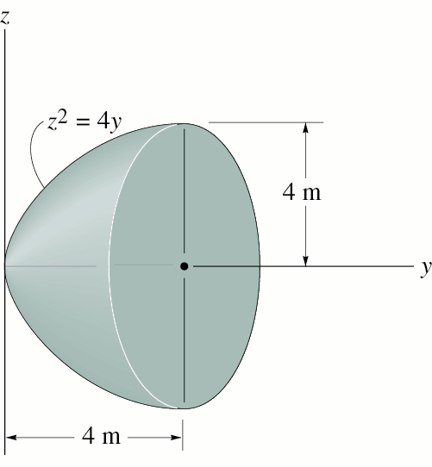
Example: Finding Centroids of Volumes using Integration
Locate the centroid of the paraboloid.

Slide 38
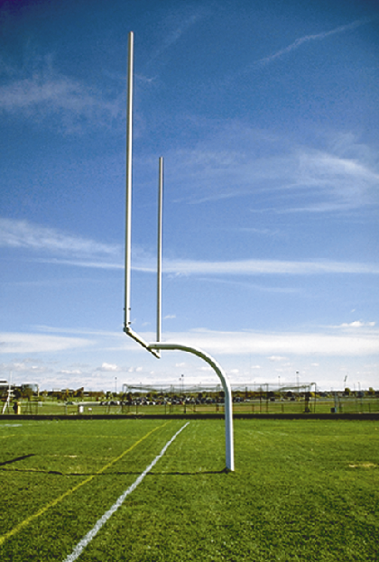
Finding Centroids of Lines
Centroids of Lines
In addition to finding centroids of areas and volumes, it is useful to be able to find the centroid of a line. Examples include a curved bar or a sagging cable where the weight acts at its centroid.
Consider the case of the football goalpost shown to the right. The center of gravity of the lower curved portion of the bar can be found by finding the centroid of the line which follows the path of the bar.

Slide 39
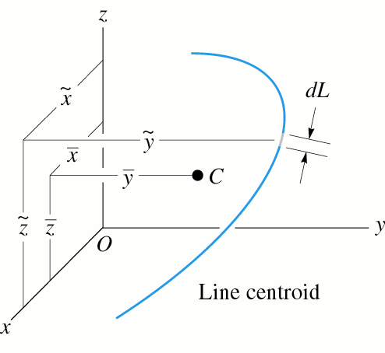
Finding Centroids of Lines
The illustration to the right shows that weight of the curved bar acts at its centroid, C, with coordinates ( x, y, z ). The centroid can be calculated by integration as follows:
Notes:
dL refers to a differential length along the curved bar
dL can be expressed in terms of dx, dy, and dz for purposes of performing the integration (see next page)
in the formula above refer to the coordinates of the incremental length
the limit L means that the integration is performed over the entire length of the line

Slide 40
Finding Centroids of Lines (continued)
Expressing dL in terms of dx and dy (2D problem).
y
Expand the circled area
dL
dy
dL
dx
x

Slide 41
Example: Finding the Centroid of a Line
Example: Determine the x-component of the centroid of the sagging cable which is used to temporarily support a wall during construction. (Where would the centroid be if the cable was taut?)
y
y = 1.25x²
20 ft
x

Slide 42
Determining Center of Mass or Center of Gravity
Centers of Mass for objects composed of different materials
For objects composed of uniform materials the centroid is equal to the center of mass. If an object is composed of different materials, the centroid may be different than the center of mass.
C = G
Case 1: Object composed of uniform material
The centroid and the center of gravity are the same.
G
C
(wood)
(steel)
Case 2: Object composed of two materials
The centroid is the same as in Case 1, but the center of gravity shifts to the right.

Slide 43
Determining Center of Mass or Center of Gravity
The difference between calculating the centroid using volume, mass, or weight is simply a scale factor, since mass and weight are proportional to volume as indicated below.
ρ (Greek letter rho) = mass density (typically expressed in kg/m³ or slug/ft³)
m = ρV
γ (Greek letter gamma) = weight density or specific weight (typically in N/m³ or lb/ft³)
W = mg = ρgV = γV
the centroids for mass and weight can be found as follows:

Slide 44
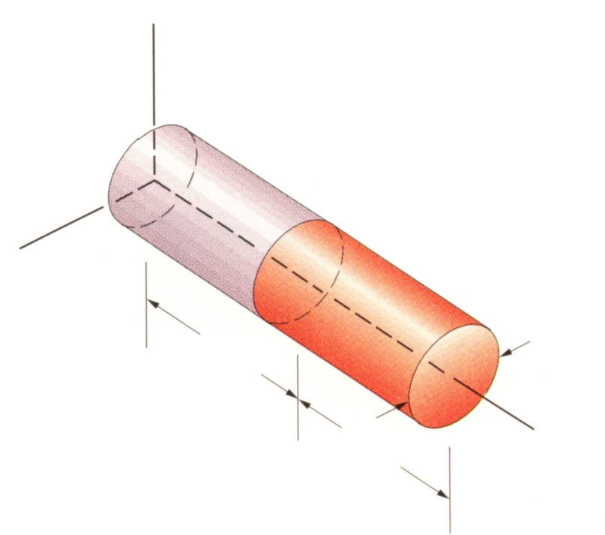
Example: Determining Center of Mass or Center of Gravity
The cylinder shown below is made up of steel and bronze. If γ = 0.284 lb/in³ for steel and γ = 0.318 lb/in³ for bronze, find the center of gravity of the rod. Also determine the total mass of the object in slugs and the total weight of the object in lb.
y
Steel
Bronze
z
2.5 in
8 in
8 in
x

Slide 45
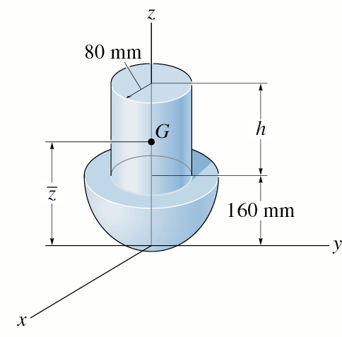
Example: Determining Center of Mass or Center of Gravity
The assembly is made from a steel hemisphere, ρ_{st} = 7.80 Mg/m³, and an aluminum cylinder, ρ _{Al} = 2.70 Mg/m³. Determine the mass center of the assembly if the height of the cylinder is h = 200 mm.
Also determine the total mass of the object in kg and the total weight of the object in N.

