Slide 1
Get Started
with Pearson’s MyProgrammingLab
Notes:
Note to presenter: This entire Getting Started presentation is designed to be delivered in under 15 minutes.
Thank you for the opportunity to tell you more about the Pearson digital solution that your Educator has selected for this course.
1

Slide 2
The TRUTH is in the numbers… https://www.youtube.com/watch?feature=player_embedded&v=OjRUOpRkKP0
Notes:
Note to presenter: If you have internet connection, then show the Truth in Numbers video: http://www.youtube.com/watch?feature=player_embedded&v=OjRUOpRkKP0. Otherwise, just keep the slide up on the screen and discuss the highlights:
4,500 students participated in a recent Pearson MyLab and Mastering survey. 88% say it helps them understand the subject matter and 84% say they feel they are more prepared for exams. 85% say they would recommend their instructor continue to use the program.
It is important to your educator that you have the practice and support needed to learn the material and pass this course and that’s what MyProgrammingLab is intended to do.

Slide 3
You Need:
You Need:
Course ID:
Example: TIDCC-BEA-9765-0
Notes:
Note to presenter: This slide is 100% consistent with all Pearson web portals and should not be adjusted.
If you haven’t already purchased your course materials you will need to do so today. To get started with Pearson MyProgrammingLab you will need a valid email address. It should be an email you have easy access to as you may receive important communication from your course instructor at this address. You also need the Course ID for the MyProgrammingLab course your instructor has assigned for the semester and the Course ID you will use to get started is _______. Please make note of this Course ID. You also need to have purchased access to MyProgrammingLab and you do this by purchasing an Access Code or buying instance access – let me explain this options in more detail.

Slide 4
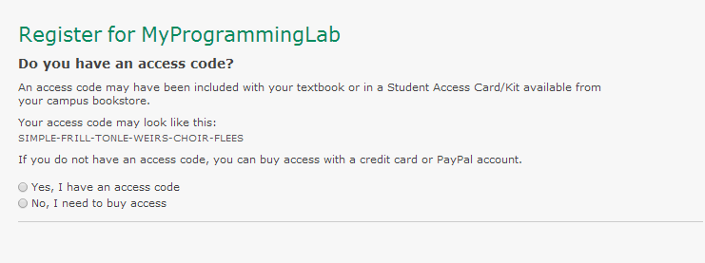
Click On Student REGISTER

Slide 5
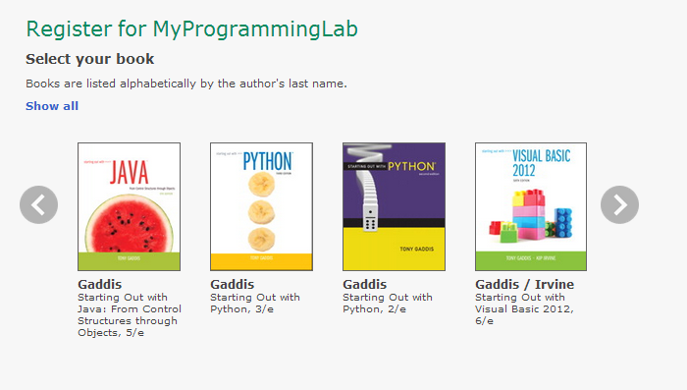
Direct Purchasing:

Slide 6
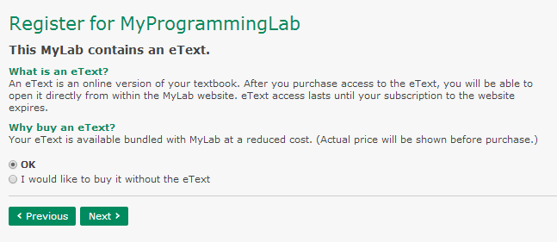
Direct Purchasing:

Slide 7
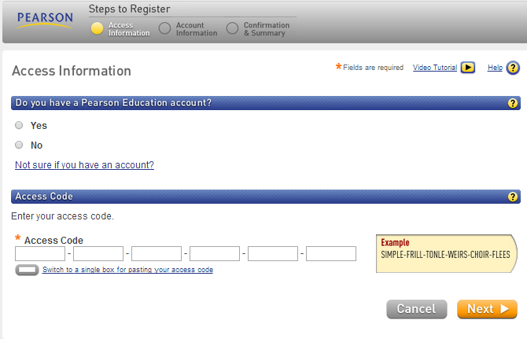
Redeeming Access Code

Slide 8
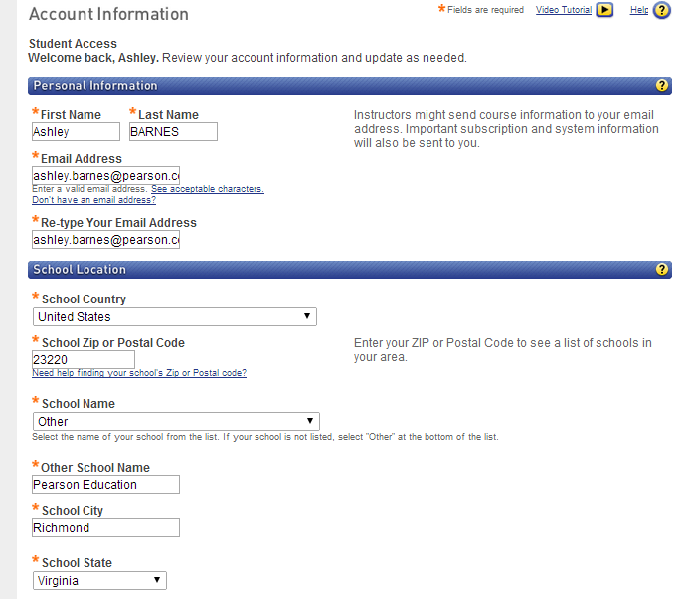
Account Information

Slide 9
Once you Login: COURSE ID

Slide 10
Need help?
Visit www.MyProgrammingLab.com and click the “Student” button under “Register Now” for:
Helpful videos
Frequently Asked Questions
System Requirements
Other helpful “getting started” info!
Or visit our 24/7 Technical Support site at http://247pearsoned.custhelp.com.
Send us a Tweet at @PearsonSupport
Notes:
Here are a few helpful resources to help you get started with Pearson MyProgrammingLab.
You’ll notice these on the flyer that accompanies this presentation.

Slide 11
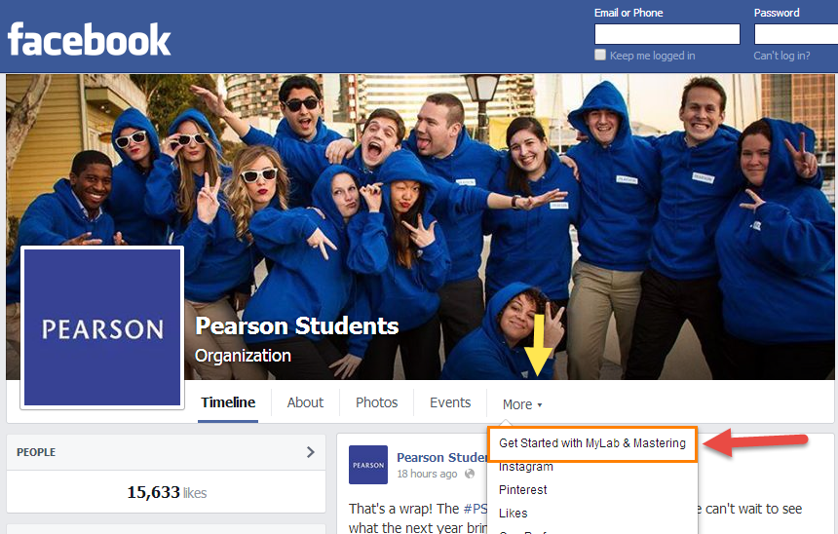
/PearsonStudents
Notes:
There are some add’l steps and tips to getting started and we encourage you to “like” the Pearson Students Facebook page at www.facebook.com/PearsonStudents. If you have a Smartphone with the Facebook app installed, then let’s take a minute so you can like the page now.
Once at our Facebook page you’ll notice a section dedicated to Getting Started – here’s where you will find resources to help you get up and running with Pearson MyProgrammingLab quickly and easily.

Slide 12
Notes:
Click on “Get Going” to watch a 3-part video series for Pearson MyProgrammingLab that takes less than 10 minutes to watch start-to-finish. These videos were created by a student who interned for us, Jonathan, and he worked really hard to ensure the videos would help you get up and running very quickly.
If you have any difficulties during the registration process, then there is a link right here on our Facebook page to “Get Help” and that will help you to connect with a 24/7 Support agent who can assist you. We also encourage you to view the “Get Assured” section where we’ve pinned advice and tips from real students who have successfully used a Pearson digital solution in their course.

Slide 13
Notes:
You are now ready to purchase access and get started with Pearson’s MyProgrammingLab! Thank you and Best wishes for the semester.
13

