Slide 1
Chapters 4: Mathematical Functions, Characters, and Strings
The following topics will be covered in this chapter:
Math functions
Characters
Strings
Formatted input/output using the iomanip library
Notes:
Slides 1-6 are primarily review as we covered functions earlier.
We will not cover section 4.11 (an introduction to data files.) We will cover data files extensively in Ch. 13.

Slide 2
Math Functions
Need cmath or cstlib headers
#include <cmath> or #include <cstlib>
Note what type and form parameters take
Trig functions use radians not degrees
The table to the right lists some math library functions
Note that
so this is implemented in C++ as
y = pow(x,1.0/3.0);

Slide 3
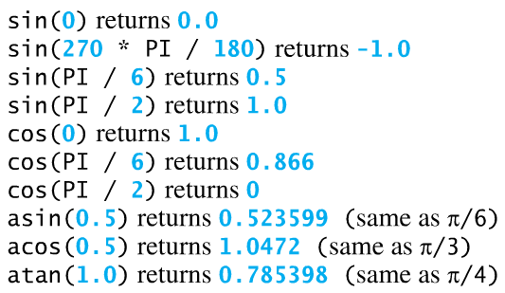
Trigonometric Functions
All trigonometric functions in cmath using radians.
The argument for sin, cos, and tan is an angle in radians.
The return value for asin, acos, and atan is an angle in radians between –π/2 and + π /2.
Recall that 90° = π/2 radians, 180° = π radians, etc.
To convert from radians to degrees, multiply by 180/π.
To convert from degrees to radians, multiply by π/180.
Textbook Examples: Assume that PI has already been defined as:
const double PI = 3.14159;

Slide 4
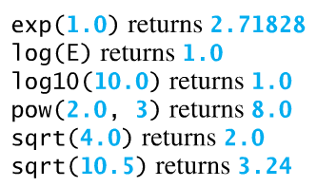
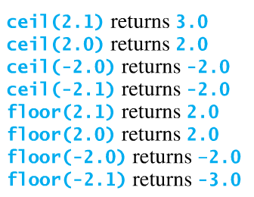
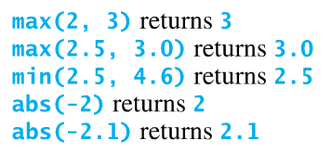
Additional Textbook Examples: Assume that E has been defined below as:
const double E = 2.71828;

Slide 5
Math Functions
Example using functions from cmath:
Sample Program Output:
This program will calculate the area of a circle
Enter the radius of the circle: 20
The area of the circle is 1256.64
Press any key to continue . . .

Slide 6
Math Functions
Example: Write C++ expressions corresponding to each of the mathematical expressions below.

Slide 7
Characters
Characters (type char) were already discussed in Chapter 2, but a few more details are introduced here.
The char data type is used to represent a single character.
Character literals are in single quotes. Strings are in double quotes.
Character values are actually stored as integers based on the ASCII code (see following slide).
The following two assignments are equivalent:
‘A’ is a character
“A” is a string
char letter = ‘A’;
char letter = 65; // ASCII value for uppercase A

Slide 8
ASCII Code Notes: Uppercase letters: 65 - 90 Lowercase letters: 97 - 122 Digits (0 - 9): 48 - 57 ‘a’ – ‘A’ = 32 ‘b’ – ‘B’ = 32 … ‘z’ – ‘Z’ = 32

Slide 9
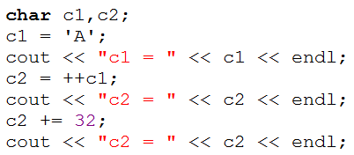
Characters
All numeric operators, including the increment and decrement operators, as well as the shortcut operators, work with characters.
Example: Determine the output for the code below:
c1 = _______
c2 = _______
c2 = _______
\’ Single Quote 39
\? Question Mark 63
\v Vertical Tab 11

Slide 10
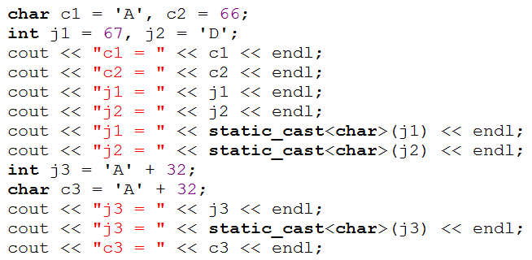
Characters
Character variables may be assigned character values or integer values, but they are displayed as characters.
Integer variables may be assigned character values or integer values, but they are displayed as integers.
To display integer variables as characters use: static_cast<char>(variable)
To display character variables as integers use: static_cast<int>(variable)
Example: Determine the output for the code below:
c1 = _______
c2 = _______
j1 = _______
j2 = _______
j1 = _______
j2 = _______
j3 = _______
j3 = _______
c3 = _______

Slide 11
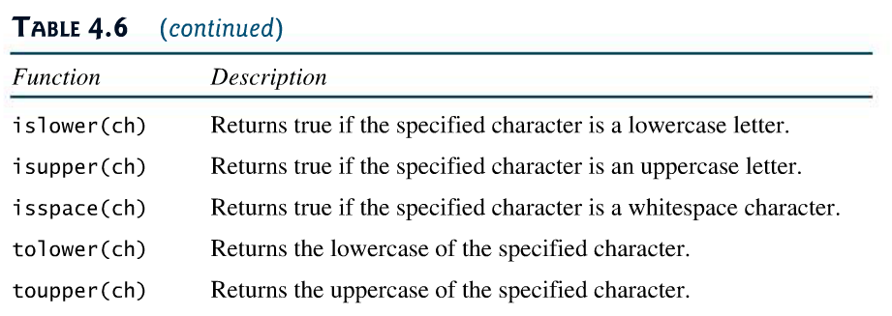
Character Functions
The following functions are available with the <cctype> header file.
isdigit(ch) Returns true if the specified character is a digit (0-9)
isalpha(ch) Returns true if the specified value is an alphabetic
character (upper or lower case letter)

Slide 12
Text Example

Slide 13
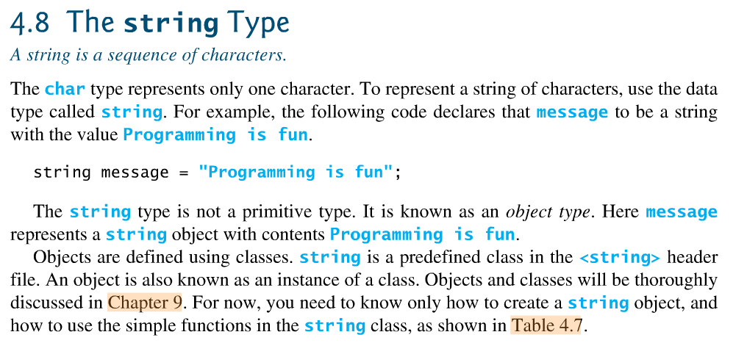
The string Type
We have introduced several primitive types, including int, float, double, and char. The char type is used to represent only a single character.
To represent multiple characters, we can use the data type called a string. It is not a primitive type, but is an object type and objects are defined using classes.
We will learn more about classes and object-oriented programming soon, but for now we can easily use the string class. Using strings is somewhat like using other types, but since they are objects, they may have their own operators and have associated member functions. These functions are used with dot notation:
Form: objectname.memberfunction(arguments)
Note: Additional information on strings will be presented in Chapter 10.
Notes:
13

Slide 14
Example: Using the string class
#include <iostream>
#include <string> // string class
using namespace std;
int main()
{
int J, N; // declare variables of type int
string Name; // declare an object using class string
J = 2;
Name = “John Doe"; // string values are in double quotes
N = Name.length(); // use member function to find length
cout << “Length of string = " << N << " characters ";
Notes:
14

Slide 15
Declaring strings
Similar to declaring variables for types (such as double X;)
Same rules for identifier names as with other variables
Form: string StringName;
Example:
string College, Semester, Course, Last_Name;
string x,y,z;
Initializing strings
Can be initialized in two ways:
Using the = operator (when the string is declared or later)
Putting the string value in parentheses when the string is declared.
In either case, the string value is place in double quotes.
Example:
string College = “TCC”; // declare and initialize
string Last_Name (“Doe”); // declare and initialize
string Course; // declare
Course = “EGR 125”; // initialize
Notes:
15

Slide 16
Operators
C++ has overloaded some of the arithmetic and relational operators to work with string objects.
Concatenation (+, +=)
The + operator is used for concatenation, or to join two strings.
Similarly, += can be used to add a string on to the end of another string.
Example:
string Prefix = “EGR”, Number = “125”;
string Course, Suffix = “-N02B”;
Course = Prefix + Number; // concatenation
cout << Course << endl; // Output: EGR125
Course += Suffix; // concatenation
cout << Course << endl; // Output: EGR125-N02B
Notes:
16

Slide 17
String functions
String indices
A string of length N has indices from 0 to N-1.
They can be accessed using the .at() function.
message.length() is 14
Notes:
17

Slide 18
Character access using [ ]
Individual characters can also be accessed using brackets.
The first element in string S1 is S1[0].
S1.at(k) is equivalent to S1[k];
The last element in string S1 is S1[S1.length() -1].
Example:
string Topic = “Programming”;
int N = Topic.length( );
cout << N << endl; // What is the output? _____
cout << Topic[0] << endl; // What is the output? _____
cout << Topic[3] << endl; // What is the output? _____
cout << Topic.at(3) << endl; // What is the output? _____
cout << Topic[N-1] << endl; // What is the output? _____
18
Notes:
18
18

Slide 19
Comparing Strings
Relational operators (>, >=, etc) are used to compare two strings
Strings are compared based on:
ASCII value – refer to the table of ASCII Codes for single characters
Lexicographically – basically refers to the ordering that might be used in a dictionary. A word that would occur earlier in the dictionary is less than a word that occurs later in the dictionary. Example: “Williams” < “Williamson”
Notes:
19

Slide 20
ASCII Codes
Notes:
20

Slide 21
Comparing Strings - Examples
Examples: Circle True or False for each expression below:
“A” < “B” True False
“A” < “a” True False
“A” < “AA” True False
“John” < “John Doe” True False
“1” < “2” True False
“123” < “1111” True False
“A” < “1” True False
“Z” == 90 True False
Notes:
21

Slide 22
Using cin to read string inputs
cin reads the input until the first white space is encountered.
cin in works well for reading one word at a time.
cin does not work for reading entire sentences (or lines in a file).
If a keyboard input has spaces, only the portion up to the first white space is read and the remainder of the input is left in the input buffer, where it may be used by the next input.
Example:
string Course;
cout << “Enter course: ”;
cin >> Course; //If the user enters Intro to Engineering
// then Course = “Intro” and the remaining
// characters are still in the buffer.
Example: See next slide
22
Notes:
22
22

Slide 23
Case 1: Mary Smith enters her name (works correctly)
Error. Mary read as first name and Ann is left in the buffer. Ann is then automatically used for the last name.
Case 2: Mary Ann Smith enters her name
23
Notes:
23
23

Slide 24
Using getline to read string inputs
Getline is a function in <string> that can be used to read single or multiple lines from the keyboard or from a file.
Form: getline (InputObject, String, ‘Terminator’)
Where
InputObject = cin (other options later in the course)
String = name of the input string
Terminator – continue reading inputs until this terminator is encountered (the Terminator is not included in String). The default Terminator is ‘\n’.
Examples:
getline(cin, S1); // read one line from the keyboard
// into string S1
getline(cin, S1, ‘\n’); // same as line above
getline(cin, S2, ‘*’); // read characters until an asterisk (*)
// is encountered.
getline(cin, Full_Name); // read full name from keyboard
// (one line)
24
Notes:
24
24

Slide 25
Using ignore with getline
If a number (int, double, etc.) is read using cin, there may still be a newline character (‘\n’) in the input buffer. This may cause problems if getline is used directly after reading a number as getline may stop after reading the newline character.
One way to avoid this problem is to use the function ignore.
Form: ignore(NumberOfCharacters, ‘Terminator’)
Typical usage: cin.ignore(NumberOfCharacters, ‘Terminator’)
where
NumberOfCharacters = max number of characters to ignore before encountering terminator
Terminator = Final character to ignore
Example:
cin.ignore(100,’\n’); // ignore up to 100 characters from the
// keyboard and stop after first ‘\n’ encountered
Key Point: Use cin.ignore( ) when you read inputs using cin and then you switch to reading inputs using getline.
Notes:
25
25

Slide 26
Class example
Try the following example in class:
Define strings for first, middle, and last name.
Prompt the user to enter the names separately and read them using cin.
Define a string for full name
Form the full name in the form Last, First MiddleInitial. using concatenation.
Define another string for full name (Full_Name2, perhaps).
Prompt the user to enter their full name (First Middle Last) and read it using getline( ).
Recall that when getline( ) is used after using cin, there is an extra \n left in the buffer. cin.ignore(100,’\n’) can be used to ignore it.
Find the length of each full name.
Display the initials.
Display all strings.
26
Notes:
26
26

Slide 27
Formatting Output
Output values are formatted in C++ by inserting I/O manipulators into cout statements for printing
Example: cout << setprecision(6) << x << y;
Usually affects all outputs from that point on (no need to include in every cout statement), but might be compiler dependent.
We must include the header iomanip as follows: #include <iomanip>
Basic form: cout << manipulator(parameter);
The table below lists several common I/O manipulators:
I/O Manipulator

Slide 28
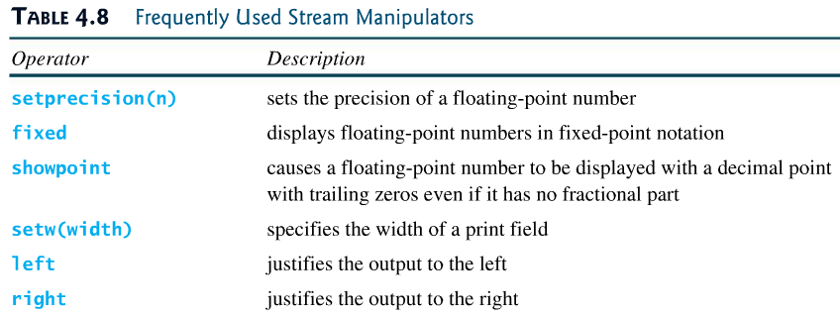
I/O Manipulators
Another useful I/O manipulator is scientific.
Fixed is used for fixed-point notation.
Scientific is used for scientific notation.
Different formats are sometimes used. The following two lines are equivalent:
cout << left << x << endl;
cout << setiosflags(ios::left) << x << endl;

Slide 29
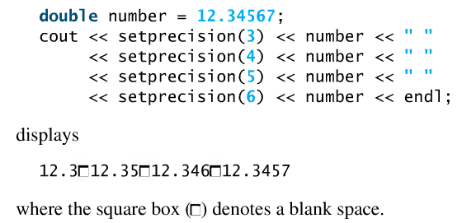
setprecision(N)
Uses N significant digits unless fixed or scientific is also used.
Uses N digits after the dp if fixed or scientific are used
Will not include trailing zeros unless showpoint is used
Note that the numbers are rounded off, not truncated.
Example:

Slide 30
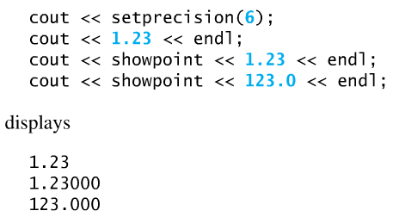
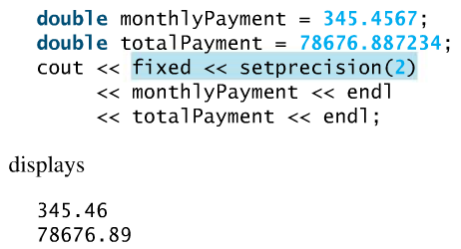
I/O Manipulators – Additional examples

Slide 31
How many digits?
If setprecision(N) is used, N may mean the number of significant digits or it may mean the number of digits after the decimal point.
If fixed or scientific are NOT specified
setprecision(N) means
N significant digits
If fixed or scientific are specified
setprecision(N) means
N digits after the decimal point
Example:

Slide 32
Default to scientific notation
Even if scientific is not specified, scientific notation will be used if enough digits are not specified by setprecision(N) to properly display the number.
If setprecision(N) is used without also using fixed or scientific
Scientific notation is used if the number is > 10^{N}
For example, if setprecision(3) is used (without using fixed or scientific), then the largest number that can be displayed without scientific notation is 999.
(How could you display 1000 with only 3 digits?
It would have to be displayed in scientific notation as 1.00E+03)

Slide 33
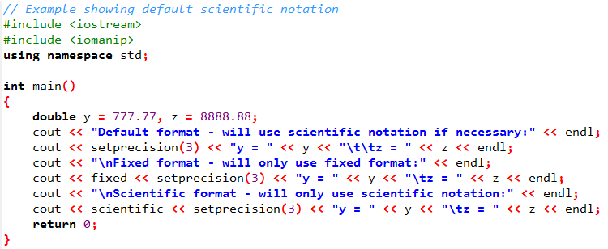
Example - Default to scientific notation

Slide 34
setw( )
Sets field width
Right justifies contents
C++ automatically expands if width too small
Useful for tables where fixed widths are needed
Only applied to the next item displayed (other IO manipulators are applied to all items displayed until they are changed)
Example:
int num = 5;
cout<<“number =“<<setw(7)<<num<<endl;
Output:
number = 5
*******
Field size

Slide 35
setfill( )
Using setw( ) may result in blank spaces before a number (with right justification) or after (with left justification). setfill( ) can be used to specify that other characters be used instead of blanks.
Form: setfill(‘c’) , where c is the character to be displayed
Example: setfill(‘*’) – display asterisks (*) instead of blank spaces
Example: setfill(‘0’) – useful for displaying leading 0’s with integers
Example:
double Cost = 5;
cout << right << fixed << setprecision(2);
Cout << “$“ << setw(8) << Cost << endl;
Cout << “$“ << setw(8) << setfill(‘*’) << Cost << endl;
Output:
$ 5.00
$****5.00

Slide 36
Class example
Try the following example in class:
Write a program to calculate the area and perimeter of a right triangle once the user enters the base and height.
Display the results using a variety of I/O manipulators, including:
setprecision( )
fixed
scientific
showpoint
setw( )
right
left
setfill( )
36
Notes:
36
36

Slide 37
37
Class example
Nicely formatted tables can be created using io manipulators.
Write a program that prompts the user to enter 3 values of radius and then displays a table with radius, surface area, and volume.
Required formatting:
Use the following heading:
radius(m) surface area(m^2) volume(m^3)
*****************************************
Column 1: 9 characters wide, 1 digit after the dp
Column 2: 19 characters wide, 2 digits after the dp
Column 3: 13 characters wide, 2 digits after the dp
Use a fixed format with right justification
Sample output:
Hint: If you paste your table into Word, the formatting may be wrong if a true type font is used. Try using Courier New.
width = 9
width = 19
width = 13
Notes:
37
37

