Slide 1
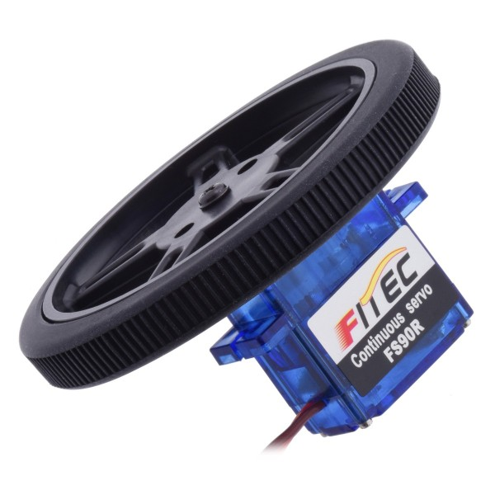
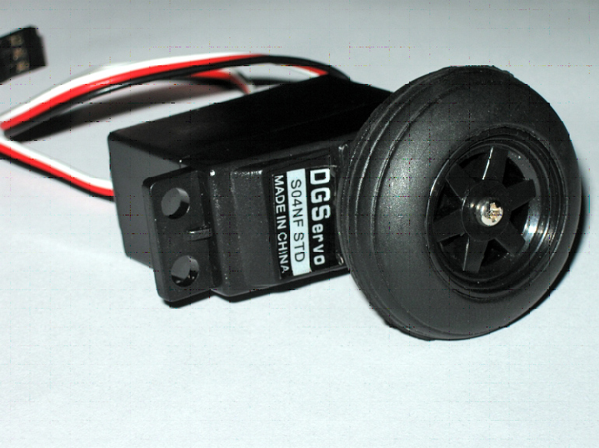
Servos – Used as drive wheels
http://www.hackthecar.com/nl/wheels/1053-pololu-wheel-for-feetech-fs90r-micro-servo-608mm-pair-black-3700386728198.html
http://yourduino.com/sunshop2/index.php?l=product_detail&p=251

Slide 2
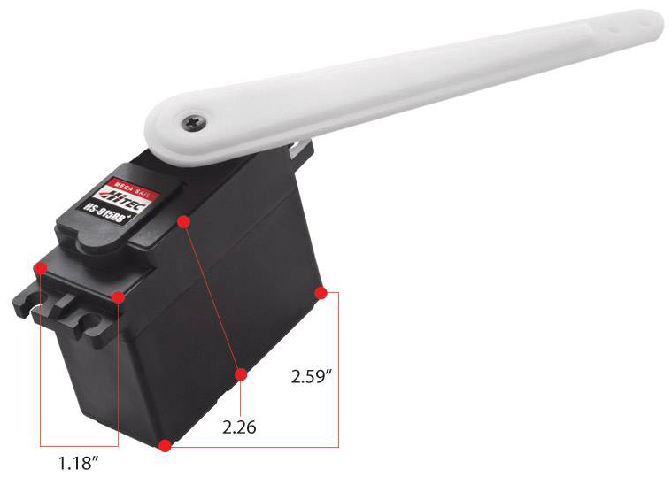
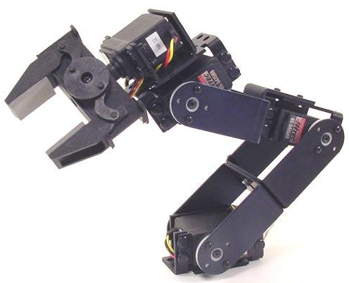
Servos – Used to move robot arms or grippers
http://www.robotshop.com/en/hs-815bb-sail-arm-servo-motor.html
http://www.robotshop.com/media/files/Images/rblyn81(arm).jpg

Slide 3
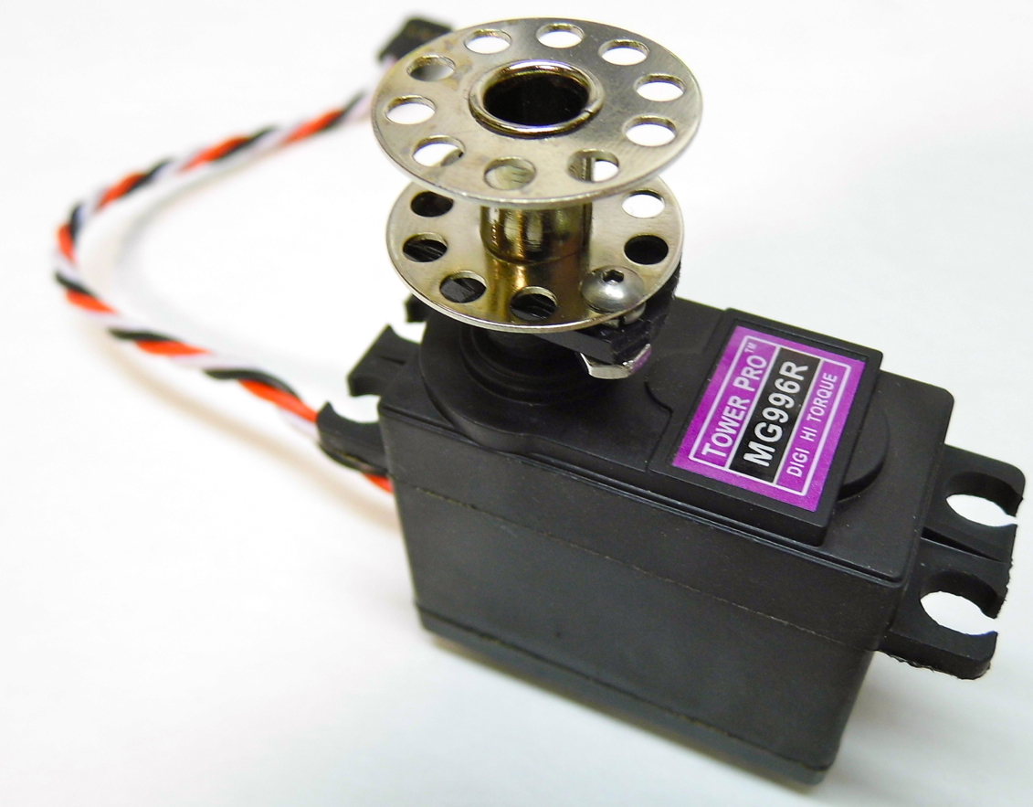
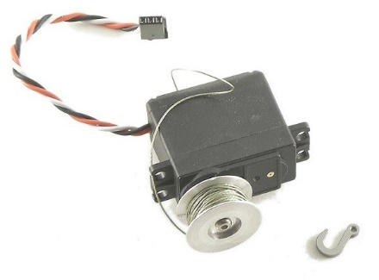
Servos – Used as winches (to wind up a string perhaps)
http://www.rccrawler.com/forum/vendors-electronics/394695-locked-up-rc-winch-recovery-options.html
http://rctruckstop.com/2012/09/06/rc-winches/

Slide 4
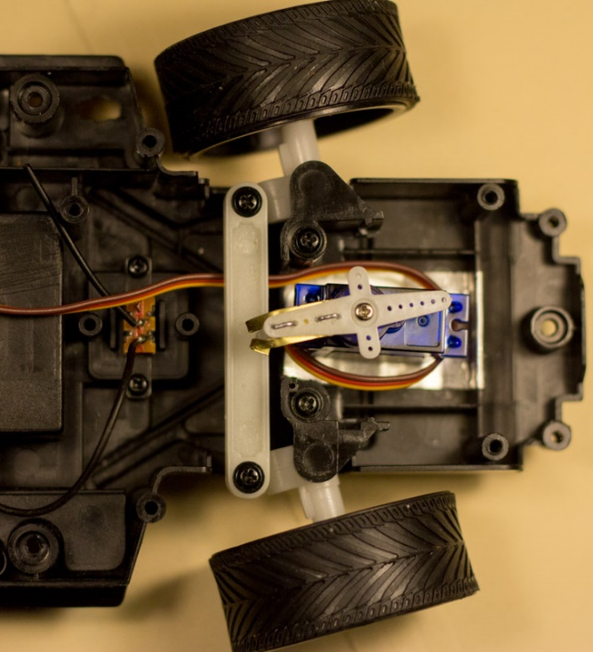
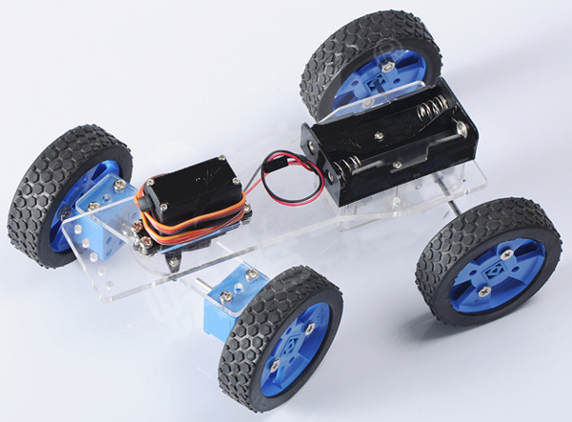
Servos – Used for steering
http://www.banggood.com/Assembling-DIY-Smart-Car-Kit-Servo-Steering-Remote-Gripper-With-Remote-Control-p-1004683.html
http://andrewdai.co/beaglecar/rc-car.html

Slide 5
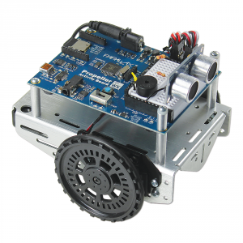
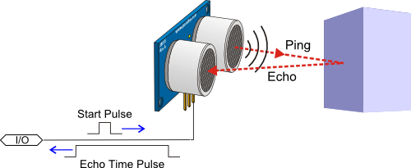
PING))) Ultrasonic Distance Sensor
Provides precise, non-contact distance measurements within a 2 cm to 3 m range
Ultrasonic measurements work in any lighting condition, making this a good choice to supplement infrared object detectors

Slide 6
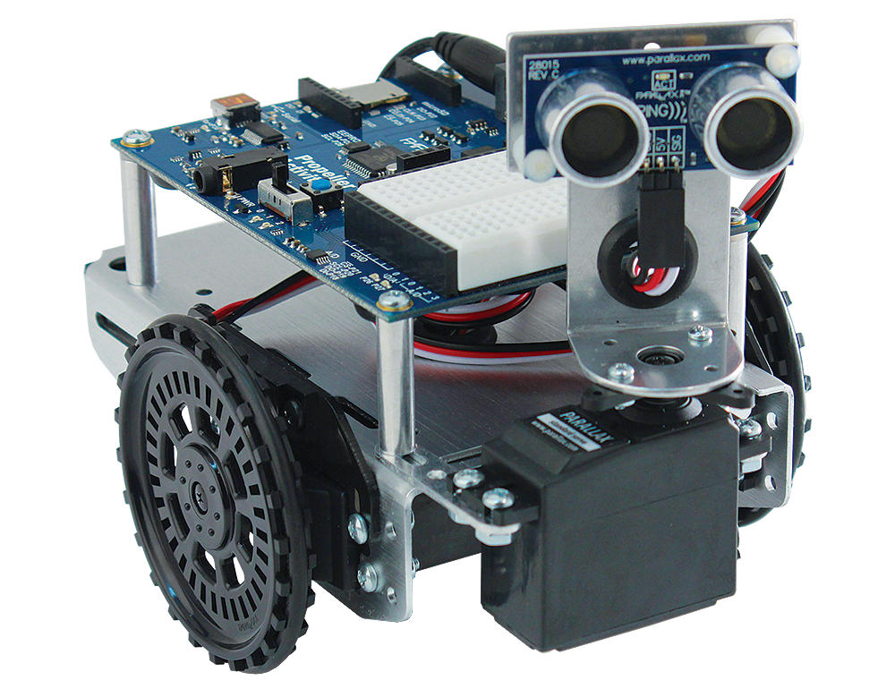
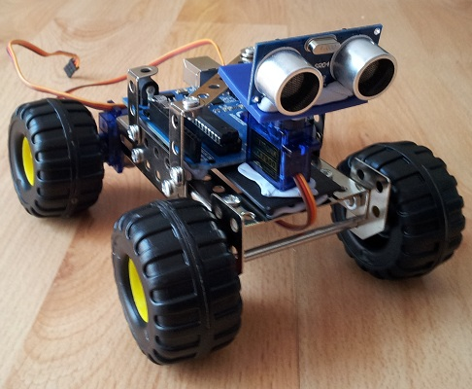
PING Sensors mounted on a servo
(for scanning and searching)
http://letsmakerobots.com/node/33806
https://www.parallax.com/sites/default/files/styles/full-size-product/public/910-28015Aa_0.png?itok=k2Kn1SMj

