Slide 1
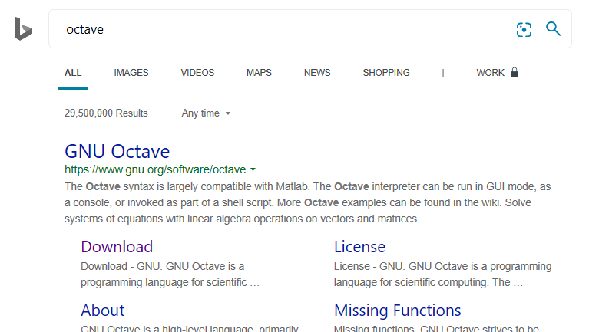
EGR 120/EGR 110 – Using Octave instead of MATLAB
TCC’s MATLAB license does not allow students or faculty to freely download the software at home.
To complete MATLAB assignments, you have the following choices:
Work on campus in labs where MATLAB is installed
Buy the student version of MATLAB ($99)
Use a free clone of MATLAB such as Octave or FreeMat
Information on downloading and using Octave is presented below.
Search for Octave in a browser and select Download
Octave claims that it is “largely compatible” with MATLAB.
You may find some small differences, but generally the code will be the same.

Slide 2
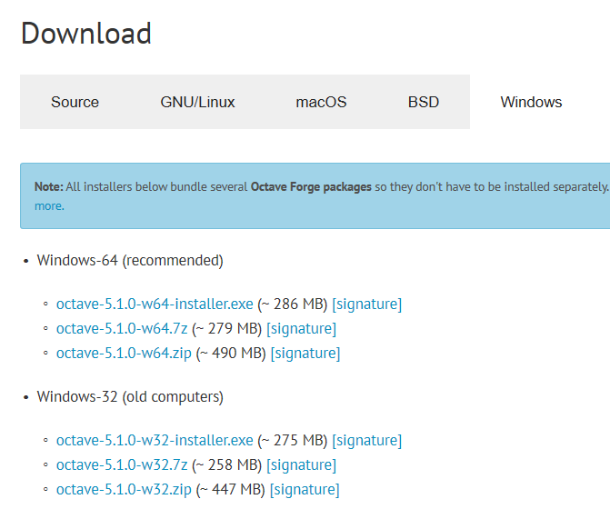
EGR 120/EGR 110 – Using Octave instead of MATLAB
Select the desired platform below. I selected Windows
Select an installer package. I selected the first one listed and it worked fine.
The software took a while to install.
After installing Octave, you should have an icon on your desktop. Use it to launch the software.

Slide 3
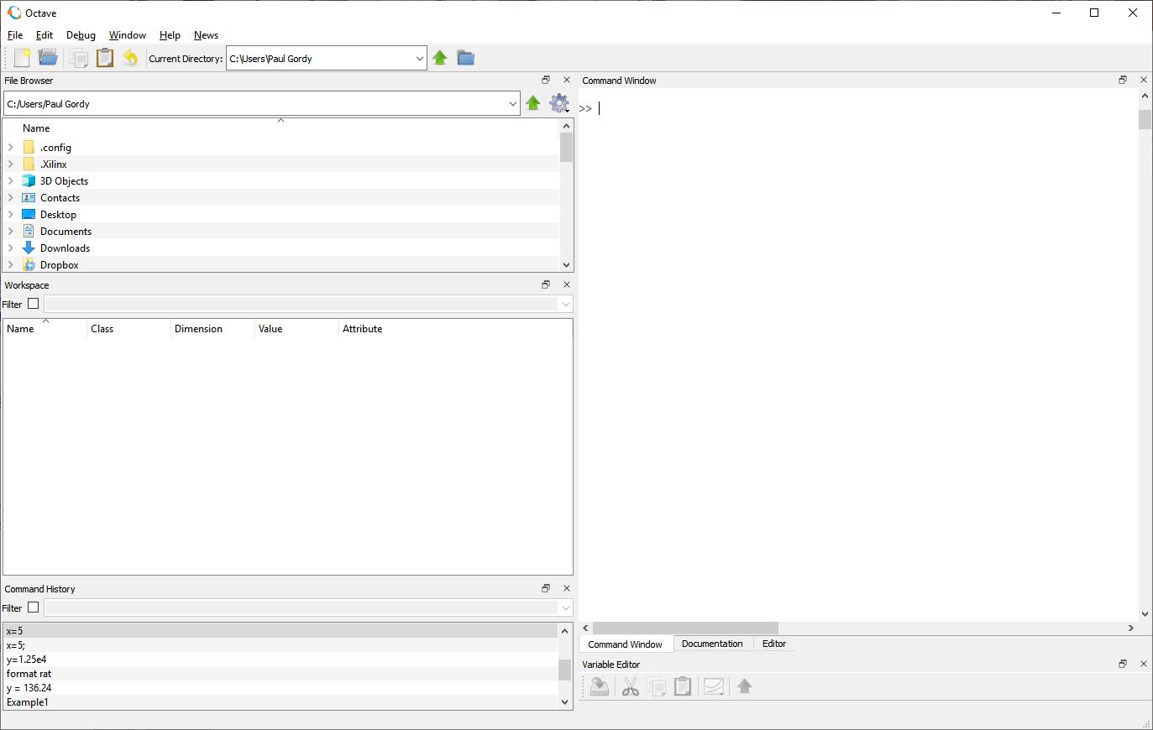
EGR 120/EGR 110 – Using Octave instead of MATLAB
Octave looks a little different from MATLAB, but has the same basic features.
File Browser (your scripts will appear here)
Workspace (variables stored in memory)
Command History
Command Window
Editor (use to make programs (scripts or .m files)

Slide 4
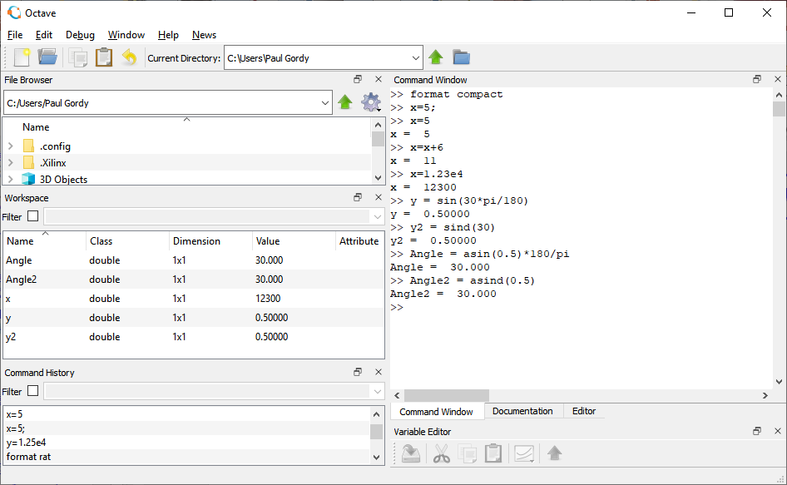
EGR 120/EGR 110 – Using Octave instead of MATLAB
Some examples were entered in the Command Window
Using the Command Window:
Looks just like MATLAB!

Slide 5
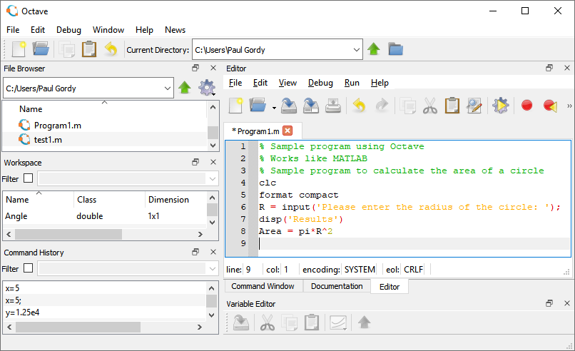
EGR 120/EGR 110 – Using Octave instead of MATLAB
1) Select Editor
Using the Editor to create a program (or script or .m file)
2) Select New Script
3) Enter your code (just like MATLAB)
Your new script (after saving)
4) Select Save File and Run
(the Octave file will have a .m extension just like MATLAB

Slide 6
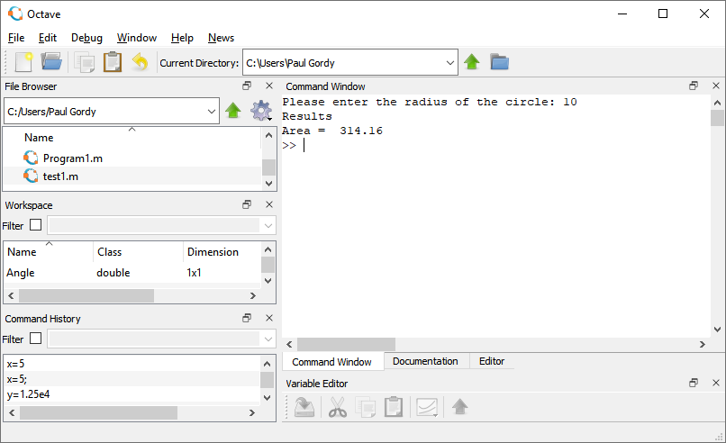
EGR 120/EGR 110 – Using Octave instead of MATLAB
Running the script and viewing the results
User entered 10 and the results were shown
Switch back and forth between the Editor (to modify or run the program) and the Command Window (to enter inputs and view the results)
Select Command Window to enter inputs and view results (or to see error messages)

Slide 7
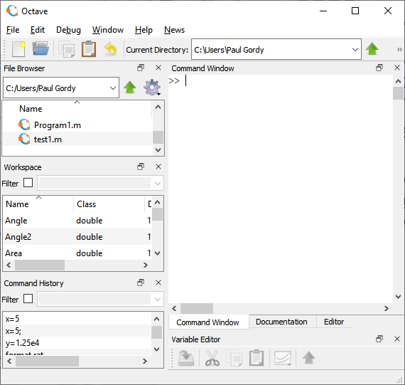
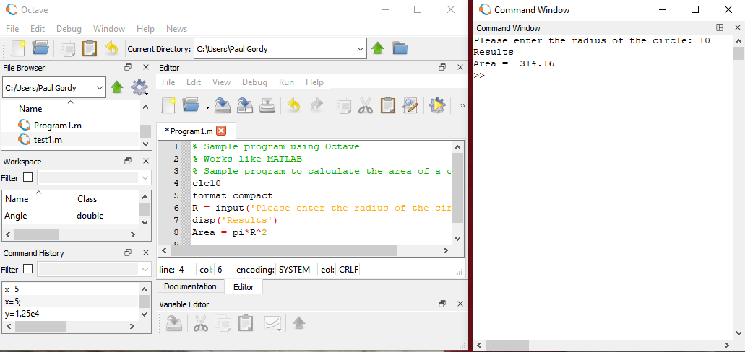
EGR 120/EGR 110 – Using Octave instead of MATLAB
Optional slide: Can I see the Command Window and the Editor at the same time? Yes.
1) Select the Command Window.
Grab it by the title bar and drag it to the right of the main window.
2) Result after dragging:
Select the Editor window on the left, make changes, and select Run.
Select the Command Window on the right, enter values, view results.
Grab here and drag to the right
3) You can return the Command Window to its original position as follows by selecting Window – Reset Default Window Layout

