Slide 1
Arduino-BOT Lecture #5 EGR 120 – Introduction to Engineering
1
Navigating the Arduino-BOT with infrared (IR) sensors
References:
1) Arduino-BOT Lectures #1-5 - http://faculty.tcc.edu/PGordy/Egr120/
2) Robotics with the Board of Education Shield for Arduino web tutorials - http://learn.parallax.com/tutorials/robot/shield-bot/robotics-board-education-shield-arduino
3) Board of Education Shield for Arduino documentation - https://www.parallax.com/downloads/robotics-board-education-shield-arduino
Arduino web site (software, microcontrollers, examples, and more) - https://www.arduino.cc/
Infrared sensors

Slide 2
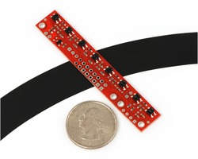
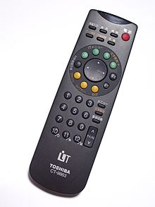
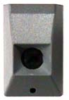
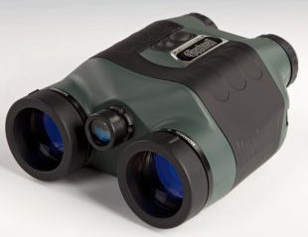
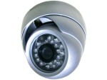
Arduino-BOT Lecture #5 EGR 120 – Introduction to Engineering
2
Infrared Applications
Infrared (IR) technology is used widely today with applications such as:
Remote control of TV and other electronic devices
Remote control of environmental systems and computers
Operation of information kiosks and talking signs
Remote temperature sensing
Night vision devices with infrared illumination
Infrared imaging cameras detect heat loss or overheating
Array of 8 IR sensors for line following
Stanley garage door IR safety beam sensor
IR night vision camera
Fluke IR Building Diagnostics thermal imaging camera
Bushnell
night vision binoculars
Toshiba TV remote

Slide 3
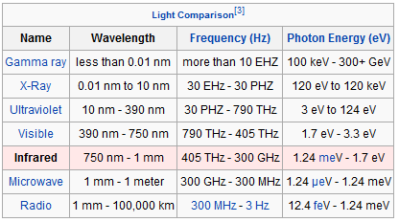
Arduino-BOT Lecture #5 EGR 120 – Introduction to Engineering
3
Infrared Light
The table below shows the wavelength for different types of light. Note that infrared light is not in the visible spectrum. This means that:
We cannot see the light used to navigate with infrared sensors.
The infrared sensors do not depend on visible light, so the Arduino-BOT can navigate with infrared sensors just as well in the dark!
Reference: http://en.wikipedia.org/wiki/Infrared

Slide 4
Arduino-BOT Lecture #5 EGR 120 – Introduction to Engineering
4
Infrared sensor circuits
The sensor circuit consists of an infrared diode (transmitter) and a phototransistor mounted in a housing.
The infrared diode shines a beam downward onto the track.
The beam bounces off the track and is received by a phototransistor (receiver).
The sensor circuit can detect the difference between light-colored surfaces and dark-colored surfaces by the amount of light that is reflected.
Infrared light bounces off track surface
0.25”
Critical
Distance

Slide 5
Arduino-BOT Lecture #5 EGR 120 – Introduction to Engineering
5
Navigating with infrared sensors
There are many possible approaches to navigation using infrared sensors. One approach is described below.
Basic navigation method:
If the left sensor hits the tape, turn left (slow the left wheel).
If the right sensor hits the tape, turn right (slow the right wheel).
How much should each wheel be slowed? It depends on:
The speed of the Arduino-BOT.
The sharpness of the turn.
Light from left sensor sees tape, so turn left

Slide 6
Arduino-BOT Lecture #5 EGR 120 – Introduction to Engineering
6
Possible improvements for line following:
Good modifications to try in EGR 120:
If the Arduino-BOT can’t turn sharp enough to make a turn, slow down the inner wheel a little more.
If the Arduino-BOT makes the turns, but jerks back and forth, try using less drastic turns.
Adjust the spacing between the sensors.
Other adjustments beyond EGR 120:
Add more sensors. One approach is to use the innermost sensors for gradual turns and the outer sensor for more drastic turns.
Rather than assigning a specific turning radius to a given sensor, the program could be modified to increment or decrement the Pulse Width sent to each servo. For example, if the left sensor hits the tape, turn a little more left. If it is still hitting the tape, turn even sharper left, etc.
Each sensor could be turned ON just before it is read (and all others turned OFF) to eliminate interference from the other sensors.
Use a PID (Proportional-Integral-Derivative) controller – a sophisticated, but widely used algorithm to minimize the error between the intended and actual path.

Slide 7
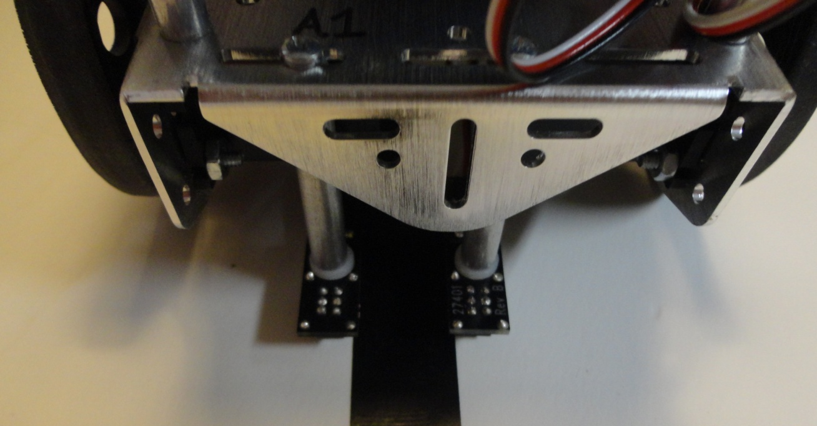
Arduino-BOT Lecture #5 EGR 120 – Introduction to Engineering
7
Mounting QTI sensors on the BOE-BOT
Mount two QTI sensors on the front of the Arduino-BOT as illustrated to the right.
Space the two sensors so that they just straddle a piece of ¾” black electrical tape as shown below.

Slide 8
Arduino-BOT Lecture #5 EGR 120 – Introduction to Engineering
8
Connecting cables to the QTI sensors
The cables that are connected to the cables can easily be reversed, so care must be taken to connect them correctly.
Connect Black wire to B
Connect White wire to W

Slide 9
Arduino-BOT Lecture #5 EGR 120 – Introduction to Engineering
9
Wiring the QTI sensors
Unfortunately, the QTI sensor cables cannot be used in the servo ports on the Arduino-BOT since the cables from the QTI sensors do not have 5V in the same position as the cables from the servos.
As a result, a header should be used to connect each QTI sensor cable to the breadboard on the Arduino-BOT.
Plug header into end of QTI sensor cable.
The header will then be plugged into the breadboard on the Arduino-BOT.
9

Slide 10
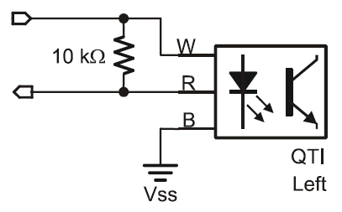
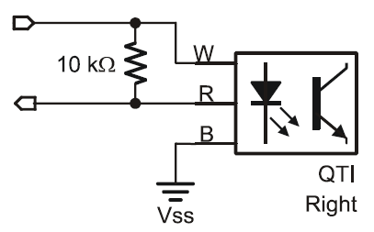
Arduino-BOT Lecture #5 EGR 120 – Introduction to Engineering
10
Wiring the QTI sensors
Each QTI sensors should be wired on the breadboard as indicated below.
5V
Connect the white lead (W) to 5V
Connect the black lead (B) to GND
Connect the red lead (R) to the digital input (Pin 5 or 6 in this case)
Connect a 10 kΩ resistor between the white and red leads
Pin 6
GND
5V
Pin 5
GND

Slide 11
Arduino-BOT Lecture #5 EGR 120 – Introduction to Engineering
11
11
Wiring the QTI sensors
A picture of a breadboard with two wired QTI sensors is shown below. Note the connections listed to the right:
A cable from each sensor is plugged into the breadboard using a header.
The black wire from each cable is connected to GND (ground).
The white wire from each cable is connected to 5V.
The red wires from the cables are connected to digital inputs 5 (right sensor) and 6 (left sensor).
A 10 kΩ resistor (brown-black-orange) is connected between the red wire and the white wire for each cable.
LEDs have been added to test each sensor. An LED for the right sensor is connected to digital input 3 and then to a 220 Ω resistor (red-red-brown) to GND (ground). The left sensor similarly uses input 9. (Oops! The resistors were left off.)

Slide 12
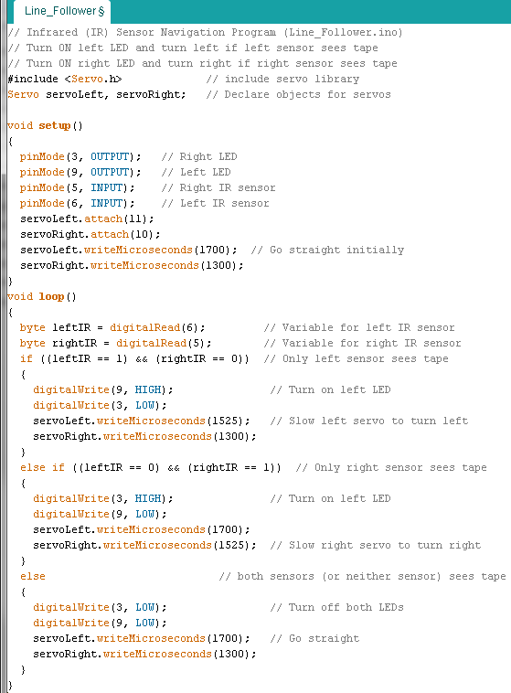
Arduino-BOT Lecture #5 EGR 120 – Introduction to Engineering
12
Navigating infrared sensors – Sample program
Adjust these values so that the robot can make the sharpest turns without jerking back and forth

Slide 13
Arduino-BOT Lecture #5 EGR 120 – Introduction to Engineering
13
The Arduino-BOT is ready to navigate the track by following the black lines.
The right LED should turn on every time the right sensor moves over the tape.
The left LED should turn on every time the left sensor moves over the tape.

