Slide 1
Excel A EGR 120 – Introduction to Engineering
Microsoft Excel
Reading Assignment: Chapter 14 in Engineering Fundamentals – An Introduction to Engineering, 5E by Moaveni
Homework Assignment: Homework Assignment #6
x(m) | F (N)
0.00 | 0.00
0.50 | 1.55
1.00 | 2.30
1.50 | 3.48
2.00 | 4.66
2.50 | 5.44
3.00 | 6.82
3.50 | 7.75
4.00 | 9.54
4.50 | 10.22
5.00 | 11.19
5.50 | 12.09
6.00 | 13.47

Slide 2
Excel A EGR 120 – Introduction to Engineering
Microsoft Excel
Excel is a spreadsheet program. Spreadsheets are very useful to engineers and are easy to use. You will likely use Excel in many engineering courses as well as on the job as a working engineer.
Why use a spreadsheet program?
Tabulating data
Performing repeated calculations, such as in a table
Producing graphs (dozens of different types)
Analyzing graphs (linear regression, statistical analysis, etc.)
Matrix operations
Performing parametric analyses (such as investigating the effect on a graph as quantities are varied)
Presenting results in a professional manner for reports
Much more

Slide 3
Excel A EGR 120 – Introduction to Engineering
Cell Addresses
Spreadsheets contain cells that are organized into rows and columns
Rows are numbered (1,2,3,….)
Columns are lettered (A, B, … Z, AA, AB, … AZ, BA, … ZZ , AAA, AAB,…
Each cell is identified by its row and column number, such as cells A1, Z4, and AA163. This is referred to as the address of the cell.
Column D
The address also appears here in the Name Box.
Cell D5
Try It! Scroll around a spreadsheet to see the column ordering.
Row 5

Slide 4
Excel A EGR 120 – Introduction to Engineering
Excel Worksheets
Each Excel file may contain multiple “worksheets.” A new file has only one worksheet labeled Sheet1.
It is often convenient to use multiple worksheets for multiple problems.
A new file has only one worksheet
Add worksheet
3 worksheets set up for 3 homework problems

Slide 5
Excel A EGR 120 – Introduction to Engineering
Excel Worksheets
For all assignments in this course, use a separate worksheet for each problem. Rename each worksheet with the problem number.
Try It! Create additional worksheets and rename them.
Right-click on Sheet1 to rename it
Worksheets renamed

Slide 6
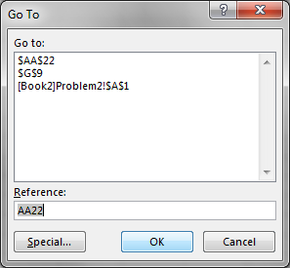
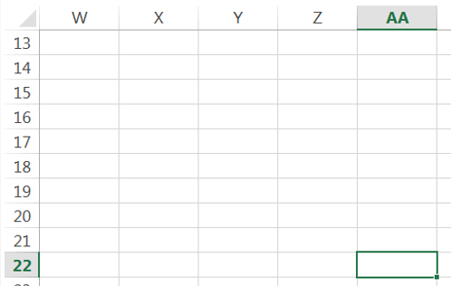
Excel A EGR 120 – Introduction to Engineering
Moving around the spreadsheet
Arrows – for general movement
Scrollbars – for general movement
PageUp/PageDown – moves up or down one screen at a time
Home – move to column A
Useful shortcut keys:
Ctrl + Home – move to cell A1
Ctrl + G – Opens the GoTo window. Enter the desired cell address. See the example below to go to cell AA22.
Try It! Use the shortcuts to move around a spreadsheet.
Note: Use Sheet2!AA22 to Go To the same cell on Sheet2

Slide 7
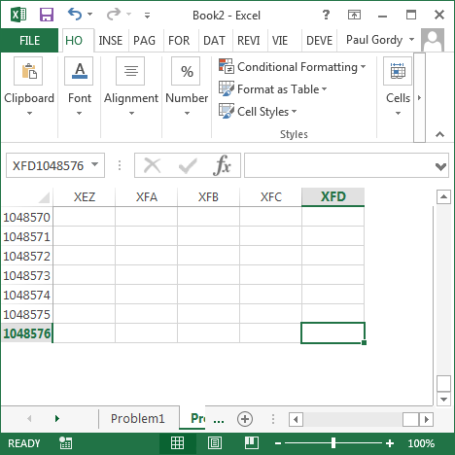
Excel A EGR 120 – Introduction to Engineering
How many cells are in a spreadsheet?
Try using Ctrl + G to go to cell XFD1048576 and you will find the lower right hand corner of the spreadsheet (see image below)
Row XFD indicates that there are 24(26²) + 6(26) + 4(1) = 16384 (=2¹⁴) rows.
The total number of cells is (16384)(1048576) = (2¹⁴)(2²⁰) = 2³⁴ = 17,179,869,184 so you could store over 17 billion pieces of information in each worksheet!

Slide 8
Excel A EGR 120 – Introduction to Engineering
Entering data into a spreadsheet
Cells in a spreadsheet can contain numbers, text, or formulas
Numbers
Examples include:
50
3.75
1,000 (commas not recommended, but work)
1.26e-3 or 1.26E-3 (Scientific notation)
No spaces allowed (or will be treated as text)
Leading 0’s ignored (007 appears as 7)
Text
Examples include:
John Doe
123-45-6789 (a SSN perhaps)
kg⋅ m/s² (a unit, including a superscript)
α (degrees) (Greek letters or other symbols)

Slide 9
Excel A EGR 120 – Introduction to Engineering
Entering data into a spreadsheet
Formulas (more on this later)
Formulas generally begin with =, although beginning with + or – work also
Formula appears on the formula bar, result appears in cell
Double-click on cell to reveal formula or look on formula bar
Examples:
=50 + 100 (displays the results)
=A6 + D7 (add the cell contents and display the results)
= 50^3 + 100^2 (50³ + 100²)
= 50*sin(3*pi()*A4) (using Excel functions for sin(x) and π
+50 + 100 (displays the results)
-50 - 150 (displays the results)

Slide 10
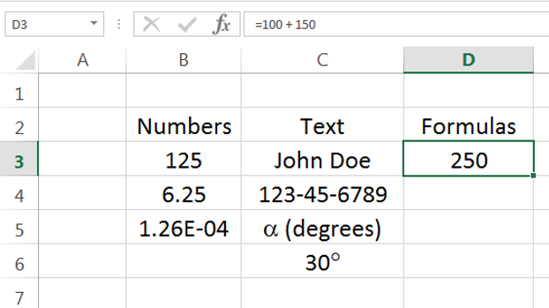
Excel A EGR 120 – Introduction to Engineering
Try It! Enter some numbers, text, and formulas.
Formula shown in formula bar
Result of formula shown in the cell

Slide 11
Excel A EGR 120 – Introduction to Engineering
Cursors in Excel
Select or highlight cells. Appears when you move over a cell. Used to select or highlight cells.
Move cells. Appears when you move over the edge of a cell or a highlighted group of cells (such as a table). Used to move (drag) the cell or group of cells.
AutoFill. Appears when you move over the lower right-hand corner of a cell or a highlighted group of cells. Dragging the corner over new empty cells uses AutoFill to fill out those cells.

Slide 12
Excel A EGR 120 – Introduction to Engineering
AutoFill - Excel can detect patterns in your entries and help you fill out columns or rows of cells with numbers.
Example:
Enter the number 1 in one cell and 2 in the cell under it.
Highlight both cells.
Move the mouse over the lower right corner until the + symbol appears.
Drag the corner downward.

Slide 13
Excel A EGR 120 – Introduction to Engineering
AutoFill – AutoFill can be used on multiple columns at one time.
Drag lower right
corner downward
Try It! Use AutoFill to create various sequences.

Slide 14
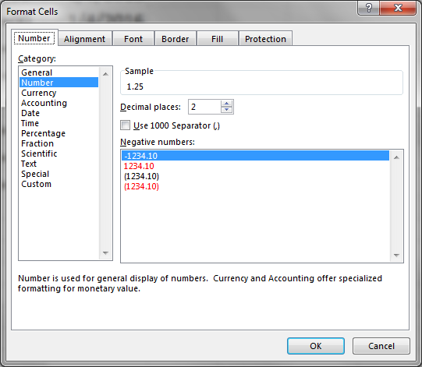
Excel A EGR 120 – Introduction to Engineering
Numeric format – the format for numbers, currency, and dates can easily be adjusted as follows:
Select the Quick Format box for many popular formats (the box may list “Number” or the last format used).
Right-click on highlighted cells or pick the Quick Format box and More Number Formats to access the Format Cells window
Try It! Change various numeric formats.

Slide 15
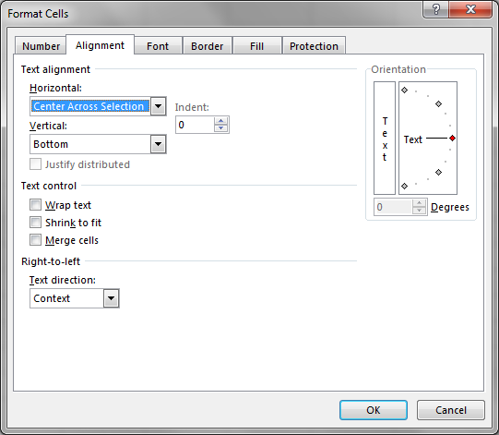
Excel A EGR 120 – Introduction to Engineering
Alignment format – alignment can be adjusted as follows:
Quick alignment tools - located on the Home ribbon
Center an entire column by selecting the letter at the top of the column
For more alignment control:
Right-click on highlighted cells and select Format Cells
Select Alignment – many options are available
Example: Center a table heading across 3 columns
(select Center Across Selection
under Horizontal text alignment)

Slide 16
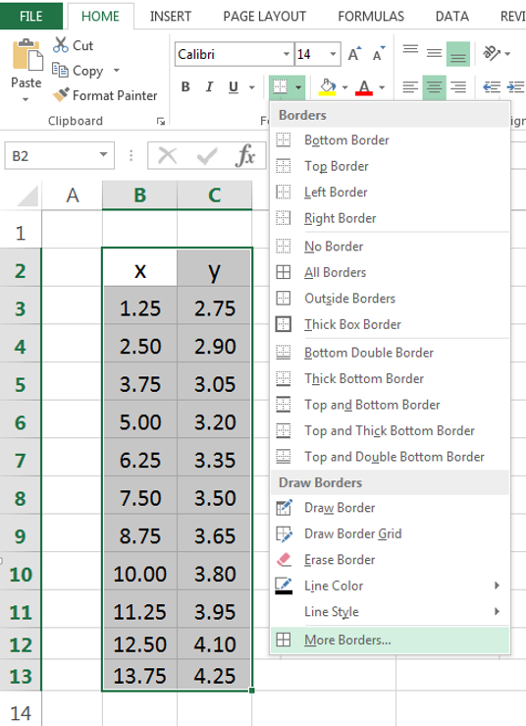
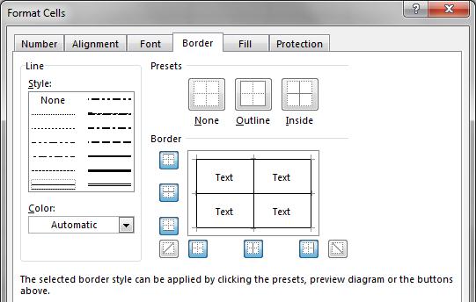
Excel A EGR 120 – Introduction to Engineering
Borders – can be added as follows:
Quick Border Tool
Format Cells window – access by:
Select More Borders on the bottom of the Quick Border Tool:
Right-click on highlighted cells
Select Format Cells
Select Border
Quick Border Tool
Right-click

Slide 17
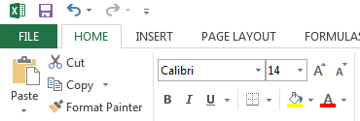
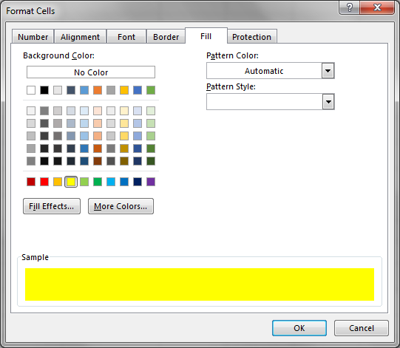
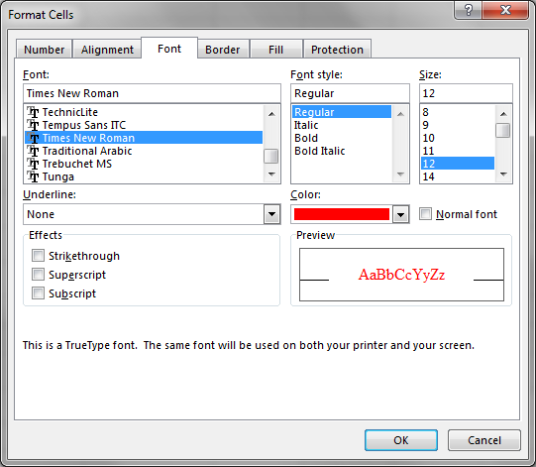
Excel A EGR 120 – Introduction to Engineering
Shading (Fill) – similar to Borders (use quick tool on Home menu or Format Cells window)
Fonts – similar to Borders (use quick tool on Home menu or Format Cells window)
Quick Font Tool
Quick Fill Tool

Slide 18
Excel A EGR 120 – Introduction to Engineering
Adjusting Column and Row Width – try each of the following
Adjusting a single column
Select the letter at the top of the column
Move the mouse to the edge of the letter until a double-arrow appears
Hold down left mouse button and adjust width
Adjusting a single row
Similar to adjusting a column
Changing font size will typically result in new row size
Auto-adjusting rows and columns
Similar to above except double-click with the double-arrow appears
Making multiple columns the same width
Select multiple columns by highlighting the letters at the top of the columns
Adjusting any one column will result in all columns having the same width
Auto-adjusting any one column with auto-adjust them all
Spillover
If the contents of a cell are too wide for a column, they will spill over into the cell to the right if it is empty.
If the cell is not empty, the cell contents are truncated.
A number will change to ##### if there is not enough room to display it.
Try It! Try various ways to adjust row and column widths.

Slide 19
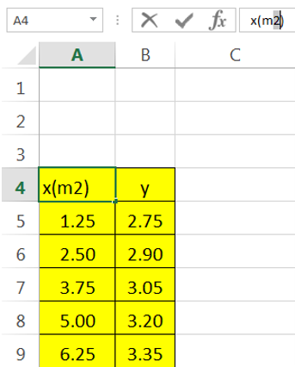
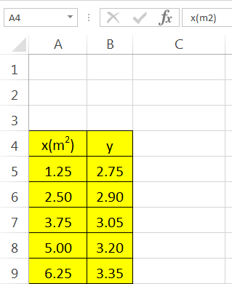
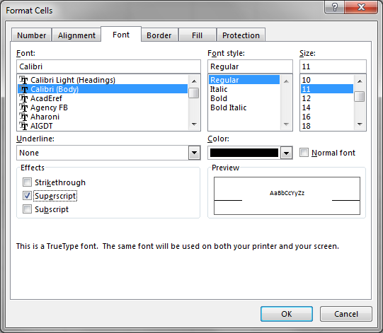
Excel A EGR 120 – Introduction to Engineering
Superscripts and Subscripts – think of a superscript or a subscript as a font change
Procedure:
Type the desired quantity without the superscript or subscript - such as x(m2)
In the formula area, highlight the portion that is to be changed to a superscript or subscript and then right-click in the highlighted area (see figure on left)
Select superscript or subscript in Format Cells window (see center figure).
Note that when selecting cell A4 below, the superscript appears in the spreadsheet, but not in the formula line (see figure on right).
Highlight 2 and right-click

Slide 20
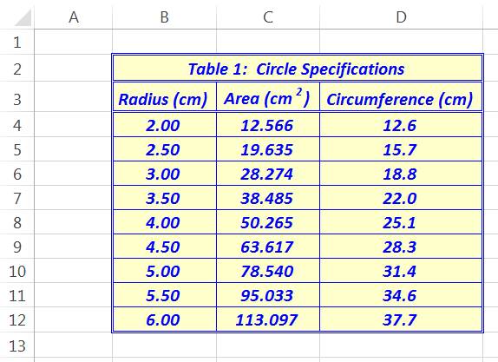
Excel A EGR 120 – Introduction to Engineering
Try It! Create a table with the formatting indicated.

Slide 21
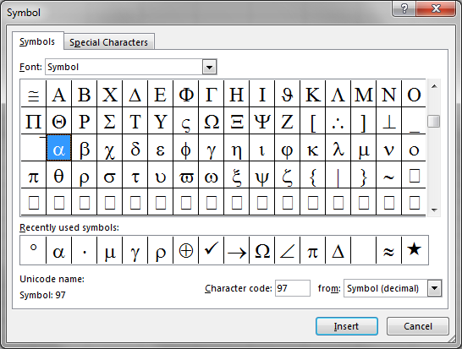
Excel A EGR 120 – Introduction to Engineering
Greek letters – two methods:
Select Insert – Symbol (be sure Symbol font is listed)
Use the Symbol Font. Enter regular text (any font) and then change the font to the Symbol font using the table shown to the right (this is convenient in many programs or in places where Insert – Symbol isn’t available).

Slide 22
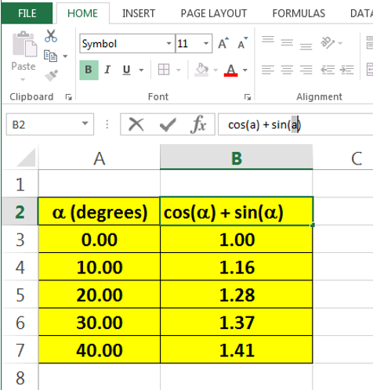
Excel A EGR 120 – Introduction to Engineering
Try It! Create a table with Greek letters or other symbols
Note that “a” appears, not α. “a” is equivalent to α in the Symbol font.

Slide 23
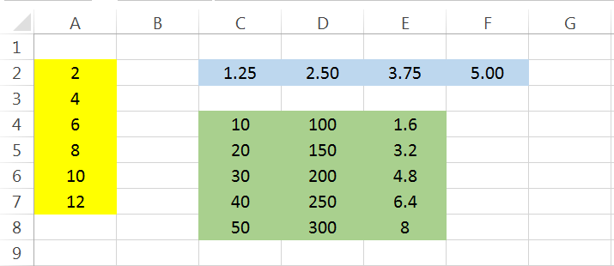
Excel A EGR 120 – Introduction to Engineering
Ranges in Excel
Many functions in Excel operate on a range of values.
Example: =Sum(A1:A10)
Form for a range: Upper_Left_Cell:Lower_Right_Cell
Right-click on a range to select Assign Name to give it a name
If A2:A7 is named Values, then =Sum(A2:A7) or =Sum(Values) can be used
C2:F2
A2:A7
C4:E8

Slide 24
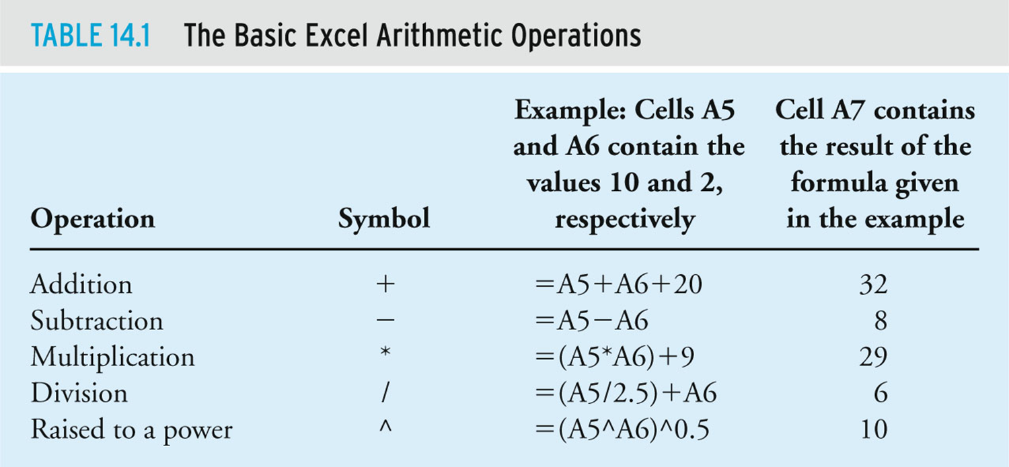
Excel A EGR 120 – Introduction to Engineering
Formulas in Excel – Table 14.1 from the textbook
Entering formulas: always begin with = (+ and – will also work)
Cell addresses and function names are not case-sensitive
Exponentiation uses the caret symbol (^). Ex: Use =10^2 for 10²

Slide 25
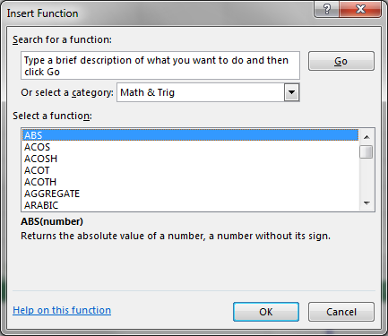
Excel A EGR 120 – Introduction to Engineering
Functions in Excel
Using functions – 3 methods:
Type in the name
Select Formulas – Insert Function
f_{x} (next to the Formula Box on the Home ribbon)
Result is displayed

Slide 26
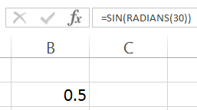
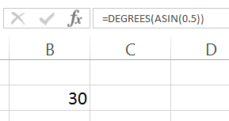
Excel A EGR 120 – Introduction to Engineering
Trigonometric Functions in Excel
Work with radians, not degrees (also generally true of MatLab, C++, MathCAD, etc)
Two convenient functions in Excel:
radians(x) – converts x from degrees to radians
degrees(x) – converts x from radians to degrees
Example: =sin(radians(30)) is used to calculate the sin(30°)
Example: =degrees(asin(0.5)) is used to calculate the sin⁻¹(0.5) (result is 30°)
Function for π: pi() (accurate to 15 digits)

Slide 27
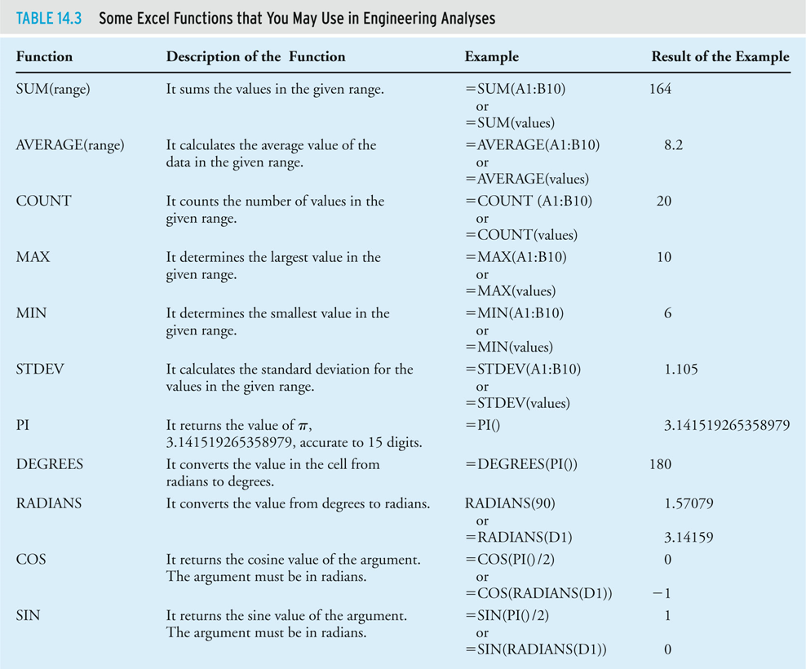
Excel A EGR 120 – Introduction to Engineering
Functions in Excel – Table 14.3 from the textbook
Range (A1:B10)
also named values

Slide 28
Excel A EGR 120 – Intro to Engineering
More Functions in Excel - Tables 14.3 & 14.4 from the textbook

Slide 29
Excel A EGR 120 – Intro to Engineering
More Functions in Excel Table 14.4 from the textbook

Slide 30
Excel A EGR 120 – Introduction to Engineering
Example: If x is the value stored in cell B2, complete the Excel formulas for each equation below.
Mathematical Equation | Formula in Excel
3x³
5e^{-2x}
4cos(30°)
3⋅ln(4π)
4sin⁻¹(x) – result in degrees
5⋅log(x)⋅sin²(x)
6⋅log₃(x)
(2⋅10³)/x!
|x-2|

Slide 31
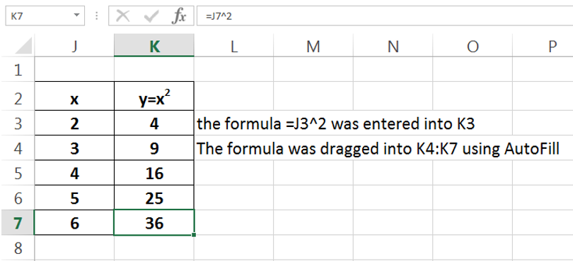
Excel A EGR 120 – Introduction to Engineering
Excel - copying formulas
Excel automatically updates cell addresses as they are copied.
You simply need to enter a formula once in a table - and then copy it to the other locations (or use AutoFill).
Example: Note that the formula =J3^2 in K3 was automatically changed to =J7^2 when it was copied into K7.
Try It! Enter a formula once, copy it using AutoFill, and examine the cell addresses.

Slide 32
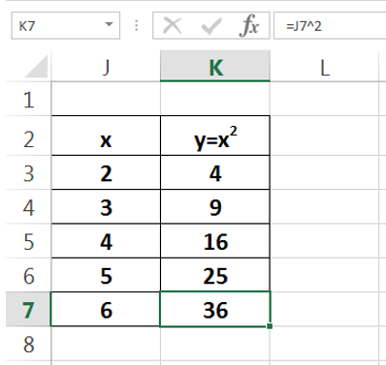
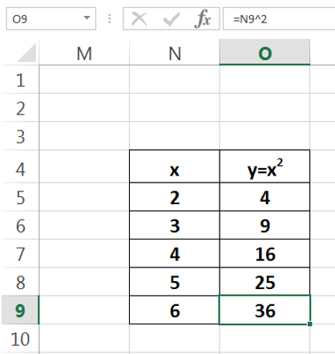
Excel A EGR 120 – Introduction to Engineering
Try It! Drag the table from the last example to a new location.
Formula updated
Entire table dragged from J2:K7 to N4:O9
Excel – moving and copying tables
Excel automatically updates the cell addresses in all formulas when a table is moved or copied.

Slide 33
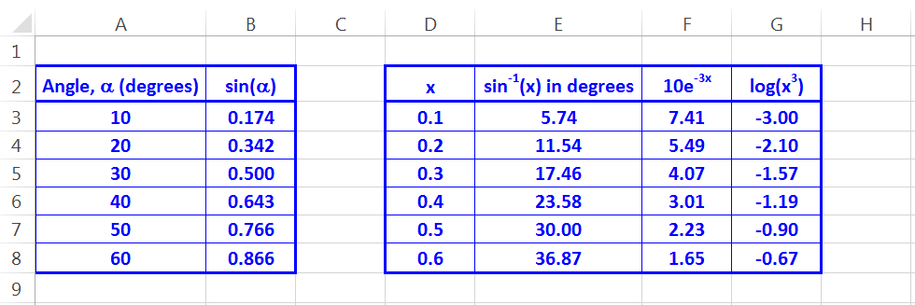
Excel A EGR 120 – Introduction to Engineering
Try it! Create the spreadsheet shown below.
Simply type the values into columns A and D as given values.
Use Excel formulas to perform the calculations required in columns B, E, F, and G by entering each formula only once and then copy it (use AutoFill) into the remaining table locations.

Slide 34
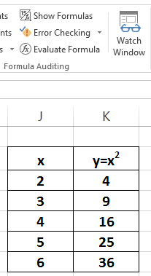
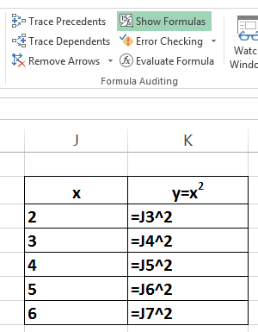
Excel A EGR 120 – Introduction to Engineering
Excel – Show Formulas tool
The Show Formulas tool on the Formula menu can be used to display all formulas in the spreadsheet.

Slide 35
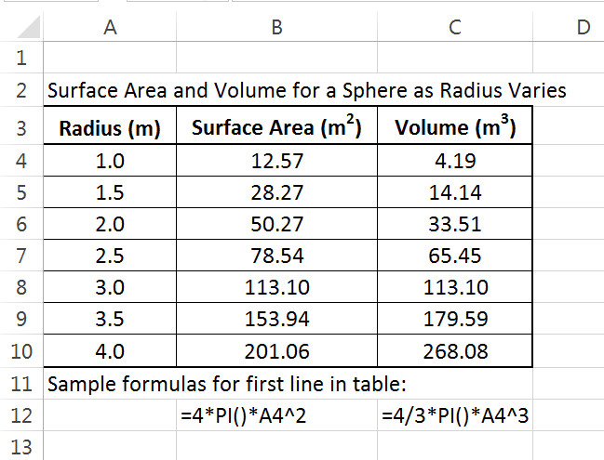
Excel A EGR 120 – Introduction to Engineering
Excel - Displaying sample formulas under a table
Displaying sample formulas under a table is highly recommended.
This is helpful others understand your calculations.
This is helpful to instructors if your results are incorrect!
The reader may wonder: “How where these values determined?”
“Oh, now I understand.”

Slide 36
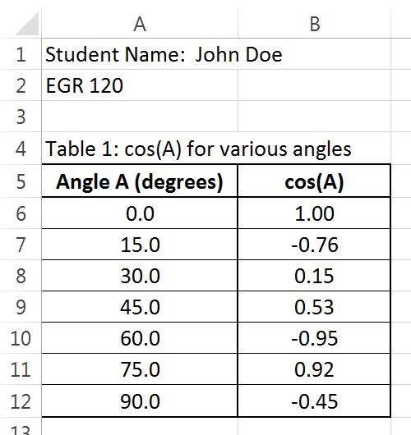
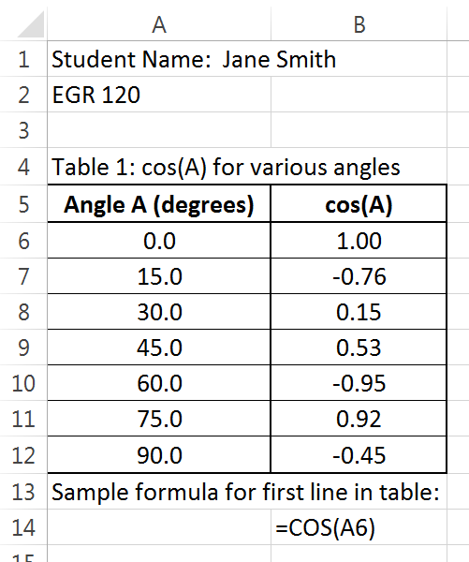
Excel A EGR 120 – Introduction to Engineering
Example: An instructor grades two students’ papers …...
Incorrect results, but I can’t tell what you did. Show sample formulas under the spreadsheet as required!
(-15)
Incorrect results, but I see the problem. Your formula should be =COS(RADIANS(A6)).
(-5)

Slide 37
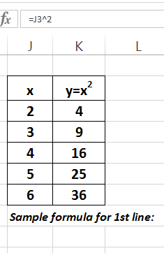
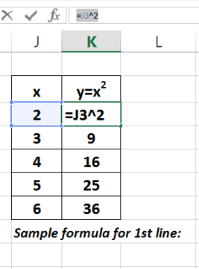
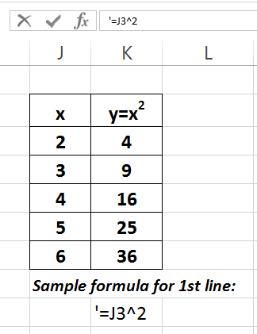
Try It! Try any example and display sample formulas.
Excel A EGR 120 – Introduction to Engineering
Excel – Copying sample formulas under a table
Displaying sample formulas under a table is required in EGR 120. recommended.
Select the cell with the formula to be copied.
Highlight the formula in the Formula Bar and copy it.
Hit Esc to exit the Formula Bar, select the destination cell, type ‘ and then paste.

Slide 38
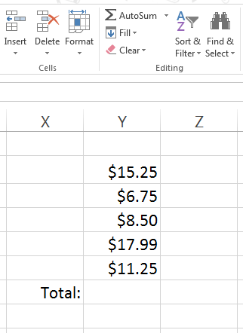
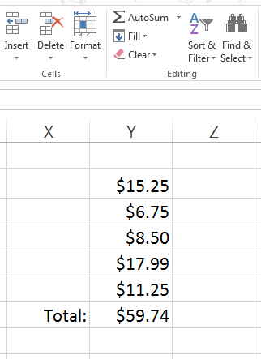
Excel A EGR 120 – Introduction to Engineering
AutoSum – Sums (or totals) are used commonly in Excel. You can use the AutoSum tool to perform sums quickly.
Highlight the cells to be totaled plus one additional cell
Excel fills in the sum when you select AutoSum
Note: Select cell Y6 and check the formula bar to see what formula Excel inserted into the cell:

Slide 39
Excel A EGR 120 – Introduction to Engineering
Excel - relative addresses and absolute addresses
We have already seen that Excel will automatically update cell addresses when formulas are copied or tables are moved.
The cell addresses that were used in these cases are referred to as relative addresses.
Sometimes it is desirable to have a cell address that will not be updated, such as when a cell is used to hold an important constant. An address that will not be updated is referred to as an absolute address.
There are four ways that an address can be expressed:
B2 - relative address (row and column both updated)
B$2 - absolute address (column is updated, but not the row)
$B2 - absolute address (row is updated, but not the column)
$B$2 - absolute address (neither the row nor the column are updated)

Slide 40
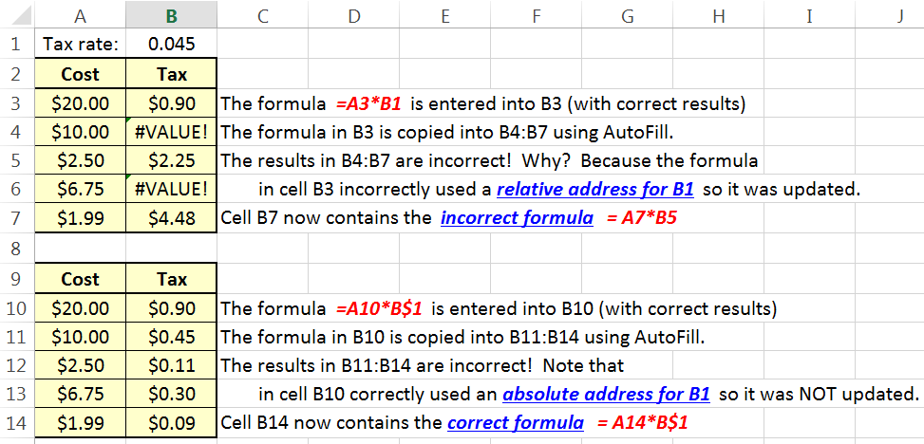
Excel A EGR 120 – Introduction to Engineering
Example – Relative versus Absolute Addresses
Top table - uses a relative address for the tax rate and produces incorrect results.
Lower table - uses an absolute address for the tax rate and produces the correct results.

Slide 41
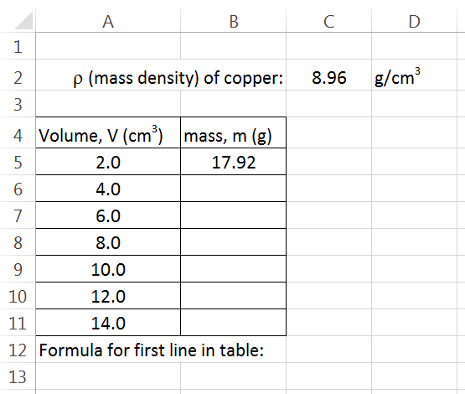
Excel A EGR 120 – Introduction to Engineering
Try It! Create a table similar to the one below, but show all values of mass. Mass can be calculated using m = ρV.
Note how 8.96 has been carefully placed in its own cell
Enter only one formula for mass and then use AutoFill. Be sure to use an absolute address for the density.
Show a sample formula

Slide 42
Excel A EGR 120 – Introduction to Engineering
Microsoft Drawing Tools and Microsoft Equation 3.0
As with Microsoft Word, we can use Microsoft Drawing Tools and Microsoft Equation 3.0 to add sketches, diagrams, or equations to enhance our data and calculations in Excel.
Try several examples in class or on your own.
Check out the following presentation on the course website: Microsoft Equation and Drawing Tools

Slide 43
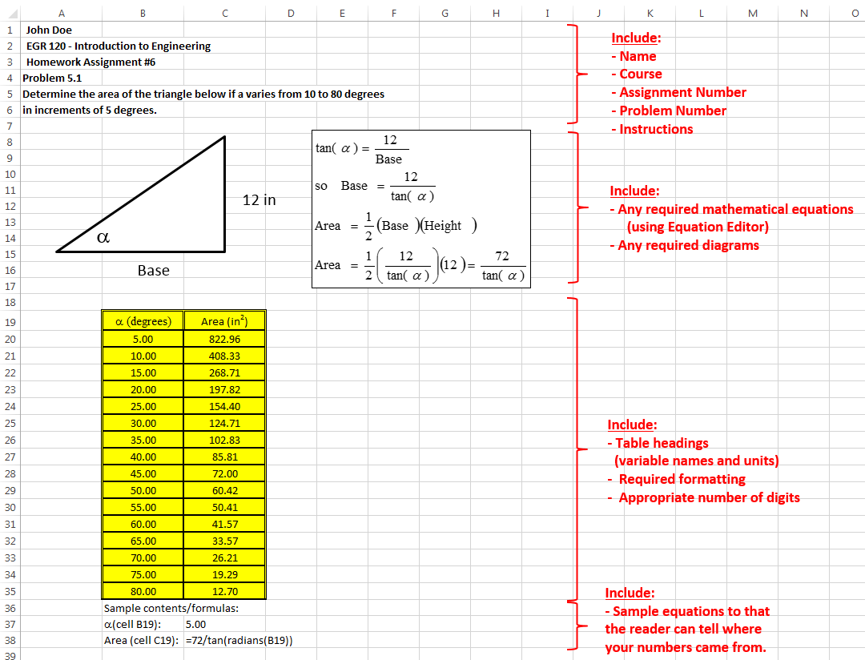
Sample Homework Problem using Excel

