Slide 1
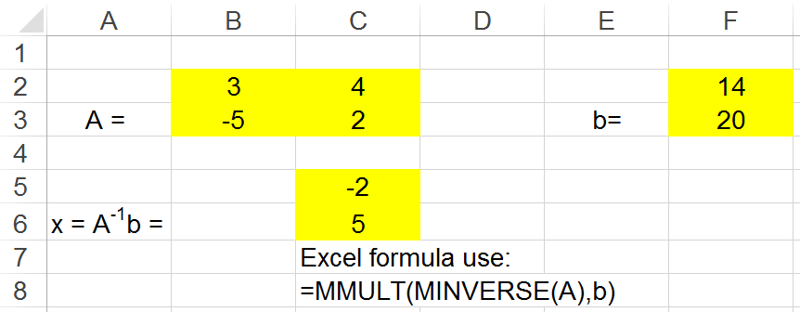
1
Excel C EGR 120 – Introduction to Engineering
Microsoft Excel - Lecture C
Reading Assignment: Chapter 14 in Engineering Fundamentals – An Introduction to Engineering, 5E by Moaveni
Homework Assignment: Homework Assignment – Excel C

Slide 2
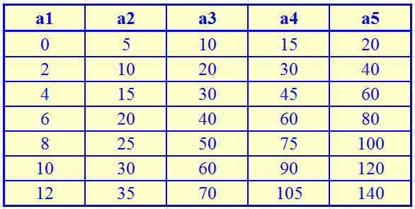
2
Excel C EGR 120 – Introduction to Engineering
Graphing Multiple Curves
Excel can easily graph multiple curves on one chart.
Excel will assume that if multiple columns are highlighted before inserting a chart that the leftmost column contains common x values and that all other columns contain multiple sets of y values. This is generally a good assumption – but not always!
x values
4 sets of y values

Slide 3
Excel C EGR 120 – Introduction to Engineering
Example 1: Graphing with 1 set of x-values and 2 sets of y-values
This is the default case, so Excel correctly assumes that the leftmost column highlighted contains x-values and all other columns contain y-values.
Highlight the entire table
Select Insert – Scatter – Scatter with Smooth Lines and Markers (a good choice for empirical data unless you plan to add a trendline).

Slide 4
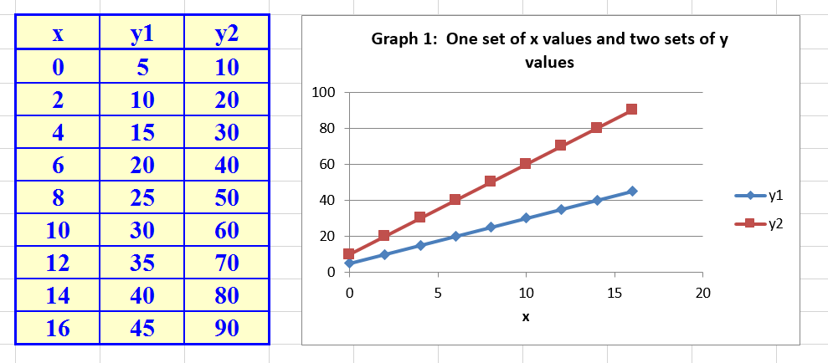
4
Excel C EGR 120 – Introduction to Engineering
Example 1 (continued):
The graph appears correctly and various types of formatting can be added.

Slide 5
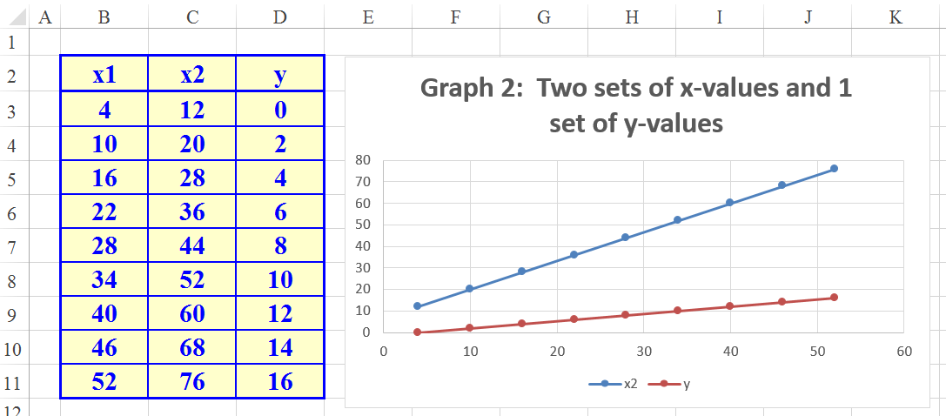
5
Excel C EGR 120 – Introduction to Engineering
Example 2: Graphing with 2 sets of x-values and 1 set of y-values
This is the not the default case, so Excel incorrectly assumes that the leftmost column highlighted contains x-values and all other columns contain y-values.
It will be necessary to correct the series of x-values and y-values.
Highlight the entire table and insert a scatter graph. Note that the graph is not correct.

Slide 6
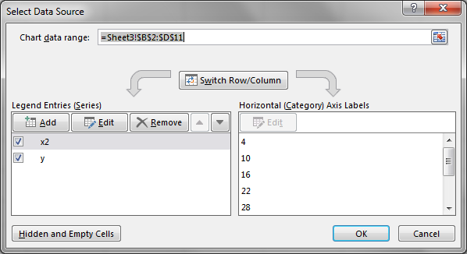
6
Excel C EGR 120 – Introduction to Engineering
Example 2 (continued): Pick Select Data in one of several way, including:
From the Design ribbon under Chart Tools (shown below)
Right-click in the graph area (not shown).
Use the graph tool that appears to the right of the graph (shown below)
Note that two series are shown:
x2
y

Slide 7
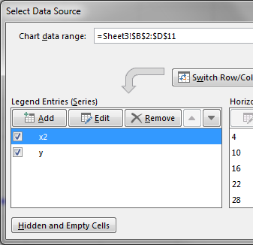
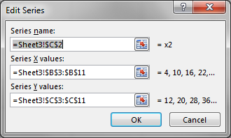
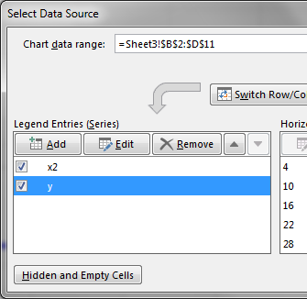
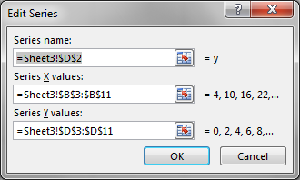
7
Excel C EGR 120 – Introduction to Engineering
Example 2 (continued):
Select each series (highlighted in blue below) and select Edit to see which columns are used.
The 1st series incorrectly uses columns B and C (x1 and x2) instead of
columns B and D (x1 and y)
The 2nd series incorrectly uses columns B and D (x1 and y) instead of
columns C and D (x2 and y)

Slide 8
8
Excel C EGR 120 – Introduction to Engineering
Example 2 (continued):
To change a series, click on the Select Tool next to the series.
In the example below, change the Series Y values from column C to column D.
Changing the Series Y values
Select Tool
(continued on the next slide)

Slide 9
9
Excel C EGR 120 – Introduction to Engineering
Example 2 (continued):
Highlight the desired Series Y values (in column D) and then click on the Return Tool to update the Series Y values.
Highlight the correct Series Y values
Return Tool

Slide 10
10
Excel C EGR 120 – Introduction to Engineering
Example 2 (continued):
Similarly, update the second series.
The 1st series should use columns B and D (x1 and y)
The 2nd series should use columns C and D (x2 and y)
The original and final graphs are shown below.
Original (incorrect) Graph
Final (correct) Graph

Slide 11
11
Excel C EGR 120 – Introduction to Engineering
Try It! Create a graph of altitude versus time for two hot-air balloons. Note that there are two sets of x values (time) and one set of y values (altitude).
The time for each balloon to reach each altitude is shown in the table below.
(You can copy this table and paste it in Excel.)
Altitude (ft)
10000
 | Balloon A | Balloon B
Altitude, h (ft) | Time, t (s) | Time, t (s)
0 | 0.0 | 0.0
1000 | 45.2 | 48.9
2000 | 91.3 | 98.8
3000 | 138.8 | 150.3
4000 | 187.6 | 203.9
5000 | 237.6 | 258.9
6000 | 289.4 | 317.4
7000 | 343.1 | 379.3
8000 | 399.0 | 446.3
9000 | 458.5 | 515.1
10000 | 522.5 | 588.2
8000
6000
4000
2000
0
Images: http://en.wikipedia.org/wiki/Hot_air_balloon

Slide 12
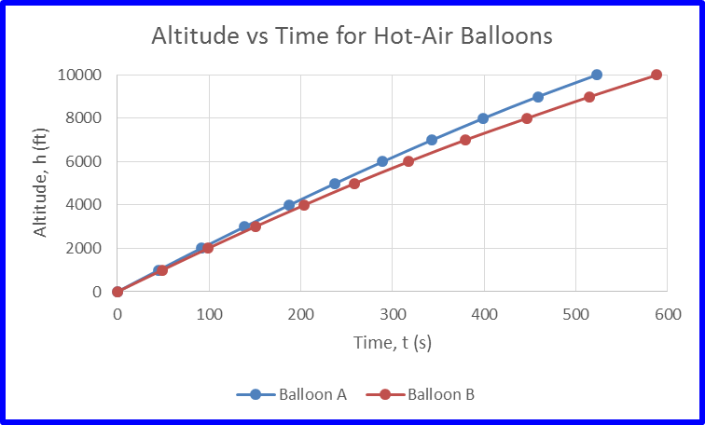
12
Excel C EGR 120 – Introduction to Engineering
Result: Your graph should look similar to the one shown below.

Slide 13
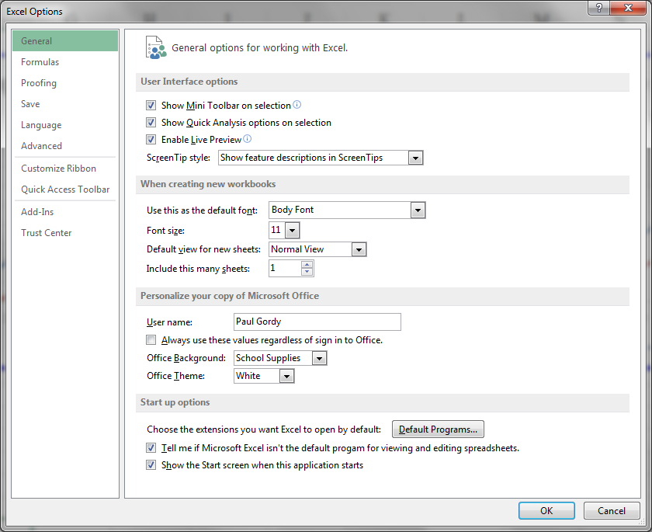
13
Excel C EGR 120 – Introduction to Engineering
Excel Add-Ins
Our next topic is histograms, but histograms are part of an Excel Analysis ToolPak that must be added to a basic Excel installation. No extra software installation is required, but you must tell Excel to add these analysis features.
Select File
Select Options

Slide 14
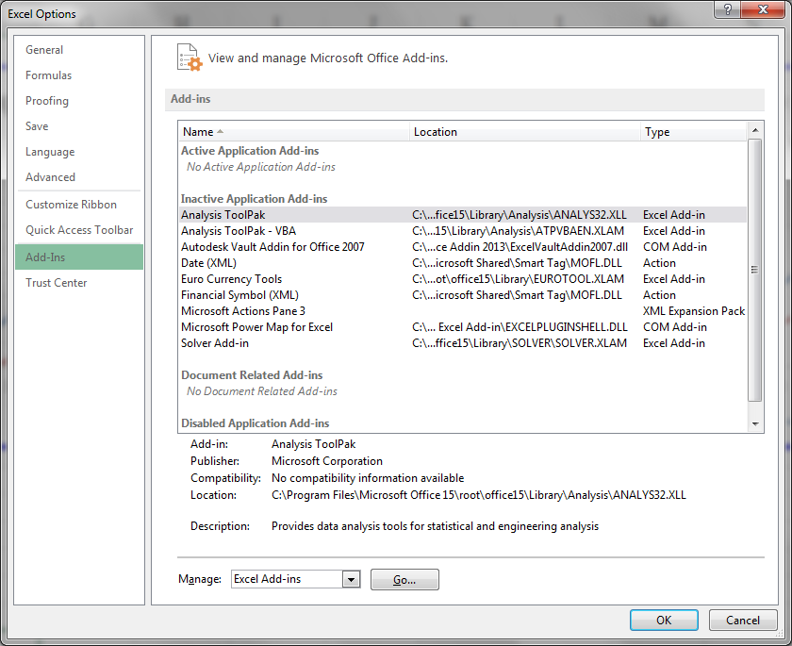
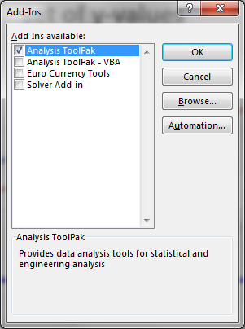
14
Excel C EGR 120 – Introduction to Engineering
Excel Add-Ins (continued)
Select Add-Ins
Select Analysis TookPak
Select Go next to Manage: Excel Add-ins
Check the box next to Analysis ToolPak in the Add-Ins Window and then OK.

Slide 15
15
Excel C EGR 120 – Introduction to Engineering
Excel Add-Ins (continued)
If the Analysis ToolPak was correctly added, it can be accessed by selecting: Data - Data Analysis

Slide 16
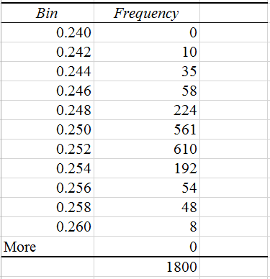
16
Excel C EGR 120 – Introduction to Engineering
Histograms
A histogram is a graph of frequency of events.
Histograms are very useful for displaying the number of items that occur in each of several possible ranges.
Example: Suppose a company produces 0.25” threaded steel rod and they have a desired tolerance of ±0.008”. They measured a run of 1800 rods and produce a histogram to show the distribution.
We will see how to produce and interpret this chart in the following slides.

Slide 17
17
Excel C EGR 120 – Introduction to Engineering
Histograms – Procedure
Enter the data to be into one column (the data might be a large number of measurements, for example).
Create a column of “bin values” which correspond to the ranges into which you want to divide your data. In particular, Excel wants a column of bin values, where the bin values are the upper limits for each range.
Bin Values
18
19
20
21
22
23
24
25
26
27
28
Example: Suppose you wanted to display the number
of runners that crossed the finish line in a 5k race in
ranges of 1 minute.
Number of runners under 18 minutes
Number of runners in 18-19 minute range
….
Number of runners in 27-28 minute range

Slide 18
18
Excel C EGR 120 – Introduction to Engineering
Histograms – Procedure (continued)
Select Data - Data Analysis - Histogram
Select:
Input Range (your data)
Bin Range
Output Range (specify the upper left cell where Excel should writes its report)
Check Chart Output to generate a graph (histogram)
Try It! This example using runners in a 5k race is continued on the following slides. Open Excel at try it. Pick your own times if you wish.

Slide 19
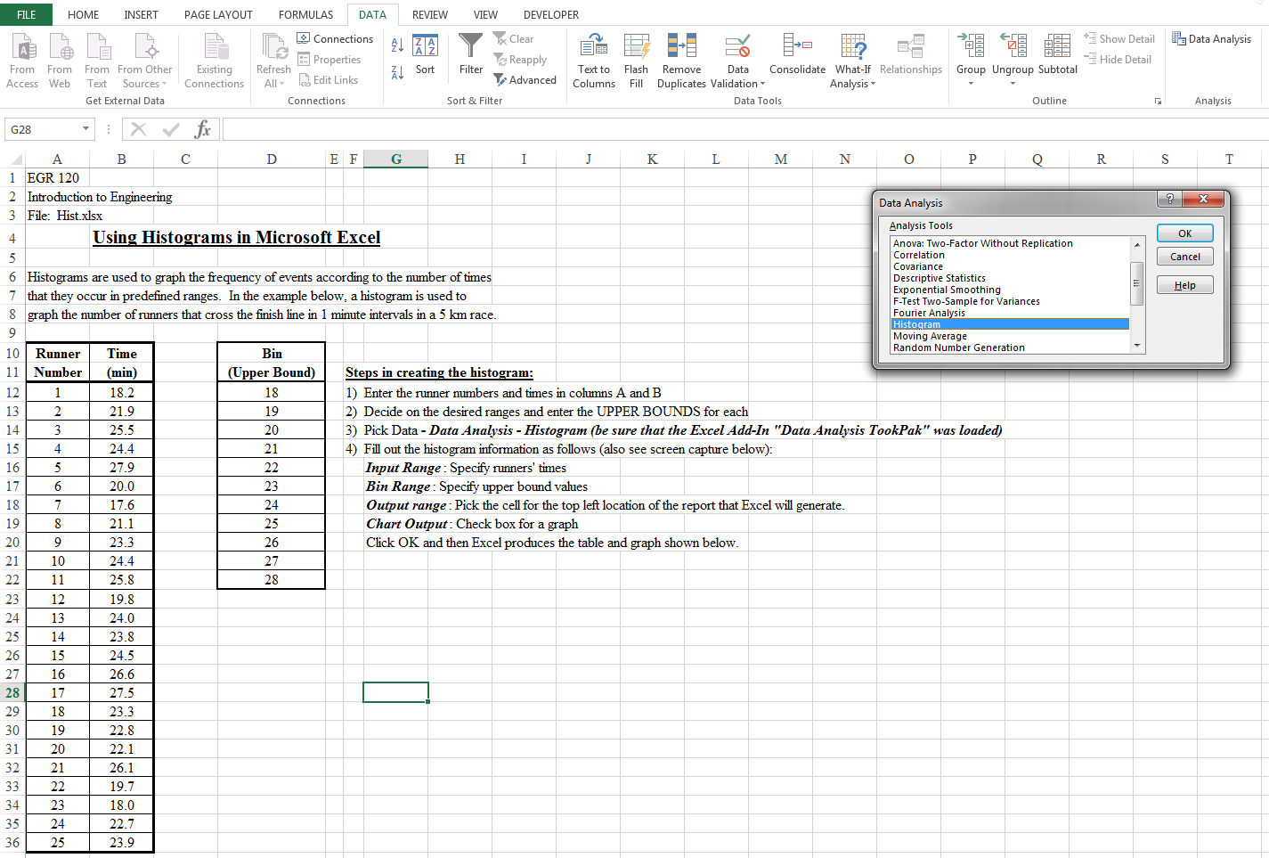
19
Excel C EGR 120 – Introduction to Engineering
Pick Data – Data Analysis and select Histrogram
Add bins (upper limits) from smallest to largest
Add times for runners (Runner Number is optional)

Slide 20
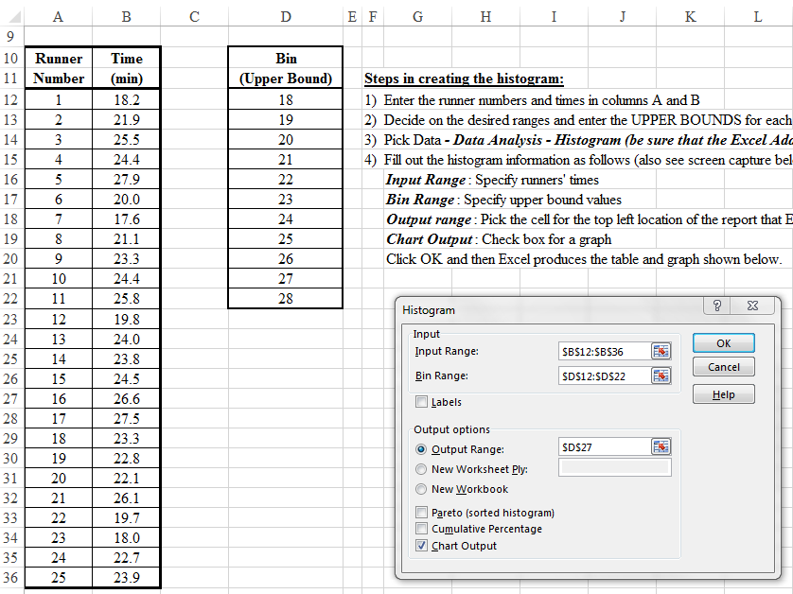
Excel C EGR 120 – Introduction to Engineering
20
D27 picked as a convenient location for the upper-left corner of Excel’s output table and graph (histogram)

Slide 21
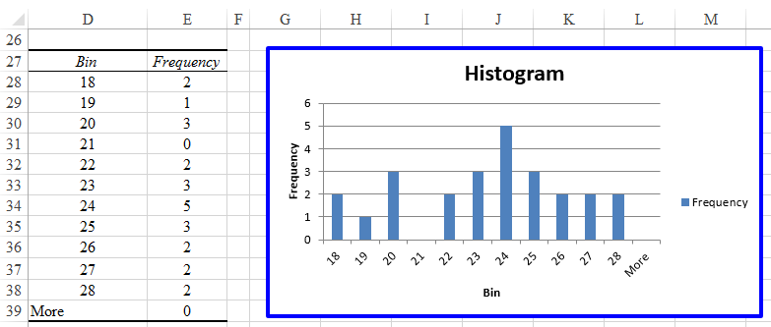
21
Excel C EGR 120 – Introduction to Engineering
Histograms – Results:
Note that Excel put the upper-left corner of the table and graph in D27 as specified.
How many runners finished the race in under 18 minutes? ________
How many runners finished the race in under 20 minutes? ________

Slide 22
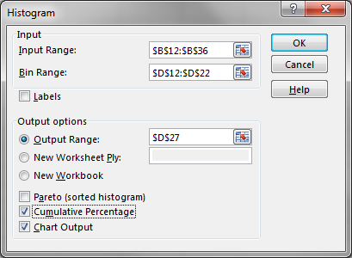
22
Excel C EGR 120 – Introduction to Engineering
Histograms – Adding Cumulative Percentage
It is often useful to know what percentage of items fell within a given range.
For example, we might want to know what % of the runners finished between 22 and 26 minutes in the last example.
Cumulative Percentage can be added by checking the box indicated in the Histogram window shown below.
The results are shown on the following slide.

Slide 23
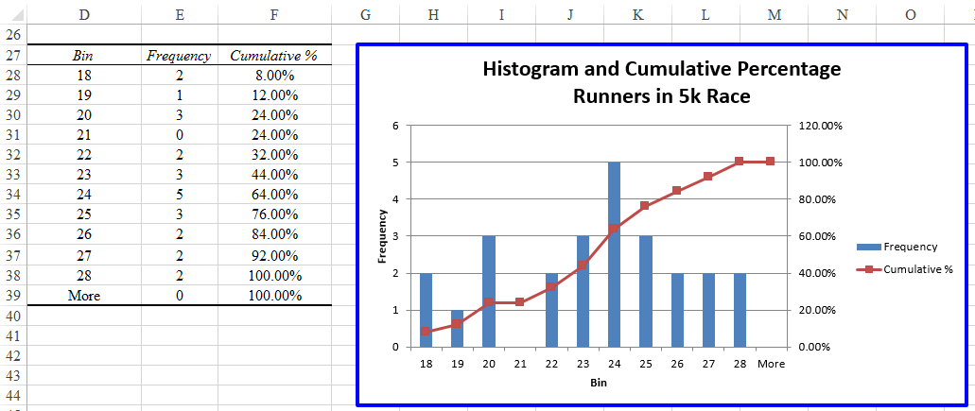
23
Excel C EGR 120 – Introduction to Engineering
Histograms – Adding Cumulative Percentage (continued)
What % of the runners finished in under 20 minute? 24.00%
What % of the runners finished between 22 and 26 minutes?
84.00 – 32.00 = 52.00%
What percentage finished with a time over 23 minutes? ________

Slide 24
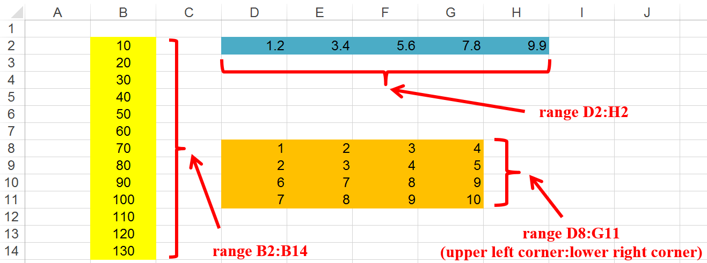
20
Excel C EGR 120 – Introduction to Engineering
Ranges in Excel - Many functions in Excel work on ranges of data, such as averages, summations, determinants, etc. We can use the range of data in the formula, or assign a name to the range.
Sample Excel formulas:
= AVERAGE(B2:B14) or = AVERAGE(X)
= SUM(D2:H2) or = SUM(Distances)
= MDETERMINANT(D8:G11) or = MDETERMINANT(A)

Slide 25
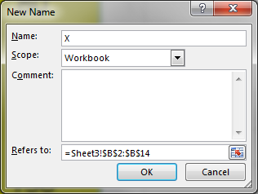
21
Excel C EGR 120 – Introduction to Engineering
To Name a Range in Excel:
Highlight the cells
Right-click in the highlighted cells and select Name a Range
Add the desired name to the window (X was added in the example below)

Slide 26
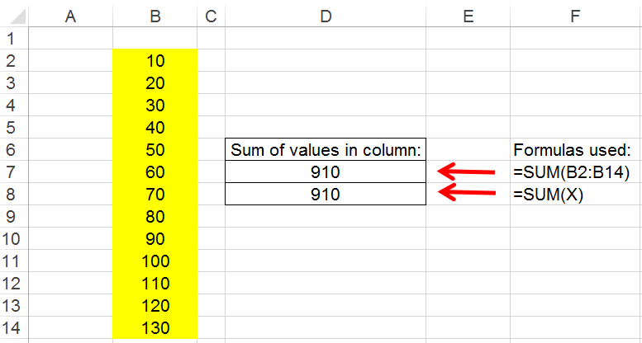
22
Excel C EGR 120 – Introduction to Engineering
Using Named Ranges:
In the previous slide, the range of cells B2:B14 was named X.
Excel formulas can now refer to either the range or the name.

Slide 27
27
Excel C EGR 120 – Introduction to Engineering
Lookup Tables and Lookup Functions
Sometimes it is necessary to assign values according to predefined ranges.
Lookup tables and Lookup functions in Excel are useful in such cases.
Examples:
Use a shipping rate based on the cost of a purchased item
Assign a letter grade based on the course average
Cost of item | Shipping rate
$0.00 - $49.99 | 10%
$50.00 - $99.99 | 5%
$100.00 or more | Free (0%)
Course Average | Grade
90-100 | A
80 – 90 | B
70 – 80 | C
60 – 70 | D
0 - 60 | F

Slide 28
28
Excel C EGR 120 – Introduction to Engineering
Lookup Function - The Lookup Function in Excel has the following format:
Lookup(lookup value, lookup vector, result vector)
where
Lookup value - value to compare to a set of ranges (for example, a grade)
Lookup vector - a range of values that you need to create in Excel corresponding to the minimum value in each range. A common error is to use a lookup vector that is not in the correct form (see example below).
Result vector - a range of results (letter grades) to be used based on how the lookup value compares to the lookup vector.
Course Average | Grade
90-100 | A
80 – 90 | B
70 – 80 | C
60 – 70 | D
0 - 60 | F
Min values (Lookup Vector) | Grade (Result Vector)
0 | F
60 | D
70 | C
80 | B
90 | A
Put the table in the proper form for Excel

Slide 29
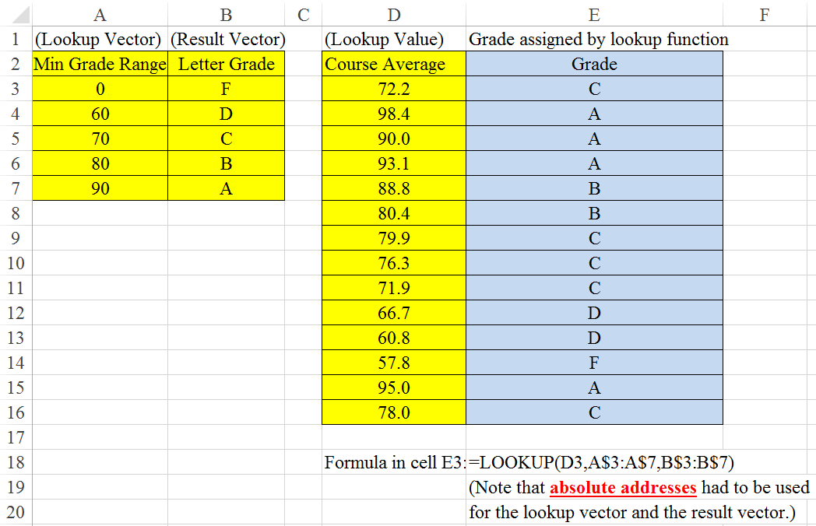
29
Excel C EGR 120 – Introduction to Engineering
Example: Using a Lookup Function to assign letter grades
“Lookup Table”

Slide 30
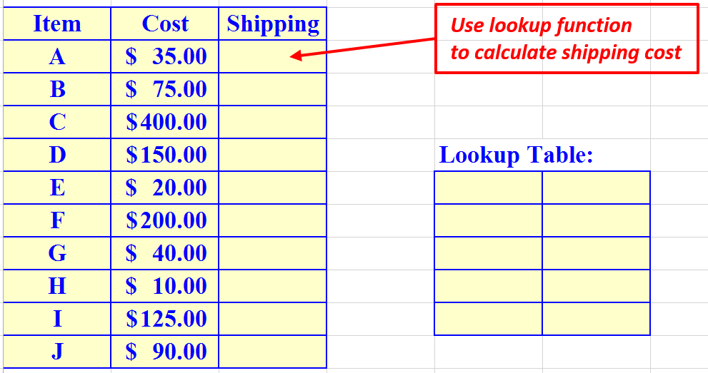
30
Excel C EGR 120 – Introduction to Engineering
Try It! Use a lookup table and the lookup function to calculate the shipping rate using the rates indicated for a table of items.
Cost of item | Shipping rate
$0.00 - $24.99 | 10%
$25.00 - $49.99 | 8%
$50.00 - $99.99 | 5%
$100.00 - $199.99 | 2%
$200.00 or more | Free (0%)
Sample table of items:

Slide 31
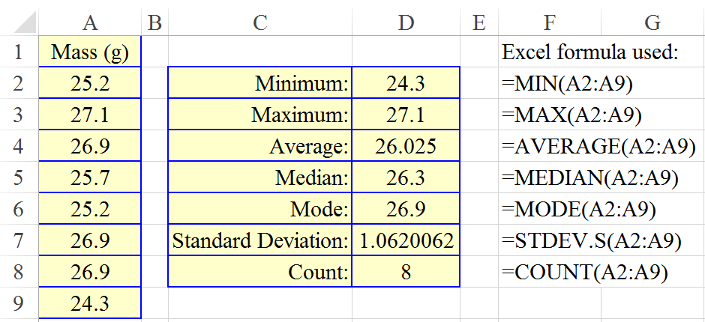
31
Excel C EGR 120 – Introduction to Engineering
Statistical Functions in Excel:
Many of the statistical functions used below are probably obvious.
Some definitions are provided:
median(range) – returns the median (value in the middle) of a range of data
stdev.s(range) – returns the standard deviation of a range (sample population)
mode(range) – returns the value that occurs most often in a range of data
Additional illustrations on following slides

Slide 32
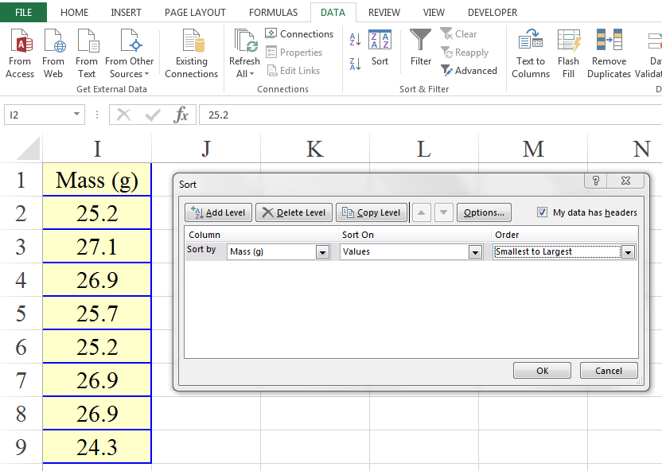
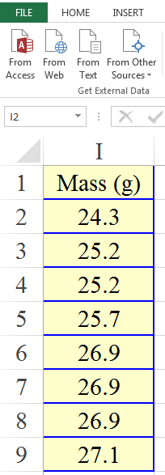
32
Excel C EGR 120 – Introduction to Engineering
Sorting
In order to explain the median function on the previous slide, it is helpful to introduce sorting.
Highlight the data to be sorted.
Select Sort (the Sort window allows for many additional options)
Sorted data (smallest to largest)

Slide 33
33
Excel C EGR 120 – Introduction to Engineering
Statistical functions – illustrated with sorted data
Smallest
The median is the middle value (once sorted). If there are an even number of values, it is the average of the two middle values.
The mode is the value that occurs most often. Note that 26.9 occurs 3 times.
Largest

Slide 34
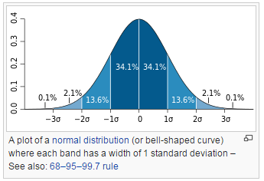
34
Excel C EGR 120 – Introduction to Engineering
Normal Distributions and Standard Deviation
Standard deviation, σ, is a measure of how close the data is to the average (or mean). A small standard deviation indicates that most data points are close to the mean. A common distribution of data is the normal distribution (bell-shaped curve) where:
68.2% of the data is within one standard deviation of the mean
95.4% of the data is within two standard deviations of the mean
99.7% of the data is within three standard deviations of the mean
The normal distribution and other distributions are discussed in more depth in a statistics course.
http://en.wikipedia.org/wiki/Standard_deviation

Slide 35
35
Excel C EGR 120 – Introduction to Engineering
Example: Using the Mean and Standard Deviation for grades
Some universities assign grades based on the mean, , and the standard deviation, σ, as follows:
 | A/B cutoff
 | B/C cutoff
 | mid-C
 | C/D cutoff
 | D/F cutoff
F
D
C
B
A
Notes:
This isn’t considered to be a good method for class sizes < 35 students, so it is rarely used at a community college.
The grade that you need to receive an A depends on how the class performs!
From the previous slide we see that 68.2% of student receive grades of B, C, or D. This implies that 15.9% receive A’s and 15.9% receive F’s.

Slide 36
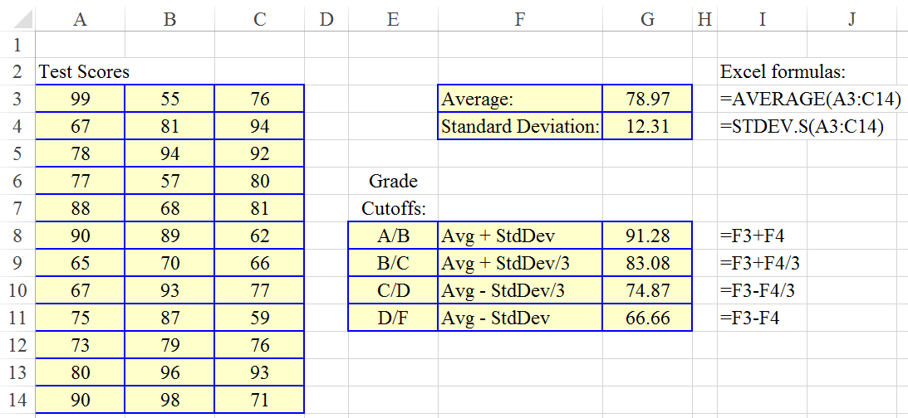
36
Excel C EGR 120 – Introduction to Engineering
Example: Determine the grade ranges for the following 36 test scores.
What letter grade is assigned for the grades shown to the right?
Test Score | Letter Grade?
65
81
73

Slide 37
23
For reference only
Excel C EGR 120 – Introduction to Engineering
Matrix Operations in Excel
Excel can easily perform matrix calculations, but the procedure for performing the calculations isn’t obvious. First, let’s define some matrix operations:
Matrix Functions and Operations
MDETERM(D) - Find |D|, the determinant of matrix D
- D must be a square matrix
MMULT(D,E) - Multiply matrices D and E
- Only defined if the number of columns in matrix D
matches the number of rows in matrix E.
MINVERSE(D) - Find the inverse of matrix D (if it exists)
- D must be a square matrix
TRANSPOSE(D) - Find the transpose of matrix D
- if D has dimension (mxn) then D^{T} will have
dimension (nxm)
D + E - Add matrices D and E (must have same dimensions)
D – E - Subtract matrix D from matrix E (must have same dimensions)

Slide 38
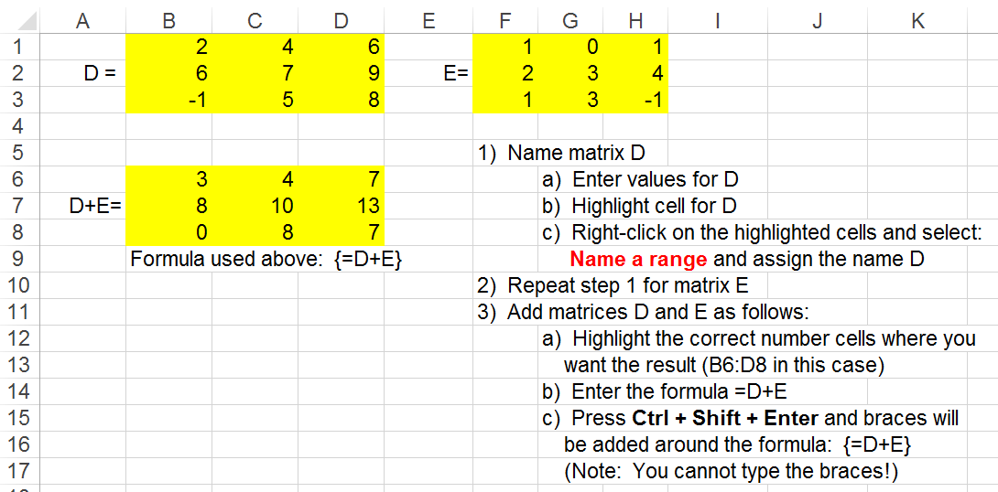
38
For reference only
Excel C EGR 120 – Introduction to Engineering
To enter a matrix formula:
Highlight the cells where you want the result (so you must know the size!)
Type the matrix formula (without braces)
Press Ctrl + Shift + Enter (and Excel will fill out the matrix and add braces)
Example: Adding 2 matrices

Slide 39
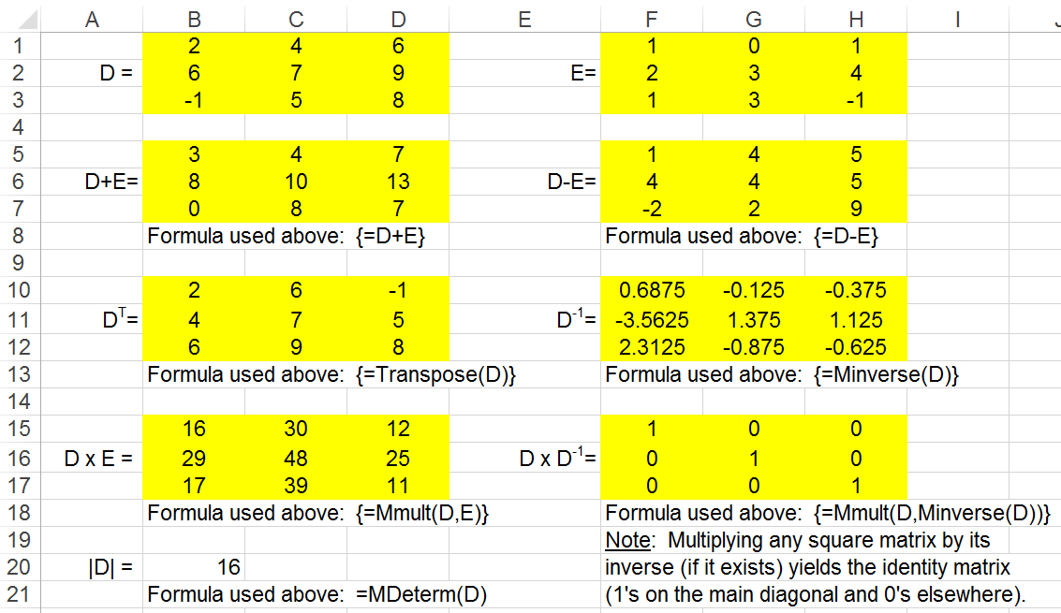
For reference only
39
Excel C EGR 120 – Introduction to Engineering
Example: Other matrix operations

Slide 40
For reference only
40
Excel C EGR 120 – Introduction to Engineering
Solving Simultaneous Equations using Matrices - Background
Suppose that we want to solve the following two simultaneous equations:
3x₁ + 4x₂ = 14
-5x₁ + 2x₂ = 20
These equations can be written in the matrix form Ax = b shown below:
Matrix A
Matrix x
Matrix b
The matrix equation Ax = b can be solved by pre-multiplying both sides of the equation by A⁻¹
Ax = b
A⁻¹Ax = A⁻¹b
Ix = A⁻¹b, where I is the identity matrix and AA⁻¹ = A⁻¹A = I
x = A⁻¹b, so solve this equation to find x₁ and x₂
x = A⁻¹b
Key matrix equation for solving simultaneous equations.

Slide 41
For reference only
41
Excel C EGR 120 – Introduction to Engineering
Example - Solving Simultaneous Equations using Matrices in Excel
Solve the same two simultaneous equations illustrated on the previous slide:
3x₁ + 4x₂ = 14
-5x₁ + 2x₂ = 20
Steps:
Enter the values for A and b. Highlight and name the data ranges as A and b.
Highlight the two cells where the result should be placed (C5:C6 in this case).
Type the formula = Mmult(Minverse(A),b) and press Ctrl + Shift + Enter.
The results should appear in the highlighted area. Note that x₁ = -2 and x₂ = 5.

Slide 42
For reference only
42
Excel C EGR 120 – Introduction to Engineering
Try It! Use matrix operations in Excel to perform the following operations.
Enter matrices F and G below and assign names to them.
Find H = F + G
Find F^{T}, |F|, and F⁻¹
Solve the following three simultaneous equations: (Answer: x = 2, y = 3,and z = 6)

