Slide 1
Excel B EGR 120 – Introduction to Engineering
Microsoft Excel – Creating Graphs
Reading Assignment: Chapter 14 in Engineering Fundamentals – An Introduction to Engineering, 5E by Moaveni
Homework Assignment: Homework Assignment – Excel B
Equation determined using linear regression.
Trendline

Slide 2
Excel B EGR 120 – Introduction to Engineering
Graphing with Excel
Many software packages, including Excel, have excellent graphing capabilities. However, if care is not taken to use good graphing practices and standards, Excel can easily be used to generate poor graphs. Several features related to good graphing practices are discussed below. These practices for good graphing should be used whenever graphs are generated using Excel, MATLAB, or any software.
Good Graphing Practices and Graphing Terminology
Using the best type of graph.
Identify the independent and dependent variables.
Label the axes and add a title to the graph.
Choose proper calibrations for each axis.
Display the results correctly: Markers? Lines? Connect dots? Smooth curve?
Methods for drawing a smooth curve (for empirical data)
Linear versus log scales and types of trendlines

Slide 3
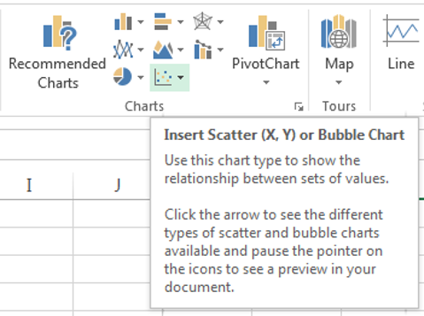
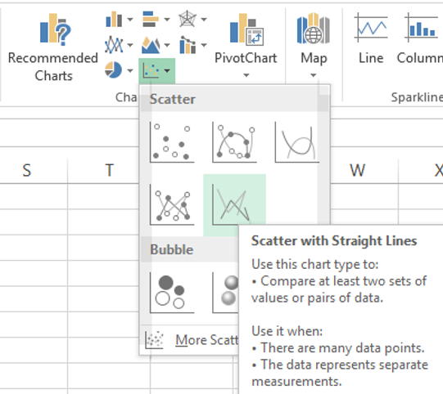
Excel B EGR 120 – Introduction to Engineering
1. Using the best type of graph
Excel offers many types of graphs (referred to as charts)
The following tools appear on the Insert menu:
Pause the mouse over each chart tool for a description.
Select the arrow next to each chart tool for additional options.

Slide 4
Excel B EGR 120 – Introduction to Engineering
1. Using the best type of graph
The most common type of Excel chart used for engineering courses is the scatter graph.
Students often incorrectly select the line graph. Line graphs are used for non-numeric data on the x-axis, such as days of the week or months.
Avoid this
Use this

Slide 5
Excel B EGR 120 – Introduction to Engineering
2. Identify the independent and dependent variables
The x-axis is used to display the independent variable.
The y-axis is used to display the dependent variable.
Note that in an equation y = f(x), the value of y depends on the value of x inserted into the function.
y = f(x)
dependent
variable
independent
variable
x
So if you have data values for P and Q, which goes on the y-axis?
If you want to express P = f(Q), then P goes on the y-axis.
If you want to express Q = f(P), then Q goes on the y-axis.

Slide 6
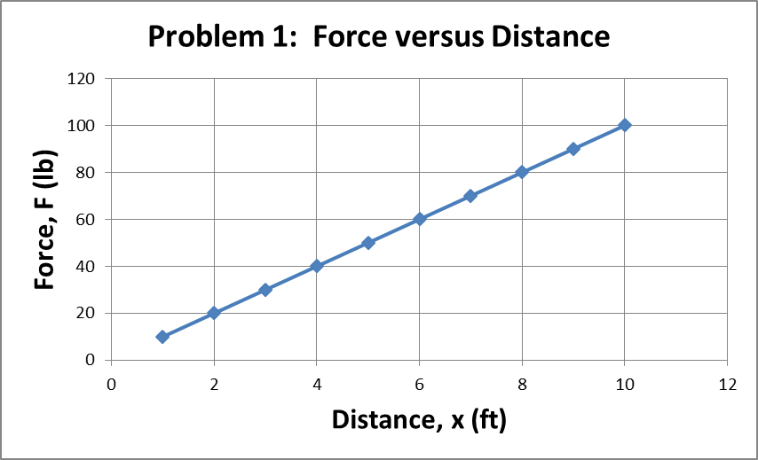
Excel B EGR 120 – Introduction to Engineering
Label the axes and add a title to the graph
Include the variable name, variable symbol, and units for each axis. Also add a descriptive title.
Example:
title
axis labels
variable
name
unit
variable
symbol

Slide 7
Excel B EGR 120 – Introduction to Engineering
4. Choose proper calibrations for each axis
Graphs with poor calibrations (numbers on the axes) are difficult to interpolate, or estimate values between the calibrations.
Use the “1, 2, 5 rule”. Pick calibrations that are 1, 2, or 5 times 10^{N}, where N is an integer. (In other words, increments of (⋅ ⋅ ⋅ 0.1,0.2,0.5 or 1,2,5 or 10,20,50 ⋅ ⋅ ⋅ )
Excel generally does this for you automatically. Other graphing programs may not (such as MatLab or MathCAD).
Example: See next slide.

Slide 8
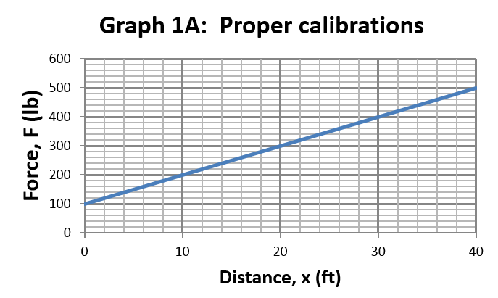
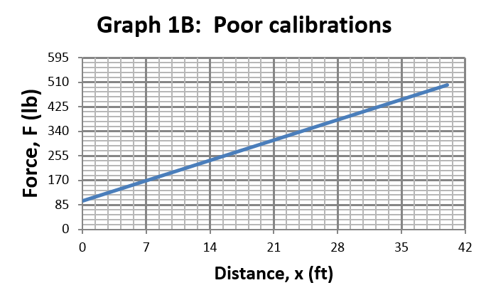
Excel B EGR 120 – Introduction to Engineering
4. Choose proper calibrations for each axis
Example: The same function is graphed twice below.
Point is easy to read as (32,420)
Point is hard to read
“1,2,5 rule” was used.
10 = 1 x 10¹
“1,2,5 rule” was NOT used.
7 ≠ 1x10^{N}, 2x10^{N} or 5x10^{N}

Slide 9
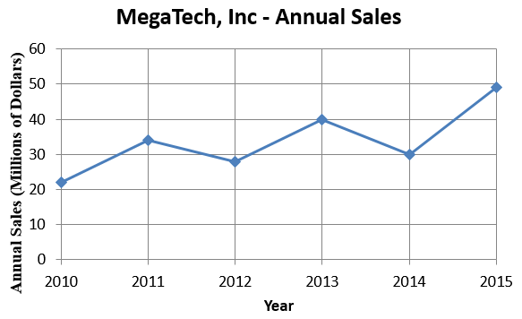
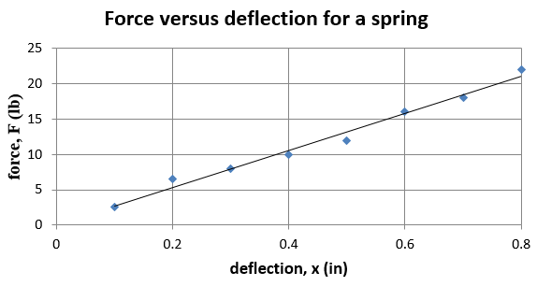
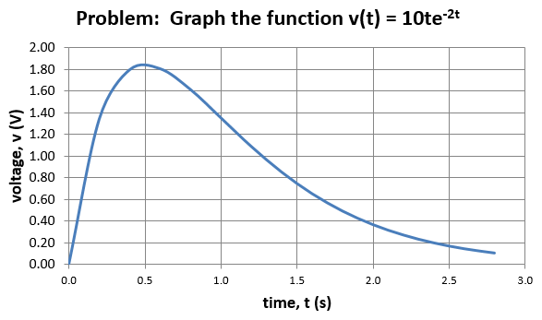
Excel B EGR 120 – Introduction to Engineering
5. Display the results correctly
Should you show the data points? It depends.
Should you connect the points or show a smooth curve? It depends.
Consider three types of quantities to be graphed with different rules for each:
observed data
empirical data
Observed data
Show data points
Connect the data points (“dot-to-dot”)
Empirical data – most engineering graphs
Show data points
Use a “smooth curve”
Theoretical curve
Do NOT show data points
Use a “smooth curve”
Theoretical curve

Slide 10
Excel B EGR 120 – Introduction to Engineering
5. Display the results correctly
A. Observed data
This type of data has no assumed form (we do not expect it to follow some mathematical formula).
Show data points and connect them (“dot-to-dot”).
Example: Annual sales are not known to be linear, exponential, etc., so we simply show the data points and connect them.
observed data

Slide 11
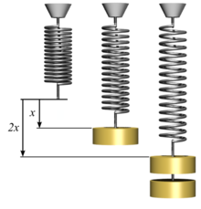
Excel B EGR 120 – Introduction to Engineering
5. Display the results correctly
B. Empirical data
This type of data is assumed to follow some mathematical formula and thus should be displayed using a “smooth curve” rather than by connecting the points.
Most engineering data will be of this type.
Reference: http://en.wikipedia.org/
Example: A linear curve (straight line) is used to represent the point since the data is assumed to follow Hook’s Law, F = kx.
empirical data

Slide 12
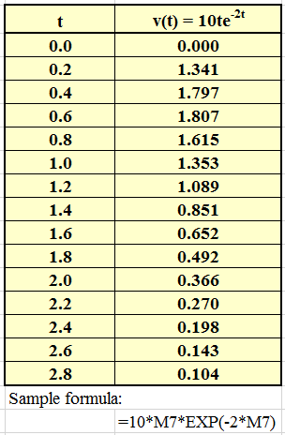
Excel B EGR 120 – Introduction to Engineering
5. Display the results correctly
C. Theoretical functions
When graphing a mathematical function we sometimes generate a few “points” in a spreadsheet, but the points picked are not data, so use a smooth curve, but do not show the points.
Example: Graph the function v(t) = 10te^{-2t} using Excel. To graph this function we need to generate some “points”, but these aren’t data points and we could have used other points (increments of 0.25 or 0.3 perhaps), so we don’t show the points. We use a smooth curve since it is a continuous function.
Theoretical curve

Slide 13
Excel B EGR 120 – Introduction to Engineering
6. Methods for drawing a smooth curve (for empirical data)
Consider three ways to draw a smooth curve.
Visual estimation
This method is not precise and results will vary. This is what you do when you create a graph by hand (perhaps using a ruler).
B. Method of least averages
This is a statistical method intended to generate the line (or curve) that will result in the least average error between the line and the data points.
This seems to be the best method intuitively, but the next method is preferred.
C. Method of least mean squares (linear regression)
This is a statistical method intended to generate the line (or curve) that will result in the least average square error between the line and the data points.
This is generally considered to be the method that produces the line that best fits the data. This method is used by Excel when you pick “Add a trendline.”
Linear regression determines the slope, m, and the intercept, b, of the line that best fits the data. It also determines the correlation coefficient, R².

Slide 14
Excel B EGR 120 – Introduction to Engineering
How does linear regression work?
Linear regression, or the method of least mean squares, is a method for determining the equation of a straight line that best fits a set of data.
In the graph shown below, linear regression calculates the slope and intercept of the line such that (Δ₁)² + (Δ₂)² +(Δ₃)² +(Δ₄)² +(Δ₅)² is minimized.

Slide 15
Excel B EGR 120 – Introduction to Engineering
How does linear regression work? (continued)
The equation of a line can be represented as y = mx + b, where
m = slope b = y-intercept
In an upper-level statistics class students might see a derivation for the formulas used to calculate m and b based on the method of linear regression. The formulas are shown below. Note that:
n = number of data points

Slide 16
Excel B EGR 120 – Introduction to Engineering
The correlation coefficient gives a measure how good the trendline fits the data or how well you can trust the equation.
Values of R are as follows:
-1 < R < 1
or
0 < R² < 1
where R² = 1 represents a prefect fit and R² ⁼ 0 represents the worst possible fit.
What constitutes a “good fit” depends on many factors, including the number of points and the range of the data, but for this class we might consider R² > 0.95 to be a good fit.
Correlation Coefficient, R

Slide 17
Excel B EGR 120 – Introduction to Engineering
How does linear regression work? (continued)
Let’s try an example. Use the linear regression formulas for m and b to calculate the linear equation that best fits the data shown below.
t | f(t)
1 | 30
3 | 45
5 | 50
7 | 60
9 | 80
Try it! Graph these data points in Excel, add a linear trendline, and see if you get the same equation and R² shown below. You should!
y = 5.75x + 24.25
R² = 0.9582
So this is what Excel does when you select “Add a trendline.” It performs these calculations of m and b for the best fit line (y = mx + b) and then it adds the line to your graph!

Slide 18
Excel B EGR 120 – Introduction to Engineering
Linear versus log scales and types of trendlines
Linear or log scales are used with different types of trendlines as shown below:
1) linear equation: y = mx + b
an equation of this form will exhibit a straight-line relationship on linear scales used for the x and y axes
2) exponential equation: y = be^{mx}
taking the natural log of both sides of the equation yields ln(y) = mx + ln(b)
an equation of this form will exhibit a straight-line relationship if the y-axis is on a log scale and the x-axis is on a linear scale.
3) logarithmic equation: y = mln(x) + b
an equation of this form will exhibit a straight-line relationship if the y-axis is on a linear scale and the x-axis is on a log scale.
4) power equation: y = bx^{m}
taking the log of both sides of the equation yields log(y) = mlog(x) + log(b)
an equation of this form will exhibit a straight-line relationship if both the y-axis and the x-axis are both on log scales.
5) polynomial equation: y = A₀ + A₁x + A₂x² + A₃x³ + … + A_{N}x^{N} (Nth-order)
the data does not typically exhibit a straight-line relationship with any combination of log or linear scales, so use linear scales for both axes.

Slide 19
Excel B EGR 120 – Introduction to Engineering
Linear versus log scales - Summary
Note that Excel will perform a regression analysis (by adding a trendline) for any of the types of equations listed on the previous slide no matter what scales are used on the axes. However, it is common to use the types of axes indicated below:
Type of Equation | x-axis | y-axis
Linear | Linear | Linear
Exponential | Linear | Log
Logarithmic | Log | Linear
Power | Log | Log
Polynomial | Linear | Linear
Learn this table and use it on all graphing assignments
Now that good graphing practices have been discussed, graphing with Excel will be covered.

Slide 20
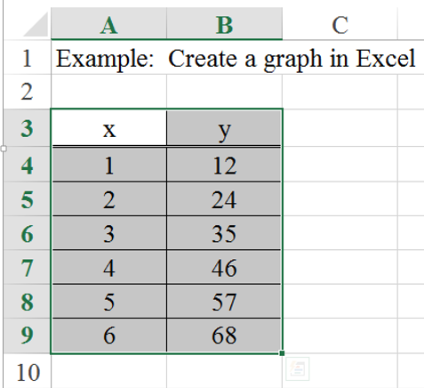
Excel B EGR 120 – Introduction to Engineering
Basic steps in creating an xy graph:
Create the table of information
It is easiest if the x (independent) values are in the column to the left of the y values, but it is not necessary.
Highlight the entire table (You can highlight the headings also.)
Try It! Open Excel, create this table, and then switch back and forth between Excel and these PowerPoint notes to continue following the example.
Note: Excel likes to use the word chart instead of graph. The terms are interchangeable.

Slide 21
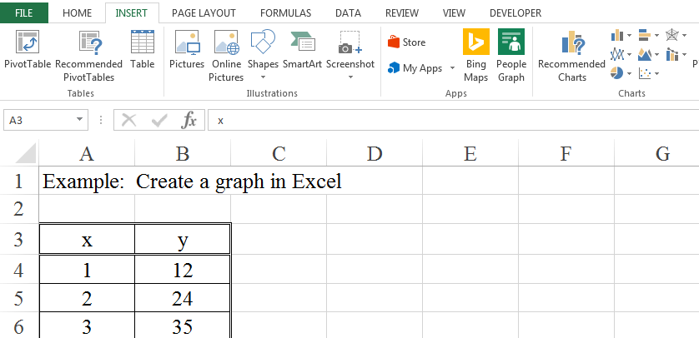
Excel B EGR 120 – Introduction to Engineering
Basic steps in creating an xy graph:
Select the Insert ribbon and the type of chart
Several types of charts are now available on the ribbon.
For engineering data, we will typically use a scatter chart.
Do NOT select a Line Chart. Line charts are typically used for non-numeric data on the x-axis.
Select a scatter graph for xy data.

Slide 22
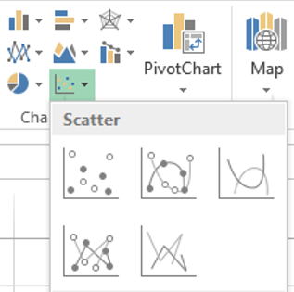
Excel B EGR 120 – Introduction to Engineering
Basic steps in creating an xy graph:
Select the type of scatter graph. Note that there are 5 options.
If you plan on adding a trendline so that Excel will determine the equation that best fits the data, select Markers only.
If you do not plan to add a trendline, select whichever type is appropriate.
Use Markers only for this example
Smooth Line and Markers.
Markers only. Use this option if you plan to add a trendline.
Smooth Line only.
Straight Line only.
Straight Line and Markers.

Slide 23
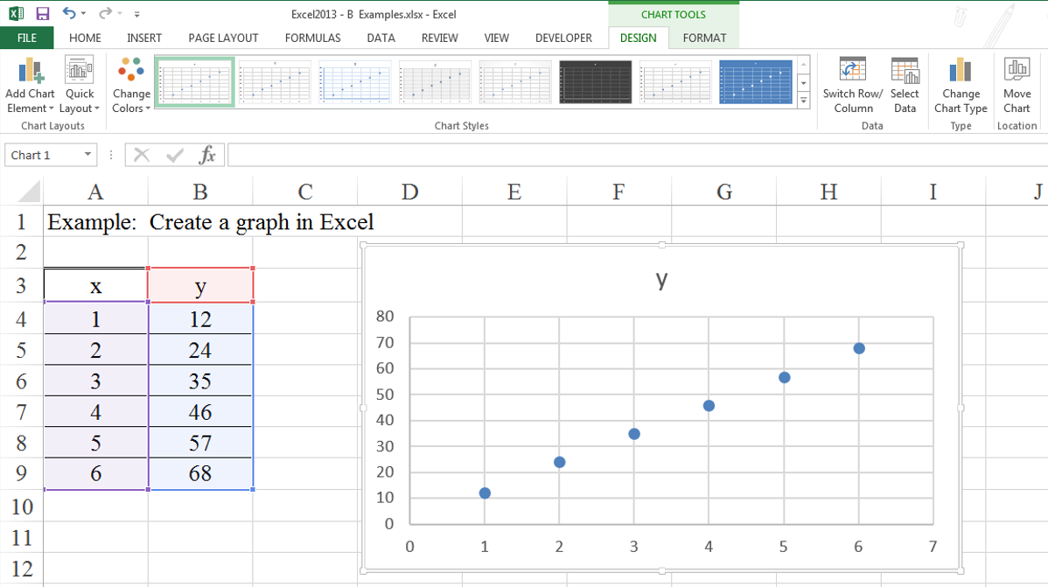
Excel B EGR 120 – Introduction to Engineering
Basic steps in creating an xy graph:
The graph should now appear in the spreadsheet.
Excel puts data in the left column on the x-axis and data on the right column on the y-axis by default.
Note that the graph still needs to be formatted.

Slide 24
Excel B EGR 120 – Introduction to Engineering
Basic steps in creating an xy graph:
Formatting the graph
Excel uses “context-sensitive” ribbons, so when you click on the graph the ribbons change. There are two key ribbons used for charts.
Try It! Explore some of the features on each ribbon.
Design ribbon
Format ribbon

Slide 25
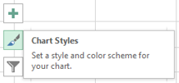
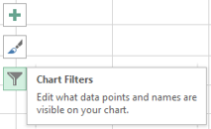
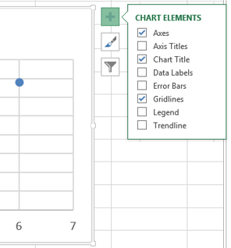
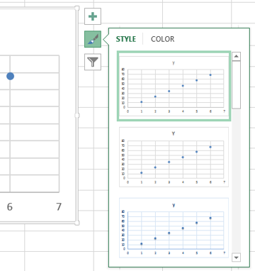
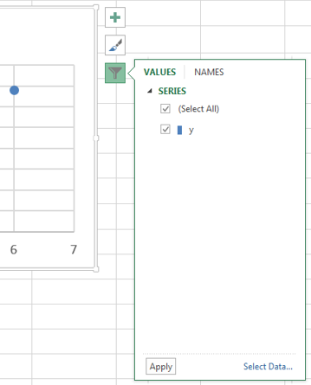
Excel B EGR 120 – Introduction to Engineering
Formatting the graph (continued)
Three useful tools also appear next to a graph when you select it.
Pause over each tool for a brief description or select it for details.

Slide 26
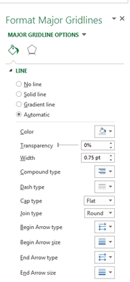
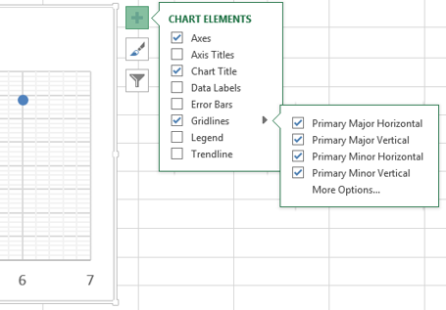
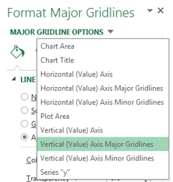
Excel B EGR 120 – Introduction to Engineering
Formatting the graph - Adding gridlines
Check the desired gridline options or pick More Options..

Slide 27
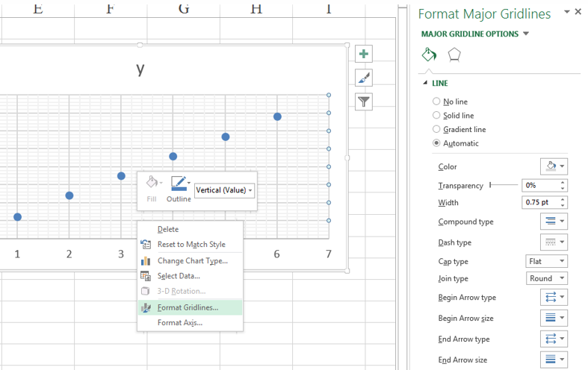
Excel B EGR 120 – Introduction to Engineering
Formatting the graph - Adding gridlines
Another method for adding or formatting gridlines is to right-click on a gridline and select Format Gridlines…

Slide 28
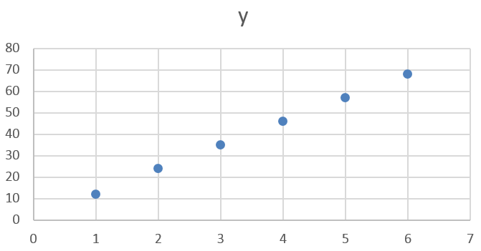
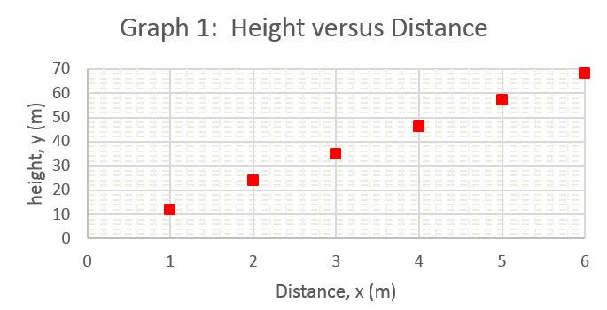
Excel B EGR 120 – Introduction to Engineering
More on Graph Formatting:
Using the last example graph, try the following formatting features:
Title: Add a title to the graph.
Axis labels: Add labels to the x and y axes.
Max and Min values: Change the max y value to 70 and the max x value to 6.
Gridlines: Add major and minor gridlines on both axes.
Gridline type: Change the minor gridlines to dotted lines.
Markers: Change the markers to red squares.
Others? Experiment with other graph formatting features.
Try It! Add the formatting indicated to the graph.
Original graph
Formatted graph

Slide 29
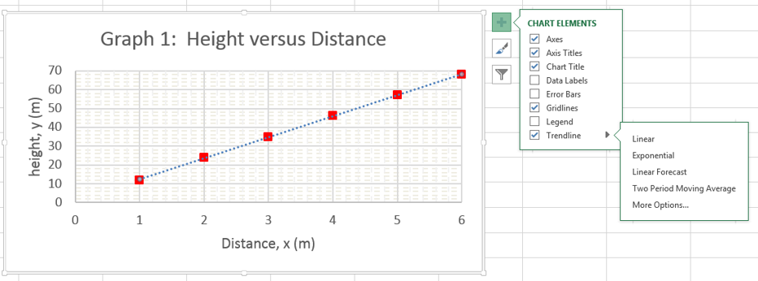
29
Excel B EGR 120 – Introduction to Engineering
Trendlines
Adding a trendline to your graph instructs Excel to analyze your data points in order to determine the line that best fits your data using linear regression.
Options include displaying the equation and the correlation coefficient, R².
Several types of trendlines are available, including linear, exponential, power, etc.
Example: For the last graph add a linear trendline.

Slide 30
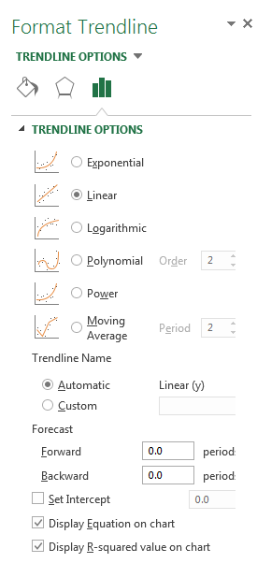
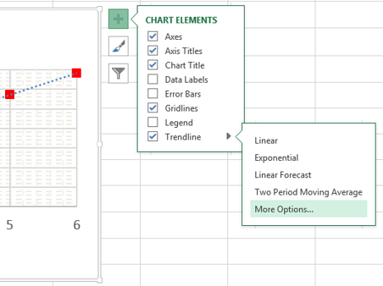
30
Excel B EGR 120 – Introduction to Engineering
Trendlines (continued)
Select More Options… in order to:
Pick the type of trendline
Display the equation
Display the value of R²
6 types of trendlines are available
Check the boxes to show both the equation and the value of R²

Slide 31
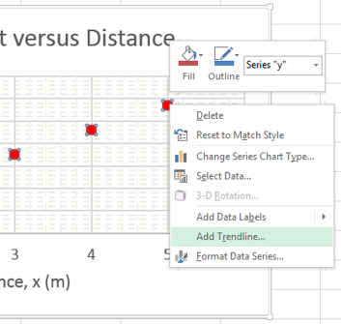
31
Excel B EGR 120 – Introduction to Engineering
Trendlines (continued)
Another way to add a trendline is to right-click on any data point and select Add Trendline…

Slide 32
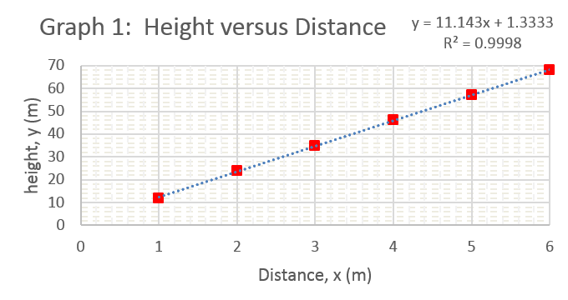
32
Excel B EGR 120 – Introduction to Engineering
Trendlines (continued) – Final Result:
Be sure to move the trendline equation to an easy to view location (it may be on top of the graph).
Note that R² is close to 1 indicating a very good fit.
Trendline Equation and R²
trendline

Slide 33
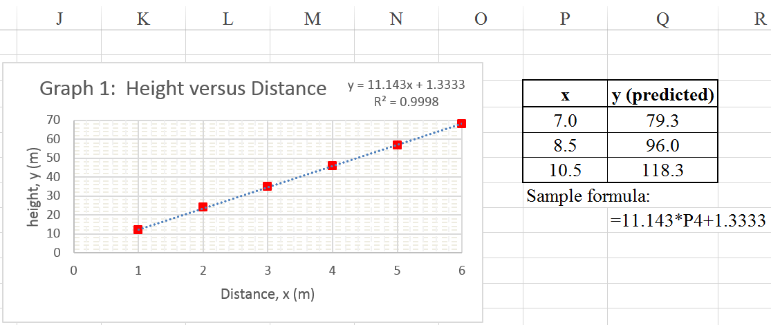
33
Excel B EGR 120 – Introduction to Engineering
Trendlines – Using the trendline equation to predict values
The trendline equation can be used to predict other (x, y) values.
Example: Use the trendline equation to predict y for x = 7.0, 8.5, and 10.5.
Discuss the results shown below.
Note that 11.143(10.5) + 1.333 = 118.3

Slide 34
34
Excel B EGR 120 – Introduction to Engineering
Class Example: Linear Regression
The data from slide 17 (“How does linear regression work?”) is shown below.
Create the table of values
Highlight the table and select
Insert – Scatter Chart – Markers Only
Add a title and axis labels to the graph
Log or linear scales? Check table on slide 19.
Add gridlines to the graph
Add a linear trendline to determine a linear equation that represents the data.
Verify that the results are the same as from slide 17:
y = 5.75x + 24.25
R² = 0.9582
Use the trendline to predict the f(t) for t = 10, 15, and 20 (show these values in a separate table). Include a sample Excel equation.
t | f(t)
1 | 30
3 | 45
5 | 50
7 | 60
9 | 80

Slide 35
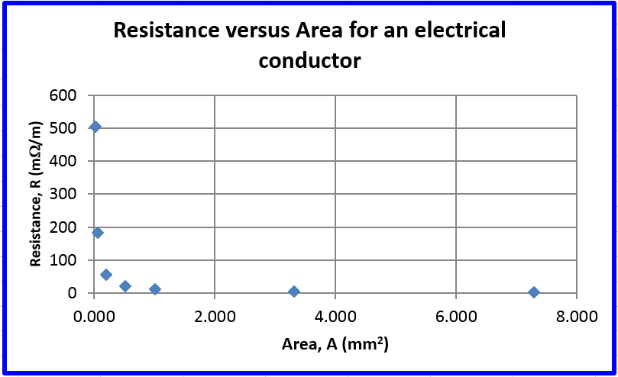
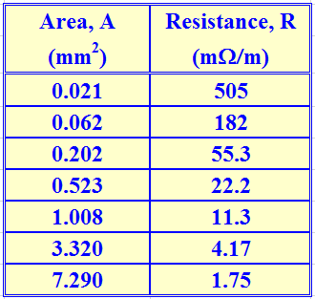
34
Excel B EGR 120 – Introduction to Engineering
Example: Power Regression
Plot R vs A and find a power formula that expresses R in terms of A (i.e., y = bx^{m} or R = bA^{m})
Recall that power functions are typically graphed using log scales for both axes.
Create the table of values
Highlight the table and select
Insert – Scatter Chart – Markers Only
Add a title and axis labels to the graph
Add gridlines to the graph

Slide 36
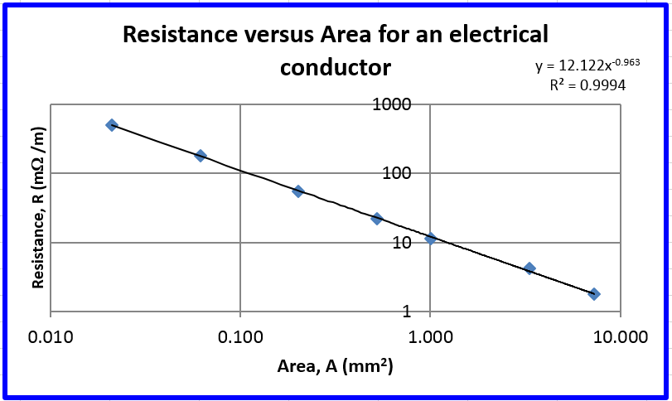
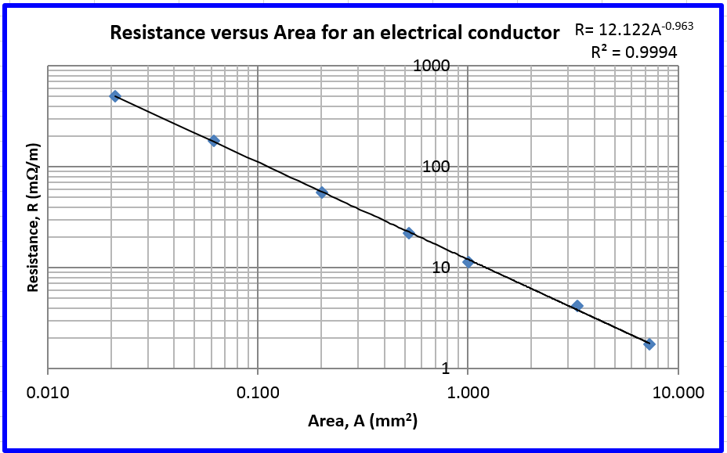
35
Excel B EGR 120 – Introduction to Engineering
Example: Power Regression (continued)
Switch both axes to use log scales
Add a trendline (power) – be sure to check the boxes to display the formula and the value of R²
Add minor gridlines to both axes
Problem: Excel uses default axis crossings of 0 on linear scales and 1 on log scales. It would be nicer to let the y-axis cross the x-axis at x = 0.010 in this case (see next slide).

Slide 37
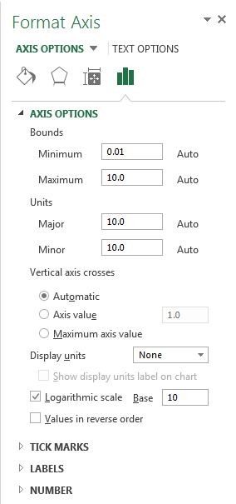
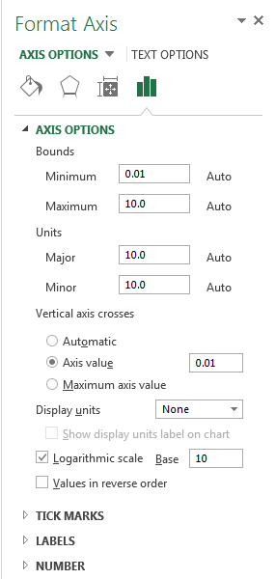
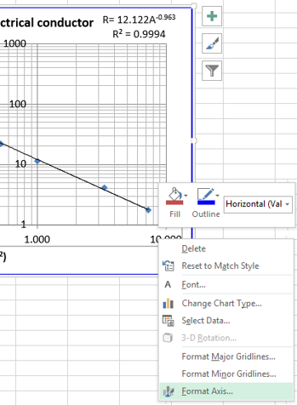
36
Excel B EGR 120 – Introduction to Engineering
Example: Power Regression (continued)
Interesting Note: The location of the y-axis values is an x-axis property!
Right-click on the x-axis and select Format Axis…
Change where the vertical axis crosses the x-axis.

Slide 38
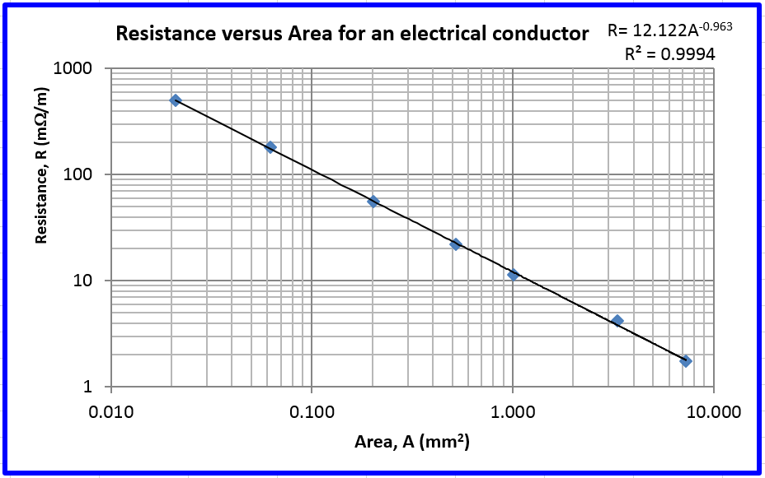
37
Excel B EGR 120 – Introduction to Engineering
Example: Power Regression (continued)
Change the trendline equation so that it uses R and A instead of x and y.
Final graph:
Warning: If variables are changed in the trendline, it will no longer be active, so updating data in the table will change the graph, but not the trendline.) Another option is to use the Equation Editor to display the result using R and A.

Slide 39
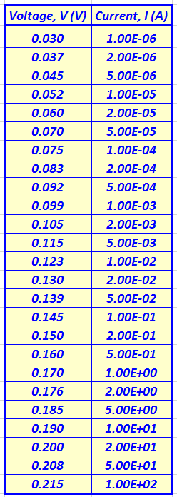
38
Excel B EGR 120 – Introduction to Engineering
Which trendline to use? What if the relationship between our (x, y) data is uncertain so we don’t know which trendline to use? One approach might be to graph the data using various types of trendlines to see which fits the best (R² closest to 1).
Example: Measured voltage and current values for a diode are shown to the right. Graph the following data 4 times, using linear, logarithmic, exponential, and power trendlines to see which fits the best. In each case use log or linear scales as appropriate (recall the table repeated below).
Type of Equation | x-axis | y-axis
Linear | Linear | Linear
Exponential | Linear | Log
Logarithmic | Log | Linear
Power | Log | Log
Polynomial | Linear | Linear

Slide 40
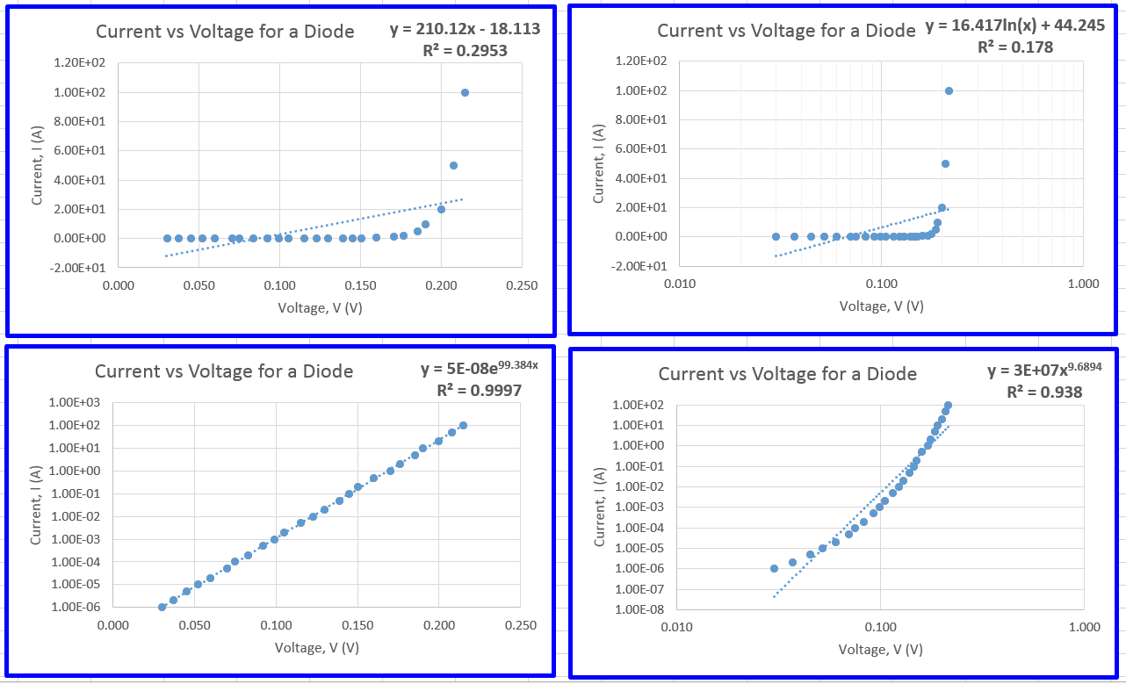
39
Excel B EGR 120 – Introduction to Engineering
Example: (continued)
Which trendline fits best? How can you tell?
Were the correct linear/log scales used in each case?
linear trendline
logarithmic trendline
exponential trendline
power trendline

Slide 41
34
Excel B EGR 120 – Introduction to Engineering
Class Example - Power Regression
Power formulas are very common. For example, the formula for the area of a circle is a power formula: A = πR². Suppose that someone drew circles with different radii and measured the area for each circle. They might then use power regression to find the formula. Let’s try it.
Create the table of values
Highlight the table and select
Insert – Scatter Chart – Markers Only
Add a title and axis labels to the graph
Add gridlines to the graph
Add a power trendline to determine a power equation that represents the data.
Display the equation and the value of R².
Log or linear scales? Check table on slide 19.
Add minor gridlines
Use the trendline to predict the area of circles with R = 30, 100, and 200 (show these values in a separate table). Include a sample Excel equation.
Radius, R (cm) | Area, A (cm²)
0.1 | 0.30
0.2 | 0.125
0.5 | 1.75
1 | 3.25
2 | 13.5
5 | 81.5
10 | 325
20 | 1275
50 | 8000

Slide 42
34
Excel B EGR 120 – Introduction to Engineering
Class Example - Exponential Regression
Data for a silicon diode is shown below. Voltage is the independent variable.
Create the table of values
Highlight the table and select
Insert – Scatter Chart – Markers Only
Add a title and axis labels to the graph
Add gridlines to the graph
Add a exponential trendline to determine an exponential equation that represents the data.
Display the equation and the value of R².
Log or linear scales? Check table on slide 19.
Add minor gridlines
Use the trendline to predict the diode current for voltages of 1.0, 1.1, and 1.2V (show these values in a separate table). Include a sample Excel equation.
Voltage, V (V) | Current, I (A)
0.53 | 0.01
0.57 | 0.02
0.60 | 0.05
0.65 | 0.1
0.72 | 0.2
0.77 | 0.5
0.82 | 1
0.88 | 2
0.93 | 5
0.99 | 10

