Slide 1
Engineering Societies EGR 120 – Introduction to Engineering
Engineering Societies
Pass around the following items:
Journals/Magazines from various societies

Slide 2
Engineering Societies What is an Engineering Society? The word “society” sometimes gives the misleading impression that an engineering society is just some sort of social forum for getting engineers together. Engineering societies are much more than that. They play an extremely important role in the engineering profession. They have several important roles as listed below.
Engineering Societies EGR 120 – Introduction to Engineering
Key Functions of Engineering Societies 1. The sharing of ideas 2. Development of standards 3. Professional feedback 4. Promotion of the profession/public service 5. Codes of Ethics 6. Assisting ABET in setting standards for engineering programs

Slide 3
Engineering Societies There are currently close to 100 professional engineering societies. Examples include organizations such as:
Engineering Societies EGR 120 – Introduction to Engineering
ASME – American Society for Mechanical Engineering
ASCE – American Society for Civil Engineering
IEEE – Institute of Electrical & Electronics Engineering
SME – Society of Manufacturing Engineers
SAE – Society of Automotive Engineers
AAEE – American Academy of Environmental Engineers
AIAA – American Institute of Aeronautics and Astronomics
NSPE – National Society of Professional Engineers
SWE – Society of Women Engineers
NSBE – National Society of Black Engineers
ASEE – American Society for Engineering Education

Slide 4
Key functions of an Engineering Society
Engineering Societies EGR 120 – Introduction to Engineering
1. The sharing of ideas
Transactions or journals are published in very specific areas to keep engineers informed about new developments and research within their area of expertise.
The journals are very specific. For example, IEEE alone has over 100 different journals, with titles including:
The IEEE Transactions on Applied Superconductivity
The IEEE Transactions on Cloud Computing
The IEEE Transactions on Biomedical Circuits and Systems

Slide 5
Key functions of an Engineering Society
Engineering Societies EGR 120 – Introduction to Engineering
The instructor may pass around a few sample journals and transactions.
1. The sharing of ideas (continued)
Why are journals important?
Societies typically publish less technical magazines as well, such as IEEE Spectrum, which is aimed toward all engineers in a given discipline. Other magazines, like IEEE Communications target specific areas with related articles.

Slide 6
Key functions of an Engineering Society
Engineering Societies EGR 120 – Introduction to Engineering
2. Development of standards
Why are standards important?
Some standards are familiar to the average person, while others are familiar only professionals within a given area.
Examples:
IEEE 1754 – Standard for 32-bit Microprocessor Architecture
IEEE 488 Bus
SAE standards for viscosity of oil (such as SAE 10W40 motor oil)
ASME standards for pipe sizes, bolt sizes, thread sizes, etc

Slide 7
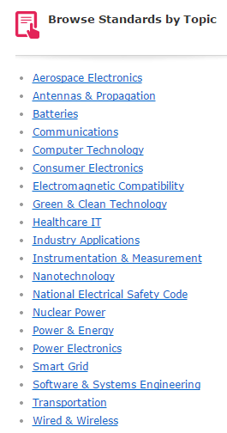
Engineering Societies EGR 120 – Introduction to Engineering
2 of hundreds of standards for computer technology:

Slide 8
Key functions of an Engineering Society
Engineering Societies EGR 120 – Introduction to Engineering
3. Professional feedback
Local chapters
Conferences
Committees
Seminars
Student Chapters (more on this later)

Slide 9
Key functions of an Engineering Society
Engineering Societies EGR 120 – Introduction to Engineering
4. Promotion of the profession/public service
Legislative issues related to engineering
National Engineer’s Week
MathCOUNTS
Future City
CANstruction
Speakers
Judges in competitions

Slide 10
Key functions of an Engineering Society
Engineering Societies EGR 120 – Introduction to Engineering
5. Codes of Ethics
Enhancing the integrity of the engineering profession is an important concern
Most societies have a written code of ethics
More on this topic later
6. Assisting ABET in Setting Standards for Engineering Programs
Consider the following excerpt from ABET’s web site:
“The quality standards programs must meet to be ABET-accredited are set by the ABET professions themselves. This is made possible by the collaborative efforts of many different professional and technical societies. These societies and their members work together through ABET to develop the standards, and they provide the professionals who evaluate the programs to make sure they meet those standards.”
Also look back at the ABET criteria for Civil Engineering Programs and note the statement: Lead Society: American Society of Civil Engineers

Slide 11
Student Chapters Most Engineering Societies have student chapters with greatly reduced membership costs. These student chapters are typically very active, with benefits such as:
Engineering Societies EGR 120 – Introduction to Engineering
Guest speakers
Industrial tours
Opportunities for leadership and teamwork
Scholarships
Resume enhancement
Competitions
Why get involved in competitions?
Design/teamwork experience
Realistic design challenges
Important connections with sponsors for internships & jobs
Credit for technical electives
Resume enhancement
Fun & travel
See examples to follow

Slide 12
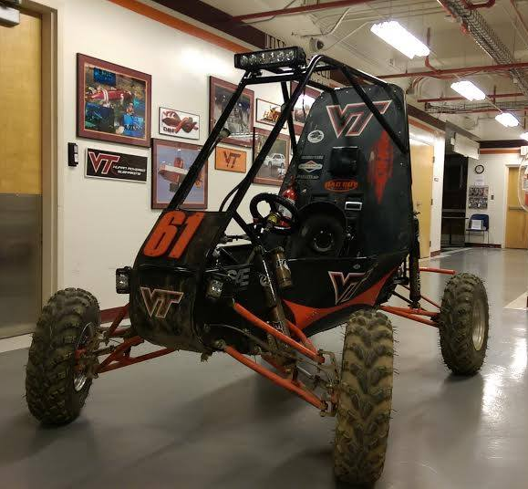
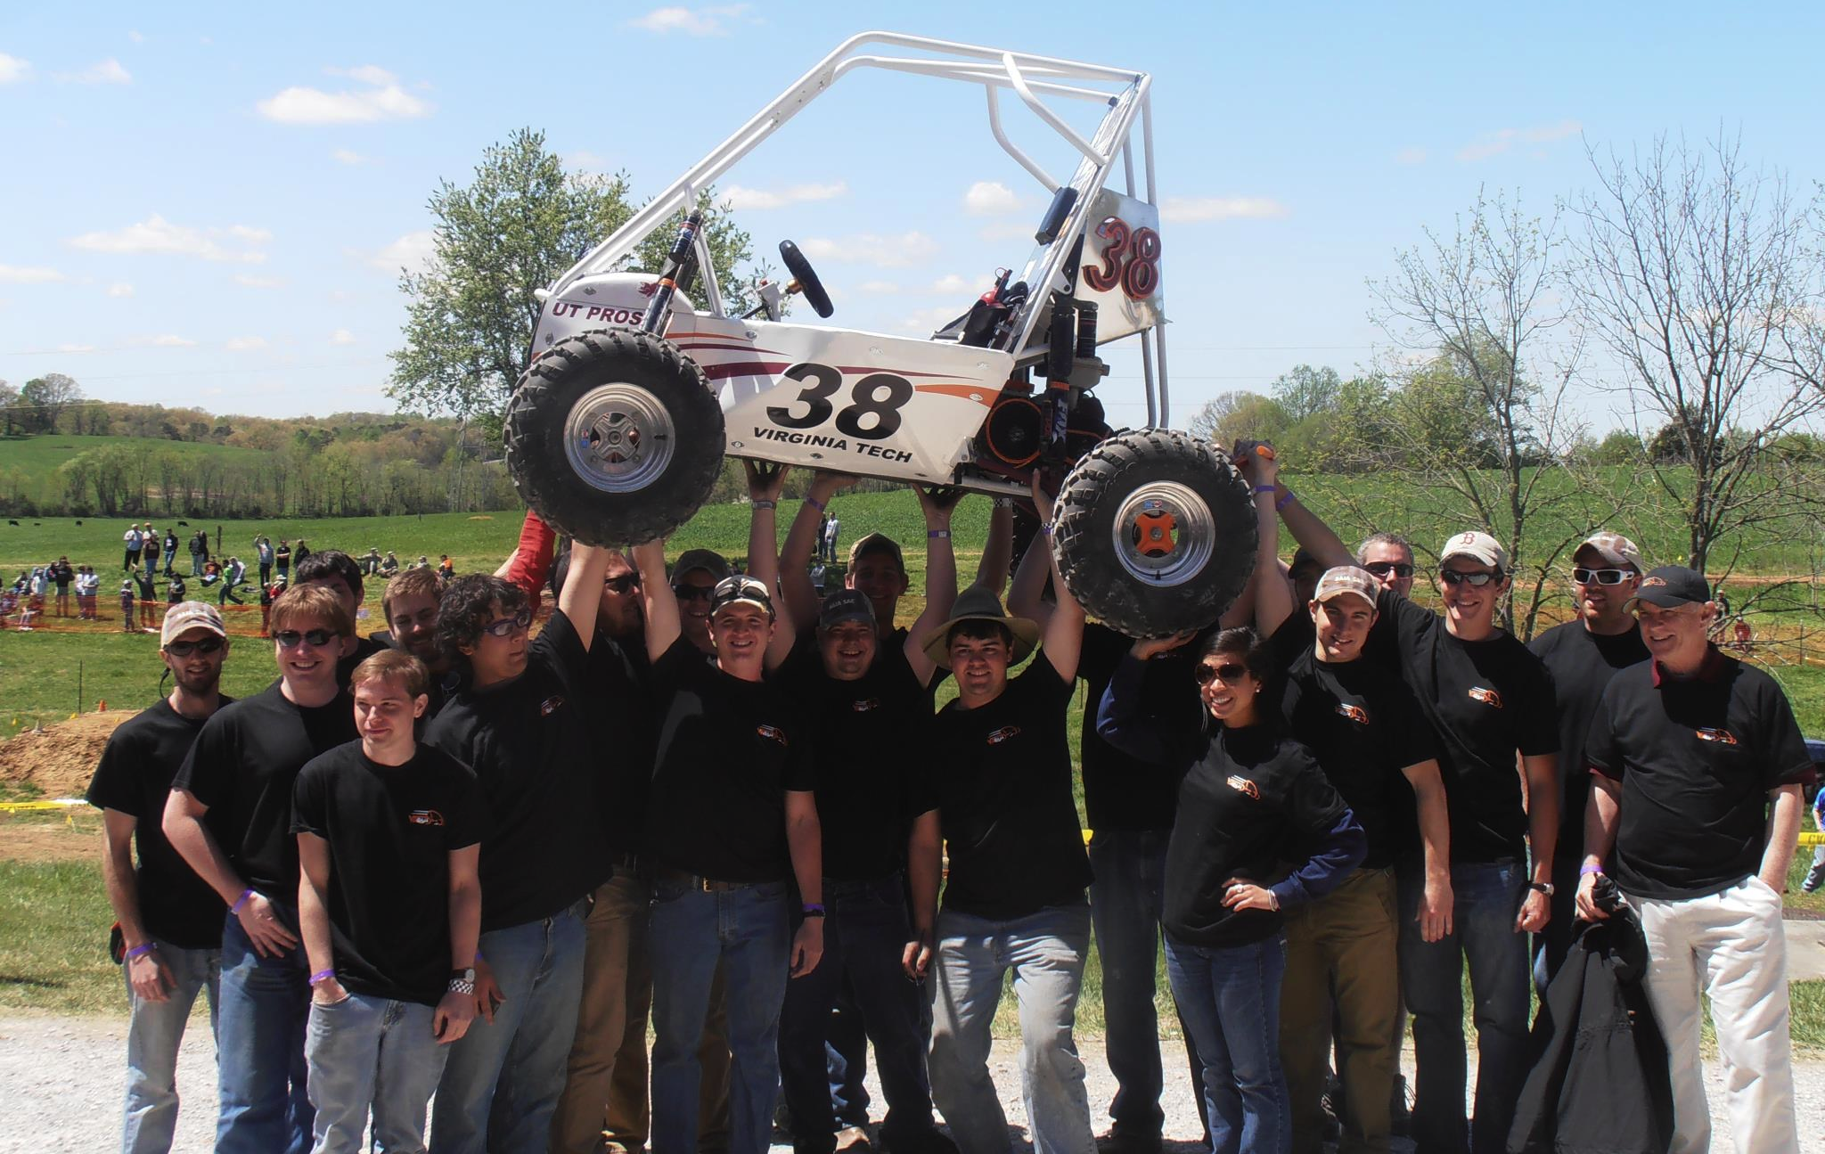
Engineering Societies EGR 120 – Introduction to Engineering
Welcome to the official website of Virginia Tech Baja. Our team's mission is to design and construct a single-seat off-road vehicle to meet the rules set forth by the Society of Automotive Engineers. After thorough testing of a prototype vehicle, a production vehicle will be fabricated and subsequently entered for international SAE sanctioned competition. https://sites.google.com/site/vtbajasae/home
Check out their video:
https://www.youtube.com/watch?v=7-FwO6WVwV4
http://www.sae.org/

Slide 13
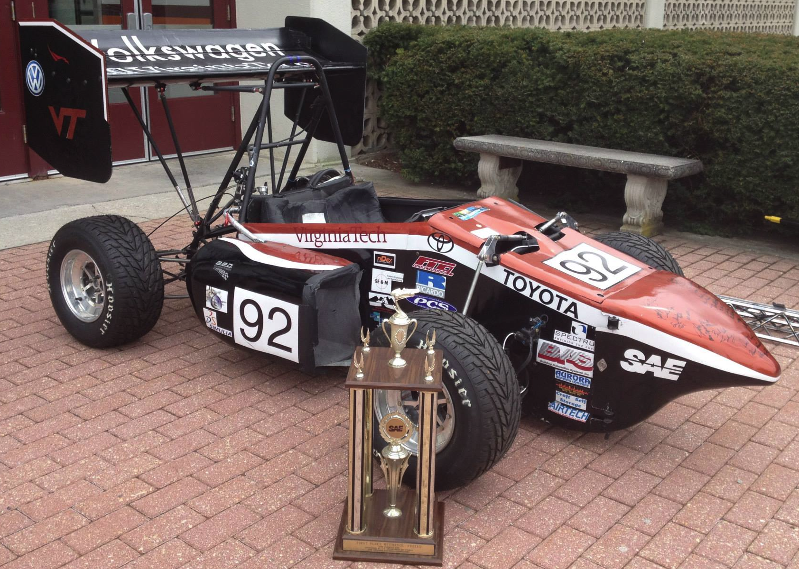
Engineering Societies EGR 120 – Introduction to Engineering
https://www.youtube.com/watch?v=_clsbkk0ptI
What is FSAE?
Competition Objective: The Formula SAE competition is for SAE student members to conceive, design, fabricate, and compete with small formula-style racing cars. The restrictions on the car frame and engine are limited so that the knowledge, creativity, and imagination of the students are challenged. The cars are built with a team effort over a period of about one year and are taken to the annual competition for judging and comparison with approximately 130 other vehicles from colleges and universities throughout the world. The end result is a great experience for young engineers in a meaningful engineering project as well as the opportunity of working in a dedicated team effort.
http://www.vtmotorsports.com/index.php

Slide 14
Engineering Societies EGR 120 – Introduction to Engineering
IEEE Southeastcon Hardware Competition
The IEEE Hardware Competition typically involves designed an autonomous vehicle to perform a challenging task. The track shown below was for a recent competition. Student teams designed solar-powered vehicles (that were originally discharged ) that had 3 minutes to sit under one of the 4 lights suspended over the track and to navigate the track. For example, a vehicle might charge for two minutes and navigate for 1 minute. Points could be earned by moving, completing laps, and going through or over obstacles.
Check out this YouTube video on the University of Louisville’s solar car!
http://www.youtube.com/watch?v=pCEEkO8seis

Slide 15
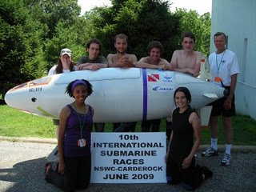
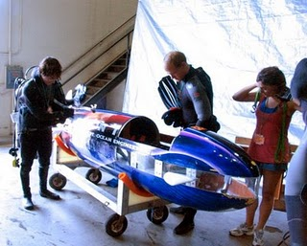
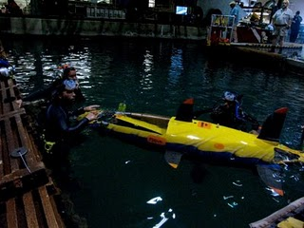
Engineering Societies EGR 120 – Introduction to Engineering
International Submarine Races
Check out this YouTube video:
http://www.youtube.com/watch?v=xL8UCPPAWEQ
http://www.usatoday.com/news/education/2009-07-01-submarine-race_N.htm

Slide 16
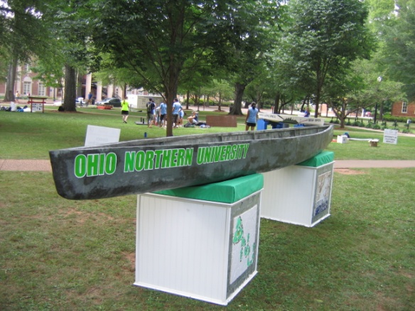
Engineering Societies EGR 120 – Introduction to Engineering
ASCE National Concrete Canoe Competition
The ASCE National Concrete Canoe Competition (NCCC) provides students with a practical application of the engineering principles they learn in the classroom, along with important team and project management skills they will need in their careers. The event challenges the students' knowledge, creativity and stamina, while showcasing the versatility and durability of concrete as a building material.
Each year, the NCCC, which is held in mid-June, is hosted by an ASCE Student Organization. Teams qualify for the NCCC by placing first in one of the 18 conference competitions held throughout the United States during the spring. Teams placing second in a conference competition behind a university that finished in the top five at the previous year's national competition are also invited. To be eligible to compete the entrant school must be a recognized ASCE Student Chapter or ASCE International Student Group.
The winners of the ASCE National Concrete Canoe Competition are determined by compiling the team's total number of points from the academic and race portions of the competition. Academic scholarships totaling $9,000 are awarded to the winning teams' undergraduate civil engineering program.
Check out this YouTube video:
http://www.youtube.com/watch?v=WqgTk4gZ0Lc

Slide 17
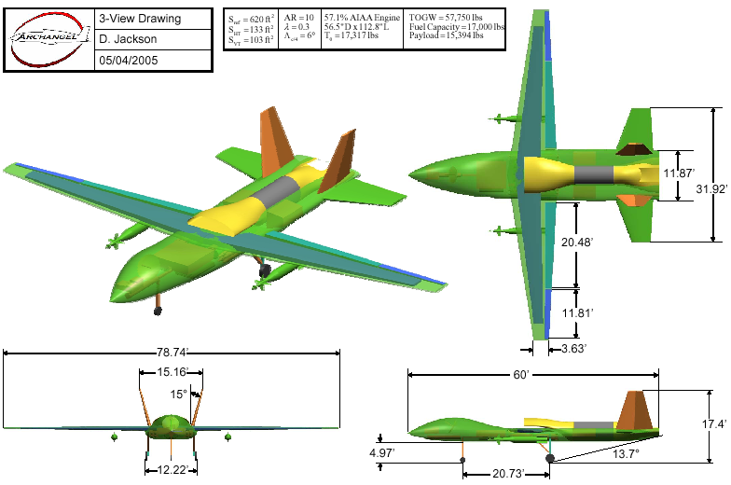
Engineering Societies EGR 120 – Introduction to Engineering
AIAA Design Competition
Advanced Gunship
Virginia Polytechnic Institute and State University

Slide 18
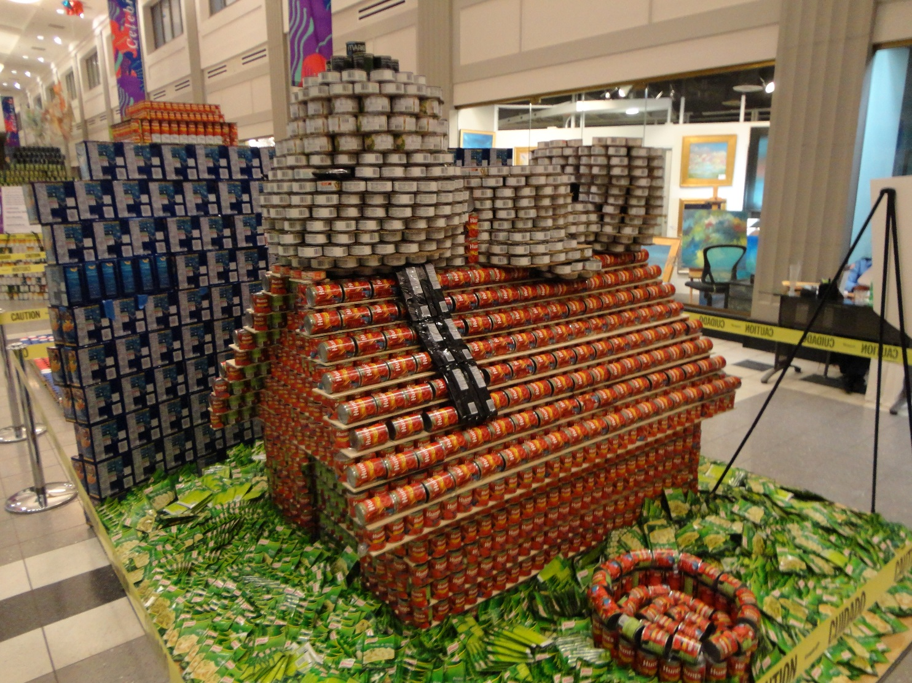
Engineering Societies EGR 120 – Introduction to Engineering
TCC Engineering Club
CANstruction is a nationwide competition sponsored by the Society for Design Administration (SDA). The goal of the competition is to build structures out of canned and pre-packages food items which will later be donated to local food banks.
The TCC Engineering Club has competed in this event since 1997.
“What’s for dinner?”
CANstruction 2011

Slide 19
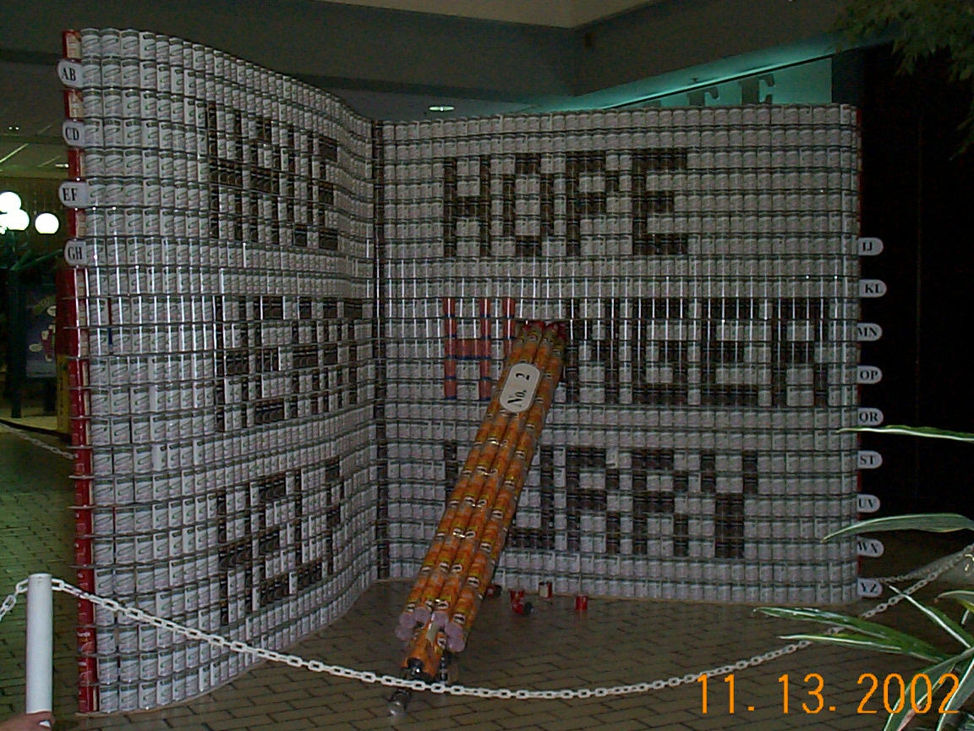
Engineering Societies EGR 120 – Introduction to Engineering
TCC Engineering Club CANstruction 2002
Title of display:
“Erase Hunger”
TCC Engineering students built a huge dictionary with a pencil erasing the word “HUNGER” from the dictionary using over 7000 cans.
The students earned the “Juror’s Favorite” award for their entry.

Slide 20
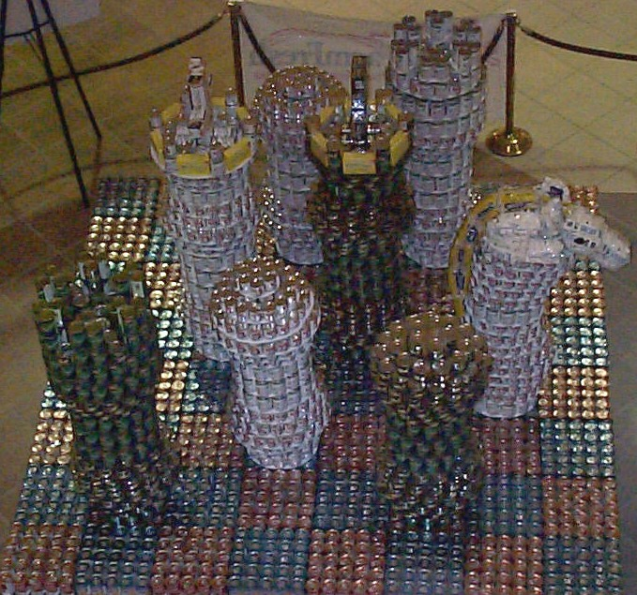
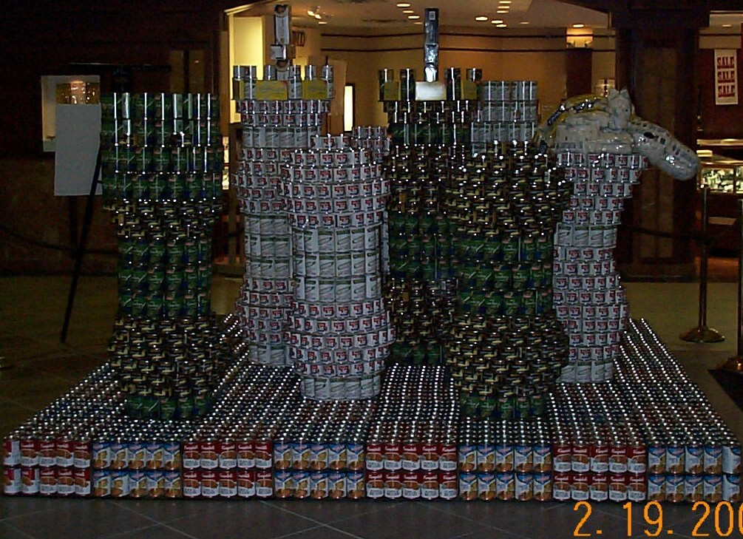
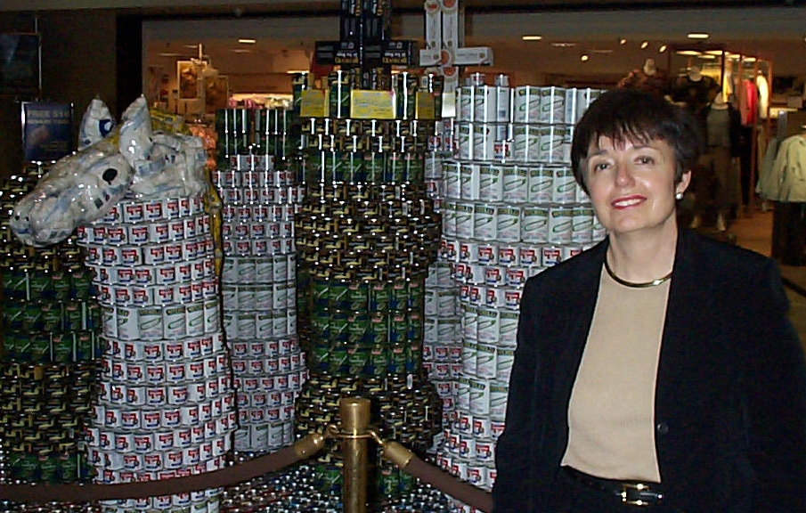
Engineering Societies EGR 120 – Introduction to Engineering
TCC Engineering Club CANstruction 2004
Title: “Put Hunger in Check”
TCC Engineering students built a huge chessboard with one of the kings in checkmate.
Over 8150 cans were used to build the CANstructure.
Right: Susan Mayo, Farm Fresh Community Relations Director, came to see the display.

Slide 21
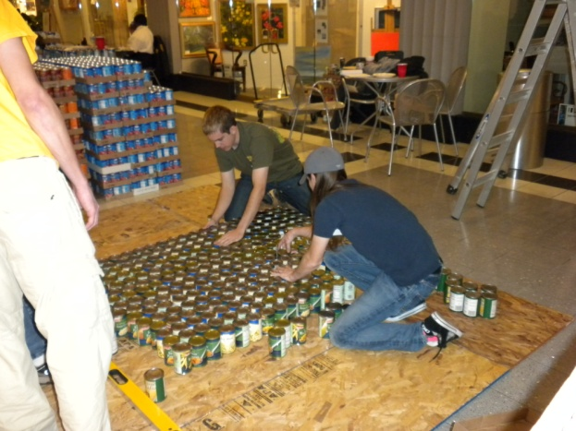
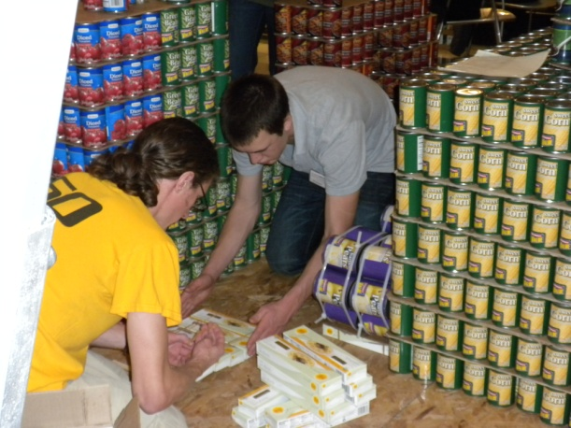
Engineering Societies EGR 120 – Introduction to Engineering
TCC Engineering Club CANstruction 2010
TCC Engineering Club captures the top two awards:
“Structural Ingenuity”
“Juror’s Favorite”
Title: “Demolish HUNGER”
The TCC Engineering Club’s entry used 10,600 cans of food and weighed 9000 lb (4.5 tons).
All food was donated to the local foodbank after the event.

Slide 22
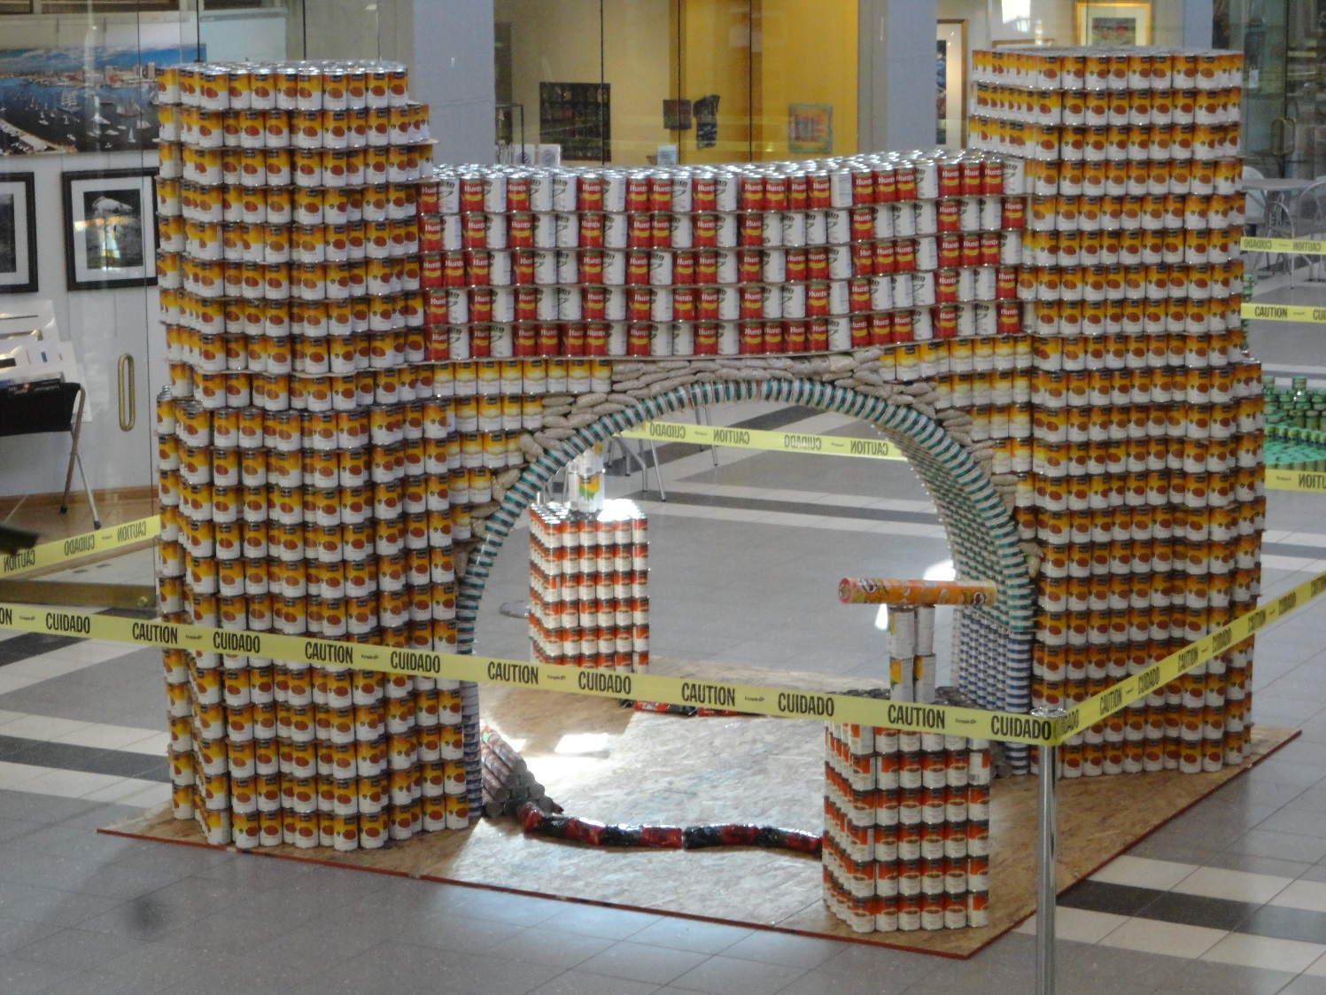
Engineering Societies EGR 120 – Introduction to Engineering
TCC Engineering Club CANstruction 2013
Check out this amazing video that includes a time-lapse of the construction.
https://www.youtube.com/watch?v=qme79o7FgX8
“End HUNGER with a Bang!”

Slide 23
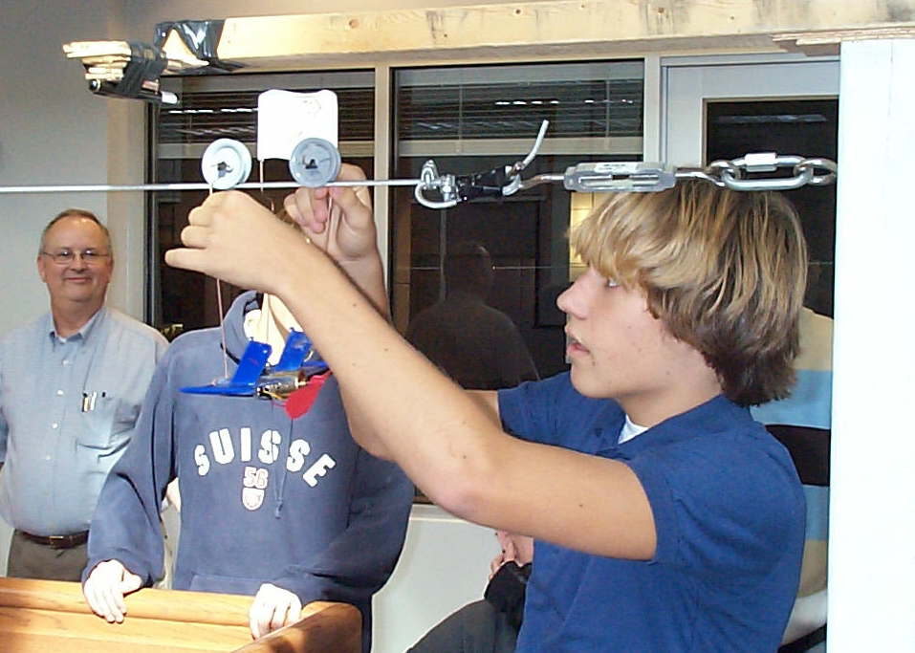
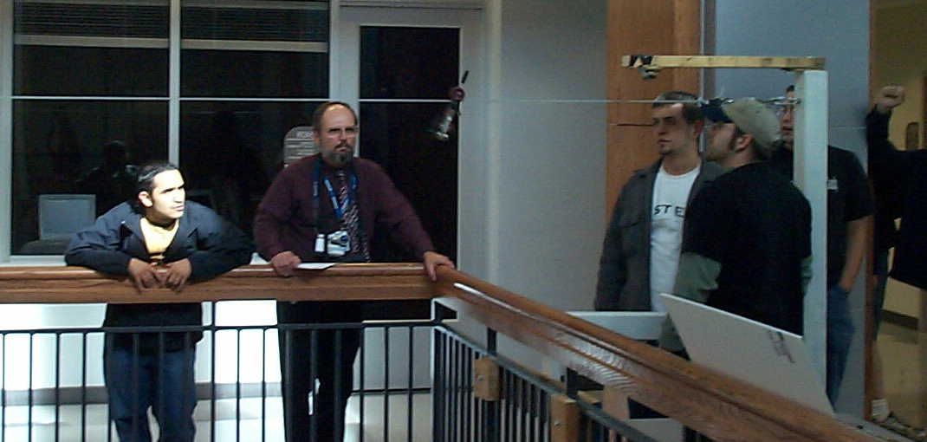
Engineering Societies EGR 120 – Introduction to Engineering
TCC Engineering Club Cable Car Competition
There were 40 entries in the
competition, including:
30 vehicles built by TCC students
10 vehicles built by high school students (10 teams of three students each).
The winner completed the
course in 2.9 seconds!
Students built vehicles using a motor from Radio Shack and a 9V battery to travel along a 45 ft cable between the upper walkways in the ATC.

Slide 24
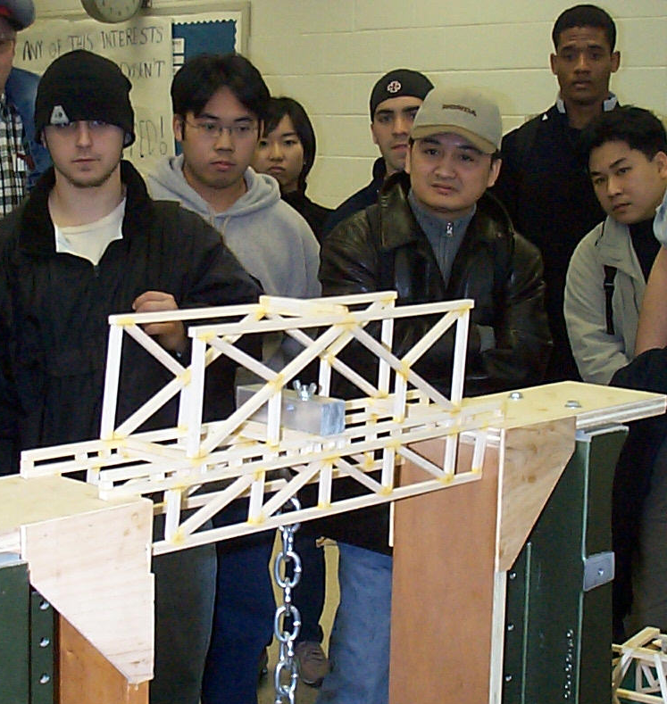
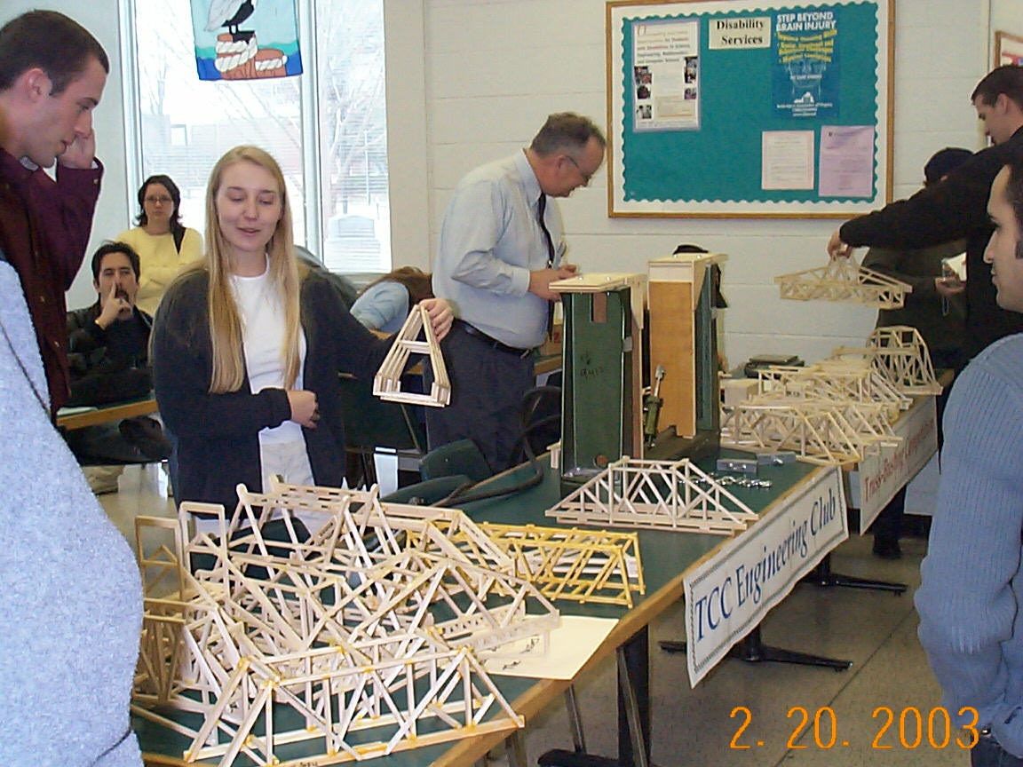
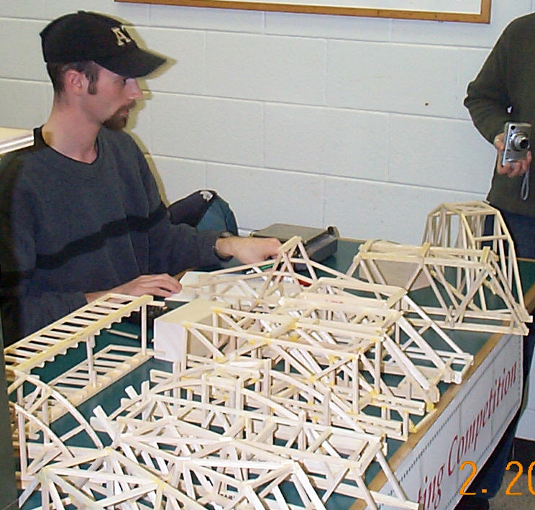
Engineering Societies EGR 120 – Introduction to Engineering
TCC Engineering Club
Bridge Truss Competition
Two structural engineers from Clark Nexsen (on the left in the picture above) served as judges for the competition. These young engineers were recent Virginia Tech graduates.

Slide 25
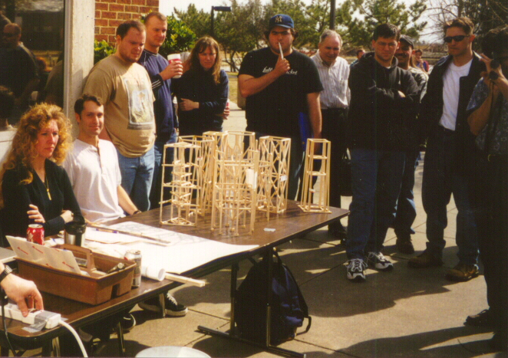
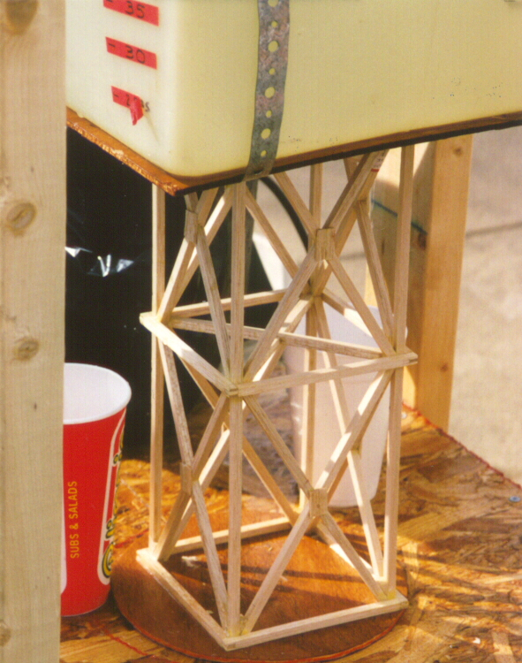
Engineering Societies EGR 120 – Introduction to Engineering
TCC Engineering Club
Water Tower Competition
Students built balsa wood towers to support a huge tank of water. The tank was filled until the tower was crushed. The full tank weighted 300 lb.

Slide 26
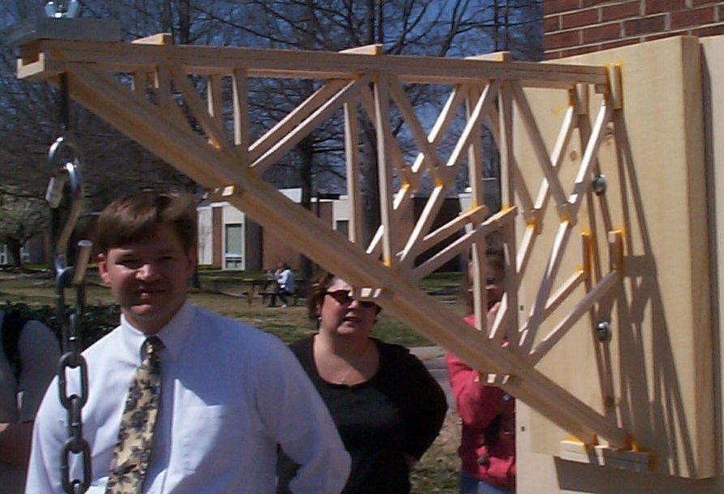
Engineering Societies EGR 120 – Introduction to Engineering
TCC Engineering Club Cantilever Truss Competition
Students designed a cantilever truss to support a vertical load applied 16 inches from the base (wall). Loads were applied until the trusses failed.
Top left: A structural engineer from judged the competition.
Bottom left: The winner’s truss supported a load 1305 times greater than the weight of the truss
(it supported 106 lb using 35.8 g of balsa wood).

Slide 27
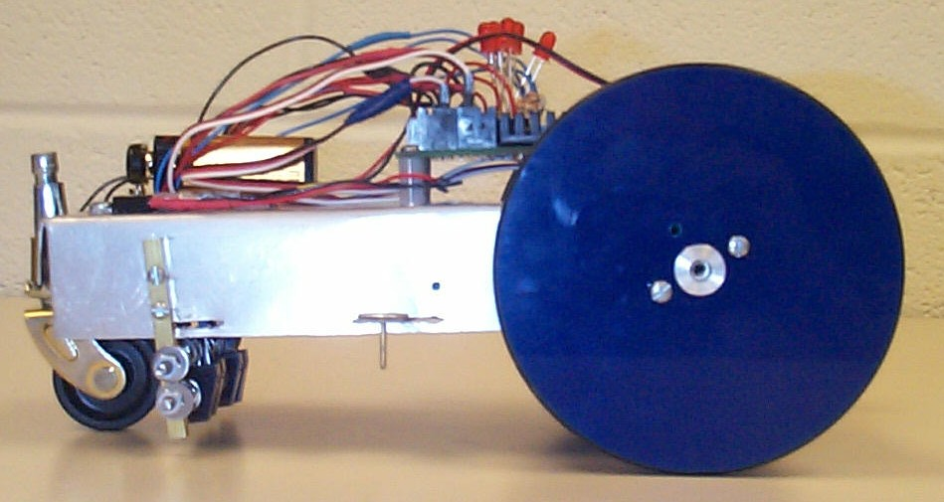
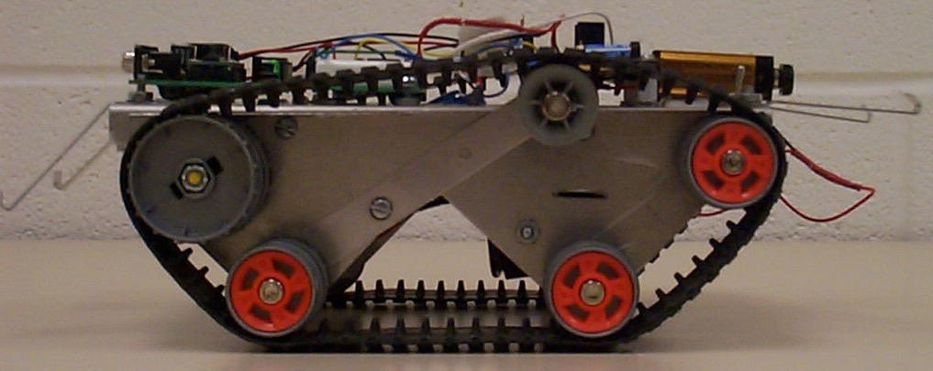
Engineering Societies EGR 120 – Introduction to Engineering
2002 ASEE Model Design Competition - Montreal, Quebec
Plywood joint
R16
24
Start/Stop Area
Start/Stop Area
Turn
Area
Turn
Area
24
3/4” electrical tape
2x2 (nominal size) wooden strips
This car was designed to follow the tape on the track (and captured 3rd Place).
This tank was designed to climb over the barriers. It was faster than the car, but stripped a gearbox at the competition and didn’t complete the course.

Slide 28
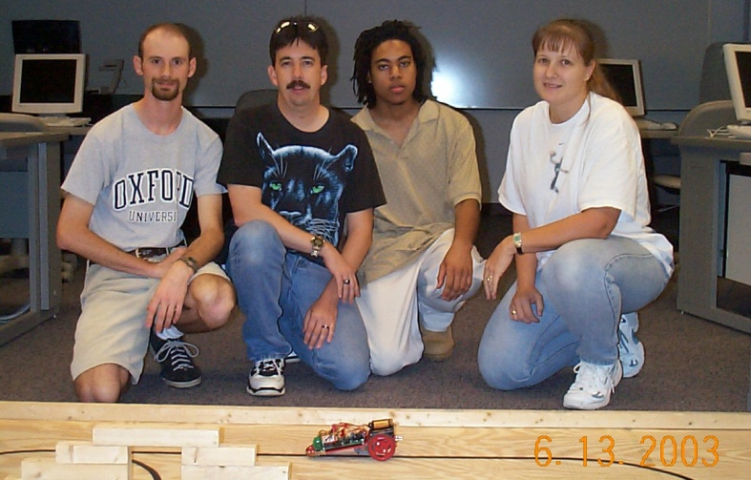
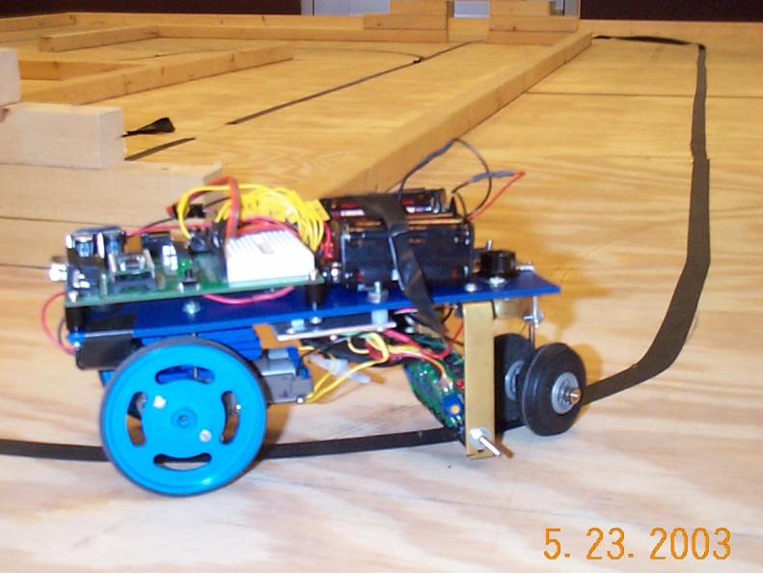
Engineering Societies EGR 120 – Introduction to Engineering
2003 ASEE Model Design Competition - Nashville, TN
8’
R12”
Tunnel 1
TCC’s red car was designed to follow the tunnel path.
Bridge
12’
Start/Finish
Tunnel 2
Vehicles could follow three routes on the track:
The tunnel path
The bridge path
The longest path
TCC’s blue car was designed to follow the bridge path.

Slide 29
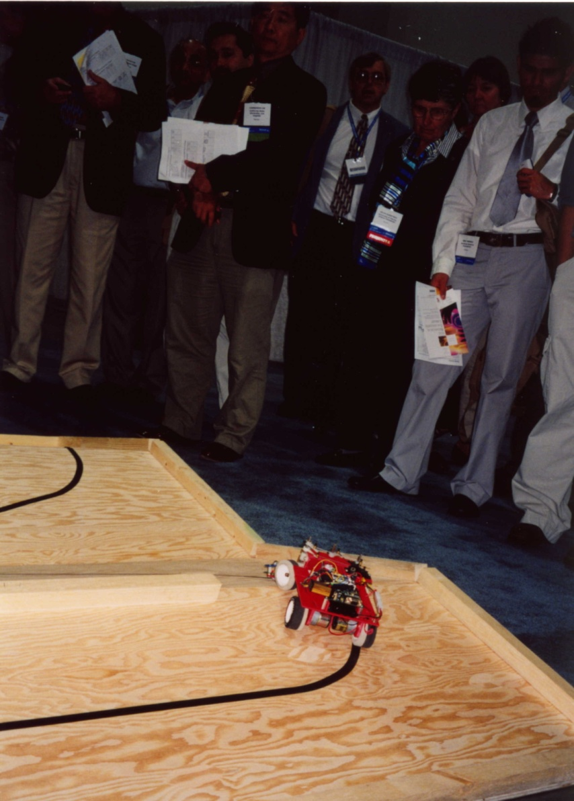
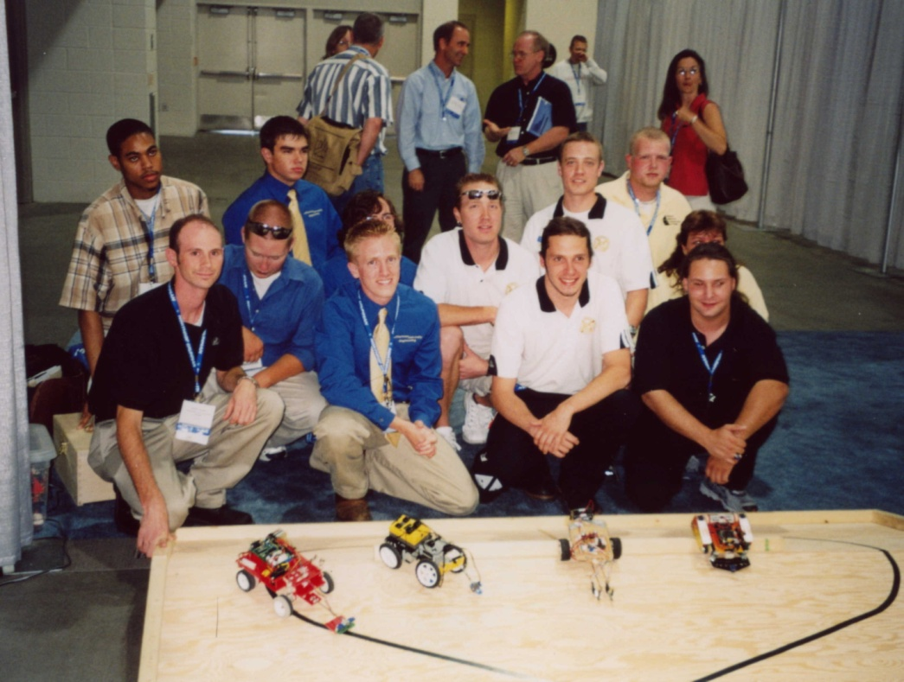
Engineering Societies EGR 120 – Introduction to Engineering
2004 ASEE Model Design Competition – Salt Lake City, UT
Group photo above includes TCC team members Steve Work (front left) and Alton Davis (rear left).
Goal: Complete two laps around the figure-8 track which included peaks and valleys.
Result: TCC Captures 1st Place!

Slide 30
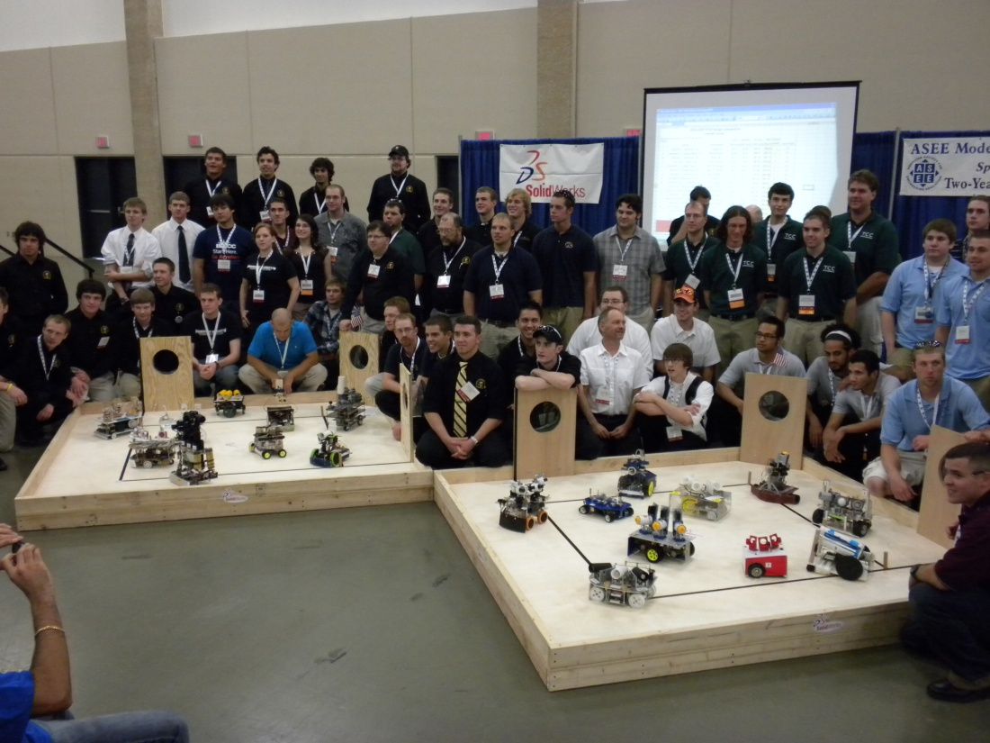
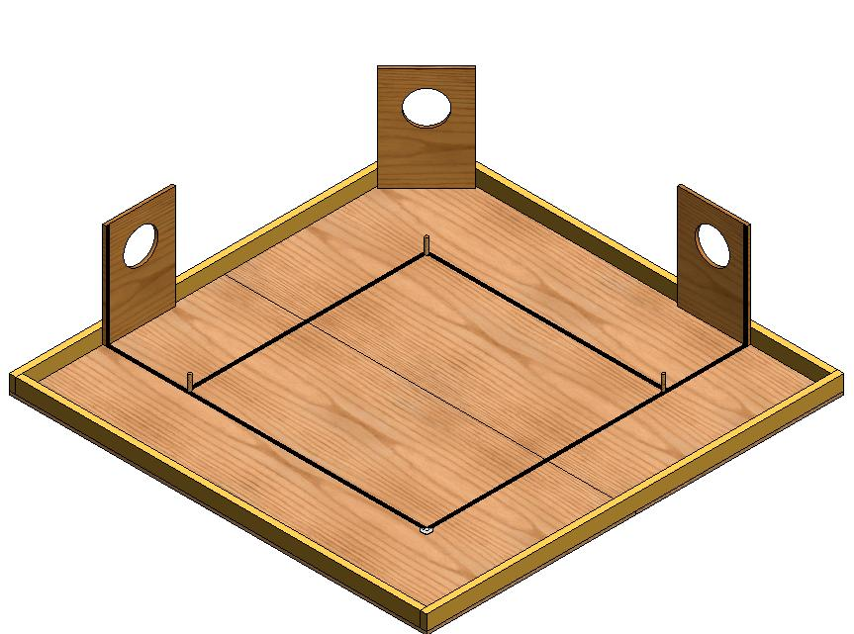
Engineering Societies EGR 120 – Introduction to Engineering
2010 ASEE Model Design Competition – Louisville, KY
Baseball Bots!
The 21 teams that competed gathered for a photo just after the event.
Result: TCC entered two teams and captured 2nd Place (VB Campus) and 5th Place (Tri-Cities Center)!
Check out this YouTube Video:
http://www.youtube.com/watch?v=MqIRehvgwwY
Goal: Design an autonomous robot to:
Start over home plate
Fire ping pong balls through each outfield target
Race around the bases knocking over the dowel on each base
Cross home plate as quickly as possible.

