Slide 1
Lecture #6 EGR 110 – Engineering Graphics
Statistics and Data Files
Read: Section 3.6 in MATLAB, An Introduction with Applications, 5th Edition, by Gilat.
Topics Covered in this section include:
Using statistical functions in MATLAB
Working with data files in MATLAB

Slide 2
Lecture #6 EGR 110 – Engineering Graphics
2
Statistical Functions in MATLAB:
MATLAB includes several statistical functions. Definitions of these statistical functions (and a few others) are provided below (assuming that N is a vector):
max(N) – returns the largest element in vector N
min(N) – returns the smallest element in vector N
mean(N) – returns the mean (average) value of the elements in vector N
median(N) – returns the median (middle) value of the elements in vector N
If N is sorted from smallest to largest, the median is:
The value in the middle if N has an odd number of elements
The average of the two middle values if N has an even number of elements
mode(N) – returns the value of N that occurs most often
std(N) – returns the standard deviation of the values in vector N
size(N) – returns the size of vector N (number of rows and number of columns)
numel(N) – returns the number of elements in vector N
sort(N) – sorts the elements in vector N from smallest to largest
sum(N) – returns the sum (total) of the values in vector N

Slide 3
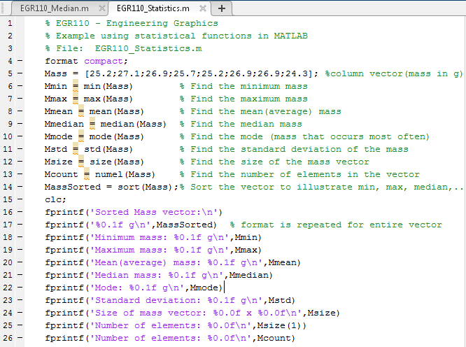
Lecture #6 EGR 110 – Engineering Graphics
3
Example – Using Statistical Functions in MATLAB:
The output of the program is shown on the following slide.

Slide 4
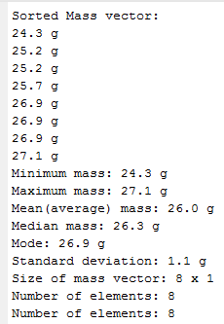
Lecture #6 EGR 110 – Engineering Graphics
4
Output of the program on the previous slide:
Smallest
The median is the middle value (once sorted) if there are an odd number of values. If there are an even number of values, it is the average of the two middle values.
Mode = 3
Largest
The mode is the value that occurs most often. Note that 26.9 occurs 3 times.

Slide 5
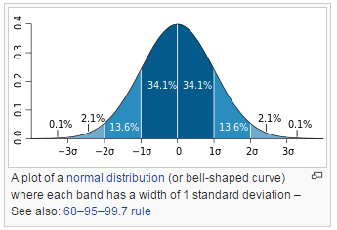
Lecture #6 EGR 110 – Engineering Graphics
5
Normal Distributions and Standard Deviation
Standard deviation, σ, is a measure of how close the data is to the average (or mean). A small standard deviation indicates that most data points are close to the mean. A common distribution of data is the normal distribution (bell-shaped curve) where:
68.2% of the data is within one standard deviation of the mean
95.4% of the data is within two standard deviations of the mean
99.7% of the data is within three standard deviations of the mean
The normal distribution and other distributions are discussed in more depth in a statistics course.
http://en.wikipedia.org/wiki/Standard_deviation

Slide 6
Lecture #6 EGR 110 – Engineering Graphics
6
Example: Using the Mean and Standard Deviation for grades
Some universities assign grades based on the mean, , and the standard deviation, σ, as follows:
 | A/B cutoff
 | B/C cutoff
 | mid-C
 | C/D cutoff
 | D/F cutoff
F
D
C
B
A
Notes:
This isn’t considered to be a good method for class sizes < 35 students, so it is rarely used at a community college.
The grade that you need to receive an A depends on how the class performs!
From the previous slide we see that 68.2% of student receive grades of B, C, or D. This implies that 15.9% receive A’s and 15.9% receive F’s.

Slide 7
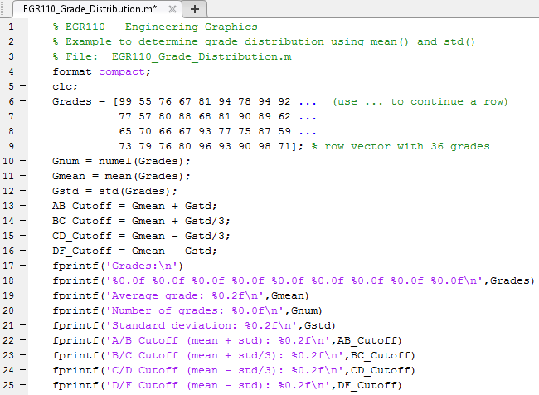
Lecture #6 EGR 110 – Engineering Graphics
7
Example: Determine the grade ranges for the following test scores if they are calculated as previously shown. The output is shown on the following slide.

Slide 8
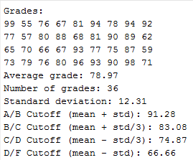
Lecture #6 EGR 110 – Engineering Graphics
8
Output of the program on the previous slide:
What letter grade is assigned for the grades shown below?
Test Score | Letter Grade?
65
81
73

Slide 9
Lecture #6 EGR 110 – Engineering Graphics
Text Files in MATLAB
MATLAB can easily write to or read from text files (or data files). Text files are useful for processing large amounts of data. Data is sometimes automatically by equipment and then analyzed using MATLAB or other software.
Detailed formatting can be used with files, but a simple and commonly used type of file is a commas-delimited file.
In a commas-delimited file, data is separated into columns using commas. The file can then be easily read into a matrix using the csvread(‘filename’ ) function in MATLAB.
Note: csv stands for comma separated values.
Creating a text file
NotePad is recommended for creating text files. Note that creating .doc or .docx files in Microsoft Word will not work well for text files as the files contain hidden characters for formatting.
Example: NotePad was used to create 3 data files on the following slide. A MATLAB program was written to read each of the 3 data files to see how the information is stored in MATLAB.

Slide 10
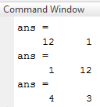
Lecture #6 EGR 110 – Engineering Graphics
Example: Read 3 data files to see how the formatting affects the way they are stored.
3 data files were read and the size of each vector or matrix was determined
1
2
3
4
5
6
7
8
9
10
11
12
Read as a 1x12 row vector
1 | 2 | 3 | 4 | 5 | 6 | 7 | 8 | 9 | 10 | 11 | 12
Read as a
12 x 1
column vector
1 | 2 | 3
4 | 5 | 6
7 | 8 | 9
10 | 11 | 12
Read as a
4x3 matrix

Slide 11
Lecture #6 EGR 110 – Engineering Graphics
Example: Recall the earlier example where 36 grades were loaded into a vector using the following instruction:
Another option for specifying the 36 grades is to put them in a text file and read the file. We could read the grades into either a row vector or a column vector (either works well), so we could enter the values into NotePad with one of the following options:
One grade per line (36 lines total) – read into a column vector
All 36 grades on a single line separated by commas (this option is shown below) – read into a row vector

Slide 12
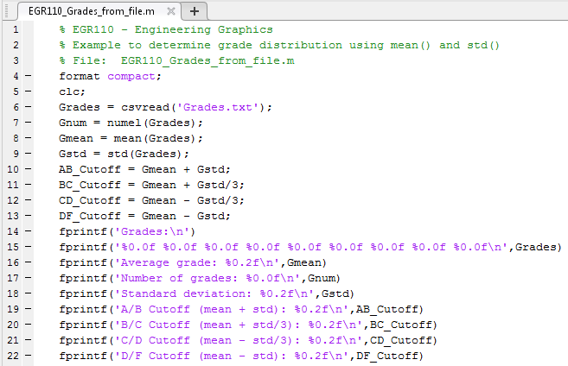
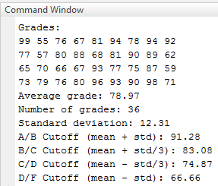
Lecture #6 EGR 110 – Engineering Graphics
Example (continued): The MATLAB program below is a modified version of the previous program (on slide 7) that assigned grades to a vector using a list. Only one instruction (line 6) was changed (highlighted below) so that the grades can be read from a text file instead.

Slide 13
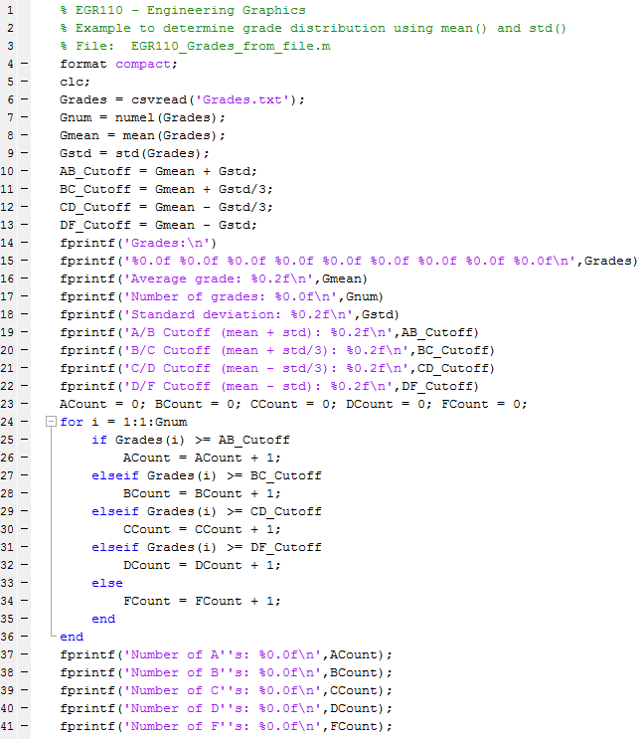
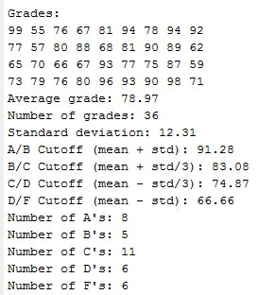
Lecture #6 EGR 110 – Engineering Graphics
Example (continued):
One more feature was added to the previous program: A for loop was added to count the number of grades in each range and the results were displayed.

Slide 14
Lecture #6 EGR 110 – Engineering Graphics
Reading two columns of data into a matrix:
Recall that commas are used to separate values into columns, so the text file shown below would be read into a matrix with two columns.
mydata.txt
A (array in MATLAB)
10,20
30,40
50,60
70,80
10 | 20
30 | 40
50 | 60
70 | 80
MATLAB instruction:
A = csvread(‘mydata.txt’)

Slide 15
Lecture #6 EGR 110 – Engineering Graphics
Submatrices: Separating columns from a matrix
Each column in a text file might correspond to a different variable. If a text file is read into a matrix, it is useful to be able to separate the matrix into various columns or other submatrices.
If A1 is a submatrix of matrix A, then A1 can be defined as:
A1 = A(StartRowNum:EndRowNum, StartColNum:EndColNum)
Row numbers
Column numbers
1 2 3 4
1 | 2 | 3 | 4
5 | 6 | 7 | 8
9 | 10 | 11 | 12
13 | 14 | 15 | 16
17 | 18 | 19 | 20
21 | 22 | 23 | 24
1
2
3
4
5
6
Matrix A has 6 rows and 4 columns (6 x 4 matrix). Various submatrices of A will be found on the following slides.
A =

Slide 16
Lecture #6 EGR 110 – Engineering Graphics
Example: Submatrices B,C,D,E
are all derived from matrix A:
1 | 2 | 3
5 | 6 | 7
B = A(1:2, 1:3) =
1 | 2 | 3 | 4
5 | 6 | 7 | 8
9 | 10 | 11 | 12
13 | 14 | 15 | 16
17 | 18 | 19 | 20
21 | 22 | 23 | 24
7 | 8
11 | 12
15 | 16
19 | 20
23 | 24
3
7
11
15
19
23
C = A(2:6, 3:4) =
A =
E = A(1:6, 3:3) =
Try it!
D = A(2:2, 1:4) =
5 | 6 | 7 | 8
What submatrix is
produced by A(1:2, 2:3)?
Describe submatrix F
18 | 19 | 20
22 | 23 | 24
F =
A(1:2, 2:3) =
F = A( )

Slide 17
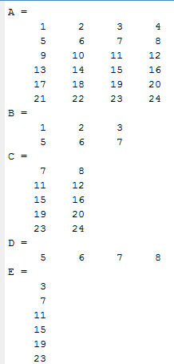
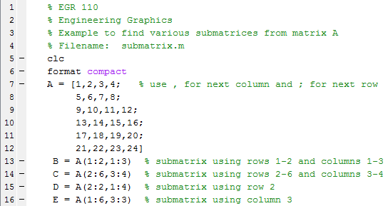
Lecture #6 EGR 110 – Engineering Graphics
Example: Use MATLAB to find submatrices B, C, D, E
The results agree with the previous slide.

Slide 18
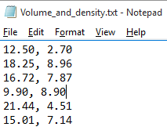
Lecture #6 EGR 110 – Engineering Graphics
Example: Reading a text file into a matrix
Use Notepad to create a text file with the following values of Volume and Density. Each line represents the Volume and Density for a single part.
Write a MATLAB program to read the file into a matrix, separate the matrix into separate vectors (submatrices) for Volume and Density, and create a vector containing the Mass for each part, where Mass = Volume*Density.
Determine the Total Mass by summing the Mass for each part.
Volume (cm³) | Density (g/cm³)
12.50 | 2.70
18.25 | 8.96
16.72 | 7.87
9.90 | 8.90
21.44 | 4.51
15.01 | 7.14
Text file created using Notepad:

Slide 19
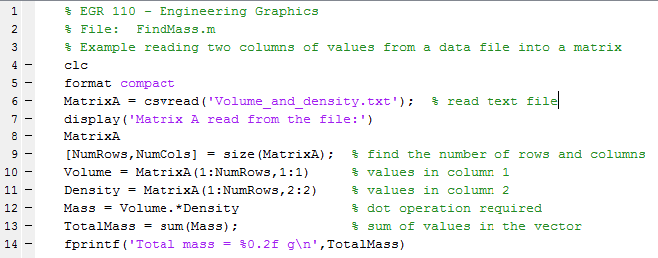
Lecture #6 EGR 110 – Engineering Graphics
MATLAB program written to read the text file and find total mass:
The output of the program is shown on the following slide.

Slide 20
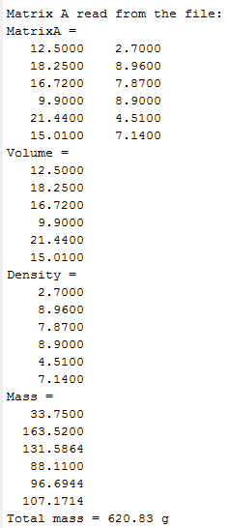
Lecture #6 EGR 110 – Engineering Graphics
Original table and output of MATLAB program:
Note that the vectors for Volume and Density were extracted from matrixA.
Volume (cm³) | Density (g/cm³)
12.50 | 2.70
18.25 | 8.96
16.72 | 7.87
9.90 | 8.90
21.44 | 4.51
15.01 | 7.14

Slide 21
Lecture #6 EGR 110 – Engineering Graphics
Class Example:
1) Students measured the voltage of the 36 new 9V batteries to be used in their team project and recorded the following voltages (in volts):
9.62, 9.38, 9.58, 9.48, 9.79, 9.17, 9.33, 9.83, 9.44, 9.58, 9.77, 9.66,
(add 24 more values distributed between 9.15 and 9.85)
A) Enter the values above into Notepad in a format so that they can be read into either a single column vector or a single row vector. Save the text file.
B) Write a MATLAB program to read the text file and use functions in MATLAB to find and display each of the following:
Average voltage
Median voltage
Mode
Standard deviation
Number of batteries tested
Standard deviation
Maximum voltage
Minimum voltage
The MATLAB program should also display the voltages (6 per line) with a descriptive heading
The MATLAB program should also sort the voltages from smallest to largest and display them again (6 per line) with a descriptive heading

Slide 22
Lecture #6 EGR 110 – Engineering Graphics
Class Example:
Data from a robot test shows that it traveled different distances at different velocities. The values are shown in the table below.
Time, T (s) | Velocity, V (cm/s)
12.50 | 2.70
18.25 | 8.96
16.72 | 7.87
9.90 | 8.90
21.44 | 4.51
15.01 | 7.14
A) Enter the values above into Notepad in a format so that they can be read into either a single column vector or a single row vector. Save the text file.
B) Write a MATLAB program to :
Read the text file into a matrix and then create separate vectors for T and V from the matrix. Assume that the number of rows in the text file is unknown.
Create a new vector for Distance, where Distance = Velocity⋅Time
Use MATLAB functions to find and display average distance, maximum distance, and minimum distance (include units).

