Slide 1
EGR 110 – Inventor Lecture #8
Mass Properties of Solids
A powerful analysis feature available in Inventor is the ability to determine the mass properties of complex objects. Many engineering students will later calculate these properties in courses like Statics and Mechanics of Materials. The calculations can become quite involved, even for fairly simple objects, so the ability of Inventor to find mass properties for a complex object made of various types of materials is quite impressive.
Center of Gravity (CG) of a part (steel sleeve)
Center of Gravity (CG) of an assembly (steel sleeve + bronze bushing)

Slide 2
EGR 110 – Inventor Lecture #8
Mass Properties of Solids
We can specify the material type for each part, including the density.
Inventor can then calculate:
Volume
Mass
Surface Area
Center of Gravity
Mass Moments of Inertia
Principle Moments of Inertia
Other mass properties
Important notes about finding Center of Gravity with Inventor:
Orientation of axes is critical for each part
Before building each part for an assembly, determine:
Which part will be the base part
Where the origin will be on the base part
What axis orientation will be used on the base part
The origin and axis orientation for an assembly is the same as the origin and axis orientation in the base part.

Slide 3
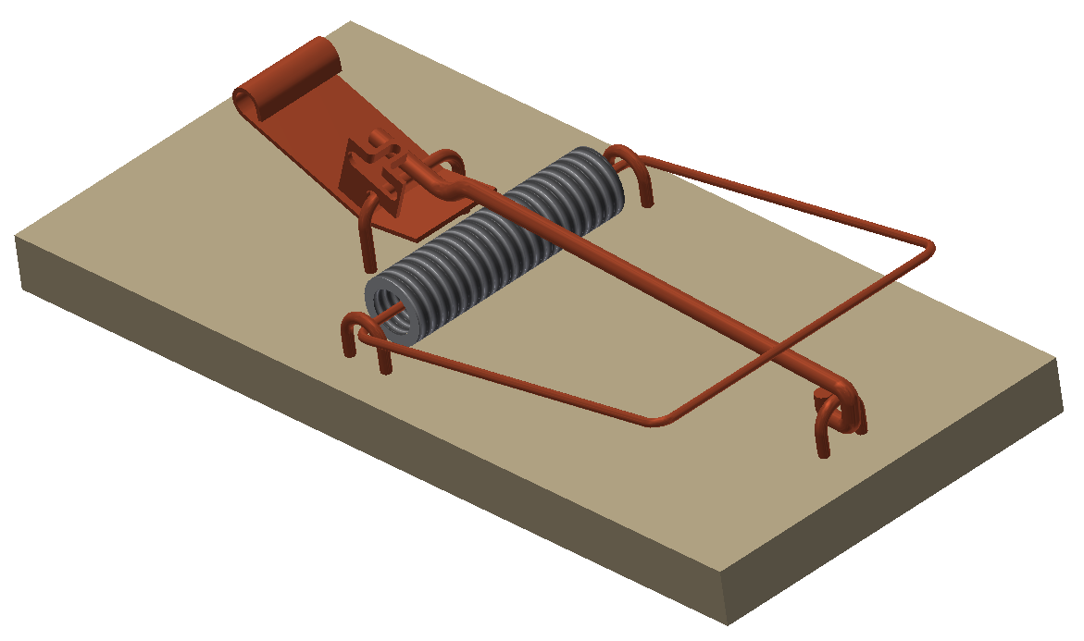
EGR 110 – Inventor Lecture #8
Example – Selecting the base part, origin, and axis orientation
Suppose that the mousetrap below is to be modeled and the center of gravity is to be determined. Before modeling any parts, it is important to:
Select the base part (the wooden base is a good choice)
Select the origin for the base part (pick a corner perhaps)
Select the axis orientation for the base
Origin and axis orientation selected
Wooden base selected as base part

Slide 4
EGR 110 – Inventor Lecture #8
Center of Gravity (or center of mass)
It is often important to know the center of gravity or center of mass of a part in order to use it properly. Examples:
The center of gravity of the boom of a crane is important in determining the max load that the crane can lift.
Weights are added to wheels on automobiles in order to “balance” the wheels such that their center of gravity will be in line with the axle of the wheel.
Example – Finding Center of Gravity: Students taking EGR 140 – Statics learn to calculate the center of gravity for various types of objects. Shown on the following slide is a problem from a statics text used recently in EGR 140. The solution is also shown. You do not need to understand the solution at this point, but it will be nice to see that we can build the part in Inventor and achieve the same result.

Slide 5
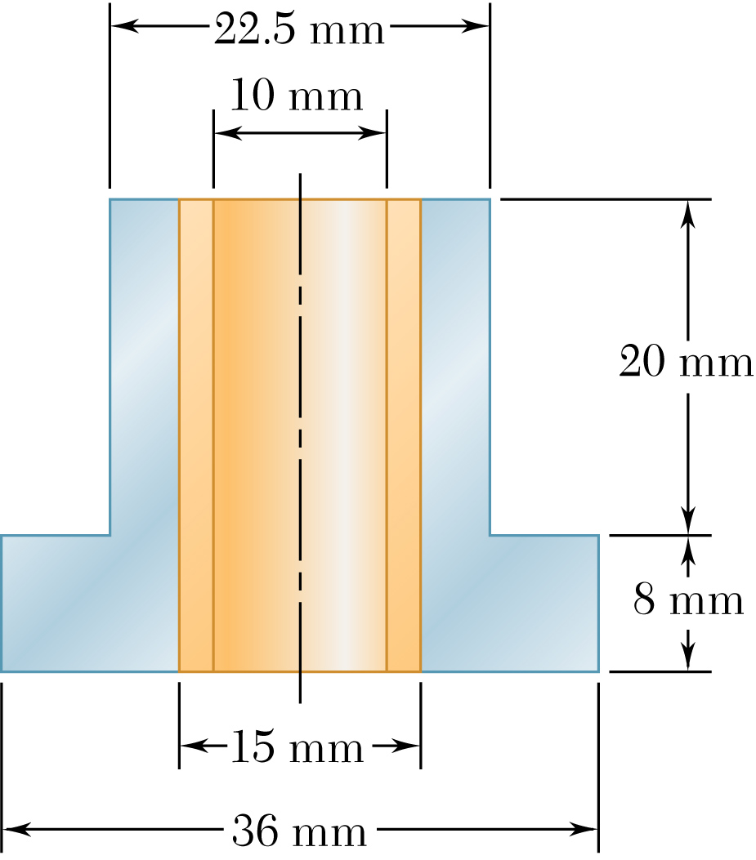
EGR 110 – Inventor Lecture #8
Problem 5-113 (Statics, 7E, by Beer & Johnston)
A bronze bushing is mounted inside a steel sleeve. Knowing that the density of bronze (soft tin) is 8874 kg/m³ and mild steel is 7860 kg/m³, determine the center of mass of the assembly.

Slide 6
EGR 110 – Inventor Lecture #8
Analytical Solution (not required for EGR 110, but common in EGR 140):
The coordinates of the “centroid” or center of mass or center of gravity of an object are
referred to as:
Symmetry implies that so we only need to find
Begin by dividing the object into three parts
as shown:
A – Bronze bushing
B – Upper part of steel sleeve
C - Lower part of steel sleeve
y
A
B
Note: The terms center of gravity and center of mass are essentially the same. The centroid (center of area or center of volume) is equivalent to the center of gravity only for uniform material (all parts made of the same material).
C
x
z

Slide 7
EGR 110 – Inventor Lecture #8
Analytical Solution (continued):
Note that the volume of a cylinder is:
and the volume of a hollow cylinder is:
So the volumes of parts A, B, and C are as follows (using diameters in meters) :
y
A
B
C
x
z

Slide 8
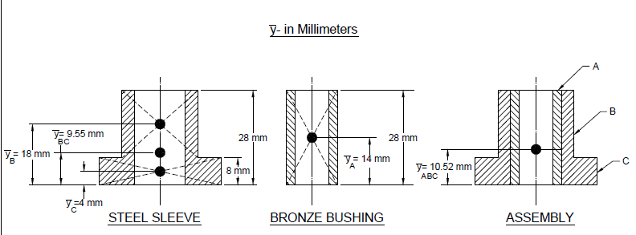
EGR 110 – Inventor Lecture #8
Analytical Solution (continued):
To find the center of mass for the entire object, we will first find the center of mass for each part.

Slide 9
EGR 110 – Inventor Lecture #8
Analytical Solution (continued):
If the mass density of each part is known, then the mass can be calculated as follows:
m = ρV
or mass = (mass density)(volume)
The center of mass of the entire object can now be found by finding the mass and centroid of each part and then by finding a weighted average of the centroids of each part as follows.
Part | Material | Volume (m³) | Mass Density (kg/m³) | Mass (kg)
A | Bronze (ST) | 2.749E-06 | 8874 | 0.0244 | 14
B | Steel | 4.418E-06 | 7860 | 0.0347 | 18
C | Steel | 6.729E-06 | 7860 | 0.0529 | 4
B and C | Steel | 1.115E-05 | - - - | 0.0876 | 9.55
A, B, and C | - - - | 1.390E-05 | - - - | 0.1120 | 10.52

Slide 10
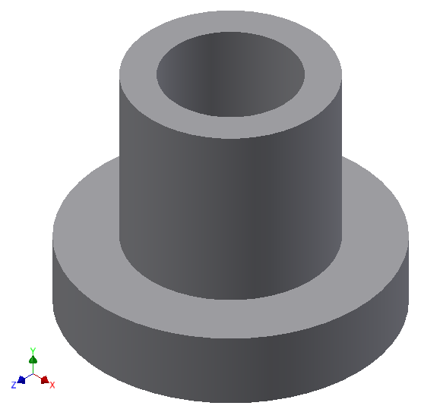
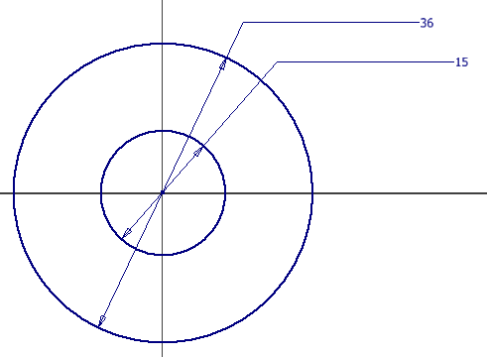
EGR 110 – Inventor Lecture #8
Solution using Inventor
Build a model of Problem 5-113 with Inventor and find the center of gravity. Use the steel sleeve as the base part with the origin at the base of the cylinder and the y-axis along the center of the cylinder.
Create the steel sleeve
Create a new metric part and use a top view (xz) 2D sketch plane since we want the axis of the cylinder along the y-axis
Be sure that the center of the cylinder is located at the origin.
Note that two extrusions are required for the part. Only the sketch plane for the first extrusion is shown below.
Centers at origin
Steel Sleeve after two extrusions (note the y-axis direction)
Sketch Plane (top view) for first extrusion

Slide 11
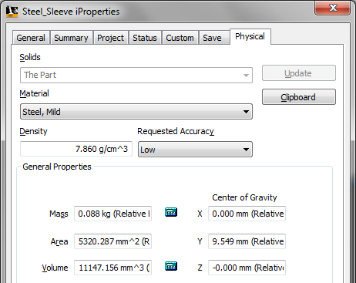
EGR 110 – Inventor Lecture #8
Solution using Inventor (continued)
Specify the material and density and check center of gravity
Right-click on the part name (Steel Sleeve) and select iProperties
Select the Physical tab in the iProperties window
Change the material type to Steel, Mild
Note that the density (7.860 g/cm³ or 7860 g/m³) agrees with the value used in the hand analysis
Note that the mass and center of gravity agree with the hand analysis

Slide 12
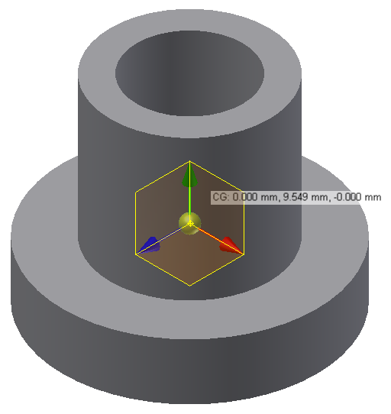
EGR 110 – Inventor Lecture #8
Solution using Inventor (continued)
Display the Center of Gravity (CG) icon for the steel sleeve
Select View – Center of Gravity from the main menu. (Select OK if prompted to update the center of gravity.) The center of gravity axes icon should appear. Note that the origin of this icon is located at the CG.
Pause the mouse over the center of gravity icon until the select tool appears. Click on the down arrow and Pick Center of Gravity.
Note that the axes are color coded as follows:
Value agrees with hand calculations
x-axis: Red y-axis: Green z-axis: Blue
Pause over Center of Gravity icon and select Center of Gravity

Slide 13
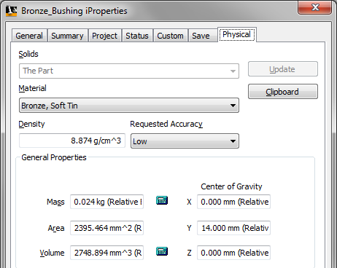
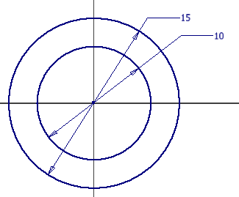
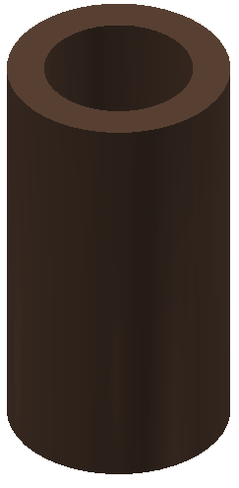
EGR 110 – Inventor Lecture #8
Solution using Inventor (continued)
Create the bronze bushing
Create a new metric part and use a top view (xz) 2D sketch plane
Be sure that the center of the cylinder is located at the origin.
Change the material type to Bronze, Soft Tin
Note that the density (8.874 g/cm³ or 8874 g/m³) agrees with the value used in the hand analysis
Note that the mass and center of gravity agree with the hand analysis

Slide 14
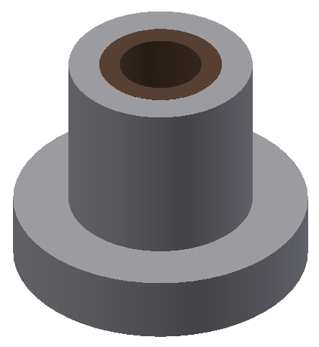
EGR 110 – Inventor Lecture #8
Solution using Inventor (continued)
Create the assembly
Create a metric assembly drawing (New, Standard (mm).iam).
Use the steel sleeve as the base part. Note that the origin for the assembly will be the same as the origin of the base part. Right click on the steel sleeve and select Place Grounded at Origin.
Next add the bronze bushing to the assembly.
Use an Insert Constraint to complete the assembly.
Note that the mass and center of gravity agree with the hand analysis

Slide 15
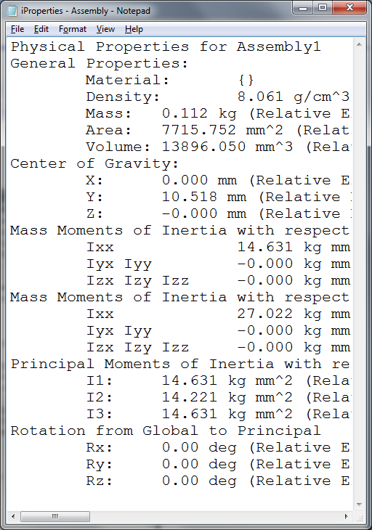
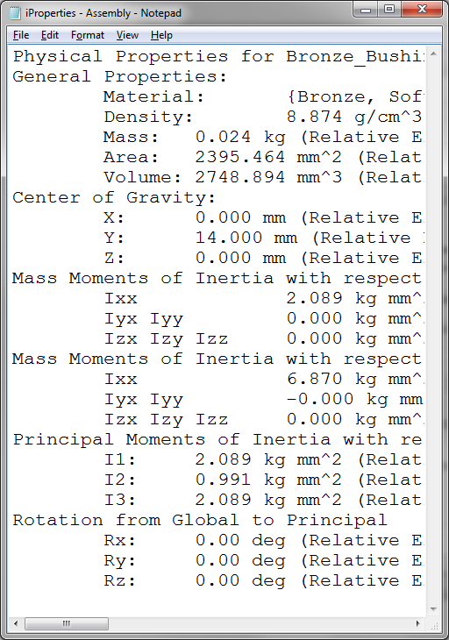
EGR 110 – Inventor Lecture #8
Solution using Inventor (continued)
Copying iProperties to the Clipboard
Select Clipboard from the iProperties Physical window for the assembly; this places the Physical Properties of the assembly on the clipboard.
Paste the iProperties data into NotePad, Word, etc.
Repeat for each part

Slide 16
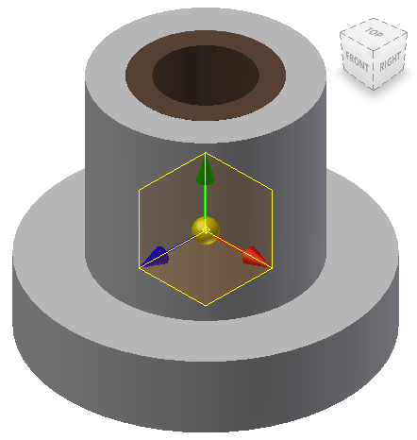
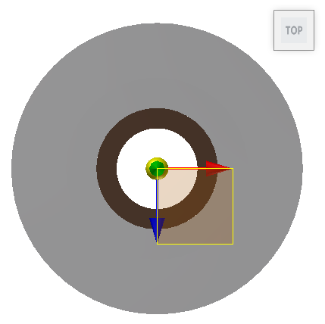
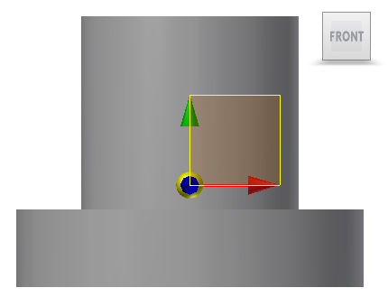
EGR 110 – Inventor Lecture #8
Solution using Inventor (continued)
Display the Center of Gravity icon for the assembly
Select View – Center of Gravity from the main menu. (Select OK if prompted to update the center of gravity.) The center of gravity axes icon should appear.
Note that the origin of this icon is located at the CG so viewing the assembly from different directions shows the location of the CG more clearly.
Inventor does not display the coordinates of the CG as it does with parts.

Slide 17
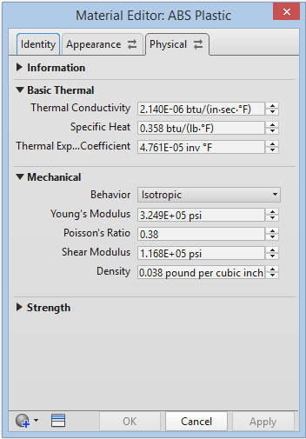
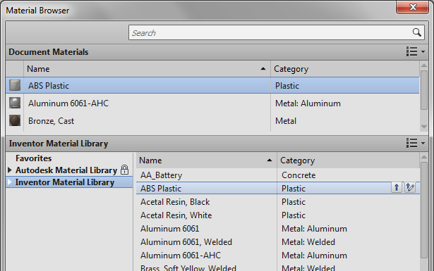
EGR 110 – Inventor Lecture #8
Adding New Materials
The previous example used two readily available materials (Steel, Mild and Bronze, Soft Tin). We can add other materials if necessary. First view the available materials as follows:
Select Tools – Material – Inventor Material Library
Select ABS Plastic (in order to add a similar material)
Note: Inventor shows the density of ABS plastic as 1.060 g/cm³ or as 0.038 lbm/in³. These are equivalent as seen below.

Slide 18
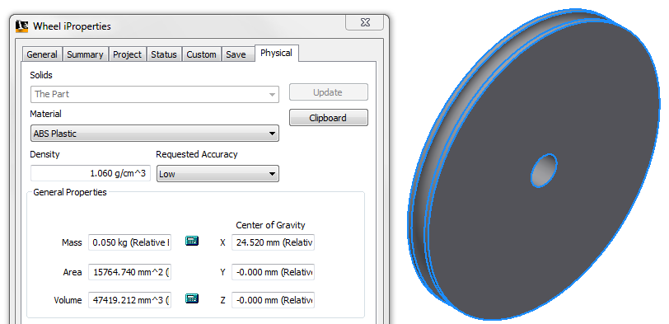
EGR 110 – Inventor Lecture #8
Adding New Materials (continued)
3D printers are used in class to build parts using ABS plastic. However, 3D printers include options for either sparse or dense material, so we may wish to create a new material in Inventor with a different density.
Example: A student designs a wheel using Inventor. The student selects ABS Plastic for the material. Checking iProperties reveals the following:
Mass = 0.050 kg
Volume = 47419 mm³
Density (of ABS Plastic) = 1.060 g/cm³ = 0.038295 lbm/in³
Problem: The student weighs the wheel and its mass is only 28 g (not 50 g). So a new material with the appropriate density will be added to Inventor.

Slide 19
EGR 110 – Inventor Lecture #8
Adding New Materials (continued)
The density of the new material can be calculated as follows:
Since mass varies linearly with density (m = pV), another way to find the new density is scale it using ρ₂ = ρ₁*(m₂/m₁).

Slide 20
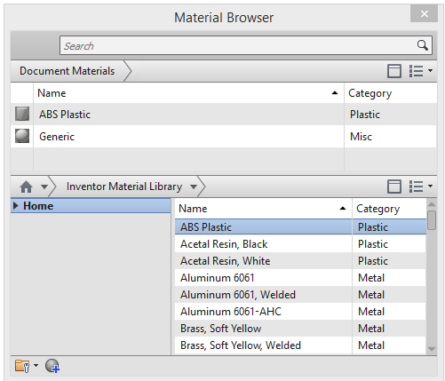
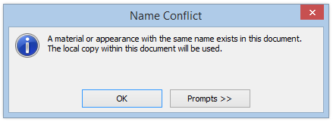
EGR 110 – Inventor Lecture #8
Adding New Materials (continued)
Now we can add a new material to Inventor with the correct density:
Select Tools – Material – Inventor Material Library
Select (Double-click) ABS Plastic and click OK on Name Conflict pop-up (in order to add a similar material)
Double-click
and then click

Slide 21
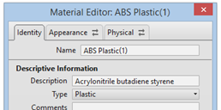
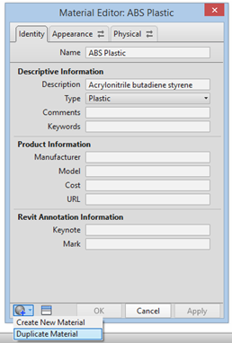
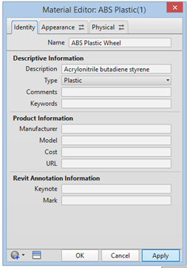
EGR 110 – Inventor Lecture #8
Adding New Materials (continued)
Select Create New Material icon at the bottom of the Material Editor. Click on Duplicate Material.
The new material is a copy of ABS Plastic and is named ABS Plastic(1). Change the name to ABS Plastic-Wheel, then click outside of the Material Editor, then click Apply, and then click on the Physical Tab.

Slide 22
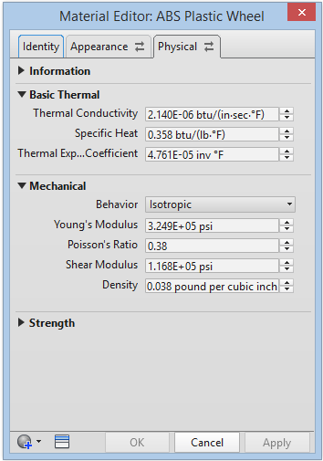
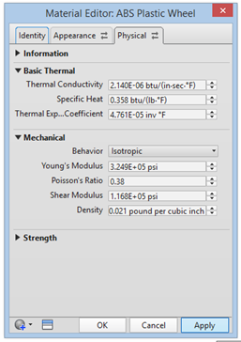
EGR 110 – Inventor Lecture #8
Adding New Materials (continued)
Open the Mechanical Properties Dropdown box and change the Density from .038 to .021332 lb/in³. Click outside of the Material Editor and then click Apply and close the Material Editor and Material Browser.
Open the Material Browser and Right-click on ABS-Plastic Wheel and click on Assign to Selection.

Slide 23
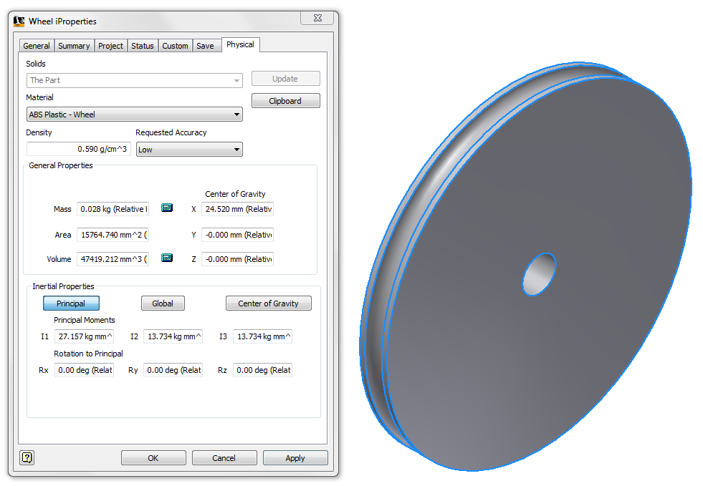
EGR 110 – Inventor Lecture #8
Adding New Materials (continued)
OR using the iProperties for the wheel select the new material and check the density and mass as follows:
Select iProperties for the wheel
Change the Material to ABS Plastic – Wheel and select Apply
New material
New density
New mass

