Slide 1
EGR 110 – Inventor Lecture #3
Drawing Files
So far we have printed directly from sketches or from the model view of a part (.ipt). A better approach is to create a drawing file (.idw) in Inventor. From the drawing file we can:
Insert a part (a specified view)
Create other views (top, front, side, isometric, auxiliary, section, …)
Annotate the drawing (dimensions, centerlines, notes, etc)
Change dimension styles
Scale the drawings (our models are always full size)
Select/modify a title page

Slide 2
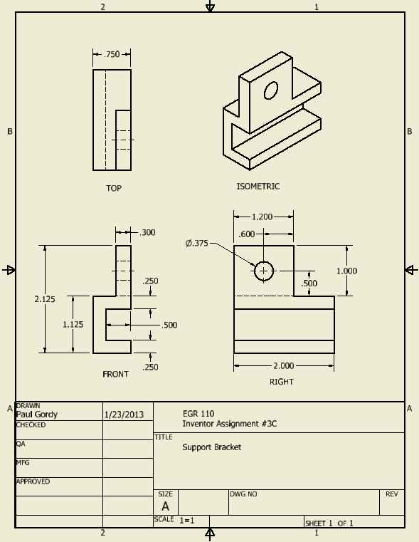
EGR 110 – Inventor Lecture #3
Inventor Part (.ipt)
Inventor Drawing (.idw)

Slide 3
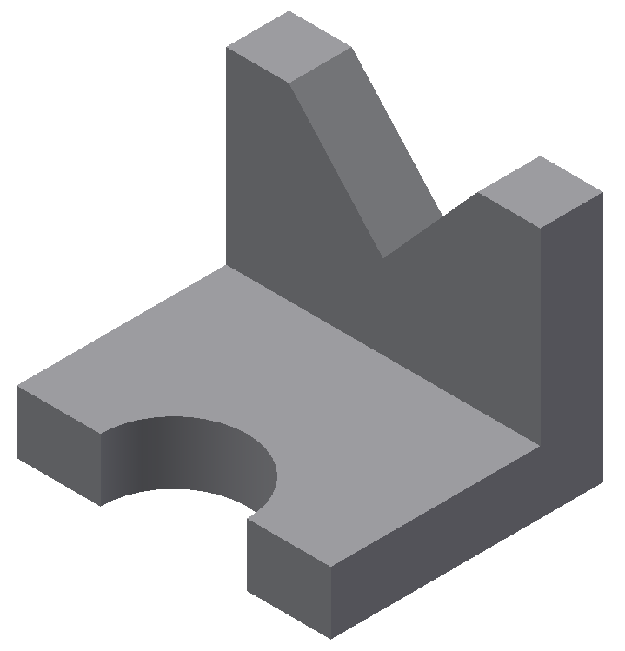
EGR 110 – Inventor Lecture #3
Example:
Create a part (such as Prob 4 on sheet A-2 (page D-23) in Engineering Graphics Text and Workbook, Series 1.2, by Craig & Craig).
Add convenient dimensions (which will later be imported into a drawing file).
Save the part and remember the name (such as Part2.ipt)
Note: It is a good idea to decide how you want an object to be oriented and then choose an appropriate 2D sketch plane to begin. In this case beginning with a front view will work well.
y
x
Front
z
Front View 2D Sketch Plane

Slide 4
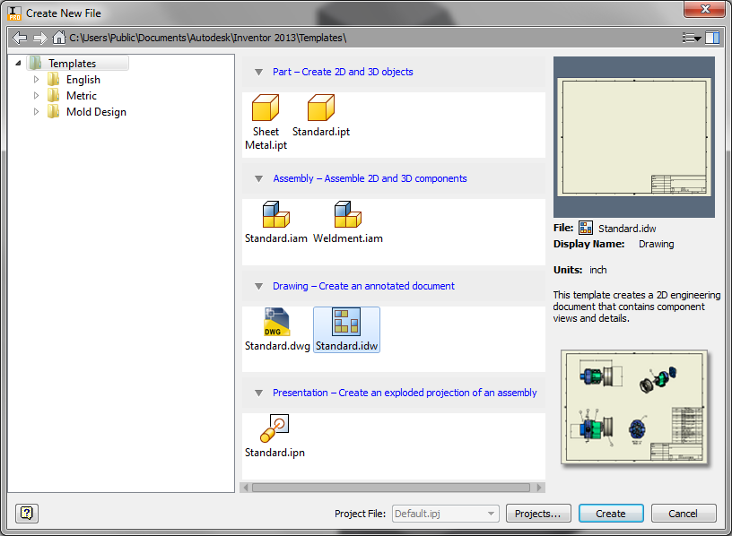
EGR 110 – Inventor Lecture #3
Creating a Drawing File
After creating the part, create a New File in Inventor and select a Standard.idw drawing file and then select Create.
Note: You can
convert a part
(.ipt) drawn in
inches to a
drawing (.idw)
by selecting the
Metric Template
and then the
ANSI (mm).idw
drawing icon
and clicking
Create. Then
when you
dimension the
drawing
Inventor will
automatically
convert the
dimensions to
mm.

Slide 5
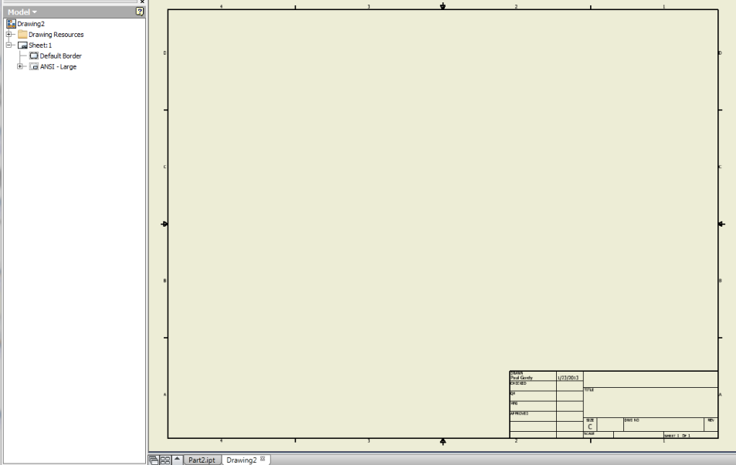
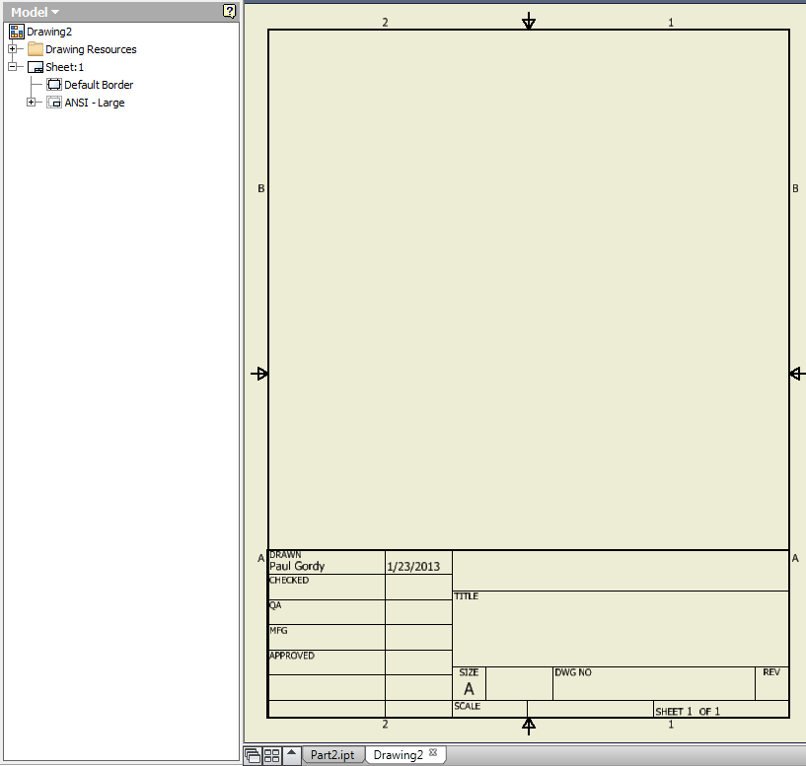
EGR 110 – Inventor Lecture #3
Selecting the sheet size
Inventor will open a C-size sheet (17 x 22) by default. We will only use A-size sheets in this course (8.5 x 11), so we need to change the sheet size.
C-size sheet
A-size, Portrait, 1 view
Right-click on Sheet1 and select Edit Sheet
Change Size from C to A size, Portrait, 1 view

Slide 6
EGR 110 – Inventor Lecture #3
Adding a Base View
Add a “base view” to the drawing file from which other views will be obtained. In the example below, the front view is selected as the base view for Part2.ipt.
Select Base view
Select the File or Inventor part (Part2.ipt)
Select the Orientation (front, top, etc)
Move the mouse over the drawing page and select/ drag where to place the view and then click OK
Select location of front view

Slide 7
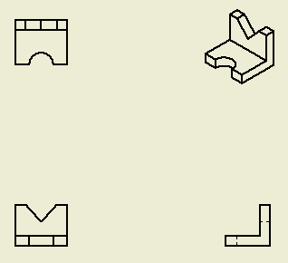
EGR 110 – Inventor Lecture #3
Adding Other Views
Immediately after adding the base view, you can move the mouse to other locations to add a right view, top views, isometric, etc. Right click and select Create when done.
Note: You can also use the Projected View tool to add views at any time.
1) Add right view
2) Add top view
3) Add isometric view then select Create
4) Final result

Slide 8
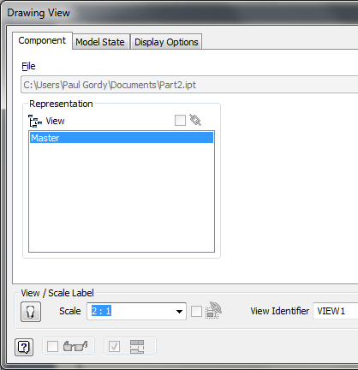
EGR 110 – Inventor Lecture #3
Changing the Scale
Note on the last slide that the views are somewhat small. The default scale is 1:1 (full scale). To change the scale:
Move the mouse over the base view until a dotted box appears around the view. Right-click in the dotted box and select Edit View.
Change the Scale to 2:1 to make the view twice as large (or use another scale factor).
Note that this affects all orthographic views. The isometric view has its own scale factor so it must be changed separately.

Slide 9
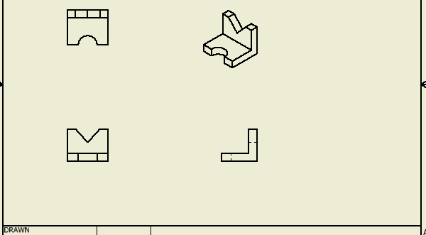
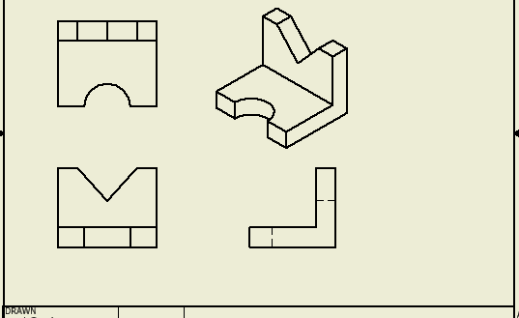
EGR 110 – Inventor Lecture #3
Changing the Scale
In the example shown:
The scale was changed to 2=1 on the front view which affected the top and right views as well.
The scale was also changed to 2=1 on the isometric view (it has a separate scale factor)
Scale 1=1
(Full Scale)
Scale 2=1

Slide 10
EGR 110 – Inventor Lecture #3
Moving Views
Recall that with orthographic projection (multiview drawings) views must always be properly aligned. So moving one view in Inventor may cause other views to move. If the front view is the base view, then:
Moving the base view will move the top and right views also to keep them aligned.
The top view can only be moved up and down so that it stays aligned with the front view.
The right view can only be moved left and right so that it stays aligned with the front view.
Moving the front view – top and right move also
Moving the right view – it will only move left or right

Slide 11
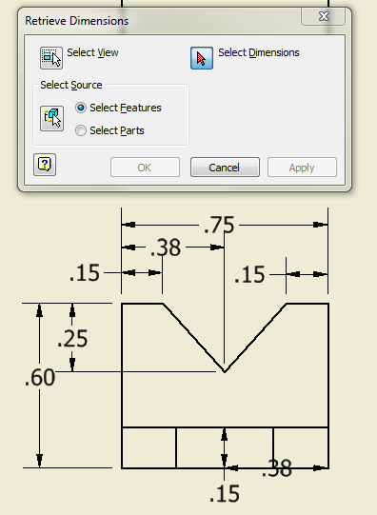
EGR 110 – Inventor Lecture #3
Retrieving Dimensions
If dimensions were added to sketches used to create a part, the dimensions can be retrieved for use in the drawing file. Before adding dimensions, move the views to space them out nicely on the drawing sheet. To retrieve dimensions for the front view:
Move the mouse over the front view until a box appears and right-click inside the box. Select Retrieve Dimensions…
Pick Select Dimensions and the available
dimensions will appear

Slide 12
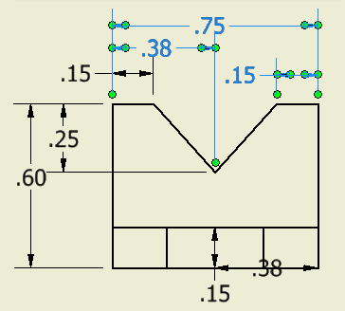
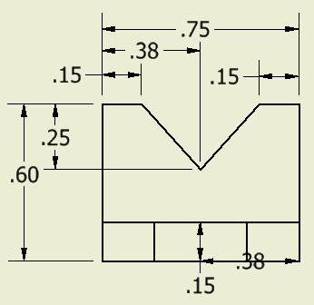
EGR 110 – Inventor Lecture #3
Retrieving Dimensions (continued)
Select the desired dimensions that you wish to retrieve. The selected dimensions will change color.
Select Apply when finished and close the Retrieve Dimensions window.

Slide 13
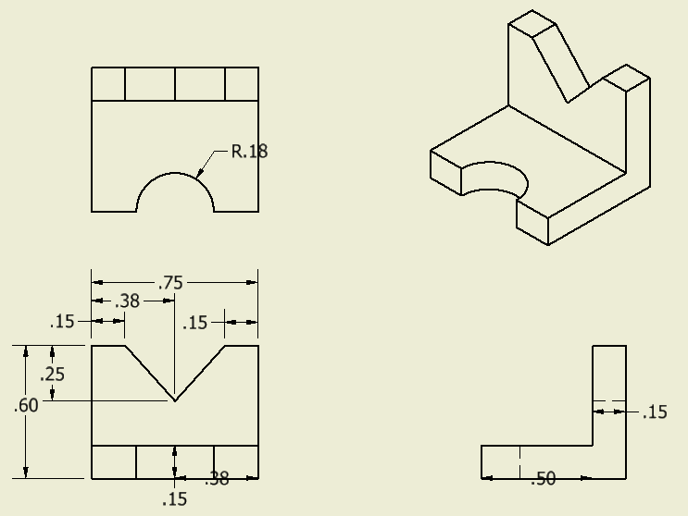
EGR 110 – Inventor Lecture #3
Retrieving Dimensions (continued)
Similarly, retrieve desired dimensions in other views.
Dimensions are not typically shown in the isometric view.

Slide 14
EGR 110 – Inventor Lecture #3
Dimension Style
Good style in dimensioning will be covered in detail a little later in the course, but for now a few useful rules are presented below:
Keep dimensions aligned as much as possible
Neatly space the dimensions
Avoid inside dimensions; i.e. dimensions actually placed within/on the body of the component
Avoid driven (redundant) dimensions
Center the dimension text within the extension lines
Specify diameter (using φ) for holes and radius (using R) for arcs
Label views (neatly centered under each view)
Always include the scale for the drawing
Use centerlines and center marks where appropriate
Generally include overall dimensions (total width, height, and depth)
Use a consistent precision (number of digits after the decimal point)
Dimensions should be shown in the view where the feature is clearest
Locate holes by their centers, not by their edges

Slide 15
EGR 110 – Inventor Lecture #3
Dimension Style (continued)
The recently retrieved dimensions violate a number of rules for dimensions. Some problems to correct are noted below.
Poor location
Number of digits:
This value should be 0.375
Missing centerlines
Label each view
Poor location. Omit one and add overall depth.
Wrong view

Slide 16
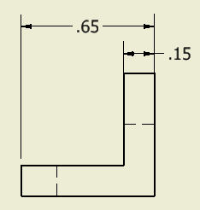
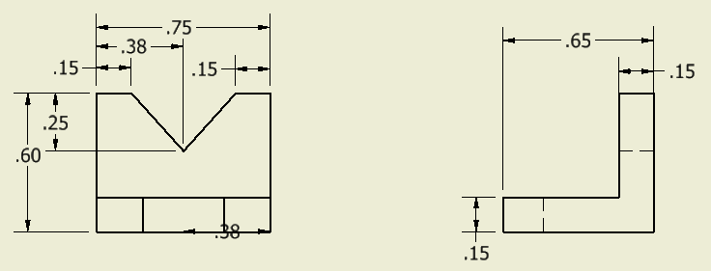
EGR 110 – Inventor Lecture #3
Problem: Poor location.
Omit one and add overall depth.
Solution: Move one dimension, delete another, and add a new dimension (use Annotate menu).
Dimension Style (continued)
Problem: Wrong view.
Solution: Delete 0.15 dimension in front view and add a new dimension in the right view.
Original
Original
Improved
Improved

Slide 17
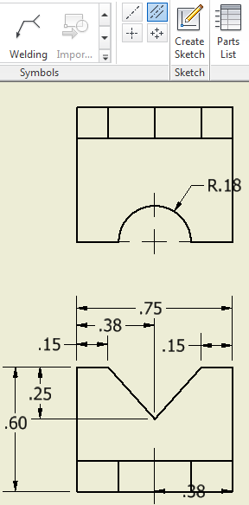
EGR 110 – Inventor Lecture #3
Centerline Bisector tool
Problem: Missing centerlines.
Solution: Use tools in Annotation menu:
Center Mark tool to add center lines in top view.
Centerline Bisector tool to add centerline in front view (pick lines on either side and the centerline will be inserted between them)
Dimension Style (continued)
Center Mark tool
Original
Improved
Another problem has now occurred: The centerline in the front view has no dash.
Solution: See next slide

Slide 18
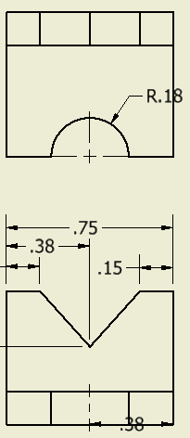
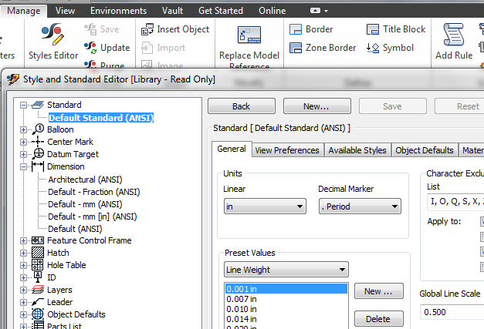
EGR 110 – Inventor Lecture #3
Dimension Style (continued)
Problem: No dashes in centerline in front view.
Solution: Change the Global Line Scale for line types as follows:
Select Styles Editor under the Manage menu.
Select Standard – Default Standard ANSI
Change Global Line Scale from 1 to 0.5 to make all dashes half size. Note that this affects all line types, including hidden lines.
Click Done, click Save Edits.
Original
Improved

Slide 19
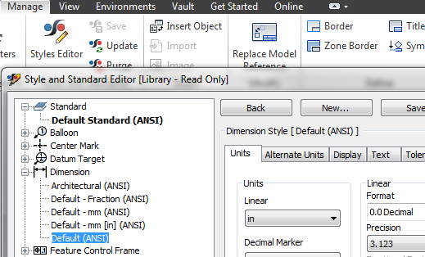
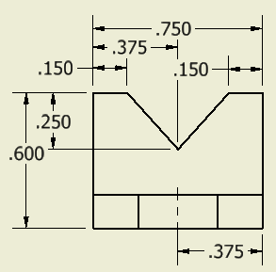
EGR 110 – Inventor Lecture #3
Problem: Incorrect number of digits
Solution: It is common to use the same number of digits after a decimal point for all dimensions, indicating a common precision. To change the number of digits from 2 to 3 for all dimensions:
Select Styles Editor under the Manage menu.
Select Dimension – Default (ANSI)
Change Precision from 2.12 to 3.123 to use three digits after the decimal point for all dimensions.
Click Done, click Save Edits.
Dimension Style (continued)
Original
Improved

Slide 20
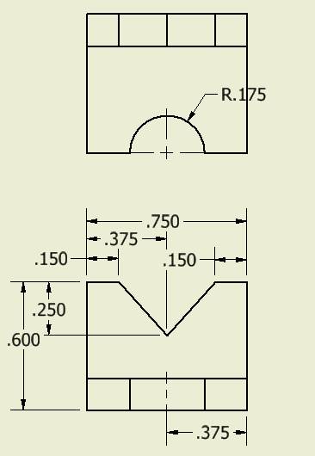
EGR 110 – Inventor Lecture #3
Dimension Style (continued)
Problem #1: Wrong view.
Solution: Delete dimension (.375) in front view and add a new dimension in the top view.
Problem #2: Poor location.
Solution: Move R.175 as it is over a visible line. Also avoid inside dimensions, so move it outside.
Original
Improved

Slide 21
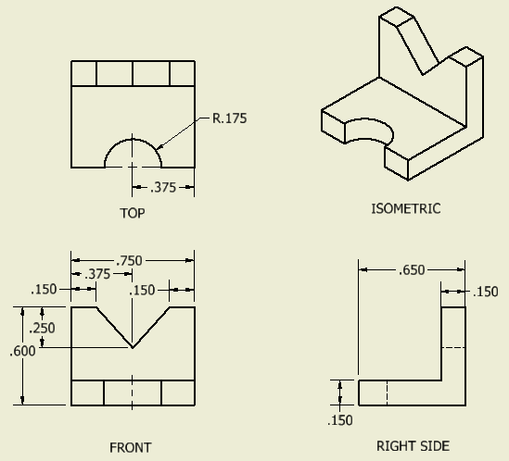
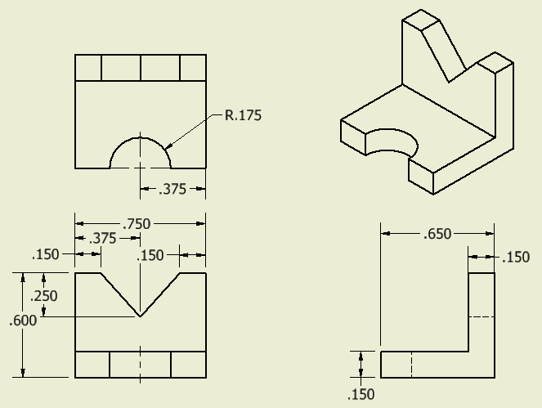
EGR 110 – Inventor Lecture #3
Label Views and Add Title Block Information
Use Annotate – Text to label views and to add title block information.
Adjust view spacing if necessary.
Improved
Original
You can also place your name and title on the drawing by right clicking the drawing Name in the Browser, select iproperties, click on the Summary Tab, put your name in the Author block and the title in the Title block, click apply and close.

Slide 22
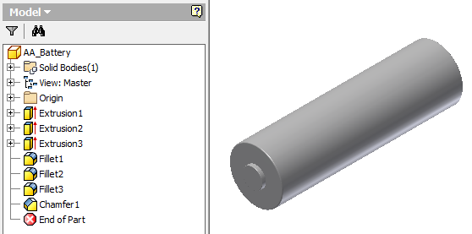
EGR 110 – Inventor Lecture #3
Volume and Density
For some parts and assemblies, it is important that we use the correct materials or assign the correct density to each part so that the center of gravity (or center of mass) will be in the correct location (for balance perhaps).
Example: The part shown below was created to model an AA battery. The battery’s mass was determined to be 23 g using a digital scale. Adjust the density of the part so that its mass is correct.

Slide 23
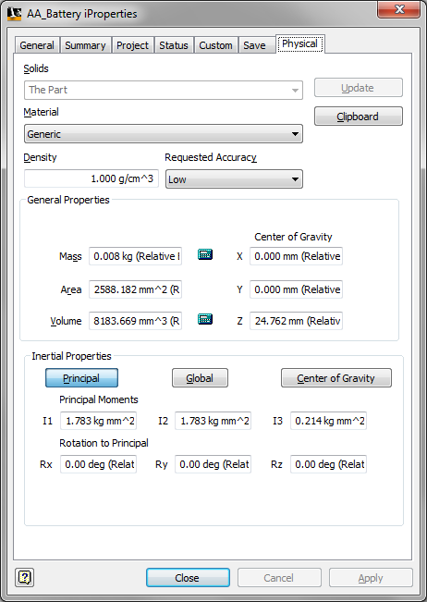
EGR 110 – Inventor Lecture #3
Determine the part’s original mass and volume
Right-click on the part name (AA_Battery) in the Model browser (of the .ipt file) and select iProperties.
Select the Physical tab
Verify that a material is assigned to the part & click Close. If not assign a material & click Close.
Original mass: 0.008 kg = 8 g
Original volume: 8183.669 mm³

Slide 24
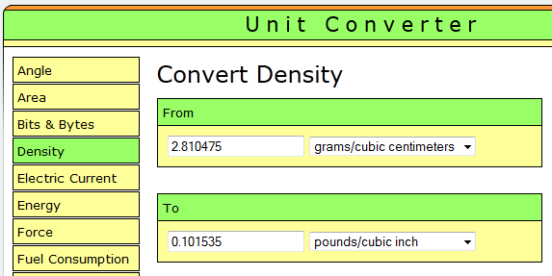
EGR 110 – Inventor Lecture #3
Determine the required density
We just determined the original mass and volume using the values from iProperties:
Convert the required density from kg/mm³ to lb/in³. This can be done using dimensional analysis, using a calculator, or using an online program.
The density with these units will be entered in Inventor
Inventor will display the result with these units.
http://www.digitaldutch.com/unitconverter/

Slide 25
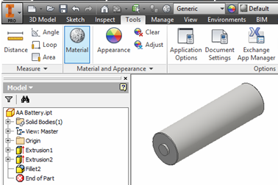
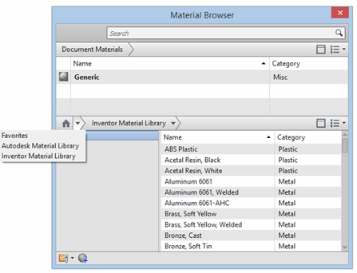
EGR 110 – Inventor Lecture #3
Change the Material type
Select Material under the Tools menu
Note that the current material in the Document Materials at the top of the Materials Browser is Generic.
Click on the Create New Material icon (second from left) at the bottom of the Material Browser.

Slide 26
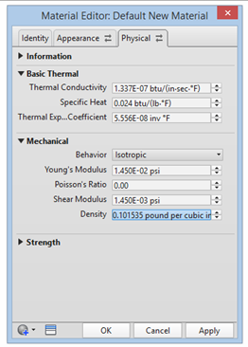
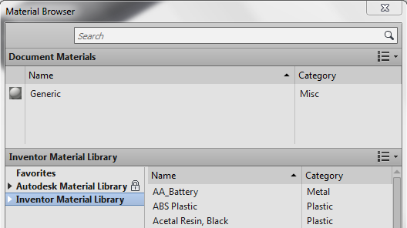
EGR 110 – Inventor Lecture #3
Change the Material type (continued)
When the Default New Material box opens change the name to AA_Battery and then click on the Physical tab.
When the Physical tab opens change the density to .101535 lb/in³, press the Enter key and click apply.
Exit the Material Editor: AA Battery, and exit the Material Browser.
Reopen the Material Browser and AA Battery should be included in the Document Materials List.

Slide 27
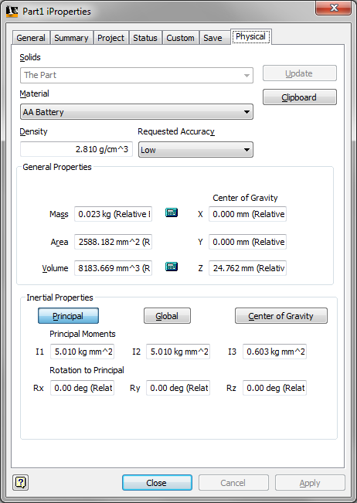
EGR 110 – Inventor Lecture #3
Change the Material type (continued)
Right-click on AA_Battery under Document Materials and select Assign to Selection (this assigns the new material to the part). Close the Material Browser.
As done previously, right-click on the part name (AA_Battery) in the Model browser of the .ipt file and select iProperties.
Select the Physical tab.
Check to see if the material and mass have been
changed to the desired value. If not change the
material to AA Battery, click Apply, and Close.
Correct mass: 0.023 kg = 23 g

