Slide 1
EGR 110 Team Project – Cable Car
Team Project
EGR 110 includes a significant team project. The team project will give you an opportunity to use your creativity, design skills, and analytical skills in completing a design project. This type of project is sometimes called a design/build project as you will not only design your product, but will build your product and test it in a class competition.
The team project will involve:
Brainstorming for ideas on how to build a product to complete a given task
Use Inventor to model individual parts of the project
Use Inventor to put all of the parts together in an assembly
Use MATLAB and Inventor to analyze and design
Manufacture some parts using a 3D printer while gathering other parts from commonly available materials
Produce detail and assembly drawings for your design
Build, test, and improve your product
Compete against other teams in your class
Give a presentation on your design to the class

Slide 2
EGR 110 Team Project – Cable Car
Design Specifications (provided)
Team Project – Design Process
Brainstorm for possible solutions
Analysis (MATLAB)
Finalize Design
Model parts in Inventor
Combine parts into an assembly
Detail drawings for each part
Assembly drawing
Center of gravity analysis
Construction:
Build some parts using 3D printer
Gather/build other parts
Assemble parts
Testing
Competition
Presentation

Slide 3
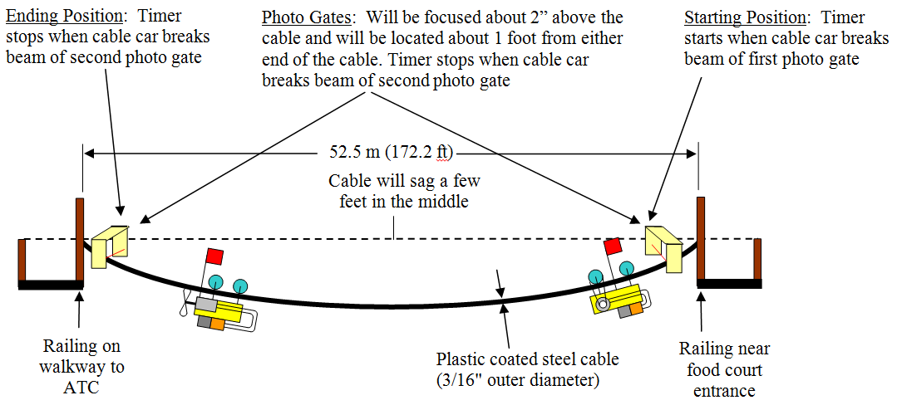
EGR 110 Team Project – Cable Car
Team Project for this semester
The team project to be used this semester will be the: Cable Car Over The TCC Lake
The basic setup for the cable car competition is shown below. We will use the cable over the lake, but joining in the campus competition on May 1 is optional.
We will make a few modifications to the rules for our class competition as noted later in this presentation.

Slide 4
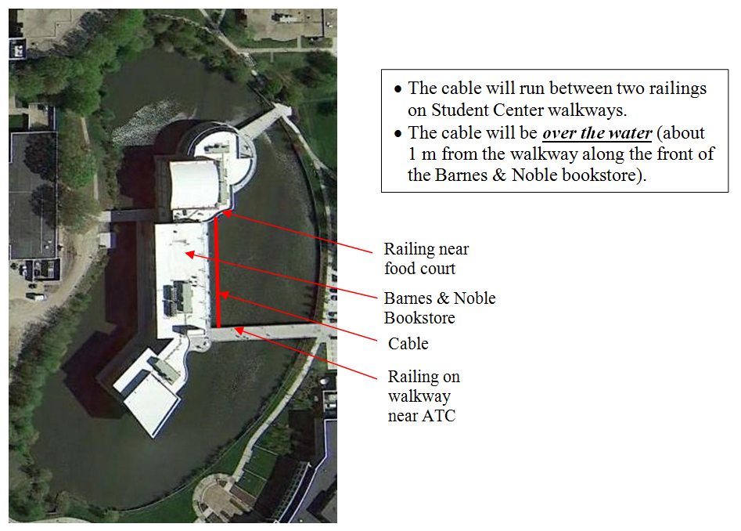
EGR 110 Team Project – Cable Car

Slide 5
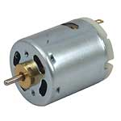
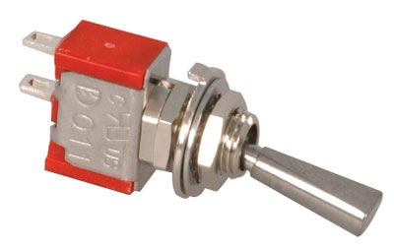
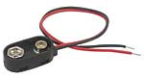
EGR 110 Team Project – Cable Car
Team Project – Materials for the project
Each team will be provided with the following materials:
12V DC Motor
Mass: 50 g
SPST Switch
Mass: 2 g
9V Battery Clip
Mass: 2 g
9V Battery
Mass: 46 g
Other materials needed from your team projects may be obtained as follows:
ach team will be provided with the following materials:
Design parts in Inventor and build with 3D printer (as a minimum all pulleys, all wheels, and the frame must be built with the 3D printer).
Some parts and hardware (limited) is available in class
Students may need to buy other parts ( axles, bearings, hardware, etc)

Slide 6
EGR 110 Team Project – Cable Car
Basic Rules: Cable Car Over TCC Lake Competition (see official rules for more detail) - Changes to the official rules for EGR 110 are highlighted in red.
Build a cable car to travel the length of a cable as quickly as possible
The cable will sag somewhat in the middle of the cable
Max cable car dimensions: 20 cm in length, 20 cm in width, or 20 cm in height.
The kits are provided to EGR 110 teams at no cost. If teams wish to participate in the campus competition, they must pay the $10.00 registration fee to be eligible for cash prizes.
The mass of the cable car should be 250 g maximum (grade penalties will be applied if it exceeds this goal).
Part of the team grade will be based on how well the car performs.
The cable car must be pulley-driven. No propellers are allowed.
All wheels, pulleys, and the frame must be built using the 3D printer.
The photo gates shown on the diagram will not be used, so no flag needs to be added to the cable car (a stopwatch will be used to time each cable car).
The cable car must use the motor, switch, and battery connector provided.
Only one 9V battery may be used on the vehicle. The 9V battery must be a standard alkaline battery – rechargeable batteries not allowed.
No additional sources of energy may be used (such as additional batteries, pre-stretched rubber bands, pre-compressed springs, balloons, CO2 cartridges, etc).
A sample 25’ cable will be available in the classroom for testing.

Slide 7
EGR 110 Team Project – Cable Car
Team Project Milestones – A number of milestones have been established to make sure that each team completes their design by the end of the semester. Check with your instructor for the exact dates for each milestone.
Step 1: Form Teams (Week 3) – The class will be divided into teams of 3-4 students each. Students can generally pick who will be on their team. Keep in mind that your team grade will depend to some extent on the other team members!
Discuss the rules of the competition, and deadlines in detail in a class.
Meet with your team members to discuss ideas for your design, including (but not limited to):
How many wheels/pulleys will be used?
What gear ratio should be used (1:1 to 1:3 recommended)?
Will a pulley be mounted on the motor shaft? How?
What type of axles/supports will be used?
How will the motor be mounted (a firm support is needed)?
How will the design stay balanced? Is the battery position adjustable?
Where should the center of gravity be located? Does moving it further below the cable make the cable car more stable?

Slide 8
EGR 110 Team Project – Cable Car
Important notes:
If teams divide up parts of the project and then one team member stops attending, other teams members must then do that team member’s work.
Stating that a team member didn’t do their job is not a valid excuse. It is up to the entire team to make sure that all tasks are completed.
If all team members except you stop attending, then you are the team!

Slide 9
EGR 110 Team Project – Cable Car
Step 2: Initial Design Proposal & Project Timeline (Due during Week 4) Each team should turn in the following items:
Detailed Hand Sketch of your team’s cable car. (See example on next slide.)
On one page include sketches of two views (side and top perhaps, but choose the best views for your design), and an isometric view such that features can be clearly seen. Use appropriate graph paper. The sketch must include all parts to be used in the cable car (other than minor hardware and fasteners), including: motor, switch, pulleys, drive belt (if used), battery clip, frame, etc.
Be sure to consider the center of gravity so that the car will be balanced. A good feature is have a design that allows the battery position to be shifted slightly to balance the car.
Use balloons to letter each component on the cable car.
Include a table with a row for each unique part and columns for the part letter in the balloon, name of the item, material (if applicable), and an indication of how or where the part will be procured (provided, 3D printer, purchased, etc.)
2) Gantt Chart - On a separate sheet(s), provide a ‘Gantt’ Timeline Chart of project tasks, milestones, and deadlines. Include tasks and time already in the past. Be realistic about the time that tasks will take. If you are unfamiliar with a Gantt chart, try searching online for “Excel Gantt Chart” or similar.
3) Cover Sheet - Include a cover sheet with a title, the group number, and the names of each of the group members.

Slide 10
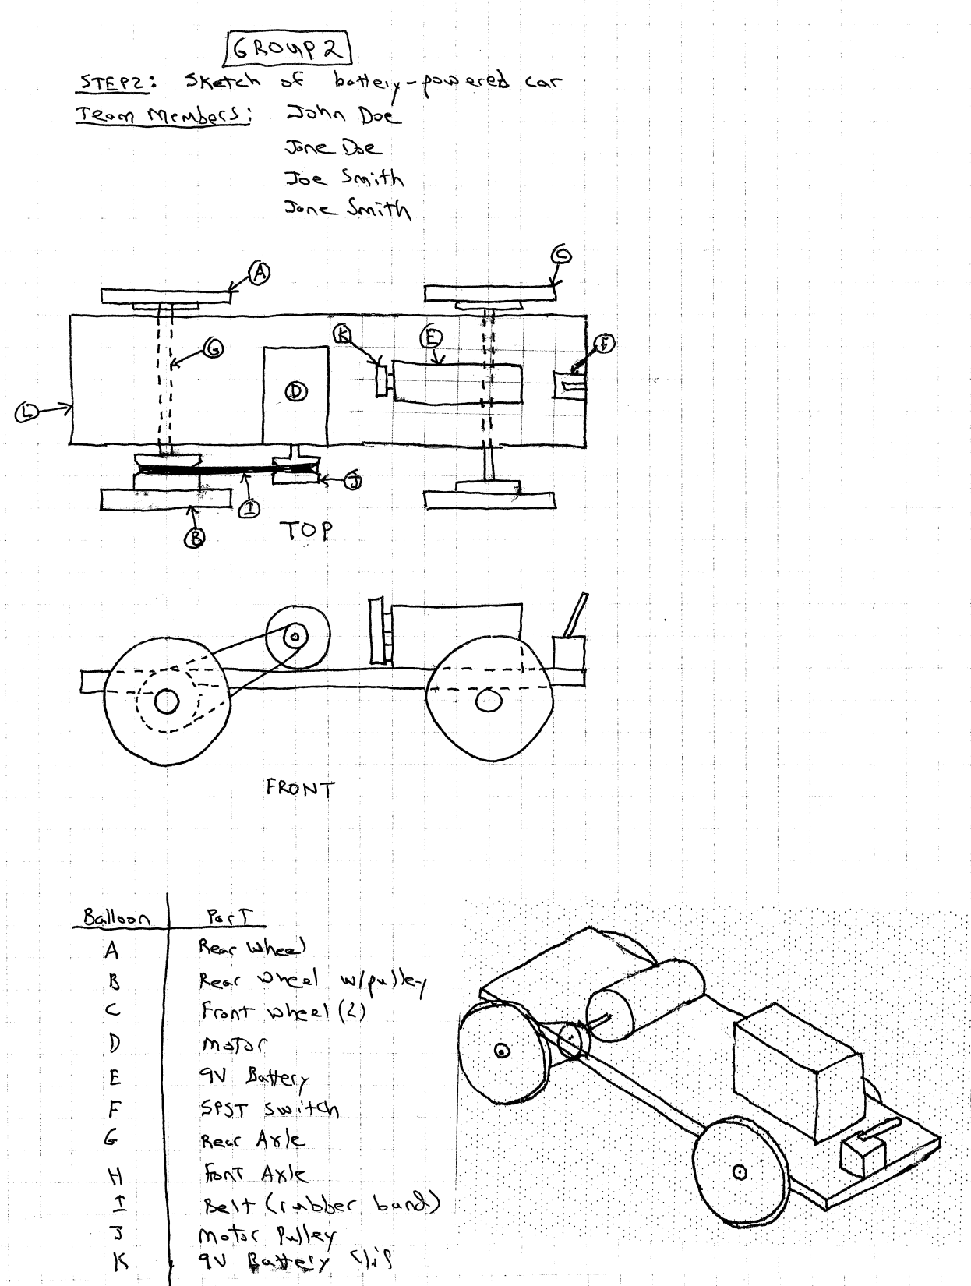
EGR 110 Team Project – Cable Car

Slide 11
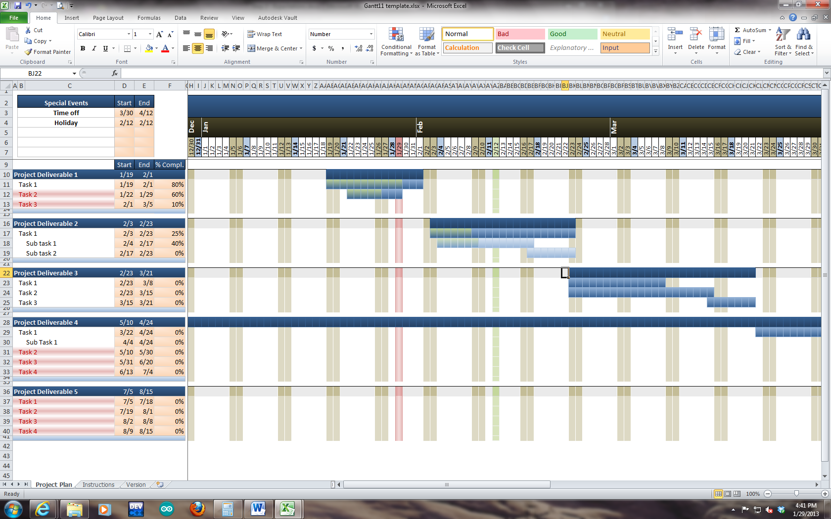
EGR 110 Team Project – Sample Gantt Chart

Slide 12
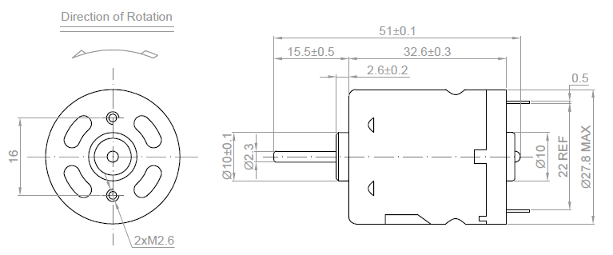
EGR 110 Team Project – Cable Car
Step 3: Inventor Models for Parts Provided (Due during Week 7)
As noted earlier, 4 parts will be provided to each team (motor, switch, 9V battery, and 9V battery clip).
Decide which team member will draw each part. Each team member must draw and least one part and their name must appear as the author of the part on the drawing file (idw). Use a descriptive name for each part that includes the author’s name. For example: Motor_John_Doe.ipt
Each part should be drawn as accurately as possible. Include all features that could interfere with another object. For example, the electrical tabs on the back of the motor should be included, but holes in the motor casing can be omitted. Extra credit might be awarded for extra detail. Ignore tolerances. Use metric dimensions for all parts.
Adjust the density of the part so that its mass is correct.
Dimensions for the parts can be found using the links below:
Motor - http://www.jameco.com/Jameco/Products/ProdDS/232040.pdf
Switch - http://www.jameco.com/Jameco/Products/ProdDS/317287.pdf
9V Battery - http://www.jameco.com/Jameco/Products/ProdDS/198731.pdf
9V Battery Clip - http://www.jameco.com/Jameco/Products/ProdDS/216452.pdf
Example: Motor dimensions are shown from the link above.

Slide 13
EGR 110 Team Project – Cable Car
Step 3: Inventor Models for Parts Provided (continued)
For each part both a part file (ipt) and a drawing file (idw) should be produced.
Turn in printouts of the drawing files (idw) in to the instructor.
Use an A-size portrait sheet.
List the author’s name
List the part name, team number, team member’s names, scale, etc.
List the volume, mass, and density.
Use metric dimensions for all parts with default units in mm.
Follow good rules for dimensioning.
Upload the part file (ipt) to the File Exchange for your group in Blackboard. This is important so that all team members will access to all parts (especially if a student stops attending class for some reason). Each team member must upload their own files (Blackboard will list who uploaded it.)
For the 9V battery clip, provide only short red and black wires (perhaps10 mm). Additional wires will not be required for any part of the project.
If a team member has dropped from the team then the team must decide who should take over responsibility for that part, and inform the instructor of the loss of team member.
I) More details and instructions may be provided at the time of the assignment.

Slide 14
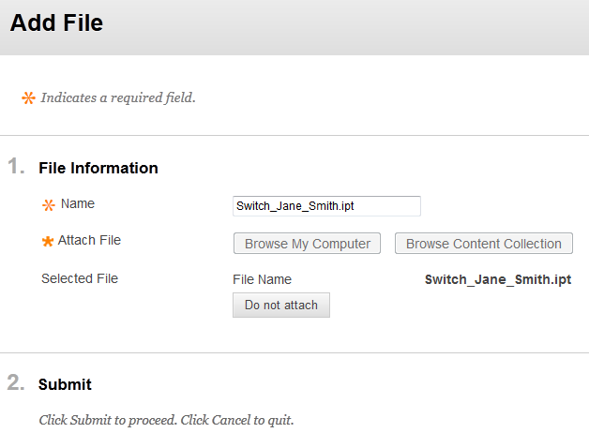
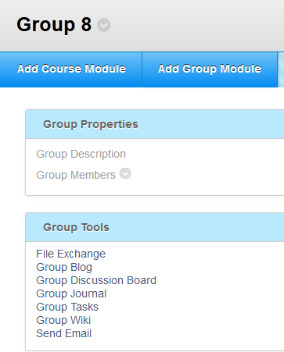
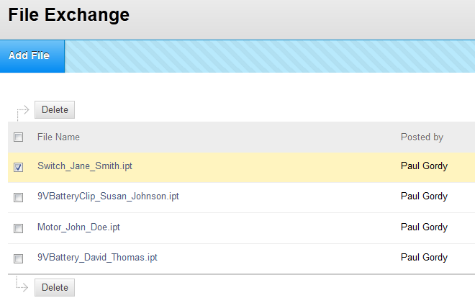
EGR 110 Team Project – Cable Car
Uploading parts to the File Exchange
2) Select Add File and find your part file
1) Select your group in Blackboard then pick File Exchange
3) List of uploaded files are available to all group members. Each author must post their own file.
Jane Smith
Susan Johnson
John Doe
David Thompson

Slide 15
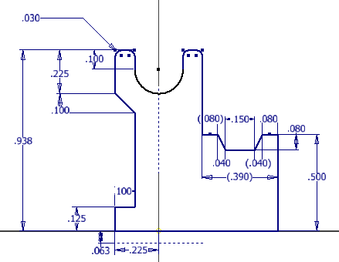
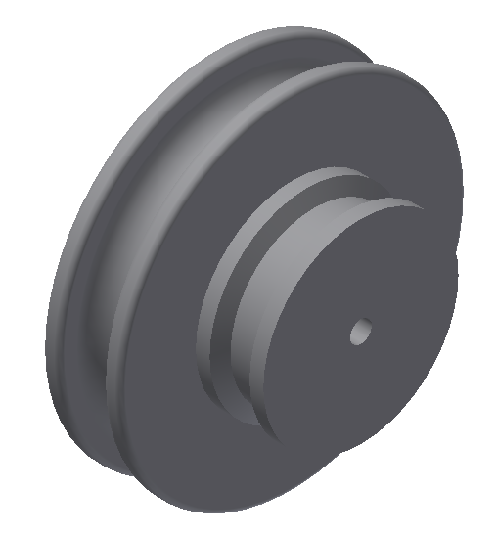
EGR 110 Team Project – Cable Car
Step 4: Pulley/Wheel Design with Inventor (due Week 6)
Each group member should design one pulley or wheel for the group. This assignment may replace Inventor Assignment #4 (check with your instructor).
Before proceeding check with the group to discuss:
How many pulleys/wheels do we need? Double pulley needed?
What diameters should be used for the wheels/pulleys? Axle hole diameter?
The cable has a diameter of 3/16” (4.76 mm). Discuss the size of the channel for the cable.
Discuss the size of the channel for the belt drive. Rubber band to be used? What size?
Discuss the use of fillets.
Discuss the thickness of material at different point on the model as the ABS plastic used by the 3D printer is not very strong. A minimum thickness of 3mm is generally recommended.
If a team has 4 members and two wheels are needed, then let different team members try slightly different designs.
More details and instructions may be provided at the time of the assignment.
Example: Sketch revolved to create a double pulley

Slide 16
EGR 110 Team Project – Cable Car
Step 5: Submit pulley/wheel designs for 3D printer (turn in on Week 7)
If the instructor has already graded your drawings for the pulleys or wheels, be sure to make any necessary changes to the Inventor parts before proceeding.
If the drawings have not been graded, discuss your design with the instructor to see if the instructor would recommend any changes before proceeding.
If your group has more than one design for each pulley or wheel, select which design is to be used. Send the instructor an email indicating the exact name of the part to be used from the File Exchange in Blackboard.
Keep in mind that it may take 8 hours or more to build parts on the 3D printer and additional time is required for the parts to soak in the parts bath to remove support material. Additionally, many groups from several classes of EGR 110 may all be trying to build parts at the same time, so allow one week for parts to be built.
More details and instructions may be provided at the time of the assignment.

Slide 17
EGR 110 Team Project – Cable Car
Step 6: Inventor Part Models and Drawings (Weeks 8-11)
In general each team should model all parts of the cable car. However, consult with the instructor to see if some parts can be omitted or simplified (such as hardware, wires, tape, rubber band, etc).
The 4 parts provided (motor, switch, 9V battery, and 9V battery clip) should have already been modeled. Divide up the remaining parts between team members and provide the instructor with a list of which parts will be designed by each team member before you begin.
Produce detail drawings for each part and submit printed copies to the instructor. Include all dimensions and good dimensioning style. Be sure to include the scale. Adjusts the density of each part to provide the correct mass and provide the mass.
Include the author’s name in the title box along with the Group’s team name/number, part name and description, etc.
Upload each file into the File Exchange for your group in Blackboard.
If a team member has dropped from the team then the team must decide who should take over responsibility for that part, and inform the instructor of the loss of team member.
If additional parts are to be made using the 3D printer, email the instructor with the exact name of the parts in the File Exchange that are to be used.
More details and instructions may be provided at the time of the assignment.

Slide 18
EGR 110 Team Project – Cable Car
Step 7: Construction and Testing (Weeks 10-14)
Construct and test your cable car.
Note that a “static test” must be performed on Week 12 (see next slide).
Check with your instructor to see when the classroom and cable are available outside of class if additional time is needed.
As you modify your actual cable car, modify the corresponding Inventor parts as well. Create additional Inventor parts if necessary. The instructor may allow you to create additional 3D parts if needed.
More details and instructions may be provided at the time of the assignment.

Slide 19
EGR 110 Team Project – Cable Car
Step 8: Static Test (Week 12)
Construct the basic elements of your cable car and place it on the cable for the instructor to see. The cable car should be able to roll along the cable if gently pushed.
The cable car does not need to run yet, but all key components should be assembled.
The switch and battery should be mounted, but do not need to be soldered yet.
Discuss with the instructor what you still needs to be done on the cable car.
The instructor may offer suggestions.
The static test may be demonstrated late with a grade penalty (to be determined by the instructor).

Slide 20
EGR 110 Team Project – Cable Car
Step 9: Inventor Assembly (Week 14)
A complete assembly of your cable car should be created by the group. Note that the assembly will need to be demonstrated in Step 10: Team Presentation.
Be sure to use a key frame element as the base part (which will not move) with the correct orientation.
Add other parts to form the assembly.
Each part should be weighed (using an electronic balance in the lab) and its density should be adjusted to match the mass.
Create a drawing for the assembly.
Add balloons for each part and a table of parts. Include the mass of each part in the table. Include the total mass for the assembly.
Use Inventor to find total mass and the center of gravity of the assembly. Verify that the center of gravity is located directly under the cable.
Include appropriate team information in the title box.
Upload the assembly and the drawing to the File Exchange for your group.
Turn in a printout of the drawing to the instructor.
More details and instructions may be provided at the time of the assignment.

Slide 21
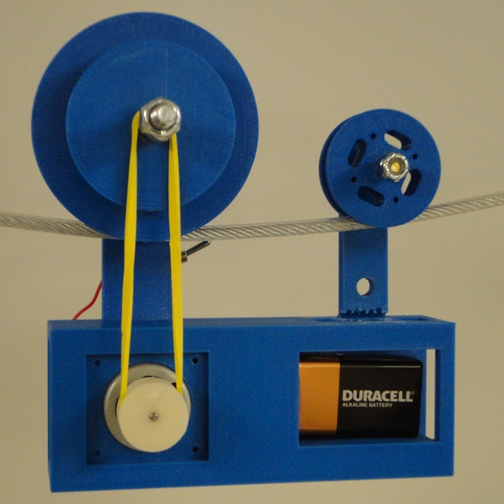
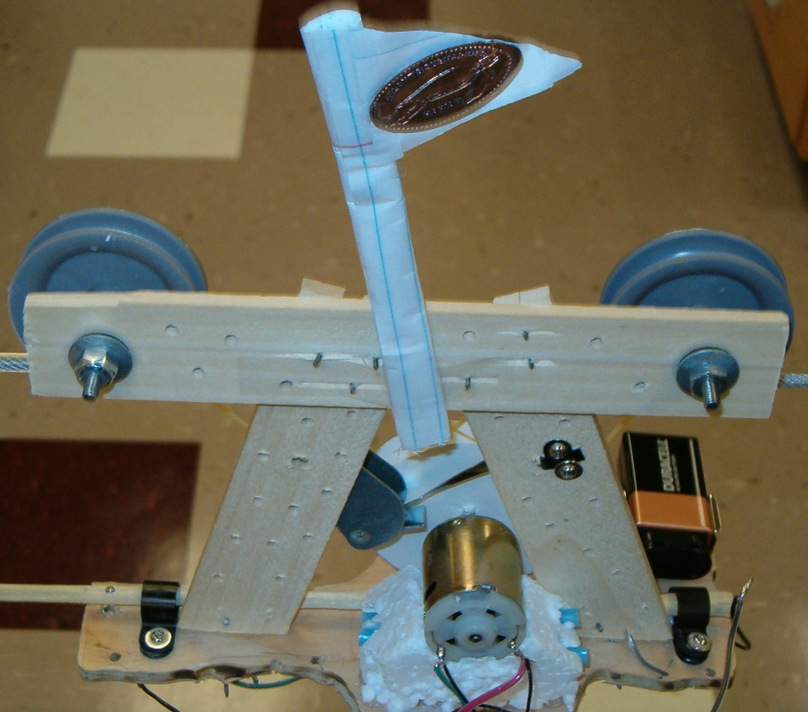
EGR 110 Team Project – Cable Car
Step 10: Competition (Week 15)
The date for the official competition will be designated by the instructor.
The first 30 minutes of class will be allotted to unofficial trial runs.
After that all attempts will be recorded and used to calculate the average of 3 best attempts.
Teams may continue to make modifications and take extra attempts until the class period ends.
Record your times for all runs and include them in your presentation.
More details and instructions may be provided at the time of the assignment.

Slide 22
EGR 110 Team Project – Cable Car
Step 11: Team Presentation (Week 16)
Make a 10-15 minute presentation to the class using PowerPoint. Turn in a printout of the PowerPoint presentation (3 slide handout version is fine) and Inventor assembly to the instructor before your presentation. The presentation should include:
Team Information (members, major, intended 4-yr school, role on the team)
A summary the significant project requirements.
Show and discuss the initial sketch and timeline of your initial design intent.
Show a final assembly (demonstrate motion if applicable) of your Inventor assembly from Step 8. Also include information on the location of the center of gravity.
Discuss problems you encountered and modifications made to your cable car.
Discuss the performance of your cable car. Compare the performance to other cable cars designs in the competition, and predictions from MATLAB.
Provide a parts list total people-hours spent on the design project.
Create a revised Gantt chart of actual time required for tasks, and compare with original timeline created in Step 2.
Discuss potential improvements that could be made to your cable car.
Discuss what your team and design ‘got right’ (or did well).
Be prepared to field questions from the class.

