Slide 1
EGR 110 – Inventor Lecture #1
Welcome to
EGR 110
Engineering Graphics
Inventor Lectures:
Inventor lectures are intended to give a general overview of the topics to be demonstrated by the instructor during the class. The demonstrations will include more detail than the lectures notes.
The instructor may go back and forth between the lecture notes and demonstrations.
Students should also read the corresponding material in the Inventor textbook. The textbook is very helpful and often presents topics in tutorial fashion.
The Inventor textbook and software is typically updated each year, but the changes are often minor. Even if this presentation refers to an earlier version of Inventor, most of the material will still be quite accurate.
Reference: Many of the images in these Inventor presentations are from Parametric Modeling with Autodesk Inventor 2013 - 2019. Autodesk Inventor tutorials, downloads, and troubleshooting solutions are available at http://knowledge.autodesk.com/support.

Slide 2
Feature-Based Parametric Modeling
EGR 110 – Inventor Lecture #1
Student Version Download of Inventor
A student version of Inventor Pro is available at: http://www.autodesk.com/education/free-software/inventor-professional
Do not download a version later than that used in the classroom. Any files created on a later version will not open in earlier versions.
One of the key elements in the Autodesk Inventor solid modeling software is its use of the feature-based parametric modeling technique. The feature-based parametric modeling approach has elevated solid modeling technology to the level of a very powerful design tool. Parametric modeling offers many benefits:
We begin with simple, conceptual models with minimal detail; this approach conforms to the design philosophy of “shape before size.”
Geometric constraints, dimensional constraints, and relational parametric equations can then be used to capture design intent.
The ability to update an entire system, including parts, assemblies, and drawings after changing one parameter of complex designs.
We can quickly explore and evaluate different design variations and alternatives to determine the best design.
Existing design data can be reused to create new designs.
Quick design turn-around.

Slide 3
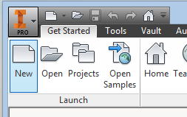
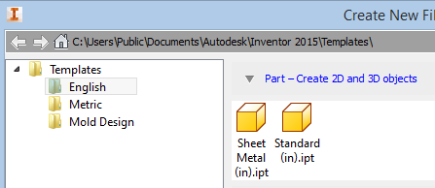
EGR 110 – Inventor Lecture #1
3
Getting Started
Launch Inventor and the initial screen below will appear.
There are 2 methods to start/open a new file, the first is:
1. Select New to create a new file
Then select Templates (English or Metric units) and then Standard (in).ipt or Standard (mm).ipt and then Create to create a new part, or:
Ribbon Tabs
and Toolbars
Application menu
Quick Access toolbar
Videos and Tutorials are available by right clicking on the Tutorials or Learning Path on the Ribbon. Videos and Tutorials are also available at:
http://knowledge.autodesk.com/support.

Slide 4
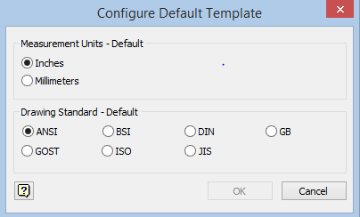
EGR 110 – Inventor Lecture #1
Getting Started (Continued)
Launch Inventor and the initial screen below will appear.
There are 2 methods to start/open a new file, the second is:
2.a. Select New Part This will open a new file in the default units and drawing format.
b. To change the defaults select the Gear icon at the upper right
c. and select inches or millimeters, retain the ANSI drawing standard.
File types in Inventor:
ipt (Inventor part) – we will be begin the course by making single parts
idw (Inventor drawing) – then parts and assemblies can be brought into drawing files where multiple views and additional features can be added
iam (Inventor assembly) – later we will combine several parts into a single assembly
ipn (Inventor presentation) – we might use this for exploded view drawings later

Slide 5
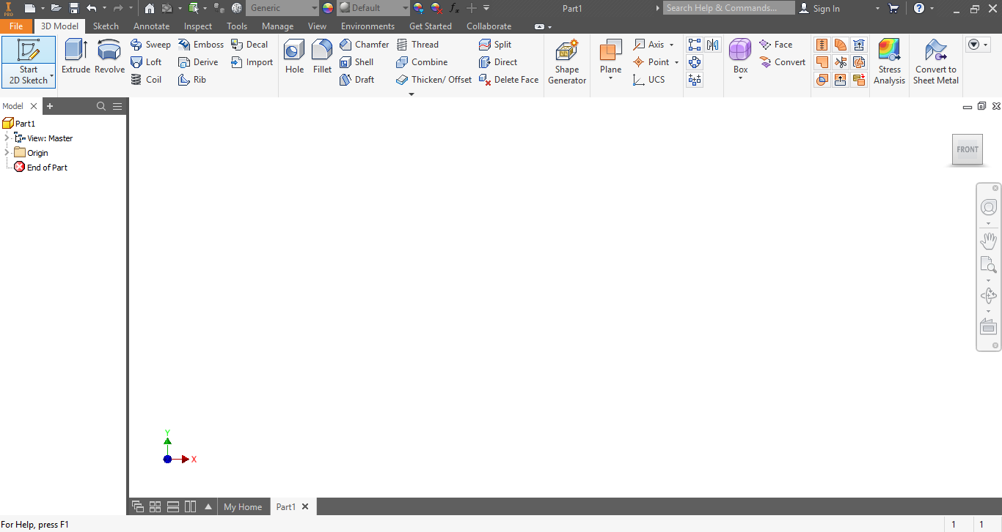
EGR 110 – Inventor Lecture #1
Inventor .ipt Initial 2019 Screen Layout
Application Menu
Quick Access Toolbar
Ribbon Tabs and Toolbars
Feature Toolbar Panel
Model Browser: If you accidently hide/remove the Model Browser click on View, click on User Interface and check Model to restore it.
View Cube
3D Indicator
Navigation Bar
Graphics
Window
Message or Single-line Help

Slide 6
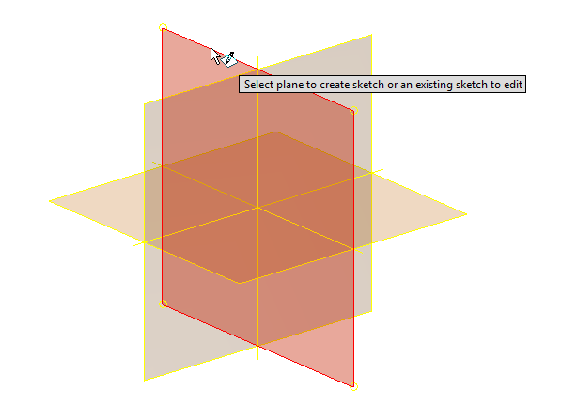
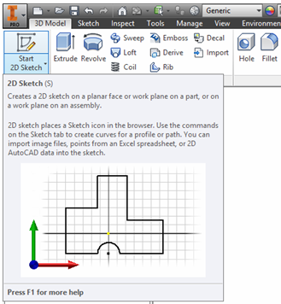
EGR 110 – Inventor Lecture #1
2D sketches: Many of our initial parts will begin with 2D sketches. These sketches will later be extruded (add thickness), revolved, or swept to create solid models. Start by clicking on the 3D Model tab in the Quick Access Toolbar and then click on Start 2D Sketch (twice) to show the planes.
Select one of the planes to create a 2D sketch on the plane. We may use the xy plane for our first few examples.
Three plane choices are available (refer to xyz icon below for orientation):
xy plane –front view
zx plane – top view
yz plane – right side view
xyz icon

Slide 7
Creating Rough Sketches
EGR 110 – Inventor Lecture #1
As the name implies, a rough sketch is not precise at all. When sketching, we simply sketch the geometry so that it closely resembles the desired shape. Precise scale or lengths are not needed. Autodesk Inventor provides us with many tools to assist us in finalizing sketches. For example, geometric entities such as horizontal and vertical lines are set automatically. However, if the rough sketches are poor, it will require much more work to generate the desired parametric sketches. Here are some general guidelines for creating sketches in Autodesk Inventor:
Create a sketch that is proportional to the desired shape. Concentrate on the shapes and forms of the design.
Keep the sketches simple. Leave out small geometry features such as fillets, rounds and chamfers; they can be added later.
Exaggerate the geometric features of the desired shape. For example if a desired angle is 85^{O} create an angle of 50-60^{O} or Inventor may assume that the intended angle is 90^{O} and draw it that way.
Draw the geometry so that it does not overlap.
The sketched geometric entities must form a closed region.
Alternatively dimensions and constraints may be included as the sketch is drawn.
If you have experience with other CAD programs you may need to temporally forget its conventions as Inventor conventions are probably significantly different.

Slide 8
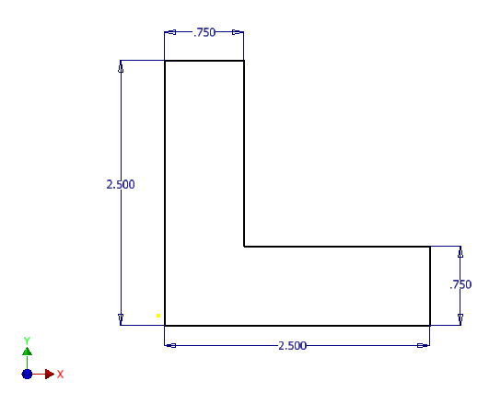
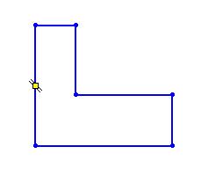
Creating Rough Sketches
EGR 110 – Inventor Lecture #1
Dimensions and Constraints
Once a rough sketch has been created, we can control the sketch (and thus capture our design intent) by adding dimensions and constraints.
Dimensions – used to control the length of lines, diameter of holes, angles, etc.
Constraints – used to make various features horizontal, perpendicular, co-linear, tangent, etc.
Sketch Ribbon
Dimension and Constraint tools

Slide 9
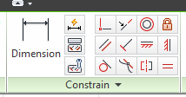
Dimension and Geometric Constraint Symbols
EGR 110 – Inventor Lecture #1
Collinear- causes 2 or more lines to be collinear
Perpendicular – causes selected lines to be perpendicular
Place dimension in sketch
Smooth – applies a continuous curve to a spline
Auto Dimension – applies missing dimensions and constraints to sketch
Concentric – causes arcs, circles, ellipses to have same center
Show Constraints – displays sketch constraints
Horizontal – causes lines or pairs of points to be parallel to the x-axis
Control Constraints – control automatic application of constraints
Symmetric – causes selected lines to be symmetric about a selected line
Coincident – constrains points to selected lines or curves
Fix – fixes points and curves relative to coordinate system
Parallel – causes selected lines to be parallel
Vertical – causes lines or pairs of points to be parallel to the y-axis
Tangent – causes curves/lines to be tangent to other curves
Equal – causes selected curves to have same radius or lines to be same length

Slide 10
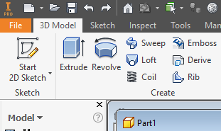
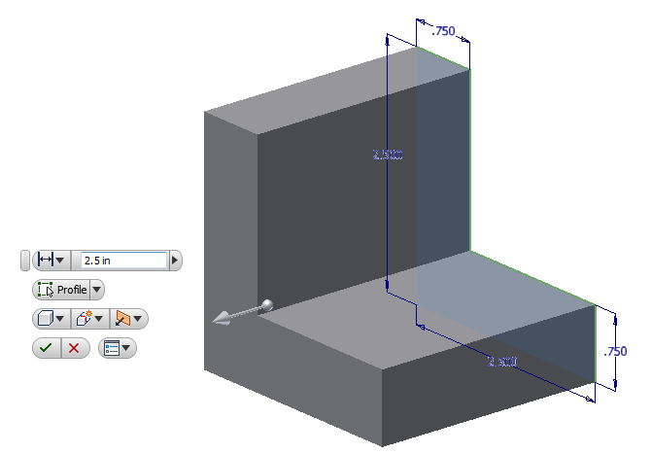
EGR 110 – Inventor Lecture #1
Creating a Solid Feature - Extrusion
2D Sketches are often used to create solid features. Three key types of figures will be created using sketches:
Extrusions (adding thickness or depth to a sketch)
Revolutions
Sweeps
We will initially concentrate on extrusions.
Sketch is extruded to make a solid

Slide 11
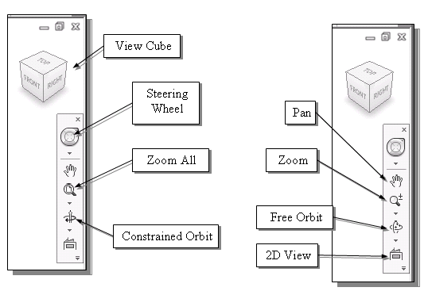
EGR 110 – Inventor Lecture #1
Dynamic Viewing Inventor includes many useful tools for rotating, zooming, panning, etc.
Clicking on the house icon will automatically Zoom to Fit the screen and rotate to isometric view.
Useful function keys
F2 – Hold down F2 and the left mouse button to PAN.
F3 – Hold down F3 and the left mouse button to ZOOM in and out.
F6 – Automatically Zooms to Fit and rotates to an Isometric view.
These may not function on all computers.
Useful mouse functions
Zoom – Scroll center wheel on mouse to zoom in and out.
Pan – Hold down the center wheel on the mouse and move the mouse to pan the model or sketch.
Down arrows provide additional options.

Slide 12
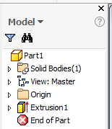
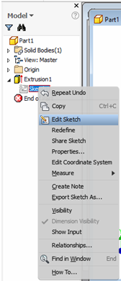
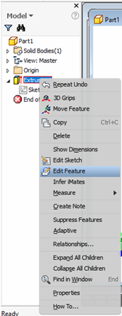
EGR 110 – Inventor Lecture #1
Browser Window
The Browser Window (shown below) is an important part of Inventor that can be used to manage your design. It will show a series of features (extrusions, revolutions, holes, fillets, etc.) used to create the part. Some features, such as extrusions, are based on sketches. Any of these features or sketches can be edited at any time. The example below shows one extrusion (Extrusion1) that is based on Sketch1. Right click on Sketch or Extrusion in Browser Window to edit.
Browser Window Editing Sketch 1 Editing Extrusion 1

Slide 13
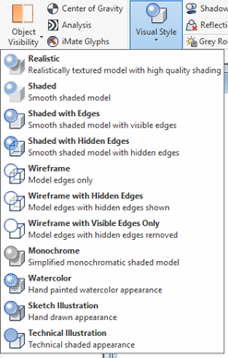
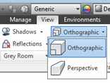
EGR 110 – Inventor Lecture #1
Visual Style
We will typically use the default Shaded visual style, but you might try some of the others. Click on View and then Visual Style to change the visual style.
Orthographic vs. Perspective
We will typically use the default Orthographic (or isometric) style (where parallel lines always appear parallel), but Perspective style (where parallel lines appear to converge in the distance) is sometimes in artist’s renderings and in other cases. Click on View and then Orthographic or Perspective to change the projection style. You might try it out.

Slide 14
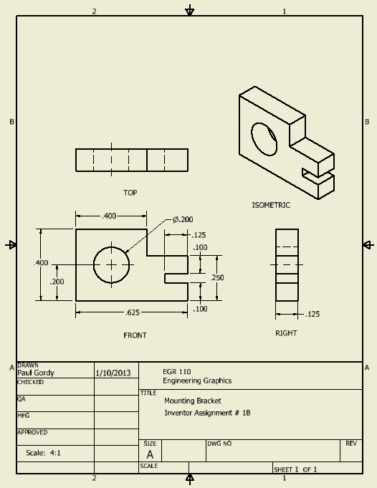
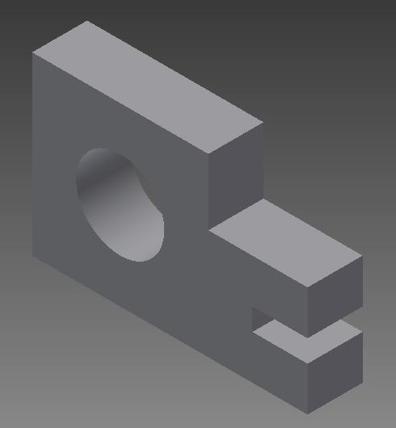
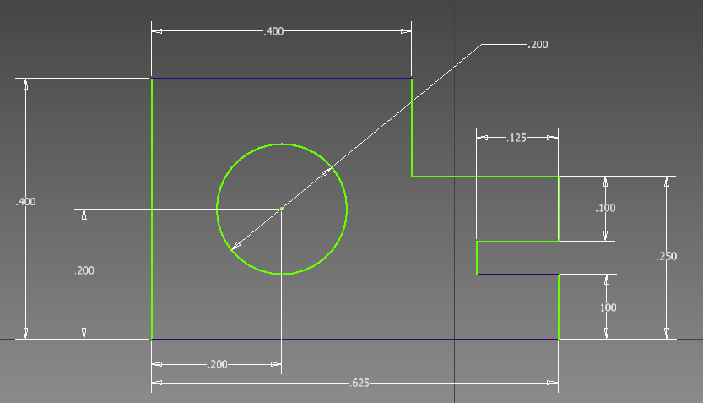
EGR 110 – Inventor Lecture #1
Printing
For the first couple of assignments, we will print sketches and models directly (using File – Print). We may print the solid model (from an isometric view) and also print the related 2D sketches. This is not the preferred method of printing and may result in printouts that are not as clear as those we will create later by printing from a drawing file (.idw).
For now, do not worry about centerlines, arrow sizes on dimensions, notes, etc. These types of features can be easily added later in drawing files. An important point is that sketches are used to express features and constraints that are necessary to create the desired solid model. When we begin to use drawing files we will be able to produce professional looking drawings that following standard drawing conventions.
In later assignments we will create professional looking drawing files from our models.
In the first couple of assignments we will simply print the solid and the related sketches.

