Slide 3
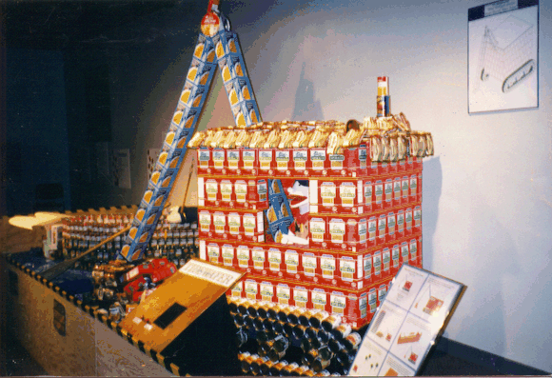
CANstruction 97 - Children’s Museum of Portsmouth

Slide 4
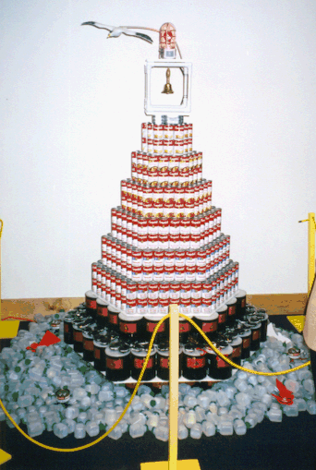
CANstruction 98
Virginia Marine Science Museum

Slide 5
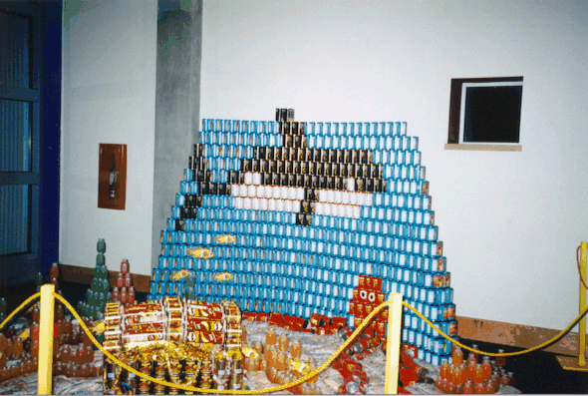

Slide 6
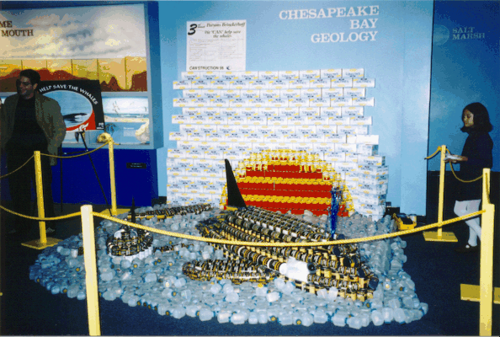

Slide 7
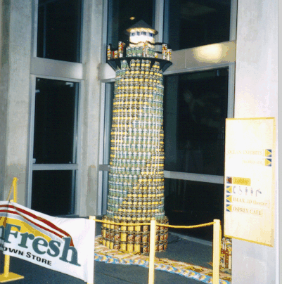

Slide 8
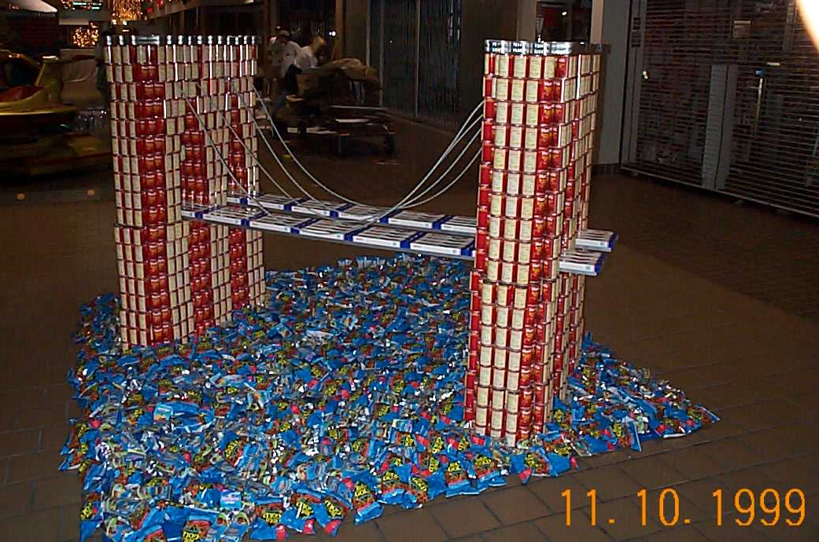
CANstruction 99 - Pembroke Mall

Slide 9
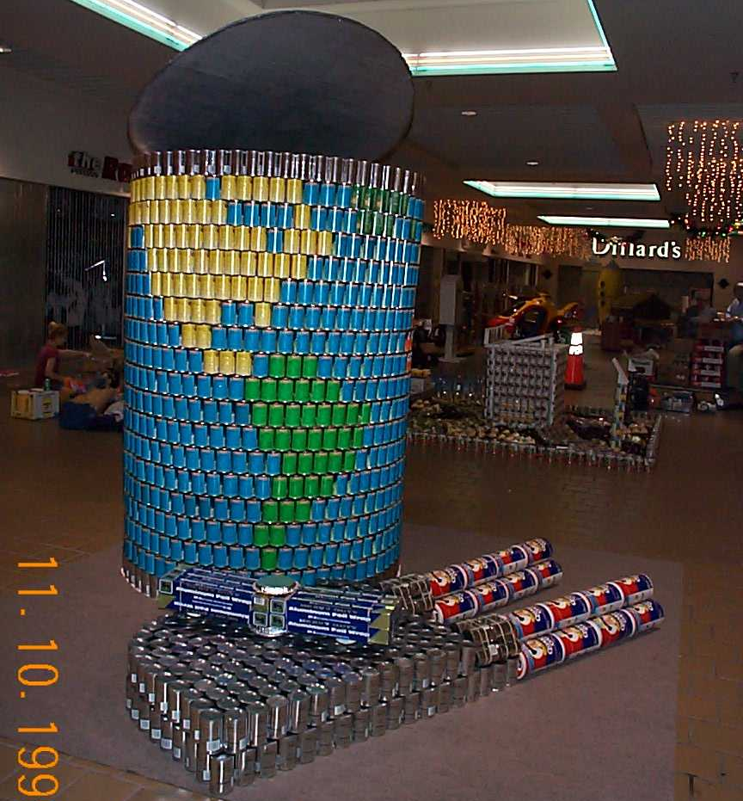

Slide 10
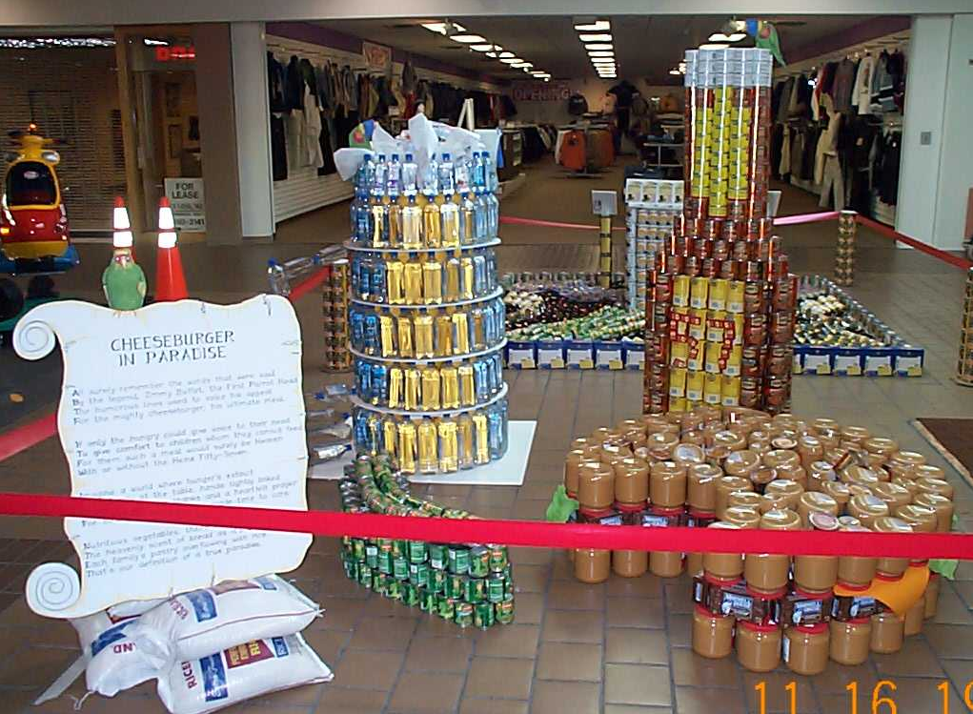

Slide 11
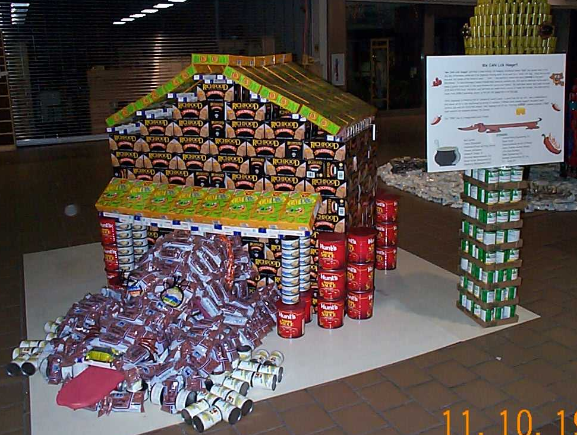

Slide 12
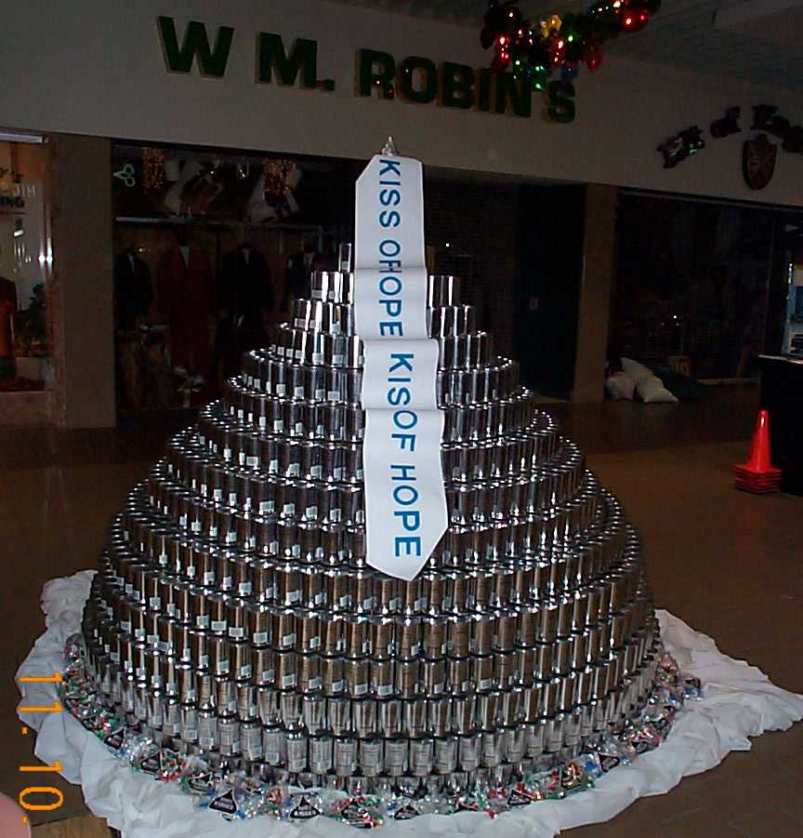

Slide 13
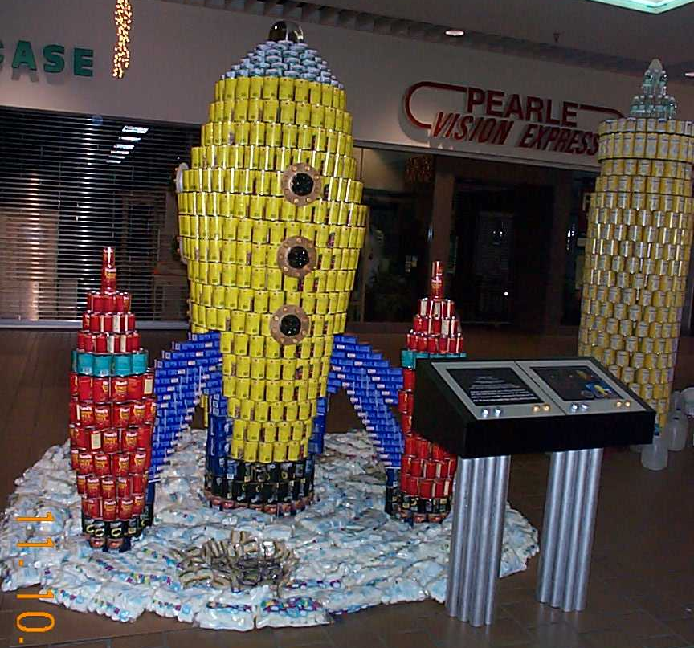

Slide 14
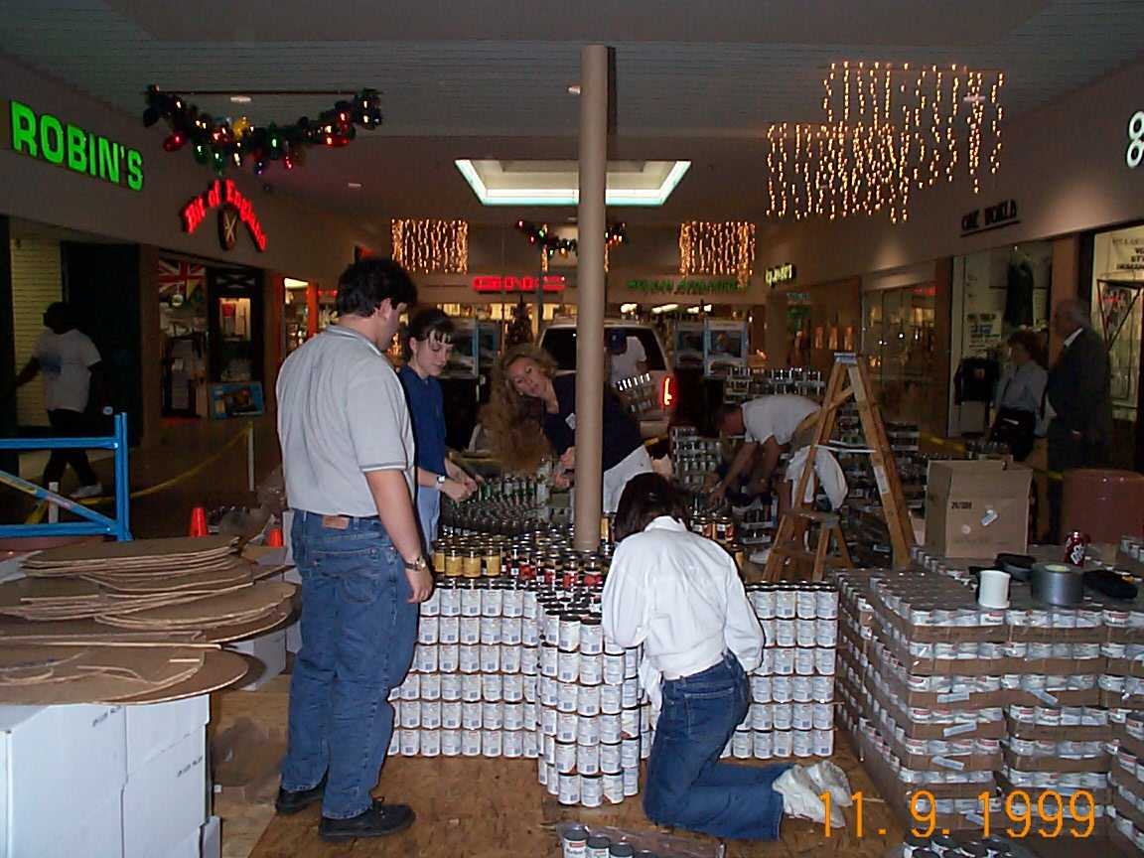

Slide 15
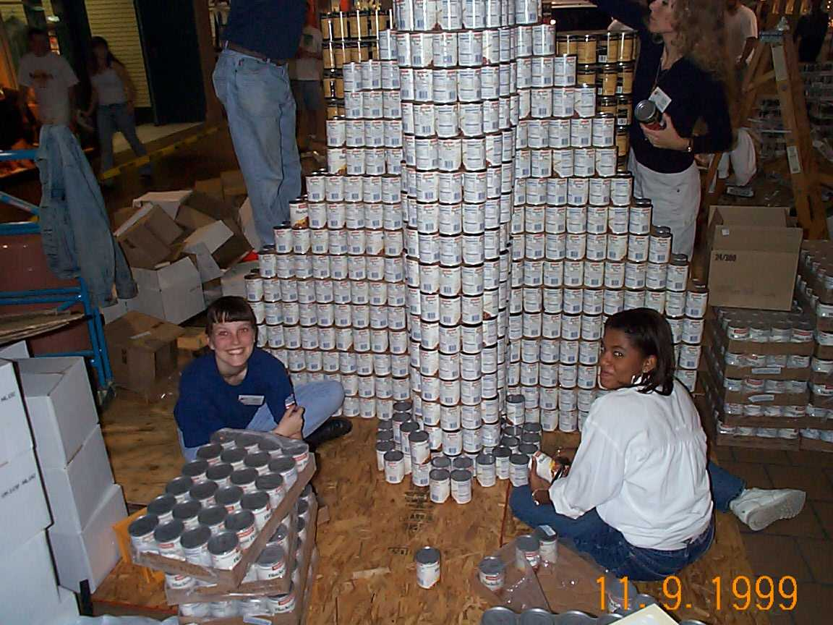

Slide 16
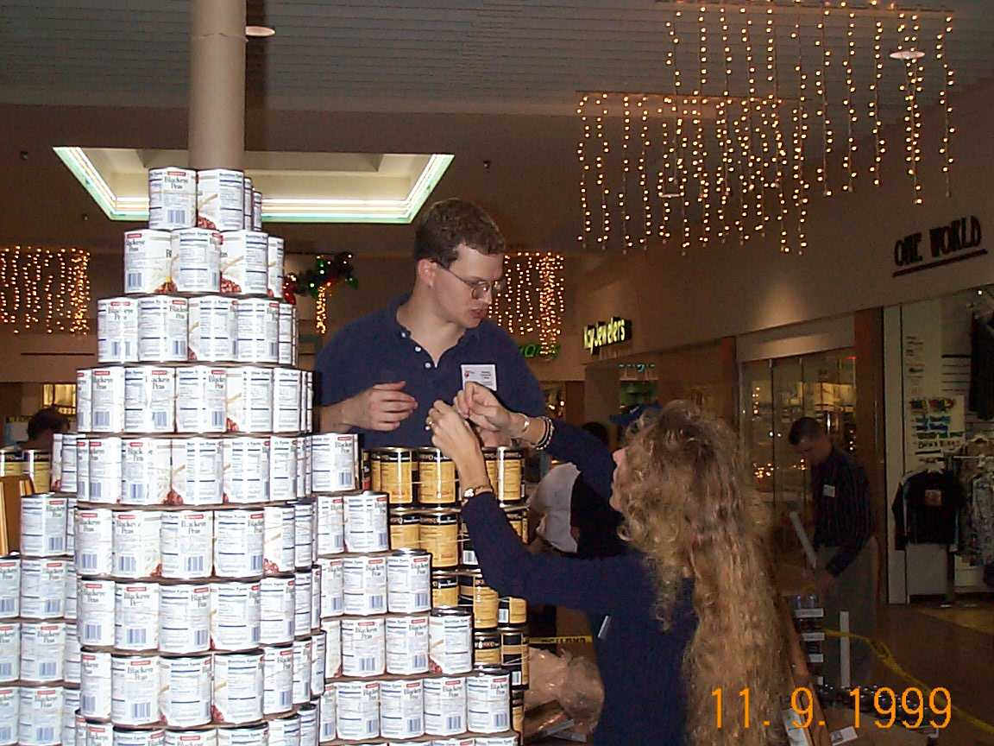

Slide 17
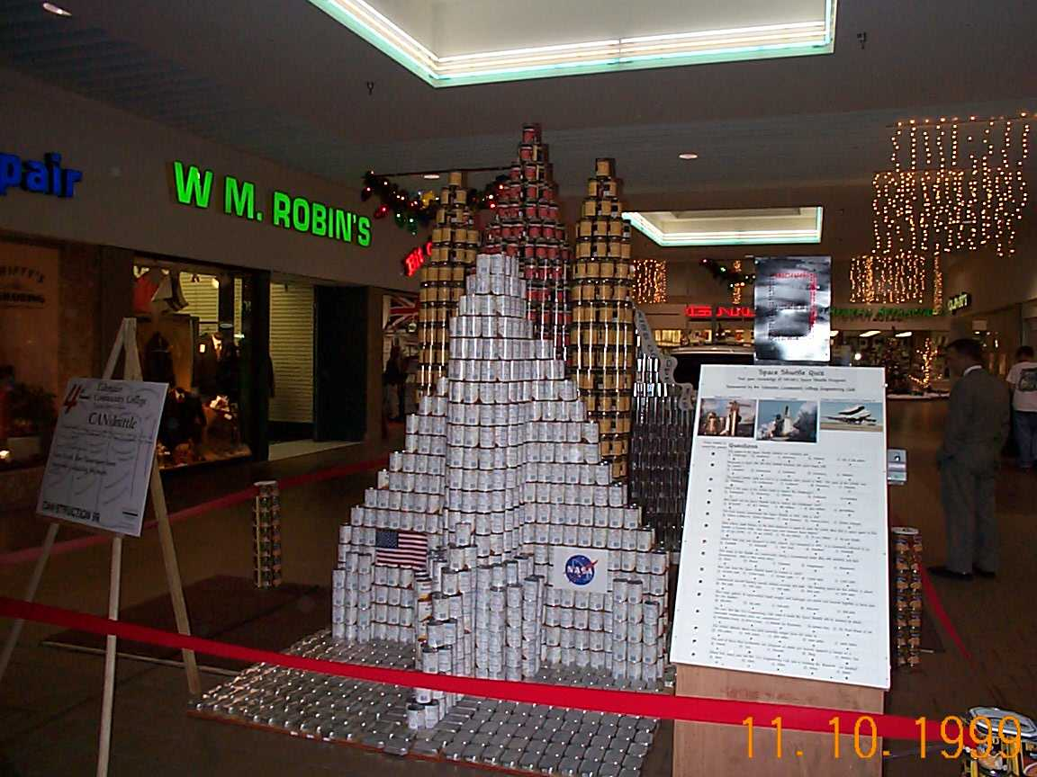

Slide 18
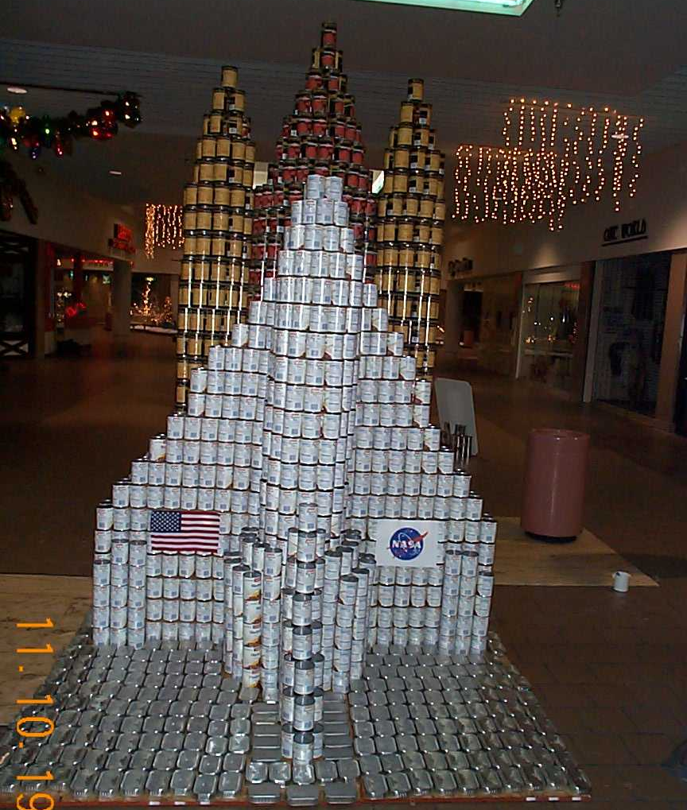

Slide 19
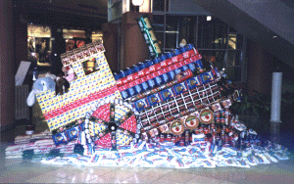
Miscellaneous CANstruction Photos

Slide 20
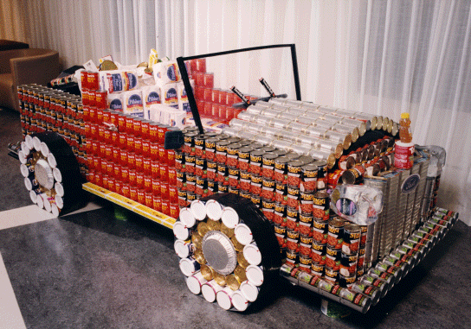

Slide 21
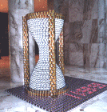

Slide 22
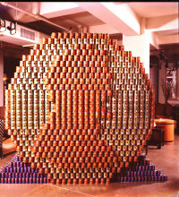

Slide 23
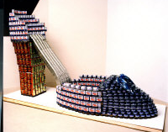

Slide 24
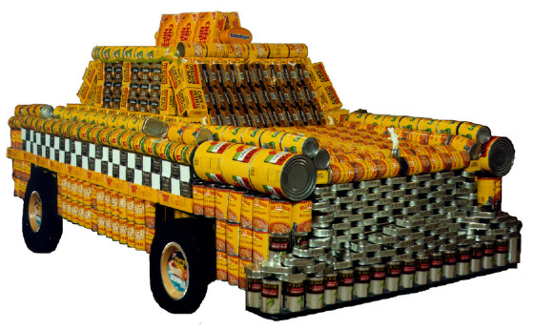

Slide 25
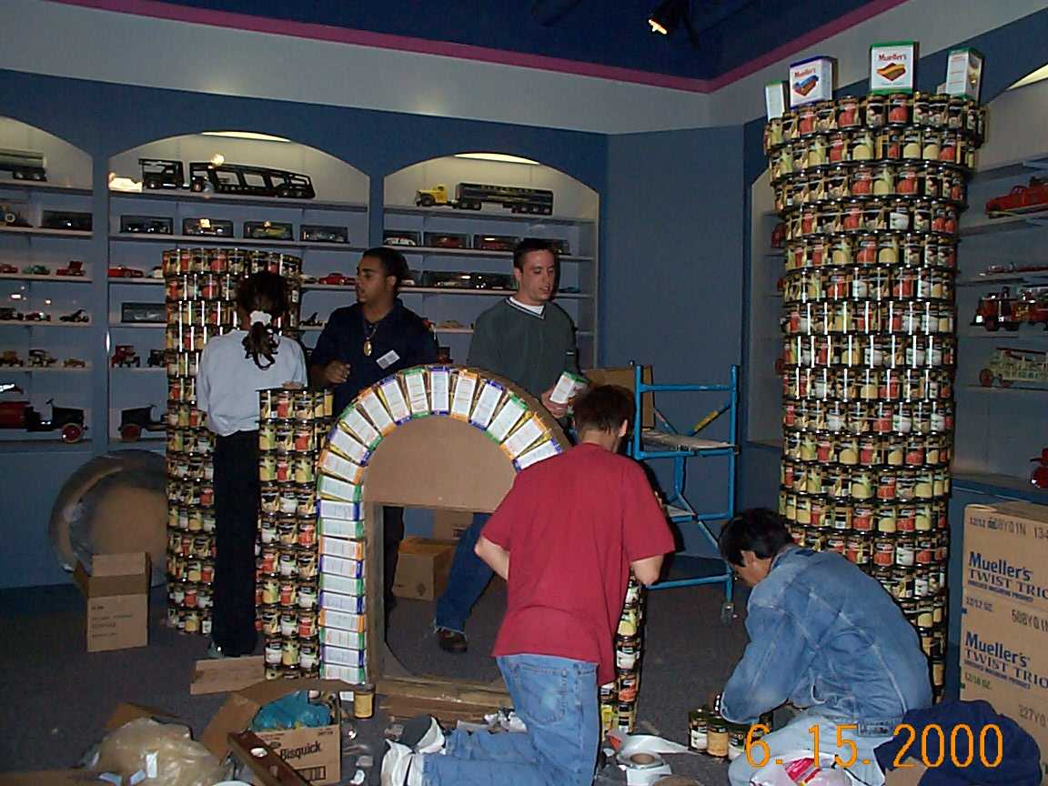
CANstruction 2000
Portsmouth Children’s Museum
October 11-12

Slide 26
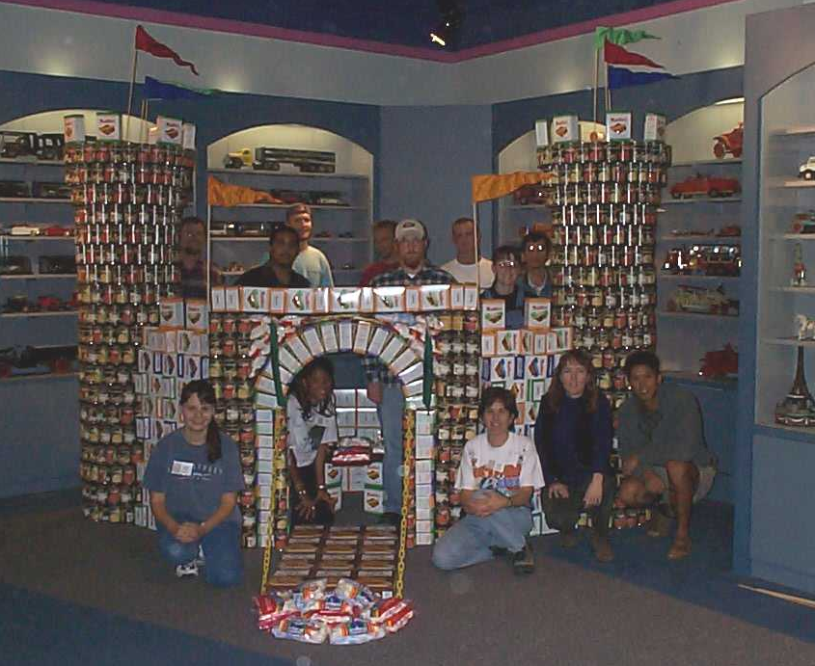
TCC Engineering Club - "CANelot”
(Award: Structural Ingenuity)

Slide 27
Michael Baker, Jr. Inc. - "Hit the 'Street' to Beat Hunger"
(Award: Children's Museum Award)

Slide 28
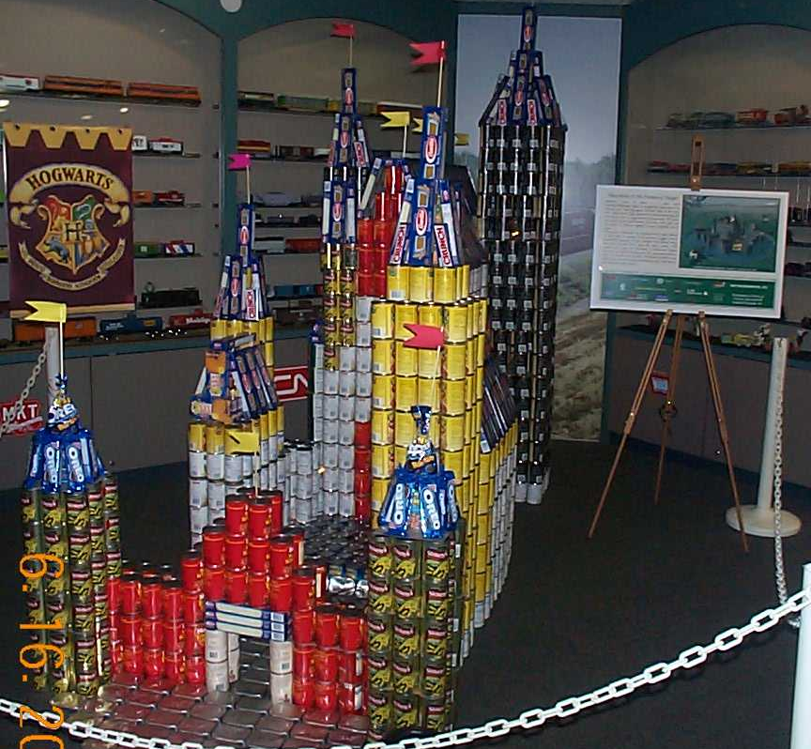
Parsons Brinckerhoff Quade & Douglas, Inc.
"Harry Potter & the Prisoners of Hunger”
(Award: Juror's Favorite)

Slide 29
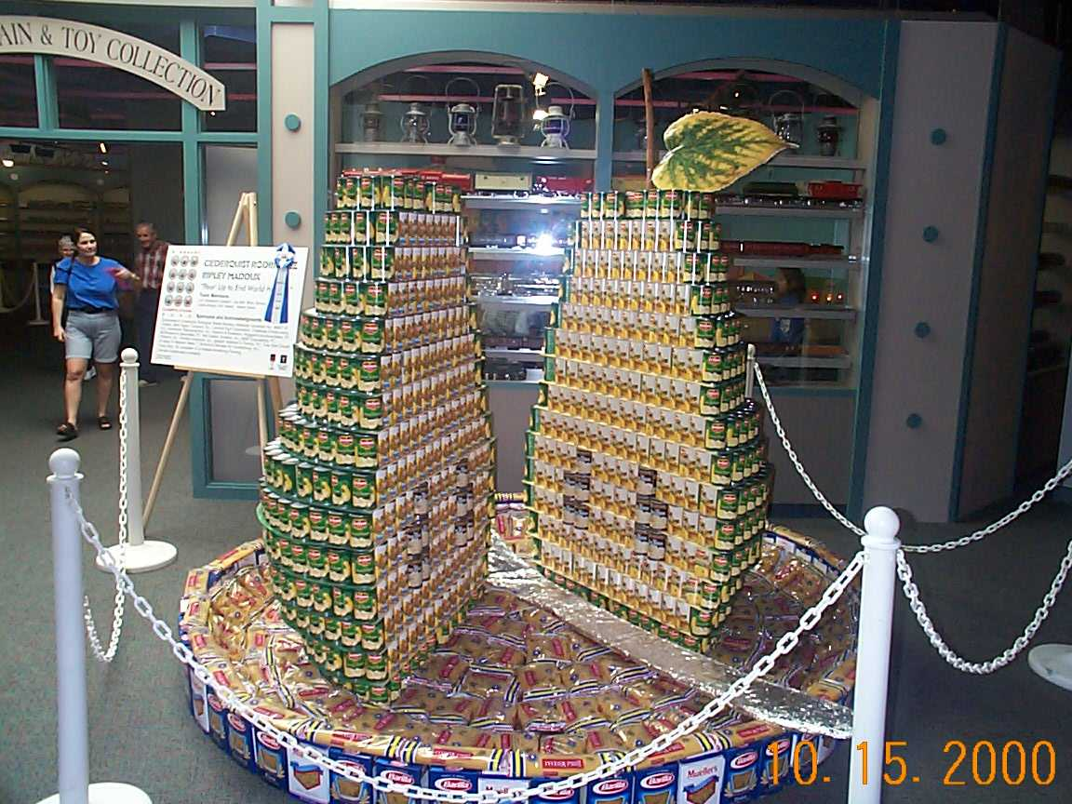
Cederquist Rodriguez Ripley Maddux
"'Pear' Up to End World Hunger"
(Award: Best Use of Labels)

Slide 30
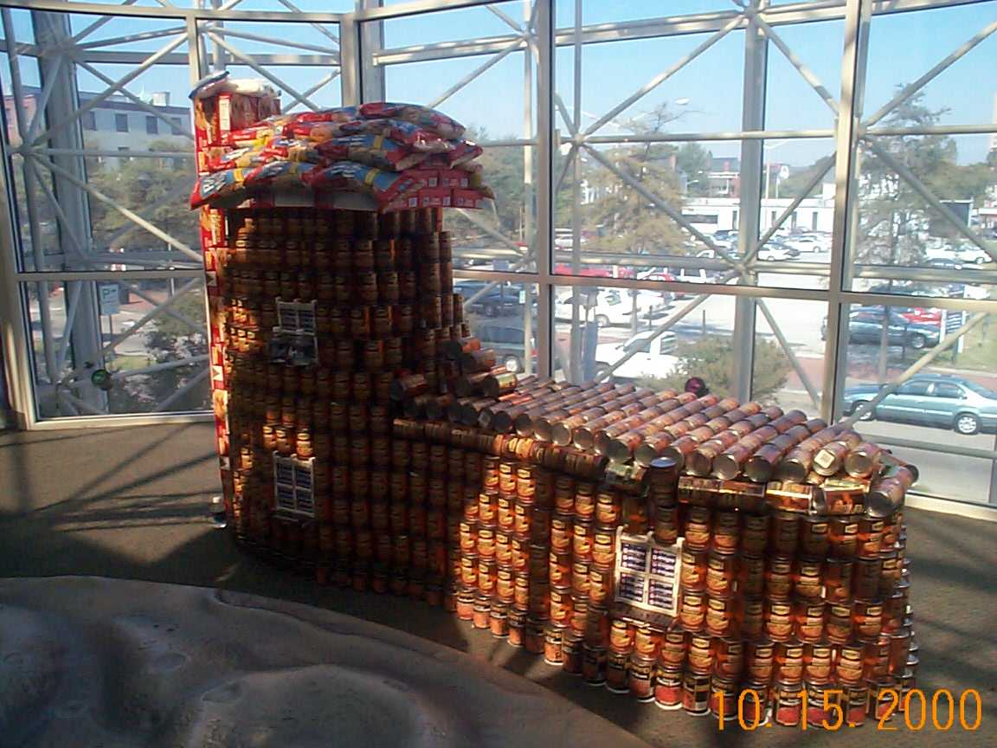
Shriver and Holland Associates - "The Cupboard is Bare"
(Award: Honorable Mention)

Slide 31
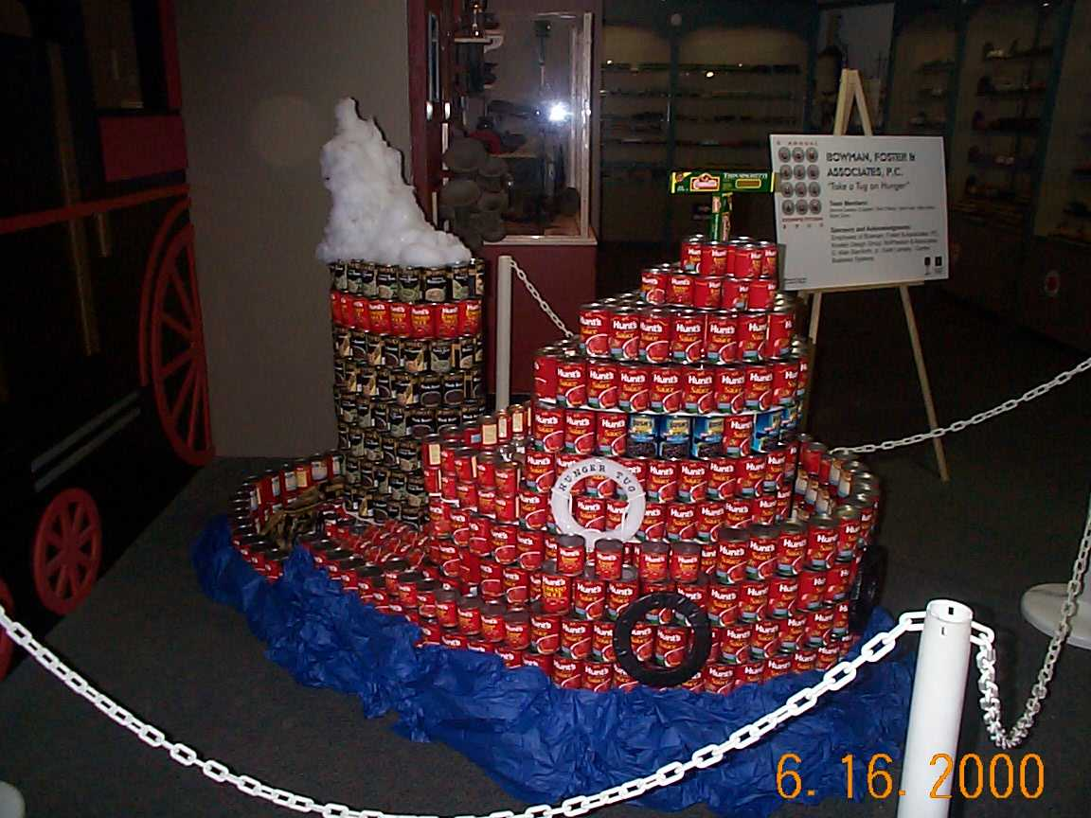
Bowman, Foster & Associates, P.C.
"Take a Tug on Hunger"

Slide 32
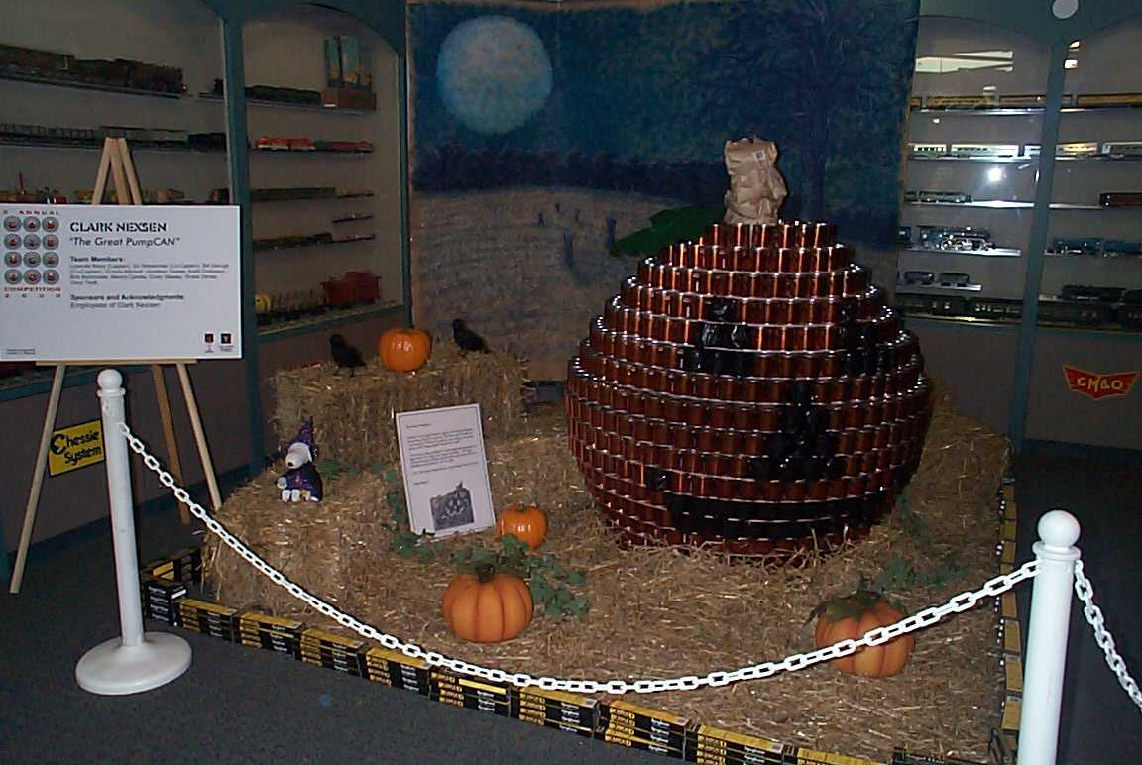
Clark Nexsen
"The Great PumpCAN"

Slide 33
Glenn & Sadler
"Ensurance Against Hunger"

Slide 34
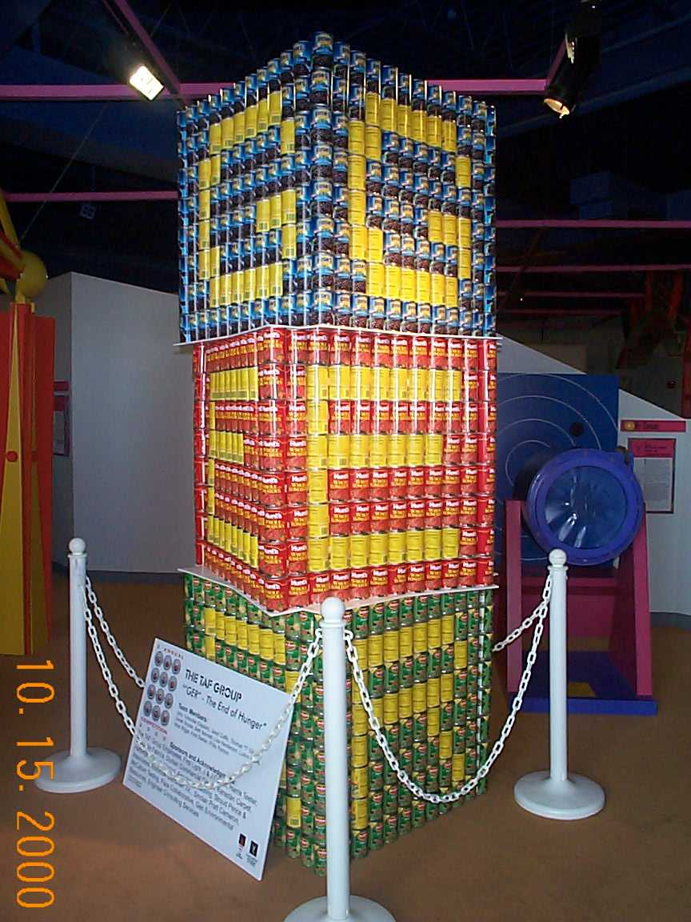
The TAF Group
"The End of Hunger"

Slide 35
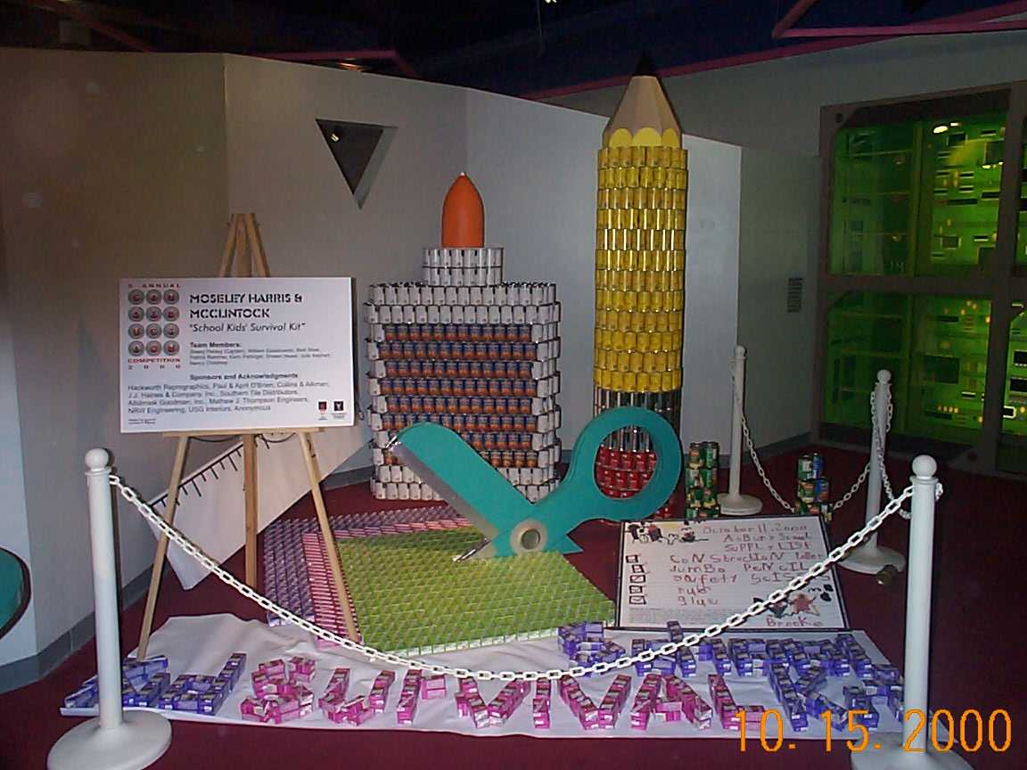
Moseley Harris & McClintock
"School Kids' Survival Kit"

Slide 36
Cederquist Rodriguez Ripley Maddux
"A 'Time' to End World Hunger"
(Award: Museum Award)

Slide 37
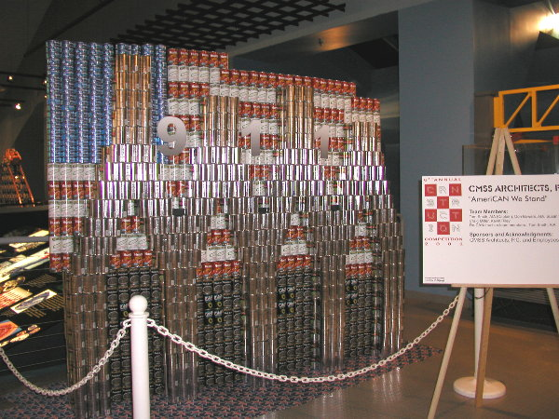
CMSS Architects, P.C.
"AmeriCAN We Stand”
(Award: Structural Ingenuity)

Slide 38
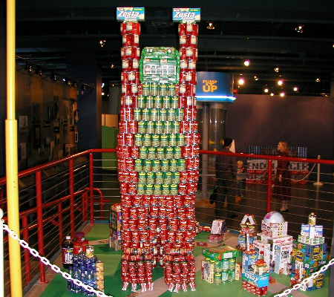
Shriver and Holland Associates
"Don't Let Hunger Drag-On"
(Award: Best Meal)

Slide 39
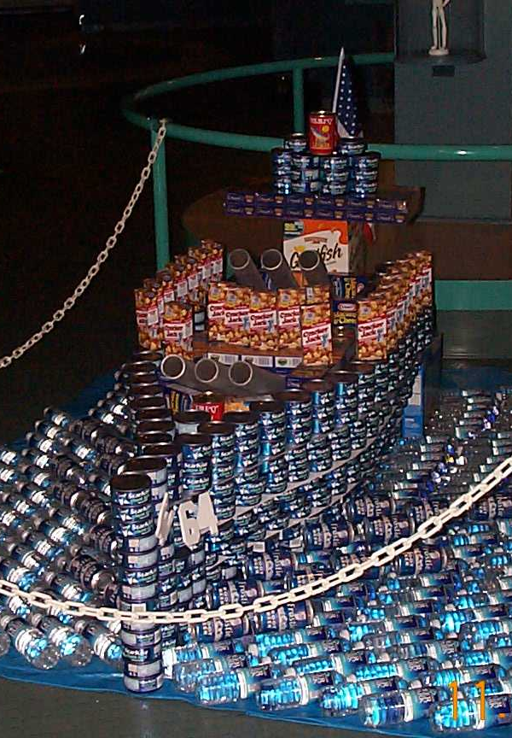
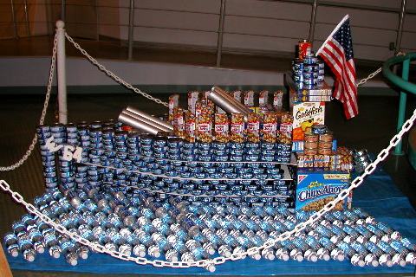
URS Corporation
"U.S.S. WisCANsin - Battling Hunger in Hampton Roads!" (Award: Best Use of Labels)

Slide 40
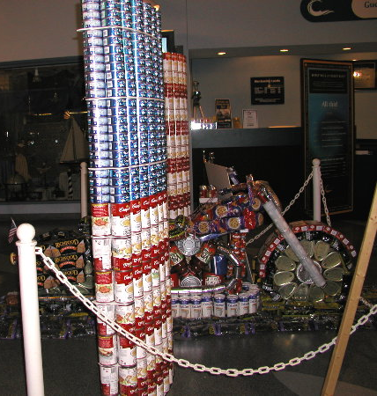
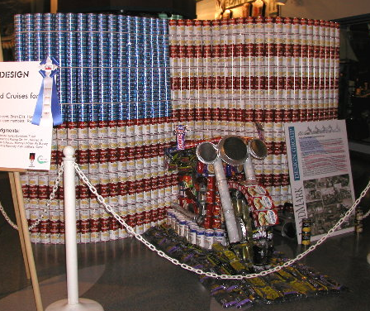
Landmark Design Group
"King of the Road Cruises for Hunger"
(Award: Juror's Favorite)

Slide 41
Moseley Harris & McClintock
"Use in Case of Emergency…EXTINGUISH HUNGER"
(Award: Honorable Mention)

Slide 42
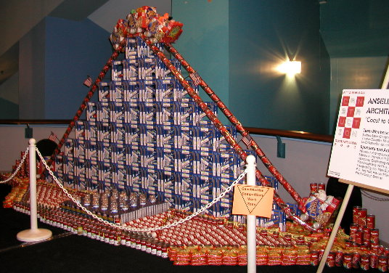
Ansel Collens Astrin Architects, P.C.
"Coast to Coast - Coaster"

Slide 43
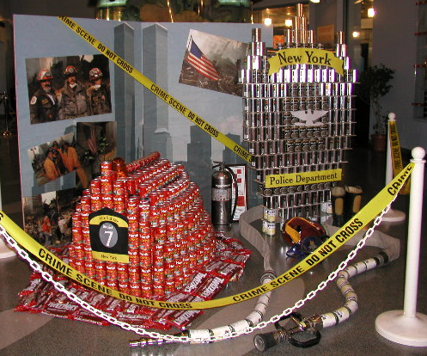
Michael Baker, Jr. Inc.
"Heroes for Hunger"

Slide 44
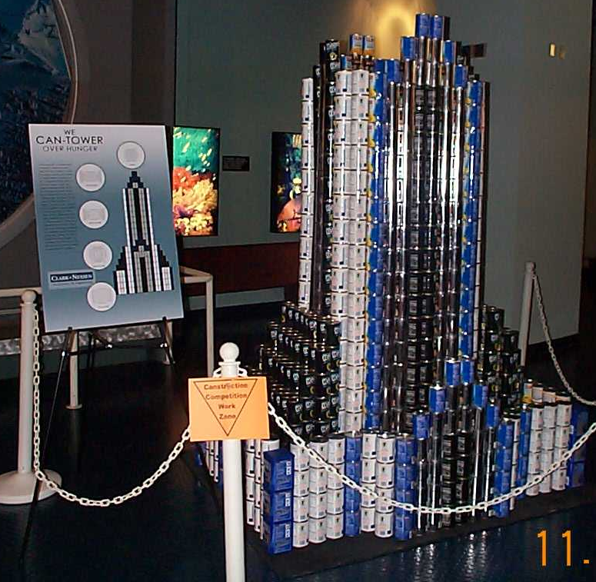
Clark Nexsen
"We CAN Tower Over Hunger"

Slide 45
Glenn & Sadler
- a division of TranSystems
"Rock-CAN-Roll"

Slide 46
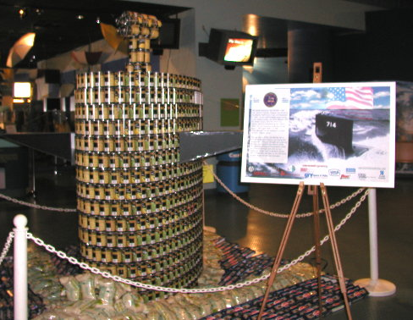
Parsons Brinckerhoff Quade & Douglas, Inc.
"USS Norfolk - Vi Per Concordium"

Slide 47
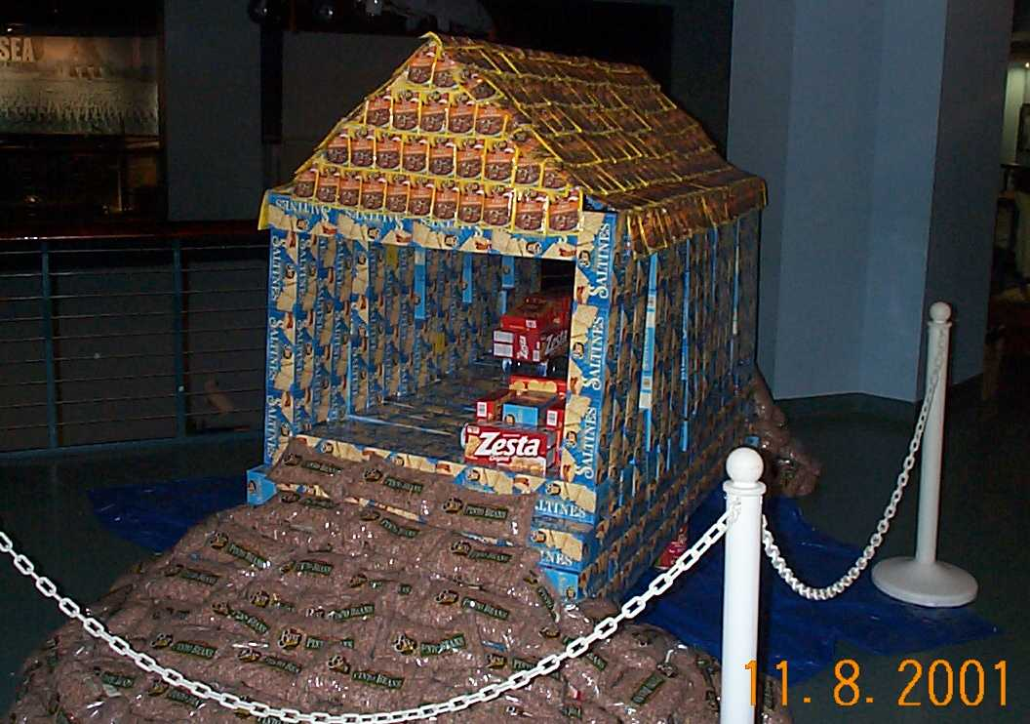
Ridgeway's
"Bridge The Gap"

Slide 48
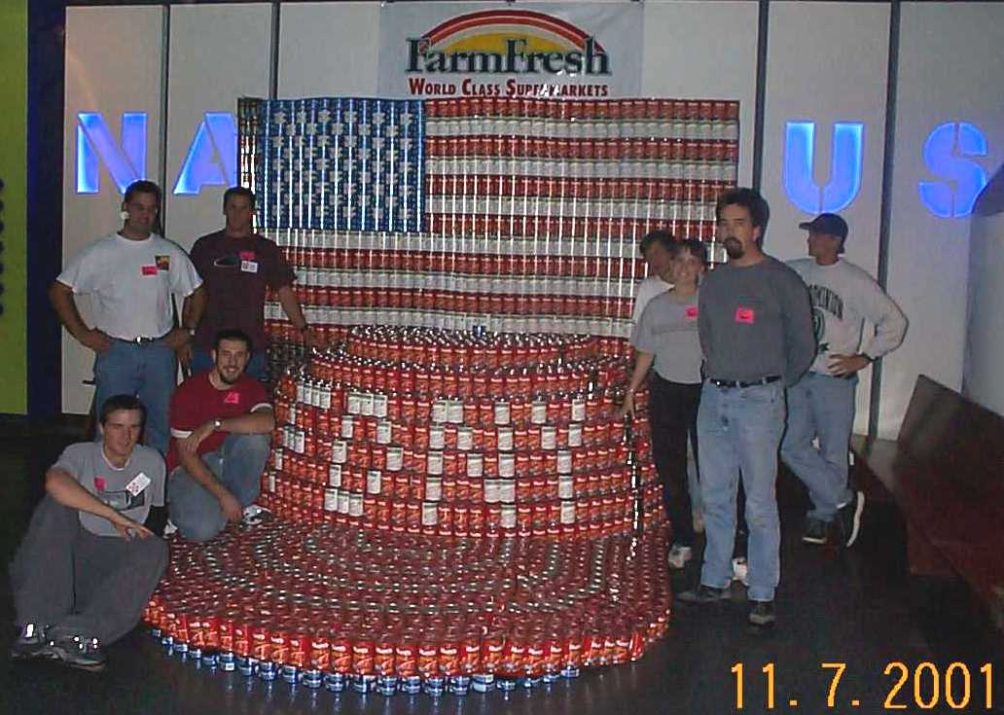
TCC Engineering Club
"United We CAN"

Slide 49
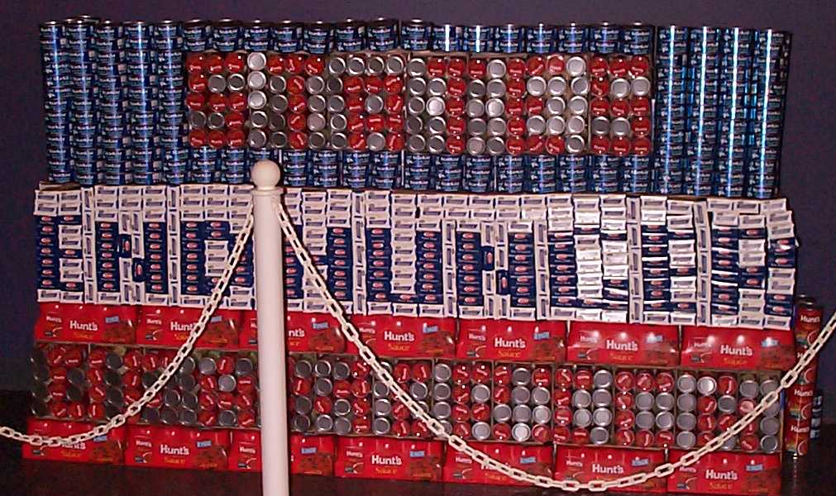
Woolpert, LLP
"U.S. License Plate of Substance"

Slide 50
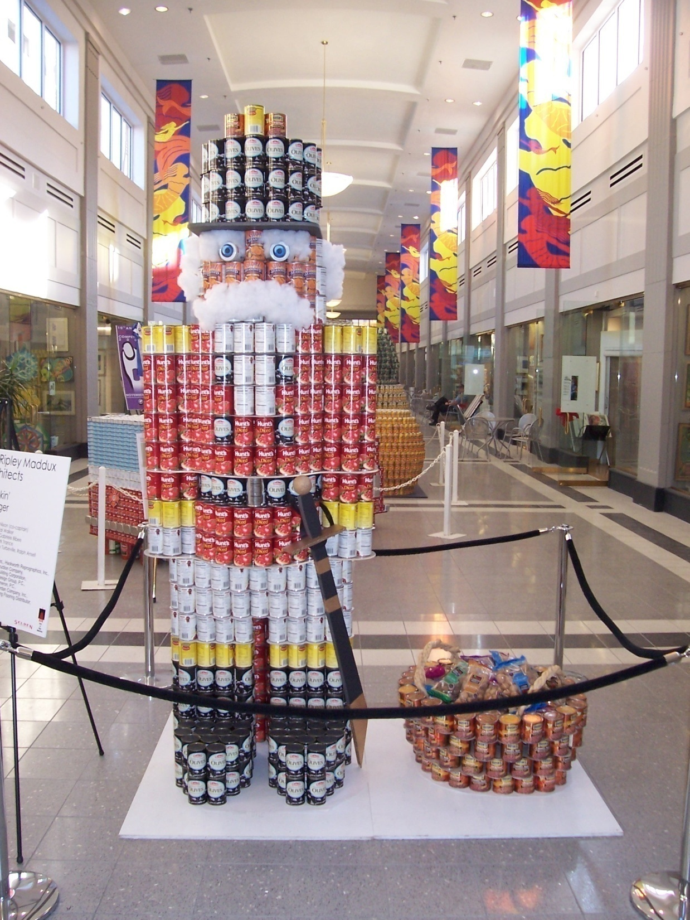
CANstruction 2006

Slide 51
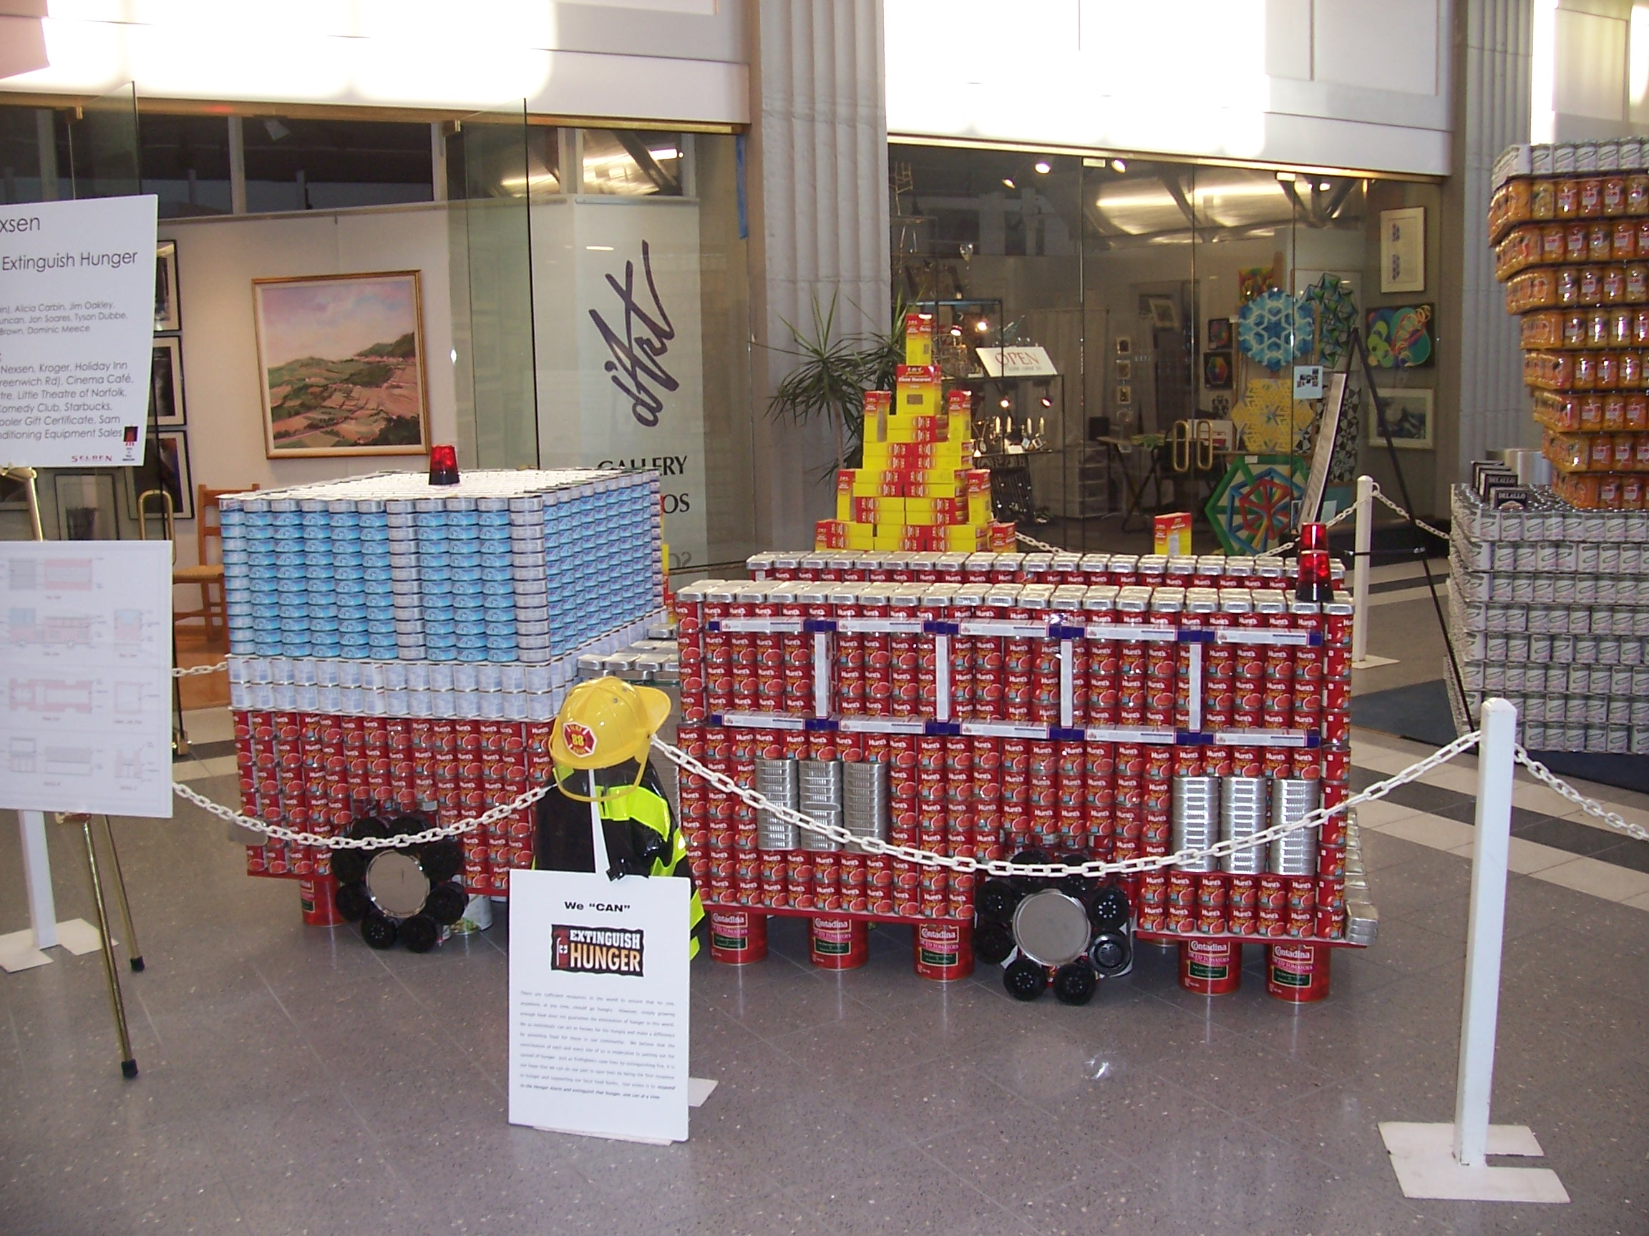
CANstruction 2006

Slide 52
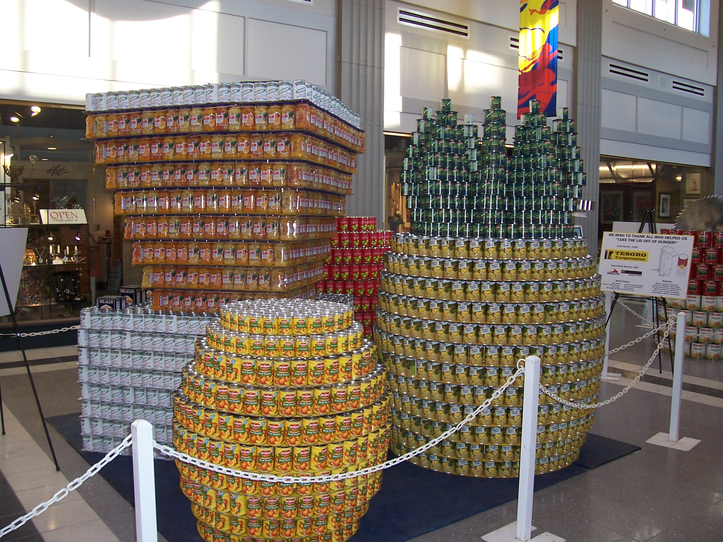
CANstruction 2006

Slide 53
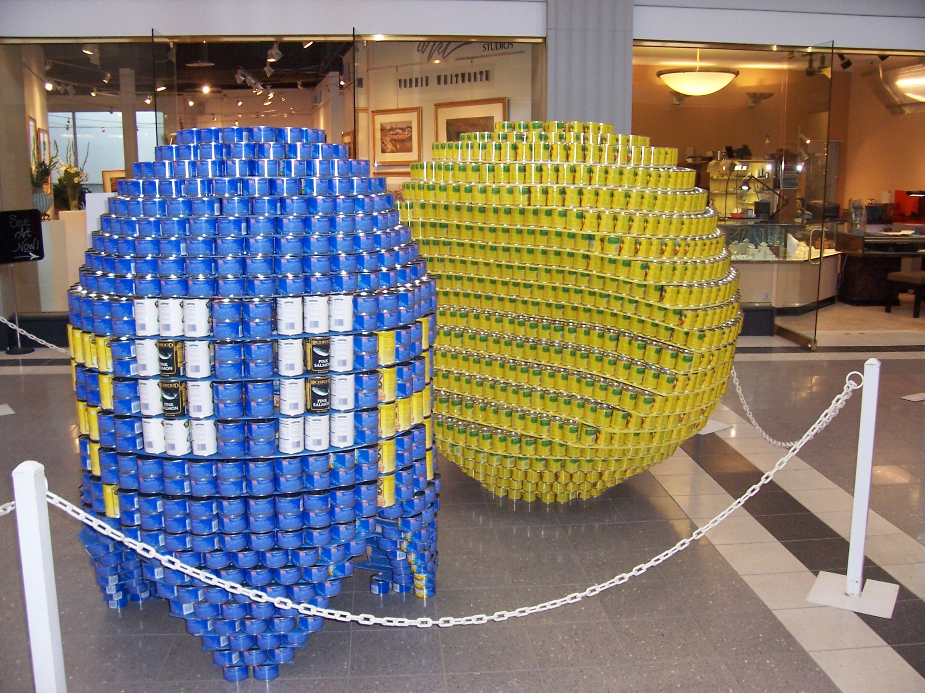
CANstruction 2006

Slide 54
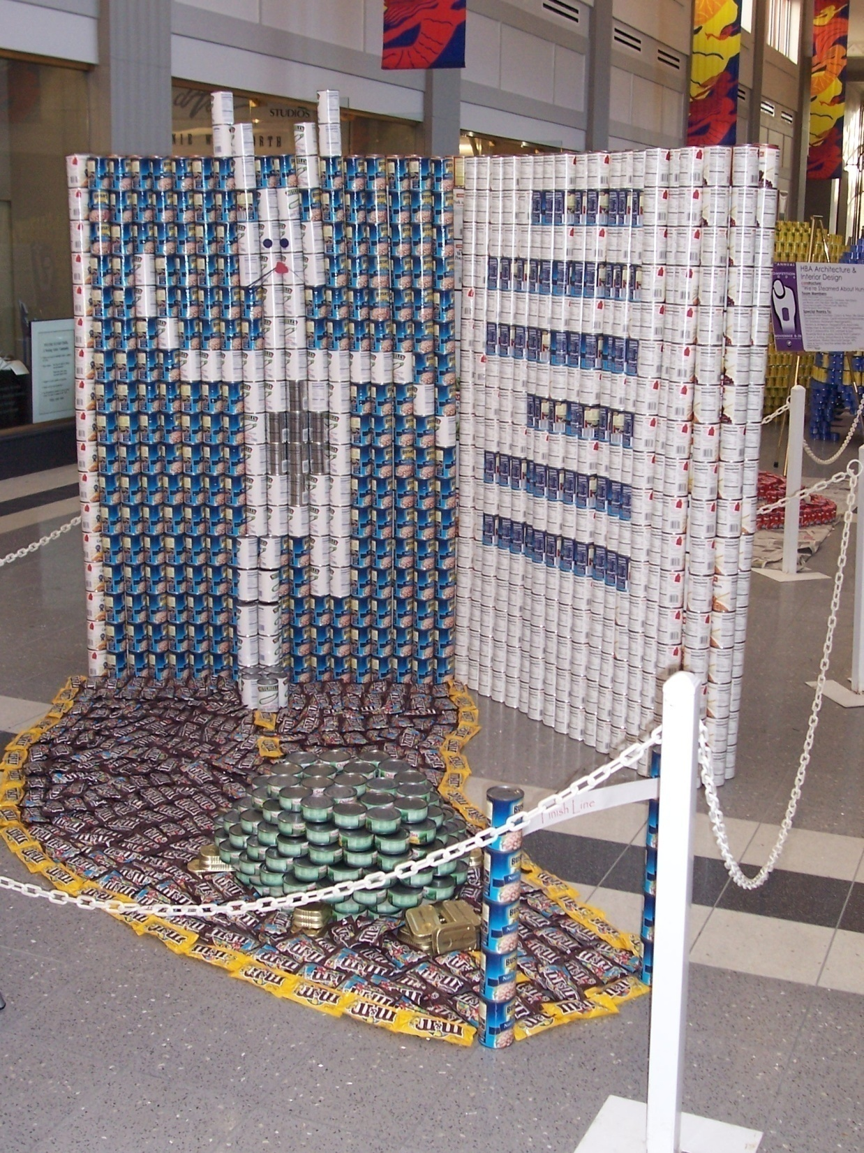
CANstruction 2006

Slide 55
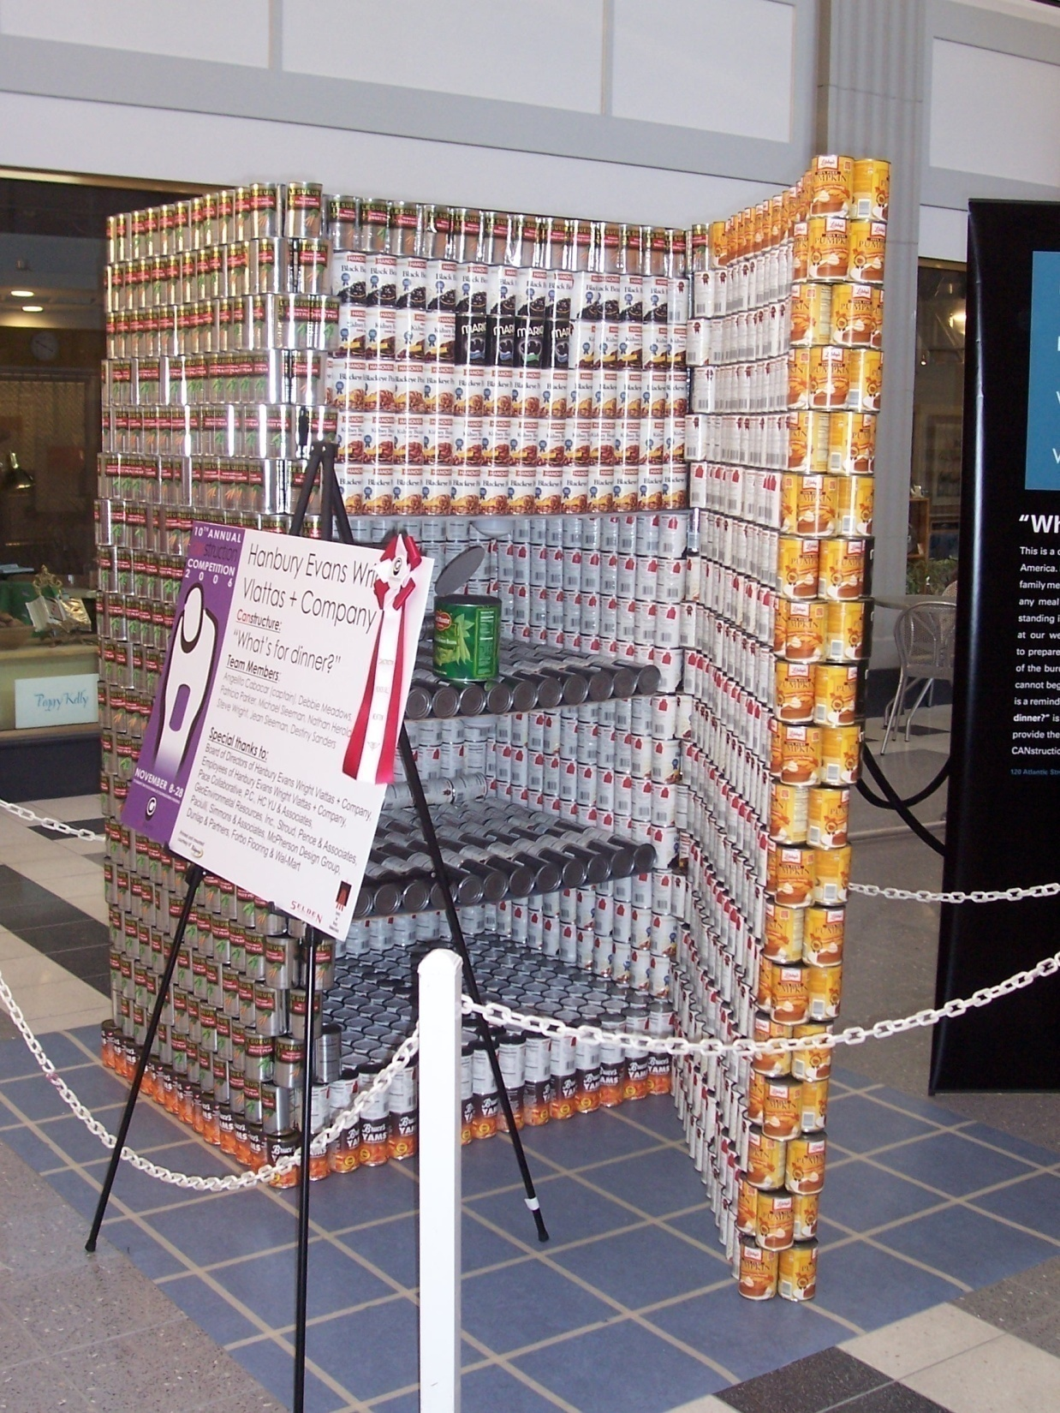
CANstruction 2006
“What’s for dinner?

Slide 56
CANstruction 2006

Slide 57
CANstruction 2006

Slide 58
CANstruction 2006

Slide 59
CANstruction 2005

Slide 60
CANstruction 2006

Slide 82
TCC Engineering Club
Title of display:
Hunger: Don’t CANdy Coat It
Award:
Structural Ingenuity
Sponsor:
Farm Fresh
Number of cans: 8936
Weight: 8362 lb
CANstruction 2005
November 16-17
Selden Arcade
Norfolk, VA

Slide 96
CANstruction 2007
TCC Engineering Club
“Hunger is NOT Abstract”
9936 cans, 9046 lb

Slide 97
CANstruction 2007
TCC Engineering Club
“Hunger is NOT Abstract”
9936 cans, 9046 lb

Slide 98
CANstruction 2007
HBA Architecture and Interior Design
“Head Toward Feeding the Hungry”

Slide 99
CANstruction 2007
Old Dominion University
“Transform Hunger”

Slide 100
CANstruction 2007
HBA MMM Design Group
“Kool Aid Man ‘CAN”

Slide 101
CANstruction 2007 - Retnauer Design Associates
“It’s NESSIE-sary to LOCH out Hungri-NESS”

Slide 102
CANstruction 2007
Landmark Design Group
“On the Road to Ending Hunger”

Slide 103
CANstruction 2007
Clark Nexsen
“Abra-CAN-Dabra”

Slide 104
TCC Engineering Club - 2008

Slide 105
TCC Engineering Club - 2009

Slide 106
TCC Engineering Club - 2011

Slide 107
TCC Engineering Club - 2012

