Slide 1
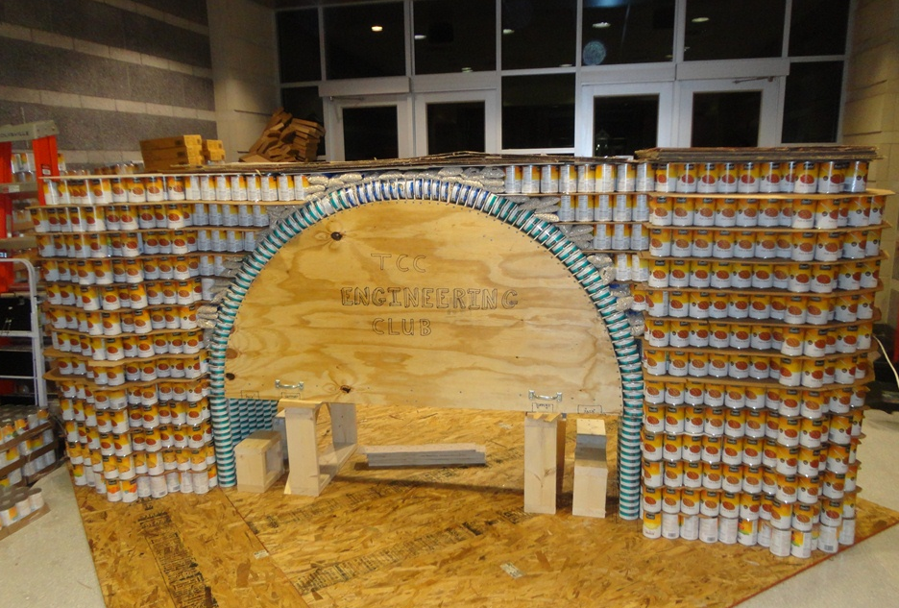
Practice Build in the ATC - Students worked for two weeks to build the arch, cut templates, etc. The wooden form will be lowered later using 4 car jacks.

Slide 2
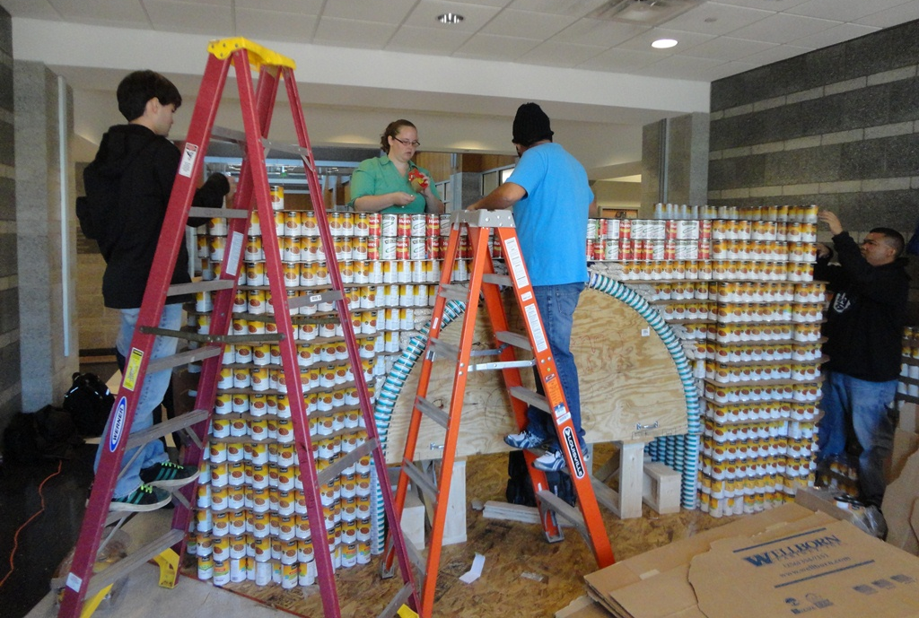
Practice Build in the ATC - The maximum size for the structure is 10’ x 10’ x 8’.

Slide 3
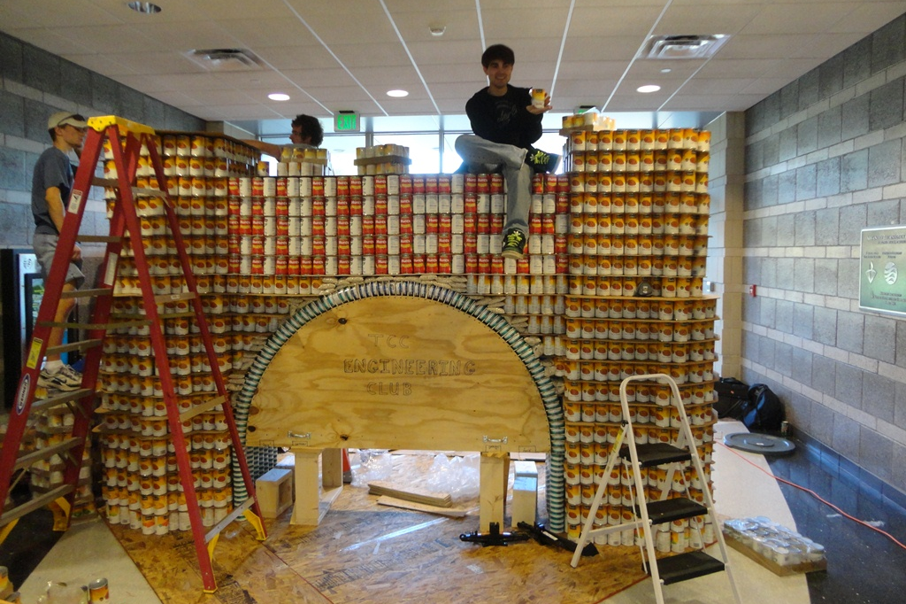
Practice Build in the ATC - The arch had to be wide enough (6’) to allow room to spell out the word HUNGER using cans.

Slide 4
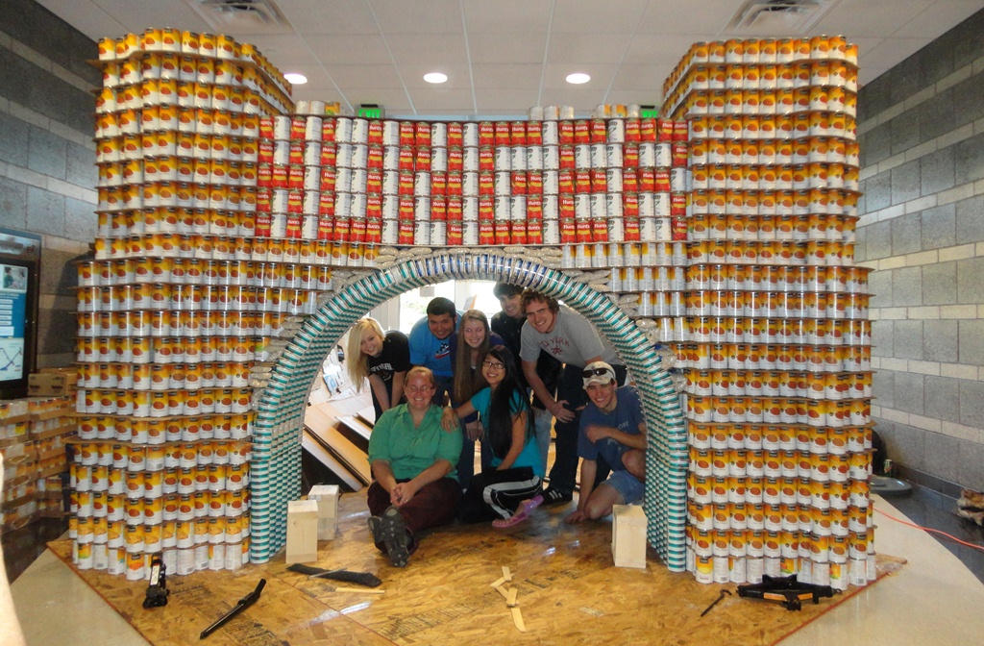
Practice Build in the ATC - There was a huge sigh of relief and loud cheers as the form was lowered and the arch held!

Slide 5
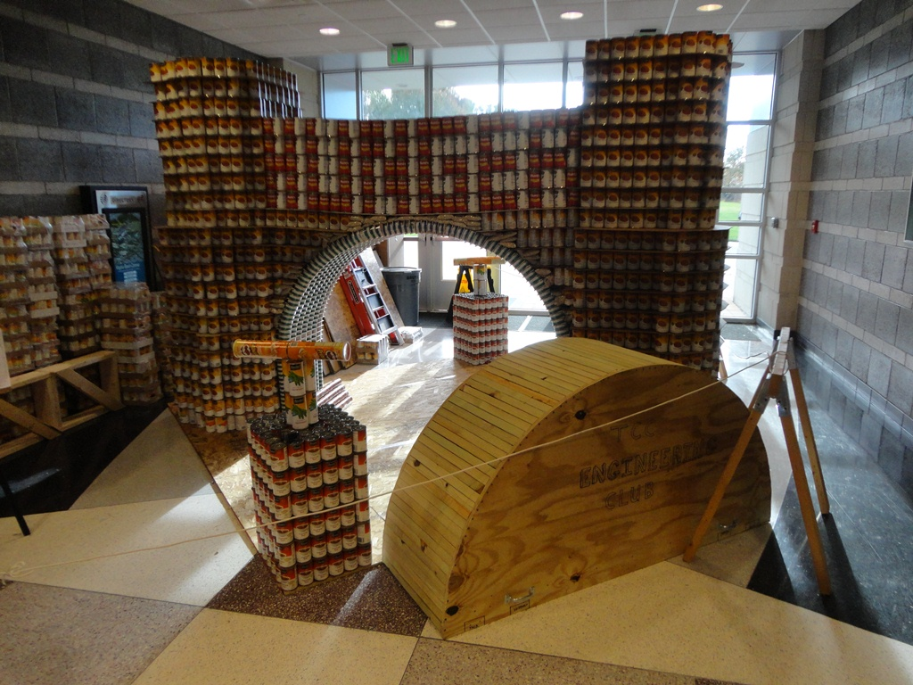
Practice Build in the ATC - Plungers, fuses, and dynamite were added to complete the structure. Now the structure had to be taken down and packed up for the competition in Norfolk.

Slide 6
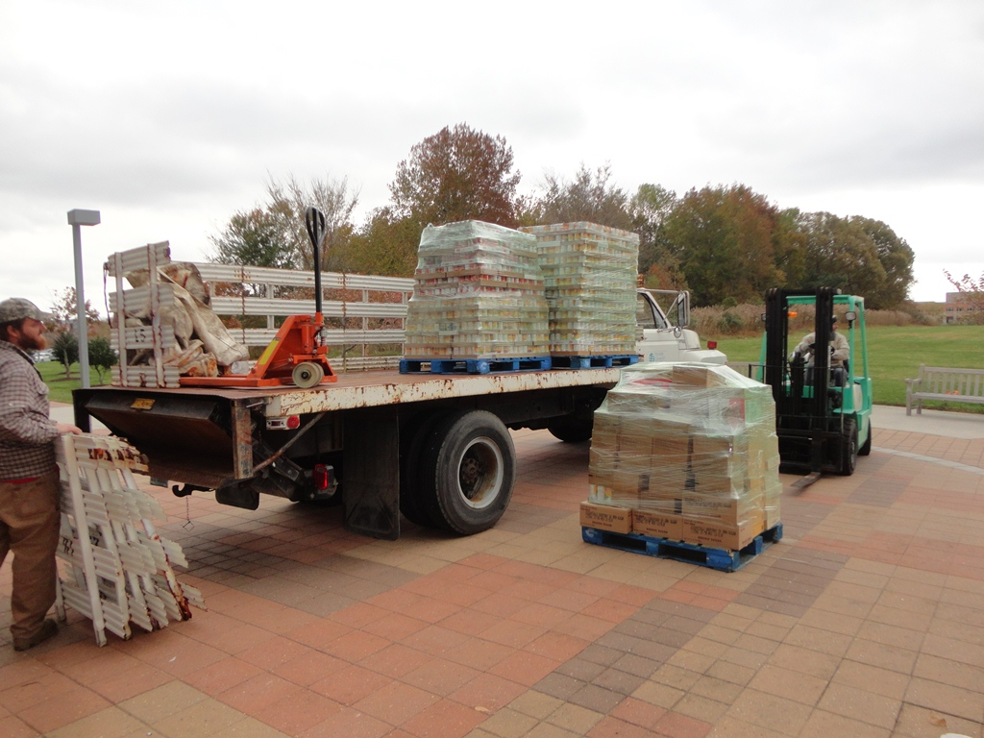

Slide 7
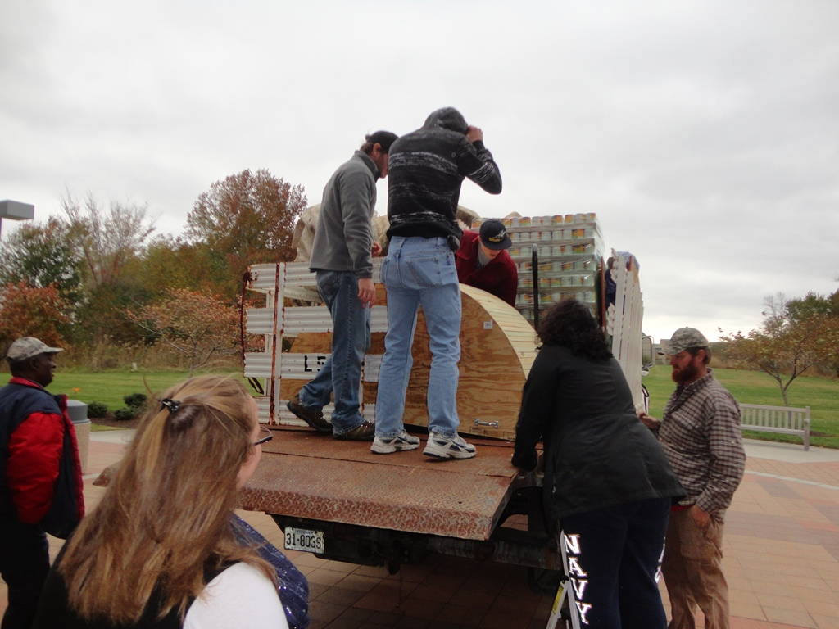

Slide 8
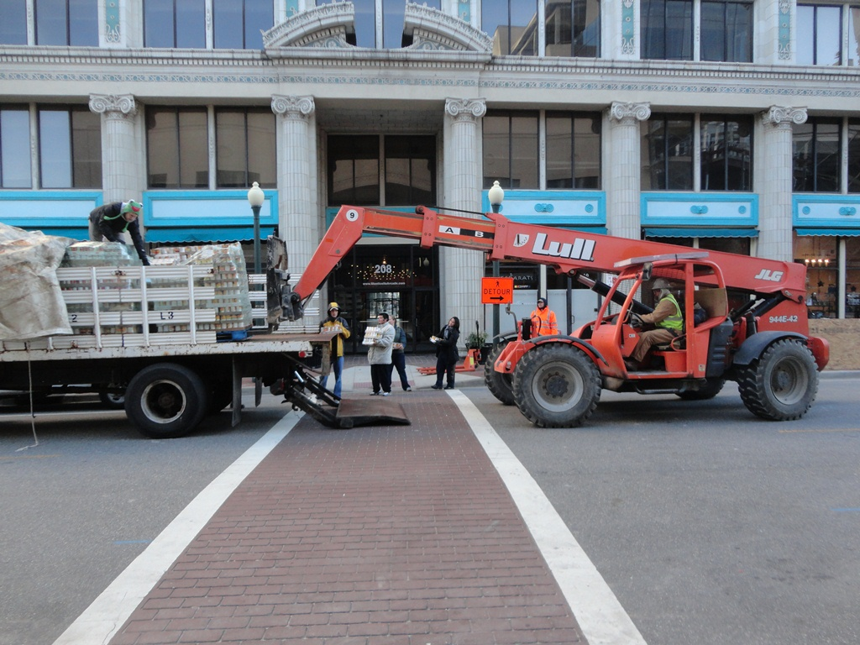

Slide 9
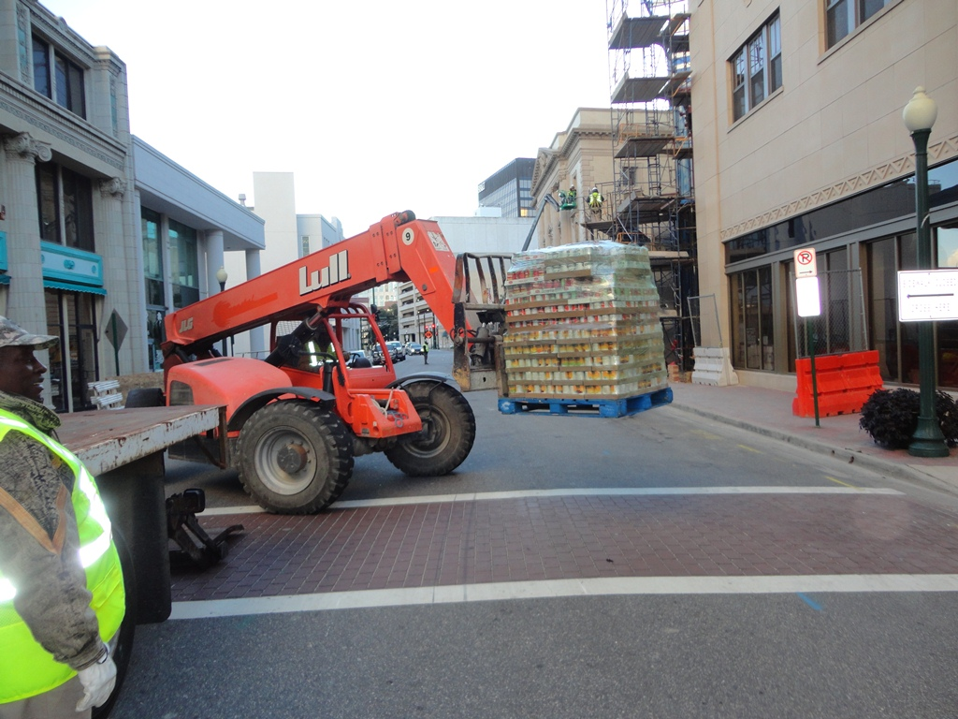

Slide 10
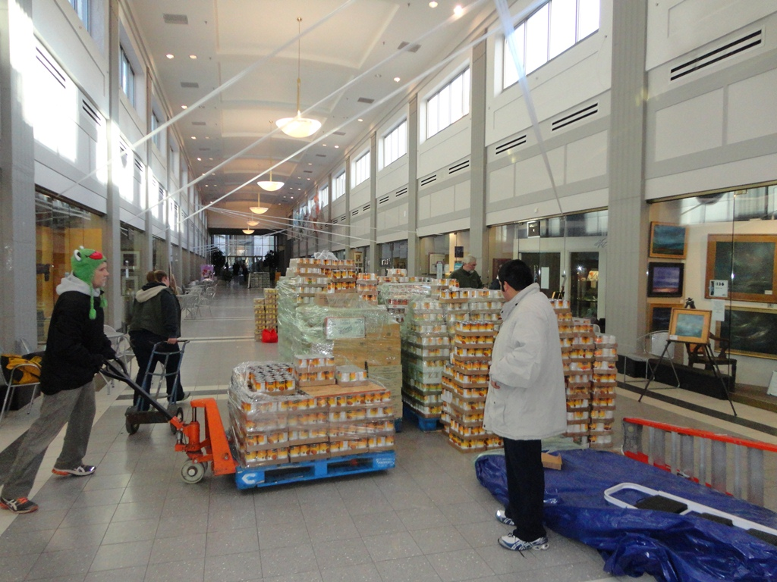

Slide 11
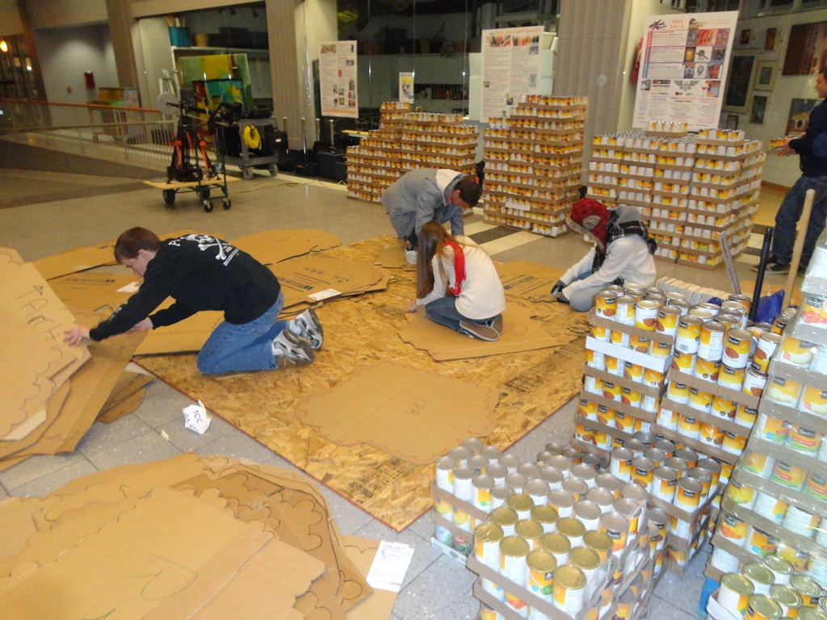

Slide 12
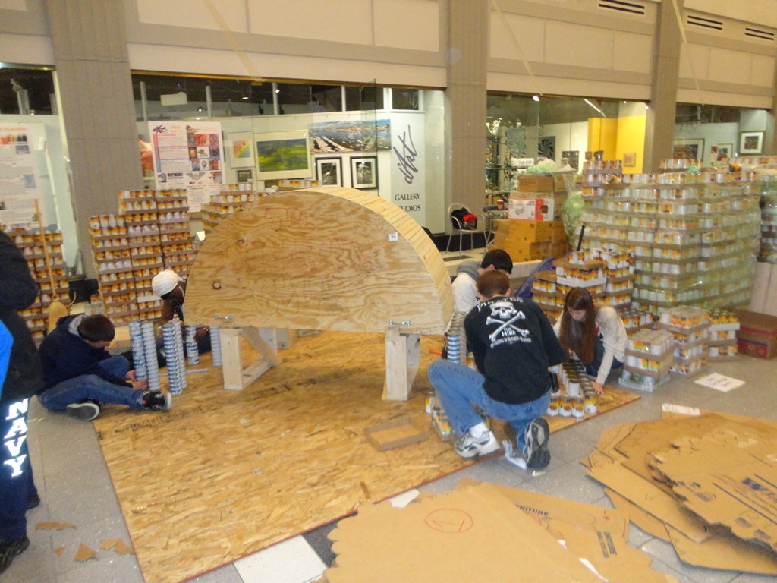

Slide 13
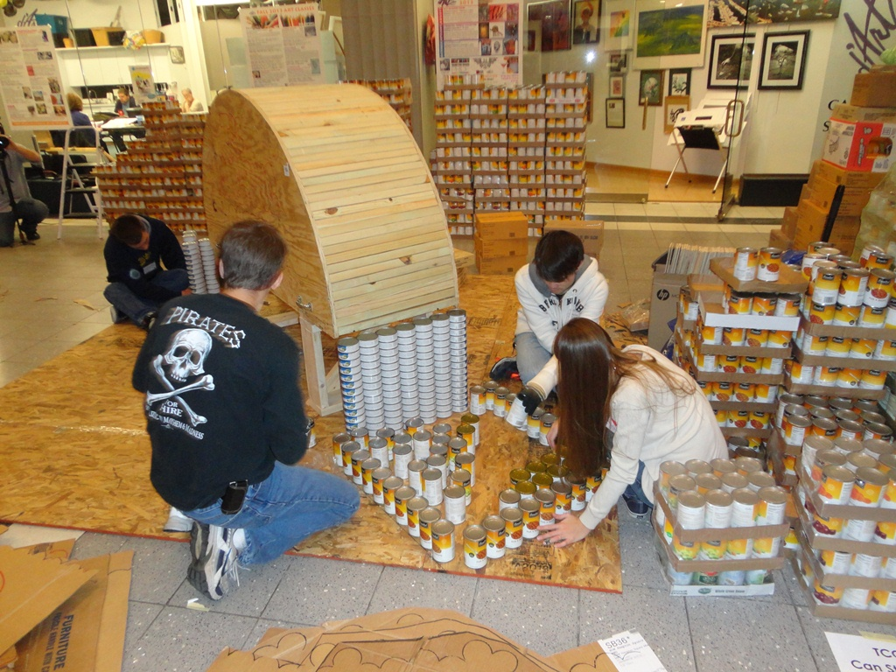

Slide 14
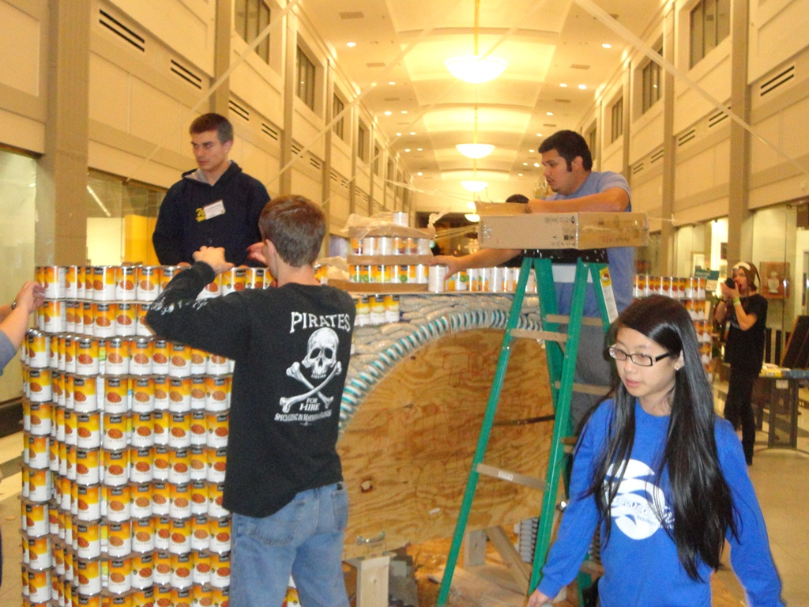

Slide 15
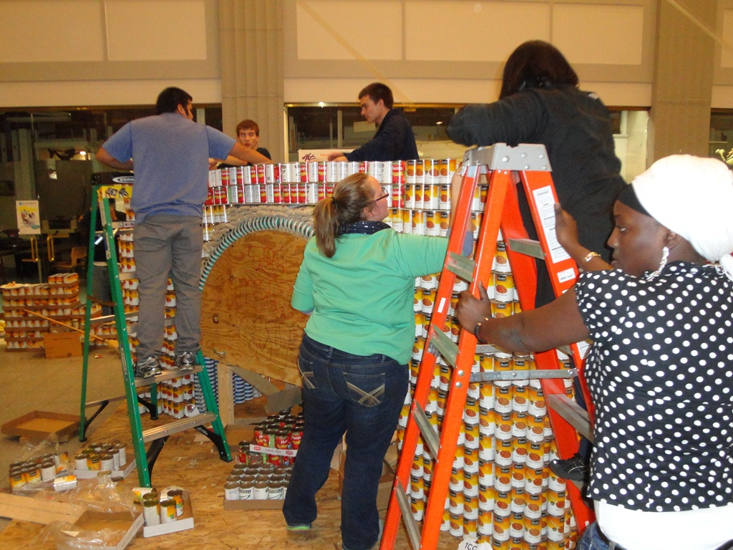

Slide 16
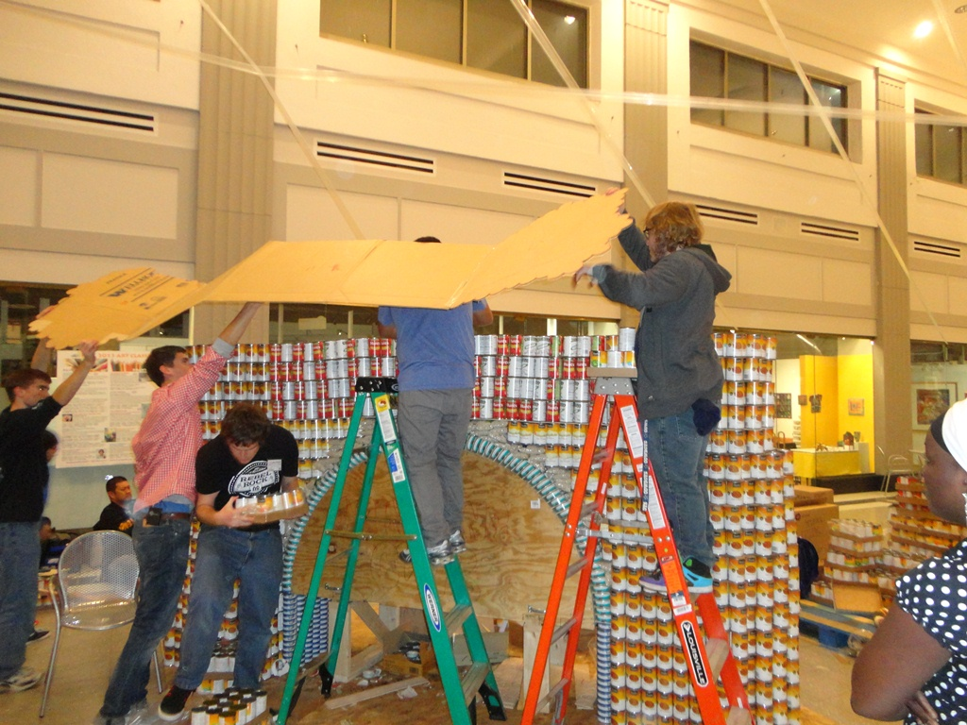

Slide 17
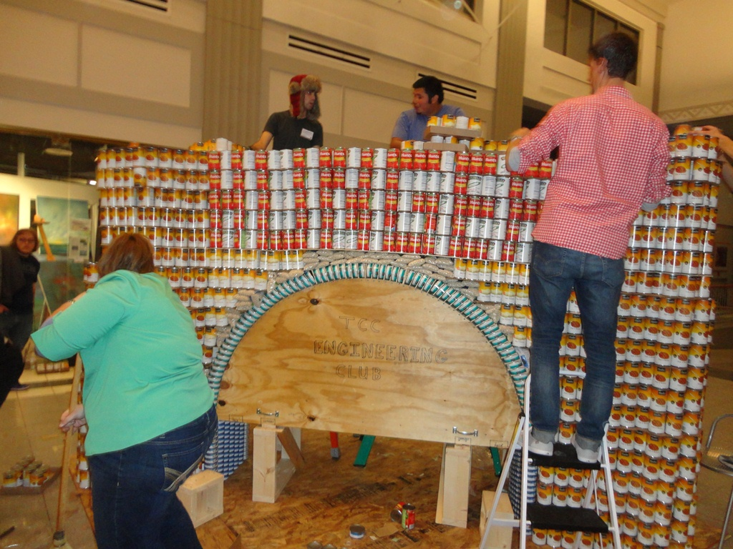

Slide 18
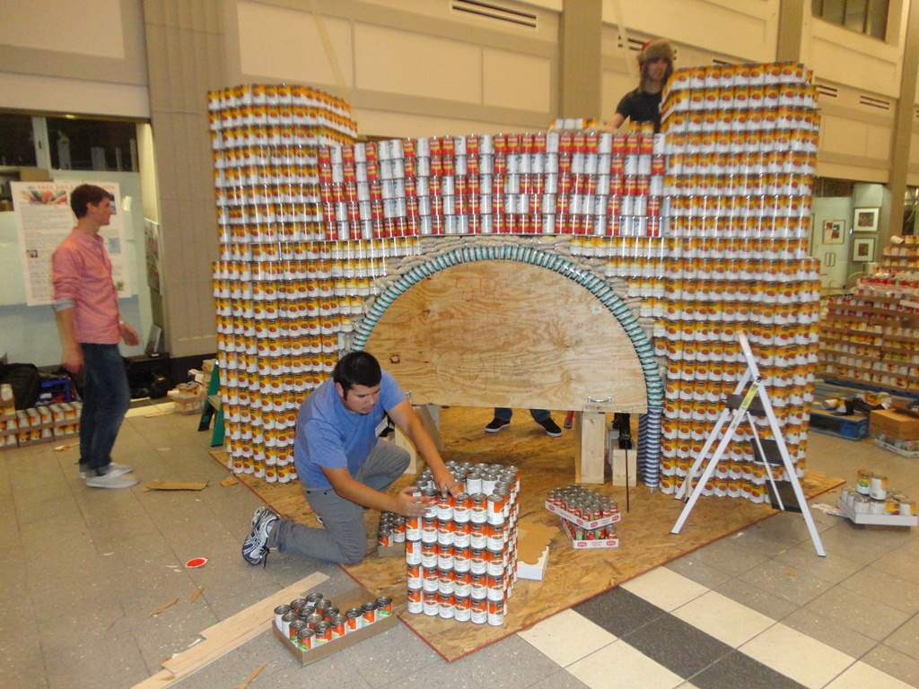

Slide 19
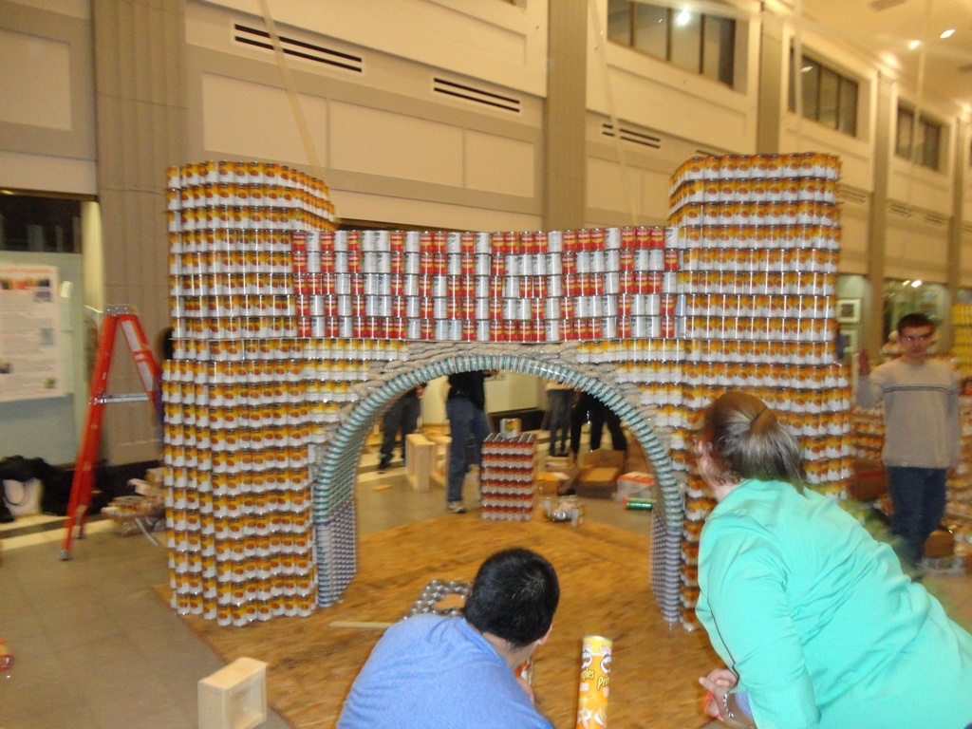

Slide 20
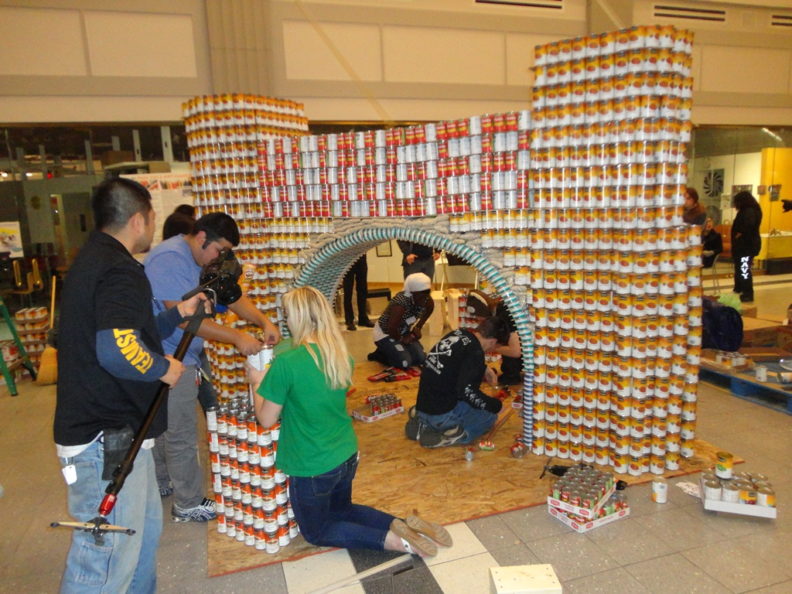

Slide 21
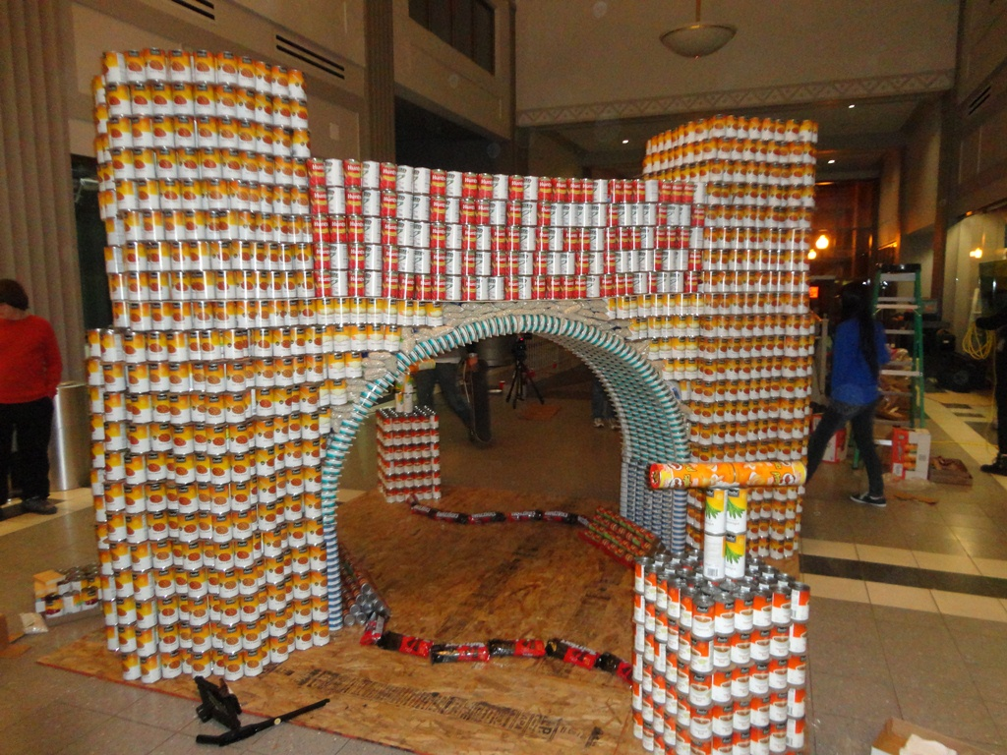

Slide 22
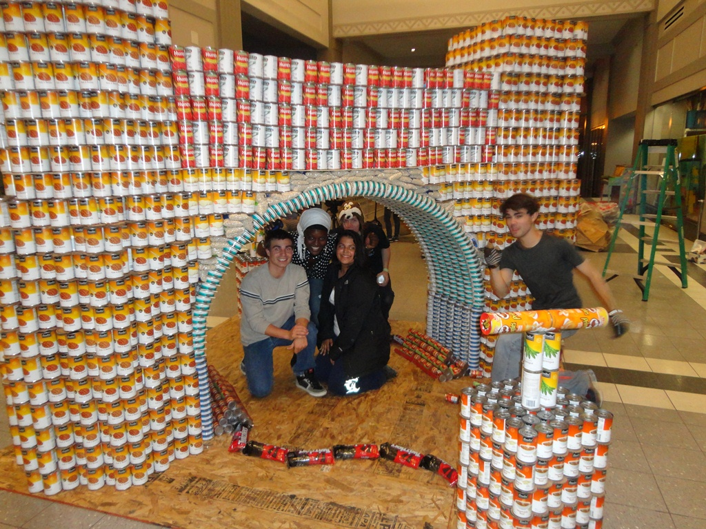

Slide 23
