Slide 1
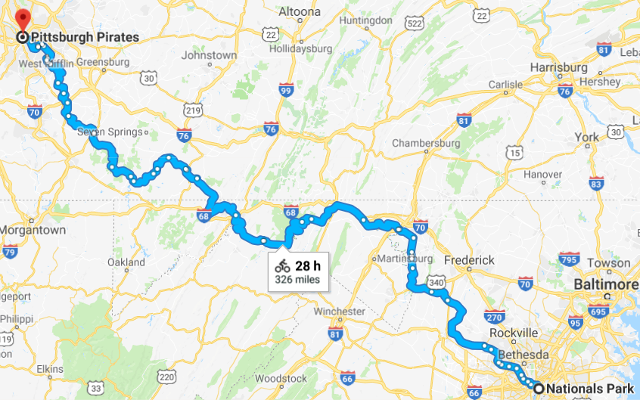
Washington DC to Pittsburgh
Via the C&O Towpath and the Great Allegheny Passage (GAP)
May 6-14, 2017
More detail to be added to this presentation later
(things to see, where to eat, cue sheets, etc.)

Slide 2
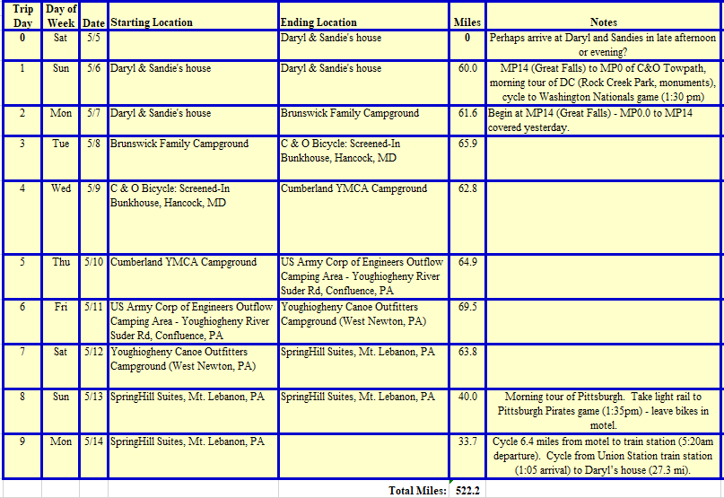
See spreadsheet for more details

Slide 3
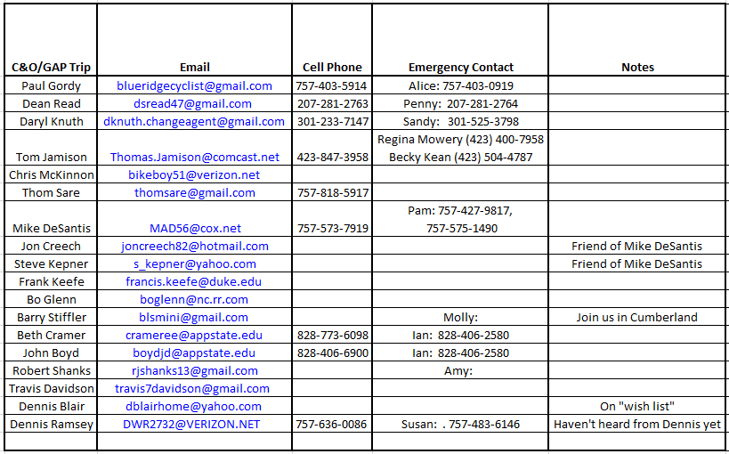
It could be a big group, although some cyclists listed aren’t certain yet. It looks like we will have at least 12 and maybe more.
See spreadsheet for more details

Slide 4
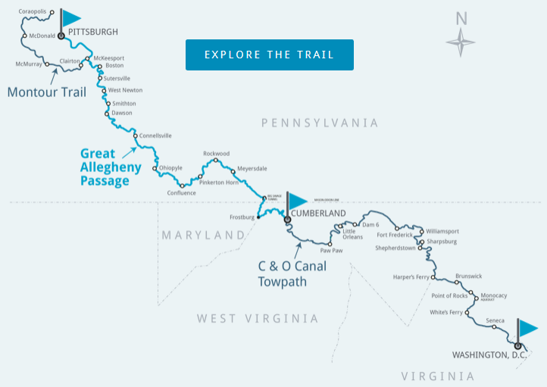
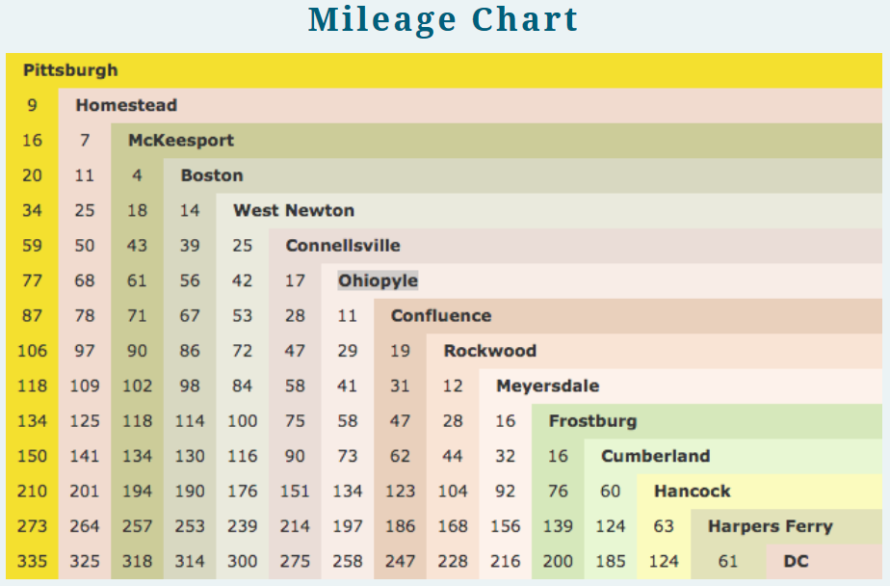

Slide 5
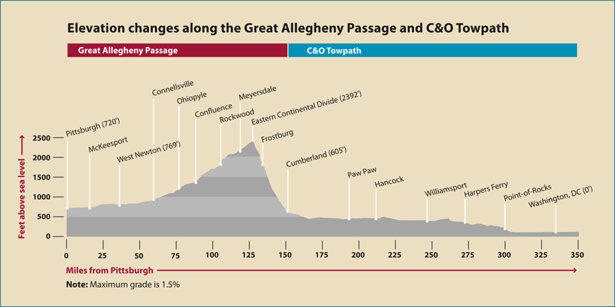
Rail-Trails are flat, right? Well, not exactly!
Day 5 will be interesting.
https://www.gaptrail.org/plan-a-visit/mileage-elevation-charts
Day 7 Start
GAP MP125
Day 6 Start
GAP MP75
Day 5 Start
GAP MP0/ C&O MP184.5
Day 4 Start
C&O MP124.5
MP150
Day 3 Start
C&O MP54
Day 2 Start C&O MP14

Slide 6
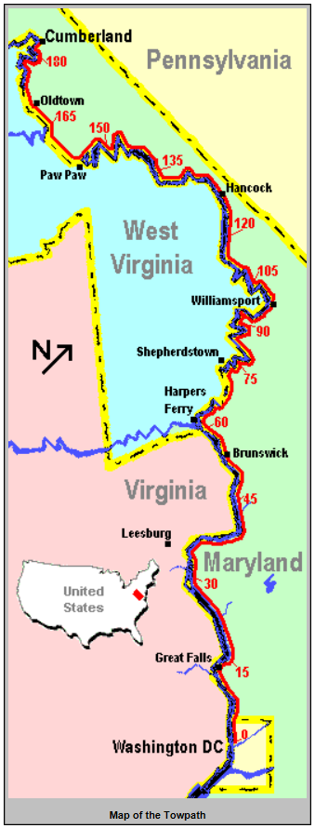
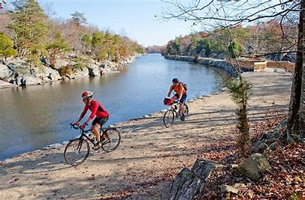
C&O Tow Path
http://www.bikecando.com/_bikecando/default.aspx
http://bikewashington.org/canal/
www.adventurecycling.org

Slide 7
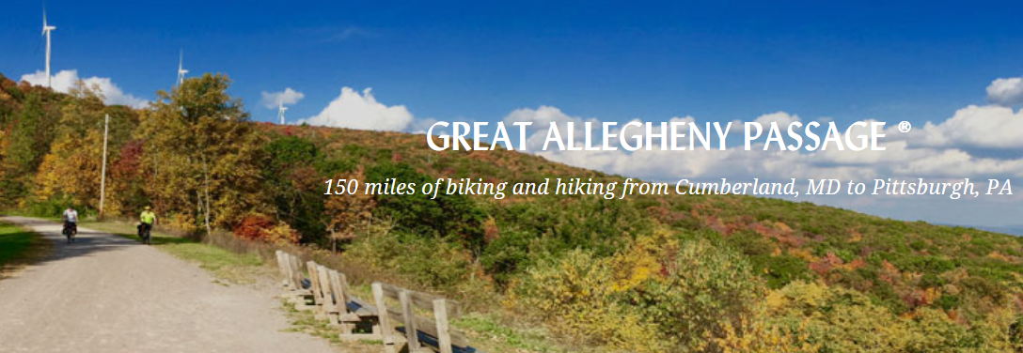
Great Allegheny Passage (GAP)
https://www.gaptrail.org/
http://www.bikecando.com/_bikecando/default.aspx
The Great Allegheny Passage soars over valleys, snakes around mountains, and skirts alongside three rivers (the Casselman, Youghiogheny, and Monongaleha) on its nearly level path. Cyclists pass through the Cumberland Narrows, cross the Mason-Dixon Line, top the Eastern Continental Divide at 2,392’, weave through the breathtaking Laurel Highlands, wind their way through 19,052-acre Ohiopyle State Park, journey through the region’s coke, coal, mining, and steel-making corridor, and end at Pittsburgh’s majestic Point State Park.

Slide 8
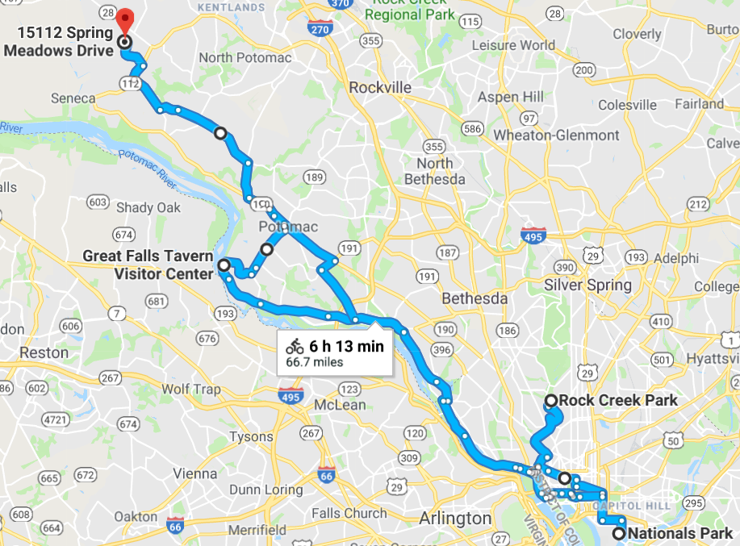
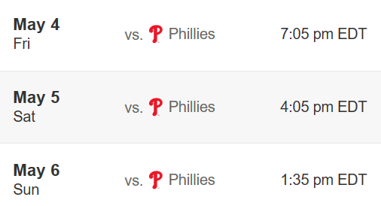
Day 1 – Sunday, May 6 MP0 to MP14 on the C&O Towpath
Day trip from Daryl and Sandie’s house
(15112 Spring Meadows Drive, Germantown, MD)
AM: Cycle from MP14 (Great Falls) to MP0 (Georgetown) on C&O Towpath with optional ride through Rock Creek Park (no cars on weekends). We start at MP14 tomorrow as we start heading to Pittsburgh, so this allows us to see the entire C&O Towpath.
PM: Cycle to Washington Nationals Game (1:30-4:30) – free valet parking! Cycle back to Daryl and Sandie’s after the game.
https://goo.gl/maps/kXGdCW6PuCM2
Washington Nationals
2018 Washington Nationals regular season single game tickets will go on sale on Thursday, March 1.
2018 Philadelphia Phillies Single Game tickets are scheduled to go on sale at 9 a.m. ET on Feb. 15.

Slide 9
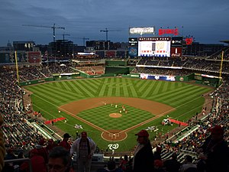
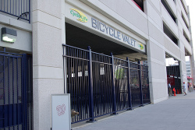
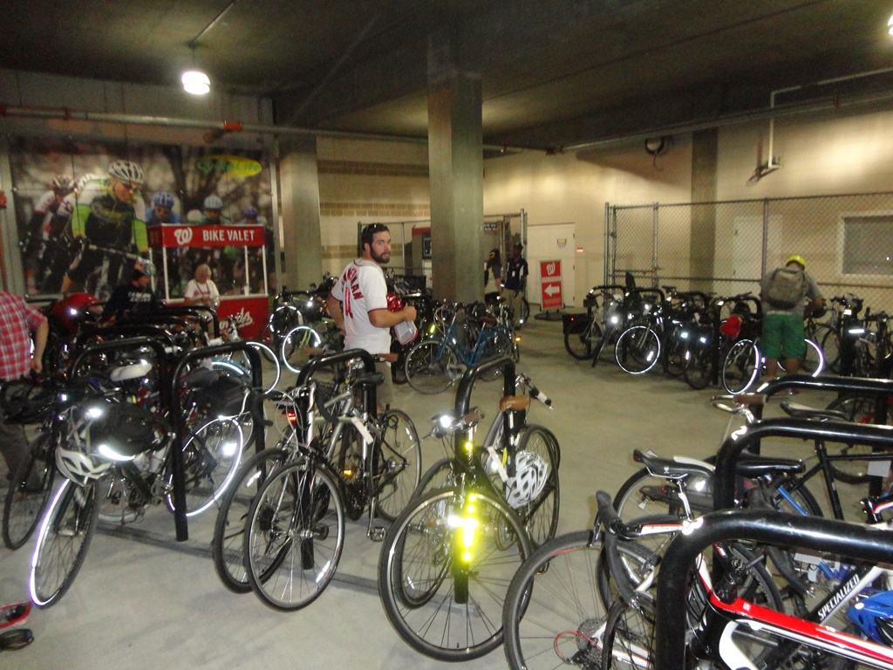
Washington Nationals
The Nationals stadium is one of the few ball parks that offers free bike valet parking. You can cycle past cars lined up for expensive parking and put your bike in a convenient location just inside the stadium with guards and bike racks where you can lock your bike. The valet parking is open 2 hours before the game until 1 hour after the game. Paul’s son Bryan is shown inside the free bike valet parking area below.

Slide 10
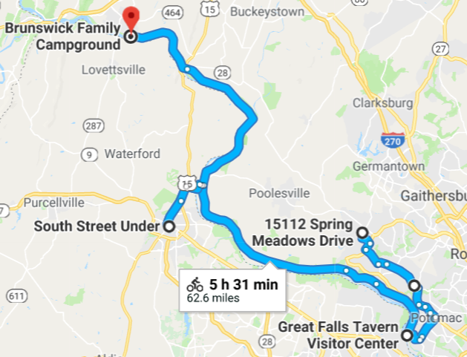
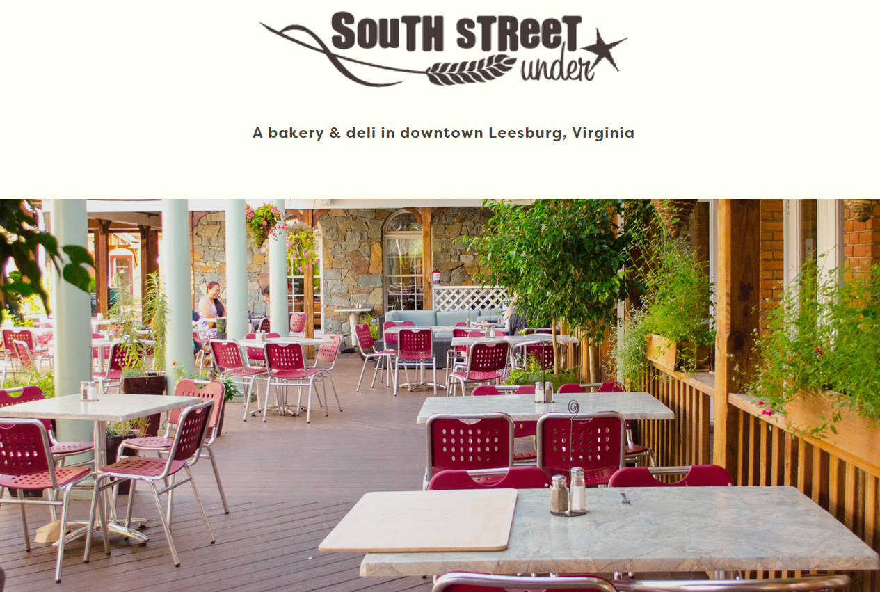
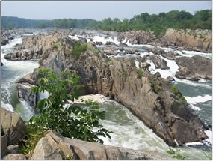
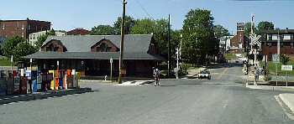
We will cycle from Daryl & Sandie’s house
MP14 - join the C&O Towpath at Great Falls. We might take a short hike to one of three overlooks by the falls and stop at the National Park Service Visitor Center.
MP35.7 - historic White’s Ferry. Take the ferry across the Potomac to Leesburg for lunch ($2.00 fee for bikes).
Lunch: South Street Under in Leesburg – bakery & deli. Good menu. Indoor & nice outdoor seating. 203 Harrison Street.
MP54.0 - We will stop and set up camp at the Brunswick Family Campground and then cycle another mile into Brunswick for dinner (Beans In the Belfry and Potomac Street Grill open until 9pm). We will also stop and visit the historic rail station in Brunswick, MD.
Day 2 – Monday, May 7
Daryl and Sandy’s house (Germantown, MD) to
Brunswick Family Campground (Brunswick, MD)
MP14.0 to MP54.0 on the C&O Towpath
https://goo.gl/maps/cq8FJ6httRo
Whites Ferry
View of Great Falls from Overlook #1
White’s Ferry
Rail Station in Brunswick, MD (MP55)

Slide 11
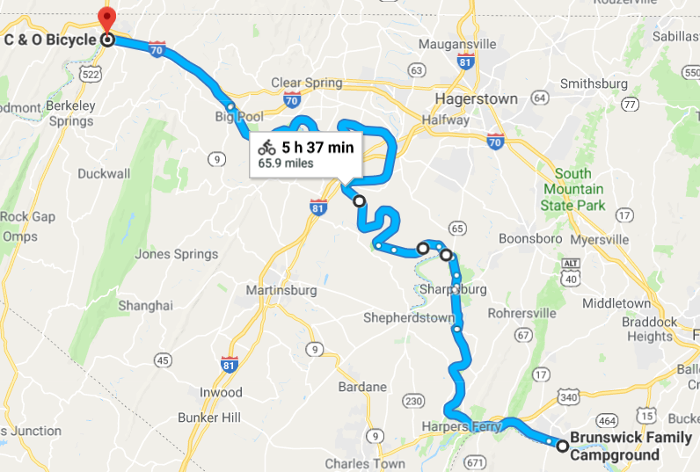
Day 3 – Tuesday, May 8 (65.9 mi + optional 8.5 mi for Auto Tour in Antietam)
Brunswick Family Campground (Brunswick, MD) to
C & O Bicycle’s Screened-In Bunkhouse (Hancock, MD)
MP54.0 to MP124.5 on the C&O Towpath
MP54 – Exit camp.
MP55 – Breakfast in Brunswick, MD - Beans In The Belfry restaurant opens at 8am.
MP58 - a lockhouse is at the point where the Appalachian Trail crosses the C&O Towpath.
MP60.7 – Take footbridge for a short visit to Harpers Ferry, WV. Some may opt to stay and visit some sites.
MP70 – Take footbridge to Harpers Ferry Road which leads to the Antietam National Battlefield. Go to the Visitor Center. Bike the “Auto Tour” (8.5 miles). Continue N on Sharpsburg Pike (65) to return to the C&O Towpath.
MP80.9 – Return to C&O Towpath at Taylor’s Landing Boat Ramp
MP99 – Williamsport, MD. NPS Visitor Center. Lunch and grocery store stop.
MP114.5 – Begin following the paved Western MD Rail Trail. (Trail continues to MP136.3 tomorrow.)
MP124.5 – Screened-in bunkhouse at C&O Bikes in Hancock, MD (we have reservations!) Restaurants within walking distance for dinner, including BuddyLou’s – 3 blocks away (highly recommended by bike shop and Thom Sare).
https://goo.gl/maps/GfhFiBLH4LH2
Antietam Battlefield
Detour from C&O Towpath through Sharpsburg and the Antietam Battlefield
C&O Towpath

Slide 12
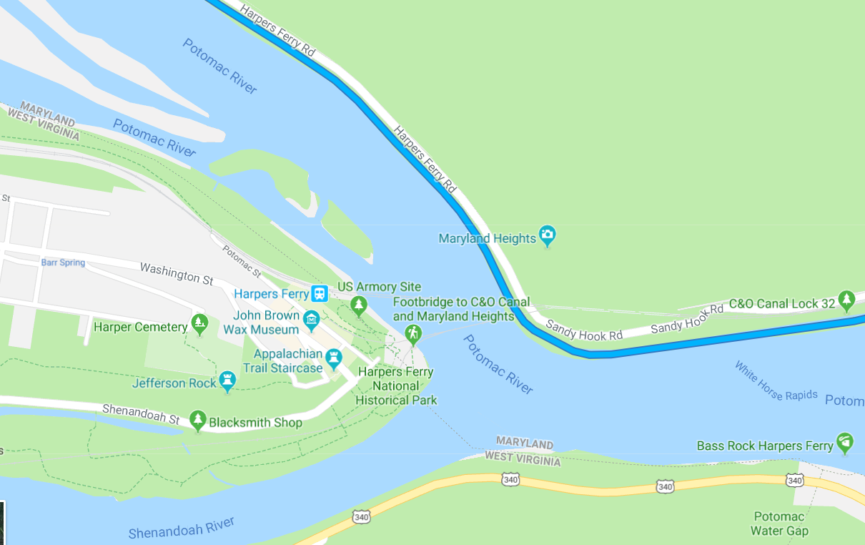
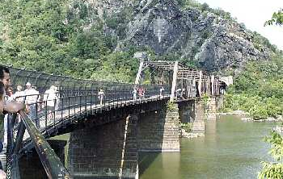
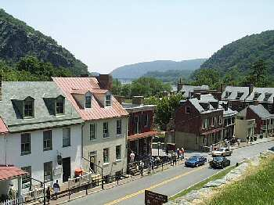
Harpers Ferry is a historic town in Jefferson County, West Virginia. It is situated at the confluence of the Potomac and Shenandoah rivers where the U.S. states of Maryland, Virginia and West Virginia meet. It is the easternmost town in West Virginia. The town's original, lower section is on a flood plain created by the two rivers and surrounded by higher ground. Historically, Harpers Ferry is best known for John Brown's raid on the Armory in 1859 and its role in the American Civil War. The population was 286 at the 2010 census. https://en.wikipedia.org/wiki/Harpers_Ferry,_West_Virginia
It might be fun to take the footbridge into Harpers Ferry and cycle through the town. We may not stay long to allow time for a longer visit at Antietam. However, some might wish to explore Harpers Ferry instead and see:
Harpers Ferry National Historical Park – including a Visitor Center and over 20 miles of trails
John Brown Wax Museum
Several other museums
John Brown’s Fort
Jefferson Rock (nice view)
Appalachian Trail Conservancy Visitor Center
Amtrak
Harpers Ferry, WV
Footbridge
(Appalachian Trail Crossing)
C&O Towpath
Mile 60.2 - Footbridge to Harpers Ferry
Mile 60.2 - Downtown Harpers Ferry
http://bikewashington.org/canal/canal_l.php

Slide 13
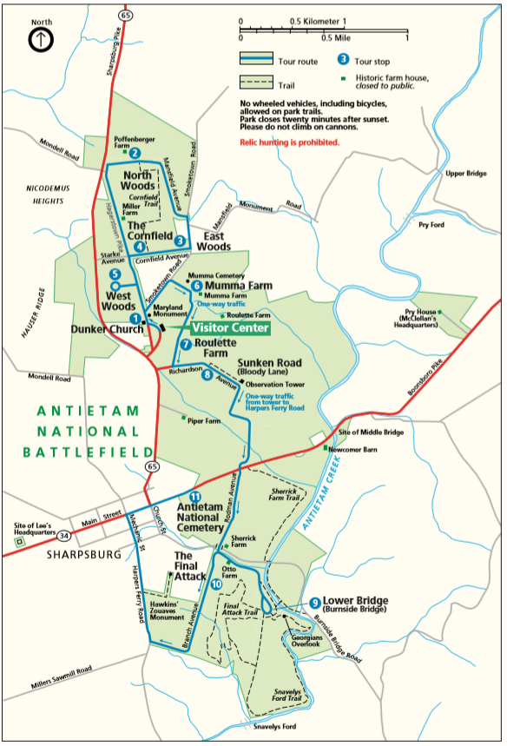
Antietam National Battlefield
The bloodiest day in American history: 23,000 soldiers were killed, wounded or missing after twelve hours of savage combat on September 17, 1862. The Battle of Antietam ended the Confederate Army of Northern Virginia's first invasion into the North and led Abraham Lincoln to issue the preliminary Emancipation Proclamation.
Fee: $5.00 (or free if you have a National Parks pass)
Visitor Center: theater, exhibits, observation room, and museum store. 26- minute orientation film narrated by James Earl Jones is shown on the hour and the half hour.
Pry House Field Hospital Museum: This new museum is located in the historic Pry House which served as Union Commander General George B. McClellan's headquarters during the battle. $5.00 fee. (on the right edge of the map)
Bicycles: Bicycling is permitted on paved park tour roads and parking lots. Riding is prohibited on all walkways, agricultural land, the Snavely’s Ford Trail, and the Sherrick Farm Trail.
Auto Tour (also great for bikes): Take the self-guided 8.5 mile auto tour through the battlefield. The tour has 11 stops and begins at the Dunker Church.
Recommendation: Begin at the Visitor Center and then cycle the Auto Tour (note that it is one-way). Note that this will add 8.5 miles to our trip.
We will exit here
We will enter here

Slide 14
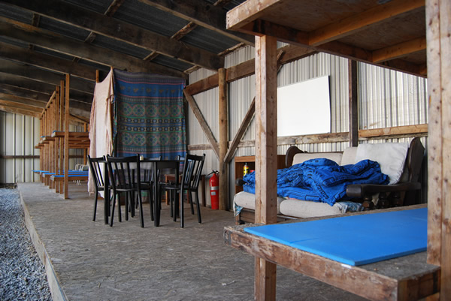
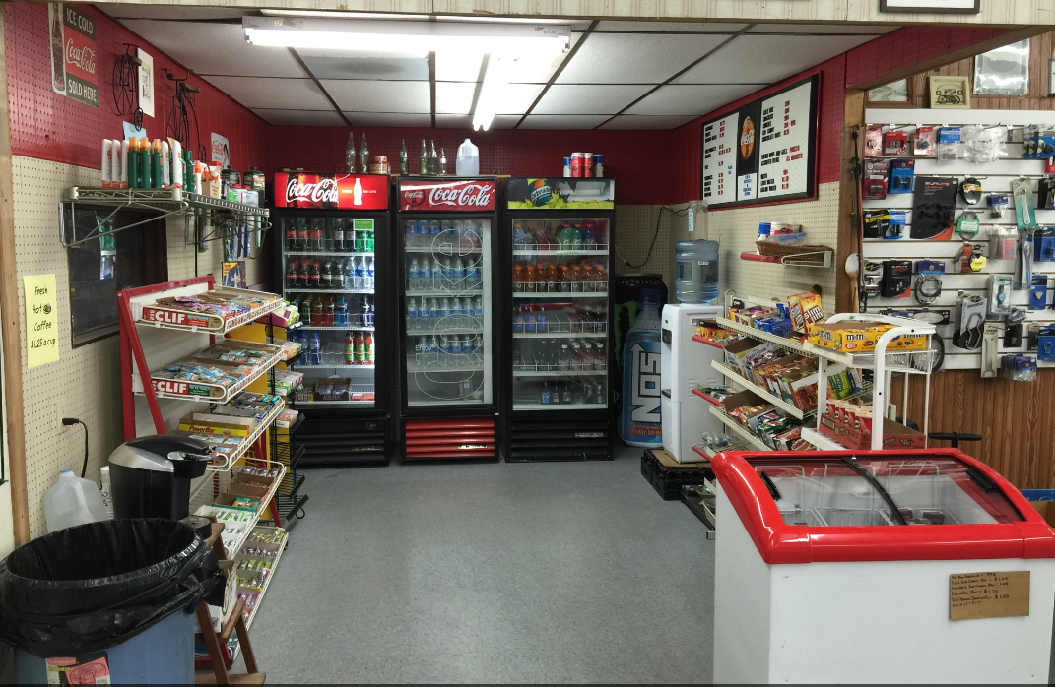
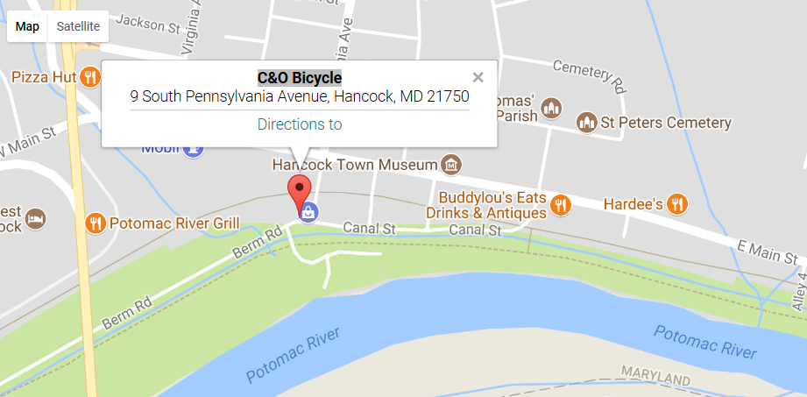
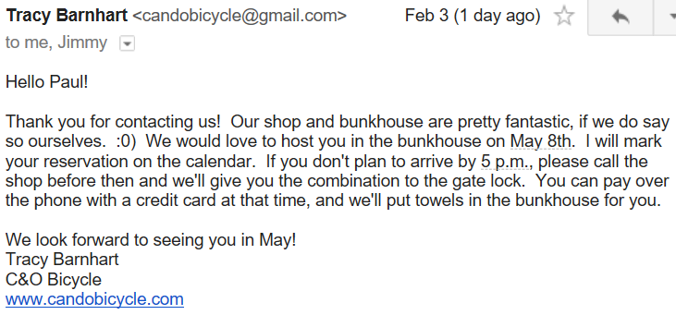
C&O Bicycle is located in beautiful, small-town Hancock, Maryland. You will find us at mile marker 124.5 of the C&O Canal, an old towpath used to transport freight from Georgetown to Cumberland. We are also at mile marker 10.7 on the Western Maryland Rail Trail, a 22.5-mile paved trail that provides a scenic route through the mountains, not over them.
Our unique shop offers bicycle rentals, repairs, and sales. We also have a screened-in bunkhouse for weary travelers to spend the night. Our general store is the perfect place to stop for a snack, a drink, or necessary supplies before hitting the trails.
Screened-In Bunkhouse: $15/cyclist, hot showers
General Store
The bike shop recommends:
Buddylou’s Eats Drinks & Antiques for dinner
Potomac River Grill for breakfast (opens 8am)

Slide 15
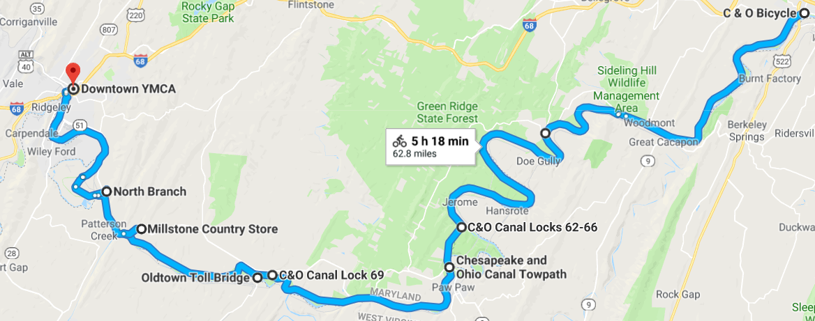
Day 4 – Wednesday, May 9 – 62.8 mi
C & O Bicycle’s Screened-In Bunkhouse (Hancock, MD) to
Cumberland YMCA (Cumberland, MD)
MP124.5 to MP184.5 on the C&O Towpath
MP124.5 – Breakfast at Potomac River Grill (opens at 8am, recommended by bike shop) – ¼ mile from C&O Bicycle via the Western MD Rail Trail. Continue on the Western MD Rail Trail after breakfast.
MP136.3 – Exit the paved Western MD Rail Trail back onto the C&O Towpath.
MP140.9 – Fifteen Mile Creek Aquaduct
MP141 – Little Orleans, MD
MP155.2 – Paw Paw Tunnel. We will likely need to walk bikes for 0.6 mi through this tunnel. Canal and small, uneven side path in tunnel. See photos next slide. Stop at tunnel entrance/exit and hike to top (good photo op).
MP156.2 – Wrenwood Inn B&B (PawPaw, WV) serves lunch 11-1. 0.5 mi off of the C&O Towpath.
MP166.7 – School House Kitchen (19210 Opessa St SE, Oldtown, MD (301) 478-5189) - Possible late lunch.
MP184.5 – Cumberland YMCA - End of the C&O Towpath. We will start the Great Allegheny Passage (GAP) tomorrow. See notes on upcoming slide. Many restaurants in Cumberland.
PawPaw Tunnel
https://goo.gl/maps/495cZ78qKyp

Slide 16
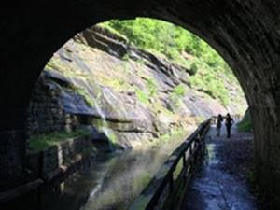
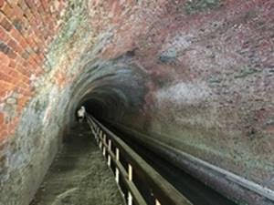
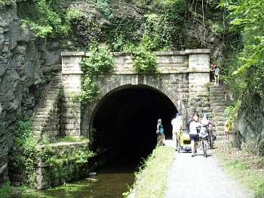
Paw Paw Tunnel
Paw Paw Tunnel (MP155.2 – MP155.8) – Canal inside tunnel with small, uneven side path. May have to walk bikes (3100’ or 0.6 mi).
PawPaw Tunnel (MP155.8) – Upstream entrance to the tunnel (we will exit here). http://bikewashington.org/canal/canal_l.php
The Paw Paw Tunnel is a 3,118-foot-long (950 m) canal tunnel on the Chesapeake and Ohio Canal (C&O) in Allegany County, Maryland. Located near Paw Paw, West Virginia, it was built to bypass the Paw Paw Bends, a six-mile (9.7 km) stretch of the Potomac River containing five horseshoe-shaped bends. The town, the bends, and the tunnel take their name from the pawpaw trees that grow prolifically along nearby ridges.
Built using more than six million bricks, the tunnel has been described as "the greatest engineering marvel along the Chesapeake & Ohio Canal National Historical Park." Located at milepost 155.2, the tunnel served to eliminate six miles of canal and is credited with contributing to the economic success of nearby Cumberland, Maryland.
Construction on the tunnel began in 1836 and was expected to be completed within two years at a total cost of $33,500. But the project proved far more complicated and costly than expected, and the tunnel would not open until 1850, more than a decade behind schedule.
https://en.wikipedia.org/wiki/Paw_Paw_Tunnel

Slide 17
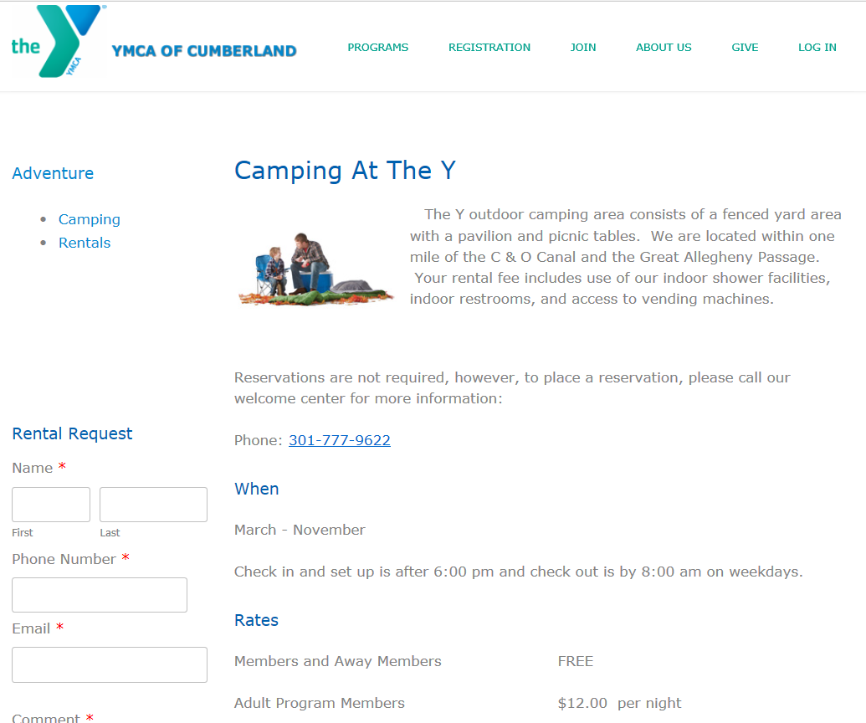
https://www.cumberlandymca.org/camping.html
There are two YMCA locations in Cumberland (Riverside and Downtown). We will use the Riverside location:
Cumberland YMCA - Riverside
601 Kelly Road Cumberland, MD
PG made reservations on 2-14-18.
Details:
Reservation made for 15.
We pay when we arrive ($12 per cyclist).
YMCA open until 10pm for using showers.
Portable bathroom near campsite.
Web site lists check in and set up after 6pm, but I found out that the time isn’t critical and we can arrive whenever we wish.
No laundry service at the YMCA, but there is in town.
will call to make reservations.
See map next slide.

Slide 18
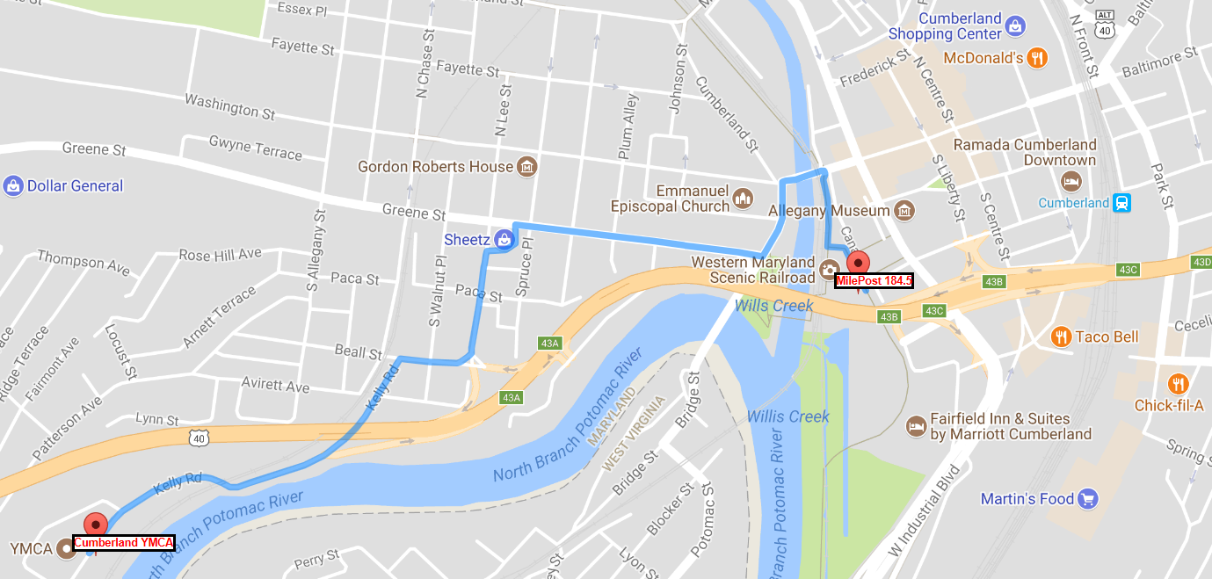
Cumberland, MD – Direction to the Cumberland YMCA from the end of the C&O Towpath
Great Allegheny Passage (GAP)
MilePost 0.0
C&O Towpath

Slide 19
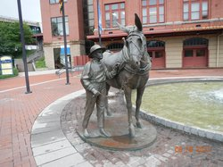
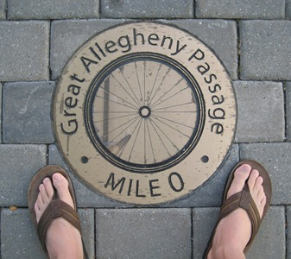
Cumberland, MD – Things to see
MP0 Marker – Look for the marker at the start of the GAP trail
C&O Canal National Historical Park and Visitors Museum - 13 Canal St, open 9-5 – Beautiful restored train station with shops
Canal Place - at the western end of the C&O Canal, showcases the heritage of this former railroad hub. It also features an enticing mix of retail, galleries and recreation. Boat rides on the canal and excursions aboard an old-time train powered by a steam locomotive are available from Canal Place.
Trestle Walk - The “Trestle Walk” project connects the station area with the C&O Canal towpath. This project provides a pedestrian walkway along a former railroad trestle which will ultimately cross the re-watered canal basin and terminate in an overlook at the Potomac River. The walkway follows the perimeter of the Crescent Lawn Festival Grounds.
Trail Connection - bike shop
Western MD Scenic Railroad - The Western Maryland Scenic Railroad offers a variety of scenic, dining, and specialty excursions throughout the year. Individual and group rates are available for the Mountain Limited, our scenic excursion, as well as Evening Paradise Dinner Trains on Saturday evenings. Also available throughout the year are various specialty and holiday excursions.
Allegany Museum - 3 Pershing St, free, history of Cumberland, MD
George Washington’s Headquarters - In Riverside Park, Greene St. – a one-room cabin
Emmanuel Episcopal Church - 16 Washington St – beautiful restored historical church on the site of pre-Revolutionary War Fort Cumberland with underground tunnels. Safe stop on the Underground Railroad. 3 Tiffany stained-glass windows.
C&O Canal National Historical Park and Visitors Museum
Mile 0 Marker at start of GAP Trail

Slide 20
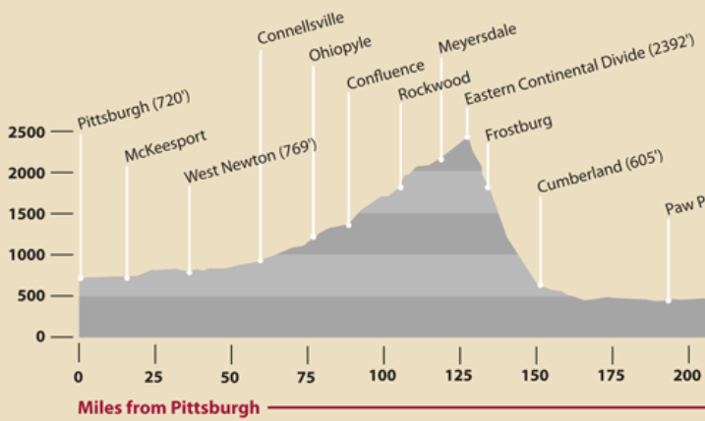
Great Allegheny Passage (GAP) Trail
On Days 5-7 we will cycle the GAP trail from Cumberland, MD to Pittsburgh, PA. The first 15 miles of the trail are adjacent to the Western Maryland Scenic Railroad (Cumberland to Frostburg) and the first 20 miles are uphill (see profile below). Note that we climb 1787’ in 20 miles with an average grade of 1.7%. The GAP trail has some nice improvements over the C&O Towpath.
The trail is wider with a nicer surface.
The C&O Towpath follows a canal and towns aren’t generally right on the trail, but the GAP Trail follows old railroad lines which went right through towns, so there are many nice “trail towns.”
The PawPaw Tunnel had a rough surface with a canal inside, whereas the tunnels on the GAP trail were train tunnels and are now paved (and in some cases lighted) for cyclists.
Day 6 Start
Day 7 Start
Day 5 Start
MP150
MP125
MP100
MP75
MP50
MP25
MP0

Slide 21
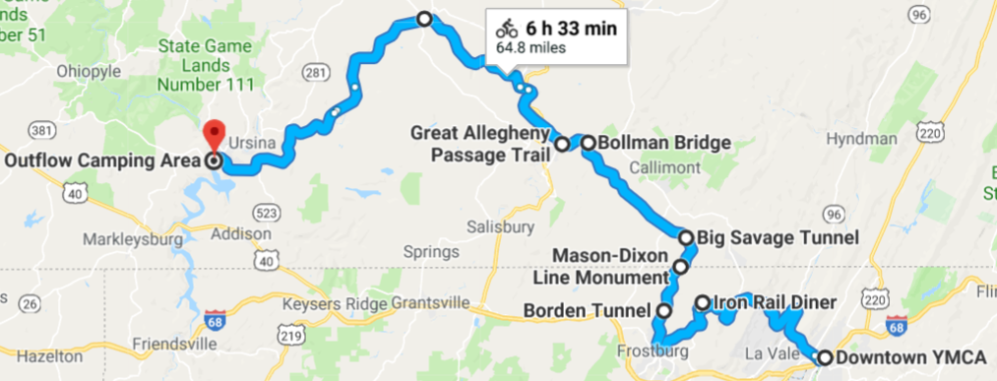
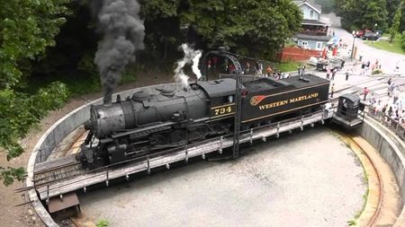
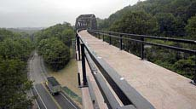
Day 5 – Thursday, May 10
Cumberland YMCA (Cumberland, MD) to
US Army Corp of Engineers Outflow Camping – Youghiogheny River (Confluence, PA)
MP0 to MP60 on the GAP Trail
https://goo.gl/maps/XiwTtFQxnbz
Frostburg Turntable
Leave the YMCA campground and cycle 1 mile into Cumberland for breakfast
MP0 – Start the Great Allegheny Passage (GAP) Trail. The first 15 miles of the trail are adjacent to the Western Maryland Scenic Railroad and the first 20 miles are uphill (see profile below). 1787’ climb.
MP6 – Brush Tunnel – 914’ lighted tunnel originally cut for two tracks, but now has one track and one bike lane. Used by Western Maryland Scenic Railroad (steam engine).
MP15 – Frostburg, MD – Steep climb into town for many shops & restaurants as well as a restored train depot and turntable (photo upper right), Thrasher Carriage Museum,
MP17.5 – Borden Tunnel - 975.5’, paved, no lights, wide since built for two tracks
MP20 – Mason-Dixon Line (cross from MD into PA). Look for marker..
MP22 – Big Savage Tunnel - longest tunnel on the GAP at 3294.6 ft, closed Oct – April and closed last year for maintenance, but should be open for us. Great views.
MP23 – Eastern Continental Divide - highest point on trip and cross into PA
MP30 – Keystone Viaduct - magnificent, curving 910’ structure
MP32 – Lunch in Meyersdale, PA (White House Restaurant or The Morguen Toole Company)
MP34 – Salisbury Viaduct – impressive1908’ structure
MP43 – Rockwood, PA (shops, restaurants, small bike shop)
MP52 – Pinkerton Tunnel – impressive site with bridges on either side of this 849’ tunnel that was restored in 2015. A trail along Pinkerton Horn used to bypass the tunnel is still available.
MP60 – US Army Corp of Engineers Outflow Camping – Youghiogheny River
MP60 - Confluence, PA – restaurants, grocery store
Keystone Viaduct
http://old.post-gazette.com/sports/outdoors/20030803walsh0803p2.asp

Slide 22
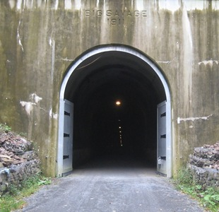
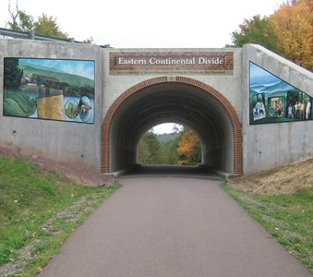
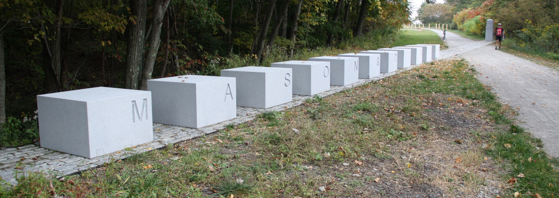
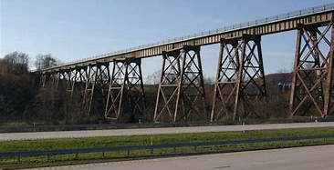
Big Savage Tunnel (MP22)
http://www.thegreatalleghenypassage.com
Eastern Continental Divide (MP23)
http://www.thegreatalleghenypassage.com
Brush Tunnel (MP6) – tracks and path share the tunnel www.bridgehunter.com
Mason-Dixon Line (MP20) - MD/PA border
http://www.johnvantine.com/biking-dc-pittsburgh-co-canal-gap-trail/
Salisbury Viaduct (MP34)
www.bridgehunter.com

Slide 23
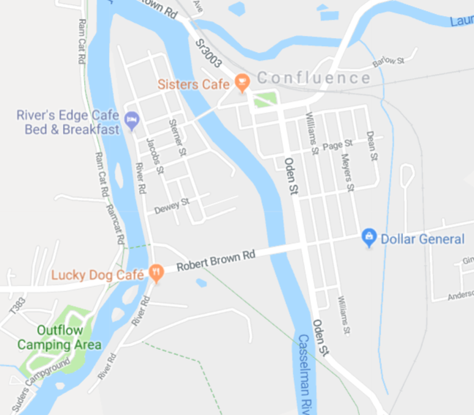
US Army Corp of Engineers Outflow Camping Area (Youghiogheny River)
Group site 1A reserved by PG. $35 total for up to 40 campers. Hot showers.
Rivers Edge Café - Dine on the wrap-around porch overlooking the river, or inside the old-world 1890’s farmhouse. Long a favorite of bicyclists on the Great Allegheny Passage.
Lucky Dog Café - Located on the bike trail we provide a comfortable setting for any appetite with a diverse menu that will appeal to everyone’s taste.
Sisters Café - Sisters’ Café is located four blocks from the Great Allegheny Passage bike trail. We provide a full menu and are open daily from 6am – 2pm year round.
Confluence Cyclery - A full service bike shop on the Great Allegheny Passage. Rentals, repairs and sales and accessories. Stop in and say hello when you are in the Confluence area.
Confluence Foodmart - Confluence Foodmart is a full service grocery store. Yough Valley Pharmacy is located inside along with our gift and home decor shop.
(Descriptions courtesy of nearby WendyWorld Campground, http://www.wendyworld.biz/ )
GAP Trail
US Army Corp of Engineers
Outflow Camping Area

Slide 24
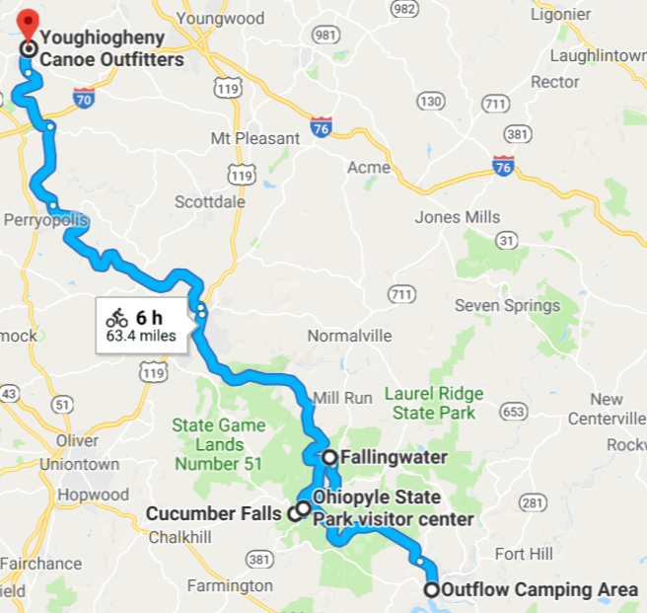
Day 6 – Friday, May 11
US Army Corp of Engineer Outflow Camping (Confluence, PA) to
Youghiogheny Canoe Outfitters Campground (West Newton, PA)
MP60 to MP114 on the GAP Trail
Leave the campground and cycle 1 mile to Sisters Café in Confluence (482 Hugart St) for breakfast (opens 6am).
MP60 – Continue on GAP trail after breakfast
MP72 – Ohiopyle, PA. Stop to see Ohiopyle State Park, Ohiopyle Falls, Cucumber Falls, 2 bike shops, many shops and restaurants
MP72 – Side trip to Fallingwater (8 mi RT)
MP72 – Return to Ohiopyle for lunch.
MP72 – Continue on the GAP trail. We ride on two trestles over the Youghiogheny River leaving Ohiopyle.
MP88 Connellsville, PA – many restaurants, shops, bike shop, Westgate Laundromat. Cross the river into town and try their bike loop through town.
MP114 - Youghiogheny Canoe Outfitters Campground (West Newton, PA)
MP 114 – West Newton, PA. Cross the century-old bridge into town for many shops and restaurants.
MP114 – Dinner – Trailside restaurant in West Newton
https://goo.gl/maps/hC8s5Cc2mAF2

Slide 25
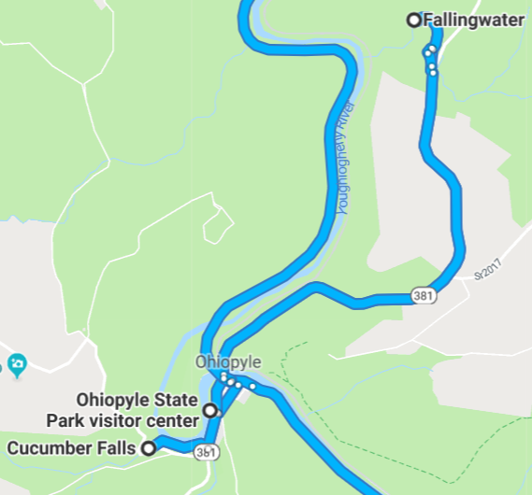
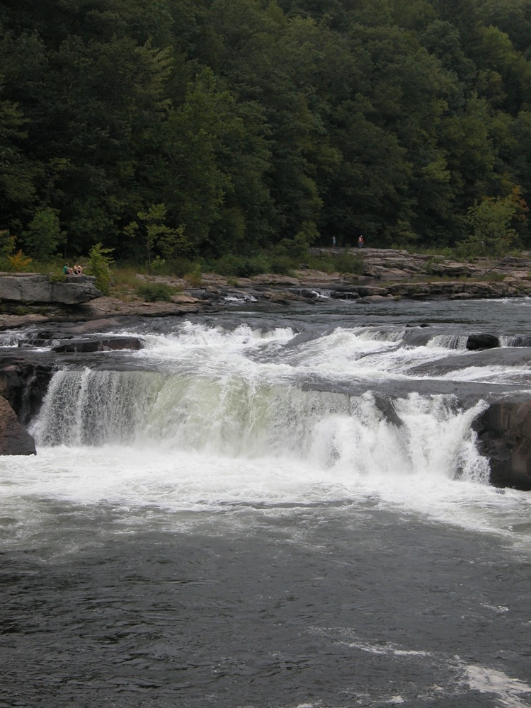
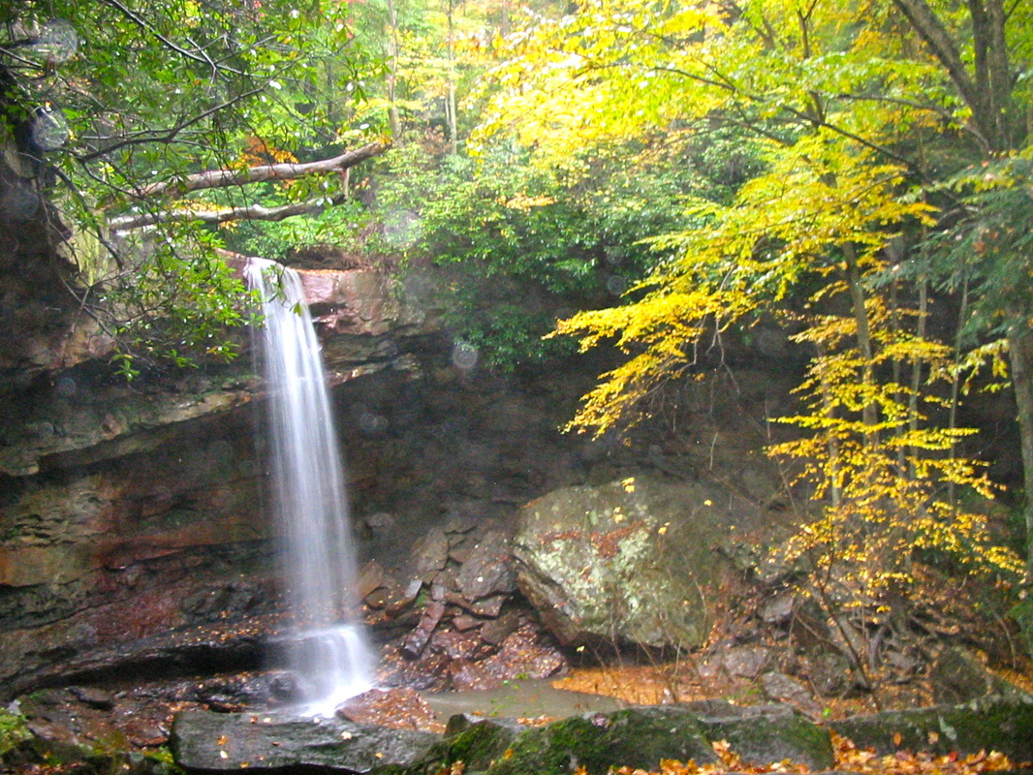
Ohiopyle (Mile 72) – The falls and river recreation have made Ohiopyle a tourist destination since the advent of the railroads. Today, Ohiopyle is the headquarters of Ohiopyle State Park, one the most popular state parks in Pennsylvania. Opportunities for whitewater rafting, hiking, and, of course, biking make this town an outdoor recreation destination for over 1.5 million visitors each year. https://www.gaptrail.org/explore/trail-towns
Cucumber Falls can be reached from Kentuck road or Rt 381. Kentuck road intersects Rt 381 just south of the main falls and just across from the natural water slides. There is a rustic stairway down into the gorge which will take you to the base of the falls. There is an overlook by the top of the falls. Maps are available for free in the park office which shows you the location of everything in the park.
Ohiopyle Falls is in Ohiopyle State Park. This is a large park, but the falls are right in the center of it and hard to miss. This is low, wide waterfall on the powerful Youghiogheny River (known as the "Yawk").
GAP Trail
Trestles
GAP Trail

Slide 26
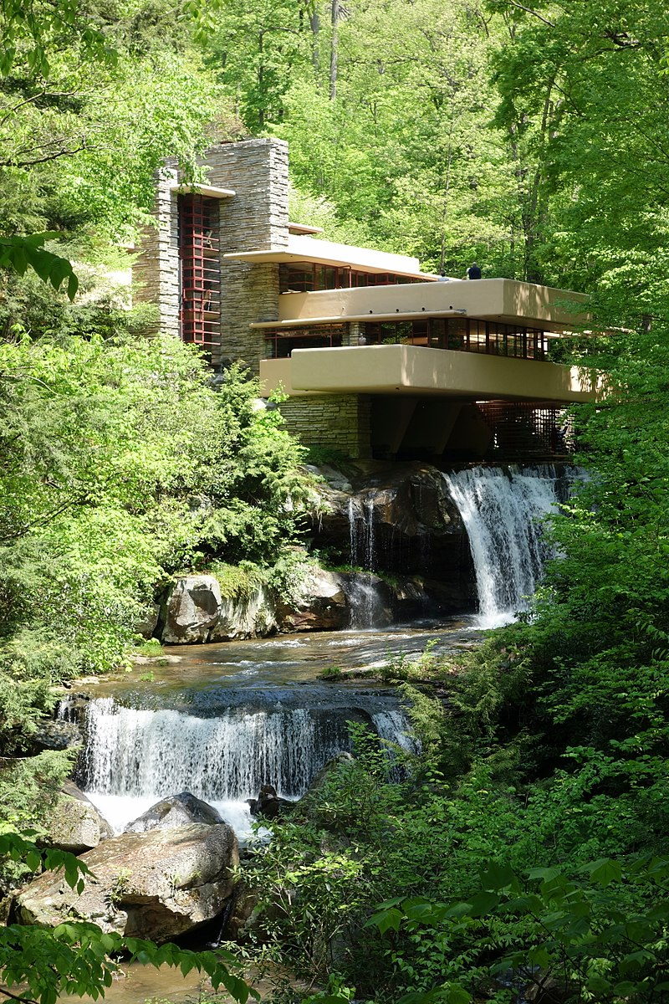
Fallingwater is a house designed by architect Frank Lloyd Wright in 1935 in rural southwestern Pennsylvania, 43 miles (69 km) southeast of Pittsburgh. The house was built partly over a waterfall on Bear Run in the Mill Run section of Stewart Township, Fayette County, Pennsylvania, located in the Laurel Highlands of the Allegheny Mountains. The house was designed as a weekend home for the family of Liliane Kaufmann and her husband, Edgar J. Kaufmann, Sr., owner of Kaufmann's Department Store.
After its completion, Time called Fallingwater Wright's "most beautiful job,"^{[5]} and it is listed among Smithsonian's "Life List of 28 places to visit before you die."^{[6]} The house was designated a National Historic Landmark in 1966.^{[3]} In 1991, members of the American Institute of Architects named Fallingwater the "best all-time work of American architecture" and in 2007, it was ranked 29th on the list of America's Favorite Architecture according to the AIA.
https://en.wikipedia.org/wiki/Fallingwater
Visiting Fallingwater
Fallingwater is 4 miles off of the GAP trail, so visiting it adds 8 miles RT to our trip (already included in the total listed).
A grounds pass costs $10.00 allowing us to see the grounds and the outside of the house (I think that this is a good option).
Tours of the house are available for $30.00, but you might need to check the schedule.
Fallingwater Visitor Center (9:15 a.m. to 4 p.m.)
Fallingwater Museum Store (9:30 a.m. to 4:30 p.m.)
Fallingwater Café (10 a.m. to 4 p.m.)

Slide 27
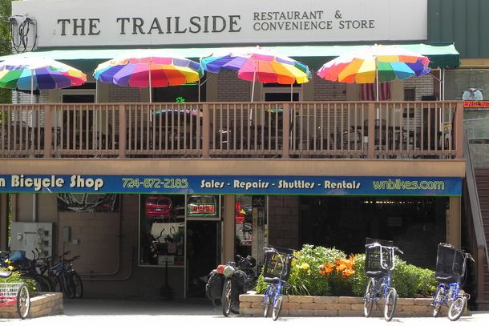
West Newton, located at mile 113 on the Great Allegheny Passage, boasts a sheltered location in a scenic river valley. Some businesses near the trail include a canoe outfitter, B&B, bike shop and restaurant with outdoor seating. At the road crossing there's a pioneer sculpture crafted from railroad spikes and be sure to pose with him for a picture! Stop by the West Newton Visitor Center for a friendly chat, trail information, and lots of trail-related merchandise. The historic downtown is just across West Newton Bridge.
Giant Eagle Supermarket
Gary’s Chuckwagon Restaurant
Great little place for breakfast or lunch. Quality homemade food for a decent price. Bakery connected to restaurant. Open 8-3.
The Trailside is located on the west side of West Newton Pennsylvania along the Great Allegheny Passage and Youghiogheny River. Our facility consists of a Pub and Restaurant with the West Newton Bike Shop on the lower level.
Good menu. Dinners, sandwiches, pizzas, salads, wraps, …
Open 5-9pm (winter hours) – check later.

Slide 28
The Hot Metal Bridge is a truss bridge in Pittsburgh, Pennsylvania, that crosses the Monongahela River. The bridge consists of two parallel spans on a single set of piers: the former Monongahela Connecting Railroad Bridge, built in 1887, on the upstream side and the former Hot Metal Bridge, built in 1900, on the downstream side.
The bridge connects 2nd Avenue at the Pittsburgh Technology Center in South Oakland with Hot Metal Street (South 29th Street) in the South Side. The downstream span reopened for pedestrian and bicycle use in late 2007 after two years of work. The Great Allegheny Passage hiker/biker trail passes over this bridge as it approaches Pittsburgh's Golden Triangle area.
Beginning in Pittsburgh's Point State Park, the trail overlaps the route of the Eliza Furnace segment of the Three Rivers Heritage Trail. Trail users are treated to an array of signage interpreting the area's industrial past. A crossing of the Hot Metal Bridge, once used to carry iron by rail from the Eliza furnaces to Pittsburgh's south side to produce finished steel, leads across the Monongahela River to the Three Rivers Heritage Trail's South Side and Baldwin Borough segments, which extend south to Homestead.
Before reaching the quaint town of Ohiopyle, you cross two impressive trestles (going south)
Dead Man's Hollow, former site of the Union Sewer Pipe Company located outside of McKeesport, Pennsylvania, now a 440-acre nature preserve and spur trail
Dravo Cemetery, originally the Seneca tribe's village known as Cyrie, later the home of the Dravo Methodist Church and Cemetery. Now a popular camping area and rest spot near Buena Vista, Pennsylvania.
By Samuel Sonne - Own work, CC BY-SA 2.5, https://commons.wikimedia.org/w/index.php?curid=802564

Slide 29
Day 7 – Saturday, May 12
Youghiogheny Canoe Outfitters Campground (West Newton, PA) to
SpringHill Suites Motel (Lebanon, PA)
MP114 to MP150 on the GAP Trail
Hot Metal Bridge into Pittsburgh - By Dllu - Own work, CC BY-SA 4.0, https://commons.wikimedia.org/w/index.php?curid=47782007
Leave the campground and stop at nearby Gary’s Chuckwagon Restaurant in West Newton for breakfast (opens 8am).
MP114 – Continue on GAP trail after breakfast
MP128 – Boston, PA – The Great Allegheny Passage passes through ‘Little Boston’ at a busy trailhead and ballpark, with many shops and restaurants.
MP132 – McKeesport, PA – McKeesport is at the junction of the Youghiogheny River and the Monongahela, which the Great Allegheny Passage follows to Pittsburgh. Connection to the Montour Trail.
MP140 – Homestead/The Waterfront – This development was once the sprawling site for the Homestead Steel Works and now features dozens of retail stores, restaurants, and entertainment venues. Trail runs along the river next to a shopping mall, Costco, restaurants, etc.
MP146 – Southside of Pittsburgh – Cross the Monongahela River into Pittsburgh over the Hot Metal Bridge. Half of this double trestle was refurbished in 2016 into a nice bike lane.
MP150 – Downtown Pittsburgh – We will ride the Three Rivers Heritage trail along the banks of the Monongahela, Allegheny, and Ohio Rivers.
MP150 – The GAP trail officially ends at Point State Park where the 3 rivers meet. A beautiful fountain, great views of the rivers, and remains of forts are within the park.
Duquesne Incline -
SpringHill Suites – Mt. Lebanon, PA – right next to light rail line which we will take to the Pirates game tomorrow.
https://goo.gl/maps/nKkHnCS285S2
See expanded view of Pittsburgh area on next slide

Slide 30
Pittsburgh area

Slide 31
Point State Park is a Pennsylvania state park on 36 acres in Downtown Pittsburgh at the confluence of the Allegheny and Monongahela rivers, forming the Ohio River. https://en.wikipedia.org/wiki/Point_State_Park
The Three Rivers Heritage Trail is a multi-use riverfront trail system in the Pittsburgh region. This 24-mile nonlinear trail has segments on both banks of Pittsburgh’s three rivers with access to city neighborhoods, business districts, and local attractions.
Follow link below for online map
The park also includes the outlines and remains of two of the oldest structures in Pittsburgh, Fort Pitt and Fort Duquesne. The Fort Pitt Museum, housed in the Monongahela Bastion of Fort Pitt, commemorates the French and Indian War (1754–63), in which the area soon to become Pittsburgh was a major battlefield. It was designated a National Historic Landmark in 1960 for its role in the strategic struggles between Native Americans, French colonists, and British colonists, for control of the Ohio River watershed.
https://friendsoftheriverfront.org/trails/three-rivers-heritage-trail/

Slide 32
Duquesne Incline
The Duquesne Incline is an inclined plane railroad located near Pittsburgh's South Side neighborhood and scaling Mt. Washington. Designed by Samuel Diescher, the incline was completed in 1877 and is 800 feet long, 400 feet in height, and is inclined at a 30-degree angle. It has an unusual track gauge of 5 ft. https://en.wikipedia.org/wiki/Duquesne_Incline
Hours: Monday through Saturday: 5:30 a.m. to 12:30 a.m.
Sundays and Holidays: 7:00 a.m. to 12:30 a.m.
FARES:
Adults (Ages 12-64) $2.50 Each Way or $5.00 Round Trip
GROUP RATES: Group Rates are Valid for Any Group of Ten or More People
Adults (Ages 12-64) $1.75 Each Way or $3.50 Round Trip
Riders of The Duquesne Incline may take a bicycle with them, on the Incline cable car, for an additional cash fare(i.e. the bicycle patron would then pay two fares, for transport of self and bicycle). inclinedplane.tripod.com/bike.htm
If time allows, we might ride the Duquesne Incline for a unique view of Pittsburgh!
We could lock bikes at the bottom and ride it round trip or ride it to the top with bikes and continue on to the hotel from the top (a shortcut)!
http://www.bikepgh.org/resources-3/bikesontransit/

Slide 33
Day 8 – Sunday, May 13
Day trip to explore Pittsburgh from SpringHill Suites Motel (Lebanon, PA) – details to be added later
AM: Loop through Pittsburgh
PM: Take light rail to Pittsburgh Pirates Game (leave bikes in motel)
See next slide for light rail details
Still working on the optional trip to explore Pittsburgh on Sunday morning.
More details later!
Springhill Suites in Mt. Lebanon is right next to the Mt. Lebanon light rail station.
Pittsburgh Pirates
2018 Washington Nationals regular season single game tickets will go on sale on Thursday, March 1.
2018 Philadelphia Phillies Single Game tickets are scheduled to go on sale at 9 a.m. ET on Feb. 15.

Slide 34
Taking light rail (the “T”) to the Pittsburgh Pirates game
We can explore Pittsburgh (or relax in the motel) and then take light rail to PNC Park for the game (leave bikes in the motel).
Catch the light rail around noon for the 1:35 ball game?
The "T" provides easy access to downtown for those fans living in the South Hills. Get off at either the Wood Street or Gateway Center stations and walk across the Roberto Clemente Bridge (closed to traffic for ball games) to PNC Park. Downtown and the bridge are festive and full of vendors on game days.
Fans coming to PNC Park are able to take advantage of the FREE Light Rail Transit (or "T") service that significantly enhances the experience for fans coming to and leaving the ballpark.
http://pittsburgh.pirates.mlb.com/pit/ballpark/parking_directions/index.jsp?content=public_transportation
Exit at Wood Street or Gateway Center
Spring Hill Suites
(next to Mt. Lebanon Station)

Slide 35
Light rail in Pittsburgh (“the T”)
It looks like we won’t need to take our bikes on the “T”, but they are allowed at all times in either direction.
https://en.wikipedia.org/wiki/Pittsburgh_Light_Rail

Slide 36
Pittsburgh Pirates
PNC Park's prime location along the shore of the Allegheny River and adjacent to Federal Street takes advantage of scenic vistas of the downtown skyline and riverfront, as well as pedestrian and riverboat access, creating an exciting and dramatic urban sports venue. It also provides easy access for pedestrians crossing the Roberto Clemente bridge from downtown, as well as those arriving from the riverwalk. http://pittsburgh.pirates.mlb.com/pit/ballpark/index.jsp
On game days the Roberto Clemente bridge is closed to vehicular traffic and spectators can take a short walk from downtown and cross the Allegheny River to PNC Park. The view is fantastic!

Slide 37
Day 9 – Monday, May 14
Cycle 6.4 miles from the motel to the Amtrak station in downtown Pittsburgh (too early for light rail). Start at 3:00am - 3:30am. Bring lights!
Take Amtrak from Pittsburgh to Washington DC (Union Station). Eat breakfast on the trail (see details in later slides)
Cycle 27.3 miles from Union Station to Daryl’s house
Problem: Light rail doesn’t run early enough to get us to the Amtrak station for a 5:20am train. The earliest we could get there is 5:11am. We will cycle there instead.
The light rail won’t get us to Amtrak in time, so we will bike to the station.

Slide 38
Cycling back to Daryl and Sandie’s house (27.3 miles) after the trip on Amtrak.
Train arrives in Union Station at 1:05pm
Make sure you pay to bring a bicycle when you buy your ticket.
https://goo.gl/maps/wRCCBxX63HQ2

Slide 39
Not all Amtrak trains allow bikes and some use different methods:
Carry-on Bicycle Service – You wheel your bike back to a special storage area on double-decker cars and they put them in racks. We will use this on the Pittsburgh-Washington trip (Capitol Limited line).
Trainside Checked Bicycle Service – You wheel your bike back to the baggage car. We used this on the Savannah Richmond Trip.
Box your bike - It counts as luggage – available on any train with a baggage car

Slide 40
Trainside Checked Bicycle Service – You wheel your bike back to the baggage car and you hand it to a conductor. We used this on the Richmond-Savannah trip (Palmetto line)
Carry-on Bicycle Service – You wheel your bike back to a special storage area on double-decker cars and they put them in racks. We will use this on the Pittsburgh-Washington trip (Capitol Limited line)

Slide 41
Paul and Alice took the Capitol Limited from DC to Chicago and back over the Christmas/New Year break (Dec 2017/Jan 2018).
The seats were spacious and the observation car is great with huge windows offering wonderful views. It was nice being able to move around between our seats, the observation car, the snack car (with booths and table) and the dining car.

Slide 42
Sunrise from the dining car on the way from Pittsburgh to Washington DC.

Slide 43
At one of the stations I asked a conductor where bikes are stored when you purchase a ticket that includes a bike. He showed me the compartment in the upper left photo.
I couldn’t see inside the compartment, but I found the other two pictures posted online by people travelling on the Capitol Limited.

Slide 44
The route from Pittsburgh to Washington DC is quite scenic and often follows the Potomac and other rivers. It was beautiful in January with all of the snow and ice. We could spot the C&O Towpath or the Great Allegheny Passage on the other side of the river.

Slide 45
Carrying your gear on the train.
Amtrak allows each passenger two checked bags as well as two carry-on items. On our trip from Savannah to Richmond we thought that we might be able to zip tie panniers together, but the train station attendants said we could not. However, we found a great solution. They will sell you a shipping box for $5.00 which is probably big enough to hold a couple of panniers along with helmet, water bottles, etc.

Slide 46
Breakfast on Amtrak
We should plan to eat breakfast on Amtrak on our trip from Pittsburgh to Washington DC. We board at 5:20am and breakfast is served from 6:30-10:00am. Paul ordered the Continental Breakfast (with oatmeal, of course) below and Alice ordered Scrambled Eggs with bacon as a side. It was quite good with nice windows to watch the scenery.

Slide 47
Lunch/Dinner on Amtrak
We could also eat lunch on Amtrak as we will not arrive in DC until 1:05pm. Reservations are needed for lunch and dinner, but not for breakfast.
Snack Car
Items vary, but typically include:
Refreshments
Sandwiches
Hot dogs
Fruit cups
Cheese/cracker trays
etc

Slide 48
Taking Amtrak on Tuesday, May 15 instead of Monday, May 14
Since the Capitol Limited only allows 8 bikes per train and we could have a dozen or more cyclists, some of us could wait until Tuesday, May 15, to catch the next train. Rather than waiting in Pittsburgh, we could cycle to the next stop on the Capitol Limited, which is in Connellsville, PA (60 miles).
There is a hotel fairly close to the train station: Cobblestone Hotel and Suites ($89.99 for two double-beds, AAA rate)
http://www.staycobblestone.com/pa/connellsville/
https://goo.gl/maps/fxTujZBSKzM2

