Slide 1
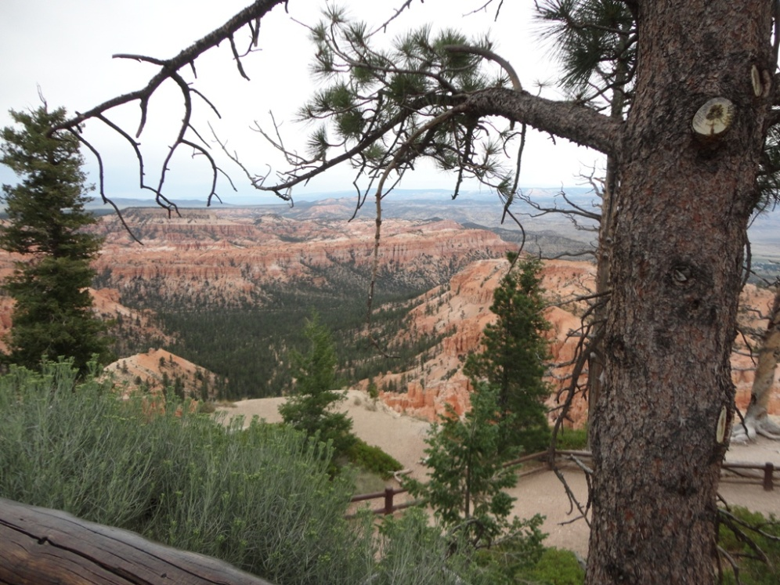
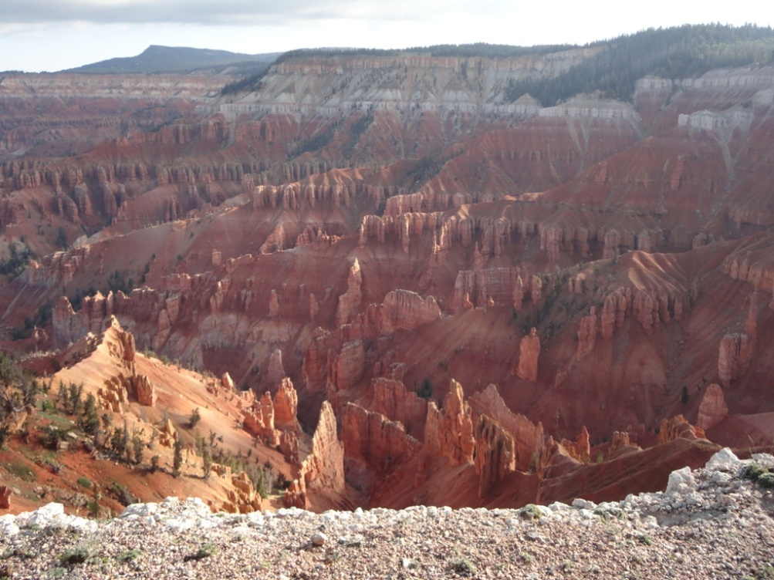
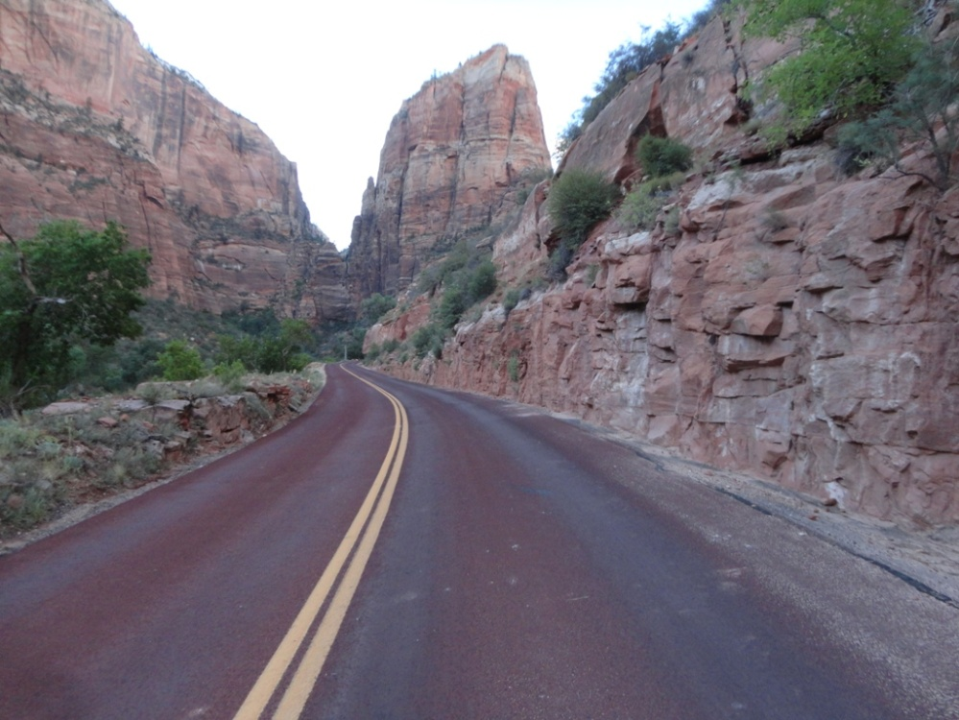
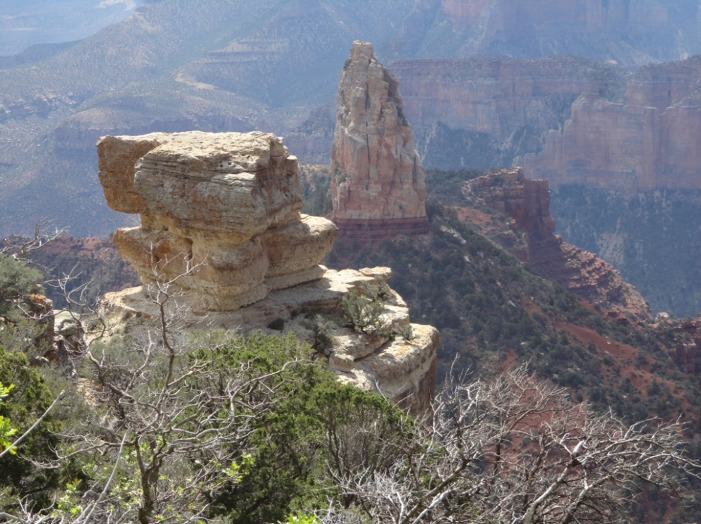
Bryce Canyon
Cedar Breaks National Monument
Zion National Park
Grand Canyon – Northern Rim

Slide 2
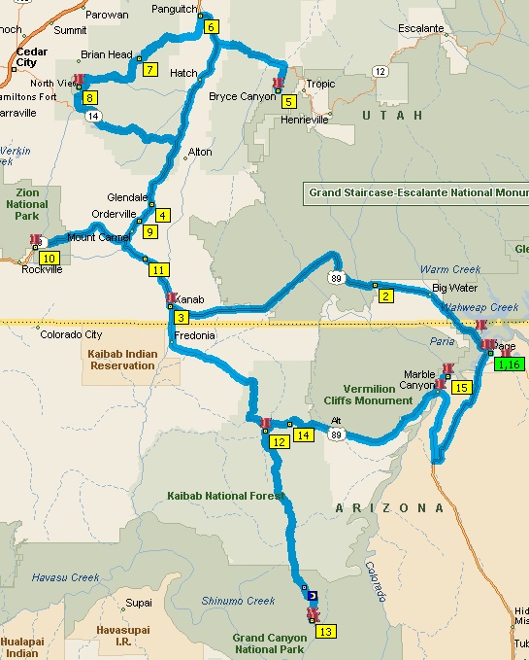
Cedar Breaks
National Monument Campground – Day 5
Bryce Canyon Campground
Days 3-4
Grand Canyon
Southern Utah
July 24 - August 3, 2013
Start/Stop/
Page, AZ
(Super8)
Days 0,1,11
Kanab, UT
(Comfort Inn)
Day 2 & Day 10
Zion National
Park Campground Day 6
Lee’s Ferry Lodge
Day 10
Jacobs Lake Inn
Day 7
Landslide!
North Rim Campground Days 8-9

Slide 3
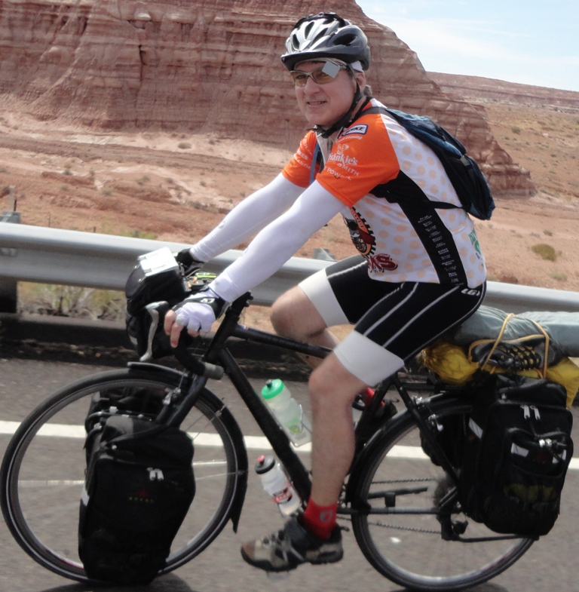
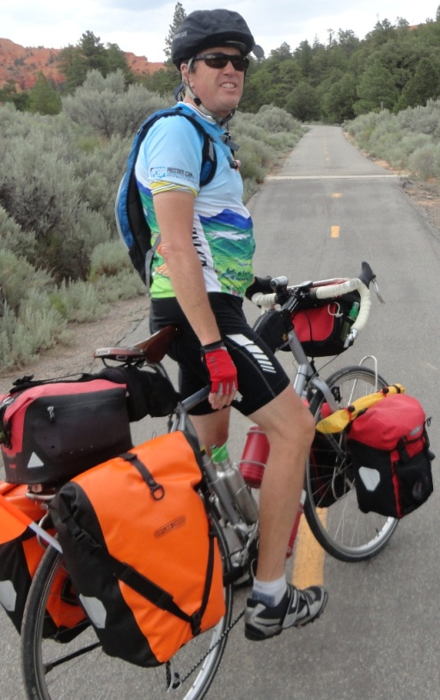
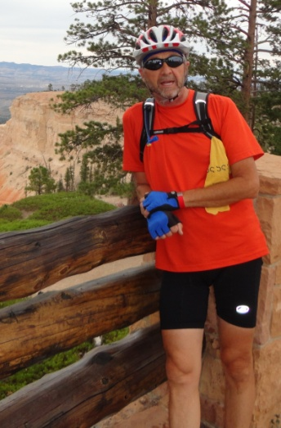
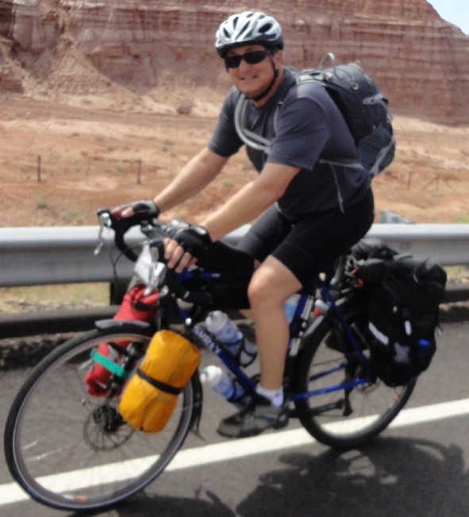
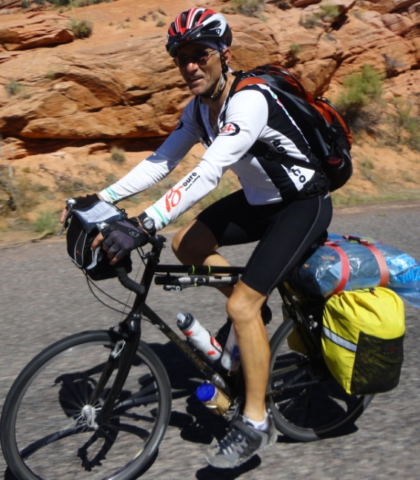
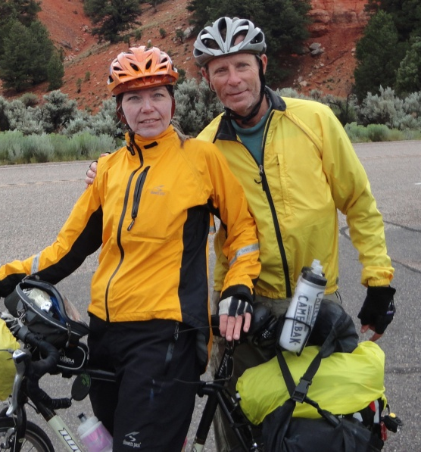
Paul - Virginia Beach
Robert - Virginia Beach
Dennis - Chesapeake
Thom - Virginia Beach
Mike - Virginia Beach
Dean – Bar Harbor, ME
Beth & John – Boone, NC
Sandy & Daryl – DC area

Slide 4
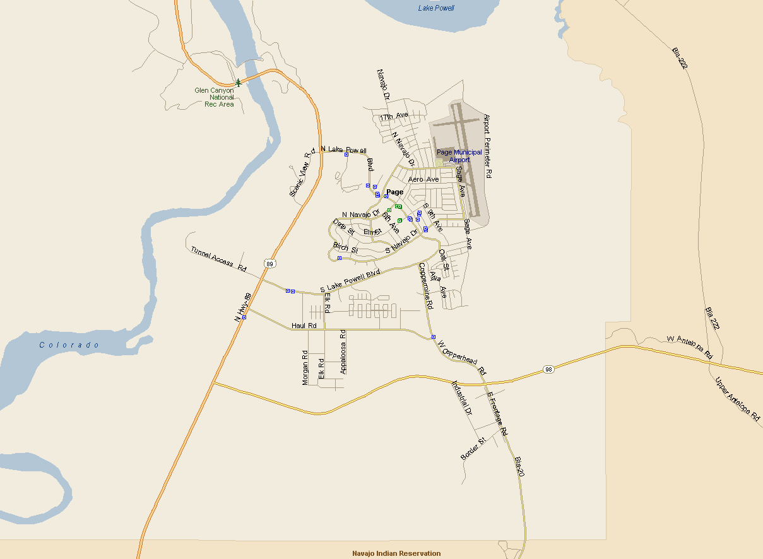
Day 1 – Map of Page, AZ
Glen Canyon Dam
Lake Powell
5.5 miles from dam to Waheap Resort & Marina (lunch on Lake Powell)
Airport
Carl Hayden Visitor Center (tours of Glen Canyon Dam)
Bridge in front of Glen Canyon Dam (700 ft over river)
Salty Dog Bikes
Super 8
Colorado River
Horseshoe Bend (4 miles from Page)
We started our trip in Page, AZ at the base of Lake Powell and the start of the Colorado River. We spent “Day 0” in Page to insure that our bikes arrived safely and to see some local sites.
Upper Antelope Canyon

Slide 5
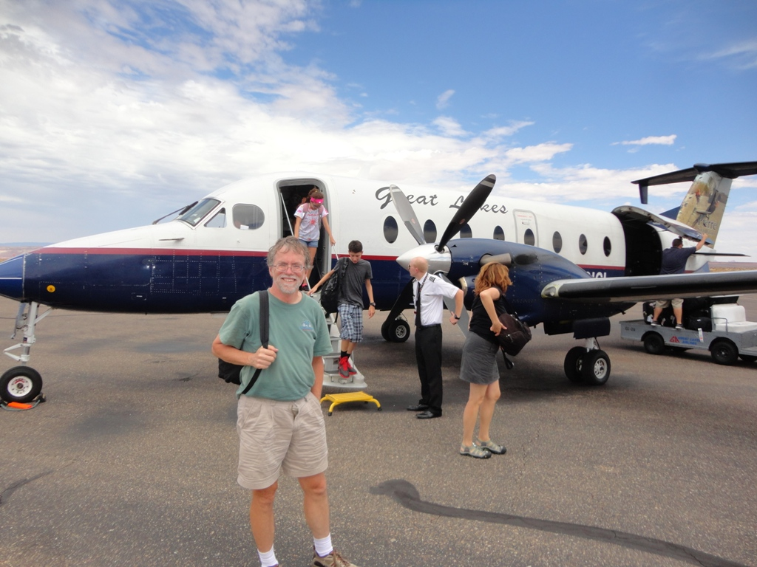
Paul exits the plane in Page, AZ

Slide 6
Assembling and adjusting bikes in the hotel in Page, AZ

Slide 7
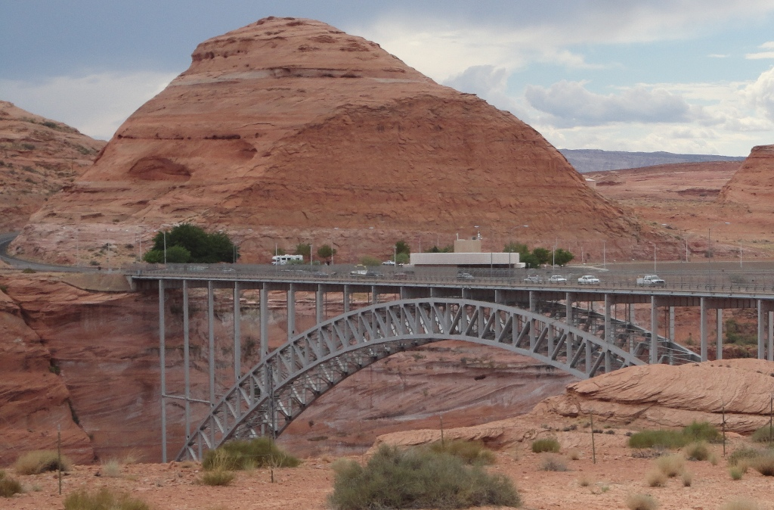
Day 0 (Page) – Bridge over the Colorado River next to the Glen Canyon Dam

Slide 8
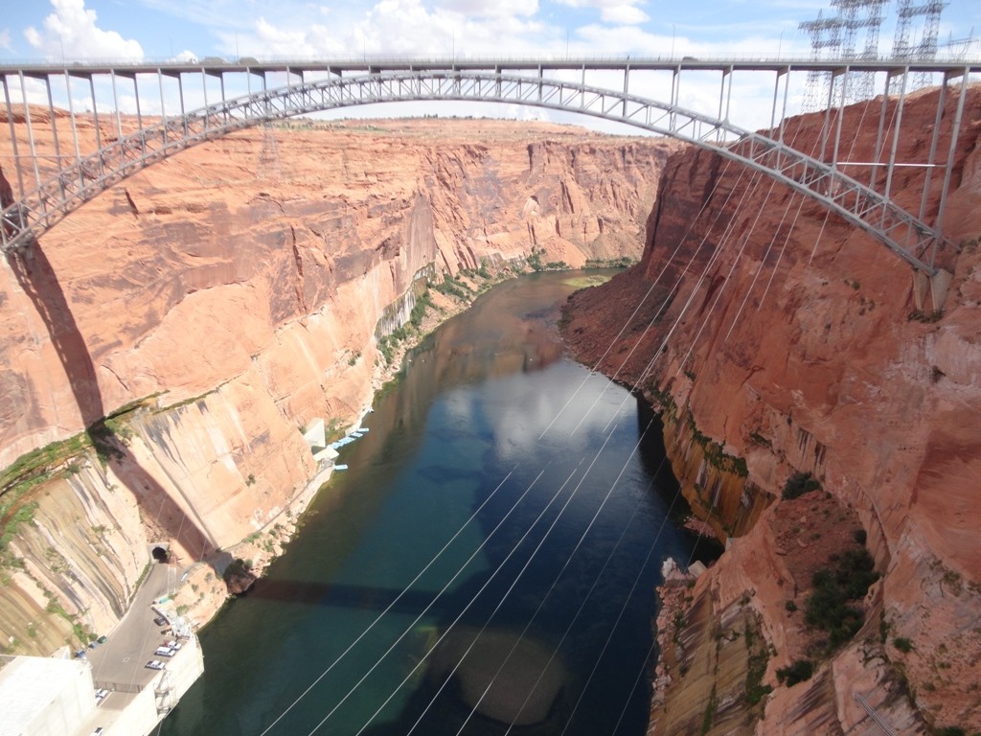
Day 0 (Page) – We cycled over the bridge (700 ft over the Colorado River)

Slide 9
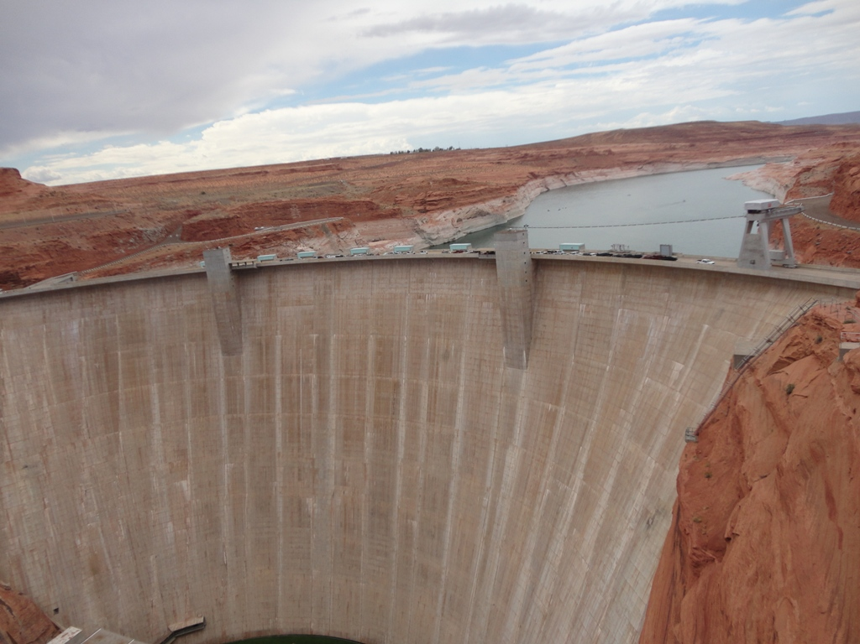
Day 0 (Page) – Glen Canyon Dam (see from the bridge)

Slide 10
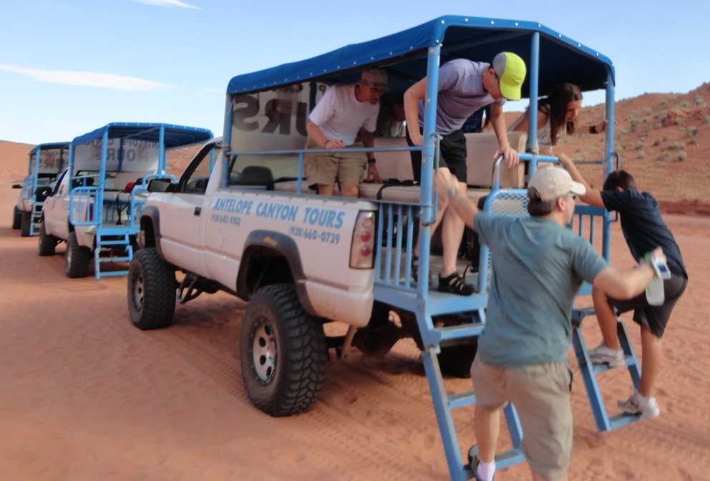
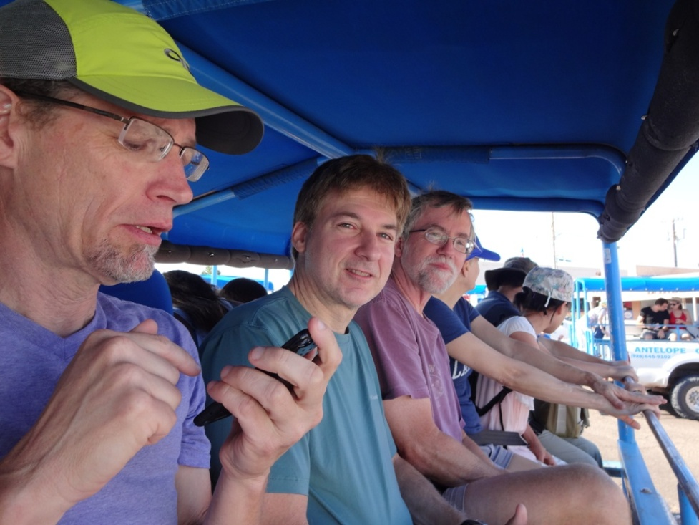
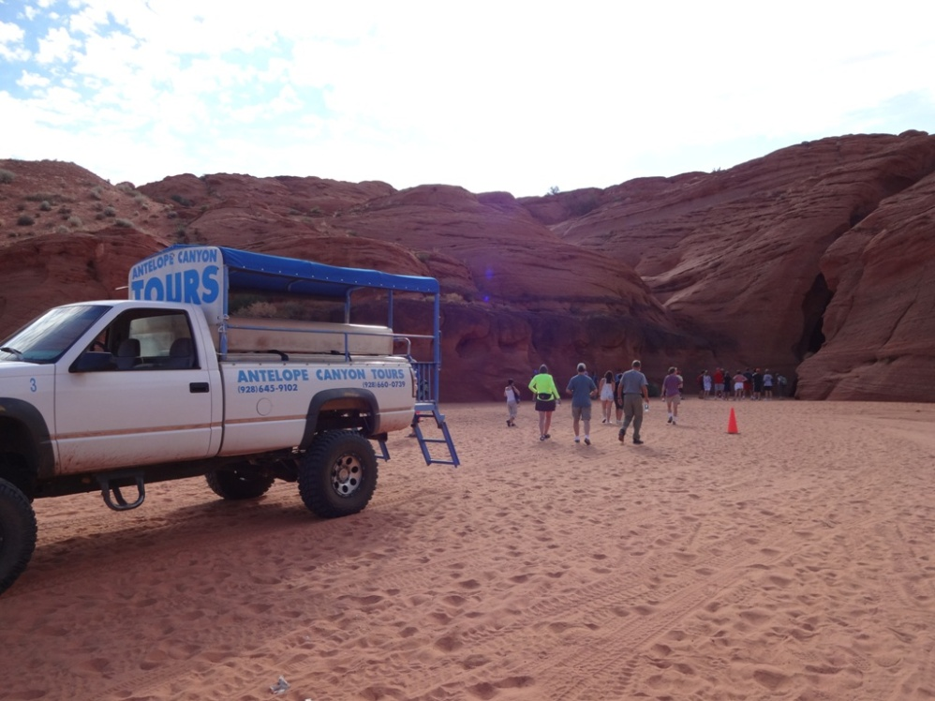
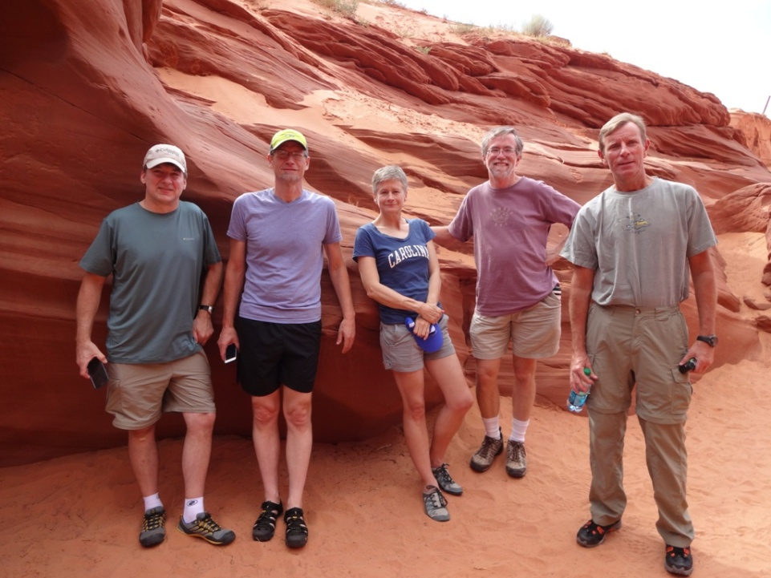
Day 0 (Page) – We took a tour of Lower Antelope Canyon. We had to be escorted to the slot canyon as it is on the Navajo reservation.

Slide 11
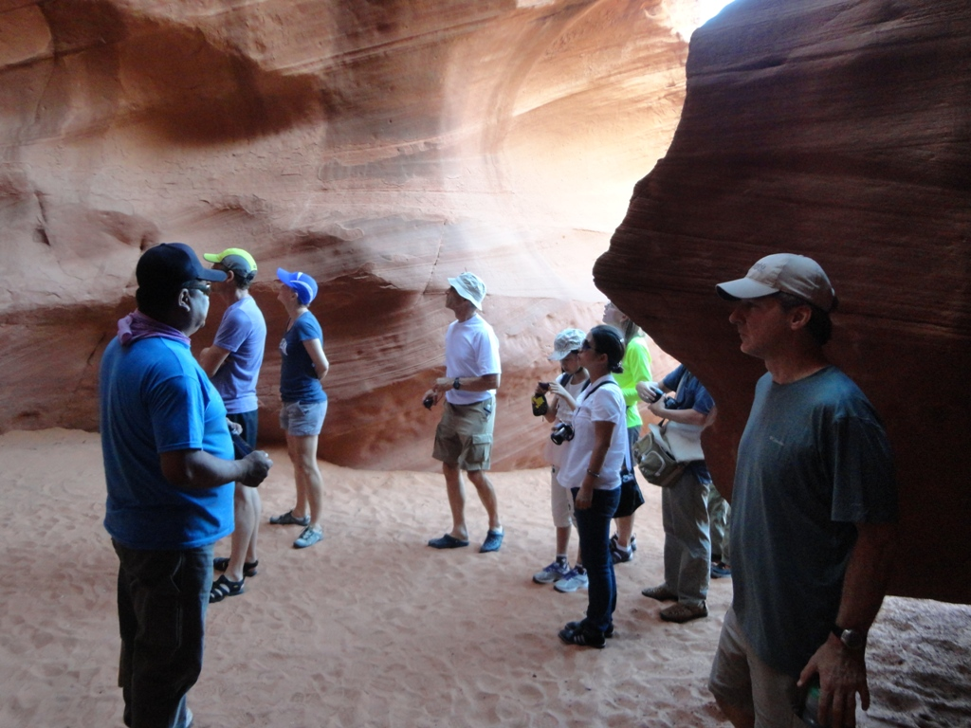
Day 0 (Page) – Inside the slot canyon

Slide 12
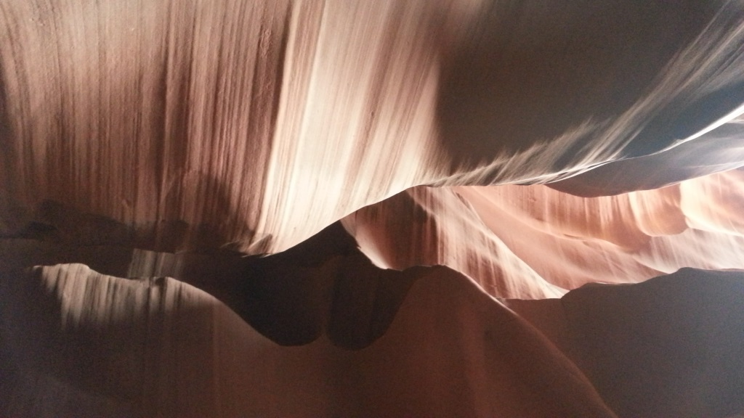
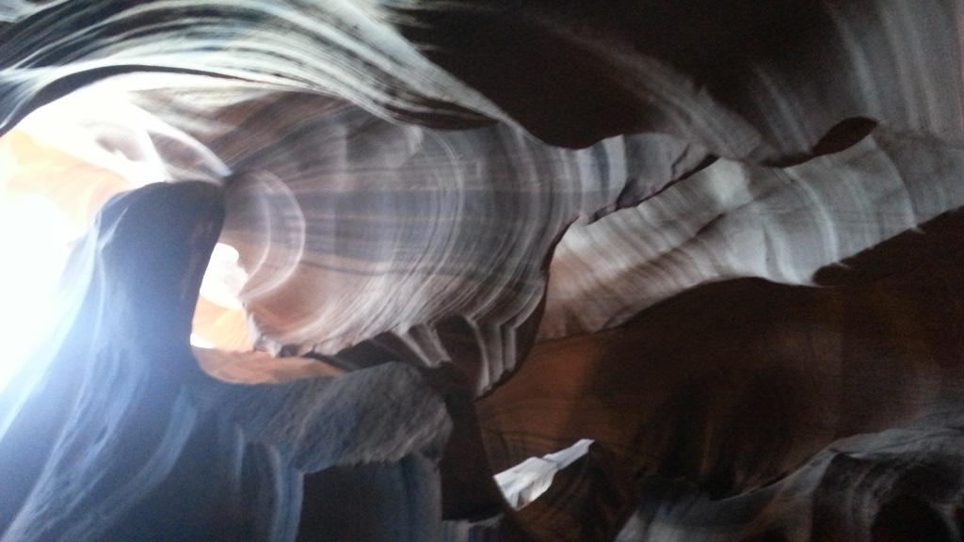
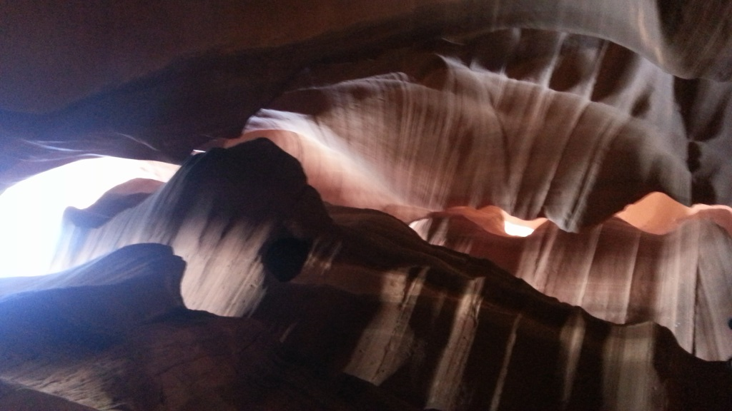
Day 0 (Page) – Inside the slot canyon

Slide 13
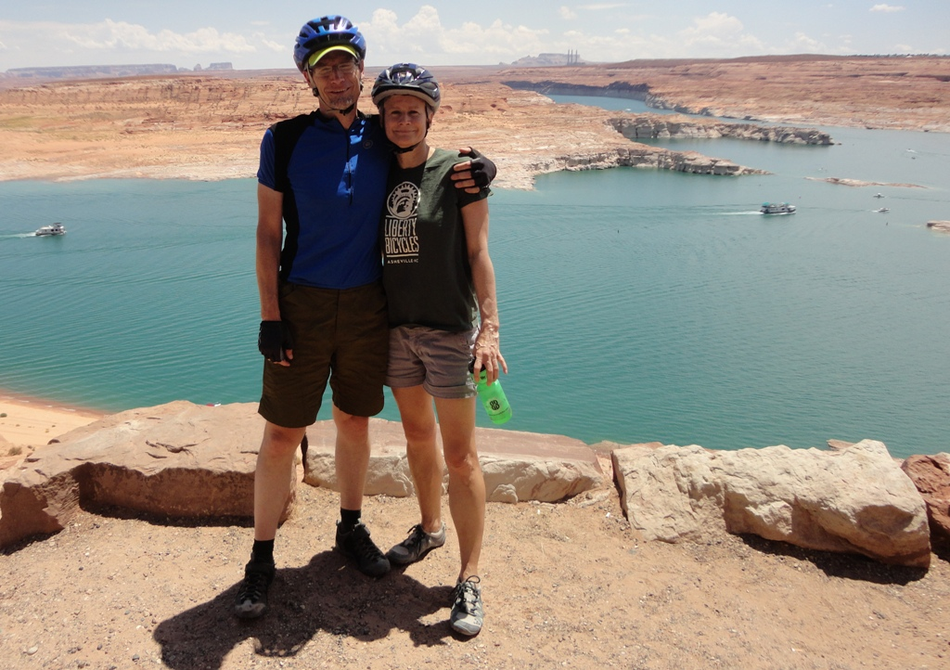
Day 0 (Page) – John & Beth with Lake Powell in the background

Slide 14
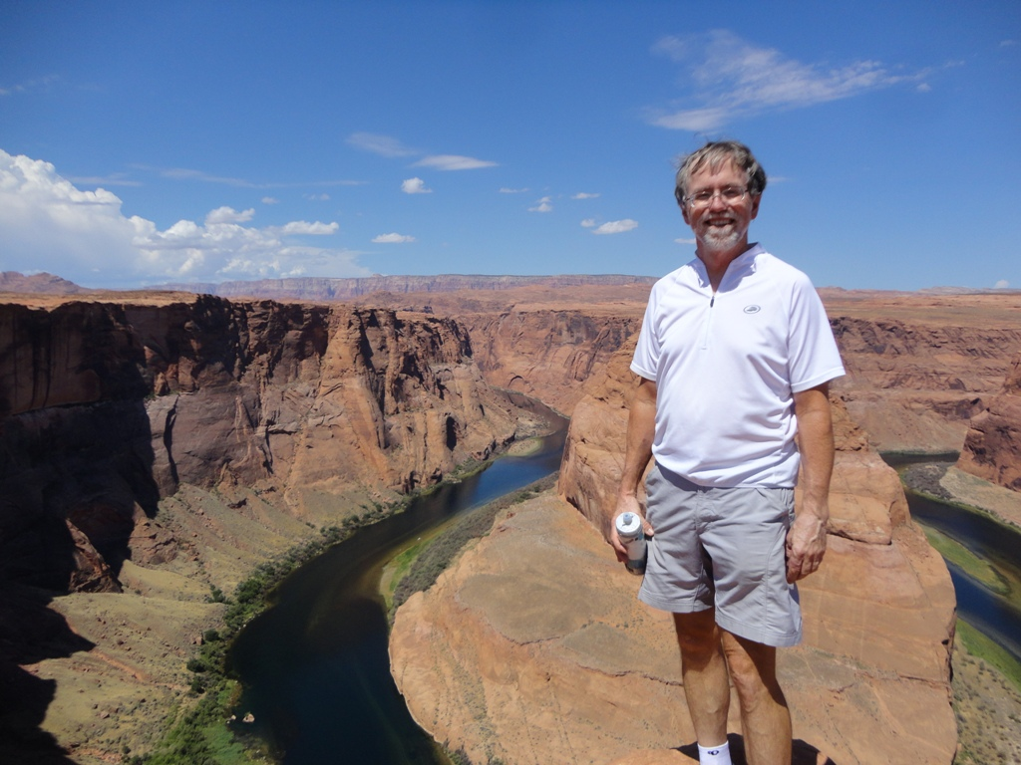
Day 0 (Page) – Paul at the Horseshoe Bend in the Colorado River near Page

Slide 15
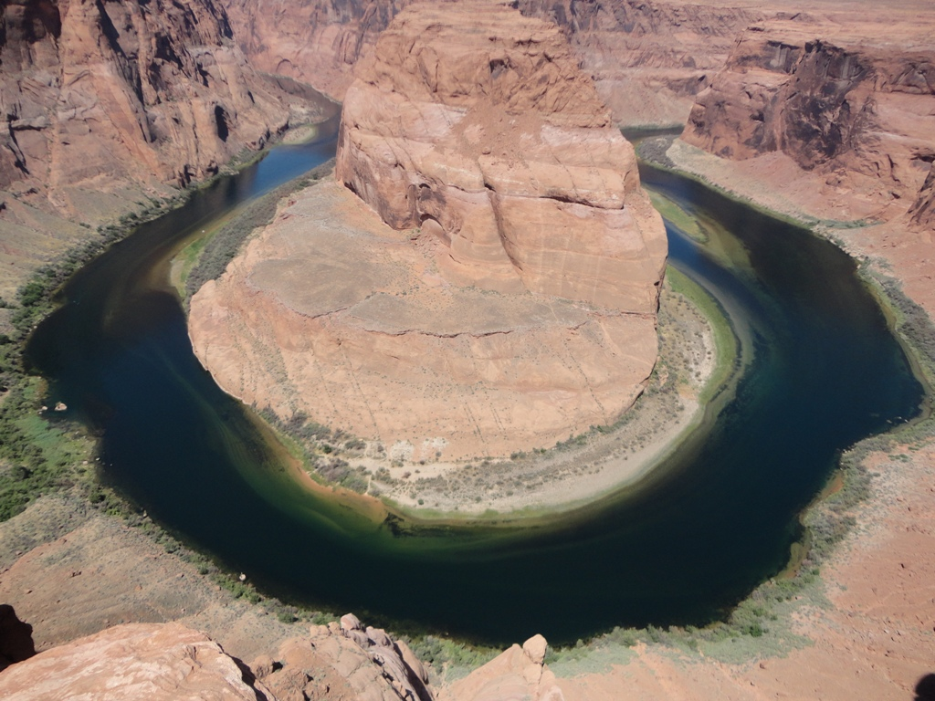
Day 0 (Page) – Horseshoe Bend on the Colorado River near Page, AZ

Slide 16
Day 1 (Page to Kanab) – It was a long hot ride to Kanab, but the scenery was amazing!

Slide 17
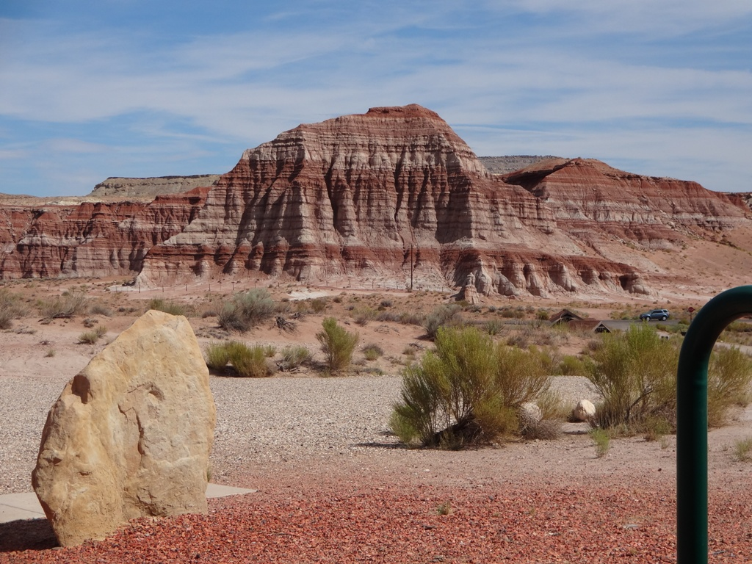
Day 1 (Page to Kanab) – Colorful rock formations were all around us

Slide 18
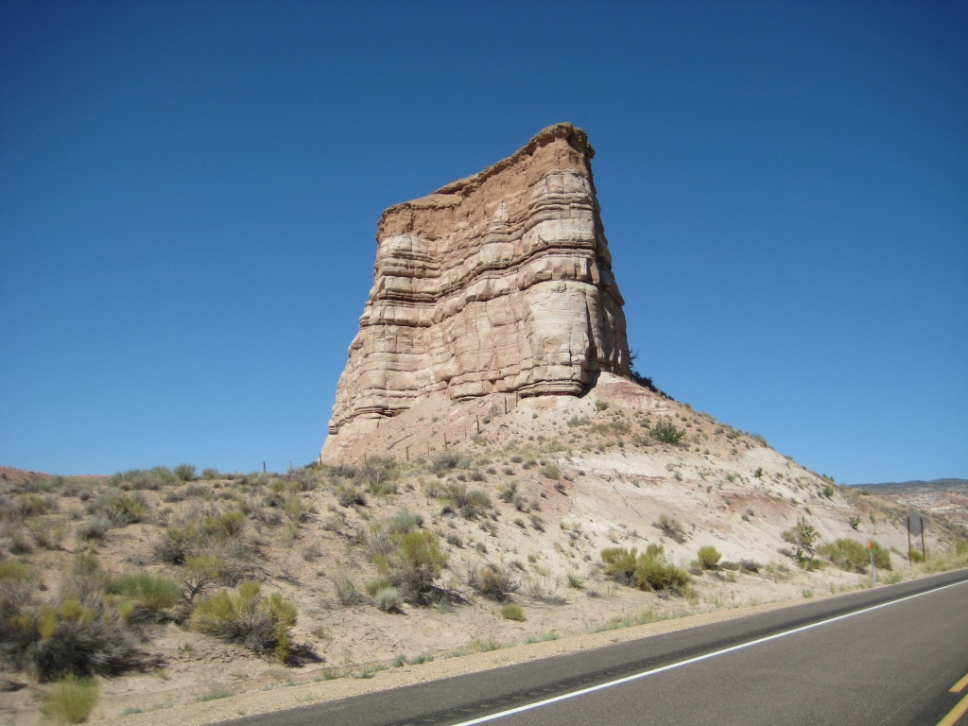

Slide 19
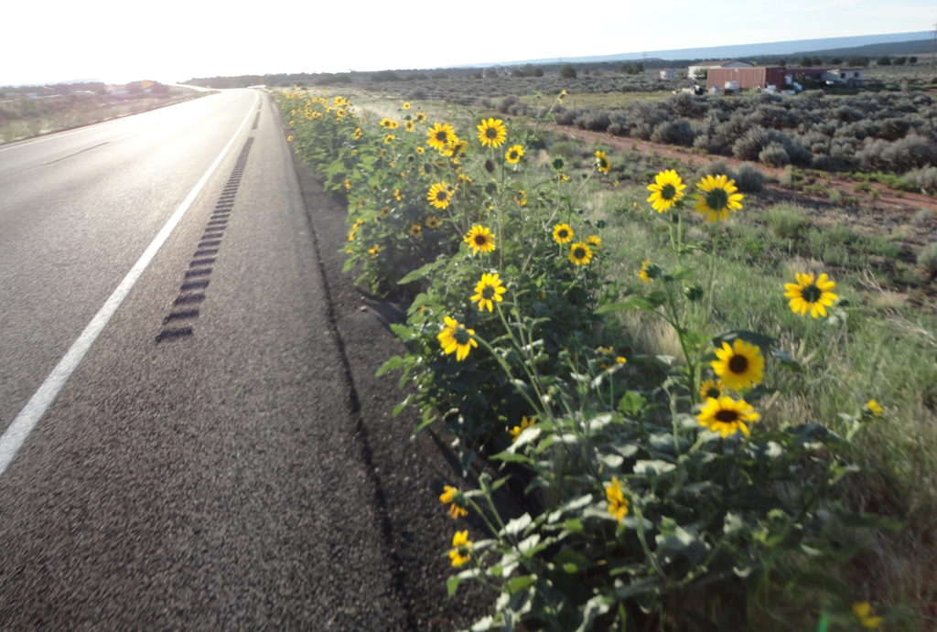
Day 1 (Page to Kanab) – Wild sunflowers were common along the road.
We were grateful for the nice shoulders on the roads.

Slide 20
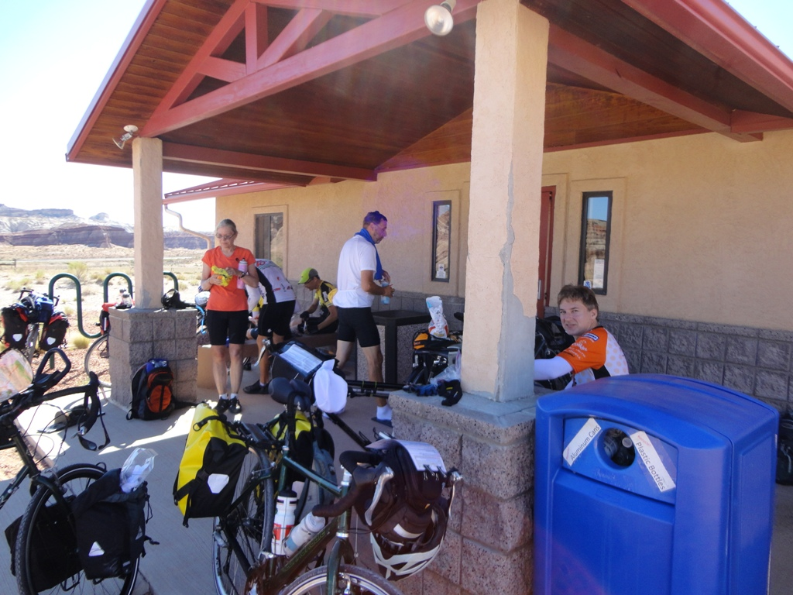
Day 1 (Page to Kanab) – We stopped for lunch at this BLM Office – it was the only place to get water for at least 50 miles as we crossed the desert-like area between Page and Kanab.

Slide 21
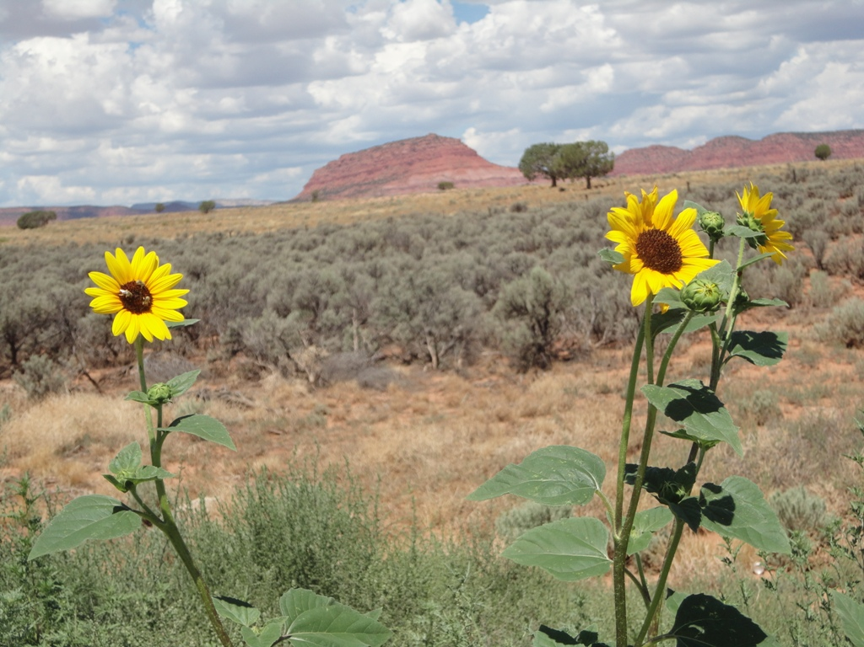
Day 1 (Page to Kanab) – Flowers were common in this hot, dry area.

Slide 22
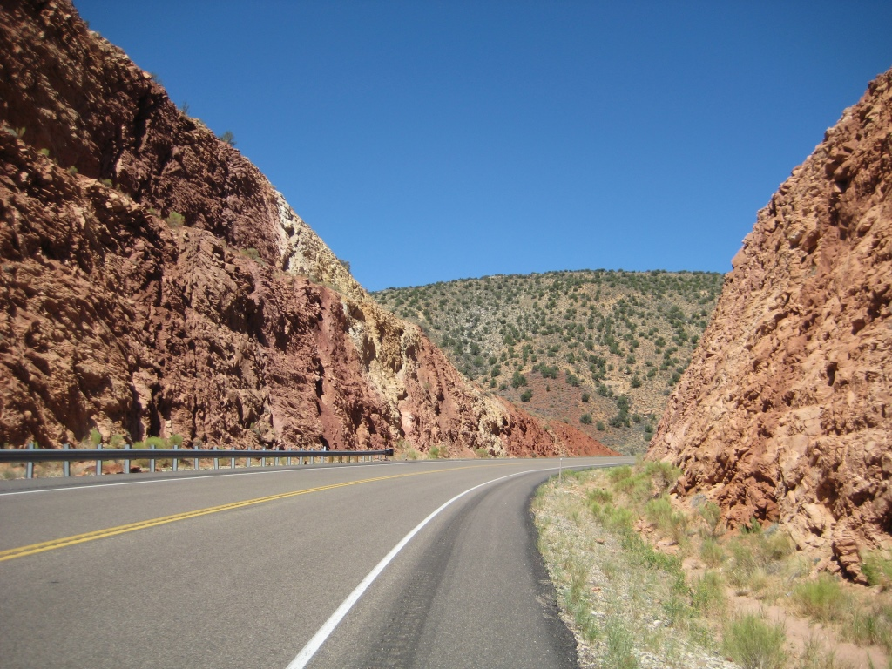
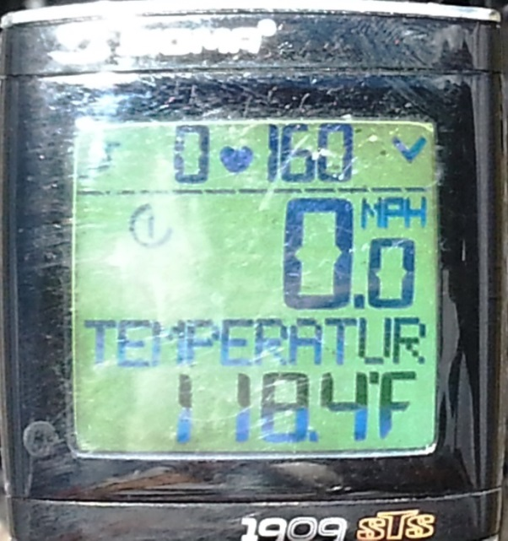
Day 1 (Page to Kanab) – It got a bit toasty out there crossing the desert! This was the temperature indication on Robert’s computer at one point. Ouch!

Slide 23
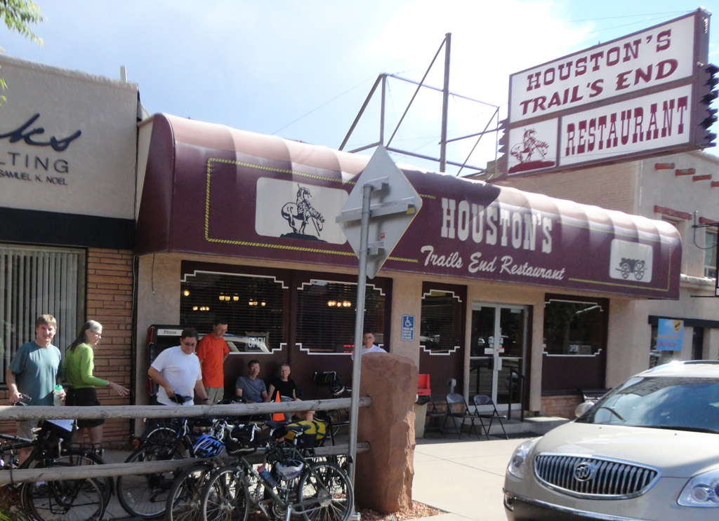
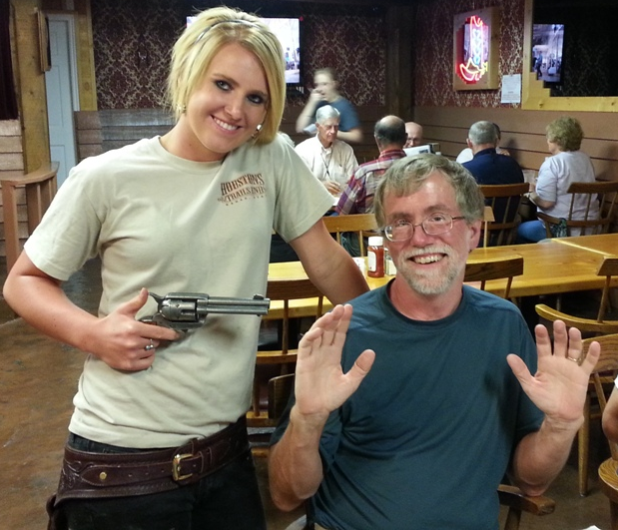
Day 1 (Page to Kanab) – Dinner in Kanab where the waitresses are armed!

Slide 24
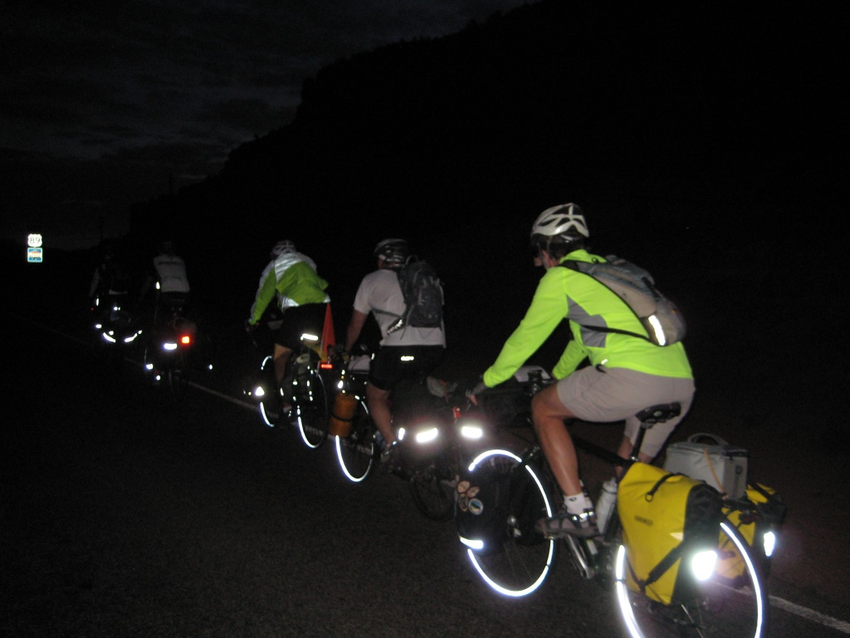
Day 2 (Kanab to Bryce Canyon) – We started early to beat the heat. Forgot about the DST time difference between AZ & UT, so we started out in the dark!

Slide 25
Day 2 (Kanab to Bryce Canyon) – Sandy cycles as the sun rises near Kanab. We started early to beat the heat.

Slide 26
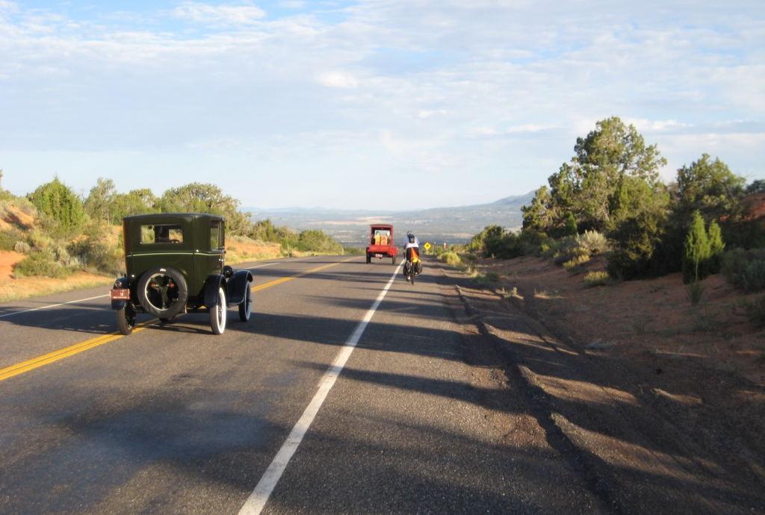
Day 2 (Kanab to Bryce Canyon) – Dennis keeps pace with some classics from yesteryear. We saw dozens of antiques cars along this stretch.

Slide 27
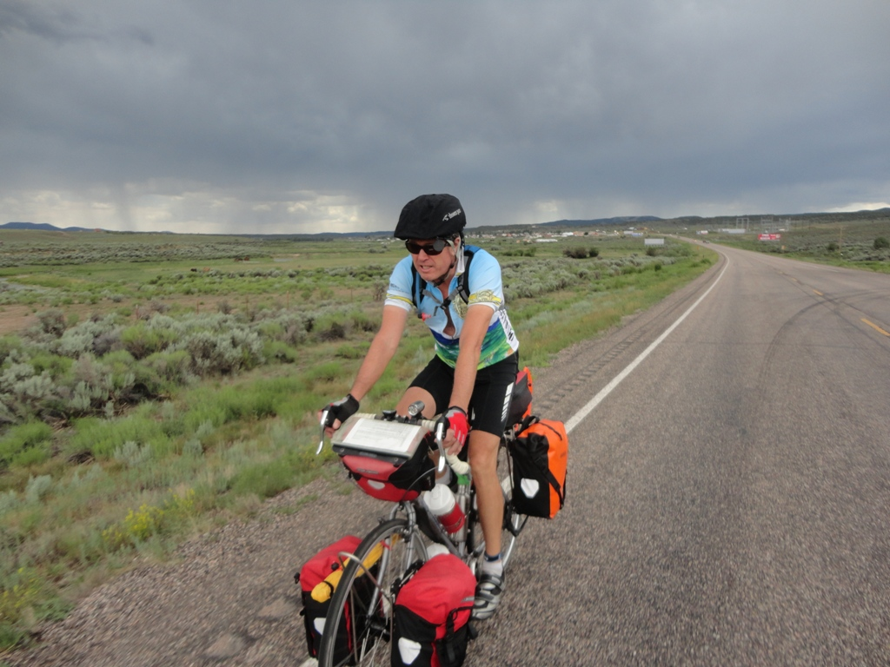
Day 2 (Kanab to Bryce Canyon) – Dennis tries to outrun the rain. July and August are the “monsoon season” out west and thunderstorms were common in the afternoons.

Slide 28
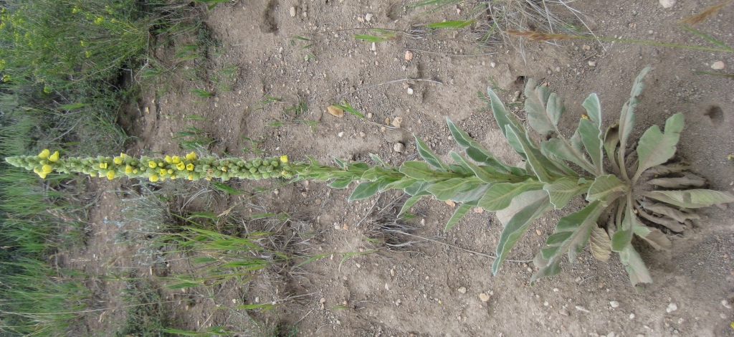
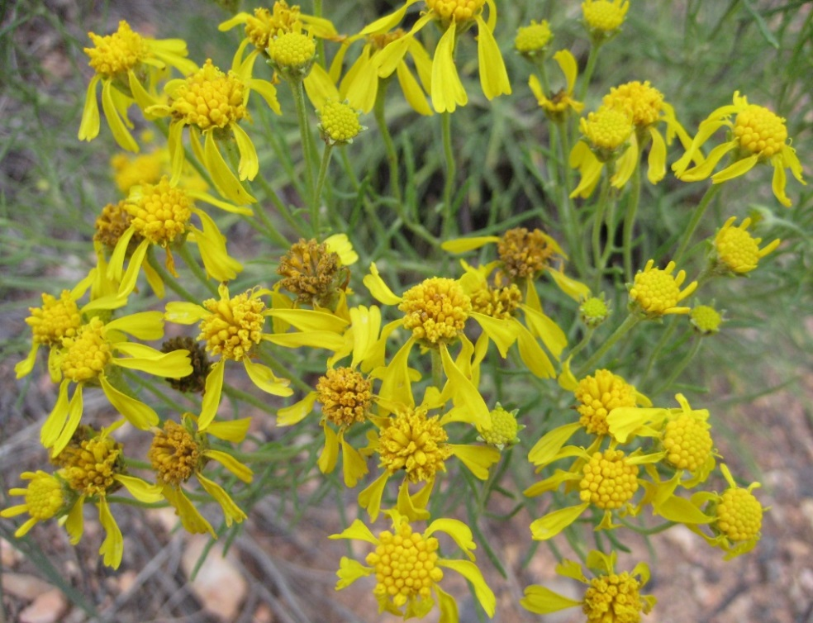
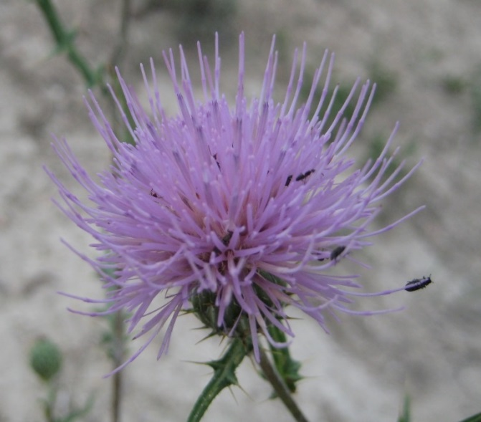
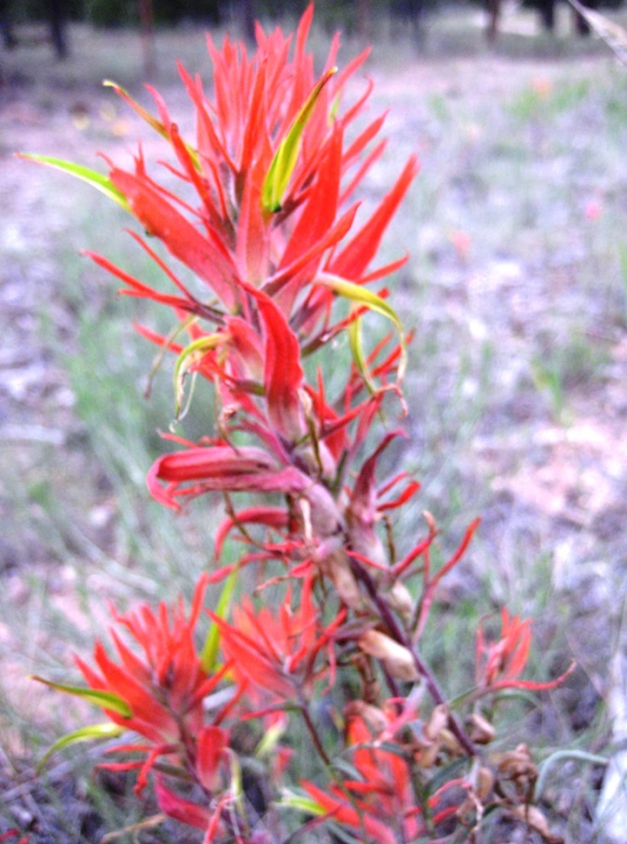
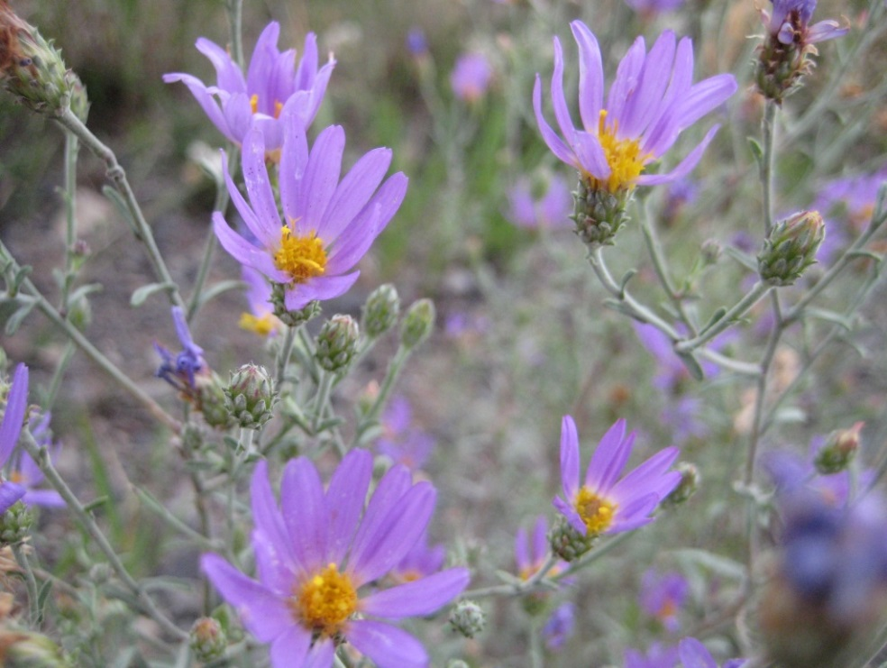
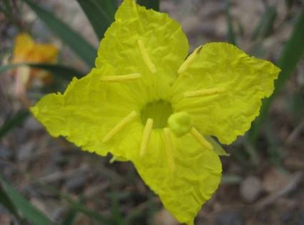
Day 2 (Kanab to Bryce Canyon) – Colorful flowering plants were plentiful on the way to Bryce Canyon.

Slide 29
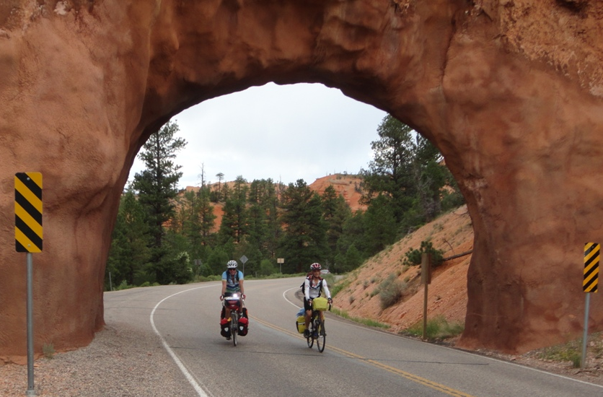
Day 2 (Kanab to Bryce Canyon) – Dennis and Dean cycle through a tunnel in Red Canyon on the way to Bryce Canyon.

Slide 30
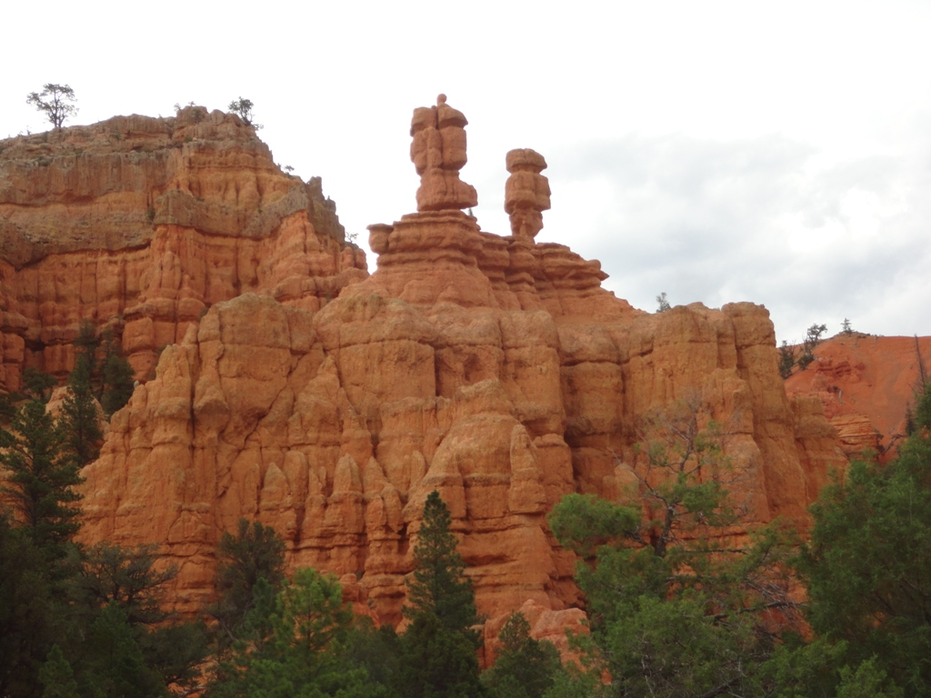
Day 2 (Kanab to Bryce Canyon) – Hoodoos in Red Canyon

Slide 31
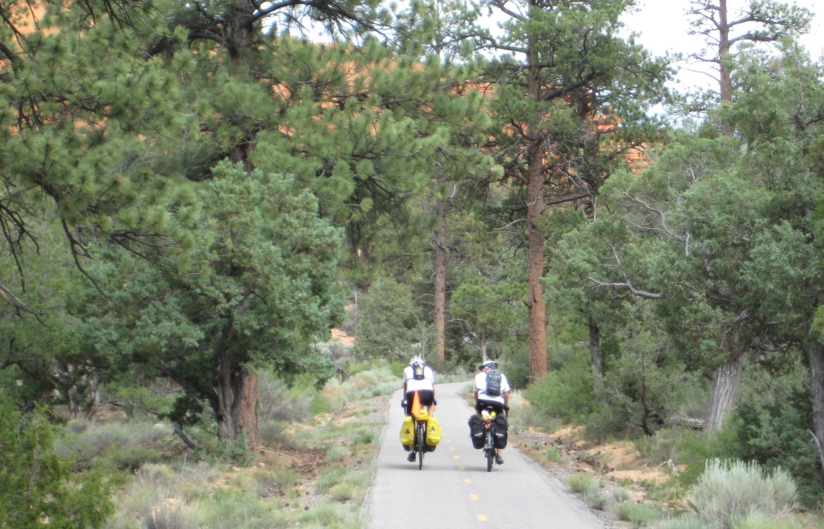
Day 2 (Kanab to Bryce Canyon) – Thom & Mike enjoying a scenic ride along the Red Canyon Trail (Robert too). This paved trail went on for ~8 miles, and was a welcome relief from riding with 65 mph traffic.

Slide 32
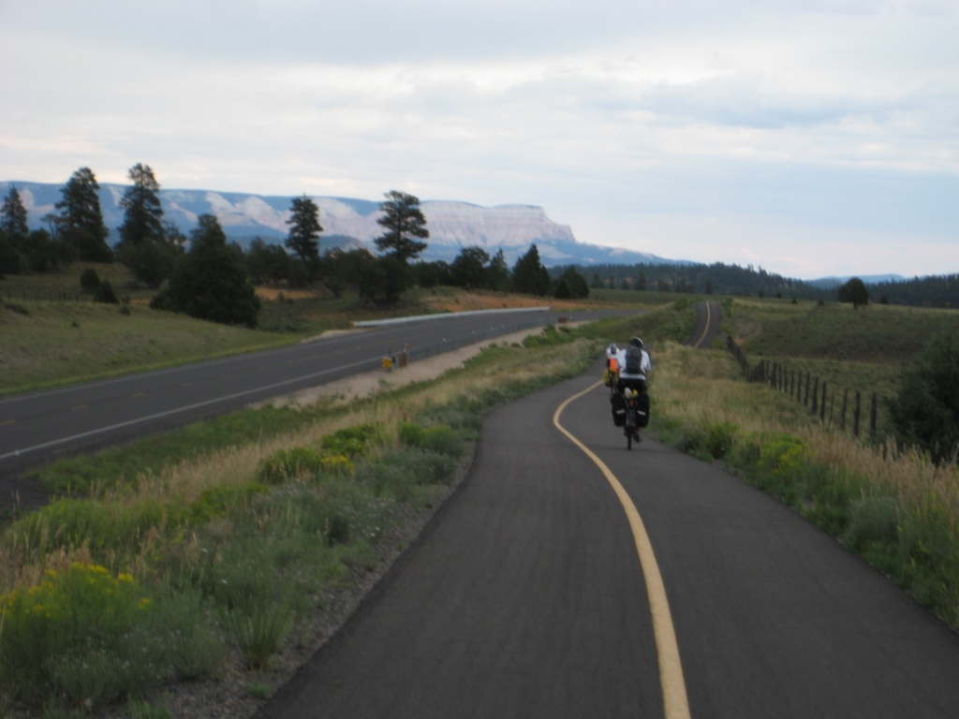
Day 2 (Kanab to Bryce Canyon) – Did I mention how awesome this trail was?

Slide 33
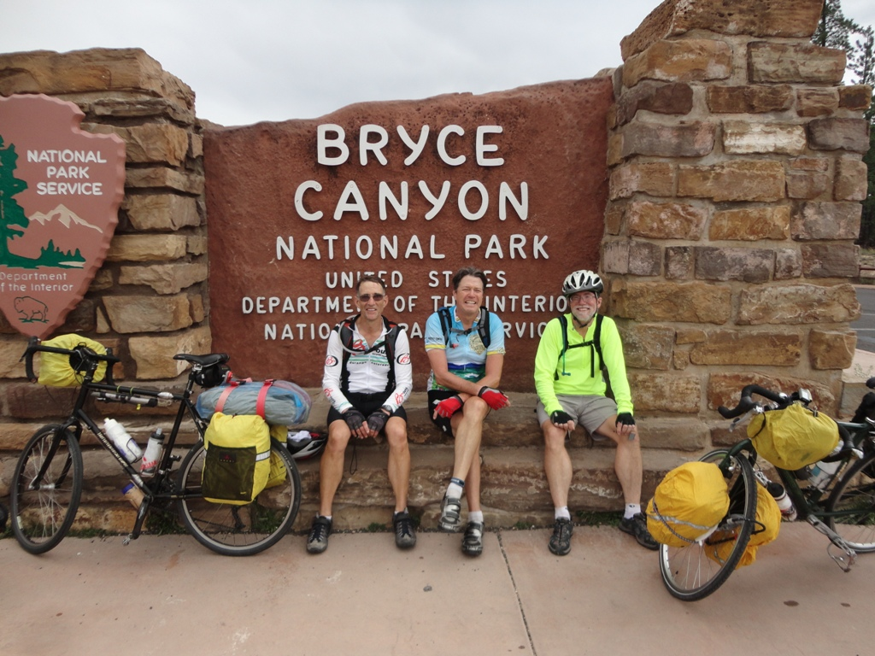
Day 2 (Kanab to Bryce Canyon) – Dean, Dennis, and Paul arrive at Bryce Canyon.

Slide 34
Day 2 (Kanab to Bryce Canyon) – Thom, Mike, and Robert arrive at Bryce Canyon (a bit later than Paul). ☺

Slide 35
Day 3 (Bryce Canyon) – We spent two nights in Bryce Canyon, so Day 3 was spent biking, hiking, and relaxing. We enjoyed the nice temperatures (lows in 50s/highs in 70s).

Slide 36
Day 3 (Bryce Canyon) – Paul and Dean hiked the renowned Navajo Trail which went from the rim down into the canyon and back up to the rim.

Slide 37
Day 3 (Bryce Canyon) – Bryce Canyon has many amphitheaters along the 20-mile road through the park.

Slide 38
Day 3 (Bryce Canyon) – The amphitheaters views in Bryce Canyon are absolutely breathtaking!

Slide 39
Day 3 (Bryce Canyon) – More amphitheater views.

Slide 40
Day 3 (Bryce Canyon) – Some folks elected to spend this “Rest Day” actually getting a bit of much needed rest. Doesn’t Thom look cozy?

Slide 41
Day 4 (Bryce Canyon to Cedar Breaks) – We left Bryce Canyon and cycled along the Red Canyon Bike Trail. We were enchanted by the views in the morning fog.

Slide 42
Day 4 (Bryce Canyon to Cedar Breaks) – Cycling through Red Canyon in the morning with temperatures in the 50s.

Slide 43
Day 4 (Bryce Canyon to Cedar Breaks) – We began a 30-mile, 4000 ft climb to Cedar Breaks National Monument (10,600 ft). Cedar Breaks gets 500 inches of snow annually and is often inaccessible due to snow until June 1. Today is was 50 degrees and raining!

Slide 44
Day 4 (Bryce Canyon to Cedar Breaks) – Signs like these were common along some parts of our route.

Slide 45
Day 4 (Bryce Canyon to Cedar Breaks) – A nice view of Panguitch Lake on the way up. We had lunch at a cozy restaurant overlooking this lake.

Slide 46
Day 4 (Bryce Canyon to Cedar Breaks) – A cold, wet, and long, difficult climb to over 10,000 ft. What you see on the right here is lava beds.

Slide 47
Day 4 (Bryce Canyon to Cedar Breaks) – The air was getting thin as Paul reached the summit!

Slide 48
Day 4 (Bryce Canyon to Cedar Breaks)
Cedar Breaks National Monument – a seemingly endless amphitheater

Slide 49
Day 4 (Bryce Canyon to Cedar Breaks) – The rain eventually subsided (or else we cycled above the clouds!) and we were rewarded with some spectacular views.

Slide 50
Day 4 (Bryce Canyon to Cedar Breaks) – More amazing views!

Slide 51
Day 4 (Bryce Canyon to Cedar Breaks) – Paul has a “supreme” view from his tent at Point Supreme Campground.

Slide 52
Day 4 (Bryce Canyon to Cedar Breaks) – The view from Robert’s tent at Point Supreme Campground wasn’t too shabby either!

Slide 53
Day 5 (Cedar Breaks to Zion) – It was only 46 degrees as we began our downhill journey from Cedar Breaks (10,600 ft) to Zion National Park (3700 ft). We would soon be shedding clothes as the temperature would be over 100 degrees in Zion!

Slide 54
Day 5 (Cedar Breaks to Zion) – A view of Navajo Lake, which we encountered on our descent. This lake was formed by a natural lava dam.

Slide 55
Day 5 (Cedar Breaks to Zion) – A really cool mural painted on the Subway restaurant where we had lunch in Mt. Carmel Junction, UT. Clever way to disguise the utilities, eh?

Slide 56
Day 5 (Cedar Breaks to Zion) – Apparently Fred Flintstone frequents these parts.

Slide 57
Day 5 (Cedar Breaks to Zion) – Bison along the road the Zion National Park

Slide 58
Day 5 (Cedar Breaks to Zion) – We had to be shuttled though the Zion Tunnel.

Slide 59
Day 5 (Cedar Breaks to Zion) – Ten cyclists & ten loaded touring bikes being shuttled through the Zion Tunnel (cycling through the tunnel is prohibited).

Slide 60
Day 5 (Cedar Breaks to Zion) – We were dropped off after going through the Zion Tunnel. We were about to begin a 3-mile, 3000-ft descent of amazing switchbacks leading into Zion. This was the most spectacular descent of the trip.

Slide 61
Day 5 (Cedar Breaks to Zion) – Paul pauses during the descent into Zion

Slide 62
Day 5 (Cedar Breaks to Zion) – Robert took an amazing video of our descent into Zion with his GoPro camera mounted on his helmet.

Slide 63
Day 5 (Cedar Breaks to Zion) – The descent into Zion

Slide 64
Day 5 (Cedar Breaks to Zion) – Cycling through Zion was unbelievable!

Slide 65
Day 5 (Cedar Breaks to Zion) – What a campsite in Zion National Park!

Slide 66
Day 5 (Cedar Breaks to Zion) – Robert & Paul went for a ride along Scenic Drive through Zion National Park, and were treated to some of the most awe-inspiring views like this.

Slide 67
Day 6 (Zion to Jacob Lake) – We crossed a hot, barren stretch between Fredonia and Jacob Lake. Here we found a bush for some relief from the 100+ degree temps.

Slide 68
Day 7 (Jacob Lake to Grand Canyon) – The 44 miles from Jacob Lake to the northern rim of the Grand Canyon is rightly called “the most beautiful 44 miles in Arizona”

Slide 69
Day 7 (Jacob Lake to Grand Canyon) – This signed let us know that the smoke in the distance was part of a controlled fire.

Slide 71
Day 7 (Jacob Lake to Grand Canyon) – Paul & Robert’s campsite at the northern rim in a grove of young Aspen trees. We were about 100 ft from the rim!

Slide 72
Day 7 (Jacob Lake to Grand Canyon) – Paul took a hike along the rim of the canyon near to our campsite.

Slide 73
Day 7 (Jacob Lake to Grand Canyon) – Daryl and Sandy’s tires and air mattresses finally caught up with us – 7 days after they should have arrived in Page!

Slide 74
Day 8 (Grand Canyon) – An incredible storm works its way down the Grand Canyon toward us at the lodge at Bright Angel Point.

Slide 75
Day 8 (Grand Canyon) – The visitor center at the northern rim had outdoor ice machines and spring water for hikers (and cyclists)!

Slide 76
Day 8 (Grand Canyon) – We spent two nights at the northern rim. We spent Day 8 cycling, hiking, and relaxing. Some of us cycled to Point Imperial, which was well worth the trip.

Slide 77
Day 9 (Grand Canyon to Kanab) – We had an amazing downhill section from Jacob Lake before the crossing the desert-like area on the way to Fredonia (computer reads 43.5 mph)

Slide 78
Day 9 (Grand Canyon to Kanab) – So nice to exit the desert and arrive in Fredonia, AZ. Just a few more miles to Kanab, UT where a motel awaits. No more camping!

Slide 79
Day 10 (Kanab to Page) – Paul changes a flat on the hot, dry stretch between Kanab and Page. We had very few flats or mechanical problems.

Slide 80
Day 10 (Kanab to Page)
Almost there! Robert celebrates as we hit the AZ line – only about 10 miles left to the end of the trip

Slide 82
We were treated to this beautiful sunrise moments before we boarded our plane at the Page, AZ airport to begin our journey home.

