Slide 1
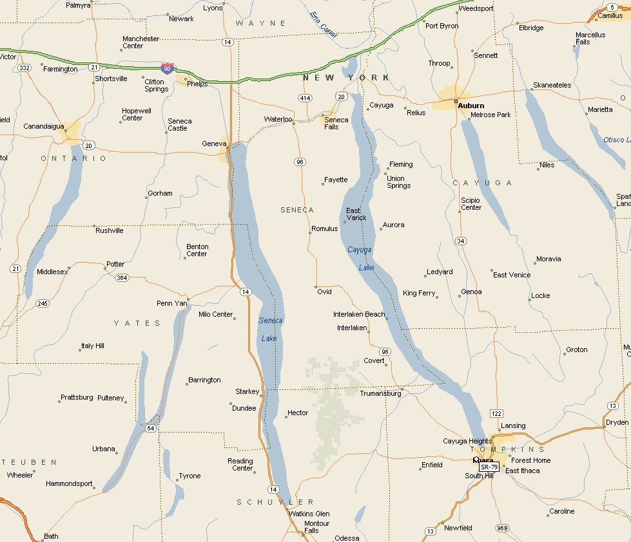
Finger Lakes Tour
August 2-11, 2016
Join us for an amazing tour in the beautiful Finger Lakes region of New York. The trip will include:
Countless beautiful shorelines
Dozens of impressive waterfalls
Rails-to-trails
Waterfront boat tours
Charming villages
Visitor centers and museums
Hikes in parks and gorges
Much more!
Skaneateles
Lake
Owasco
Lake
Canandigua
Lake
Seneca
Lake
Cayuga
Lake
10 days, 600+ miles
Circle 6 of the Finger Lakes
Ride the Old Erie Canal rail trail
Camp in beautiful state parks, sometimes for multiple days, allowing us to ride:
5 days loaded
5 days unloaded
Keuka
Lake

Slide 2
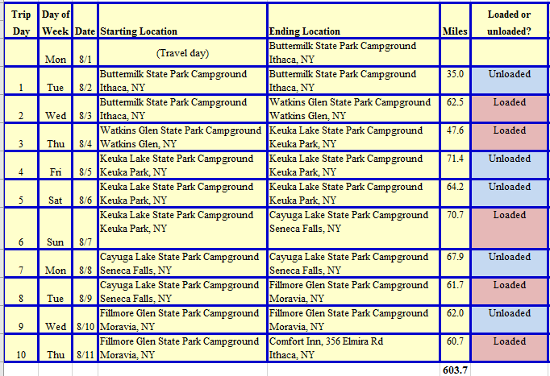
Mileage may change slightly as more details are added (restaurants, laundry, places to visit). Detailed cue sheets and elevation profiles will be developed in July.

Slide 3
2016 Finger Lakes Tour
Note that
loaded rides are in red
unloaded rides are in green
Day 7
C
- campground
C
Skaneateles
Lake
Owasco
Lake
The route for Day 1 is only a rough estimate and depends on which sites we visit in Ithaca
Canandigua
Lake
Day 10
Day 9
Day 6
Day 6
Seneca
Lake
C
Cayuga
Lake
Day 4
Day 2
Day 8
C
Keuka
Lake
Day 10
Day 3
Day 5
C
Day 1
C

Slide 4
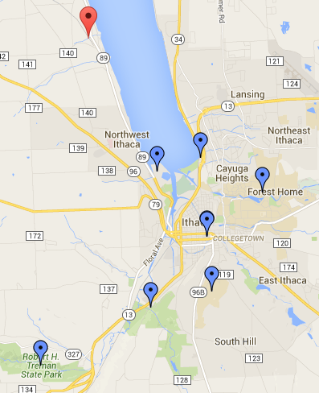
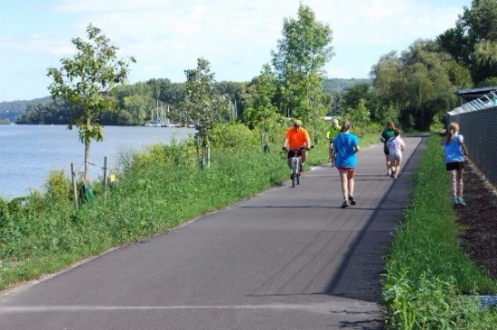
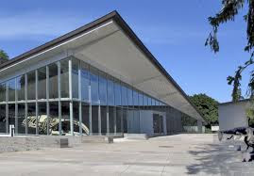
Day 1 (Tue, Aug 2) – Cycle to local sites in the village of Ithaca, NY
Buttermilk Falls State Park Campground and back - 35 miles?
Unloaded ride
Cayuga Nature Center
Day 1 will be a warmup day where we can ride unloaded and visit the many sites around beautiful Ithaca, NY. I haven’t put together an exact route yet, but will do so soon. The route may be more of a list of directions to various sites and we can pick and choose which ones we want to visit.
I will camp at Buttermilk Falls State Park, but some others might choose to stay in a hotel until we leave Ithaca on Day 2 (there is a Quality Inn 0.8 miles from the park on Elmira Rd). In either case we can join up in the morning to do some exploring.
Here are a few places to visit or things to do:
Enjoy downtown Ithaca
Cycle the Cayuga Waterfront Trail
Forest Falls on Fall Creek is a 25ft cascading fall with birds-eye view of a “hanging valley."
Explore Ithaca Falls on Falls Creek in Ithaca (listed as closed until October 2016 for construction)
Explore Buttermilk Falls in Buttermilk State Park
Explore Lucifer Falls and some amazing gorges in Robert H. Treman State Park
Denison Falls at the Cayuga Nature Center is a beautiful 21ft cascading fall. $3/adults
Explore Cornell University
Triphammer Falls is a 55ft multiple cascading fall, a centerpiece of the Cornell campus.
View falls from the Triphammer Foot Bridge or East Ave. bridge. Easy trail to walk.
Picturesque Cascadilla Falls is a 20ft multiple cascading fall, the first on a popular gorge trail that connects Cornell University to downtown from College Ave. to Court St.
Cayuga Nature Center
Johnson Museum of Art
Museum of the Earth
Sciencenter
Cornell University
Alan H. Treman State Park
Ithaca Visitor Centers
Robert H. Treman State Park
Buttermilk Falls State Park
Ithaca College
The Museum of the Earth is a natural history museum located in Ithaca, New York. The museum was created in 2003 as part of the Paleontological Research Institution, which studies the history of the Earth and its life. Wikipedia
Address: 1259 Trumansburg Rd, Ithaca, NY
The 5.5 mile Cayuga Waterfront Trail is now complete! The last section, linking Cass Park to the Farmers Market was completed in 2015.

Slide 5
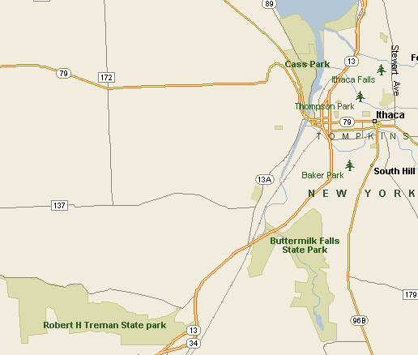
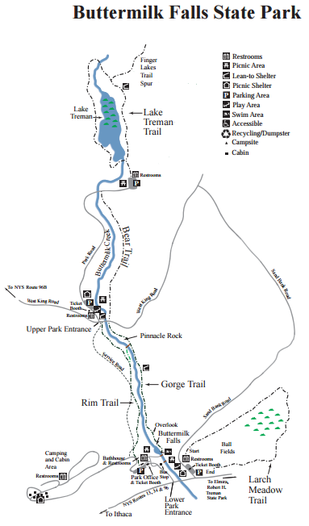
Day 1 (continued)
There are two great state parks with great hiking and falls near Ithaca:
- Buttermilk Falls State Park
- Robert H. Treman State Park
Quality Inn
356 Elmira Rd, Ithaca, NY
0.8 miles from Buttermilk State Park
PG will stay here at the end of the ride
Robert H Treman State Park

Slide 6
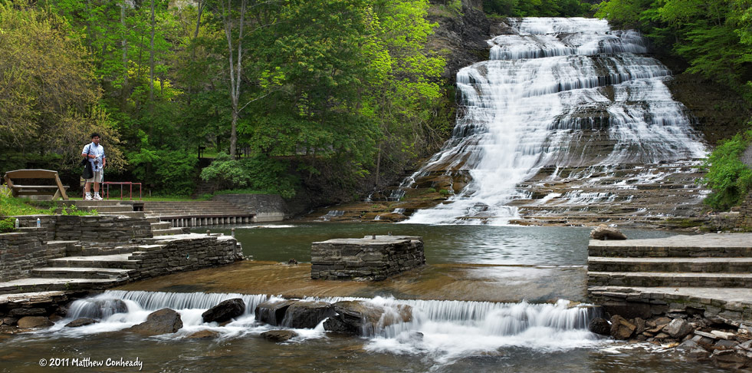
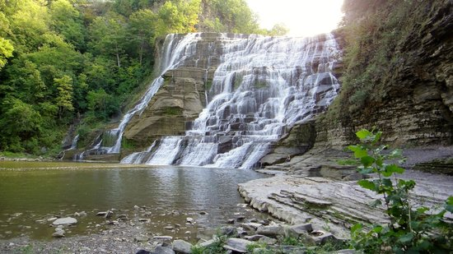
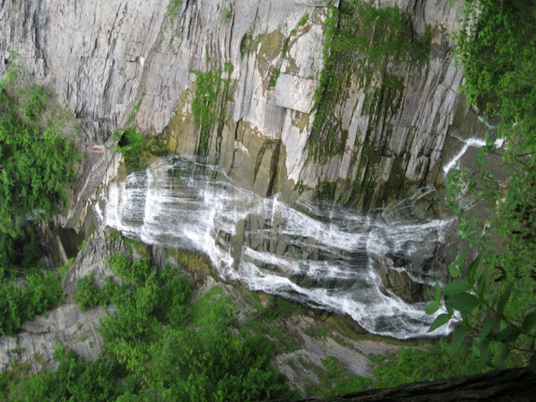
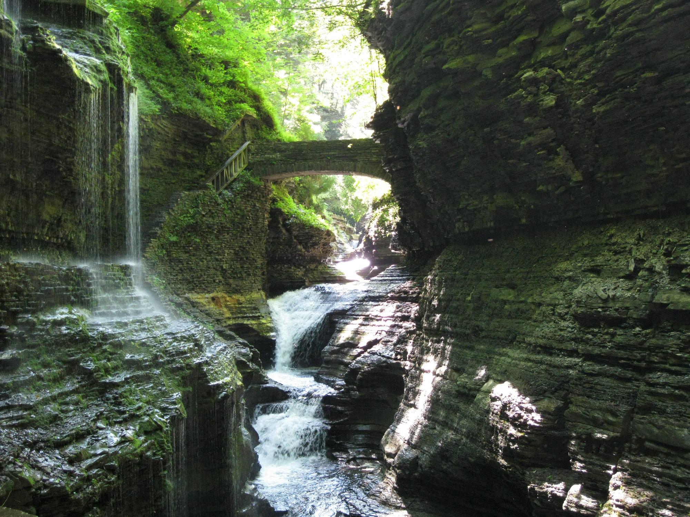
Day 1 (continued)
Ithaca Falls - Ithaca, NY To see this impressive and powerful cascade take Route 34 South (Lake Street) in Ithaca. You will pass Ithaca High School on the right and then cross a small bridge with Ithaca Falls on the left side. Across from the bridge, at the corner of Lake Street and Falls Street, there is a small gravel lot in which you can park. The path on the right side of the falls leads down into the gorge. You can walk right to the base of the falls or even fish in parts of the plunge pool. For a scenic tour, follow Fall Creek Gorge as it leads to Ithaca Falls!
Lucifer Falls - Ithaca, NY Lucifer Falls are located in the Robert H. Treman State Park in Ithaca. If you enter from the lower entrance you can hike the gorge trail to reach the falls. If you enter from the upper entrance you only have a short walk until you reach this impressive cascade. All together there are twelve falls within the park.
Buttermilk Falls State Park in Ithaca features 10 waterfalls in total, with Buttermilk Falls being the main attraction. The park also offers a beach, cabins, fishing, hiking, deer bow-hunting, nature trails, pavilions, a playground, playing fields, recreation programs, and a campground with tent and trailer sites
Robert H. Treman State Park

Slide 7
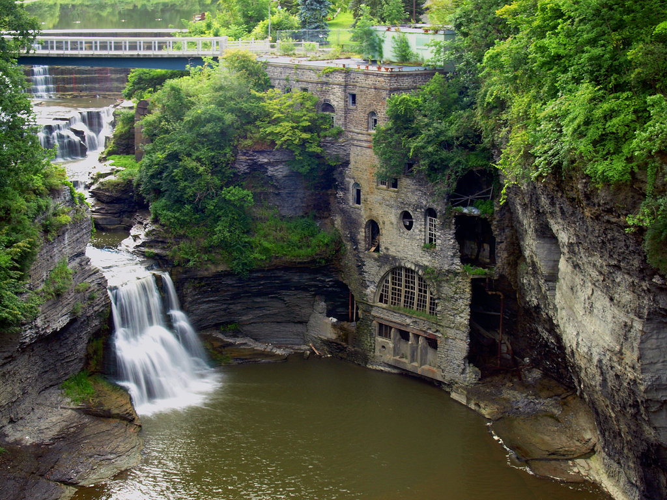
Day 1 (continued)
Wow! Check out these gorges and falls in the middle of the Cornell University campus.
Triphammer Falls on Cornell campus

Slide 8
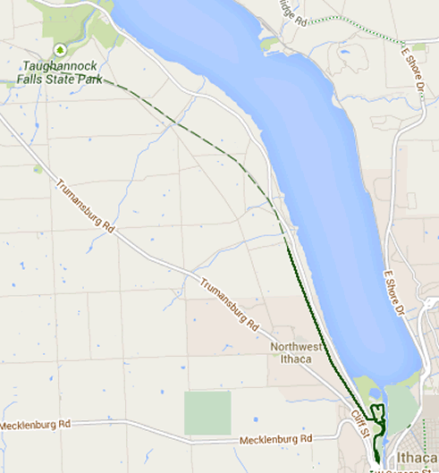
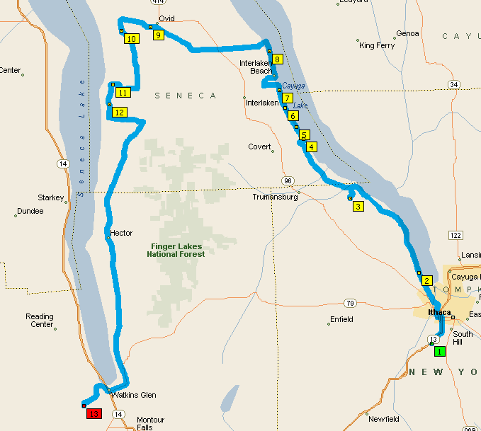
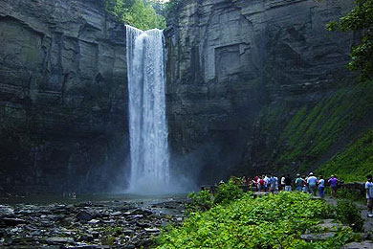
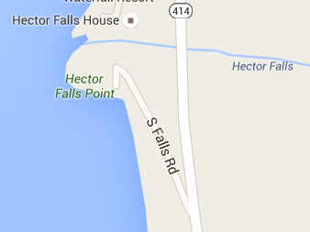
Day 2 (Wed, Aug 3) – Cycle along Cayuga Lake and Seneca Lake
Buttermilk Falls State Park Campground to Watkins Glen State Park Campground – 62.5 miles
Loaded Ride
We will leave Buttermilk Falls State Park and cycle up the western shore of Cayuga Lake. Cayuga Lake is the longest of the Finger Lakes (40 miles long with an average width of 1.7 miles and a max depth of 435 ft).
We will stop at Taughannock State Park and hike (1 mile) to the Taughannock Falls, a 215-ft plunge waterfall that is the highest-single drop waterfall east of the Rocky Mountains. We will continue along the lake to Interlaken Beach where we may stop at O’Malley’s Cabin On The Lake for lunch (opens 11:30am). We turn west and cycle through Ovid, NY on our way to Seneca Lake. Seneca is the largest and deepest of the Finger Lakes (38 miles long with an average depth of 291 ft and a max depth of 618 ft). We will cycle south along the shore of Seneca Lake and may pass through some of the Finger Lakes National Forest. We will stop and view Hector Falls and perhaps explore the falls and creek where they pass under the highway.
We will continue south along Seneca Lake to the village of Watkins Glenn. We will camp at Watkins Glen State Park Campground. We should arrive in time to explore and enjoy this popular and beautiful village. If time allows, we can take a 50-minute sightseeing cruise from the Watkins Glen waterfront. Watkins Glen State Park is also renowned for its beautiful waterfalls. We can see them after setting up camp or the next morning.
Black Diamond Rail Trail
In the morning we also have the option of taking this 8-mile rail trail from Cass Park in Watkins Glenn to Taughannock State Park instead of using the busy highway. However, work on the trail is scheduled to be completed in late summer, so we will have to wait and see.
Taughannock Falls
Hector Falls

Slide 9
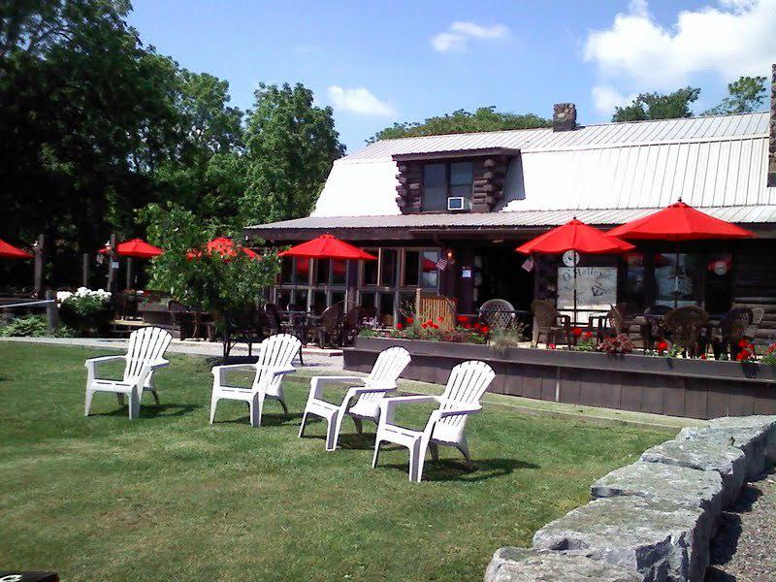
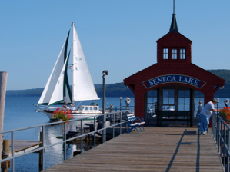
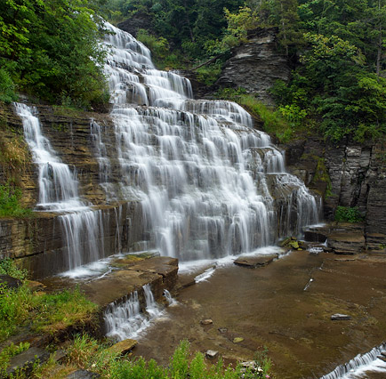
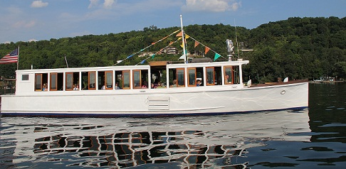
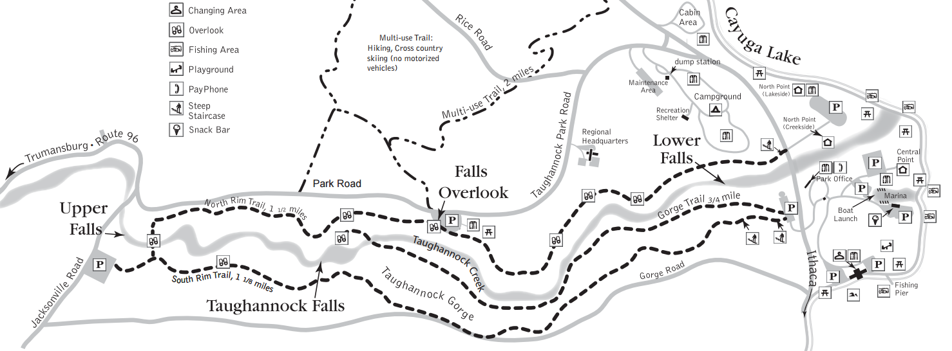
Day 2 (continued)
Visit the iconic pier house in Seneca Harbor Park
Hector Falls
Hector Falls - You can either view the falls roadside from the bridge or take a quick walk down to the left under the bridge to view the falls or take pictures from the creekbed.
Lunch along Cayuga Lake
Taughannock Falls
Captain Bill’s Sightseeing Cruise
Explore Seneca Lake aboard the vintage motor vessel Stroller IV, christened in 1934. Once aboard the Stroller IV, our Captain and 1st mate will take you back with a historical narration and show you the sights.
Discover the beauty and charm of Seneca Lake as it can only be seen from the water. You will be captivated by Hector Falls at 165 ft., the majestic cliffs of the east shore with Native American paintings, and a view of the salt industry. The sights and sounds of this ageless body of water invite you aboard our one hour cruise, a tradition since 1908.
No reservation needed.
50-minute cruise, starts on the hour, 10am – 8pm
Cost: $17.00

Slide 10
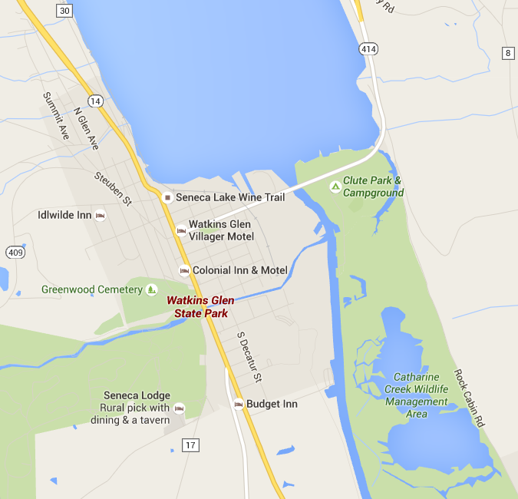
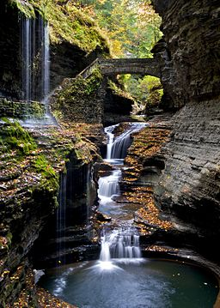
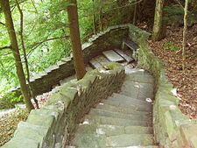
Day 2 (continued)
Watkins Glen State Park
Jacob's Ladder, near the upper entrance to the park, has 180 stone steps, part of the 832 total on the trails - Watkins Glen State Park
https://en.wikipedia.org/wiki/Watkins_Glen_State_Park
Watkins Glen State Park is the most famous of the Finger Lakes State Parks, with a reputation for leaving visitors spellbound. Within two miles, the glen's stream descends 400 feet past 200-foot cliffs, generating 19 waterfalls along its course. The gorge path winds over and under waterfalls and through the spray of Cavern Cascade. Rim trails overlook the gorge. Campers and day-visitors can enjoy the Olympic-size pool, scheduled summer tours through the gorge, tent and trailer campsites, picnic facilities and excellent fishing in nearby Seneca Lake or Catherine Creek, which is renowned for its annual spring run of rainbow trout.
In 2015, the park was chosen from more than 6,000 state parks across the nation as a nominee in the USA TODAY Readers' Choice Poll for Best State Park in the United States, and won third place!
Rainbow Bridge and Falls
Watkins Glen State Park

Slide 11
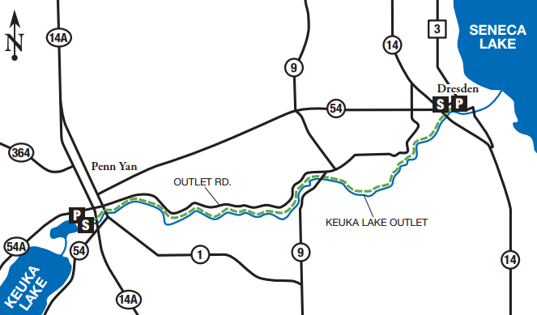
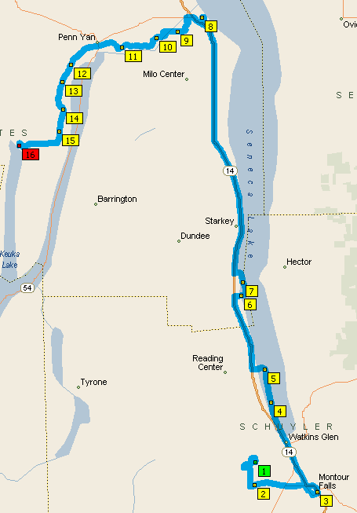
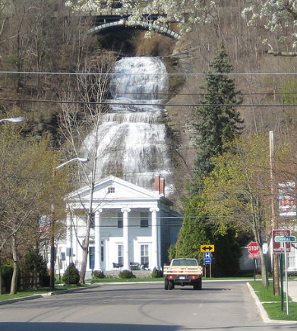
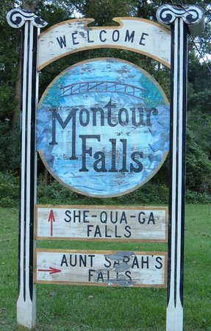
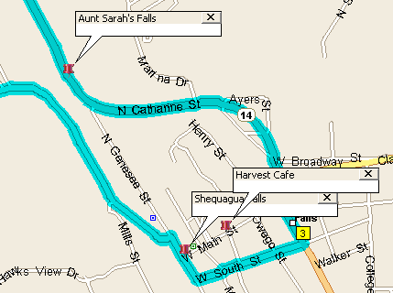
Day 3 (Thurs, Aug 4) – Cycle along Seneca Lake and Keuka Lake
Watkins Glen State Park Campground to Keuka State Park Campground – 47.6 miles
Loaded ride
Keuka Outlet Rail Trail
This is a shorter day to give us time to visit some waterfalls, ride a scenic rail-trail, and visit Amish country. If we didn’t get a chance to explore Rainbow Bridge and Falls in Watkins Glen State Park on Day 2, we can check them out before or after breakfast. When we leave camp we will cycle 6 miles to the village of Montour Falls for breakfast at the Harvest Café on Main St. You can’t miss the amazing Shequaga Falls as they loom behind the Courthouse on Main St. On the way out of town Aunt Sarah’s Falls are visible from Hwy 14. We will cycle about 25 miles up the west side of Seneca Lake to Dresden where we will take remarkable 6.8-mile Keuka Outlet rail trail over to Keuka Lake at the village of Penn Yan. The Keuka Outlet is a natural stream where water flows from Keuka Lake to Seneca Lake. At one time the stream was developed into a tow-path and a railroad line was added. We will stop along the rail trail to see the Seneca Mill Falls and Cascade Mill Falls.
When we exit the trail in Penn Yan, we will find ourselves in Amish country. (I may add a small route around Penn Yan to see some Amish farms and stores.) After cycling through Penn Yan, we will cycle along the shore of Keuka Lake until we reach Keuka Lake State Park. Keuka Lake is a Y-shaped lake with about 60 miles of shoreline. Its average depth is 101 ft and its max depth is 186 ft.
The Harvest Café in Montour Falls (224 Main St) offers up fantastic breakfast and lunch featuring wraps, salads, and our favorite – their quiche! Located in the heart of the Historic T district, with its idyllic dining room and beautiful exposed brick walls. Opens 8am.
Montour Falls is a village located in Schuyler County, New York, United States. A population of 1,711 was reported by the US Census of 2010. A waterfall at the end of W. Main Street gives the village its name.
Shequaga Falls in the village of Montour Falls

Slide 12
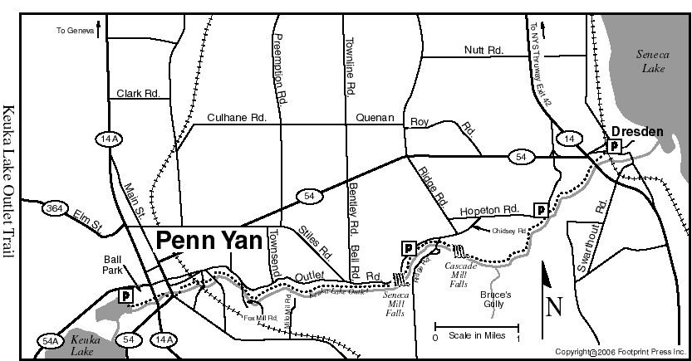
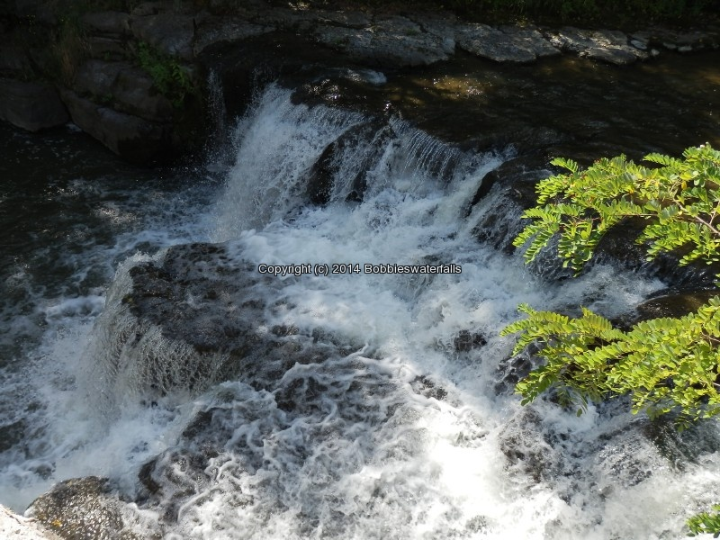
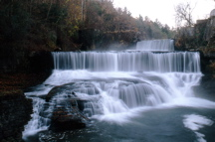
Day 3 (continued)
Things to see on the Keuka Lake Outlet Trail
Remnants from the old "Crooked Lake Canal" which was used for transportation between Seneca and Keuka lakes.
old locks
old iron truss bridge for the railroad
several dams
First waterfall (at 2 miles in) at the site of several old mills and a 1968 chemical company.
The dam creating the upper portion of this falls dates back to 1827.
The old Kelly Tire Buildings are now home of the Alfred Jensen Memorial Visitor Center. (restrooms)
Cement marker with "D3" indicates you are 3 miles from Dresden and almost halfway
Second waterfall is the site of the old Seneca Mill and Lock 17
Large brick chimney marking the site of a paper mill where a 17-foot flywheel still stands.
An old blacksmiths shop
Other historic remnants
Cascade Mill Falls along the Keuka Outlet trail
Seneca Mill Falls along the Keuka Outlet trail
Riding Time: 1 hour one way Length: 6.8 miles one way Trail Distance Between Parking Areas:
Dresden to Hopeton Road 1.0 mile Hopeton Road to Outlet Road 2.0 miles Outlet Road to Route 54A 3.8 miles Surface: Dirt (western end is paved) Trail Markings: Green and white metal �Trail� signs
Keuka Outlet Rail Trail - History
This historic trail follows the Keuka Outlet Stream and the abandoned Fall Brook Railroad which was built in 1884 to facilitate commerce between Keuka and Seneca Lakes. All along the Outlet Trail, signs of the former industrial age of the 1800’s and 1900’s are prevalent. Lining the trail are remnants of gristmills, sawmills, distilleries, stone canal locks and an abandoned bridge connecting the trail to the once vibrant (now extinct) town of Hopeton. Remnants of the Crooked Lake Canal, with its 27 locks, run along the north side of the outlet. The Outlet Trail maintains a rustic, wooded appeal with good bird watching areas and parklands along the dirt and asphalt route. An elevation drop of nearly 400 feet, beautiful scenery, gorgeous waterfalls and unusual plant life combine to make this an excellent hike for all enthusiasts. http://www.fingerlakes.org/uploads/pages/pdf/18.pdf
Keuka Outlet Rail Trail

Slide 13
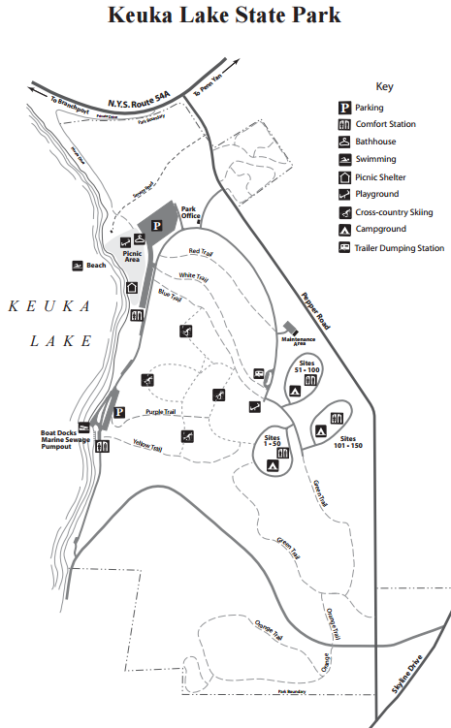
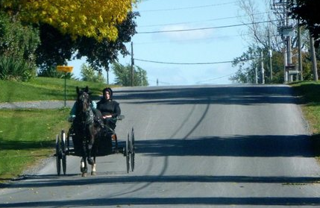
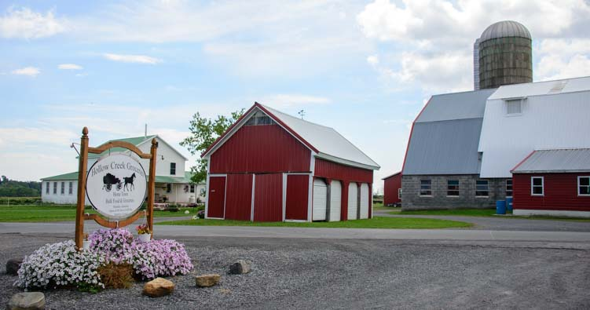
Day 3 (continued)
Amish and Mennonite Communities in the Finger Lakes region
Stop at Hollow Creek Groceries in Seneca Falls to see what a small Amish grocery store is like.
Looking for some place to travel where you can enjoy real life culture with individuals? Look no further than Penn Yan, a small town in the heart of the Finger Lakes that is home to a large population of Mennonites and Amish. If you have never been around Mennonites or Amish, I strongly encourage you to come and explore their unique ways of life. Mennonites and Amish are religious individuals who have extremely strong beliefs and practices. They typically have large families that involve the male children working on the farm and the female children working inside doing household chores. One of these chores includes making clothing for their family; Mennonites and Amish have stern dress codes. These children also attend a one room private school; however, they only go to school until they have completed eighth grade. Mennonites and Amish believe that technology can weaken their family structure; therefore they choose not to use electricity, televisions, automobiles, telephones and more. As you can see, they live a much different lifestyle without many of the conveniences we take for granted today. By simply driving through Penn Yan it is clear to visitors that this is partially a Mennonite and Amish town. It is hard to drive down the road without seeing a horse and buggy or a Mennonite or Amish individual on their bicycle. Throughout Penn Yan there are horse and buggy signs, and some stores even have horse and buggy only parking. Once you get out onto country roads, you’ll find many Mennonites and Amish houses and schools, along with considerable amounts of farm land.
http://www.fingerlakes.org/latest-news-information/blog/stories-from-our-staff/ethno-tourism
Top of the Lake Restaurant
301 Lake St Penn Yan, NY 14527
Open daily 11am – 9pm
(wonderful view of Lake Seneca)
17 Main St, Penn Yan
(nuts and ice cream, too!)

Slide 14
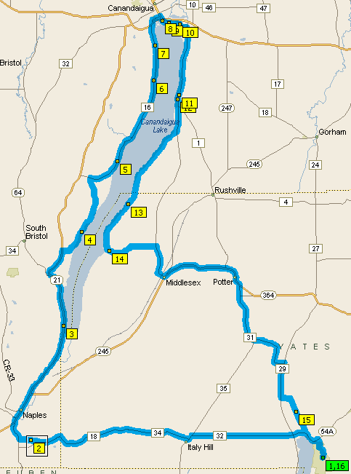
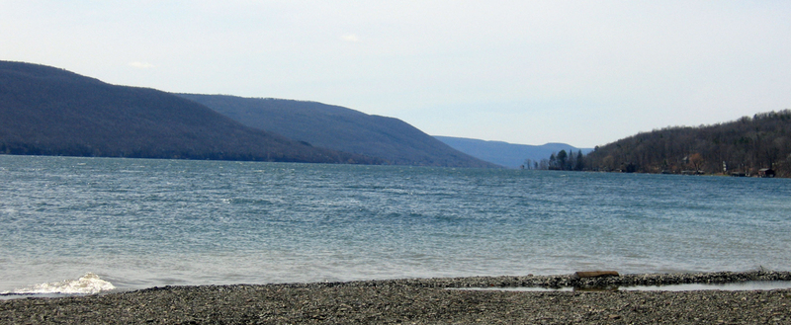
Day 4 (Fri, Aug 5) – Cycle around Canandaigua Lake
Keuka State Park Campground and back – 71.4 miles
Unloaded ride
Get ready for 2 days of unloaded riding as we camp at Keuka Lake State Park for 3 nights. We will do loop rides to and from the campground on Days 4 & 5. (Of course, you can also take a day off or do something different if you like. ) On Day 4 we will cycle around Canandaigua Lake unloaded. Canandaigua Lake is 15 miles long and 1.5 miles wide. It is known for its water quality and is the source of water for the city of Canandaigua.
The village of Naples is at the southern end of the lake. Naples is know for great views of the lake and we will particularly stop at the South Bristol Overlook on County Road 12. We will leave Naples and cycle up the west side of the lake and be treated to many nice views of the lake. Onanda Park offers nice views of the lake and features hiking trails with some gorges and waterfalls (not huge).
We will stop for lunch in the city of Canandaigua, take a walk on the City Pier for a great view of the lake, and may take time to visit some sites.
After lunch we will cycle down the east side of the lake before cutting across to Keuka Lake State Park.
Onanda
Park
Keuka Lake
State Park
View of Canandaigua Lake from Onanda Park

Slide 15
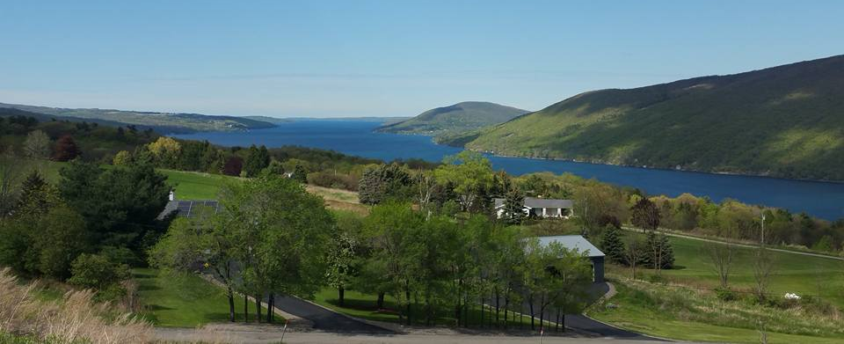
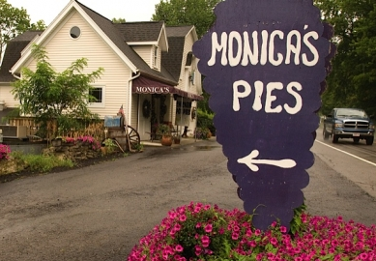
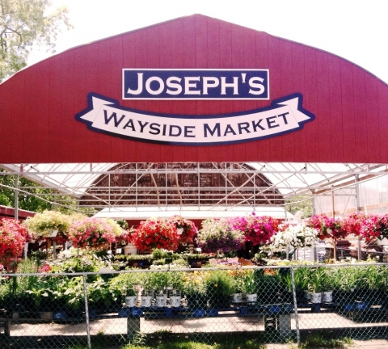
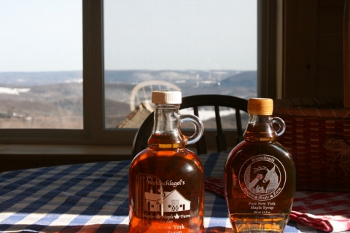
Day 4 (continued)
Sites near or in Naples, NY
To find the County Road 12 Overlook, take Route 21 south out of Canandaigua and head to Naples. Just before entering the Village of Naples (and just a little past Monica’s Pies) is the right turn onto County Road 12. It’s a sharp hairpin turn up the hill so watch for the signs carefully. About a half mile or so up the hill you’ll come to the overlook. You’ll know when you get there, you can’t miss it!
Monica’s Pies - Monica is one of many grape pie makers in the area, but unlike the other pie makers, her grape pies are available at her pie shop year round. Monica makes all kinds of jams, jellies, conserves with seasonal and holiday specialties, including a vast array of.. Address: 7599 Route 21 Naples NY 14512
WOHLSCHLEGEL'S NAPLES MAPLE FARM
Our family run maple farm produces the finest quality maple products from our certified tree farm. Our glacial soils paired with our state of the art maple process provide a unique maple flavor which bodes well for our moxilicious gourmet maple products... Address: 8064 Coates Rd Naples NY 14512 Phone: 585-775-7770
For 50 years, Joseph's Wayside Market has been one of the largest open air farm markets in the Finger Lakes Region. Joseph's has become a destination for tourists and natives alike. You'll find seasonal flowers/plants, fresh fruits & vegetables, ... Address: 201 Main St, Naples NY 14512 Phone: 585-374-2380

Slide 16
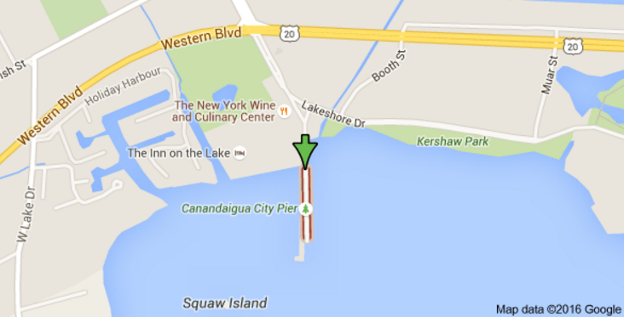
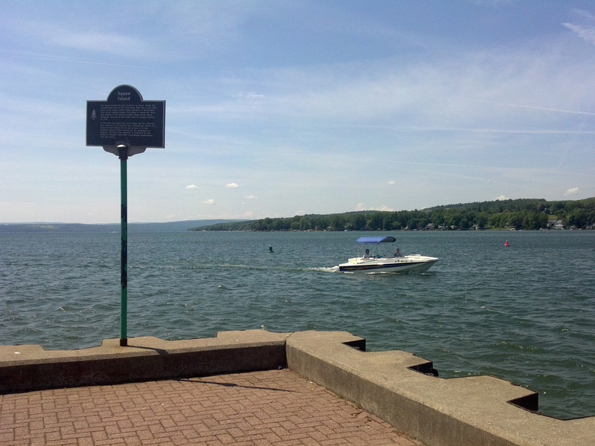
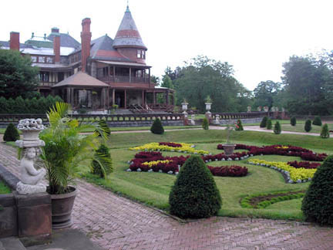
Day 4 (continued)
Sites near or in Canandaigua, NY
Granger Homestead and Carriage Museum
The Granger Homestead and Carriage Museum offers an important 1816 mansion in the Federal style in the city of Canandaigua, New York. The property remained in the Granger family for four generations. A carriage house contains a carriage museum.
295 N Main St, Canandaigua
Tour Hours: Tues, Wed, Sunday: 1-5pm Thursday thru Saturday: 11am-5pm
Admission: Adult $6, Seniors $5;
Canandaigua City Pier
City Pier, located off Lake Shore Drive, provides a view of Canandaigua Lake, fishing, seasonal restrooms and parking. Park hours are 5:00AM-9:00PM from October 31-April 30 and 5:00AM-11:00PM from May 1-October 30.
Sonnenberg Gardens and Mansion State Historic Park
Located near the north end of the lake (151 Charlotte St, Canandaigua)
Admission Prices: $14 Adults (18–59), $12 Seniors (60 +) or AAA Members (w/valid AAA member card)
Hours: 9:30 am – 4:30 pm (7 days/week)
Description: Sonnenberg Gardens is a New York State Historic Park where a late nineteenth century Victorian Estate with a Queen Anne-style mansion and nine formal gardens of the world is being preserved. This 50-acre estate is one of just two public gardens in the NYS Parks system. Sonnenberg is known for its distinctive period architecture, statuary, formal gardens, fountains and unique garden structures.
Canandaigua Farmer's Market – Nope. Only open on Saturdays.
Macri's Deli & Cafe' 699 South Main Street Canandaigua, NY

Slide 17
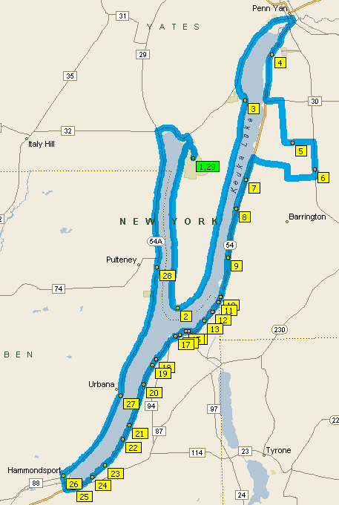
Day 5 (Sat, Aug 6) – Cycle around Keuka Lake
Keuka State Park Campground and back – 64.2 miles
Unloaded ride
Keuka Lake State Park Campground
Get ready for the 2nd day of unloaded riding as we cycle around Y-shaped Keuka Lake. The inside of the Y is called the Bluff and is known for incredible views. In fact, the entire loop around Keuka Lake is very popular loop and offers wonderful views of the lake and vineyards. I originally had Days 4 and 5 reversed until I realized that the Windmill Farm & Craft Market is only open on Saturdays. We don’t want to miss this huge event with crowds of 10,000 – 12,000. As the “horse and buggy parking area” indicates, there will be many Amish and Mennonite vendors there with local goods. If we cycle clockwise around the lake as indicated, we will hit the Windmill market after about 28 miles. We can browse for a while and perhaps eat lunch there as well. (You might bring one pannier in case you find things to buy!)
After lunch we will continue south along the shore of Keuka Lake to the village of Hammondsport. Hammondsport has a very nice town green and a public beach on Keuka. We will have the option of visiting the Finger Lakes Boating Museum. After leaving Hammondsport we will cycle up the western side of Keuka Lake back to the campground.
Finger Lakes Boating Museum
8231 Pleasant Valley Rd, Hammondsport
The Museum Collection has now grown to more than 150 boats built by many of the 40+ commercial builders identified to date as having built boats throughout the Finger Lakes Region during the last century. The museum currently has 3 floors of the Historic former Taylor Wine building to explore with several exhibit spaces and a new wing renovated in 2015. Visitors can see canoes, rowboats, row outboards, outboard runabouts, inboards, hydroplane and sailboats; as well as many related artifacts and ephemera. Our main building also contains an active boat shop where visitors are able to see restoration projects underway.
The Windmill Farm & Craft Market

Slide 18
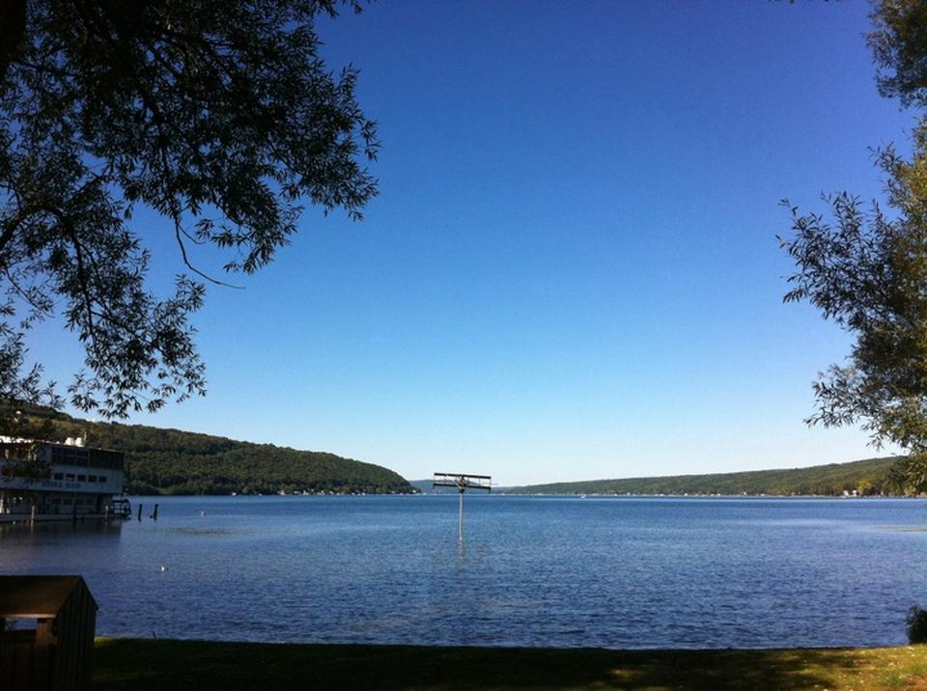
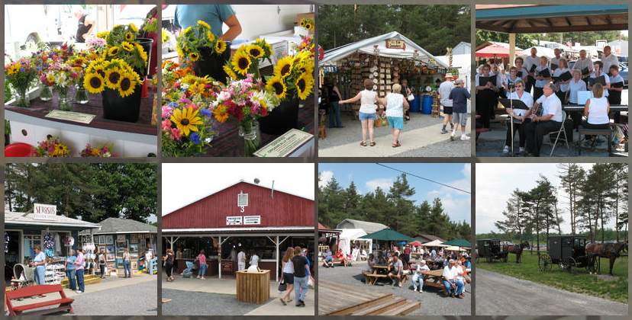
Day 5 (continued)
The Windmill Farm & Craft Market (only open on Saturdays, 8:00 – 4:30)
The Windmill is the first and friendliest farm and craft market in upstate New York, located right in the heart of the Finger Lakes Wine Region. Midway between Penn Yan and Dundee on NY Route 14A, The Windmill has become a premier tourist attraction, with a weekly attendance exceeding 8,000 - 10,000 people.
Beginning with roughly 100 vendors, The Windmill serves as an outlet for local producers and craftsmen.
Hammondsport – view from the town green and public beach

Slide 19
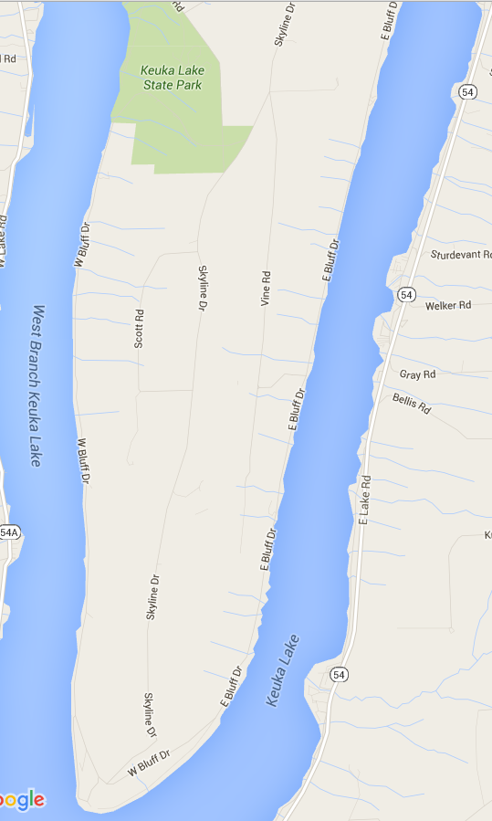
Day 5 (continued)
The area in the middle of the Y in Keuka Lake is called the Bluff, or Bluff Point.
Driving the north-south shore of either side is a highly recommended experience. Route 54A is regarded as one of the most scenic drives in the world, and Rt. 54 on the eastern shore is arguably just as enjoyable. One must also take a trip down Skyline Drive, which runs down the middle of the 700 ft high Bluff Point, which will get you a breathtaking 360 degree view of the land surrounding the northern end of the lake.
W. Bluff Dr
E. Bluff Dr
Skyline
Drive
54A
W. Lake Rd

Slide 20
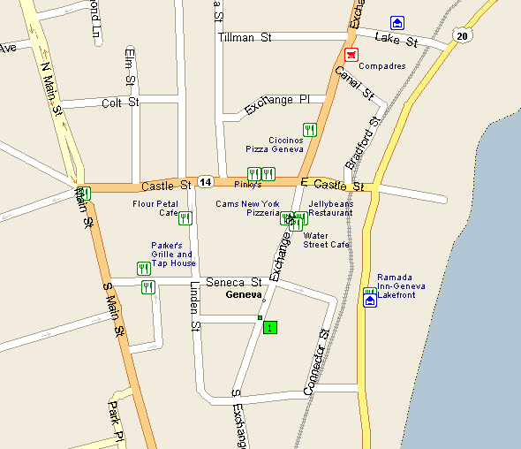
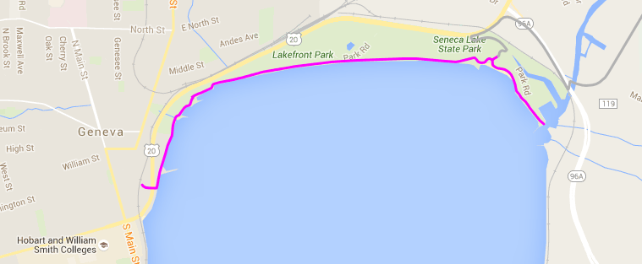
Day 6 (Sun, Aug 7) – Cycle along Seneca Lake and Cayuga Lake
Keuka State Park Campground to Cayuga Lake State Park Campground – 70.7 miles
Loaded ride
It’s time to put the panniers back on and cycle to the next camp. We will leave Keuka Lake State Park, stop in Penn Yan for breakfast, and then cycle along the western side of Seneca Lake to the city of Geneva. We cycle along the Geneva waterfront through Lakefront Park and Seneca Lake State Park and may eat lunch in Geneva as well. We will leave Geneva and cycle halfway down the eastern side of Seneca Lake before we cut across to Cayuga Lake (you can see from the map that there are opportunities for shortcuts if desired). We will cycle up the western side of Cayuga Lake to Seneca Falls and we will camp at nearby Cayuga Lake State Park.
Bike Trail
Seneca Lake State Park is adjacent to Geneva's Lakefront Park. Bike and walking paths in Lakefront Park lead to a wider path in Seneca Lake State Park that runs along the lake making for a picturesque outing. The park also offers a beach, soccer, lacrosse, softball fields, concession stands, and marina.
Seneca Lake Sate Park is open all year long for biking and walking. The swimming beach is open on weekends and holidays in season. The spray ground is a very popular attraction and is open in the summer every day.
The Lakefront Park- Seneca Lake State Park path is 2.5 miles long (one way). The entrance to Seneca Lake State Park is free if you are walking or biking.

Slide 21
Day 6 (continued)
Seneca Falls is believed to be the inspiration for Frank Capra’s It’s a Wonderful Life. Seneca is also home to:
The National Women’s Hall of Fame (76 Fall Street)
Women’s Rights National Historical Park (136 Fall Stree) – www.nps.gov/wori

Slide 22
Day 6 (continued)
Seneca Falls
Cayuga Lakes State Park
It is 3 miles from the Cayuga State Park Campground to the Seneca Falls Visitor Center

Slide 23
Day 7 (Mon, Aug 8) – Cycle on the Old Erie Canal Trail (for 28 miles)
Cayuga Lake State Park Campground and back – 67.9 miles
Ride unloaded
This is a good day to ride unloaded as we will cycle 28 miles on the crushed limestone of a rail trail. We will leave the Cayuga Lake State Park Campground and cycle to nearby Seneca Falls for breakfast. We will then cycle through the Montezuma National Wildlife Refuge, a wildlife preserve operated by the United States Fish and Wildlife Service which includes part of the Montezuma Swamp at the north end of Cayuga Lake. We will continue on quiet roads to Port Byron where we will join the scenic Old Erie Canal Trail. We will continue on the trail through Weedsport and Memphis and finish at the Camillus Erie Canal Park. The Old Erie Canal Trail is part of 360-mile Erie Canal Trail which runs from Albany to Buffalo. About 80% of the trail is complete, including the 28-mile section we will ride. We exit the trail in Camillus where we will eat lunch, visit the Erie Canal Trail Museum, and take a 45-minute scenic boat ride ($3.00, runs a 1,2,3,4,5pm), and visit the 9-Mile Creek Aqueduct. When we leave Camillus we will travel quiet roads back to Cayuga Lake State Park.
Old Erie Canal Trail
Port Byron to Camillus
(28 miles)

Slide 24
Day 7 (continued)
Old Erie Canal Trail
Port Byron to Camillus
(28 miles)
9-Mile Creek Aquaduct

Slide 25
Day 7 (continued)
45 minute boat tour for only $3.00

Slide 26
Day 8 (Tue, Aug 9) – Cycle along Cayuga Lake
Cayuga Lake State Park to Fillmore Glen State Park Campground – 61.7 miles
Ride loaded
We will leave the Cayuga Lake State Park Campground and cycle to nearby Seneca Falls for breakfast. We will then cycle down the west side of Cayuga Lake through Aurora, Union Springs, and Long Point State Park and eventually turn west to go to Fillmore Glen State Park Campground. We will eat dinner in the nearby town of Moravia, NY.
Long Point State Park
You can rent a kayak or canoe at the South Shore Marina (2810 Firelane 1, Rt. 38, Moravia, 315-497-3006,
Owasco Inlet, a creek that feeds into the southern end of Owasco Lake, is great for kayaking and canoeing. Owasco Inlet becomes Owasco Flats just before feeding into the lake, and nature lovers will find these wetlands provide a scenic vista to be treasured.

Slide 27
Day 8 (continued)
Fillmore Glen State Park
Looking for waterfalls in the Finger Lakes region? Hikers at Fillmore Glen State Park in Moravia, NY can enjoy five waterfalls that are hidden within the lush woodland. The park, named after U.S. president Millard Fillmore, expands across 938 acres and rises in elevation 349 feet from the bottom gorge, up to the dam. The grounds consist of sixty camp sites including a cottage on Cayuga Lake. Users of the cottage will find a fully furnished bedroom, kitchen, bathroom and sitting area. Outside, there is a dock and picnic area. In the summer, campers can hike on trails of differing difficulty levels. The gorge trail is great for children or less experienced hikers because it has walled edges. The stream-fed swimming pool is another attractive feature of the park.
Fillmore Glen State Park
Number of falls:
5 major waterfalls, various smaller cascades.
Size/Types: Ranging from 5-40’ high. Cascades, punchbowls, plunges and chutes. The Cowsheds falls is about 30’ high. The upper falls at the end of the gorge trail is around 40’.
Best time to visit: Year round. The Park’s gorge trails are closed after November, but the Cowsheds Falls which is accessible ¼ of a mile from the parking lot is accessible year round.
Cowshead Falls

Slide 28
Day 9 (Wed, Aug 10) – Cycle around Lake Skaneateles
Fillmore Glen State Park Campground and back – 62.0 miles
Ride unloaded
We will ride unloaded today and will stop in Moravia for breakfast. We will cycle around Lake Skaneateles (pronounced “skinny atlas”). The lake is 16 miles long with an average width of 0.75 miles and a max depth of 315 ft. It is the highest lake in elevation and is the purest lake, supplying water for the city of Syracuse. There are many wonderful views of Skaneateles and we will stop at several, including 10-mile point as well as the towns of Niles and Spafford. We will visit some waterfalls and stop in the village of Skaneateles and check out their long pier that gives a great view of the town.
Scaneateles
Scaneateles Pier
Carpenter Falls and Angel Falls
Scaneateles Pier

Slide 29
Day 9 (continued)
3. Skaneateles Lake from Route 41A, Skaneateles
A few miles south of the village are some tremendous views of the lake. The northbound lane is best. For dinner and a view, try the Sherwood Inn or the Bluewater Grill.
BONUS: Another great view is from the Route 41 parking area on the southeast end of the lake, just north of Scott.
There are a total of four waterfalls along Bear Swamp Creek in this beautiful, but somewhat treacherous ravine. Carpenter Falls drops 90 feet and Angel Falls drops 62 feet. Carpenter Falls is a somewhat easy 0.1 mile walk from the kiosk (the left trail) and Angel Falls is 0.5 mile moderate hike to the right of the kiosk.
Directions - Take US 20 towards Skaneateles until you reach NY 41A (West Lake Road). Travel south down West Lake Road for 11 miles until you see Apple Tree Point Road on your left. Go down Apple Tree Point Road for 0.5 miles and you’ll see a small parking area on your left. There is a small kiosk with information about the park and pointers leading to the different falls.
Carpenter Falls

Slide 30
Day 9 (continued)
Skaneateles
This historic town is the main draw for many visitors in the area. Buildings from the late 1790s onward have been restored and converted into shops and restaurants and the village enjoys a robust tourism industry, though by maintaining its small-town flavor, it barely shows. Every holiday season the Dickens’ Christmas festival takes place, where the community takes on Dickens-era decor and personality and the visitors flood in to interact with the village’s cast of characters.
Shotwell Memorial Park / Clift Park
Description: These two adjacent parks on the north shore in the village of Skaneateles offer a great view of the lake looking south. Clift Park has a swimming area, benches, a gazebo with regular concerts, and a beautiful pier. To the east is Shotwell Memorial Park, dedicated to the area’s veterans of foreign wars. Both parks have fantastic views as well as a plethora of shopping and dining opportunities across the street in the village.
Doug's Fish Fry
8 Jordan St, Skaneateles
Generously sized fish platters in cozy digs brightened by a colorful seascape mural & train set. Fish, lobster, scallops, salmon, chicken, and more.
Near Owasco Lake
At the southern end of Owasco Lake, in the village of Moravia, Fillmore Glen State Park is a favorite destination off the lake. These hiking trails afford some of the most magnificent views of gorges and waterfalls in all of the Finger Lakes. The trails around the Cowshead area are paved and easily accessible. The Gorge Trail, North Rim and South Rim trails are moderately challenging, and all three afford great scenic views.

Slide 31
Day 10 (Thurs, Aug 11) – Cycle around Lake Owasco and then to Ithaca, NY
Fillmore Glen State Park Campground to Ithaca, NY – 60.7 miles
Ride half unloaded (34.5 miles around the lake) and half loaded (25.2 miles to Ithaca)
First half of the ride (unloaded): We will leave our tents set up to dry and we ride unloaded for the first half of the day. We will cycle into nearby Moravia for breakfast and then cycle around Lake Owasco. Lake Owasco is 11.1 miles long and up to 1.3 miles wide with a max depth of 177 ft. The city of Auburn is at the top of the lake. The only public access to Owasco Lake is in Emerson Park in Auburn. We might take a break here and walk out to the Seawall Gazebo. There are also several museums to visit in Auburn if time allows.
Second half of the ride (loaded): After cycling 34.5 miles we will make it back to Moravia for lunch and then will pack up our gear for the trip to Ithaca (25.2 miles). Along the way we will stop by Myers Park to see the
lighthouse on Cayuga Lake
before following the shore
back to Ithaca.
Myers
Park
Emerson Park - North end of the lake, entrance on Rt 38A (East Lake Rd) this park has swimming , picnic areas, ball fields and boat launch facilities.
Emerson Park Merry-Go-Round Theatre – performing during the summer month.
Ward O’Hara Agricultural Museum - Rt 38A across from Emerson Park, a collect of farm equipment in the mid-1900's

Slide 32
Day 10 (continued)
Seward House Museum
33 South St. Auburn, NY
We invite you to visit the Seward House Museum, the historic home of William Henry Seward and his family. Serving as a New York State Senator, Governor of New York, a U.S. Senator, and as Secretary of State in the Lincoln and Johnson administrations, Seward was one of the foremost politicians of nineteenth century America.
Admission: Adults – $10.00, AAA/Senior Citizens/Military – $9.00
Open: Tuesday – Saturday 10 am – 5 pm | Sunday (June - August) 1 - 5 pm
The Harriet Tubman Home 180 South Street, Auburn, NY
The Harriet Tubman Home preserves the legacy of "The Moses of Her People" in the place where she lived and died in freedom. The site is located on 26 acres of land in Auburn, New York, and is owned and operated by the AME Zion Church.
The Harriet Tubman Home is open to visitors Tuesday through Friday from 11 AM to 4 PM, and Saturdays by appointment.
New Hope Mills Store & Cafe - Quality Since 1823
181 York St., Auburn
Makers of the famous New Hope Mills Pancake Mixes. Family owned and operated! Shopping 1000+ items in our store! Refreshments - drinks and light food in our Cafe! Auburn Store & Cafe Open Mon-Fri, 8-4; Sat, 10-2. Call for details 315.252.2676.
We might walk out through Emerson Park/Island Park in Auburn to the Seawall Gazebo

Slide 33
Extra slides!
The Finger Lakes National Forest encompasses 16,259 acres (65.80 km²) of Seneca and Schuyler counties, nestled between Seneca Lake and Cayuga Lake in the Finger Lakes Region of New York State in the United States of America. The forest has over 30 miles (50 km) of interconnecting trails that traverse gorges, ravines, pastures, and woodlands.
Entrance sign for Blueberry Patch Campground in the Finger Lakes National Forest.
There is primitive campsites located throughout the National Forest (where you can camp for free) or you can camp at the Blueberry Campground for $10 per night.

